Slide 1
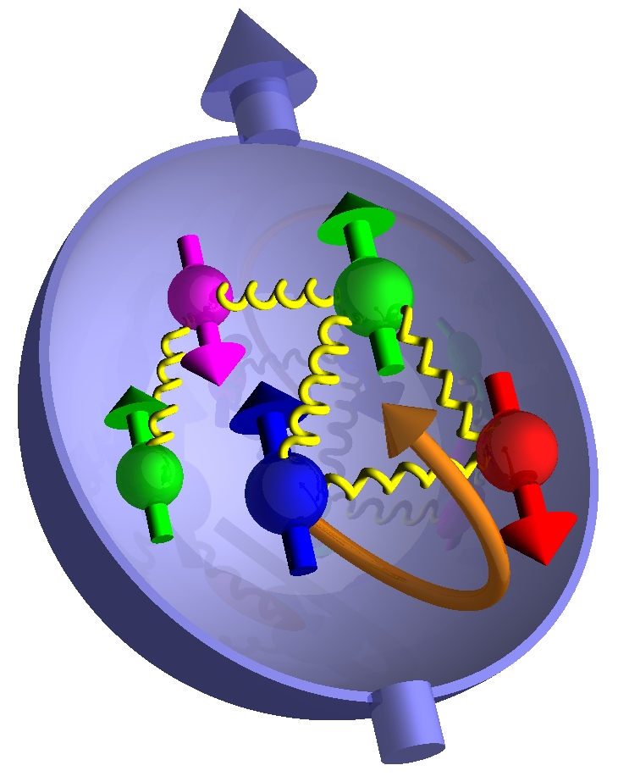
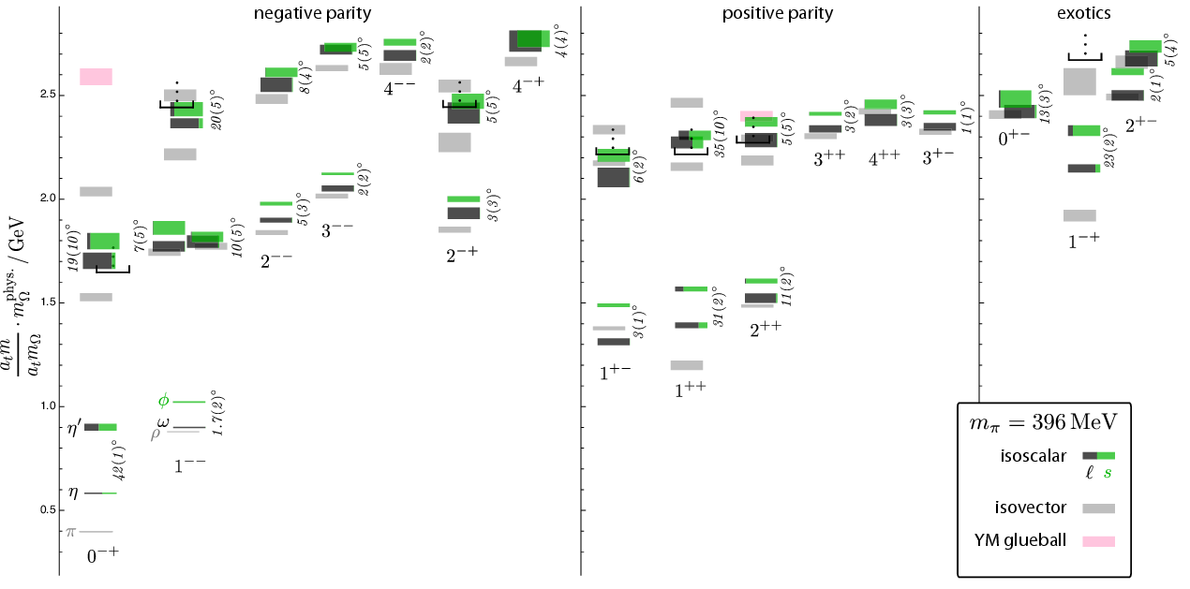
PXPS Study Group on Hadronic Physics
Paul E. Reimer
Physics Division
Argonne National Laboratory
15 June 2012
This is really just a sampling of topics of interest
Hadron Structure from Neutrino Induced Interactions
Hadron Structure from Proton Induced Interactions
Spectroscopic Studies

Slide 2
EMC Effect

Slide 3

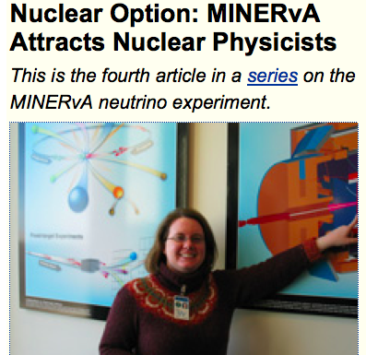
Neutrino Interactions & Hadronic Structure
MINERνA
The EMC effect
How is the proton’s structure modified when the proton is placed in a nucleus?
Directly addressed by nuclear target data in MINERνA
MINERνA Targets
C | Fe | Pb | He | Water | LD₂ | LH₂
 |  |  |  | H₂O | Future??
Deep Virtual Compton Scattering (DVCS) to measure Generalized Parton Distributions (GPDs)

Slide 4
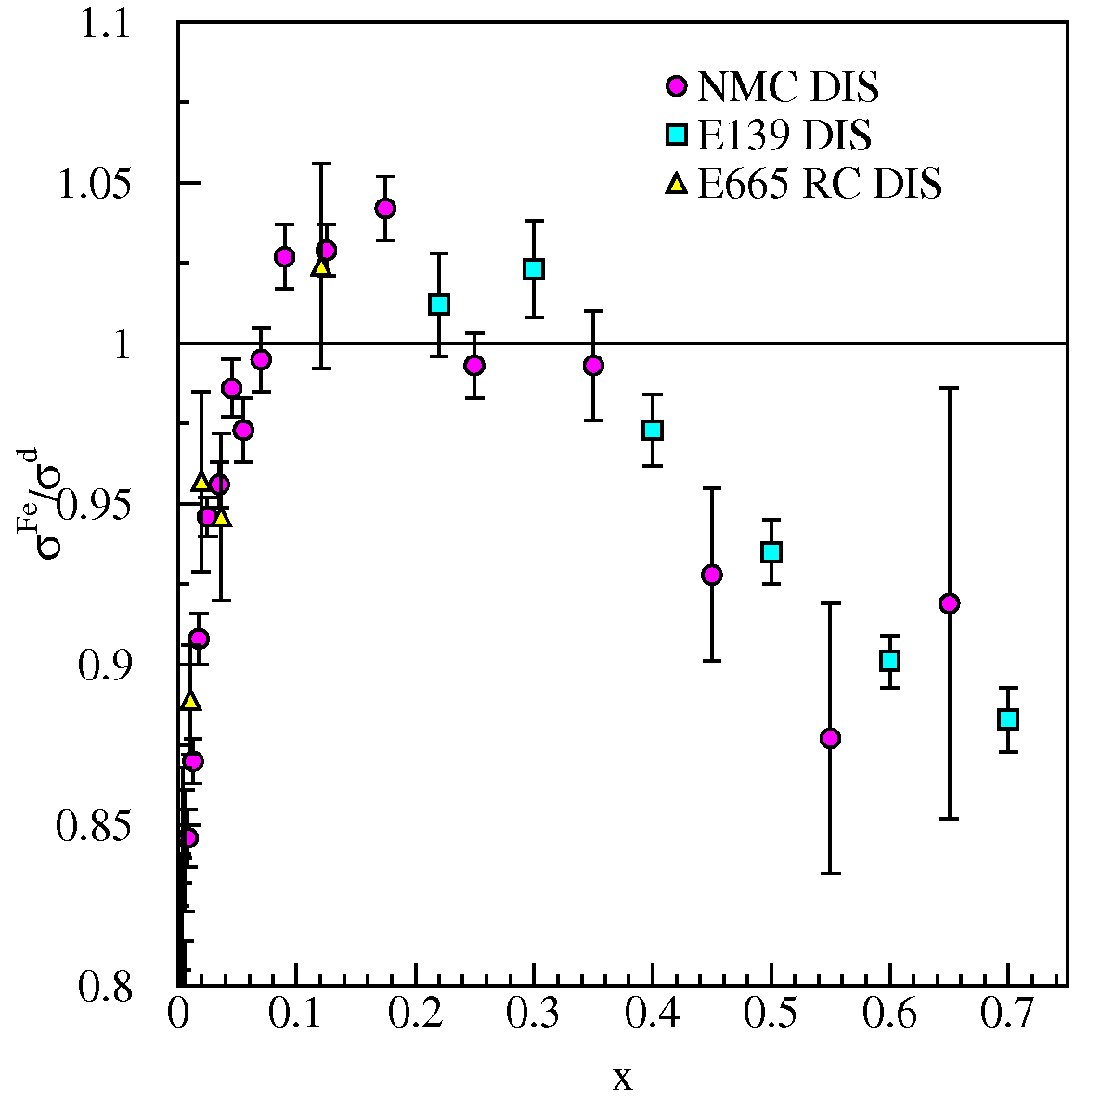
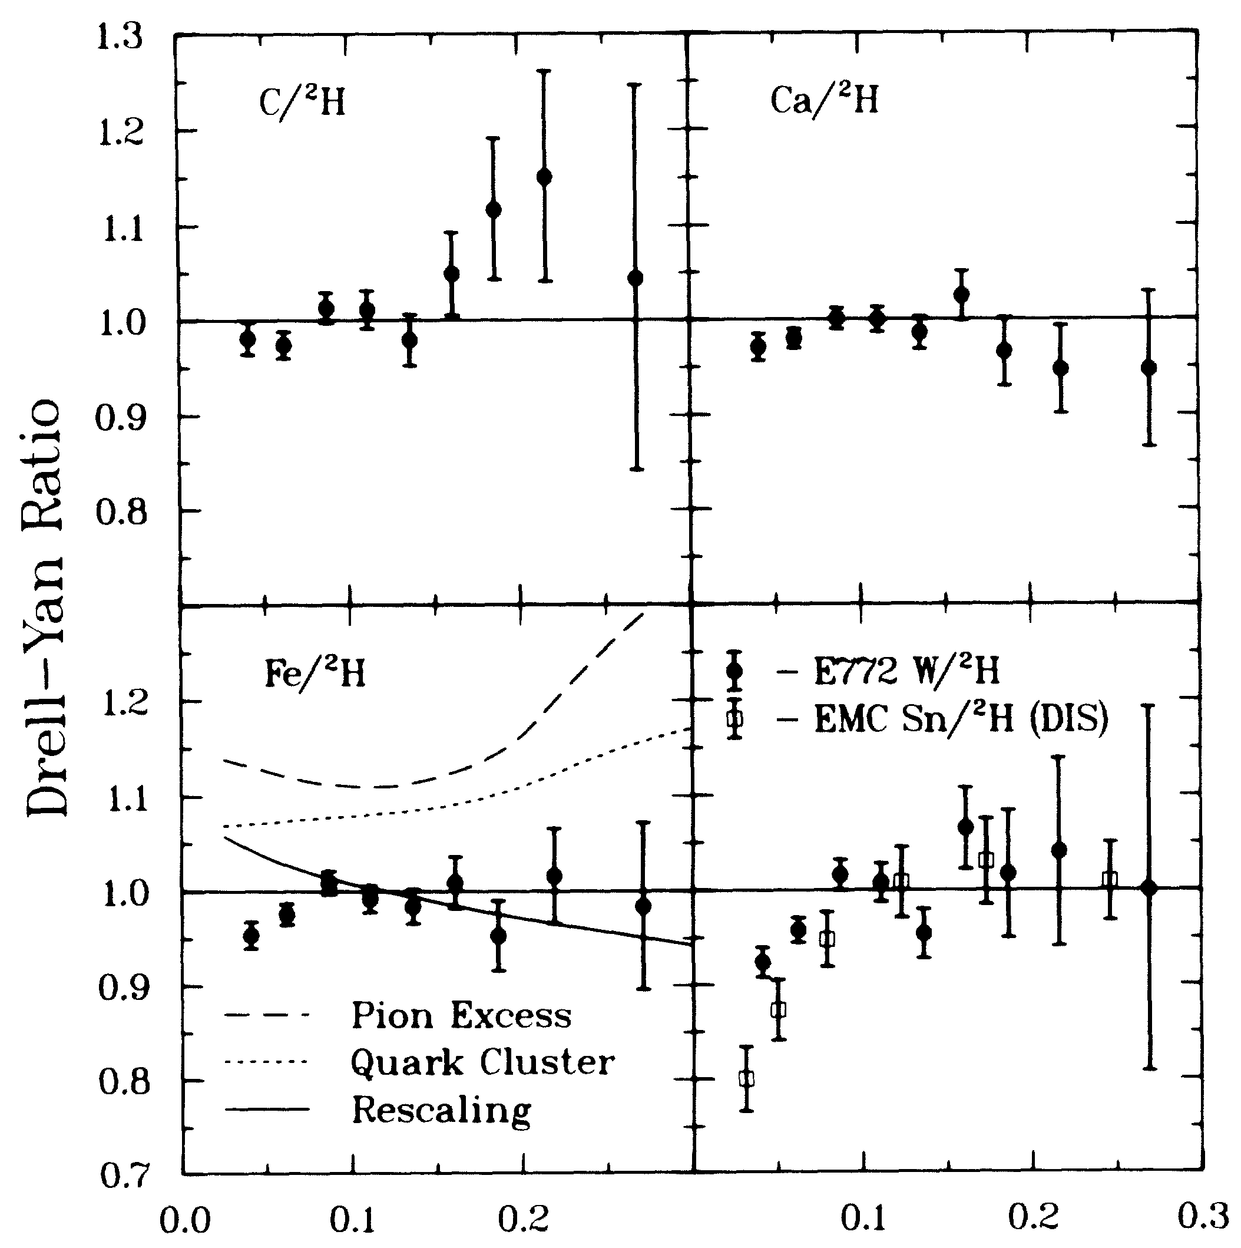
EMC Effect
Not seen in Drell-Yan (sea Quarks)
Seen in DIS (all quarks)
ν DIS ???
Data? Typically only one target in an experiment
Sensitive to different quark and antiquark combinations
Alde et al (Fermilab E772) Phys. Rev. Lett. 64 2479 (1990)
This is an area of strong overlap between working groups. For this plenary talk, I’ve assumed that it is covered by the Neutrino Working group

Slide 5
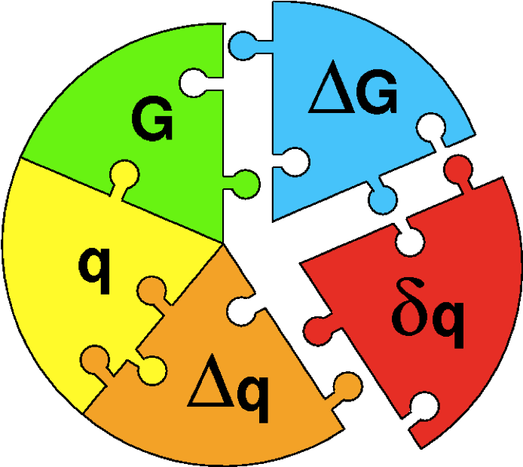
QCD and the spin puzzle

Slide 6
Transverse Momentum Distributions: Introduction
Survive k_{T} integration
Sivers Function
k_{T} - dependent, T-even
k_{T} - dependent,
NaiveT-odd
Boer-Mulders Function

Slide 7
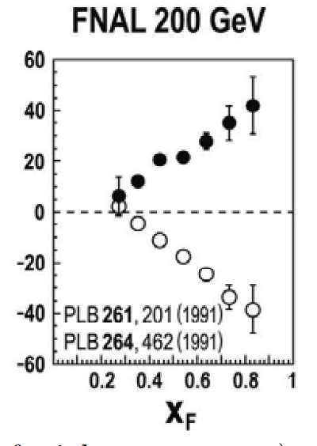
QCD Gauge Symmetry; Boer-Mulders’ and Sivers’ Functions and Polarized Protons
k_{T} - dependent, Naïve T-odd
Boer-Mulders
Sivers’
QCD Gauge invariance: Sivers’ and Boer-Mulders functions sign change:

Slide 8
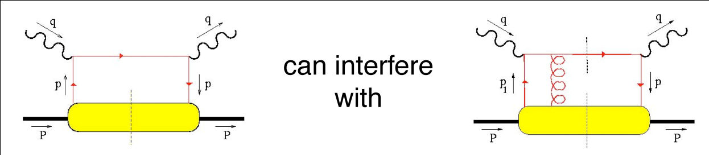
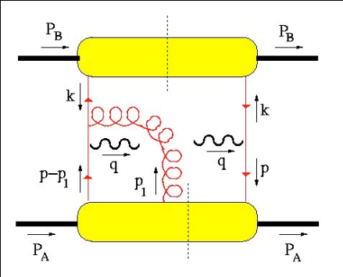
Sivers Function Measurements
T-odd observables
  SSA observable ~ odd under naïve Time-Reversal
  since QCD amplitudes are T-even, must arise from interference
  (between spin-flip and non-flip amplitudes with different phases)
A T-odd function like F₂^{perp} must arise from interference (How?)
  soft gluons: “gauge links” required for color gauge invariance
  such soft gluon interactions with the soft wavefunction are
  final (or initial) state interactions … and maybe process dependent!
  leads to sign change:
and produce a T-odd effect!
(also need L_{z} ≠ 0)
Brodsky, Hwang & Smith (2002)
Notes:
A T-odd function like the Sivers function must arise from interference. But a leading twist distribution function is just a forward scattering amplitude, how can it contain an interference?
But because of the data, and the vigorous theoretical effort surrounding these data, Brodksy, Hwang and Smith re-examined the factorization theorem and found that for the case of TMD PDFs, one has to be careful to include these diagrams, where a soft gluon re-interacts between the struck quark and the proton
While in DIS this final state interaction is attractive, in D-Y the initial state interaction is repulsive, leading to a sign change

Slide 9
Planned Polarized Drell-Yan Experiments
experiment | particles | energy | x_{b} or x_{t} | Luminosity | timeline
COMPASS (CERN) | π± + p↑ | 160 GeV √s = 17.4 GeV | x_{t} = 0.2 – 0.3 x_{t} ~ 0.05 (low mass) | 2 x 10³³ cm⁻² s⁻¹ | 2014
PAX (GSI) | p↑ + p_{par} | collider √s = 14 GeV | x_{b} = 0.1 – 0.9 | 2 x 10³⁰ cm⁻² s⁻¹ | >2017
PANDA (GSI) | p_{par} + p↑ | 15 GeV √s = 5.5 GeV | x_{t} = 0.2 – 0.4 | 2 x 10³² cm⁻² s⁻¹ | >2016
NICA (JINR) | p↑ + p | collider √s = 20 GeV | x_{b} = 0.1 – 0.8 | 1 x 10³⁰ cm⁻² s⁻¹ | >2014
PHENIX (RHIC) | p↑ + p | collider √s = 500 GeV | x_{b} = 0.05 – 0.1 | 2 x 10³² cm⁻² s⁻¹ | >2018
RHIC internal target phase-1 | p↑ + p | 250 GeV √s = 22 GeV | x_{b} = 0.25 – 0.4 | 2 x 10³³ cm⁻² s⁻¹ | >2018
RHIC internal target phase-1 | p↑ + p | 250 GeV √s = 22 GeV | x_{b} = 0.25 – 0.4 | 6 x 10³⁴ cm⁻² s⁻¹ | >2018
SeaQuest (unpol.) (FNAL) | p + p | 120 GeV √s = 15 GeV | x_{b} = 0.35 – 0.85 x_{t} = 0.1 – 0.45 | 3.4 x 10³⁵ cm⁻² s⁻¹ | 2012
pol. SeaQuest§ (FNAL) | p↑ + p | 120 GeV √s = 15 GeV | x_{b} = 0.35 – 0.85 | 1 x 10³⁶ cm⁻² s⁻¹ | >2015
Fermilab blows everyone else out of the water!
§ L= 1 x 10³⁶ cm⁻² s⁻¹ (LH₂ tgt limited) / L= 2 x 10³⁵ cm⁻² s⁻¹ (10% of MI beam limited)

Slide 10
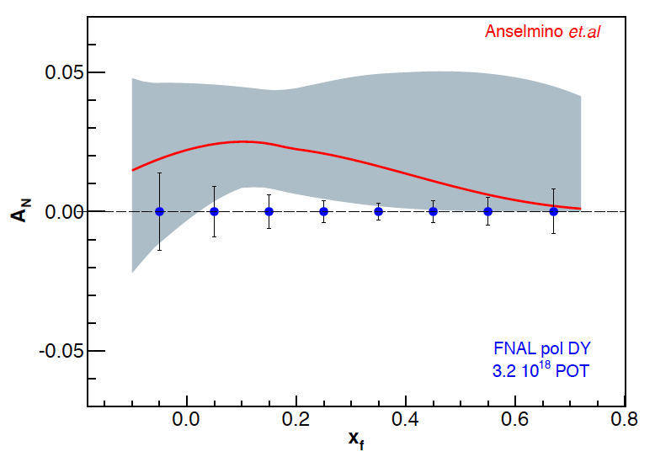
Sivers Asymmetry at Fermilab Main Injector - I
Experimental Sensitivity
  luminosity: L_{av} = 2 x 10³⁵ (10% of available beam time: I_{av} = 15 nA)
  3.2 X 10¹⁸ total protons for 5 x 10⁵ min: (= 2 yrs at 50% efficiency) with P_{b} = 70%
  Can measure not only sign, but also the size & maybe shape of the Sivers function !
Note:
~650k DY events
330k DY events
Notes:
Note that SSA A_N^sin(phi-phi_s) is scaled by 2/pi

Slide 11
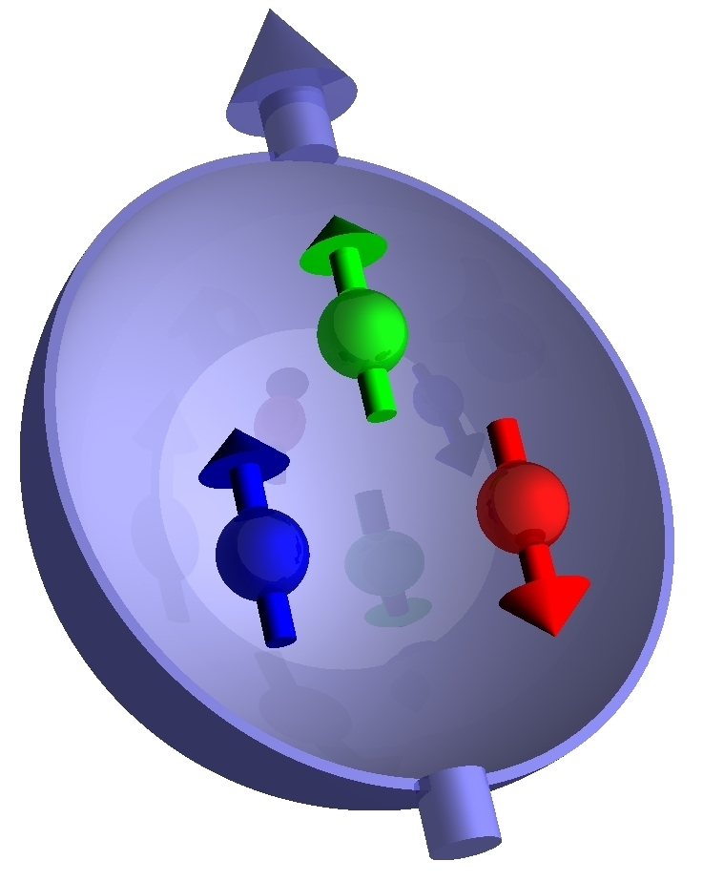
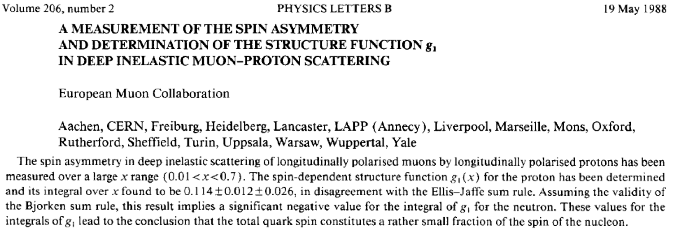
Spin Structure of the Proton
How does the spin of the proton formed from it’s constituents?

Slide 12
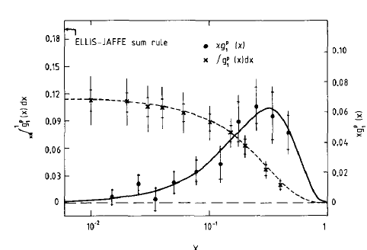
Spin Structure of the Proton
How does the spin of the proton formed from it’s constituents?

Slide 13
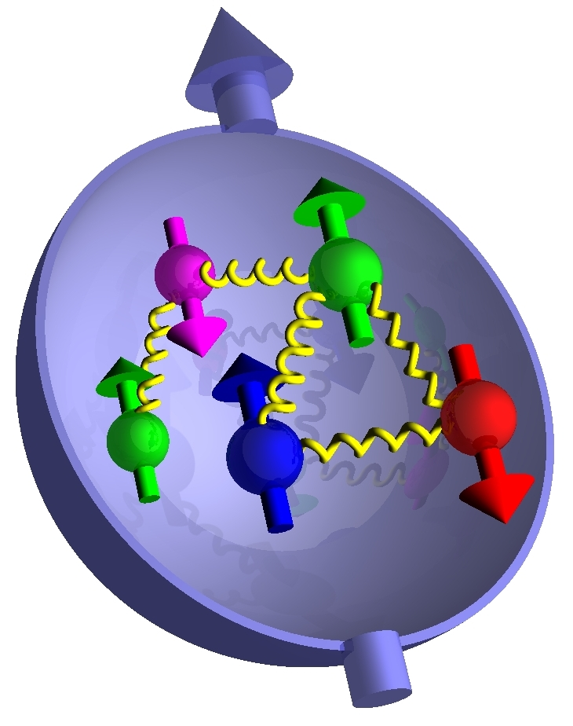
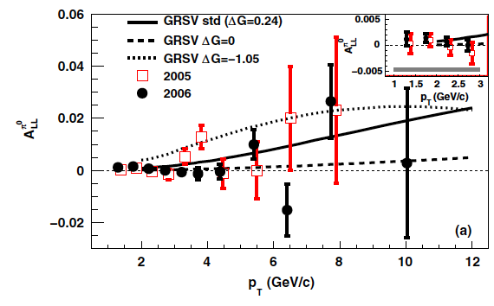
Spin Structure of the Proton
How does the spin of the proton formed from it’s constituents?
PHENIX, PRL103 012003 (2009)
Could the Glue carry the Spin?
  Still large uncertainty and limited coverage in x_{Bj}
  RHIC should expand coverage

Slide 14
Spin Structure of the Proton
How does the spin of the proton formed from it’s constituents?
Orbital Angular Momentum
k_{T} - dependent, Naïve T-odd
Boer-Mulders
Recall for a proton beam
Polarized Target g sea quarks
Polarized Beam g valence quarks
Pion Beam
g valence quarks
Sivers’

Slide 15
Low Energy Neutrino
Nucleon-nucleon correlations
  EMC effect as function of nucleon density
  Help with Mini-Boone cross section story
Δs—spin of the strange quarks
  neutral current νp elastic scattering
  Possibly need LH₂ target
  Idea from FINeSSE

Slide 16
Other Drell-Yan

Slide 17
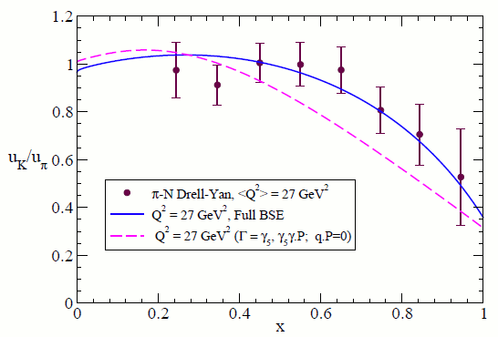
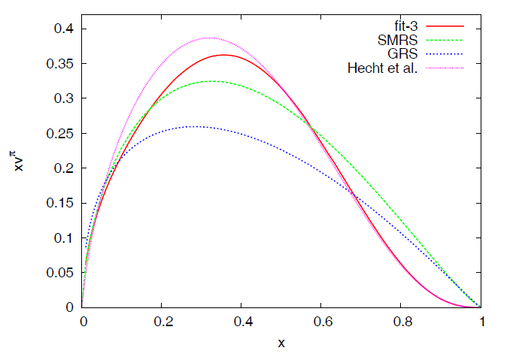
Pion and Kaon structure—Drell-Yan with meson beams
u_{K} / u_{π}
Using DSEs in QCD, one derives that the x=1 value is ≈ (f_{π}/f_{K})² (M_{u} /M_{s})⁴ = 0.3
Soft Gluon resummation and pionic valence structure
Dyson-Schwinger equations (DSE) predict large-x_{Bj} structure (1-x)^{β}
Value of ratio at x=0 will approach “1” under evolution to higher resolving scales. This is a feature of perturbative dynamics
Value of ratio at x=1 is a fixed point of the evolution equations Hence, it’s a very strong test of nonperturbative dynamics
Drell-Yan and Hadron Structure - 77pgs
17

Slide 18
Hadron Spectroscopy with Project X at Fermilab
Impressive progress in heavy quarkonium spectroscopy in recent years
However, very little progress in light meson spectroscopy for many years
S. Godfrey, Carleton University

Slide 19
Hadron Spectroscopy with project X at Fermilab
What is the physics case?
The spectrum of light conventional mesons is still poorly understood
More importantly, expect hadronic matter with the glue degree of freedom manifest explicitly:
    Glueballs
    Hybrids
In addition: Multiquark States
Lattice QCD is starting to explore the spectrum of gluonic excitations
However, we need to experimentally determine the hadron spectrum and the physical states of QCD
S. Godfrey, Carleton University

Slide 20
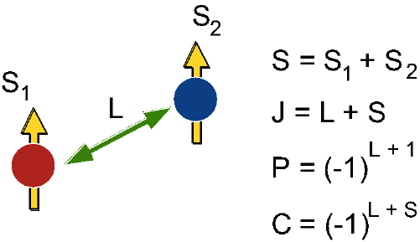
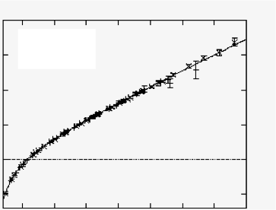
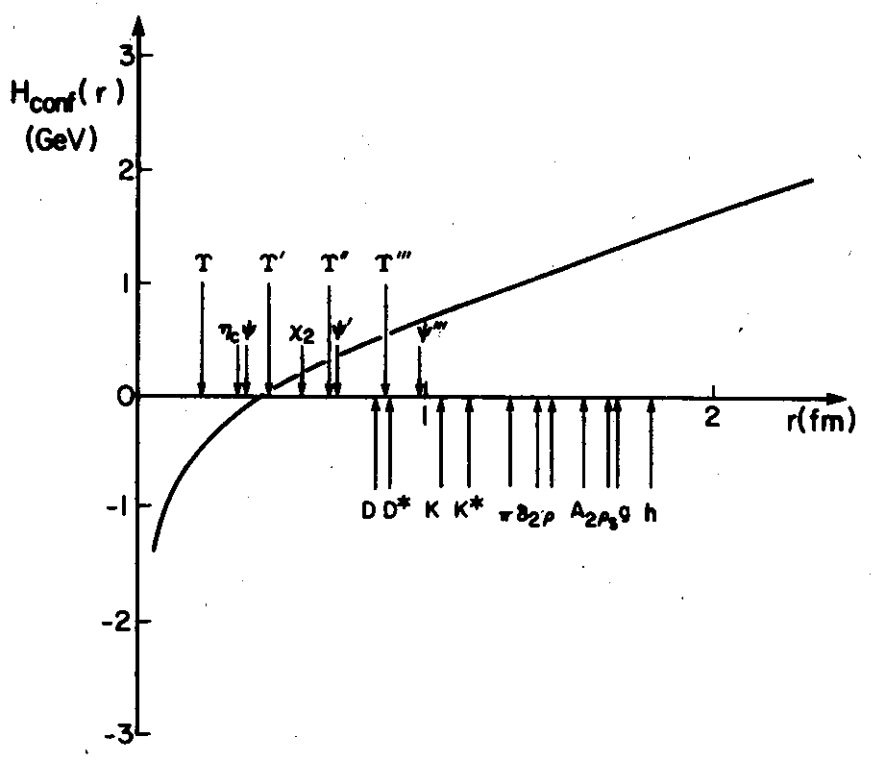
Conventional Mesons & Potential Models
Conventional Mesons & Potential Models
Meson quantum numbers characterized by given J^{PC}:
Allowed:
J^{PC} = 0⁻⁺ 1^{–-} 1⁺⁻ 0⁺⁺ 1⁺⁺ 2^{++ …}
Not allowed: exotic combinations:
J^{PC} = 0⁻⁻ 0⁺⁻ 1⁻⁺ 2^{+- …}
For given spin and orbital angular momentum configurations
& radial excitations generate the meson spectrum
S. Godfrey, Carleton University

Slide 21
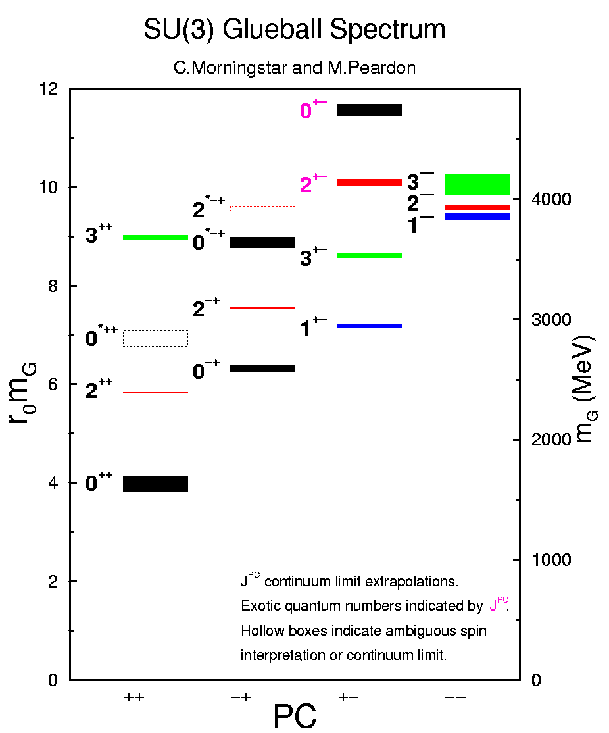
Glueballs
Glueballs
Glueballs are hadrons with no
valence quark content
Observation is test of QCD
Mass predictions by Lattice QCD
Lowest mass glueballs have
conventional quantum numbers:
M_{O}⁺⁺ ~ 1.6 GeV
M₂⁺⁺ ~ 2.3 GeV
M_{O}⁻⁺ ~ 2.5 GeV
Lowest lying glueballs with exotic
quantum numbers 0⁺⁻ , 2⁺⁻, 1⁻⁺
are much higher in mass
Difficult to produce exotic glueballs
Difficult to disentangle glueballs with conventional Q#’s from dense background of conventional states
S. Godfrey, Carleton University

Slide 22
Hybrid Mesons
Hybrid Mesons
(see Bali’s talk)
Hybrid mesons are defined as those in which the gluonic component is non-trivial
Lowest mass hybrids at ~1.9 GeV
Doubly degenerate:
J^{PC} = 0⁺⁻ 0⁻⁺ 1⁺⁻ 1⁻⁺ 2⁺⁻ 2⁻⁺ 1⁺⁺ 1⁻⁻
Lattice results generally
consistent with these predictions
M(1⁻⁺)~1.9 GeV
M(0⁺⁻)~2.1 GeV
M(2⁺⁻)~2.1 GeV
S. Godfrey, Carleton University

Slide 23
Recent Lattice results on light meson spectroscopy
Dudek et al , Phys Rev D83, 111502 (2011)
Dudek , Phys Rev D82, 074023 (2011)
Dudek et al PR D82, 034508 (2010)
Morningstar and Peardon PR D60, 034509 (1999)
S. Godfrey, Carleton University

Slide 24
What are our goals?
Define the physics case
Define the measurements needed to answer
the questions
Decide on the tools needed to make these
measurements:
    The beams
    The detector
What other facilities are available?
Is there an interested community?
S. Godfrey, Carleton University

