Slide 1
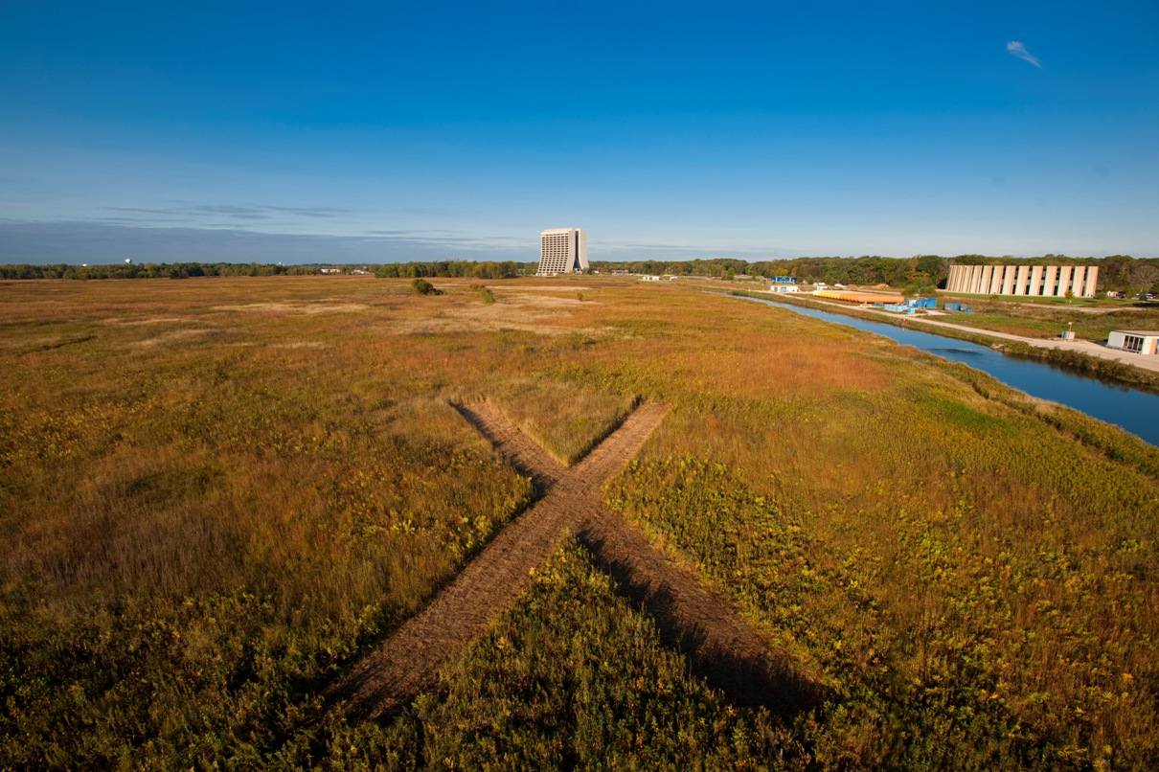
Project X: Accelerator Goals and Challenges
Steve Holmes
on behalf of the PX Team
Project X Physics Study/W&C Seminar
June 15, 2012

Slide 2
Outline
Project Goals/Reference Design
Staging Scenarios
R&D Program
Status and Strategy
Our websites:
http://projectx.fnal.gov
http://projectx-docdb.fnal.gov

Slide 3
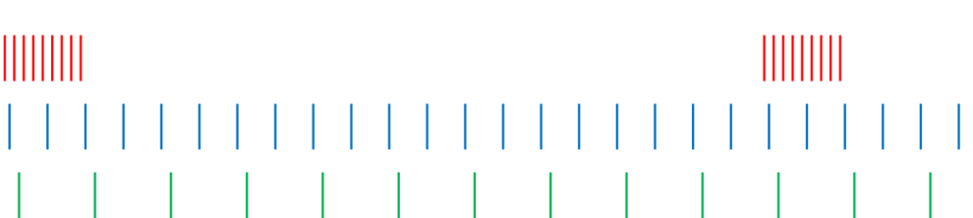
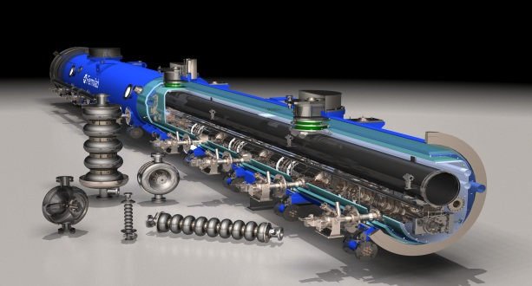
What is Project X?
An opportunity to create the foremost Intensity Frontier facility in the world: multi-MW proton beams available at energies ranging from 1 – 120 GeV
Unique ability to provide high beam power, high duty factor, independent beam formats to multiple experiments simultaneously
Capitalizing on the rapid development of superconducting rf technology
Undertaken by an international collaboration

Slide 4
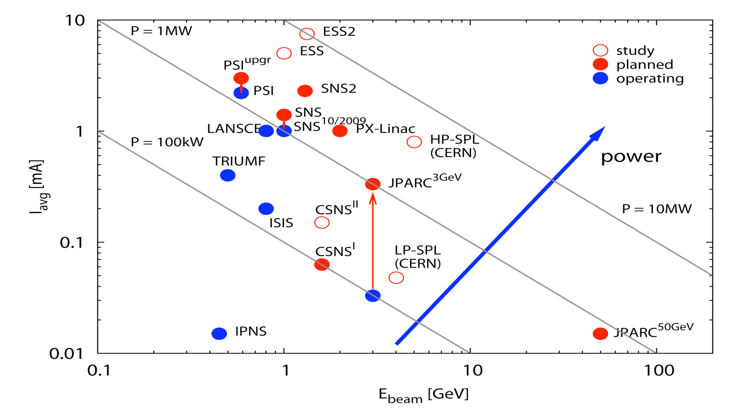
The Landscape
Project-X
M Seidel, PSI

Slide 5
The Landscape
x Duty Factor
*
Project-X CW-Linac
PSI
*
TRIUMF
power
*
Stopped/Slow kaon yield/Watt
* Beam power x Duty Factor

Slide 6

Project Goals
Mission Elements
A neutrino beam for long baseline neutrino oscillation experiments
  2 MW proton source at 60-120 GeV
MW-class low energy proton beams
for kaon, muon, neutrino, and nuclei
based precision experiments
  Operations simultaneous with the
  neutrino program
A path toward a muon source for
possible future Neutrino Factory
and/or a Muon Collider
  Requires ~4 MW at ~5-15 GeV
Possible missions beyond particle physics
  Energy applications

Slide 7
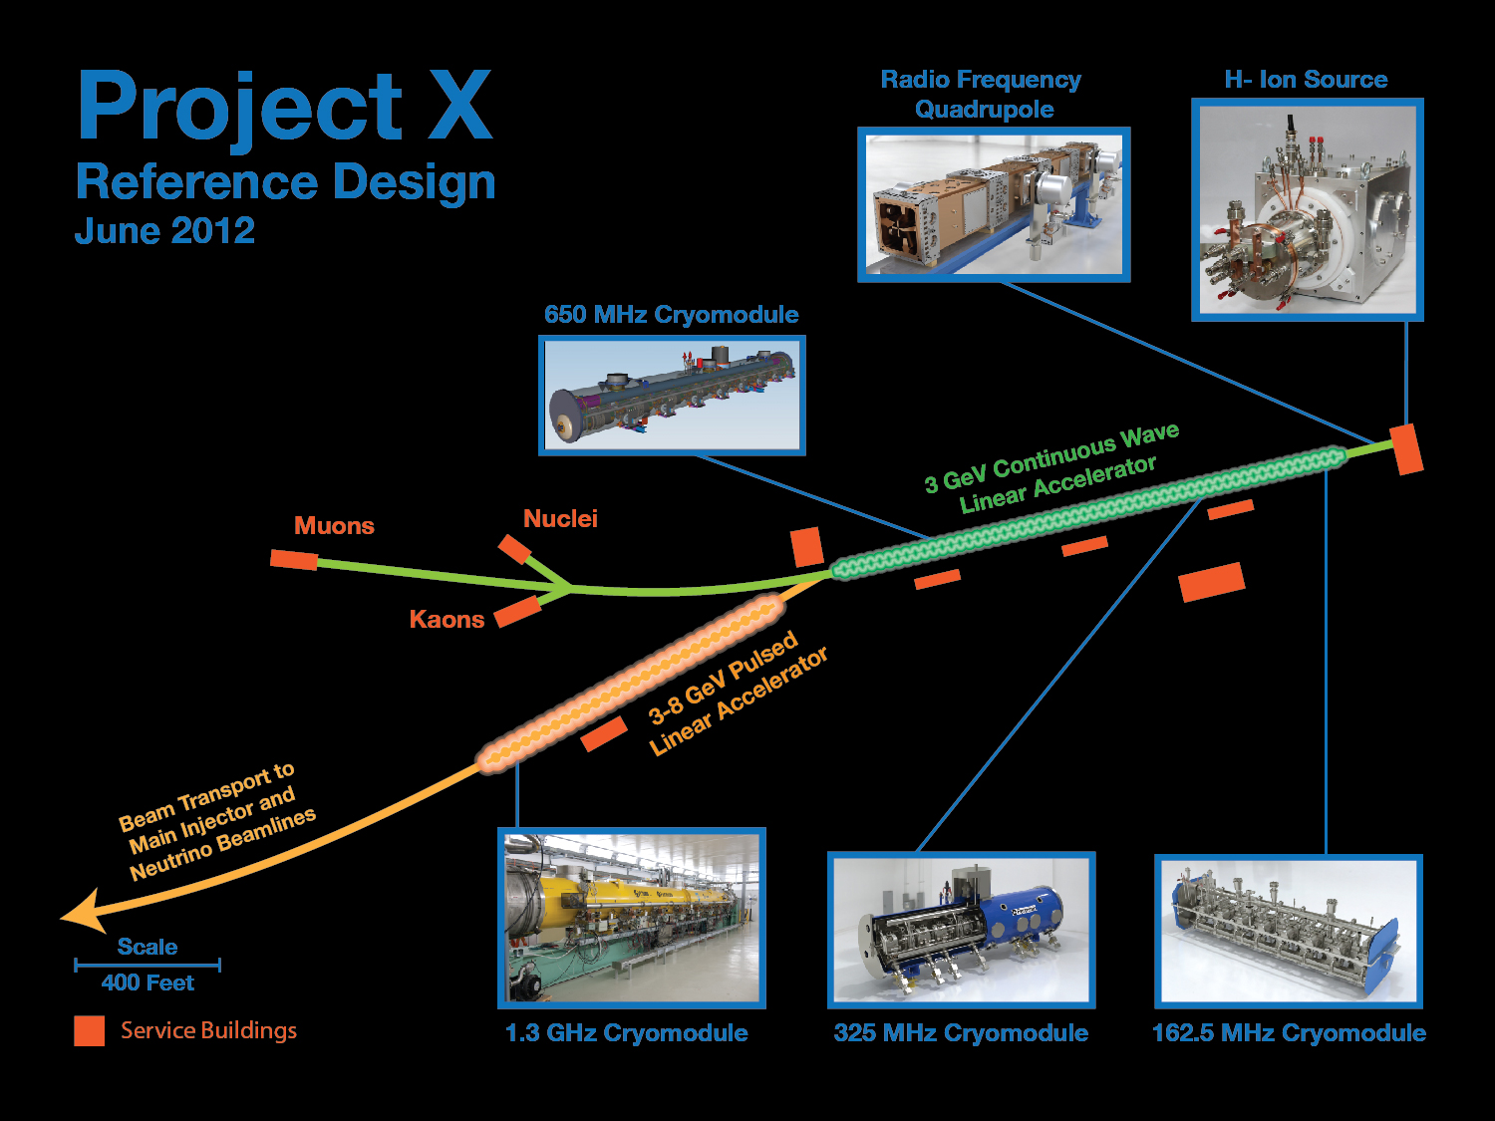
3 MW @ 3 GeV
200 kW @ 8 GeV
2 MW @ 120 GeV
      as;lkjfda;lskdjf;salkjfd
Argonne National Laboratory • Brookhaven National Laboratory • Fermi National Accelerator Laboratory • Lawrence Berkeley National Laboratory
Pacific Northwest National Laboratory • Oak Ridge National Laboratory / SNS • SLAC National Accelerator Laboratory
Thomas Jefferson National Accelerator Facility • Cornell University • Michigan State University • ILC/Americas Regional Team
Bhaba Atomic Research Center • Raja Ramanna Center of Advanced Technology • Variable Energy Cyclotron Center • Inter University Accelerator Center

Slide 8
Reference Design
Scope
3 GeV CW superconducting H- linac with 1 mA average beam current.
  Flexible provision for variable beam structures to multiple users
    CW at time scales >1 μsec, 20% DF at <1 μsec
  Supports rare processes programs at 3 GeV
  Provision for 1 GeV extraction for nuclear energy program
3-8 GeV pulsed linac capable of delivering 300 kW at 8 GeV
  Supports the neutrino program
  Establishes a path toward a muon based facility
Upgrades to the Recycler and Main Injector to provide ≥ 2 MW to the neutrino production target at 60-120 GeV.
Utilization of a CW linac creates a facility that is unique in the world, with performance that cannot be matched in a synchrotron-based facility.
Notes:
ADS Development with Nuclear Energy Applications

Slide 9
Reference Design Performance Goals
Linac
Particle Type H⁻
Beam Kinetic Energy 3.0 GeV
Average Beam Current 1 mA
Linac pulse rate CW
Beam Power 3000 kW
Beam Power to 3 GeV program 2870 kW
Pulsed Linac
Particle Type H⁻
Beam Kinetic Energy 8.0 GeV
Pulse rate 10 Hz
Pulse Width 4.3 msec
Cycles to Recycler/MI 6
Particles per cycle to Recycler/MI 2.7×10¹³
Beam Power 340 kW
Beam Power to 8 GeV program 170 kW
Main Injector/Recycler
Beam Kinetic Energy (maximum) 120 GeV
Cycle time 1.2 sec
Particles per cycle 1.5×10¹⁴
Beam Power at 120 GeV 2400 kW
simultaneous

Slide 10
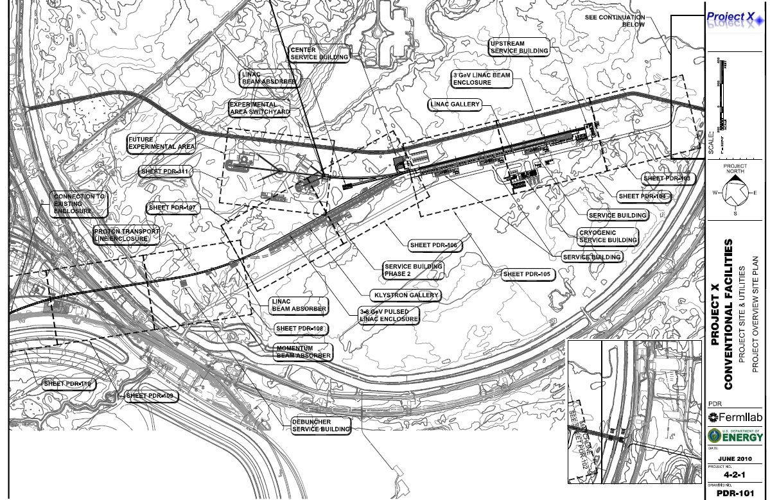
Reference Design
Siting
3 GeV Experimental Area
CW Linac
8 GeV Linac

Slide 11
Staging Opportunities
Staging principles
  Significant physics opportunities at each stage
  Cost of each stage substantially <$1B
  Utilize existing infrastructure to the extent possible at each stage
  Achieve full Reference Design capabilities (including upgradability) at end of final stage
On January 27 we described a four stage plan, consistent with these principles, to DOE/OHEP
We subsequently provided DOE with cost profiles for the first three stages, including potential in-kind contributions from India.
Notes:
Test
11

Slide 12
Staged Physics Program
Project X Campaign
Program: | NOνA + Proton Improvement Plan | Stage-1: 1 GeV CW Linac driving Booster & Muon, n/edm programs | Stage-2: Upgrade to 3 GeV CW Linac | Stage-3: Project X RDR | Stage-4: Beyond RDR: 8 GeV power upgrade to 4MW
MI neutrinos | 470-700 kW** | 515-1200 kW** | 1200 kW | 2450 kW | 2450-4000 kW
8 GeV Neutrinos | 15 kW + 0-50 kW** | 0-42 kW* + 0-90 kW** | 0-84 kW* | 0-172 kW* | 3000 kW
8 GeV Muon program e.g, (g-2), Mu2e-1 | 20 kW | 0-20 kW* | 0-20 kW* | 0-172 kW* | 1000 kW
1-3 GeV Muon program, e.g. Mu2e-2 | ----- | 80 kW | 1000 kW | 1000 kW | 1000 kW
Kaon Program | 0-30 kW** (<30% df from MI) | 0-75 kW** (<45% df from MI) | 1100 kW | 1870 kW | 1870 kW
Nuclear edm ISOL program | none | 0-900 kW | 0-900 kW | 0-1000 kW | 0-1000 kW
Ultra-cold neutron program | none | 0-900 kW | 0-900 kW | 0-1000 kW | 0-1000 kW
Nuclear technology applications | none | 0-900 kW | 0-900 kW | 0-1000 kW | 0-1000 kW
# Programs: | 4 | 8 | 8 | 8 | 8
Total max power: | 735 kW | 2222 kW | 4284 kW | 6492 kW | 11870kW
* Operating point in range depends on MI energy for neutrinos.
** Operating point in range is depends on MI injector slow-spill duty factor (df) for kaon program.

Slide 13
Staging Options
Stage 1
Scope
  1 GeV CW linac injecting into upgraded Booster
  Connection to Muon Campus
  Possible new EDM/Neutron campus (1 GeV)
Performance
  Main Injector: up to 1.2 MW at 120 GeV, 0.9 MW at 60 GeV
  Muon Campus: >80 kW to Mu2e @ 1GeV
  EDM/Neutron Campus: up to 900 kW @ 1 GeV
  8 GeV Program: up to 42 kW
Utilization of the existing complex
  Booster, Main Injector and Recycler (with PIP)
  NuMI (upgraded) or LBNE target system
  Muon Campus
  400 MeV Linac retired – eliminates major reliability risk

Slide 14
Staging Options
Stage 2
Scope
  Upgrade 1 GeV linac to 2 mA, still injecting into Booster
  1-3 GeV CW linac
  20 Hz Booster upgrade
  3 GeV Campus
Performance
  Main Injector: up to 1.2 MW at 60-120 GeV
  3 GeV Campus: 3 MW
  EDM/Neutron Campus: 1 MW @t 1 GeV
  8 GeV program: up to 84 kW
Utilization of the existing complex
  Booster, Main Injector and Recycler (with PIP)
  NuMI (upgraded) or LBNE target system

Slide 15
Staging Options
Stage 3
Scope
  3-8 GeV pulsed linac
  Main Injector Recycler upgrades
  Short baseline neutrino facility/experiment
Performance
  Main Injector: 2.4 MW at 60-120 GeV
  3 GeV Campus: 2.9 MW
  EDM/Neutron Campus: 1 MW @t 1 GeV
  8 GeV program: up to 170 kW
Utilization of the existing complex
  Main Injector and Recycler
  LBNE beamline/target
  8 GeV Booster retired – eliminates major reliability risk

Slide 16
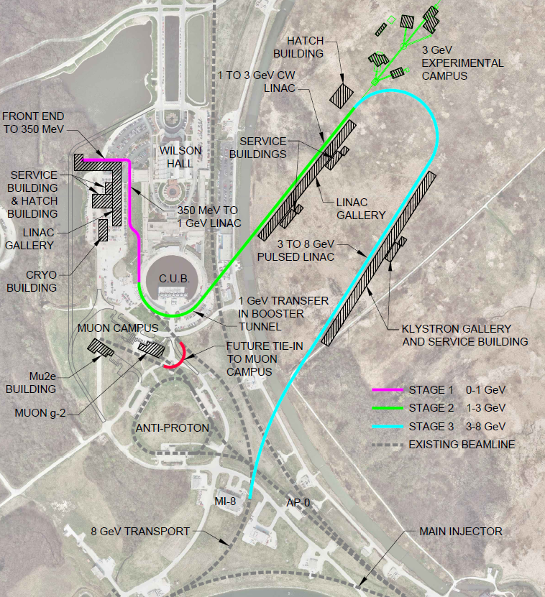
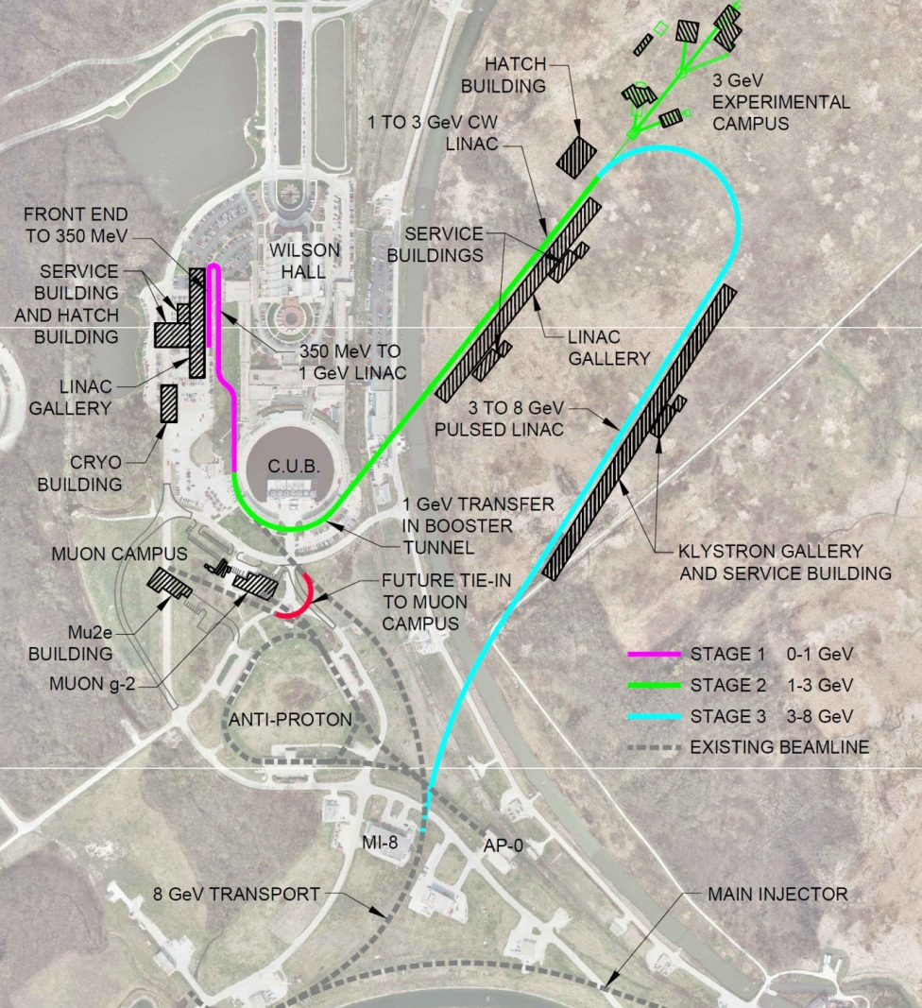
Siting Options
Most straight forward implementation is via the Reference Design siting
Alternative sitings based on “parking lot” linac to west of existing linac enclosure
  ~$50M savings
Other alternatives under development. Issues:
  Cost minimization in initial stage
  Implementation of Stages 2-4
  Connections to Muon Campus

Slide 17
Staging Options
Stage 4
Scope – beyond the Reference Design
  Current upgrade of CW and pulsed linac: 5 mA x 10% DF
  Main Injector/Recycler upgrades
  LBNE target upgrade
  Step toward a NF or MC
Performance
  Main Injector: 4 MW at 60-120 GeV
  3 GeV Campus: 2.7 MW
  EDM/Neutron Campus: 1 MW @t 1 GeV
  8 GeV program: 3-4 MW
    (Requires an accumulator ring for low duty factor)
Utilization of the existing complex
  Main Injector and Recycler
  LBNE beamline/target

Slide 18
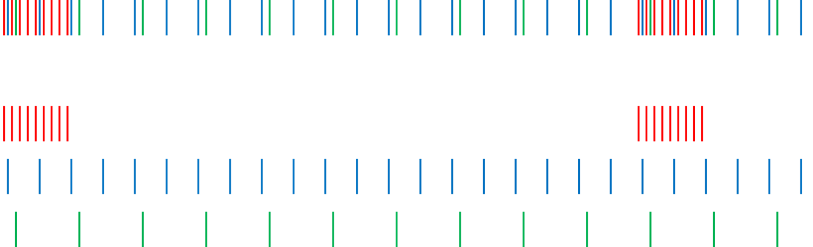
Operating Scenarios
CW Linac
1 μsec period at 3 GeV
Muon pulses (17e7) 80 MHz, 100 nsec 700 kW
Kaon pulses (17e7) 20 MHz 1540 kW
Nuclear pulses (17e7) 10 MHz 770 kW
Ion source and RFQ operate at 4.4 mA
77% of bunches are chopped @ 2.1 MeV ⇒ maintain 1 mA over 1 μsec
Separation scheme
1 μsec
Transverse rf splitter

Slide 19
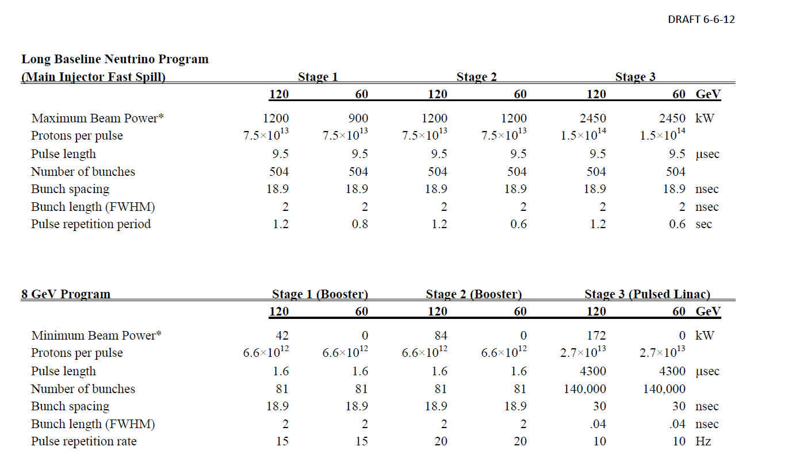
Performance by Stage projectx-docdb.fnal.gov/cgi-bin/ShowDocument?docid=1061

Slide 20
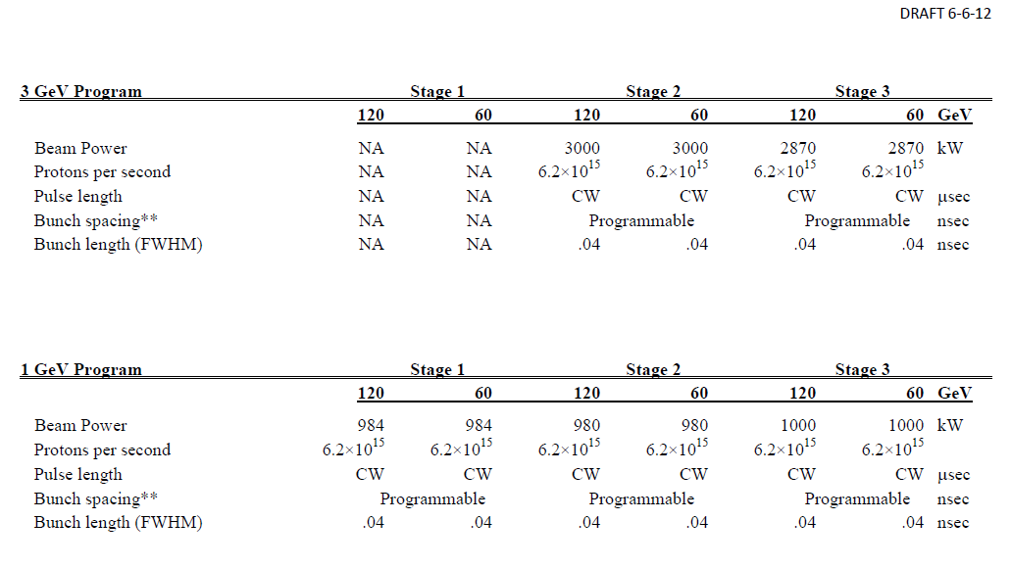
Performance by Stage projectx-docdb.fnal.gov/cgi-bin/ShowDocument?docid=1061

Slide 21
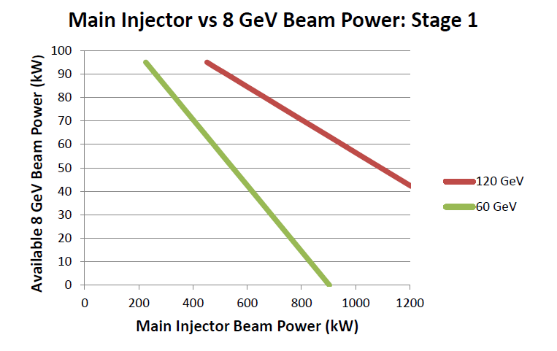
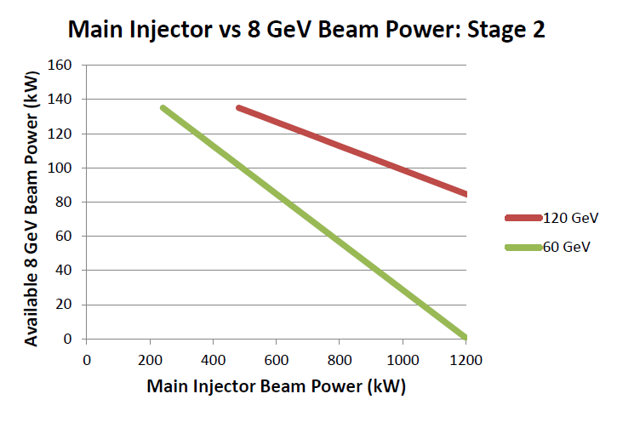
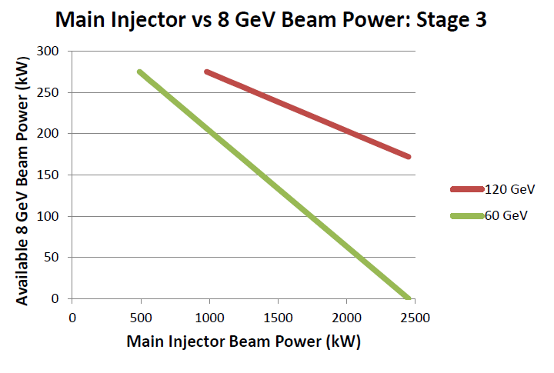
Performance by Stage projectx-docdb.fnal.gov/cgi-bin/ShowDocument?docid=1061

Slide 22
R&D Program
Challenges
Goal is to mitigate risk: technical, cost, and schedule
Primary elements of the R&D program:
  Primary technical risk element is the front end
    CW ion source/RFQ
    Wideband chopping with high (1×10⁻⁴) extinction rate
    (Low-β) acceleration through superconducting resonators with minimal halo formation
    MEBT beam absorber (>8 kW)
  Development of an H- injection system
  Superconducting rf development
    Cavities, cryomodules, rf sources – CW to long-pulse
  High Power targetry
  Upgrade paths: Multi-MW low energy neutrinos and Muon Collider
  All of these elements are required at Stage 1, with the exception of 1.3 GHz pulsed RF
  First and third elements addressed in an integrated system test: PXIE
Goal is to complete R&D phase by the end of 2016

Slide 23
Project X Injector Experiment
PXIE
PXIE is the centerpiece of the Project X R&D program
  Integrated systems test for Project X front end components
    Validate the concept for the Project X front end, thereby minimizing the primary technical risk element within the Reference Design.
    Operate at full Project X design parameters
Systems test goals
  1 mA average current with 80% chopping of beam delivered from RFQ
  Efficient acceleration with minimal emittance dilution through ~30 MeV
  Achieve in 2016
PXIE should utilize components constructed to PX specifications wherever possbile
  Opportunity to re-utilize selected pieces of PXIE in PX/Stage 1
Collaboration between Fermilab, ANL, LBNL, SLAC, India

Slide 24
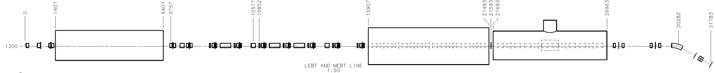
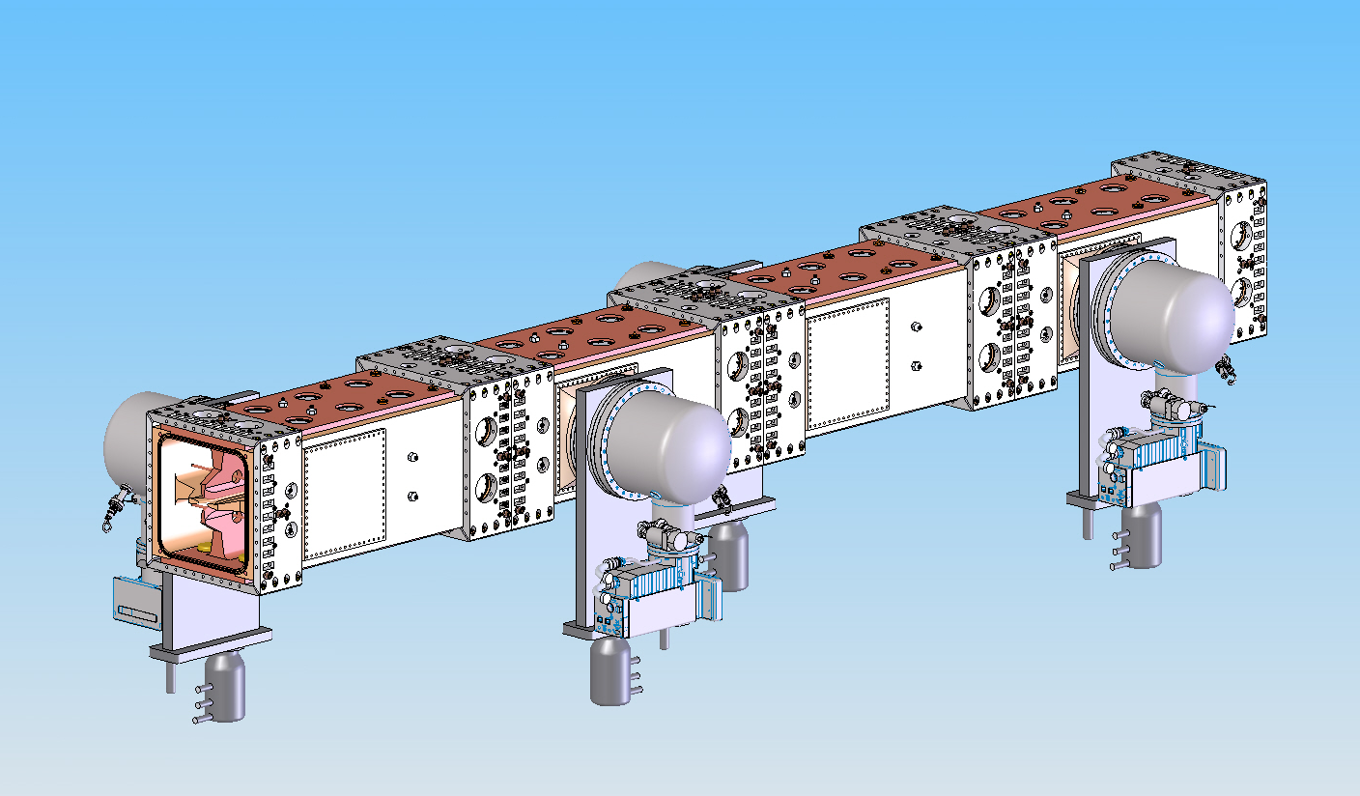
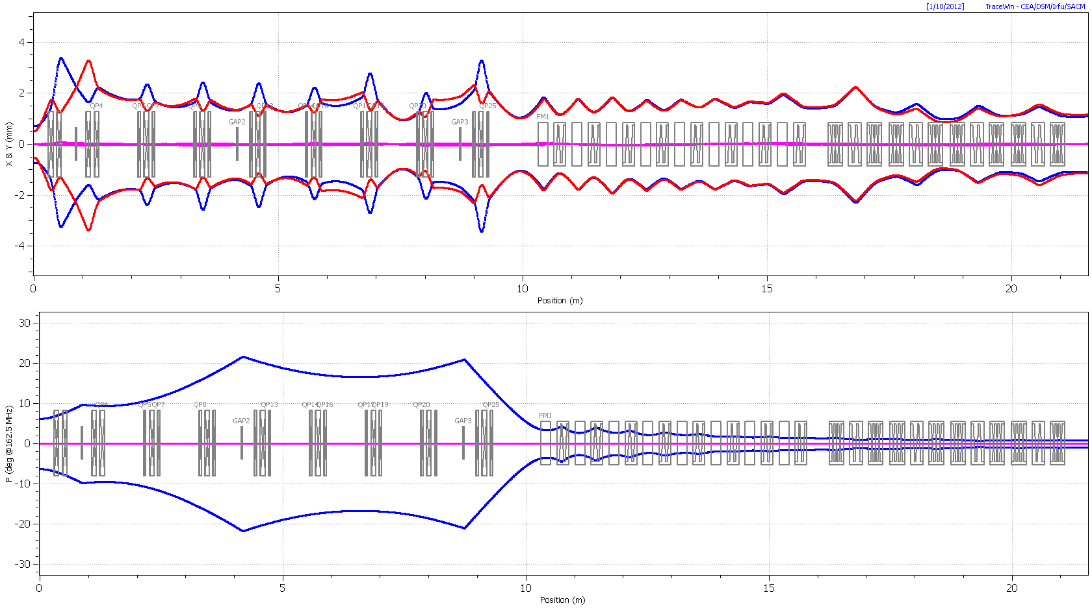
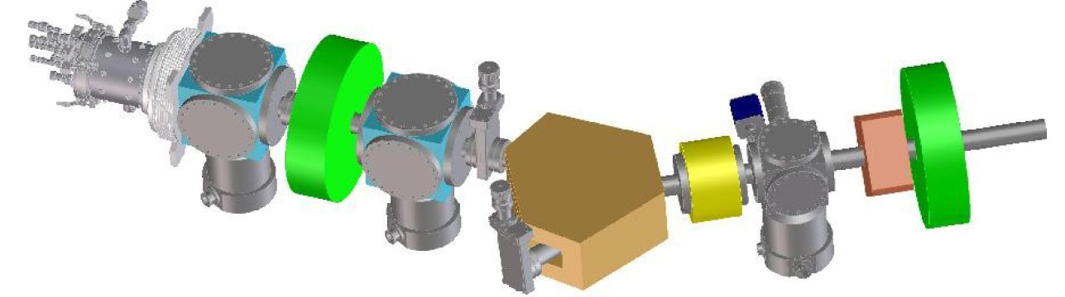
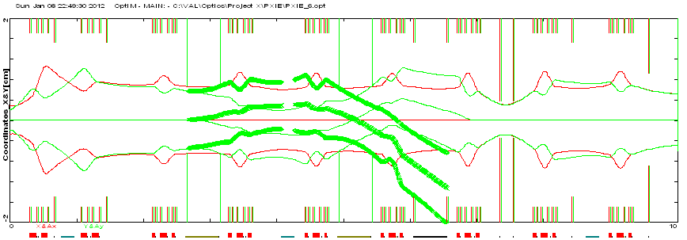
PXIE Program
RFQ
MEBT
HWR
SSR1
LEBT
LBNL, FNAL FNAL, SLAC ANL FNAL
Dump
32 m, 30 MeV
PXIE will address the address/measure the following:
  Ion source lifetime
  LEBT pre-chopping
  Vacuum management in the LEBT/RFQ region
  Validation of chopper performance
  Kicker extinction
  Effectiveness of MEBT beam absorber
  MEBT vacuum management
  Operation of HWR in close proximity to 10 kW absorber
  Operation of SSR with beam
  Emittance preservation and beam halo formation through the front end

Slide 25
PXIE Status
Whitepaper available describing rationale, goals, plan
  Shared with DOE
  http://projectx-docdb.fnal.gov/cgi-bin/ShowDocument?docid=966
Technical Review March 6-7
  https://indico.fnal.gov/conferenceDisplay.py?confId=5278
Preferred location identified (CMTF)
Cost estimate /funding plan allowing completion of the full scope of PXIE in 2016
  Requires maintenance of Project X and SRF budgets at FY12 levels
DOE has requested that we organize and execute PXIE as a “project”, not a “Project”
  Organization Chart
  Program Design Handbook
  Resource Loaded Schedule
  DOE oversight
    Periodic reporting
    Periodic review

Slide 26
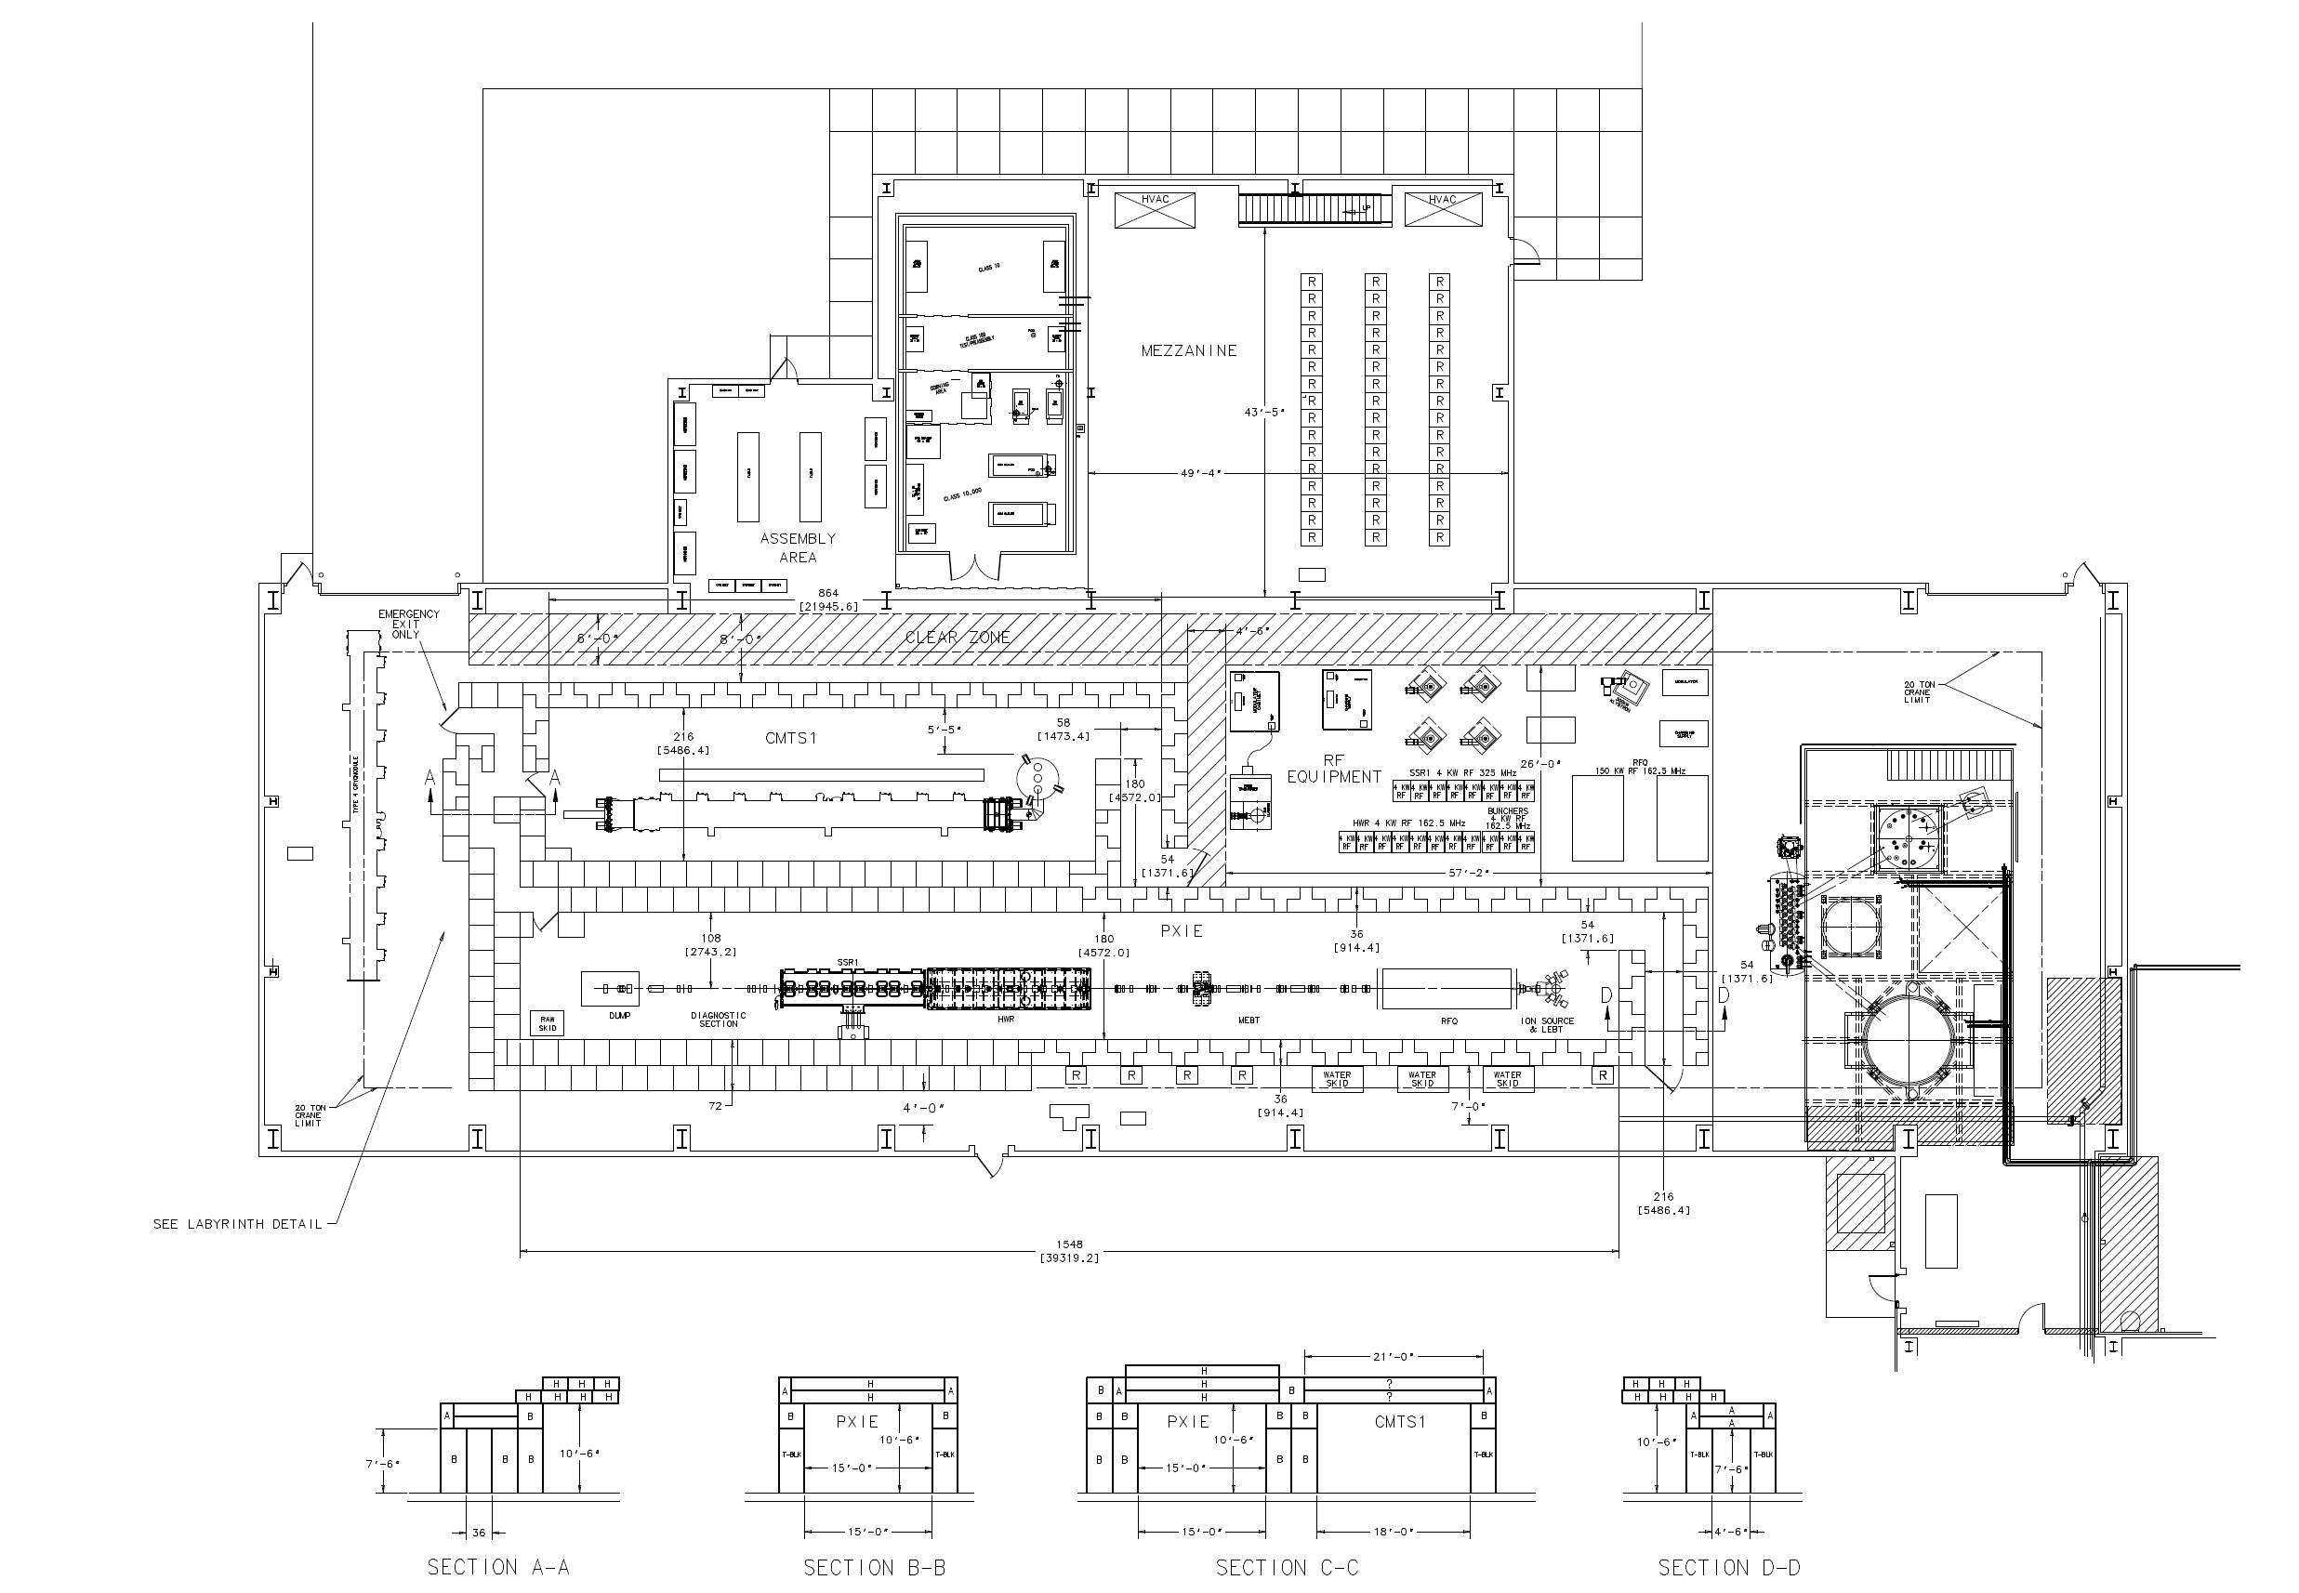
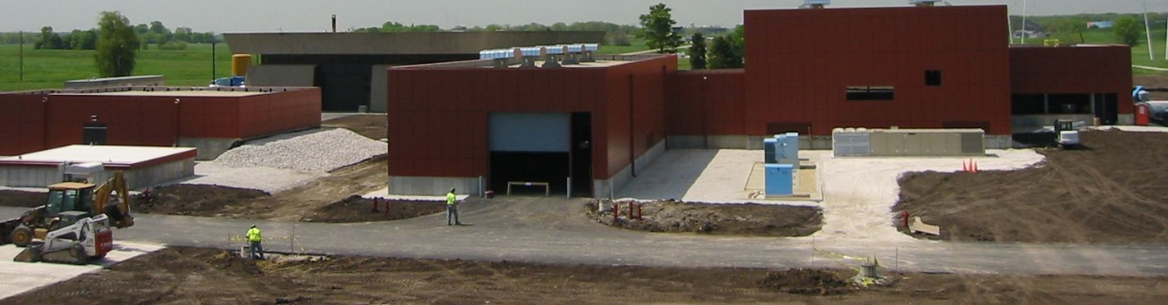
PXIE @ CMTF

Slide 27
SRF R&D
Technology Map
β=0.11
β=0.22
β=0.4
β=0.61
β=0.9
β=1.0
CW
Pulsed
162.5 MHz
2.1-10 MeV
325 MHz
10-160 MeV
650 MHz
0.16-3 GeV
1.3 GHz
3-8 GeV
Stage 1
Section | Freq | Energy (MeV) | Cav/mag/CM | Type
HWR (β_{G}=0.1) | 162.5 | 2.1-10 | 8/8/1 | HWR, solenoid
SSR1 (β_{G}=0.22) | 325 | 10-42 | 16/10/ 2 | SSR, solenoid
SSR2 (β_{G}=0.47) | 325 | 42-160 | 36/20/4 | SSR, solenoid
LB 650 (β_{G}=0.61) | 650 | 160-460 | 42 /14/7 | 5-cell elliptical, doublet
HB 650 (β_{G}=0.9) | 650 | 460-3000 | 152/19/19 | 5-cell elliptical, doublet
ILC 1.3 (β_{G}=1.0) | 1300 | 3000-8000 | 224 /28 /28 | 9-cell elliptical, quad
Notes:
I would suggest that you point out that Indian DAE labratories are already working on SSR1, 650 and ILC cavities.

Slide 28
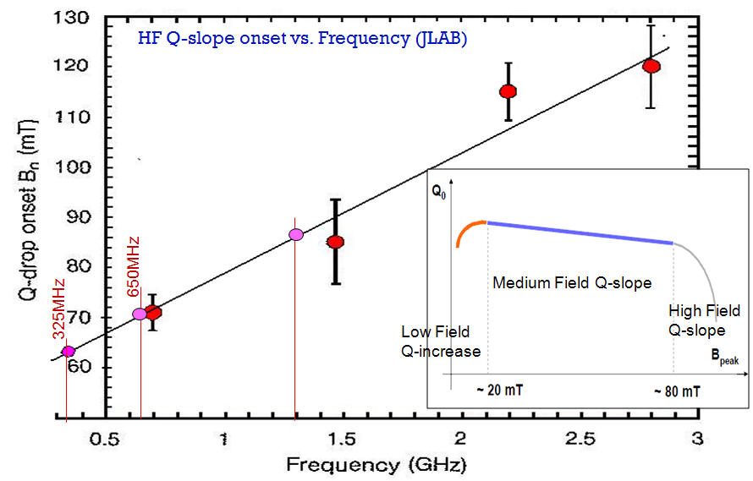
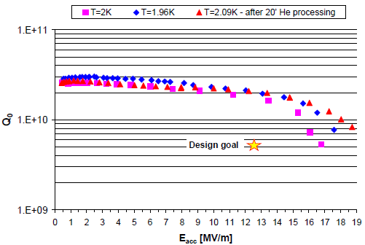
Choice of Cavity Parameters
Example: SNS, 805 MHz, β=0.81
70 mT
CW Linac assumptions:
162.5 MHz B_{pk} < 60mT
325 MHz B_{pk} < 70mT
650 MHz B_{pk} < 70mT
1300 MHz B_{pk} < 80mT
⇒ E_{acc} = 15.6 MV/m; Q_{o} ~1.7∙10¹⁰ @ 2 K

Slide 29
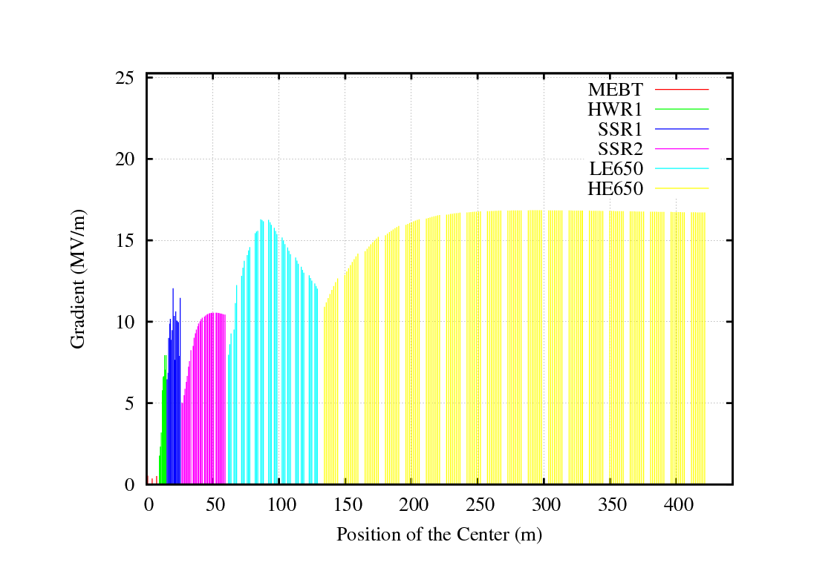
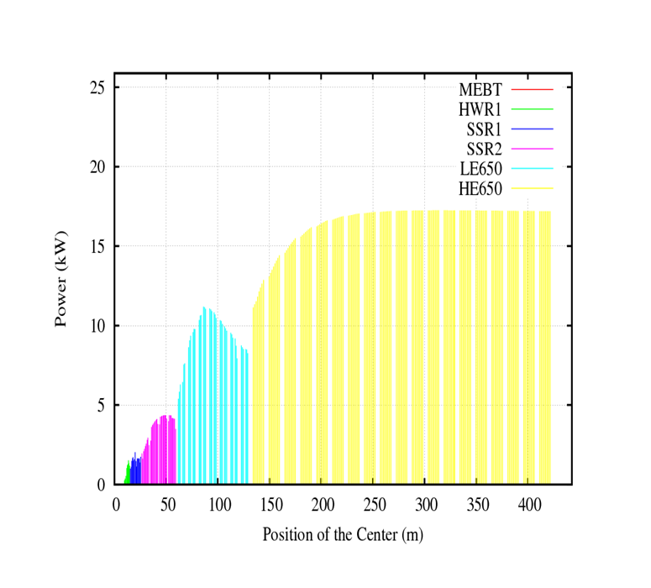
SRF Acceleration Parameters
Energy Gain
Beam Power
Stage 1
Stage 1

Slide 30
SRF Development
Cavity/ CM Status
1300 MHz
  90 nine-cell cavities ordered
  60 received (32 from U.S. industry:16 from AES, 16 from Niowave-Roark)
  ~ 40 processed and tested, ~20 dressed
  2 CM built: one from a DESY kit and a second U.S. procured
    CM1 testing at NML is complete; CM2 was delivered to NML April 26 for testing
650 MHz
  JLab built two single-cell β =0.61 cavities
  Six β = 0.9 single-cell cavities ordered from U.S. industry recently arrived
  Order for six β = 0.61 (2 JLab, 2 FNAL design) single-cell cavities in industry
325 MHz
  2 SSR1 β =0.22 cavities (Roark, Zanon) both VTS tested
    1 of these dressed and tested at STF
  2 SSR1 being fabricated in India (IUAC, spring 2012)
  10 SSR1 ordered from Industry (Niowave-Roark)
    6 delivered; 1 VTS tested, second soon to follow
Design work advanced on 325 MHz CM, but proceeding with lower priority on 650 MHz CM (not required in PXIE)

Slide 31
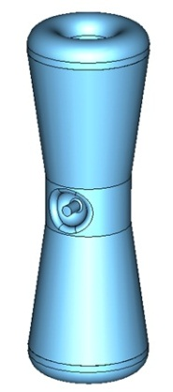
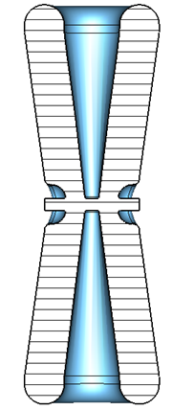
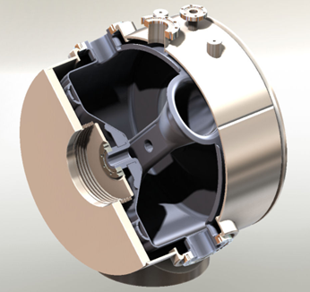
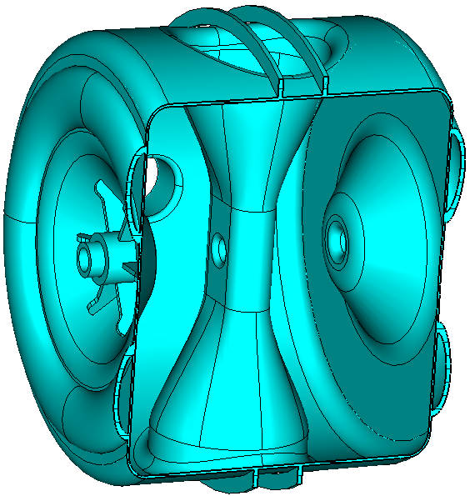
162.5 and 325 MHz Cavities
HWR (β_{G} = 0.11 ) Half Wave Resonator
  EM and mechanical design underway at ANL
  Similar to cavities & CM already manufactured by ANL
SSR1 (β_{G} = 0.22 ) Single Spoke Resonator
  Initiated under HINS program → more advanced
  8 prototype cavities to date
    3 tested as bare cavities at 2K
      Second unit met PX spec
    One dressed and tested at 4.8K
SSR2(β_{G} = 0.47 ) Single Spoke Resonator
  EM design complete
  Mechanical design in progress

Slide 32
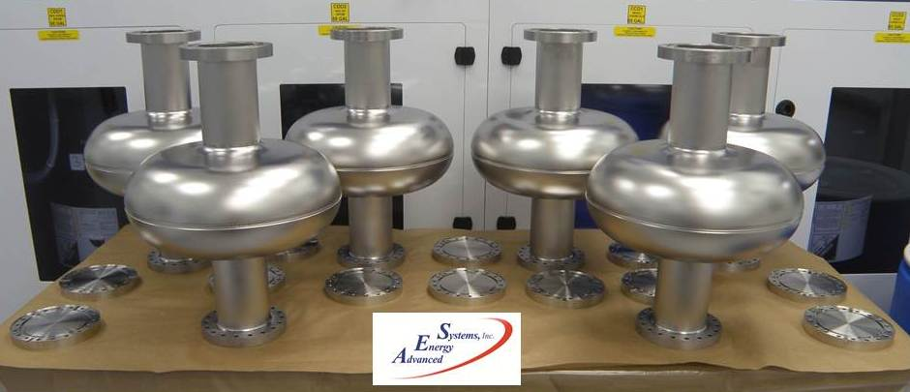
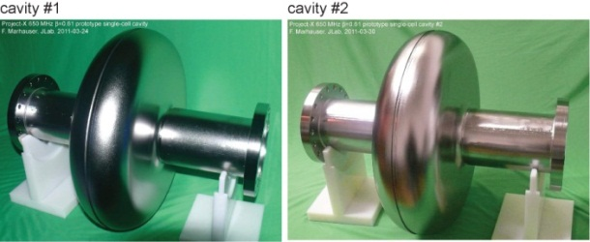
650 MHz Cavities
For purposes of cryogenic system design, the dynamic heat load limited to 250 W at 2K per cryomodule
    <35W per cavity (β_{G} = 0.61) and <25W per cavity (β_{G} = 0.9)
    Q0 = 1.7E10
Multiple single cells received from JLab and industry
  β=0.9, AES β=0.6/JLab
Five-cell design complete for β_{G} = 0.9 cavities
  Four 5-cell β_{G} = 0.9 cavities on order from AES; two expected in FY12

Slide 33
650 MHz
Single Cell Performance (JLab, β=0.6)

Slide 34
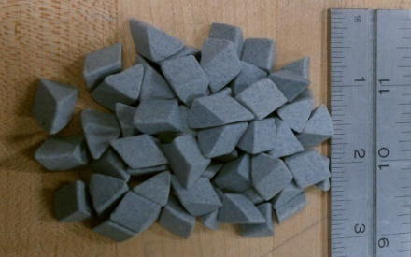
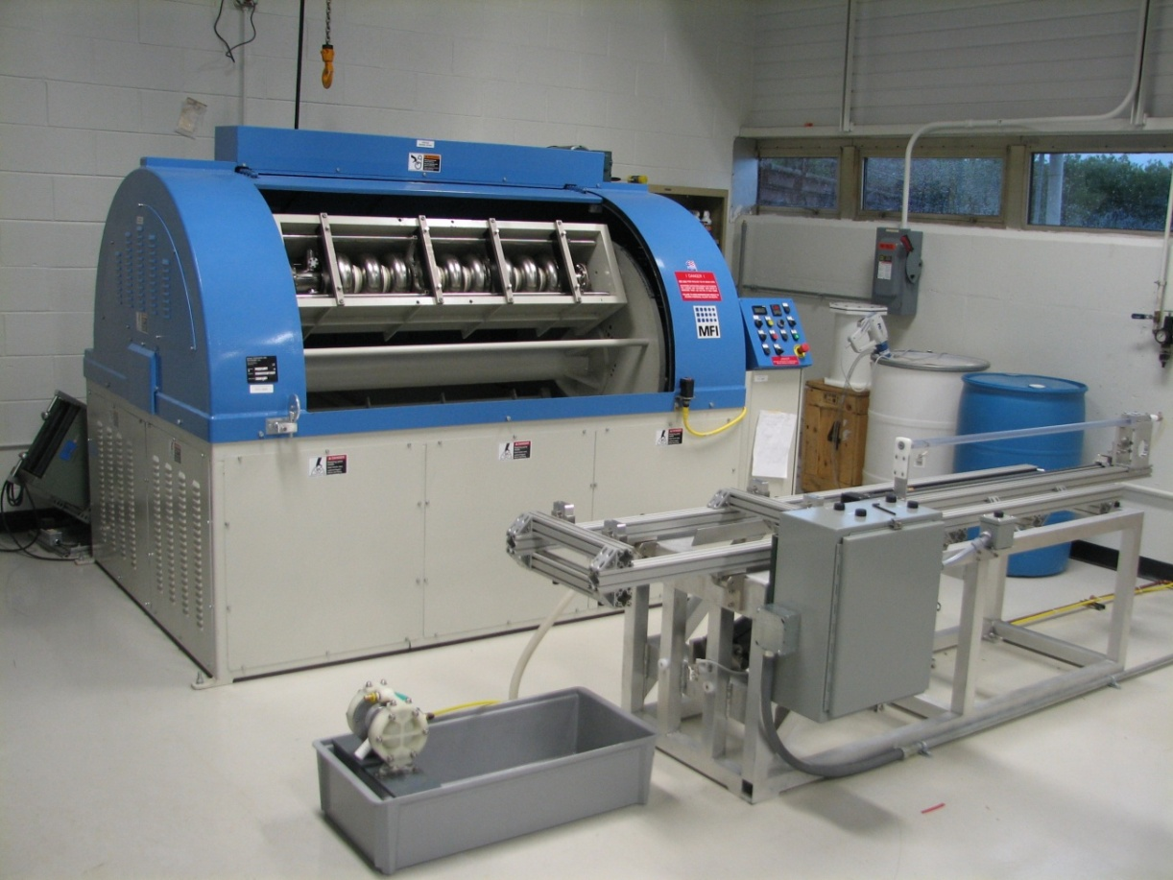
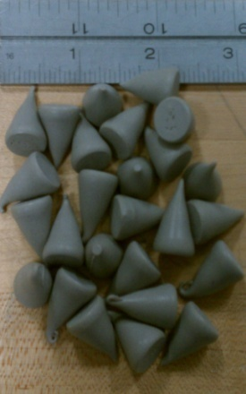
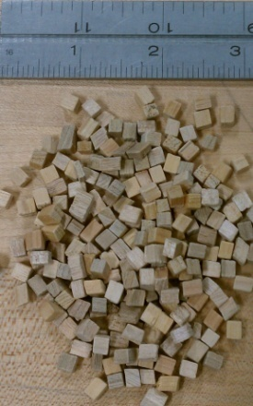
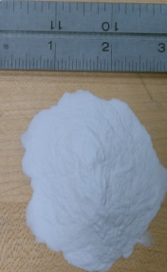
Centrifugal Barrel Polishing IB4 Tumbling Machine
C. Cooper Recipe Media
Multi-step process for elliptical cavities using multiple sets of media
Potential for up to 4 cavity-cycles per week

Slide 35
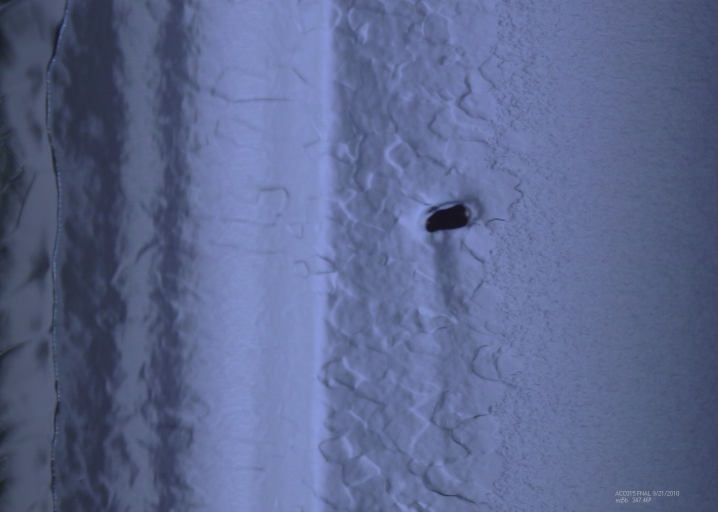

Centrifugal Barrel Polishing
9-Cell Results
Previously limited here
ACC015 Before CBP
Demonstrated cavity gradients > 35 MV/M
Drastic reductions in acid use.
Demonstrated as a cavity repair method.
After CBP and 40 μm EP

Slide 36
SRF Plan
Cavities & Cryomodules

Slide 37
SRF Plan
Infrastructure

Slide 38
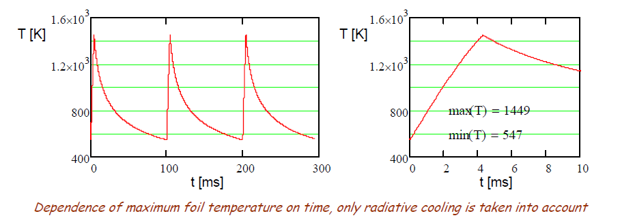
R&D
H- Injection
Need to accumulate 26 mA-ms protons in the MI/Recycler (RD)
  For a stationary foil, a single 26-ms pulse would destroy the foil.
  6 pulses at 10 Hz provide sufficient radiative cooling between pulses
    ~400 turns
  Also looking at moving/rotating foils and laser assisted stripping
1 mA-msec protons required to load the Booster in Stage 1
  600 turns

Slide 39
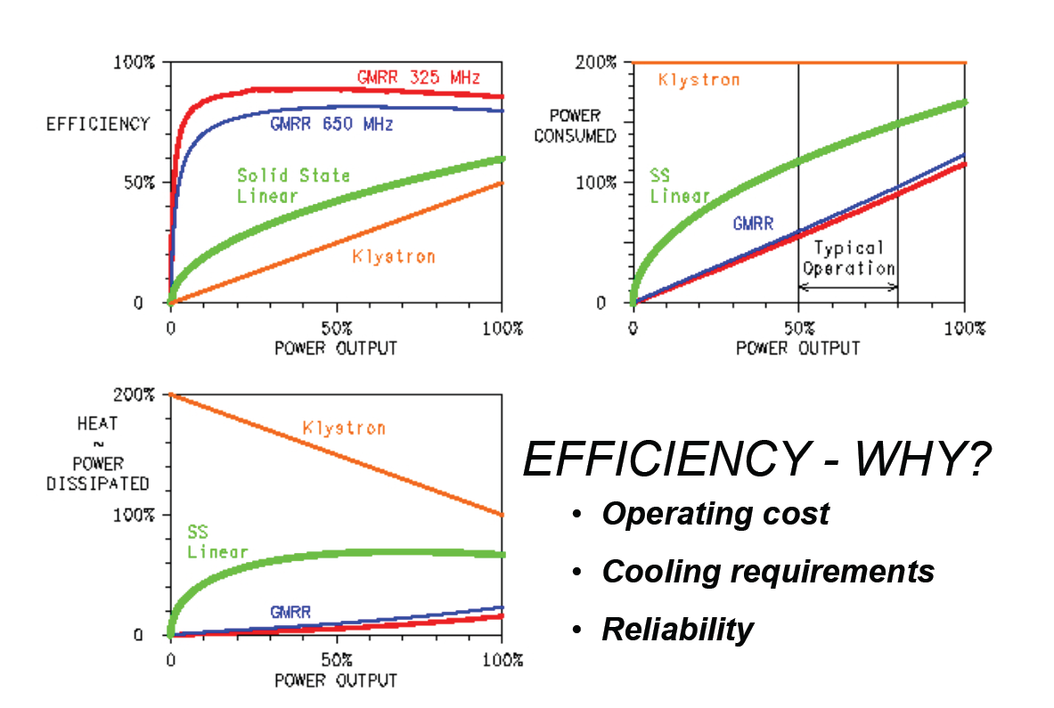
R&D
RF Sources
162.5 and 325 MHz sources will be solid state
  ~5-20 kW/unit
Evaluating multiple technologies for 650 MHz
  IOT
  Solid State
1300 MHz (Stage 3) would be based on klystrons

Slide 40
Project X Status and Strategy
Project X strategy is strongly tied to the overall DOE Intensity Frontier Strategy
  LBNE: Stage 1 proposal to DOE
  Project X and LBNE stages interleaved
Project X has been well supported financially for the R&D phase
  $13M in FY12 and FY13 + significant investment in srf
Significant effort is going into defining the physics research opportunities at all stages
  Recent workshops on opportunities with spallation sources and on short baseline neutrinos
  Project X Physics Study: Now!
  Snowmass 2013 in planning stages (DPF)
A significant contribution from India is a strong possibility
  DOE-DAE Joint Collaboration Meeting earlier this week (sponsored by US State Department)

Slide 41
Collaboration Activities
Two MOUs covering the RD&D Phase
  National IIFC
  ANL ORNL/SNS BARC/Mumbai
  BNL PNNL IUAC/Delhi
  Cornell TJNAF RRCAT/Indore
  Fermilab SLAC VECC/Kolkata
  LBNL ILC/ART
  MSU
Informal collaboration/contacts with CERN/SPL, ESS
China/ADS, UK, Korea/KoRIA
Weekly Friday meeting: https://indico.fnal.gov/categoryDisplay.py?categId=168
  Collaborator participation via webex
  Meeting notes posted
Semi-annual Collaboration meetings

Slide 42
Summary
The Project X Reference Design represents a unique facility which will form the basis for a world leading Intensity Frontier program at Fermilab over many decades
  Reference Design concept has remained stable for two+ years
R&D program underway with very significant investment in srf
  Emphasis on the CW linac/Stage 1 components, including front end development program (PXIE)
Funding constraints within the DOE have led us to identify staging scenarios
  Stage 1, based on a 1 GeV CW linac feeding the existing Booster, represents a very significant step in performance of the Fermilab complex, and offers both compelling physics opportunities and a platform for further development toward the Reference Design.
Significant effort is being invested in defining physics programs associated with all stages
  The Project X Physics Study is key!

