Slide 1
9 O’Clock Meeting
Gilberto Perez
MCR Crew Chief
Tuesday, January 18, 2022

Slide 2
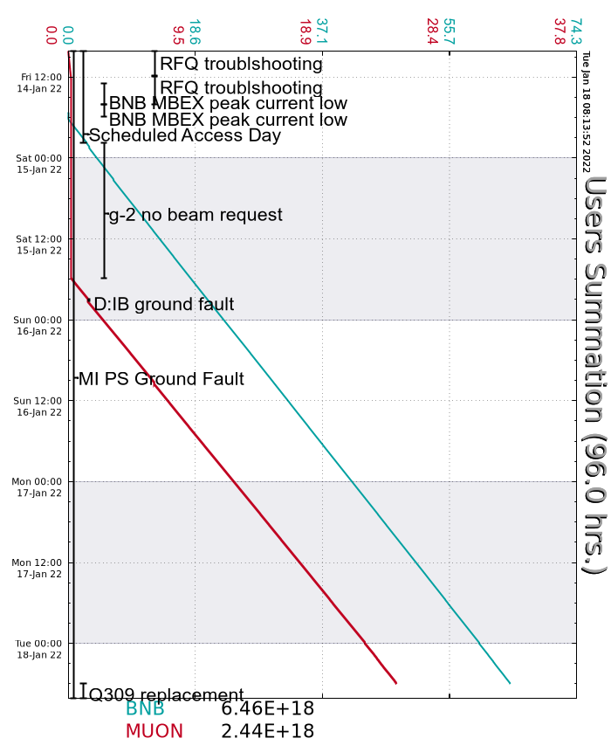
Since Friday…
Friday
RFQ driver tube replacement completed by end of day shift.
Readback issue on MBEX delayed beam to BNB until evening shift.
Accessed PreAcc Source A HV cabinet to reset boiler heater PS.
Saturday
BRF09 went down on bias supply fault. Turned on BRF20 in its place.
D:IB started to have ground faults.
Beam to g-2 by 18:00.
Sunday
A couple more D:IB ground faults.
Tuesday
Disabled beam by 06:00 and prepared MI for access as planned.
MI Center Anode supply trips on transformer oil over-temp faults.
BS809 shows indeterminate state.

