Slide 1
Summary on DC offset tests
Jixia Li
NAOC
2022.1.19

Slide 2
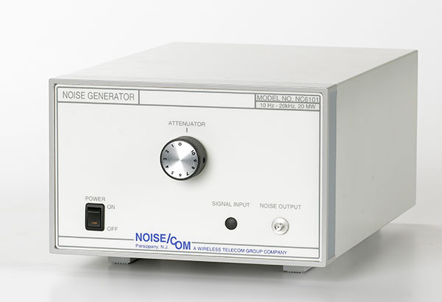
teleconf@2021.9.8
Raw ADC Samples @ different noise levels
Noise signals of different levels are directly input to the ADC on the Cylinder correlator.
  -22dBm/125MHz to 11 dBm/125MHz
  Step: ~1dB
Raw data of length 2048 can be taken done by the program in the dedicated server.
  Clock=250MHz
  2048 points corresponds to $4ns×2048=8192ns$
Tests done on March, 2020.

Slide 3
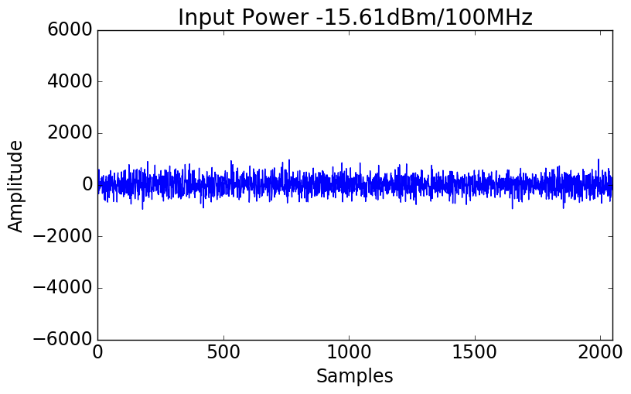
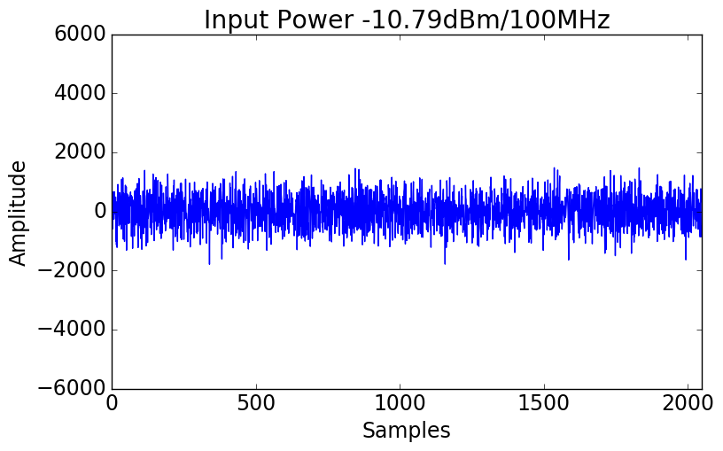
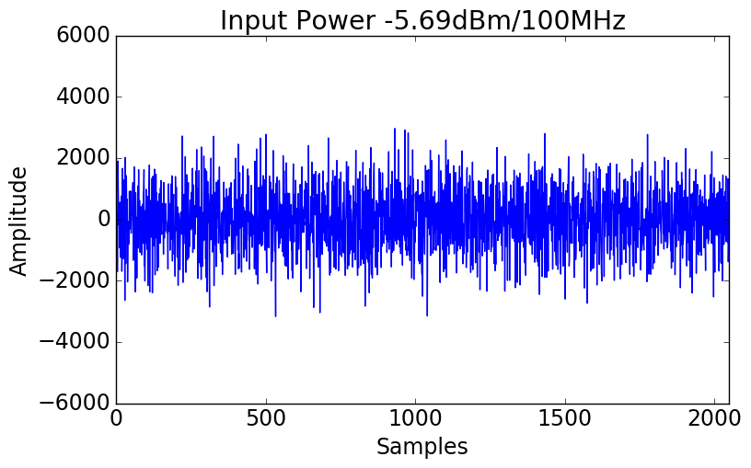
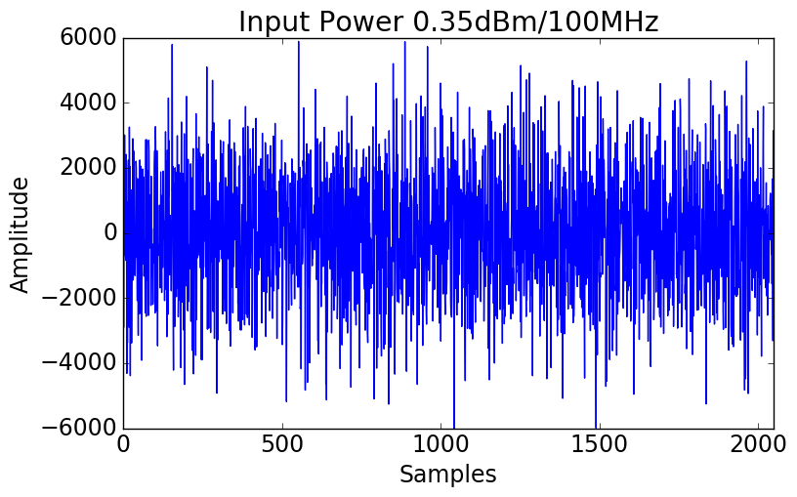
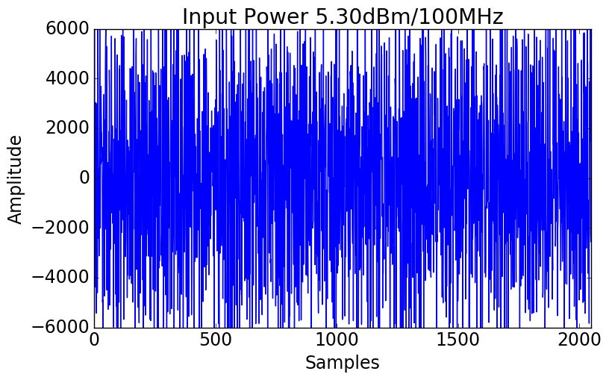
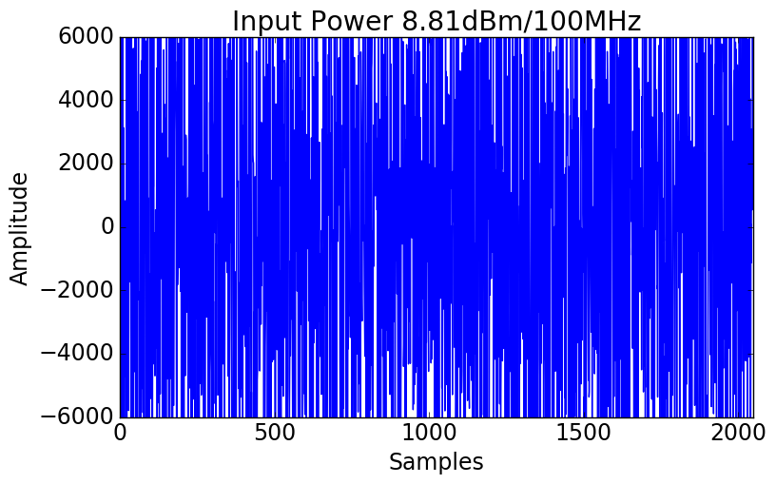
Raw ADC Samples @ different noise levels
teleconf@2021.9.8
The ordinate is fixed to the range of (-6000, 6000).
The ADC is saturated at $±8192$.

Slide 4
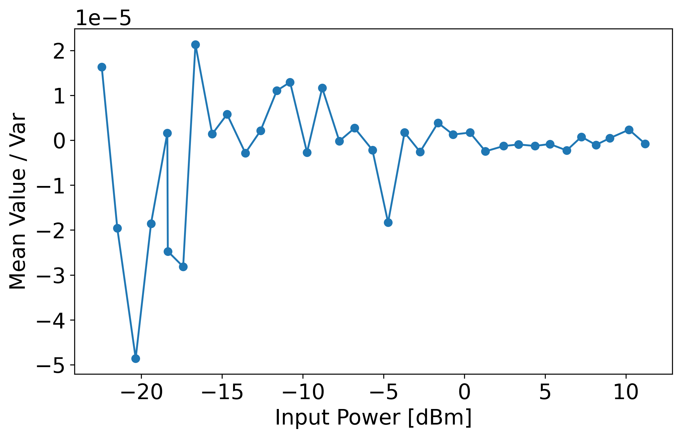
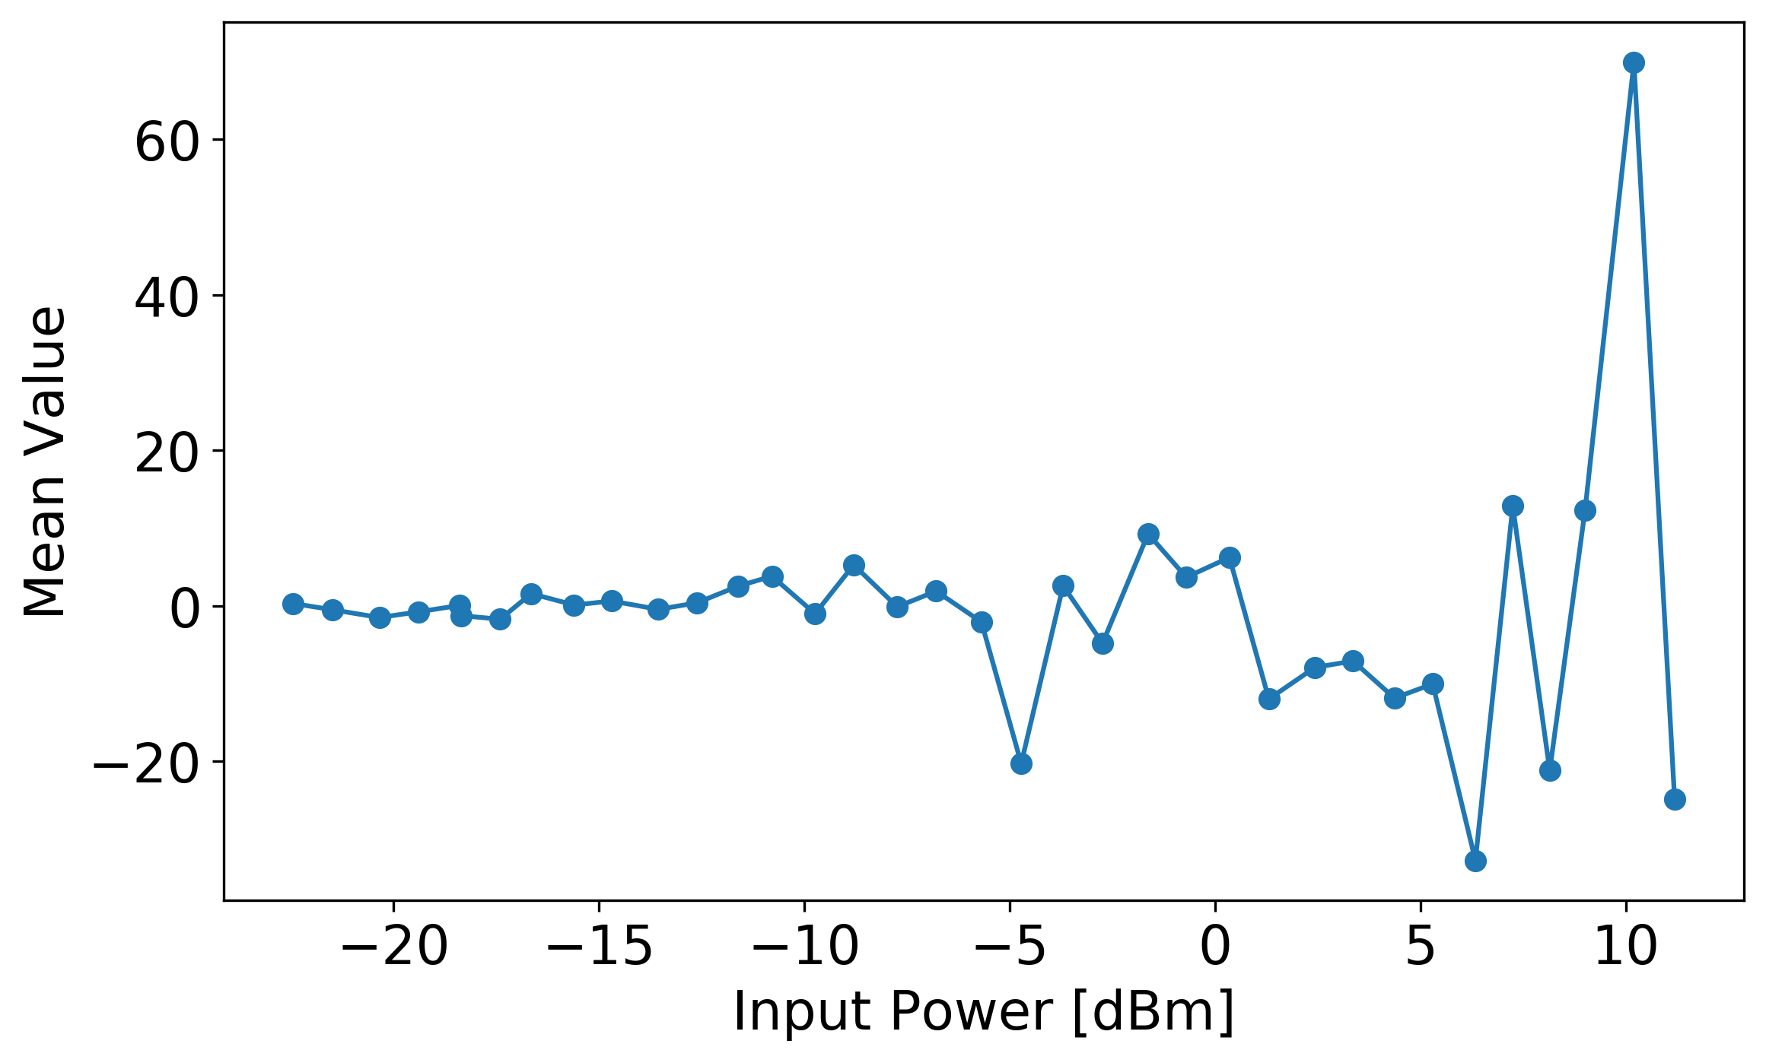
Mean Value of Raw ADC Samples @ different noise levels
teleconf@2021.9.8
Mean Value vs Input Power
Mean Value divided by variance vs Input Power
TODO: More samples needed?

Slide 5
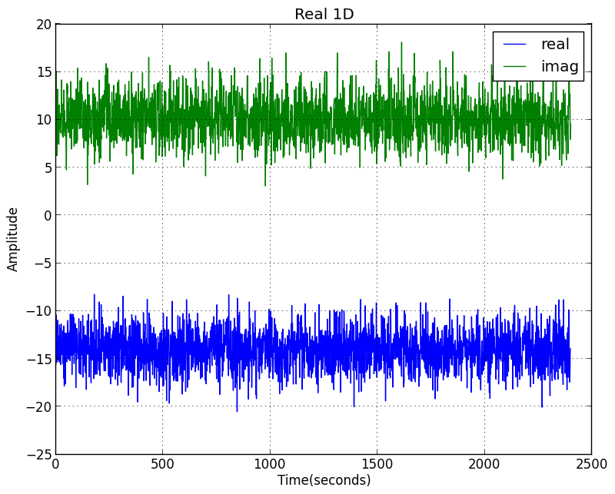
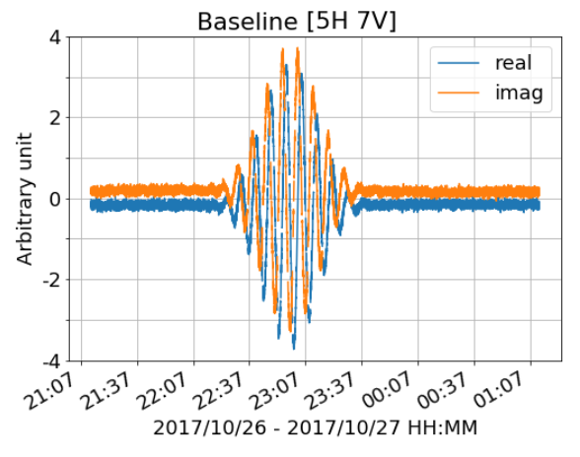
Correlation of 2 independent noise
teleconf@2021.9.15
AlgoSCR (Anh et al. 2022)
2 independent noise generators were directly input to dish correlator: ch1 and ch3

Slide 6
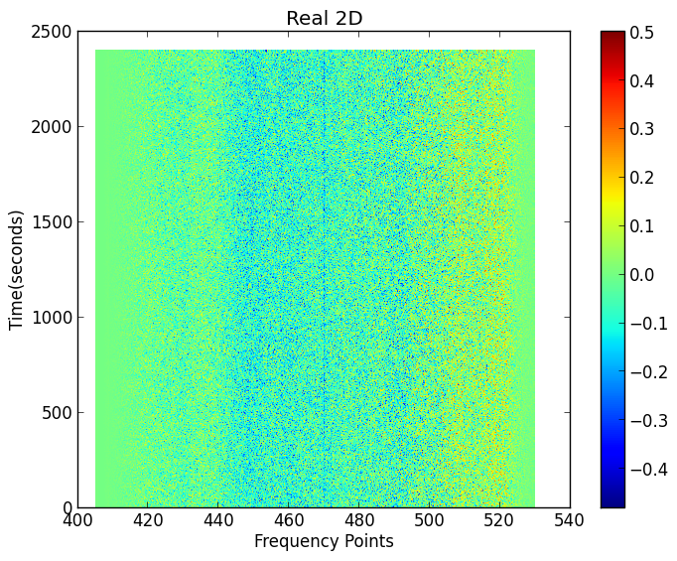
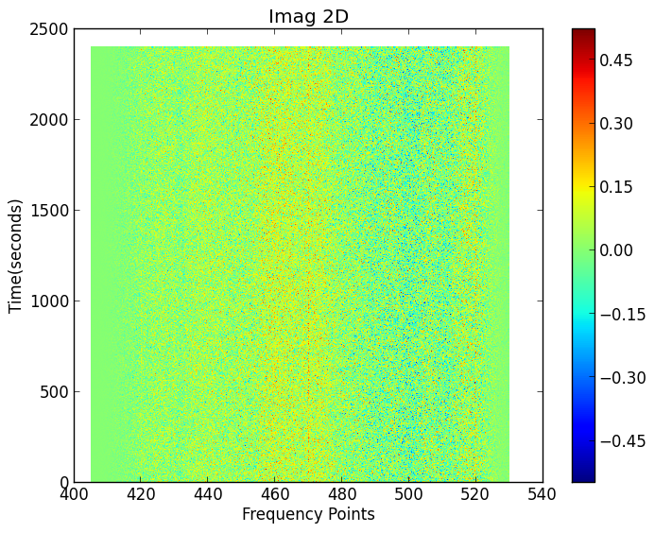
Correlation of 2 independent noise
teleconf@2021.9.15
Bandpass?
2 independent noise generators were directly input to dish correlator: ch1 and ch3

Slide 7
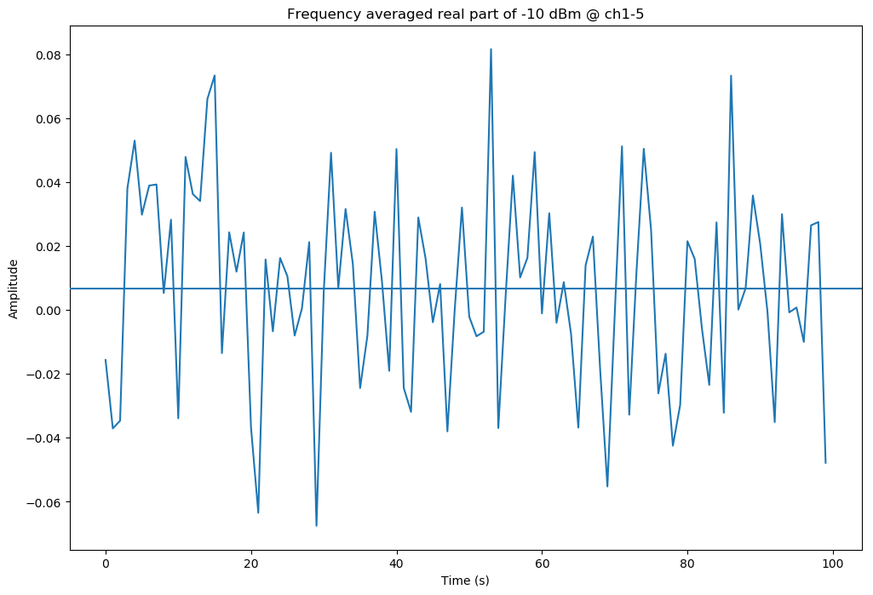
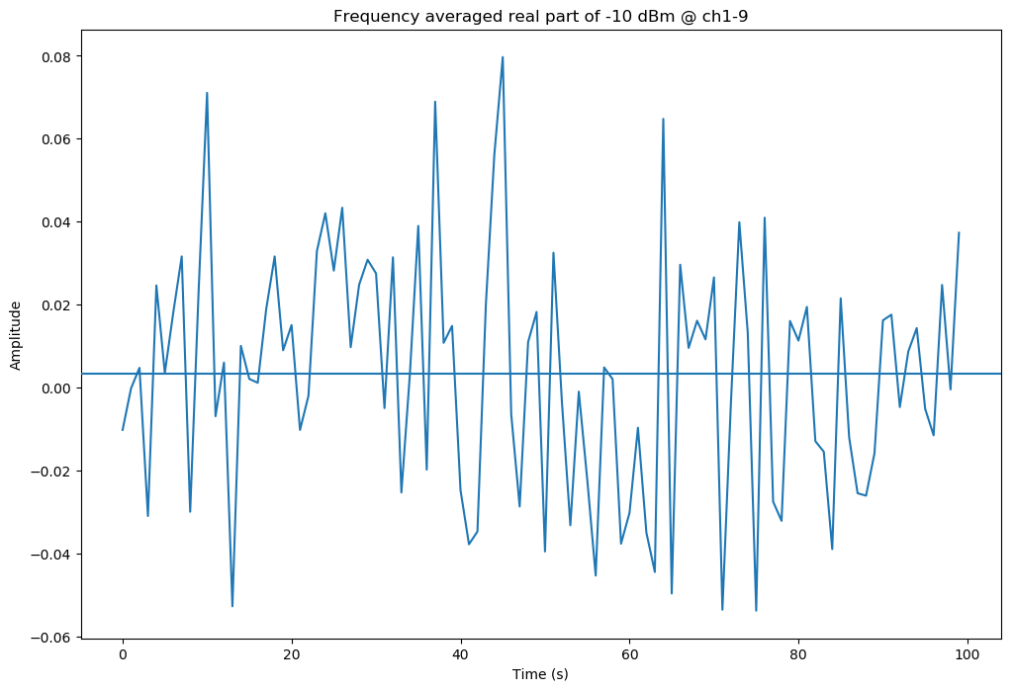
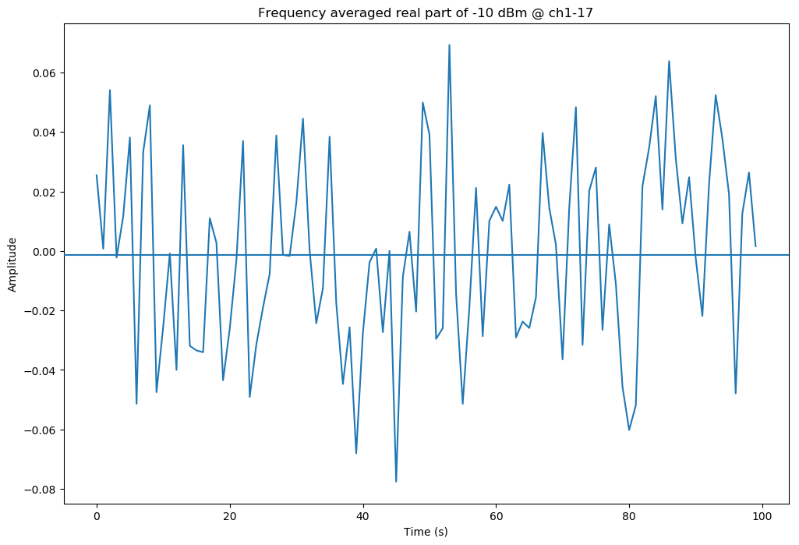
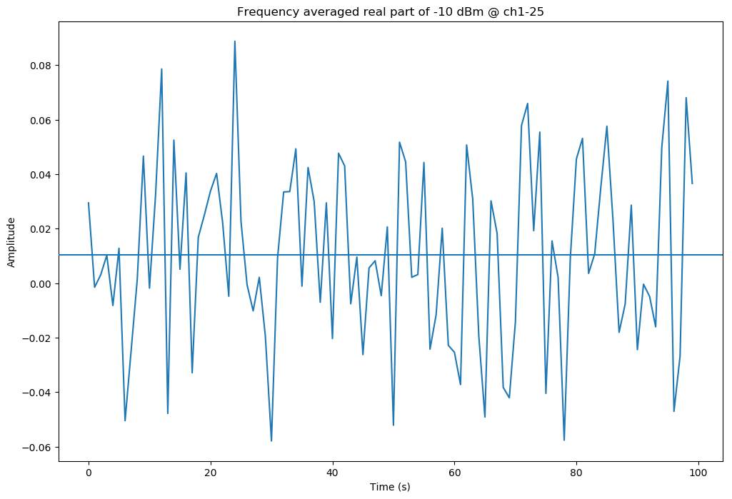
teleconf@2021.9.22

Slide 8
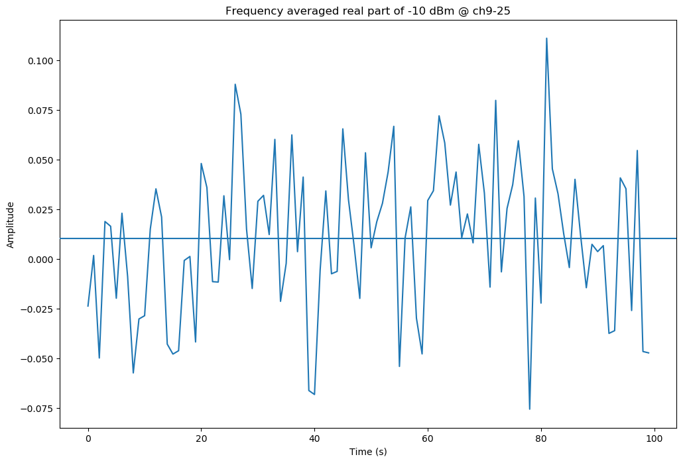
teleconf@2021.9.22
Channels | Board1 | Board2
ADC1 | Ch1,2,3…8 | Ch17,18,19…24
ADC2 | Ch9,10,11…16 | Ch25,28,29…32
Channel inputs distribution of dish correlator

Slide 9
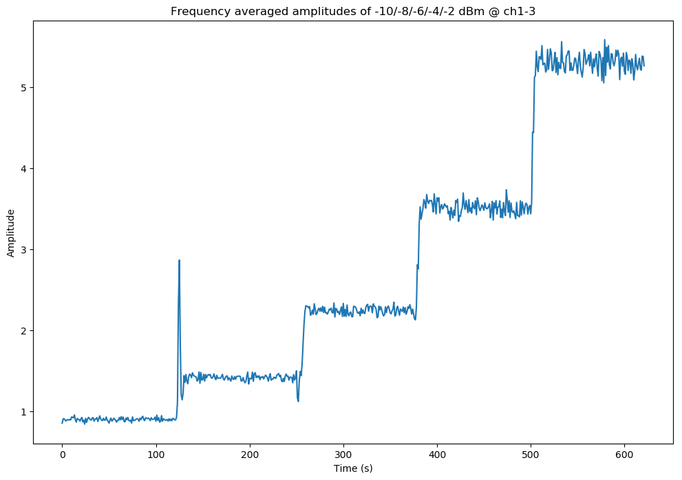
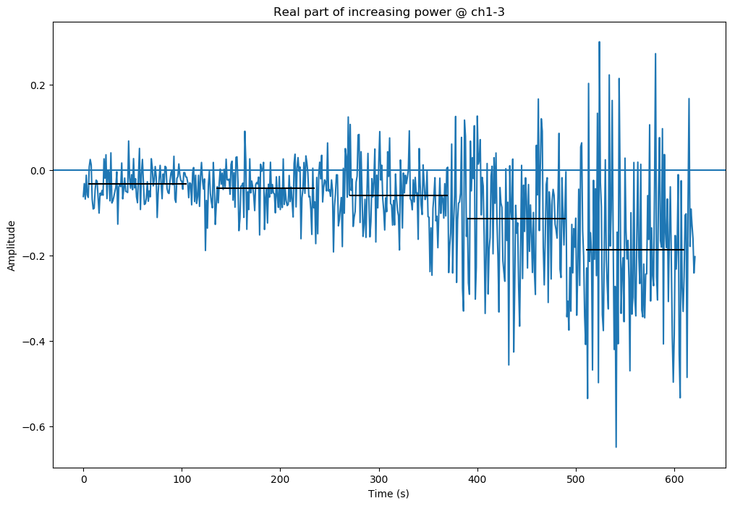
Correlation of 2 independent noise – different levels
teleconf@2021.9.22
Noise signals directly input to ADC (very short cable this time).

Slide 10
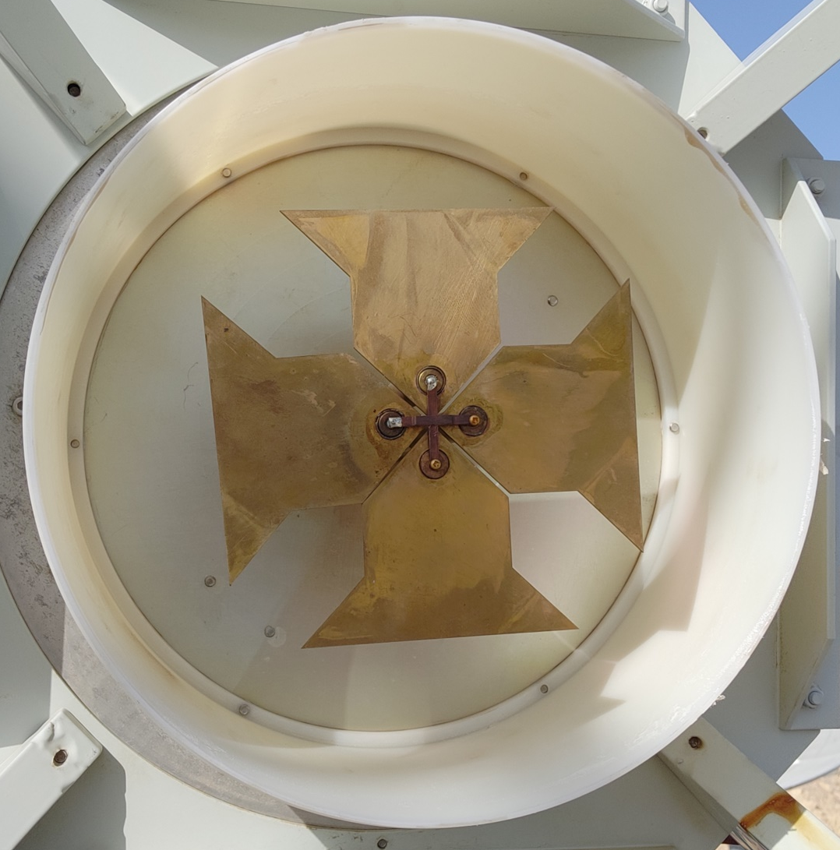
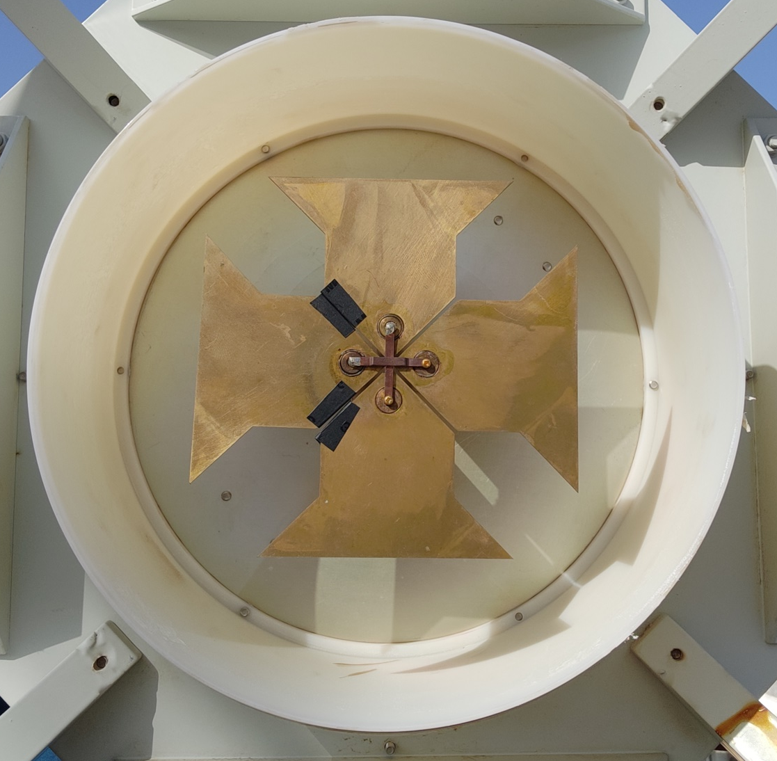
Problem found on the feed of Dish 7
teleconf@2020.10.29
Before 2020/10/27
Now
Use insulated rubber tape to avoid contact.

Slide 11
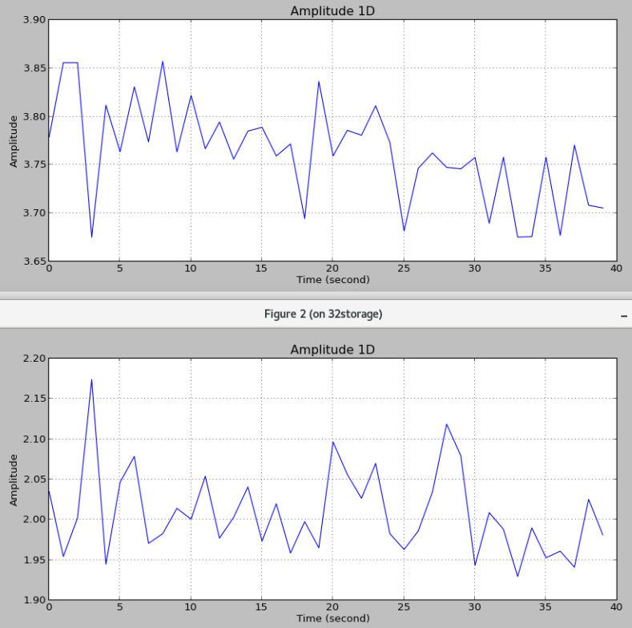
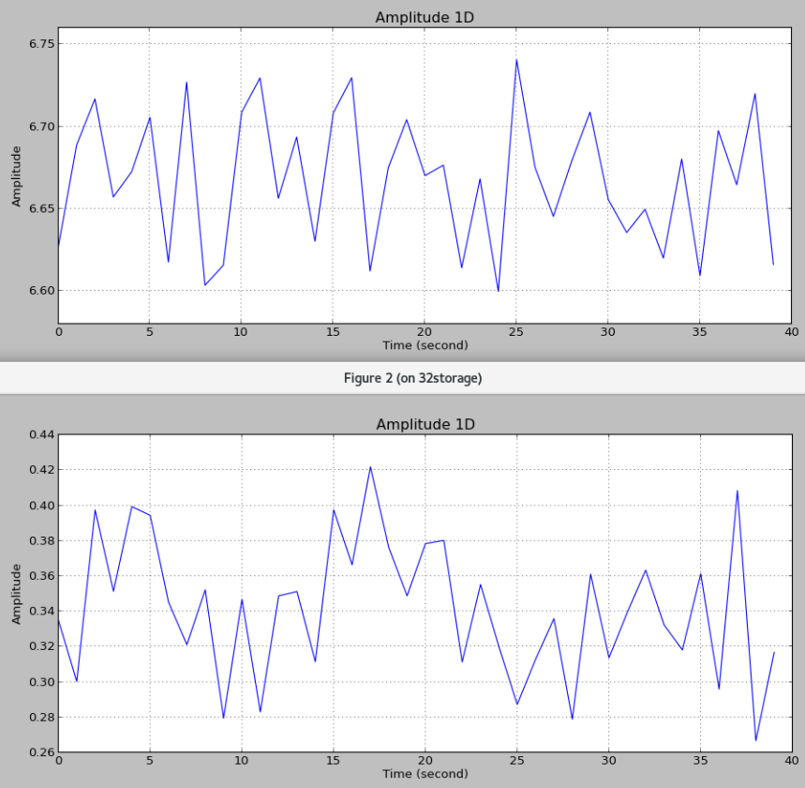
Cross-correlation amplitude
teleconf@2020.10.29
Before 2020/10/27
Now
1-13
1-13
1-14
1-14
Dish 7
The problem can be traced back to 2016!!!

Slide 12
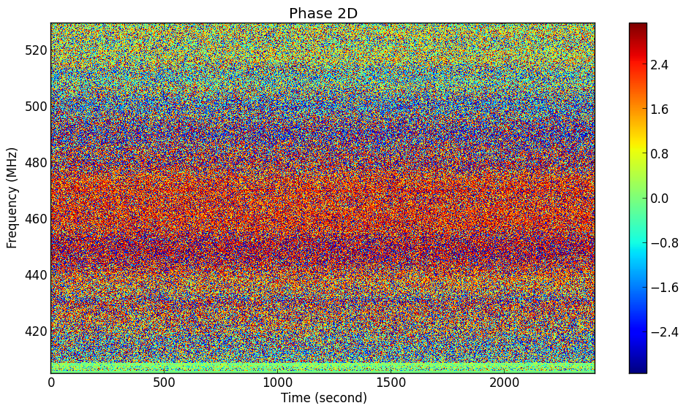
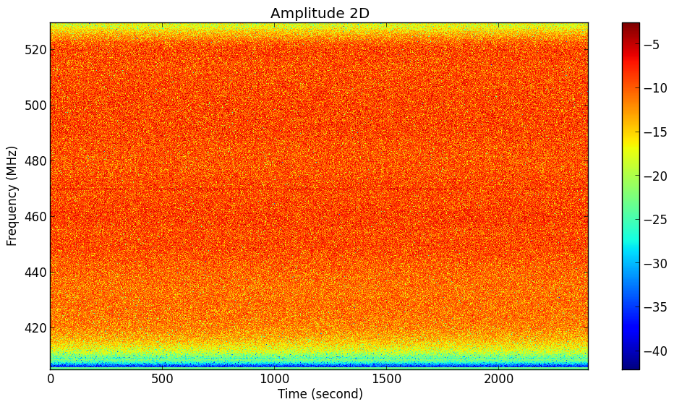
teleconf@2021.9.15

