Slide 1
ArgonCube Engineering Meeting
01/21/2022

Slide 2
Outline
Follow up from Previous Meeting
QAQC
Slow Control, Rack Protection
Schedule & BOEs
Document Updates
Windchill CAD Model Structure
Module 1 – LAr Circulation Test
Slides on Indico: https://indico.fnal.gov/event/51690/
Also on Consortium Google Drive

Slide 3
QAQC Documentation Review
Reviewed latest version of QAQC Documents
QAQC Plan, Procurement Plan, Manufacturing Plan -> if last submitted copy is the latest version that is OK
Round of comments & revisions -> post official version release to EDMS (v1)
Jan 14th – Comments sent out -> Complete
Completed for: Charge Readout, Light Readout, High Voltage, Calibration, TPC I&I,
Next steps -> Implement Revisions -> Release v1; -> Jan 24th
Overall the plans look good, many of the edits are cosmetic and minor. Component lists and descriptions of QC tests are in good shape
General suggestion –> build table of EDMS links to QC test plans for each component, we will update these links as those plans materialize

Slide 4
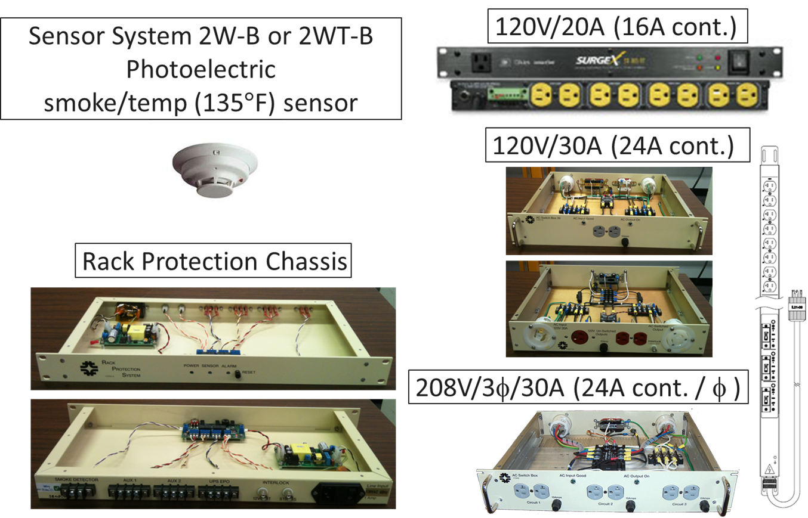
ND-LAr Slow Control / Rack Protection Summary
Next steps: document in draft ICD and pass to ND Systems Engineering (G. Cline) and ND Slow Controls (S. Luitz, T. Jonhson)
Current PDF draft at: EDMS 2667881
Source File: Windchill Link
Doodle sent out for initial meeting
1/25 @ 8AM
Initial Meeting
Last week’s talk from Linda Bagby (FNAL)
Follow-up at Fabrice’s 01/20/2022 Systems/I&I meeting
Common solution will be most useful
Define set of requirements for ND-LAr rack protection -> cavern & surface -> Doodle poll to stakeholders for initial req. gathering

Slide 5
Schedule & BOEs
January – February
Meeting with subsystem managers to review schedule and BOEs
Review labor costs & profiles
Review M&S costs
Goal is to have a robust and confident estimate by March for the CD-1rr schedule freeze
This has the most impact on US partners but would like to take the opportunity to help improve all subsystem schedules and estimates -> meet with all ND-LAr partners

Slide 6
Documentation Updates
Updated Detector Mass Tracking Budget: EDMS 2458090
Thermal Tracking Budget EDMS 2458088
Need to capture warm elements
Updated & Released TPC to LAr Cryostat ICD: EDMS 2458099
First Upload of Windchill CAD Model Structure Tree: EDMS 2683349

Slide 7
Windchill CAD Model Structure
Windchill Unique Number | Name | Description
DU-1004-7330 | ND-LAr Module Row Assembly | Integrated Top-Level Assembly for ND-LAr Row with Cryostat Lid Sections
DU-1003-7157 | ND-LAr Module Row Services Assembly | TPC Feedthroughs, Row Support Structures, LAr Services, Warm Electronics and Racks
DU-1003-5353 | LAr Cryostat TPC Lid Section Assembly | LAr Cryostat Lid Section with Penetrations for Module Services
DU-1004-7601 | ND-LAr Module Row Assembly | Five TPC Module Assembly with 1-meter Pitch, Cold Detector Elements
DU-1004-5554 | ND-LAr TPC Module Assembly | Integrated TPC Assembly that contains Cold Dectector Elements
DU-1004-4595 | ND-LAr Charge Readout Assembly | Cold Charge System Electronics Assembly
DU-1004-5922 | ND-LAr Light Readout Assembly | Cold Light System Electronics Assembly
DU-1004-5929 | ND-LAr Field Cage and HV Delivery Assembly | Field Shaping Elements and Cold HV Cable, Anode Support Structure, Cathode
DU-1004-5930 | ND-LAr Module Structure Assembly | TPC Support Structures, Flexures, Instrumentation
DU-1004-5931 | ND-LAr Calibration Assembly | Fiber Optics and Fiber Routing Hardware
*Future CAD updates from subsystems are placed in identified assemblies

Slide 8
DU-1003-7330

Slide 9
DU-1003-7157

Slide 10
DU-1004-7601

Slide 11
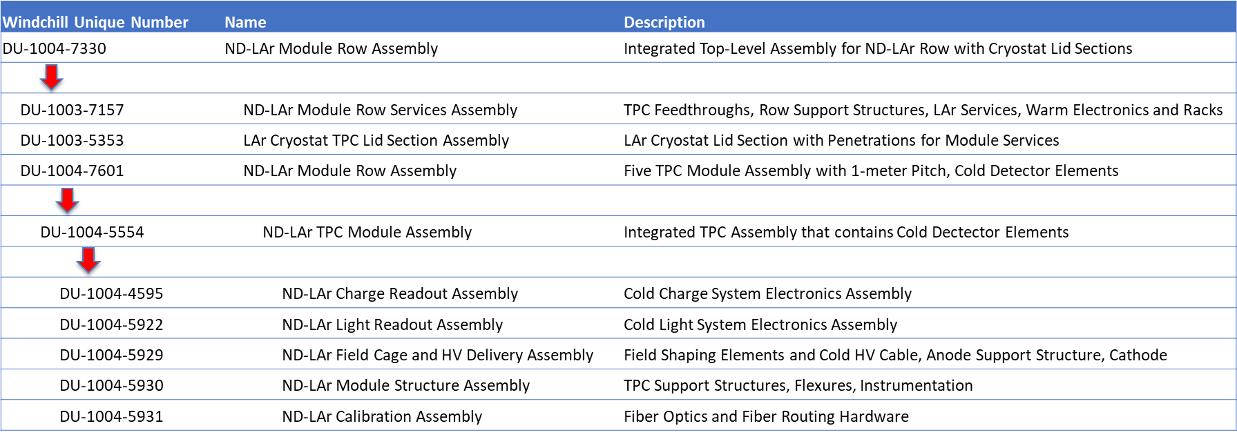
DU-1004-5554

Slide 12
Module 1 - LAr Zero Circulation Test
Issue: Per 2x2 Module 0 testing, the LAr flow rate per module is 14 times higher (350g/s) than ND Lar cryogenics current design (900g/s / 35m = 25g/s). And 2nd Module 0 test reduced the flow rate by half to about 175g/s. Unable to throttle the flow rate further down without major modifications to the cryogenic system.
The hypothesis is that 2x2 testing has been cooling the module with forced convection, and ND Lar design is based on natural convection.
Question: In order to understand if this detector can be cooled with natural convection (ND Cryo) proposes to have a “zero circulation test” which would consist on filling the detector, purifying the argon and running the detector. After that we would stop the flow rate to zero, and we would observe whether the detector is able to fully operate while the argon is boiling. The expectation is that the liquid level would be decreasing and argon would be vented continuously, so the duration of the test would be determined by the amount of ullage liquid level available until there is no liquid left to guarantee safe HV operation.
Impact to ND Cryogenics requirements -> important to settle these before CD-1rr
Approximate 1 week testing time -> suggest that we set a duration for recirculation test
What we want is to get to “quasi” steady-state and see if the detector will operate stably where performance is not degraded
How long must this be?

Slide 13
Backup

Slide 14
Rack Protection
Linda Bagby (FNAL)
What instrumentation / monitoring is required for crates / racks?
Temperature & smoke -> anything else? Humidity?
ND Slow Control -> would want temp, smoke detector bit
Surface DAQ room
Front End Electronics on top of detector
No chilled water service to top of detector
Raritan PDU – autonomous monitoring and can take action
Comes with humidity and water leak sensor (rope that is 0 or 1; water or no)
Next Steps:
Define set of requirements for ND-LAr rack protection -> cavern & surface -> Andrew to send out Doodle poll to stakeholders for initial req. gathering
Meeting key interface groups to communicate & gather interface
Follow-up at Fabrice’s 01/20/2022 Systems/I&I meeting
Common solution will be most useful

Slide 15
Module 0 / Module 1 Updates
Module 0
Moved to LArTF
Module 1
All components in Bern (2nd PACMAN shipped, delivery Jan. 10th)
Testing of TPC#2 with PACMAN#1 – hopefully finish this week
Once PACMAN#2 arrives will verify operation and begin assembling of TPC#2
Once TPC#2 is assembled with cabling – check IO connections – consult with Brooke
Before insertion to sleeve need some kind of group sign-off on collected data

