Slide 1
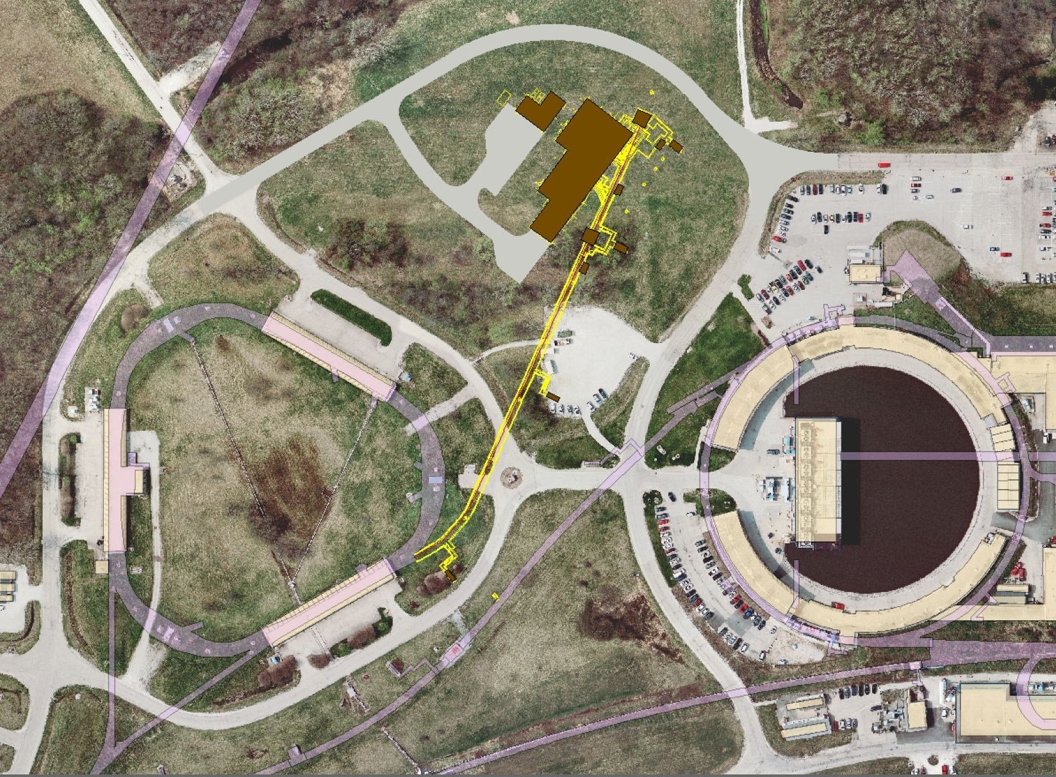
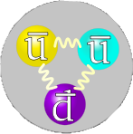

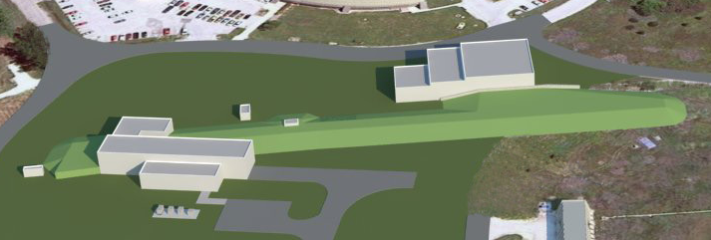
Pbars to Muons
Brian Drendel
February 17, 2012
MC-1
Building
Mu2e Building

Slide 2
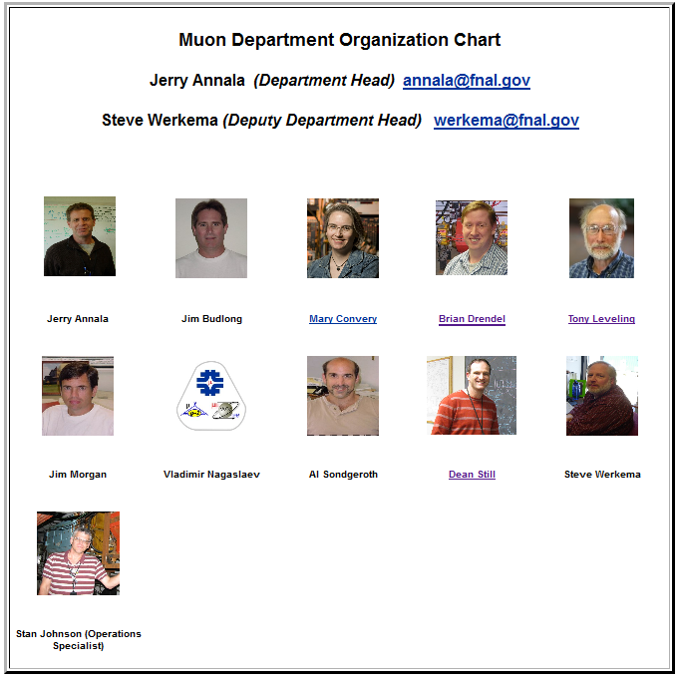
http://www-muon.fnal.gov

Slide 3
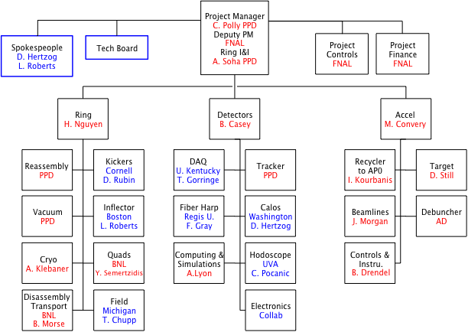

Muon g-2 Project Management
C Polly

Slide 4
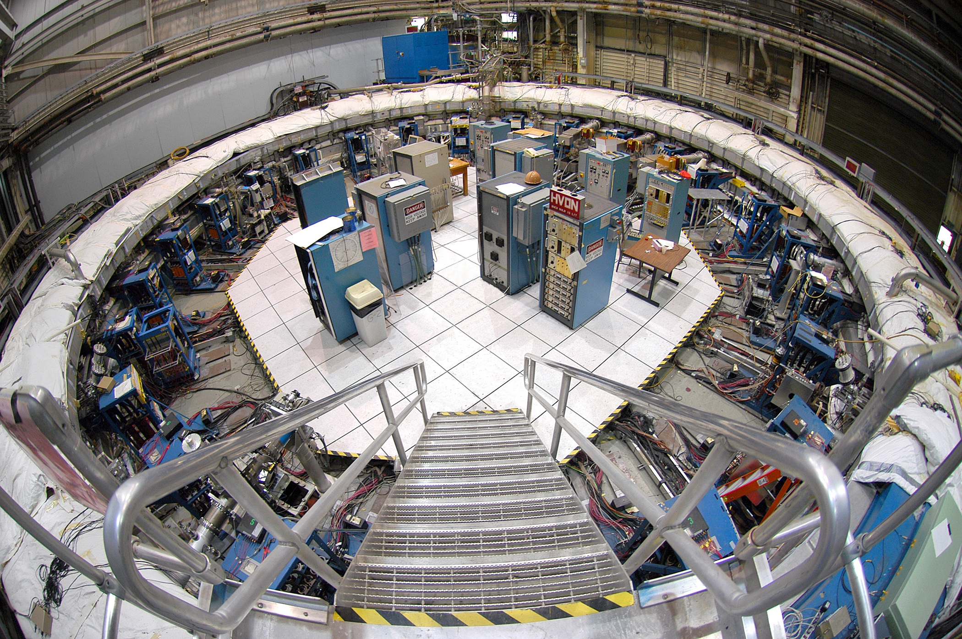
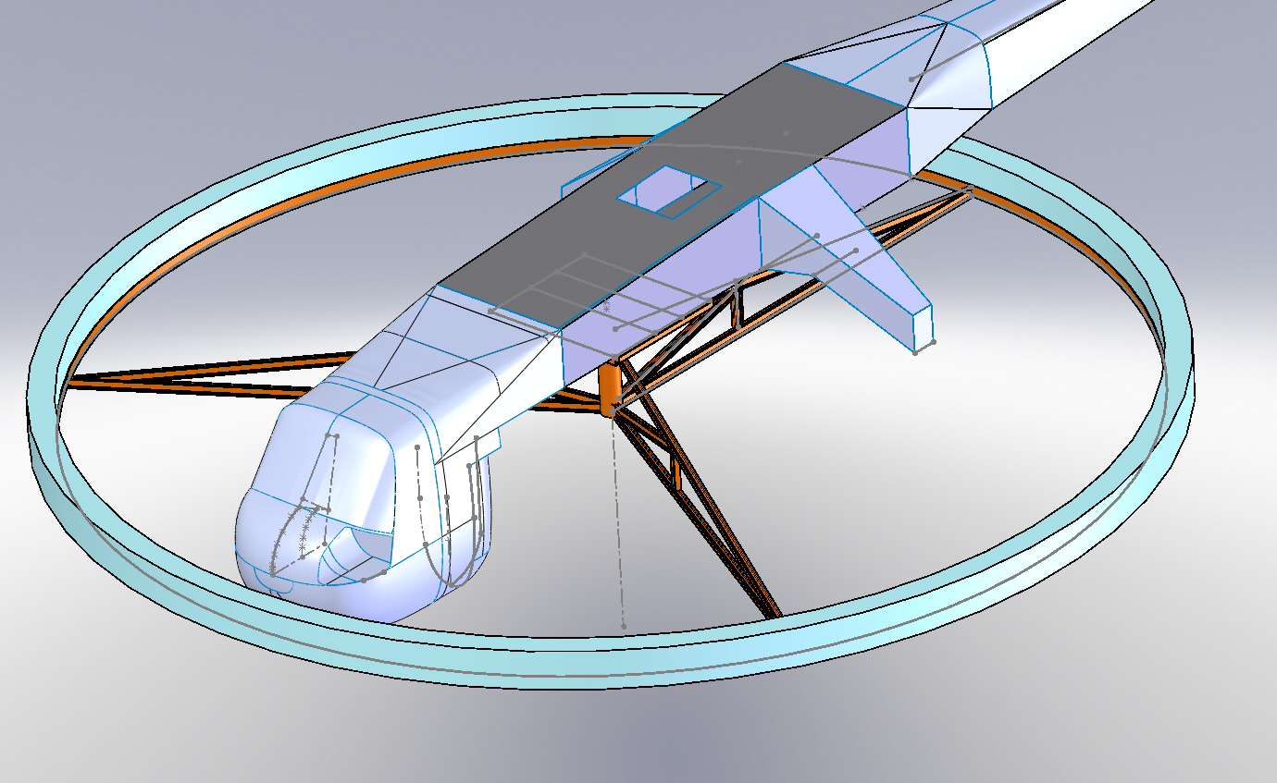
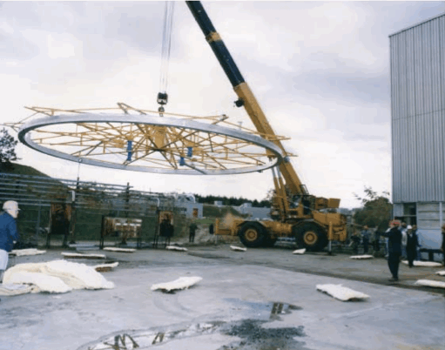
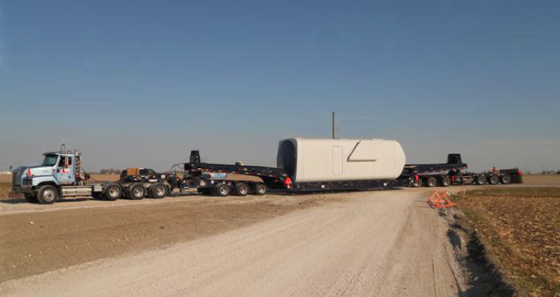
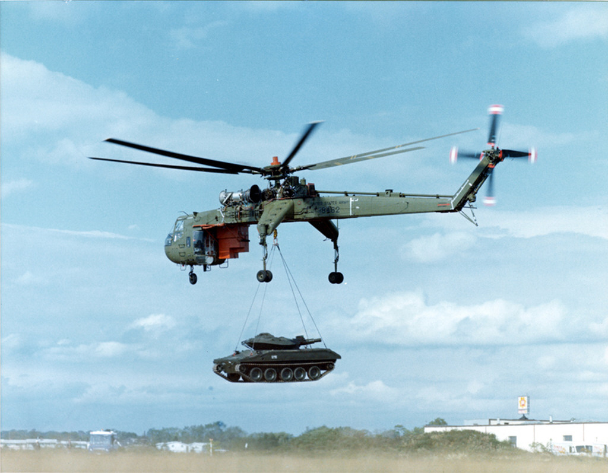
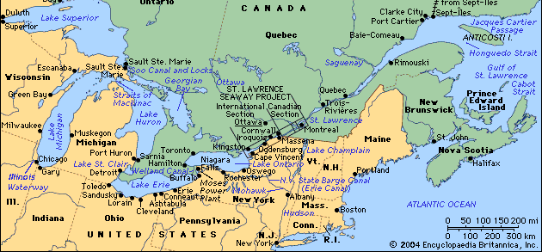
Moving g-2 From BNL to FNAL
C. Polly

Slide 5
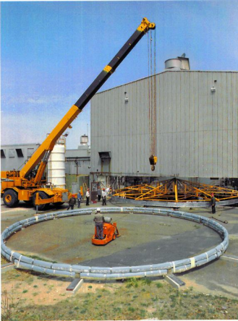
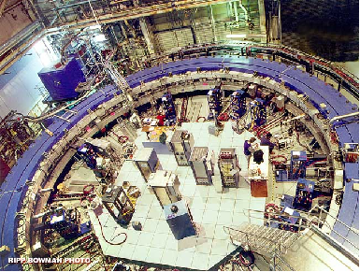
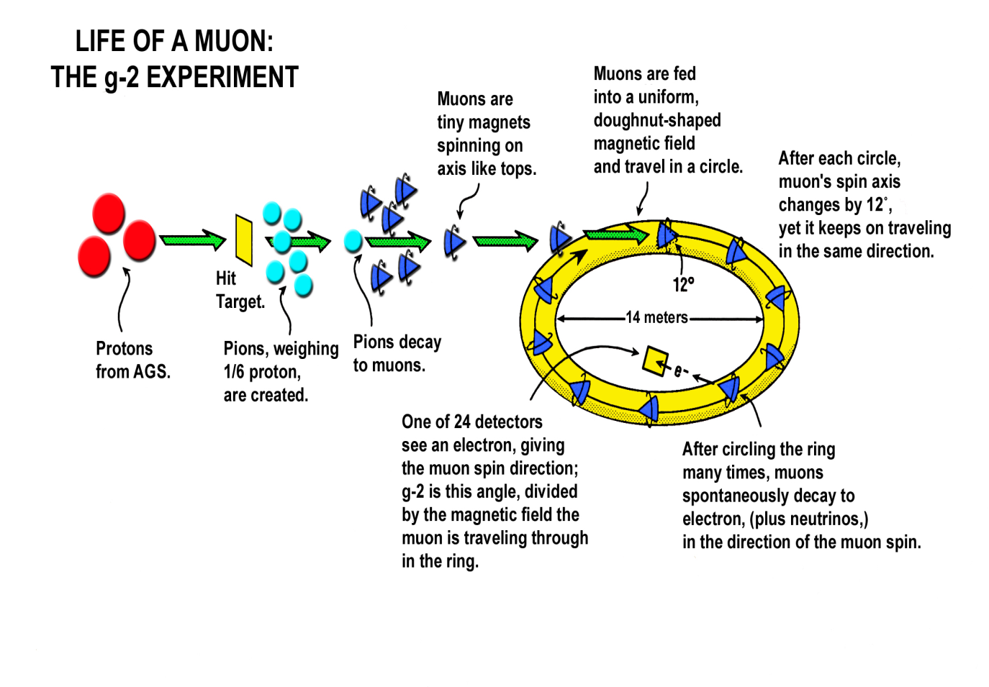
g-2 for Dummies
8 GeV protons strike target at AP0.
We collect positive charged 3.1 GeV/c secondaries.
Pbar/Muon beam lines and Debuncher ring are used as a drift space for shorter lived particles to decay.
Send 3 GeV/c muons to the detector.
The bottom line is we need to provide protons on target at AP0 and transport muons through the former Pbar beam lines and Debuncher to the g-2 experiment.
AP2/AP3/
Debuncher/
Extraction Line
Recycler/
P1/P2/
AP1
AP0
Booster
http://www.g-2.bnl.gov/

Slide 6
Particle Soup
Particle | Particle | Family | Charge | Quarks | Mass (MeV/c²) | Mean Lifetime | Matter/ Antimatter
Proton | p | Baryon | +1 | uud | 938.27 | 4.6 x 10²⁶ yr | Matter
Pbar | p | Baryon | -1 | uud | 938.27 |  | Antimatter
Pion | π⁺ | Meson | +1 | ud | 139.57 | 26 nsec | -
 | π⁻ | Meson | -1 | du | 139.57 | 26 nsec | -
Electron | e⁻ | Lepton | -1 | - | 0.51 |  | Matter
Positron | e⁺ | Lepton | +1 | - | 0.51 |  | Antimatter
Muon | μ⁻ | Lepton | -1 | - | 105.66 | 2.2 μsec | Matter
 | μ⁺ | Lepton | +1 | - | 105.66 | 2.2 μsec | Antimatter
Tau | τ⁻ | Lepton | -1 | - | 1,777 | 0.29 psec | Matter
 | τ⁺ | Lepton | +1 | - | 1,777 | 0.29 psec | Antimatter

Slide 7
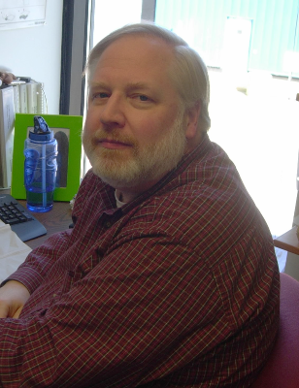
Mu2e Project Management
1
Project Management
R. Ray
FNAL
2
Accelerator
S. Werkema
FNAL
3
Conventional Construction
T. Lackowski FNAL
4
Solenoids
M. Lamm
FNAL
5
Muon Channel
S. Feher
FNAL
6
Tracker
Mukherjee
FNAL
7
Calorimeter
Stefano Miscetti
Frascati
8
Cosmic Ray Veto
C. Dukes
UVa.
9
Trigger and DAQ
M. Bowden
FNAL

Slide 8
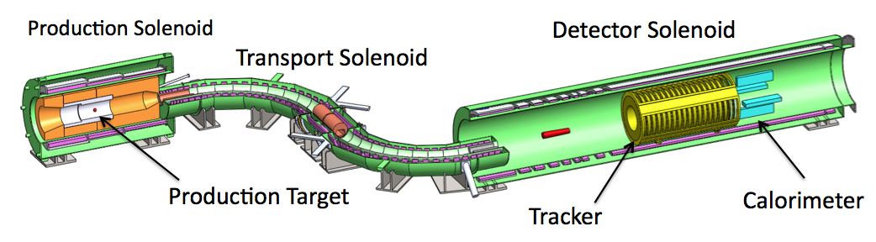
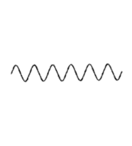
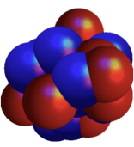


Mu2e for dummies
Protons
μ⁻
e⁻
X
Electrons
Muons
Coherent recoil of nucleus
8 GeV protons hit gold target
Production solenoid collects muons and pions
Transport solenoid filters charge sign and momentum
Muons get captured in aluminum atoms of target
If a Muon decays directly to an electron it will have an energy 104.96 MeV
Detector solenoid looks for these electrons
Bottom line…We need to use the former pbar beam lines and Debuncher to provide high intensity protons to the production solinoid.

Slide 9
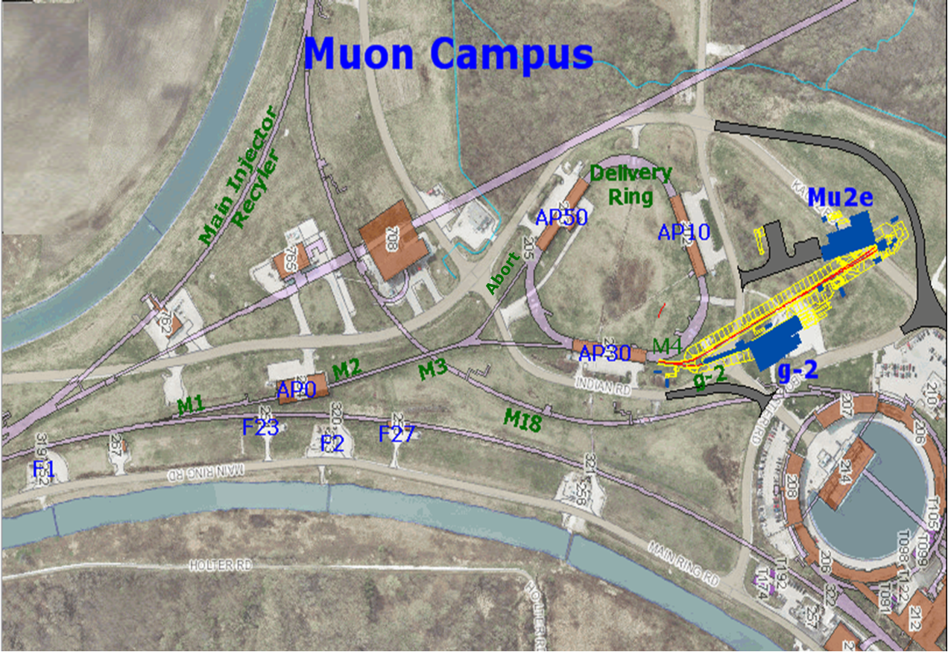
Muon Campus
Pbar Department changed to Muon Department
The Beam lines and Ring(s) may be combined into a “muon campus” that would serve multiple experiments
    Muon g-2
    Mu2e

Slide 10
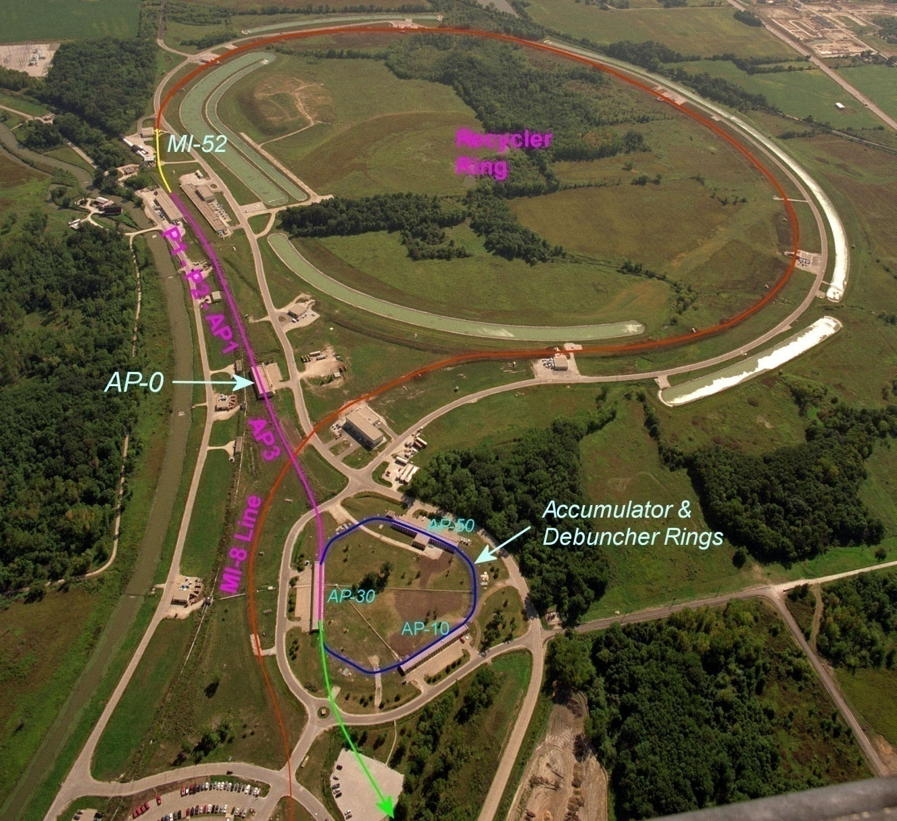
Beam path from Booster to the g-2 and Mu2e experiments
  A Booster batch of intensity ~4E12 is sent to the Recycler.
  The batch is divided into 4 2.5 MHz bunches, which are individually extracted to the Debuncher.
External beamline
J. Morgan
B. Drendel

Slide 11
Beam path from Booster to the g-2 and Mu2e experiments
The bunches are transported to either the Target Station at AP0 or Debuncher via multiple beam lines
Extracted at MI-52 from Recycler to the P1 beam line (new)
g-2:
P1 → P2 → AP1 → Target Station → AP3 → Debuncher Ring
Mu2e:
P1 → P2 → AP1 → AP3 → Debuncher Ring
External beamline
J. Morgan
B. Drendel

Slide 12
Beam path from Booster to the g-2 and Mu2e experiments
New AP-3 to Debuncher beam line connection for final 50 meters
Abort in 50 straight section can be used for:
  g-2: proton removal
  Mu2e: proton clean-up
Beam in Debuncher is extracted to the external beamline (new)
  g-2: entire pulse extracted at once
  Mu2e: Beam resonantly extracted.
The Accumulator is not used for either g-2 or Mu2e.
External beamline
J. Morgan
B. Drendel

Slide 13
Recycler to P1 line connection
From Mu2e CDR
Recycler
Q523
Q522
Q521
Q520
ODH Barrier
Q901
RRLAM
Q903
Q902
0.7364 m
HBend
Q904
P1 line
Q706
Q705
Q704
Q703
Q702
Q701
I:LAM52
VBend
C
B
A
Main Injector
V700
Q527
Q526
Q525
Q524
Q523
Q522
Q521
Q520
New beam line connects Recycler to P1 line.
Meiqin Xiao

Slide 14
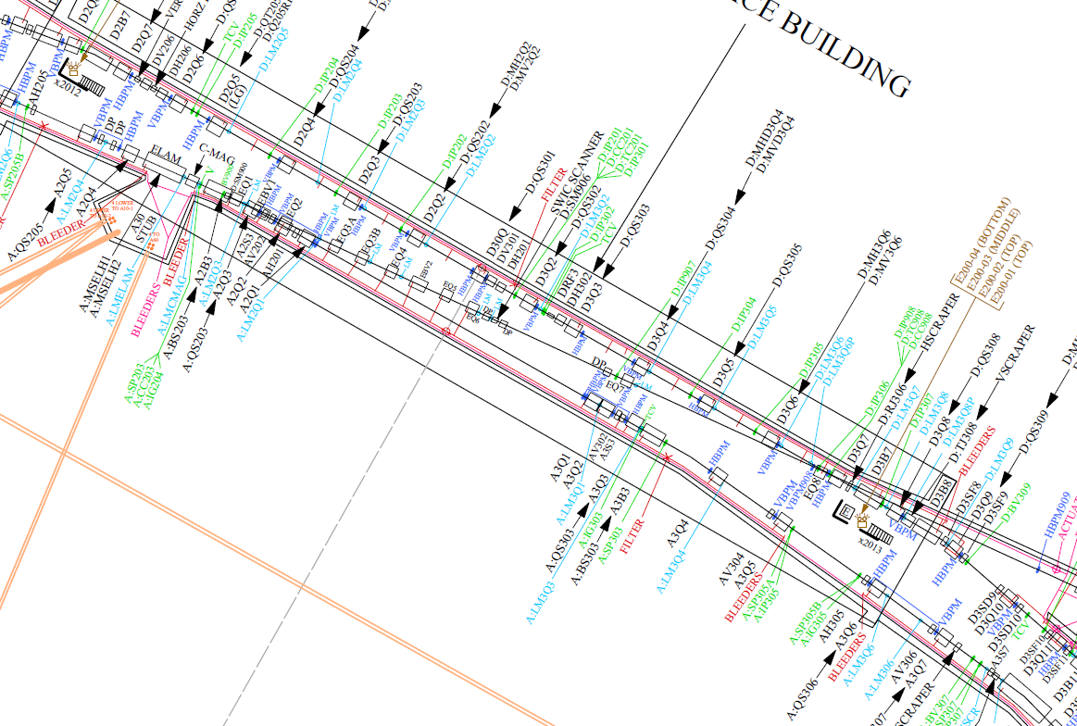
Extraction septa (Mu2e)
J. Johnstone
Extraction kicker (g-2)
Injection kickers
Horizontal bend (5°)
Extraction Lambertsons
Injection Lambertsons
Debuncher 30 Straight Section Plan

Slide 15
Antiproton Source
Beam lines
  A 120 GeV/c proton beam is transported to the Target Station via AP-1 every 2.2 seconds
An 8.89 GeV/c negative secondary beam travels down AP-2 and is injected into the Debuncher
8.89 GeV/c antiprotons are bunch rotated and stochastically cooled in the Debuncher, then transferred to the Accumulator via the D/A line
Antiprotons are accumulated over hours, then transferred to MI via the AP-3 and AP-1 lines
8.89 GeV/c protons can be “reverse injected” or sent in the reciprocal direction of the antiprotons for tune-up
J. Morgan

Slide 16
Muon g-2
Beam lines
  An 8.89 GeV/c proton bunch, 120 ns long, is transported to the Target Station via M1 at an average rate of 15 Hz, with 100 Hz bursts (20 bunches, 10 ms interval)
A 3.1 GeV/c Positive secondary beam travels down M2 and M3 and is injected into the Debuncher in the 30 straight section with Lambertsons and a kicker
Some of the pions decay into 3.09 GeV/c muons as they travel down M2/M3
The M2 and M3 lines have an increased quadrupole density to improve muon efficiency
Muons can circle the 550 meter Debuncher as many times as desired
The abort located in the 50 straight section can be used to remove protons
3.09 GeV/c muons are extracted into the M4 line, then bends into the g-2 line that transports them to the experiment
J. Morgan
J. Morgan

Slide 17
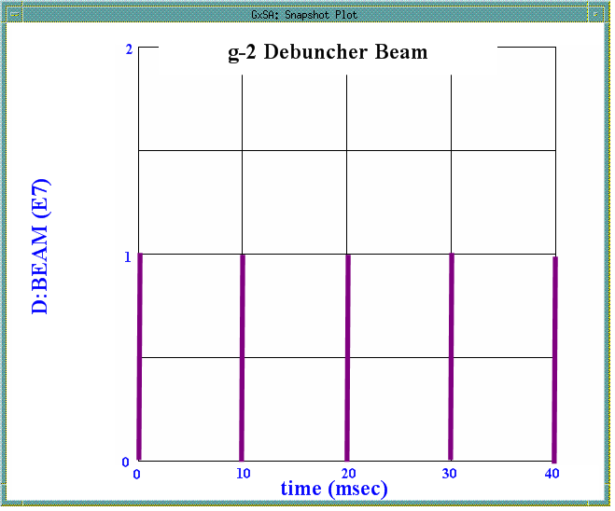
G-2 Time Line
4, 5 or 6 batches
120 ns
t
1.7 μs
Debuncher revolution period
For each 1.33 sec Nova cycle, Nova uses 12 of the 15 Hz ticks, leaving eight for either g-2.
A 4E12 Booster Batch injected into the Recycler and split into four 2.5MHz bunches of 1E12 and 120nsec long each.
Send a 1E12 bunch to the AP0 target.
Low intensity secondaries are sent via the M2 and M3 lines to the Debuncher.
Beam circulates in the Debuncher a small number of turns to maximize pion decay as well as separation of the pions and protons.
The muons are extracted as a single bunch out the M4 line.
The protons are sent to the Debuncher abort in the current AP2 line.
Repeat for remaining three bunches.
Repeat for a total of 4, 5 or 6 times in the eight empty 15 Hz ticks between Nova cycles.

Slide 18
Mu2E
Beam lines
  An 8.89 GeV/c proton bunch, 120 ns long, is transported to the Debuncher via M1 and M3 (bypassing the Target Station) at an average rate of 6 Hz with 18 Hz bursts
The 8.89 GeV/c bunch is injected into the Debuncher in the 30 straight section with Lambertsons and a kicker
A 2.5 MHz RF system maintains the short bunch as it circulates in the Debuncher
The proton bunch is resonantly extracted with an electrostatic septum and Lambertsons into the Extraction beam line, that transports them to an external Target Station to produce an intense muon beam
The remaining proton beam that is not resonantly extracted is aborted in the 50 straight section and transported to a dump
J. Morgan
J. Morgan

Slide 19
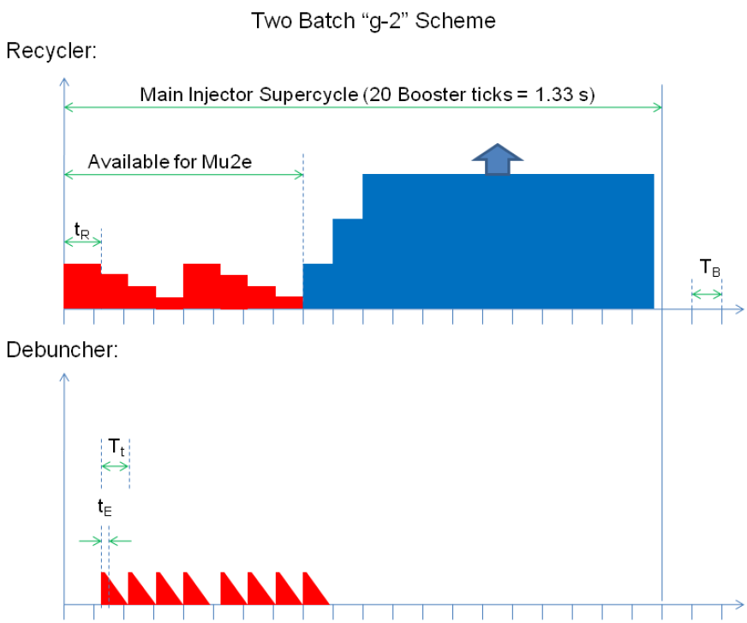
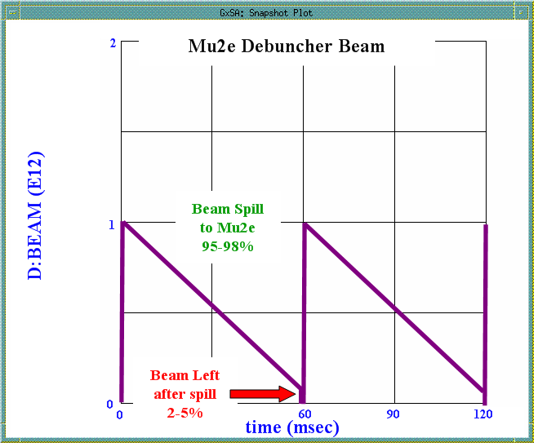
Mu2e Time Line
2 batch scenario
E. Prebys
For each 1.33 sec Nova cycle, Nova uses 12 of the 15 Hz ticks, leaving eight for Mu2e.
A 4E12 Booster Batch injected into the Recycler and split into four 2.5MHz bunches of 1E12 and 120nsec long each.
A 1E12 bunch is sent to the Debuncher via beam lines.
The 120nsec bunch is “slow spilled” out the M4 line over 58msec.
  Trev = 1.695 usec, so beam goes around ~34,000 times and we have ~3E7 spilled per revolution.
  2-5% of the beam is leftover and sent to the beam abort which will be located in the former AP2 line.
Repeat for the remaining remaining bunches
Inject a second Booster batch and repeat.
Entire process is fit into the 8 empty 15Hz ticks between Nova cycles.

Slide 20
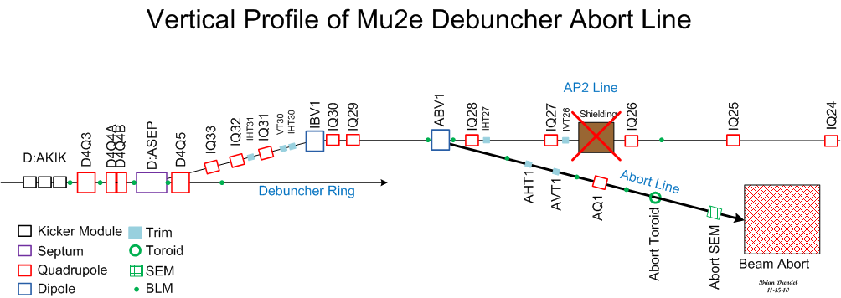
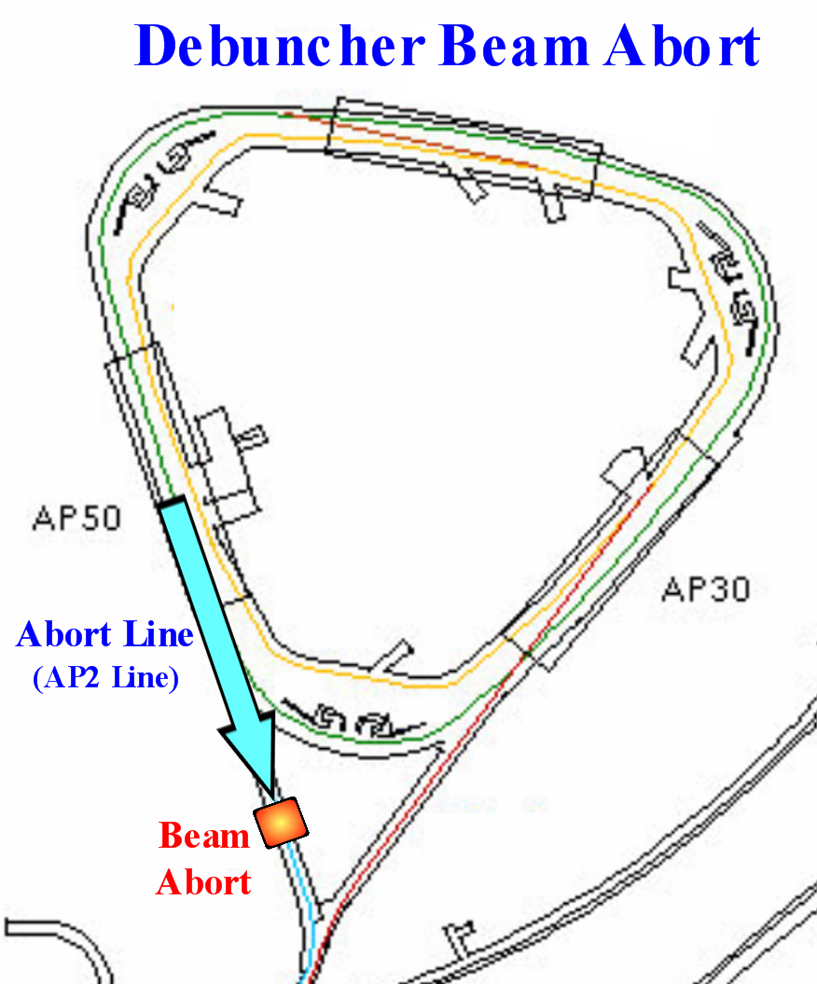
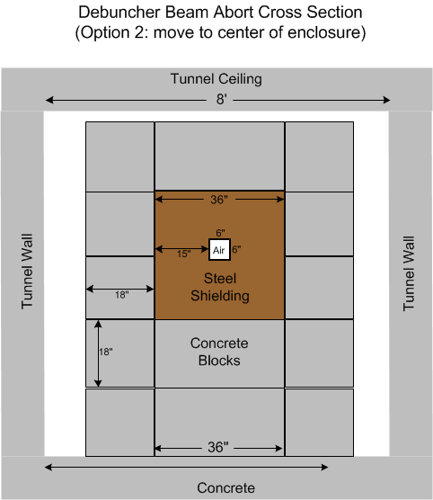
Beam abort/proton removal
D50
Transport

Slide 21
Beam Requirements
Beam Line/Ring (Service Building) | g-2 | Mu2e
P1->P2->M1 (Ap1) (MI-60, F0, F1, F2, F23, F27, AP0) | 1.0E12 primary beam (protons) 2.5 MHz 120 nsec 8.89 GeV/c <rate>=15Hz burst up to 100Hz | 1.0E12 primary beam (protons) 2.5 MHz (no longer 53MHz) 120 nsec 8.89 GeV/c <rate>=6Hz burst up to 18Hz
Target (AP0) | AP0 | N/A
M2 (AP2) ->M3 (AP3) (AP0, F27, AP30) | Low intensity secondaries (10⁵ μ⁺, 10⁷ π⁺, 2 x 10⁷ protons) 3.1 GeV/c | Same as P1->P2->M1 {No M2}
Accumulator | N/A | N/A
Debuncher (AP10, AP30, AP50) | 3.1 GeV/c Secondaries (10⁵ μ⁺, 2 x 10⁶ π⁺, 2 x 10⁷ protons) Circulates a few turns Kicked out | Same as P1->P2->M1 Slow Resonant Extraction every 56 msec
Abort Line (old downstream AP2) (AP50) | Low intensity 3.1 GeV/c protons 10msec burts | 3 to 5% of primary protons
M4 (new), g-2(new) (AP30, Experimental Halls) | Low intensity 3.1 GeV/c μ⁺ Pulses every 10msec | 1.0E12 protons Slow spill every 56 msec
Notes:
Production per proton at the exit of the pulse magnet (Cary Yoshikawa):
Pi+ = 0.87E-5
Proton = 1.99E-5
Muon+ = 0.00731E-5
Assume 80% of the pions are gone by the time you get to the Debuncher Ring

Slide 22
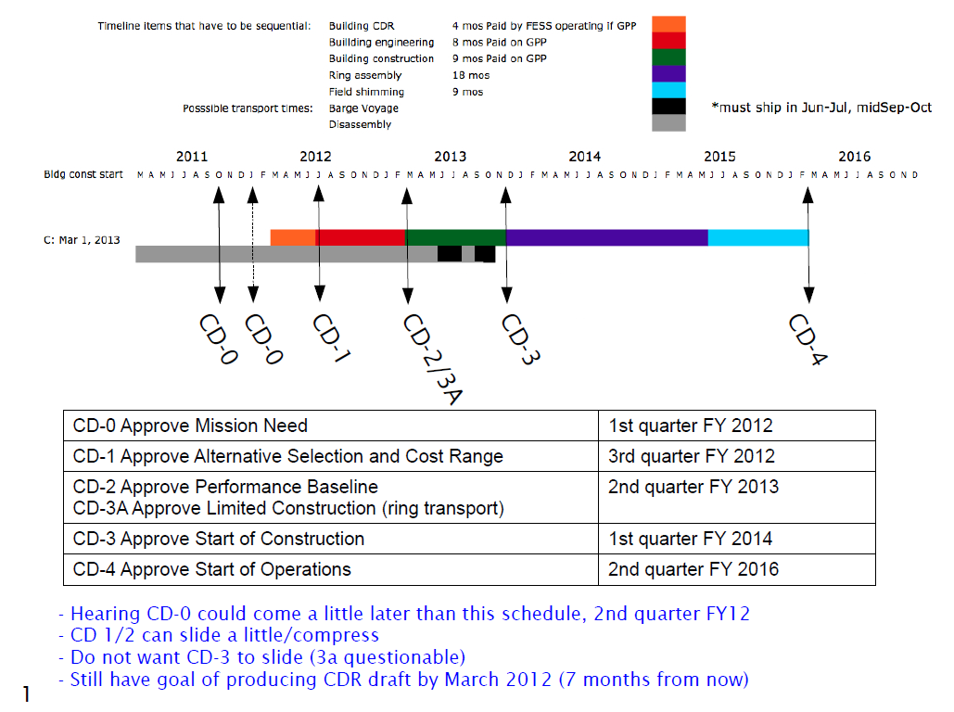
g-2 Schedule
C. Polly

Slide 23
Beam Delivery Schedule
NOvA
MINERvA
MINOS?
MINERvA
MINOS
MiniBooNE
g-2
Mu2e
MicroBooNE
C. Polly

Slide 24
Summary
The former Antiproton Source is being reporposed into a Muon Campus that will provide intensity frontier beams to Muon experiments.
Muon g-2 is expected to start running the first quarter of FY ‘16.
Mu2e is expected to start running FY ‘19.

Slide 25
References
J Morgan, B Drendel, et al, Antiproton Source Rookie Book, Fermilab Accelerator Division Document Database #2872, June 2010.
B. Drendel, Accelerator Controls and Instrumentation for Mu2e and g-2, g-2 Document Database #159
S. Werkema, Control of Trapped Ion Instabilities in the Fermilab Antiproton Accumulator, Proceedings of the 1995 Particle Accelerator Conference, p3397, May (1995).
K. Unser, A Toroidal DC Beam Current Transformer with High Resolution, IEEE Transactions on Nuclear Science, Vol. NS-28, No.3 , June 1981.
S.D. Holmes, J.D. McCarthy, S.A. Sommers, R.C. Webber, and J.R. Zagel, The TEV I Beam Position Monitor System.
J. Zagel, SEM Test Event Generator = STEGOSAUR, Unpublished.
K. Gollwitzer, D. Peterson, J. Budlong, M. Dilday, D. Nicklaus, Patrick Sheahan, Antiproton Source Debuncher BPM using Synchronous Detection, Beams Document Database #1019, http://beamdocs.fnal.gov/AD-public/DocDB/ShowDocument?docid=1019, February, 13, 2004.
Bill Ashmanskas, Debuncher BPM Intensity, http://pbardebuncher.fnal.gov/wja/docs/bpi10d/, May 22, 2006.
Bill Ashmanskas, AP2 BPM Boards, http://pbardebuncher.fnal.gov/wja/docs/ap2bpm/, March 2007.

Slide 26
References
Nathan Eddy, Elvin. Harms, Requirements for P1, P2, AP1, AP3, A1 line BPM upgrades, Beams Document Database #1279, https://beamdocs.fnal.gov/AD-private/DocDB/ShowDocument?docid=1279, September, 2004.
Nathan Eddy, Rapid Transfer BPM 53MHz Signal Expectations, Beams Document Database #1768, https://beamdocs.fnal.gov/AD-private/DocDB/ShowDocument?docid=1768, April, 2005.
Nathan Eddy, BPM Filter Module for Transfer Lines, Beams Document Database #1849, https://beamdocs.fnal.gov/AD-private/DocDB/ShowDocument?docid=1849, May 2005.
Nathan Eddy, Beam Monitoring and Control with FPGA Based Electronics, Beams Document Database # 2541, https://beamdocs.fnal.gov/AD-private/DocDB/ShowDocument?docid=2641, February, 2007.
Vic Scarpine, First Tests of an Optical Transition Radiation Dector for High-Intensity Proton beams at Fermilab, Beams Document Database #846. https://beamdocs.fnal.gov/AD-private/DocDB/ShowDocument?docid=846, September 23, 2003.
Vic Scarpine, Prototype OTR Design Review. Beams Document Database #555. https://beamdocs.fnal.gov/AD-private/DocDB/ShowDocument?docid=555, April 10, 2003.
Vic Scarpine, Optical Transition Radiation (OTR) Detectors and Beam Diagnostics. Beams Document Database #2110, https://beamdocs.fnal.gov/AD-private/DocDB/ShowDocument?docid=2110, January 24, 2007.
Vic Scarpine, G. R. Tassotto, A. H. Lumpkin. Proposed OTR Measurements of 120 GeV Proton and Antiprotons at FNAL, 2004 Beam Instrumentation Workshop, 2004.

Slide 27
References
Werkema, et al, Mu2e Accelerator Conceptual Design Report, Mu2e Document #
Glenzinski, D., Status of the Mu2e Experiment, Mu2e Document #, December 2011
Polly, C., Bringing Muon g-2 to Fermilab, g-2 Document #115, October 2011.
Polly, C., G Minus 2 Experiment, g-2 Document 82, September 2011.
Morgan, J. , Debuncher Injection and Extraction, g-2 Document #148, November 2011.
Ray, R., Project Overview: Independent Design Review of Mu2e, Mu2e Document #1526, May 2011.
Werkema, S., Accelerator Division Impact Statement for the TAPAS Proposal, Beams Document #4012, December 2011.

