Slide 1

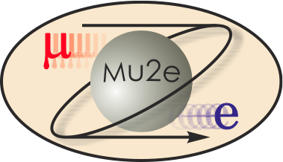
-II
Mu2e-II Workshop (xi) Introduction
Frank Porter
February 22, 2022
DocDB-40998
This meeting will be recorded

Slide 2
Mu2e-II workshops
Recent past workshops
For earlier workshops, see the Mu2e-II calendar at:
https://mu2eii-internal-wiki.fnal.gov/wiki/Main_Page#Calendar
Workshop dates | Links to recordings
Wednesday, March 3, 2021 https://indico.fnal.gov/event/47787/ | https://caltech.zoom.us/rec/share/po6RL9ZZL27yeF8sjUZ9Wk9xcBwwqm-TYgRmSNjn6yUYBE5mvb5Myza-ez2k3tFV.deUj8dQcDWOVSqAU
Wednesday, April 28, 2021 https://indico.fnal.gov/event/48516/ | https://caltech.zoom.us/rec/share/NM_b0LyWSJopNa__YAu9LXmfjJ05XrCmjXkmfwCoqj9VtBqVFKeA0N4pouLDKGMz.1f96W6EOVkyUsnT4
Wednesday, July 21, 2021 https://indico.fnal.gov/event/49360/ | https://caltech.zoom.us/rec/share/Lm8mhRjuLVcAVvyvWYmlWUNaLu-WlwRSB-uGvxncaQBz0TAHTUWKHiipsi7LMwUt.F8VaPWZ49mhfLB9w
Wednesday, September 15, 2021 | https://caltech.zoom.us/rec/share/-bUabAznMOAloD7qg9e7ae_Zp1NDGdm7nmoe3XjVxEy3bXHYJD-kR4bSIEu2Fp4I.UPHlnKPp90ZMyMjg
Tuesday, February 22, 2022, 10AM-2PM CT https://indico.fnal.gov/event/52851/ | Discussion of contributed paper contents
https://indico.fnal.gov/event/50719/

Slide 3
Purpose of this Mu2e-II Workshop
Review of draft contributed paper
  Draft Snowmass22 contributed paper on Overleaf (read link):
    https://www.overleaf.com/read/mrbgttkmfgvq
    (Let me know if you need edit link)

Slide 4
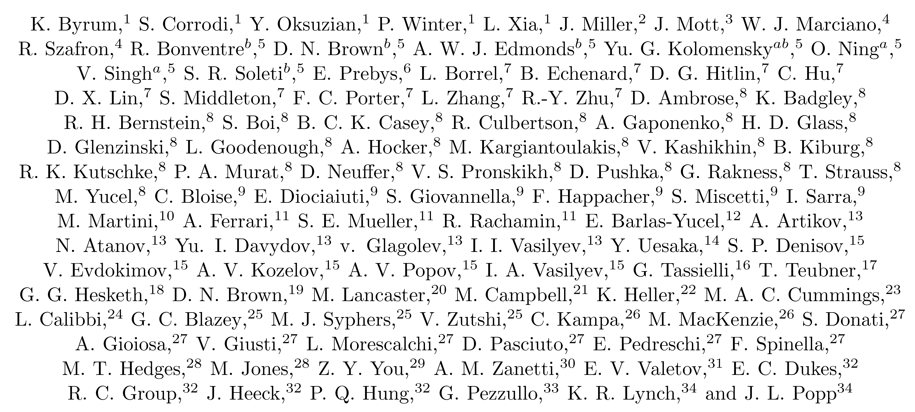
Mu2e-II contributed paper author list
Status as of Feb 17, 2022
Please check!!!!
Let me know if you want to be added
If you think people are missing, let them know so they can ask to be added

Slide 5
Mu2e-II collaboration/author list
Please respond (to fcp@caltech.edu)
  Philosophy is people need to sign on
  So please send me an email if you haven’t already
  Also, please check that I got your information right!
I will make sure anyone on the list is also on the Mu2e-II email list
  That is: mu2eii@listserv.fnal.gov
  The email list is a superset of the collaboration list
Collaboration/author list is available from the internal Mu2e-II wiki page
  https://mu2eii-internal-wiki.fnal.gov/wiki/Main_Page#Mu2e-II_Collaboration_and_Author_list
Also directly accessible with link
  https://caltech.app.box.com/file/793439425745?s=gkidbcqykvhrmfnl85rfct3z6ybhftqb

Slide 6
Mu2e-II Snowmass Schedule
March 15, 2022 deadline for submission of Mu2e-II contribution to arXiv
That is, we need to be done in 0.7 months!!
Plan to submit a day or two early
Please take a look and transmit comments as soon as possible
  Draft Snowmass22 contributed paper on Overleaf (read link):
    https://www.overleaf.com/read/mrbgttkmfgvq
This will serve as the input to the Topical Group Convenors
  Their deadline for preliminary reports is May 31, 2022

Slide 7
Mu2e-II Working Groups
Mu2e-II working groups | Convenors
Theory mu2eii-theory@fnal.gov | Lorenzo Calibbi Julian Heeck
Accelerator (including PS, production target, extinction) mu2e-ii-accelerator@fnal.gov | Karie Badgley David Neuffer Eric Prebys
Radiation mitigation (includes radiation simulation) mu2eii-radiation@fnal.gov | Michael MacKenzie Stefan Mueller Vitaly Pronskikh
Tracker mu2eii-tracker@fnal.gov | Daniel Ambrose Giovanni Tassielli
Calorimeter (and STM?) mu2eii-calorimeter@listserv.fnal.gov | David Hitlin Luca Morescalchi Ivano Sarra
CRV mu2eii-crv@listserv.fnal.gov | Craig Dukes Yuri Oksuzian
Sensitivity estimate (includes simulation, stopping target) mu2e-ii-sensitivity@listserv.fnal.gov | Lisa Goodenough Sophie Middleton Yuri Oksuzian
Trigger and DAQ mu2eii-tdaq@listserv.fnal.gov | Antonio Gioiosa Giani Pezzullo

Slide 8
Mu2e-II Working Groups
Email convenors if you wish to participate
Anyone can subscribe to email lists

Slide 9
Accelerator
Karie Badgley, Convenor, FNAL
David Neuffer, Convenor, FNAL
Eric Prebys, Convenor, UCD
Mary Anne Cummings, Muons, Inc.
Keegan Harrig, UCD
Andrei Gaponenko, FNAL
Vadim Kashikhin, FNAL
Kevin Lynch, CUNY
James Popp, CUNY
Diktys Stratakis, FNAL
  mu2e-ii-accelerator@fnal.gov

Slide 10
Radiation simulation and mitigation
  mu2eii-radiation@fnal.gov
Michael MacKenzie, Convenor, Northwestern
Stefan Mueller, Convenor, HZDR
Vitaly Pronskikh, Convenor, FNAL
Anna Ferrari, Reuven Rachamin, HZDR
Vadim Kashikhin, FNAL
James Popp, CUNY
David Pushka, FNAL
Yuri Oksuzian – CRV
Sophie Middleton – Sensitivity
Giani Pezzullo - TDAQ

Slide 11
Theory
mu2eii-theory@fnal.gov
Lorenzo Calibbi, Convenor, Nankai U
Julian Heeck, Convenor, UVa
Robert Szafron, BNL
Yuichi Uesaka, Kyushu Sangyo University

Slide 12
Tracker
  mu2eii-tracker@fnal.gov
Daniel Ambrose, Convenor, UMinn
Giovanni Tassielli, Convenor, INFN Lecce
David Brown, LBNL
Brendan Casey, FNAL
Manolis Kargiantoulakis, FNAL
James Popp, CUNY
Mete Yucel, FNAL
Tracker meetings every two weeks on Tuesdays 12AM CT

Slide 13
Calorimeter
  mu2eii-calorimeter@listserv.fnal.gov
David Hitlin, Convenor, Caltech
Luca Morescalchi, Convenor, INFN Pisa
Ivano Sarra, Convenor, LNF
Leo Borrell, Bertrand Echenard, Dexu Lin, Sophie Middleton, James Oyang, Frank Porter, Liyuan Zhang, Renyuan Zhu, Caltech
Eleonora Diociaiuti, Raffaella Donghia, Simona Giovannella, Fabio Happacher, Stefano Miscetti, LNF
Stefano Di Falco, Simone Donati, Antonio Gioiosa, Elena Pedreschi, Franco Spinella, INFN Pisa

Slide 14
Cosmic Ray Veto
  mu2eii-crv@listserv.fnal.gov
Craig Dukes, Convenor, Uva
Yuri Oksuzian, Convenor, ANL
Karen Byrum, Simon Corrodi, Peter Winter, Lei Xia, ANL
Raymond Culbertson, Gary Drake, Anna Pla-Dalmau, Greg Rakness, FNAL
Akram Artikov, Yuri Davydov, JINR, Dubna
Timothy Bolton, Glenn Horton-Smith, Yurii Maravin, Kres Neely, KSU
Gerald Blazey, Kurt Francis, Sergey Uzunyan, Vishnu Zutshi, NIU
Merrill Jenkins, U South Alabama
Steven Boi, Ralf Ehrlich, Stephen Goadhouse, Craig Group, UVa

Slide 15
Trigger/DAQ
  mu2eii-tdaq@listserv.fnal.gov
Antonio Gioiosa, Convenor, INFN Pisa
Gianantonio Pezzullo, Convenor, Yale
Richard Bonventre, LBNL
Rebecca Chislett, UCL, Tracker
Raffaella Donghia, LNF
Bertrand Echenard, Caltech
Ryan Rivera, FNAL
Roberto Soleti, LBNL
Franco Spinella, INFN Pisa – Calorimeter
Craig Dukes, UVa – CRV
Jinyuan Wu, FNAL

Slide 16
Sensitivity estimates
  mu2e-ii-sensitivity@listserv.fnal.gov
Lisa Goodenough, Convenor, FNAL
Sophie Middleton, Convenor, Caltech
Yuri Oksuzian, Convenor, ANL
Rebecca Chislett, UCL
Michael Hedges, Purdue
Cole Kampa, Northwestern
Manolis Kargiantoulakis, FNAL
Michael MacKenzie, Northwestern

Slide 17
Mu2e-II Communication Links
  Public wiki page: https://mu2eiiwiki.fnal.gov
    Please email Lisa or Frank if you wish to have write access
Private wiki page:
    https://mu2eii-internal-wiki.fnal.gov/wiki/Main_Page
  SSO log-on
  May need to contact Lisa or Frank to request access
  This page has the Mu2e-II calendar with links to zoom, indico, etc.
Mu2e-II mailing list: mu2eii@listserv.fnal.gov
Mu2e-II Slack channel link:
  https://Caltech-tka1525.slack.com

Slide 18
Additional Material

Slide 19
September 15, 2021 Mu2e-II workshop agenda
Indico timetable at: https://indico.fnal.gov/event/50719/
When (CT) | Who | What
10:00-10:20 | Frank Porter | Introduction
10:20-10:45 | Daniel/Gianfranco | Tracker
10:45-11:10 | David/Luca/Ivano | Calorimeter
11:10-11:35 | Antonio/Giani | TDAQ
11:35-12:00 | Craig/Yuri | Cosmic ray veto
12:00-12:20 | All | Break
12:20-12:45 | Michael/Stefan/Vitaly | Radiation studies
12:45-13:10 | Karie/David/Eric | Accelerator
13:10-13:35 | Lisa/Sophie/Yuri | Sensitivity
13:35-14:00 | Lorenzo/Julian | Theory
14:00 | All | End

Slide 20
Mu2e-II Parameters
``Complete’’ parameter list on public Wiki:
https://mu2eiiwiki.fnal.gov/wiki/Learn_about_Mu2e-II
Recent modification to follow Mu2e assumptions, 3rd year
(DocDB-26289, “Mu2e staging options”)
Note that this implies 1.5 ×10⁷ s/yr for CE data
Hence 4 years for total run time of 6 ×10⁷ s
Parameter | Value | Units | Value | Units
Accelerator beam | 40 | week/yr | 2.4×10⁷ | s/yr
Accelerator up time | 90 | % | 2.2×10⁷ | s/yr
Calibration, background studies, other special runs | 30 | % of delivered beam | 6.5×10⁶ | s/yr
Mu2e efficiency | 100 | %
CE data | 70 | % of delivered beam | 1.5×10⁷ | s/yr
Wiki has been updated
Also need to update PIP-II parameters to reflect current understanding (accelerator talk)

Slide 21
Mu2e-II talks
If you plan to submit an abstract or give a Mu2e-II talk, or are invited to give such a talk, please
  Email Kevin Lynch and Frank Porter
  If you have an invitation, please email us even if you do not wish to accept – we may be able to suggest someone else
Fermilab requirements – writeups
  Acknowledgment should usually include:
    This document was prepared by members of the Mu2e-II Collaboration using the resources of the Fermi National Accelerator Laboratory (Fermilab), a U.S. Department of Energy, Office of Science, HEP User Facility. Fermilab is managed by Fermi Research Alliance, LLC (FRA), acting under Contract No. DE-AC02-07CH11359.
  Fermilab preprint number
    https://mu2e-docdb.fnal.gov/cgi-bin/private/ShowDocument?docid=4083
With byline, include:
  “For the Mu2e-II Collaboration”
  Optionally as applicable; “For the <appropriate group name> working group of the Mu2e-II Collaboration”

Slide 22
Thinking about “when”
If Mu2e runs until end of 2030, when does Mu2e-II run?
Mu2e experience useful to have in designing Mu2e-II
Significant construction could happen in parallel with Mu2e run, long shutdown
Major installation cannot begin until Mu2e is complete
  Except perhaps portions of beamline from PIP-II
Sticky question: When/how can work happen in PS area?
  Residual radiation

Slide 23
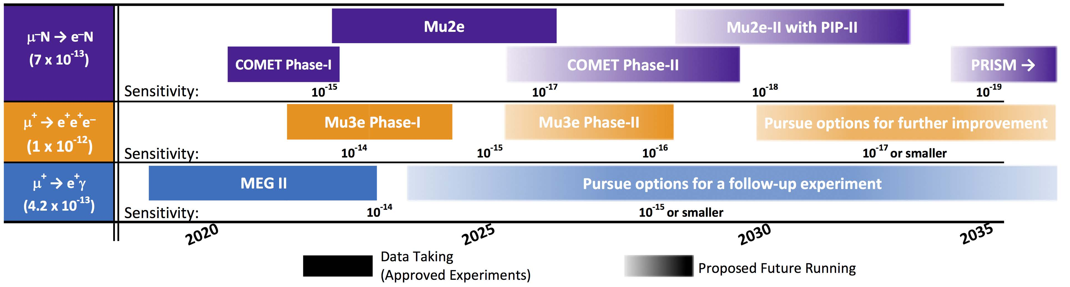
Thinking about “when”
View from 2020 European Strategy Physics input on CLFV
https://arxiv.org/pdf/1812.06540.pdf
Nice overview, but already wrong when it appeared (not only for Mu2e)
Latest Mu2e is “Project Complete” April 2024 (R.Ray, DocDB-38699)

Slide 24
Thinking about “when”
FNAL draft long-range plan (Jan 2021, excluding accompanying notes)
https://ppp-docdb.fnal.gov/cgi-bin/sso/RetrieveFile?docid=724&filename=10yr-PLAN-Current.pdf
Mu2e
Shows Mu2e running until end of FY30
Shows PIP-II operation beginning mid FY29 (PIP-II CD4 December 2028)

Slide 25
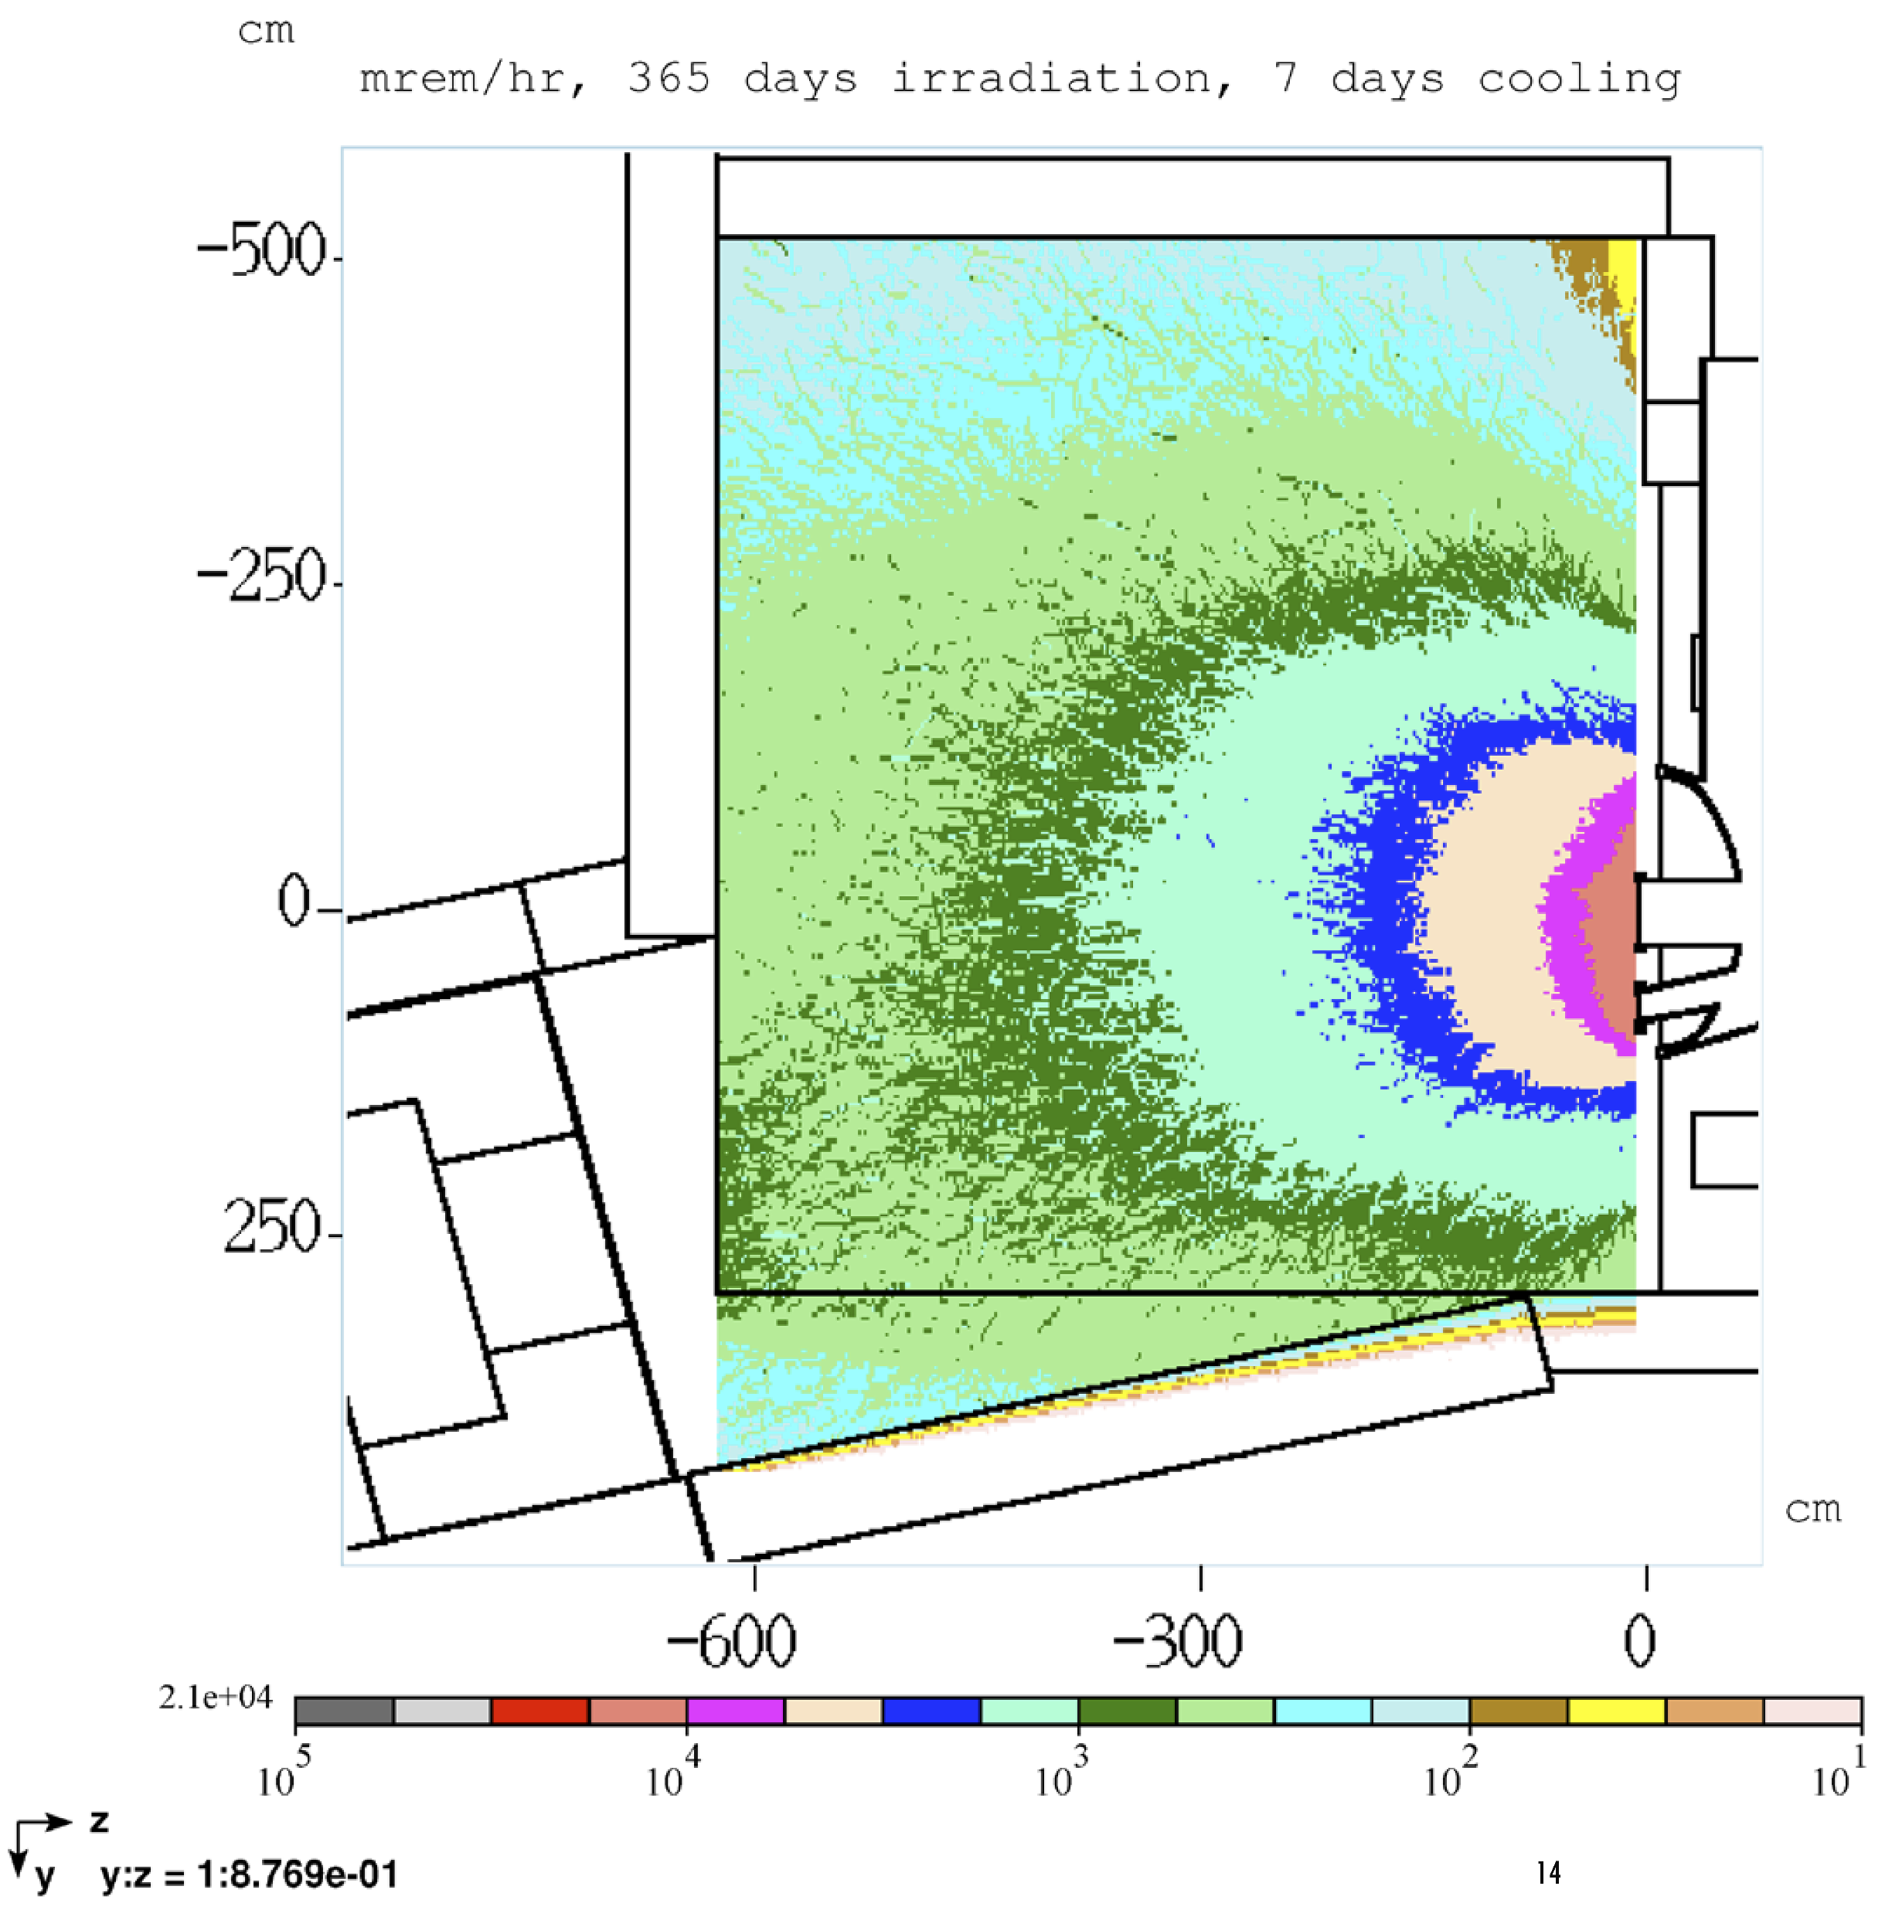
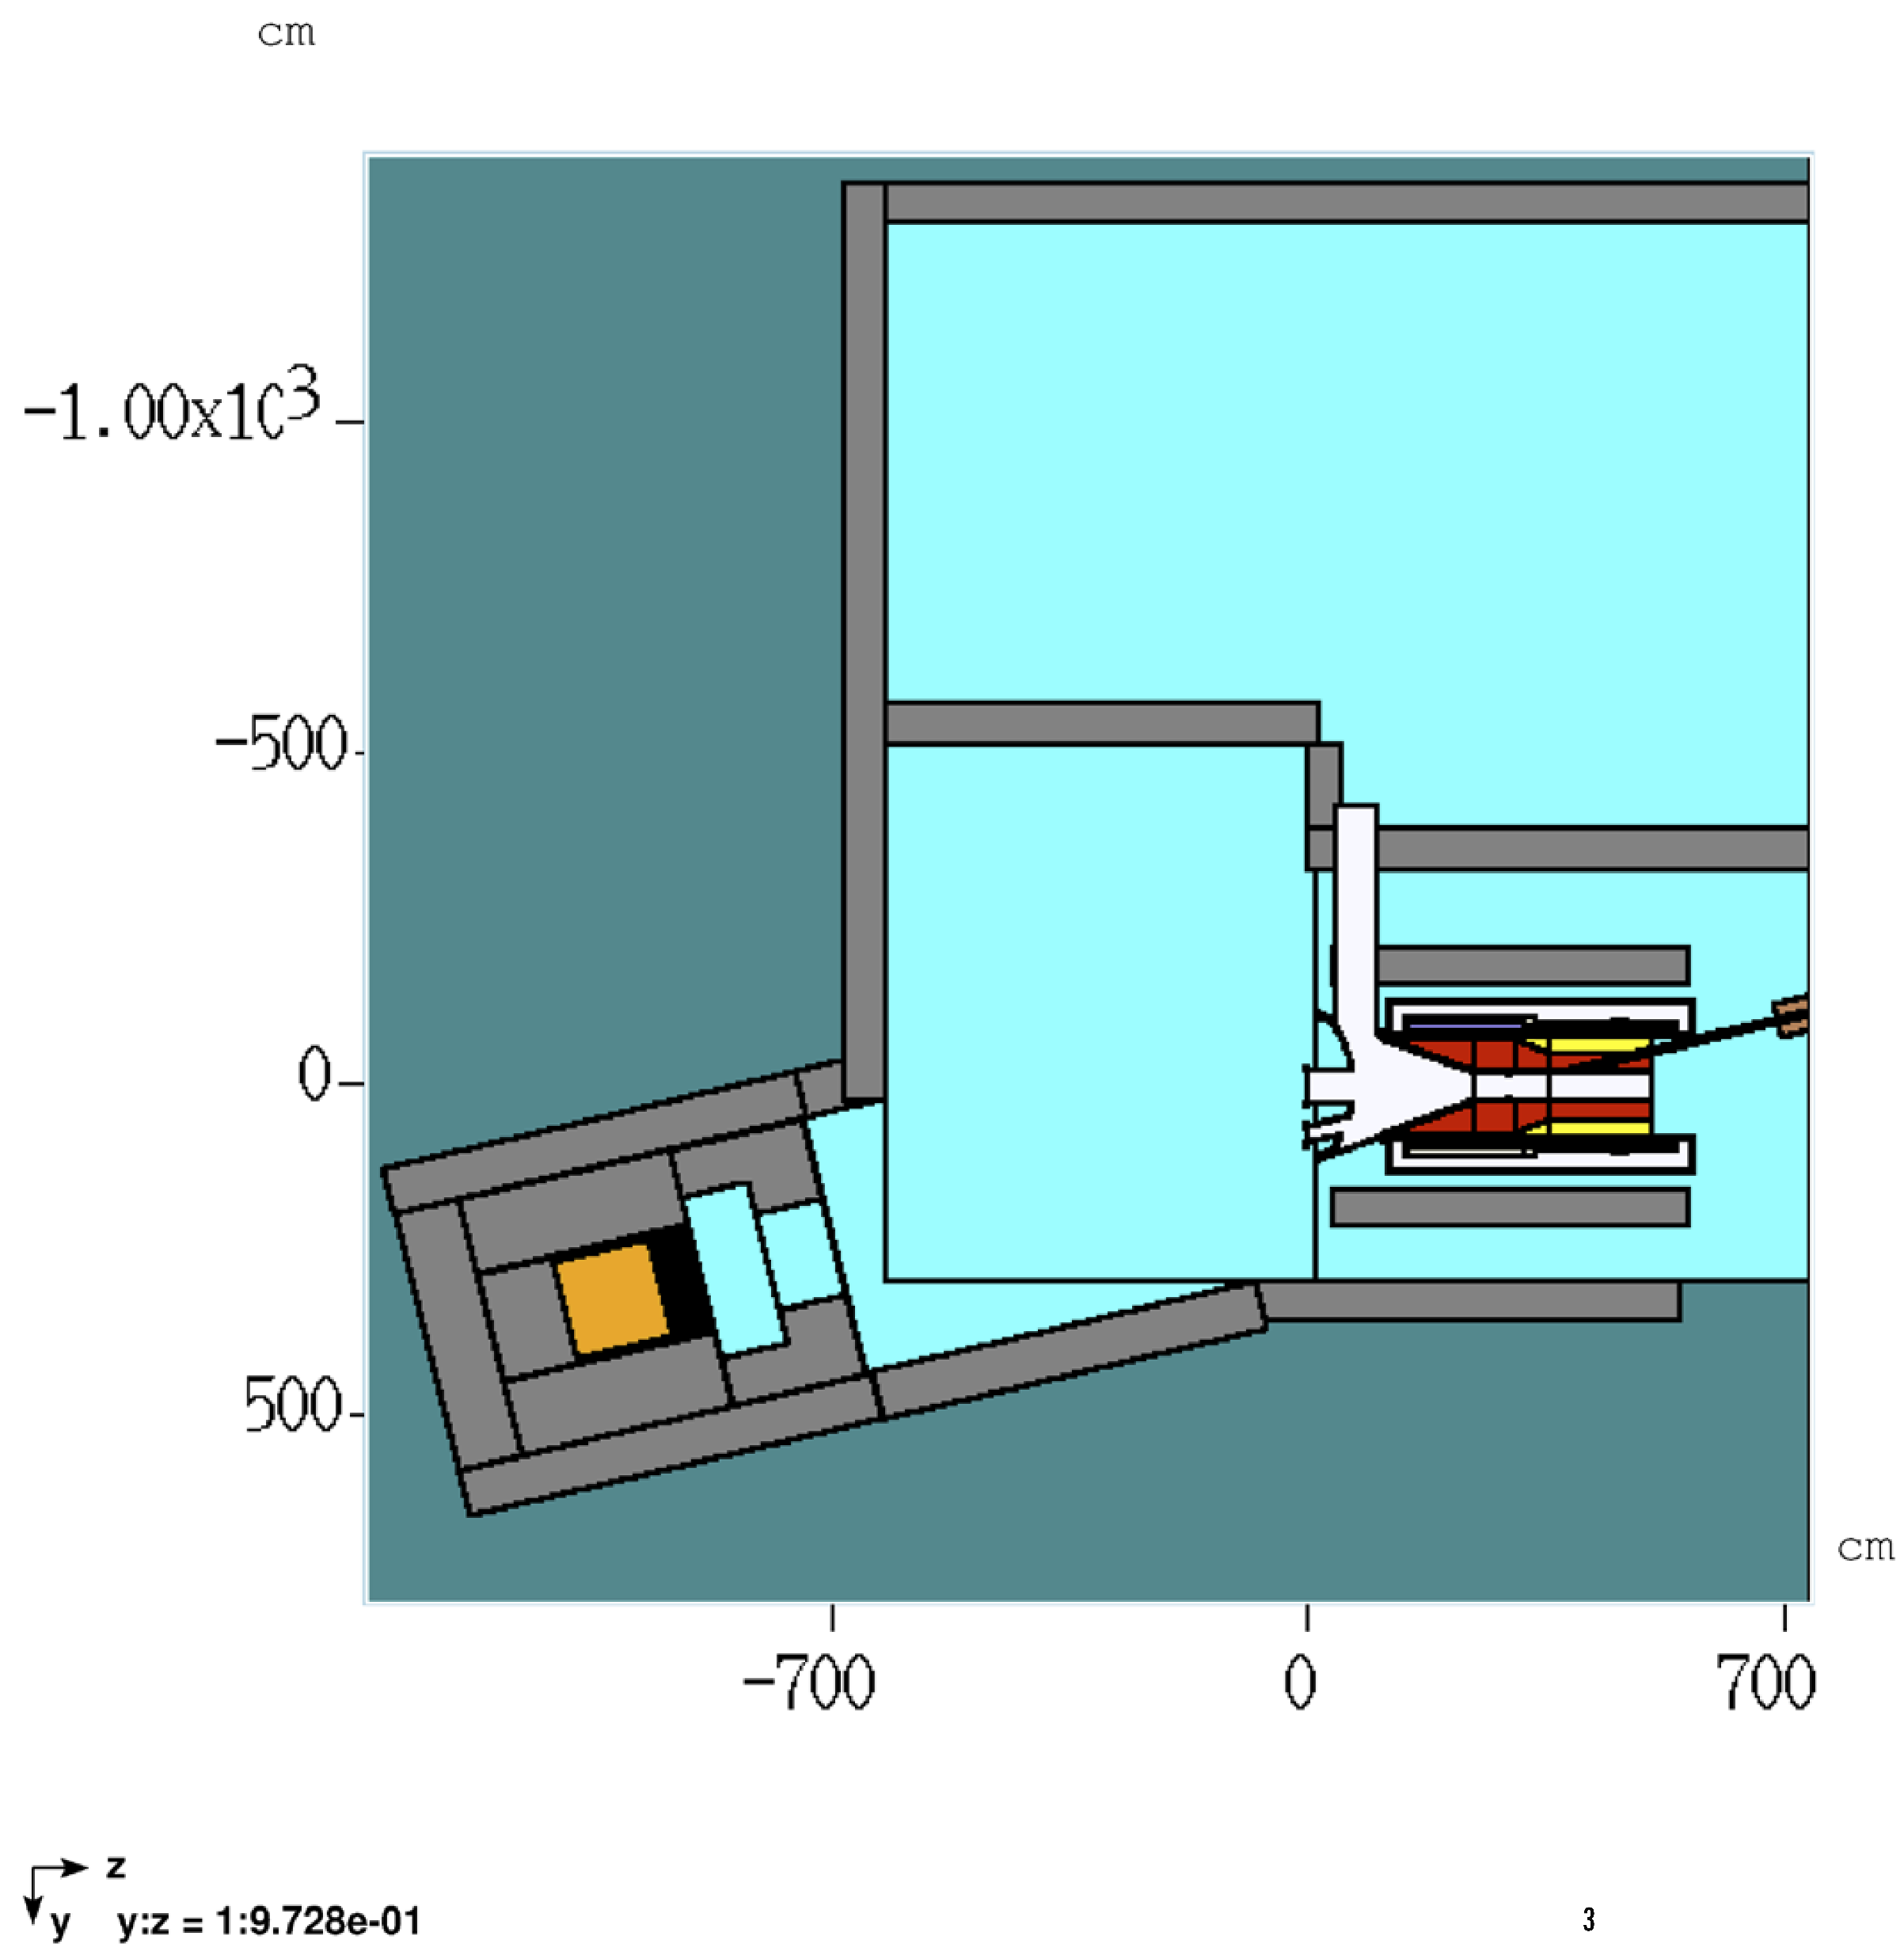
Thinking about “when”
Residual dose at production solenoid
365 days irradiation
8 GeV
8 kW
after 1 week cooldown
mid-plane of PS
DocDB-5629 (Leveling)
See also:
https://www.sciencedirect.com/science/article/abs/pii/S0168900217309415 (FermiCORD paper)
Hottest point in this region: 21 rem/hr

Slide 26
Muon stops
Quantity | Mu2e | Mu2e-II (nominal) | Units
Stopped μ/POT | 1.5x10⁻³ (37571)* | 8.9x10⁻⁵ (37571)
Beam kinetic energy | 8000 | 800 | MeV
Beam power | 8 | 100 | kW
POT (3 yr) | 3.6x10²⁰ (12014) | 4.5x10²²
Stopped μ | 5.4x10¹⁷ | 4.0x10¹⁸
SES | 3.7x10⁻¹⁷ (12014)*
numbers in () are DocDB references
POT = Protons On Target
SES = Single Event Sensitivity
POT = 3 yr x 1.92x10⁷ (s/yr) x power(W) / Ebeam(J)
*DocDB 7464 says 0.00187 stopped mu/POT (corresponds to SES 3x10⁻¹⁷);
SES here is scaled from this using 0.0015 stopped mu/POT
Stopped mu(Mu2e-II)/Stopped mu(Mu2e) = 40/5.4 = 7.4

Slide 27

Muon stops
This means that for a SES of 10x better than Mu2e, or SES = 3.7x10⁻¹⁸, the beam power should be 135 kW
In other words,
SES(Mu2e-II) = 5x10⁻¹⁸ x
$$\frac{100 kW}{P}$$
(We assume the efficiency to observe a conversion electron is the same in Mu2e-II as in Mu2e)
Comment: These are early results and will change!

Slide 28
Snowmass 22 - Endgame Schedule
White Paper submission to arXiv: no later than March 15, 2022
  Late submissions and updates unlikely to be incorporated in the working group reports
• Preliminary reports by the Topical Groups due: no later than May 31, 2022
• Preliminary reports by the Frontiers due: no later than June 30, 2022
• Snowmass Community Summer Study (CSS): July 2022 at UW-Seattle
• Final reports by Frontiers due: no later than September 30, 2022
Snowmass Book and on-line archive documents due: October 31, 2022

Slide 29
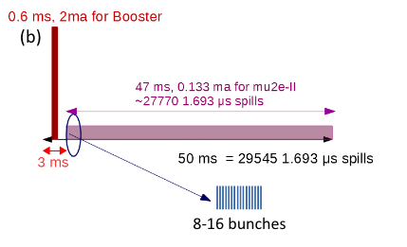
Proposed Mu2e-II beam nomenclature
Follow accelerator group usage
Beam delivery is different than Mu2e
Quantity | Name
Beam in one PIP-II RF bucket (162.5 MHz) | Bunch
PIP-II pulse (20 Hz/0.55 ms) | Pulse (but see below)*
Mu2e-II repetition (e.g., 1693 ns) | Spill (also pulse, but see above)**
Set of bunches in one spill (e.g., 8) | Burst (also pulse, but see above)**
*One PIP-II pulse is about 27770 Mu2e-II spills; suggest saying “PIP-II pulse”
to avoid confusion.
**”Pulse” may be used when distinction is not important
Eric Prebys https://indico.fnal.gov/event/44997/
David Neuffer, DocDB 33896

Slide 30
Mu2e-II Snowmass21 Committee
Name | Institution | Email
Dan Ambrose | U Minn | ambrose0028@gmail.com
Rebecca Chislett | UC London | rebecca.chislett@ucl.ac.uk
Lisa Goodenough | FNAL | goodenou@fnal.gov
Julian Heeck | U Virginia | julian.heeck@gmail.com
David Neuffer | FNAL | neuffer@fnal.gov
Yuri Oksuzian | ANL | yoksuzian@anl.gov
Frank Porter (chair) | Caltech | fcp@caltech.edu
Giovanni Tassielli | INFN-Lecce | giovani.tassielli@le.infn.it
Robert Bernstein (ex officio) | FNAL | rhbob@fnal.gov
Jim Miller (ex officio) | Boston U | miller@bu.edu

