Slide 1
Mu2e-II PIP-II Accelerator Beam for Mu2e-II
Accelerator Group: Eric Prebys, David Neuffer, Karie Badgley, Keegan Harrig, Kevin Lynch, Diktys Stratakis, Mary Anne Cummings, James Popp, Vadim Kashikin, V. Pronskikh
February 2022

Slide 2
Accelerator beam issues
Topics to include in mu2e-II white paper
Transport from PIP-II to Mu2e
Switchyard
H⁻ stripping
Extinction
Beam-Target transport
Trajectories through PS solenoid, beam dump
Target design
V. Pronskikh – LDRD
Production solenoid
Shielding, heat load, radiation, …
K. Badgley- PS report
Compatibility with PIP-III

Slide 3
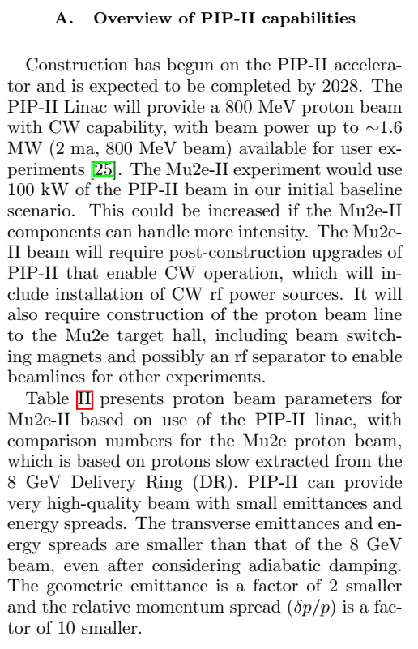
Current draft is relatively minimal
PIP-II must be adapted to enable Mu2e-II
CW rf power sources must be installed
Beam transport from PIP-II to Mu2e-II must be constructed.

Slide 4
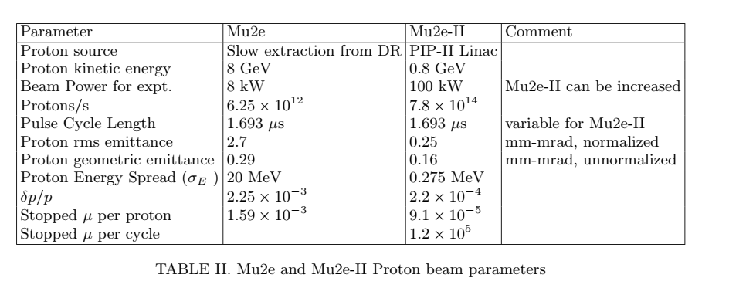
Beam parameters
Parameter table
Compares Mu2e and Mu2e-II
Proton beam quality from PIP-II Linac much better than PIP-II
Smaller beam, smaller δp/p, many more protons

Slide 5
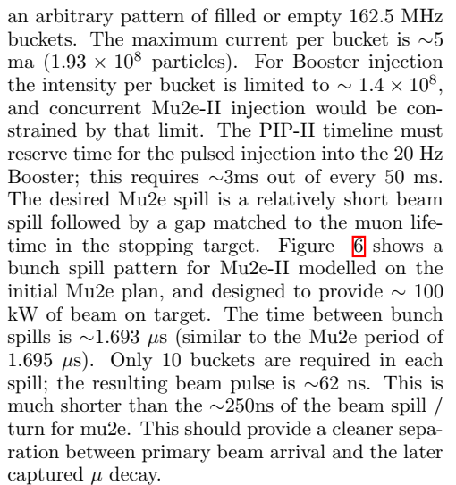

Slide 6
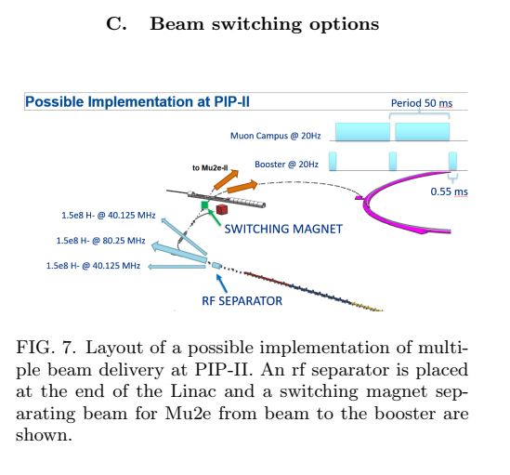
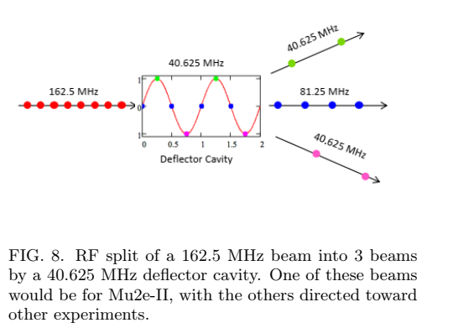
Beam sharing with other experiments
rf separator
For simultaneous beams
~80 MHz
0.7MW to other beams ?
Switching magnet
Separates entire beam to different lines
3ms out of 50 ms to PIP-II

Slide 7
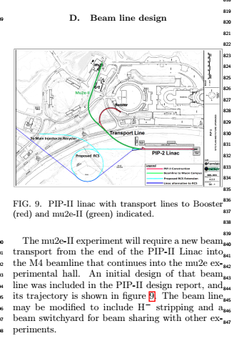
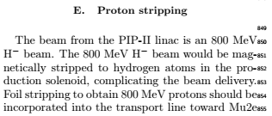
Beamline to Mu2e-II
Mu2e-II beamline from PIP-II must be implemented
Initial design in PIP-II Design Report
Construction not included in PIP-II project
Stub for future construction included
Line should include proton stripping (H⁻ → p)

Slide 8
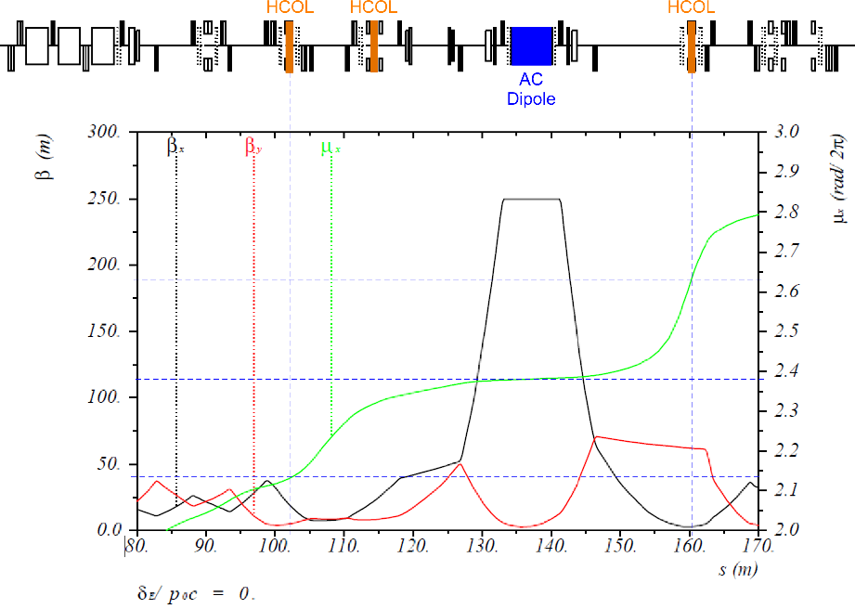
Extinction
Last part of transport to Mu2e-II is the M4 line
Includes extinction line for Mu2e
Parameters can be modified to provide extinction for Mu2e-II
Better for Mu2e-II because of superior beam quality
Extinction Monitor
Must be replaced

Slide 9
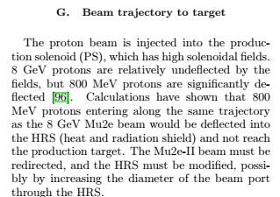
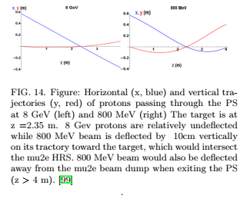
Beam trajectory to target

Slide 10
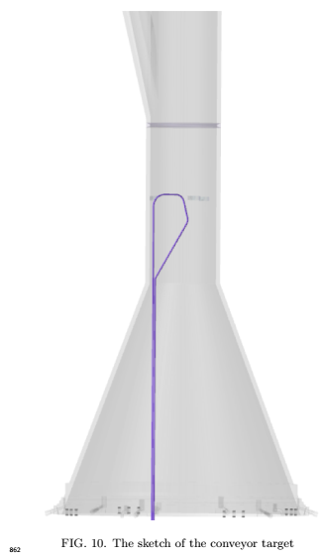
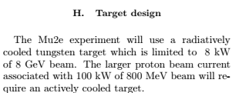
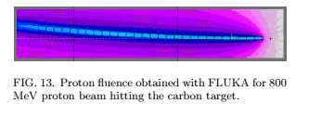
Target design

Slide 11
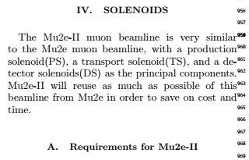
Solenoid Design
B. PS Solenoid options
Reuse Mu2e Solenoid
Replacement PS
C. Transport Solenoid
Reuse
No changes
Modify transport solenoid to enable more on-axis injection into PS ??
Could then reuse PS ?
D. Decay Solenoid
Reuse. No changes

Slide 12
Discussion
Thanks for your attention

Slide 13
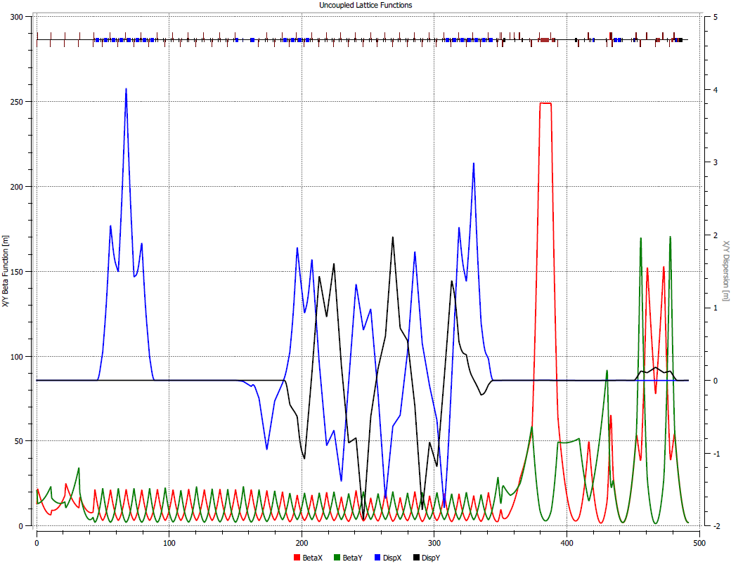
Beamline to mu2e-II experiment
800 MeV beam line from PIP-II
Switchyard – new mu2e-II transport
Switch yard location ?
Other experiments ??
Identify other experiments for facility proposal
PIP-II
Booster
mu2e-II transport
PIP-III
RCS or linac
A. Vivoli

