Slide 1
9 O’Clock Meeting
Kelli Rubrecht
MCR Crew Chief
Wednesday, January 26, 2022

Slide 2
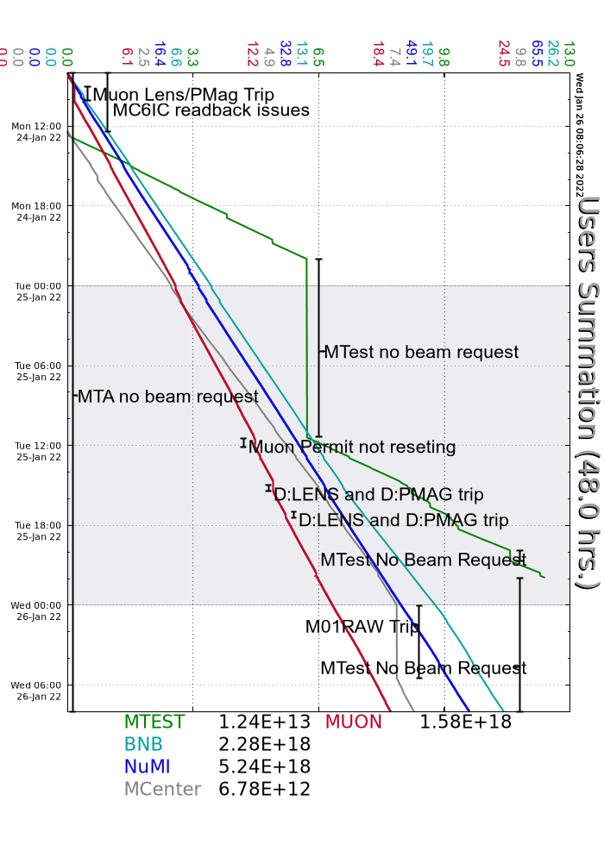
Since Monday…
Walkthroughs on the off-shifts
Beam to users as requested
Tuning up machines after long downtime
Chasing LENS, PMAG, permit trips, recovering as able
M01 RAW skid low level, experts filled
Beam to NuMI, BNB, Muon, MCenter

