Slide 1
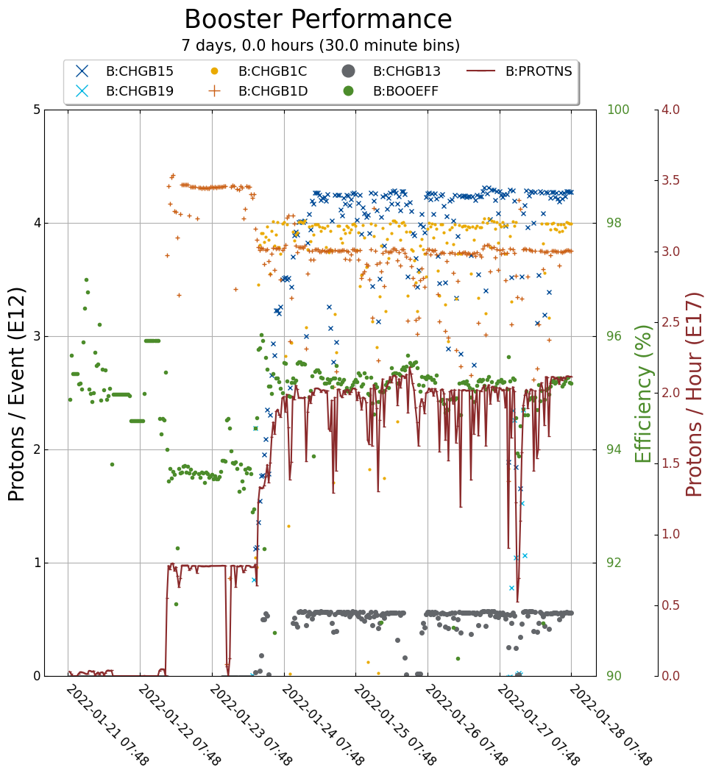
Booster Operations
Down time: 21 min
Minor RF trips…
BRF4, BRF22/WAPS
$15 - 4.25e12, 14.8T
$1C - 4.0e12, 13.8T
$1D - 3.8e12, 13.0T
2.15e17 protons per hour, Efficiency 95%
Continuing to tune for intensity and efficiency
Working with Controls and Instrumentation to fix our aperture scanning program.

