Slide 1
Muon Campus Status
D. Vander Meulen
January 28, 2022

Slide 2
D:IB Ground Fault Problem …
The D:IB ground fault was found last Friday on one of the power cables coming from the transformer outside AP-50 to the power supply inside. Hipotting identified only one bad cable which has been disconnected.
Our thanks to EE Support personnel for working overtime on Saturday to get things in a state where running to G-2 is possible while we arrange for repairs. This made it possible for us to be on and ready to deliver beam to G-2 when the MI magnet work was completed on Sunday.
We will not be able to do 8 GeV studies until a new cable is pulled. There is no date scheduled for the repair yet.

Slide 3
Other Activities This Week …
AP-0 target blower maintenance.
LCW leak rate average now between 70 – 90 gal/day. An access was done on Saturday to divert several water leaks so they don’t threaten any equipment.
We have been having problems this week with our Lithium Lens / Pulsed Magnet tripping, and with tracking errors on our M1 line trim supplies. Controls and EE Support people are helping us diagnose what the problem is.
F23 service building temperatures were getting low enough to be a concern. FESS people confirmed the building heaters are working, but the problem turned out to be a large gap in one of the doors. A temporary barrier is in place until the door gets repaired.

Slide 4
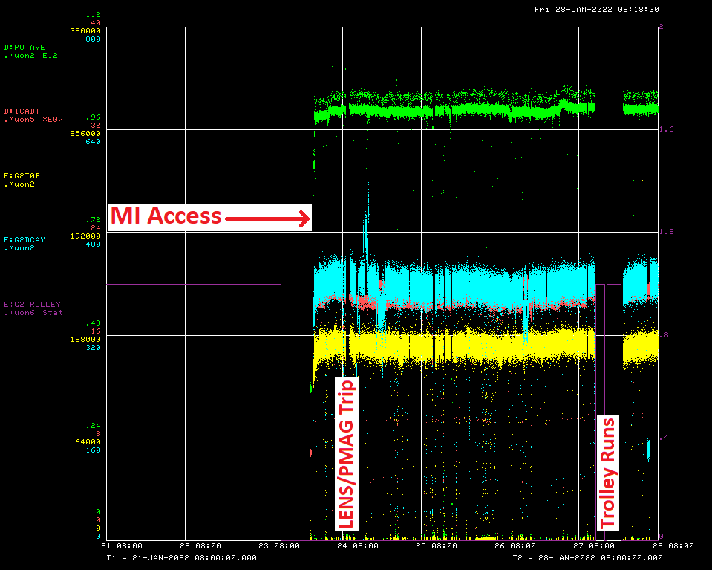

Slide 5
Down Time
Muon Campus: (Total: 2hrs 57min)
LENS / PMAG Trips: (18) 2hrs 16min
Permit won’t reset 41min
G-2: (Total: 8hrs 30min)
Trolley runs: 8hrs 30min

Slide 6
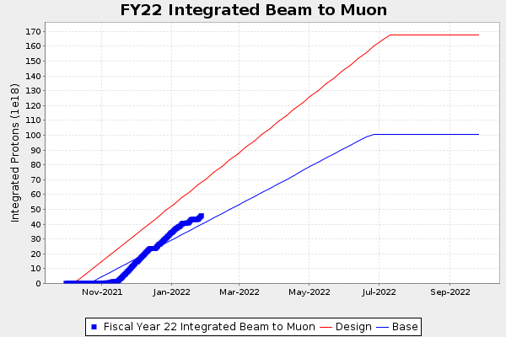
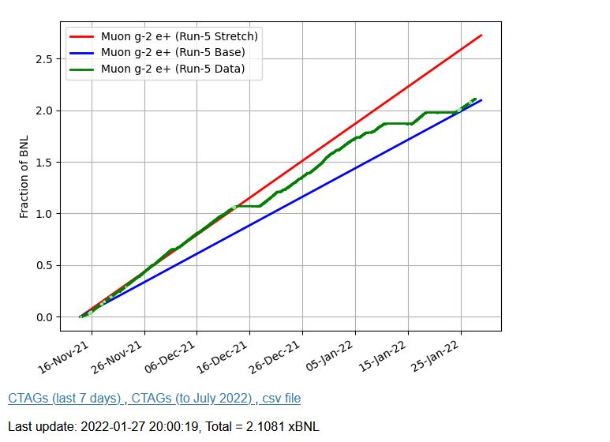
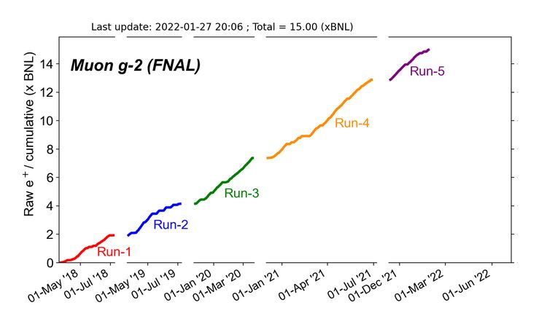
G-2 Performance – Integrated for Run 5
Run 5 # POT
G-2 Experiment POT Run Goal: ~4.2E20 POT
Run 5 period is Nov 2021 – June 2022
Run 5: Goal of ~x6 BNL
Total Run: Goal of x20 BNL
Run 5 Integrated ~ x 2.1 x BNL
Total Integrated ~ x 15 x BNL

Slide 7
Plan …
Run to G-2
Delivery Ring access time for LCW leak repairs if the opportunity presents itself.

