Slide 1
9 O’Clock Meeting
Kelli Rubrecht
MCR Crew Chief
Friday, January 28, 2022

Slide 2
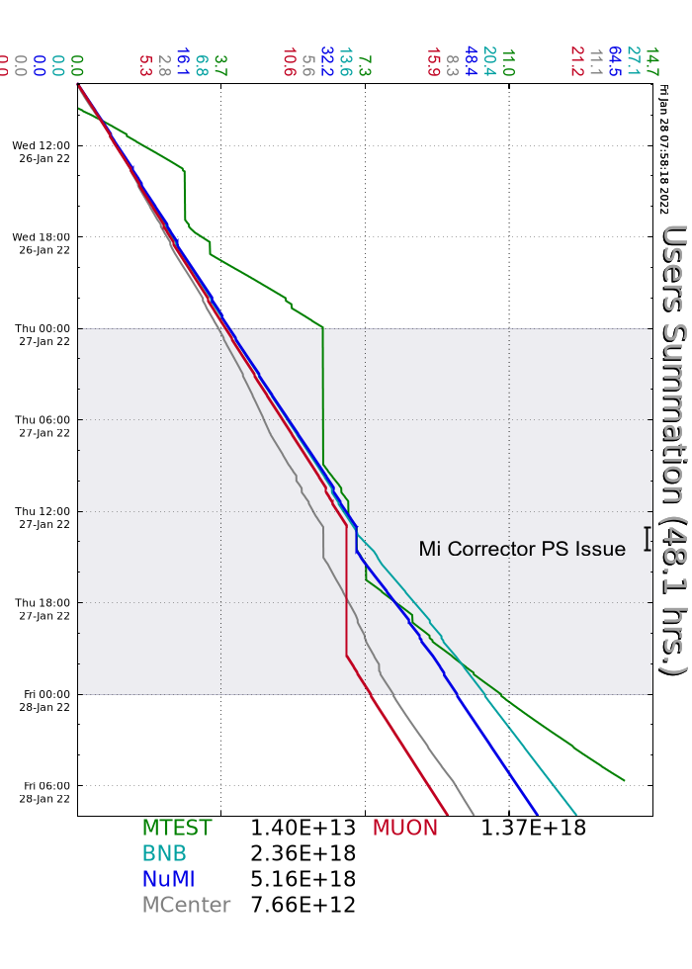
Since Wednesday…
Walkthroughs on the off-shifts
Beam to users as requested
Several Source A Boiler Heater trips requiring cabinet accesses
MI corrector regulator failure yesterday, 1.5 hrs
g-2 trolley run evening to early morning
Beam to NuMI, BNB, Muon, Mcenter, MTest

