Slide 1
MI/RR Machine Report
Meiqin Xiao
Jan 28, 2022

Slide 2
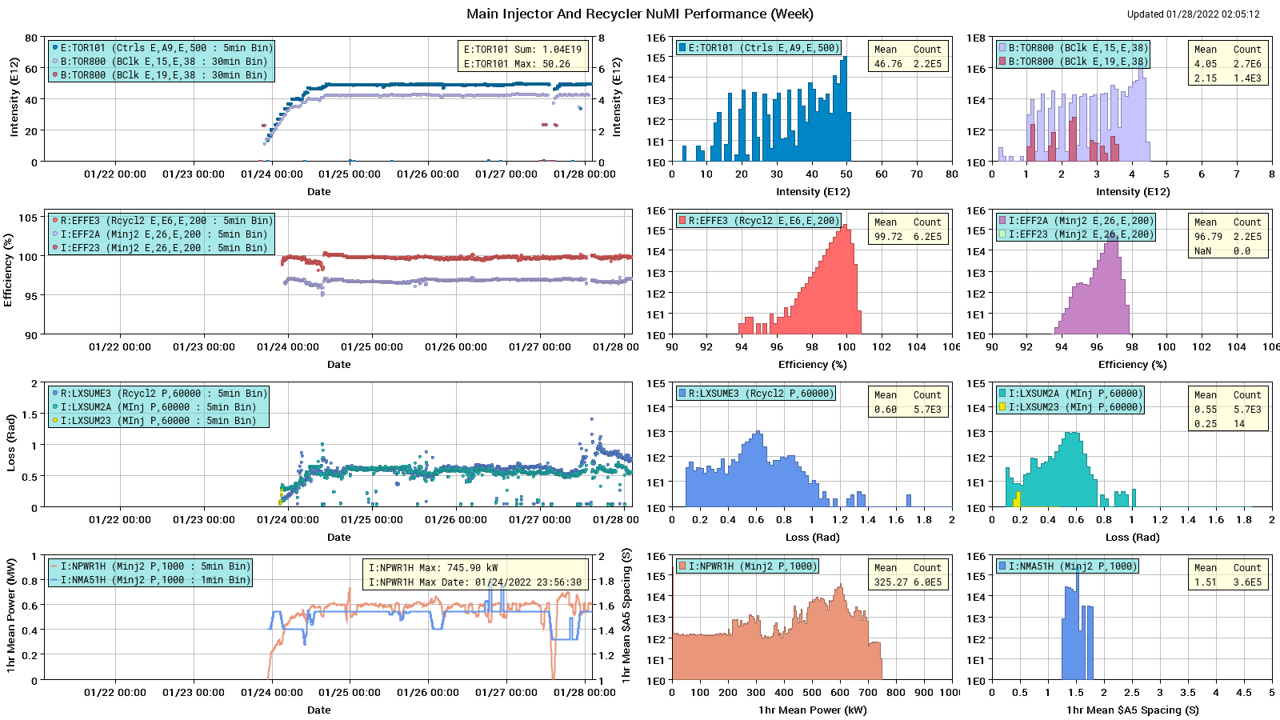
MI/RR NuMI Performance (week)

Slide 3
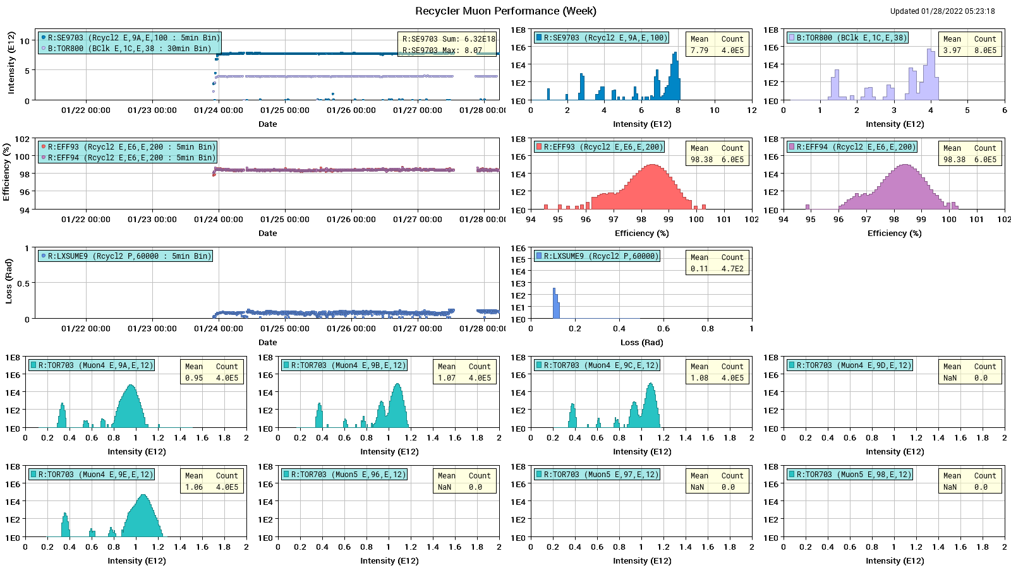
Recycler Muon Performance (week)

Slide 4
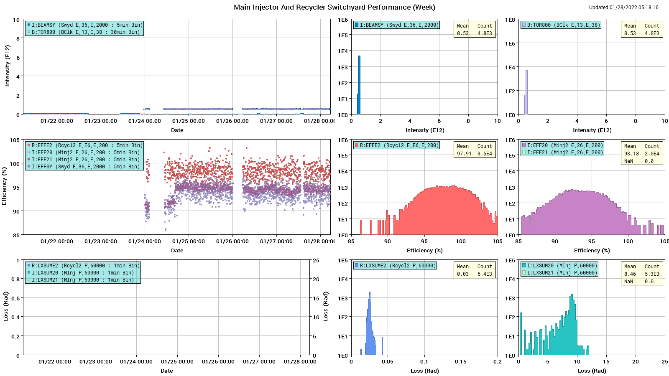
MI/RR Switchyard Performance (week)

Slide 5
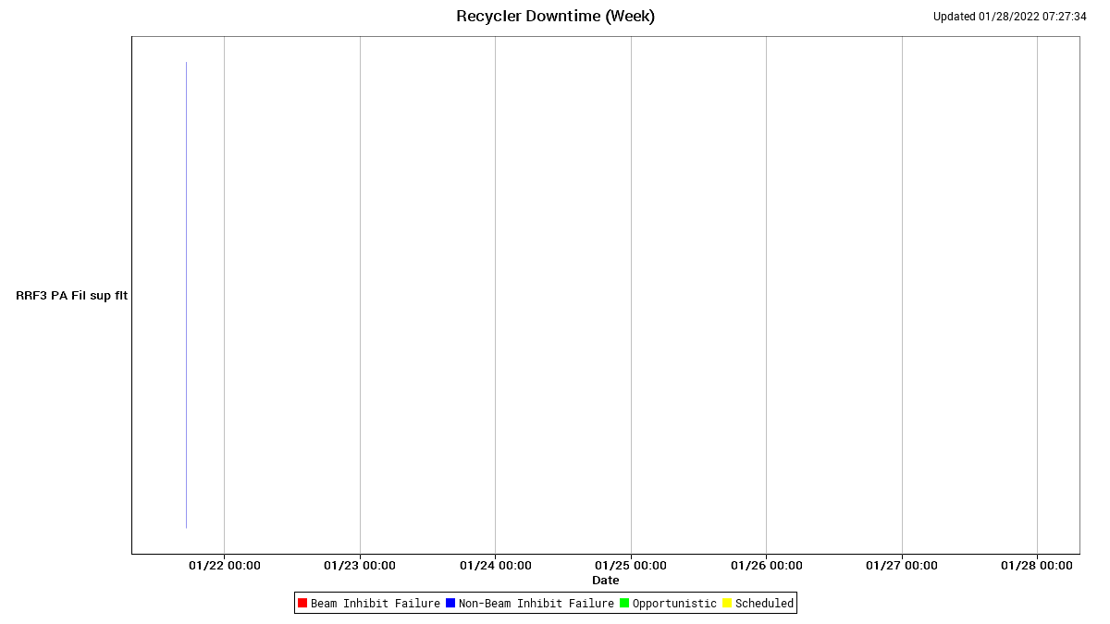
RR Downtime

Slide 6
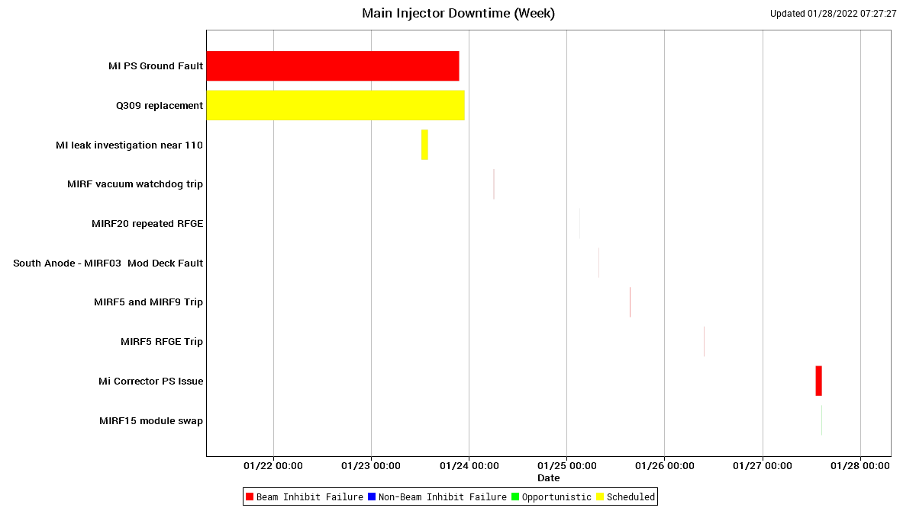
MI Downtime

Slide 7
Q415 and Q309 replacement completed, and MI is back on operations
01/21 - 01/22 Friday - Saturday
Q309 replacement was completed
01/23 Sunday
MI experts helped walk through the tunnel to check the work, and helped to turn the Machines on
MI beam to dump by 21:39, Sunday evening, beam to g-2 and NuMI by 22:50
Small leaking was found in a dipole D110-2 and 3 quadrupoles. Decided to leave these issues to next Summer shutdown
Thanks again for everyone who was involved with the efforts for the replacement of magnets Q415 and Q309
01/24-01/28 Monday – Friday : Back to Normal operations
Increasing beam intensity as the vacuum scrubbed @ Q415 and Q309
Tune up collimators for both MI and RR
new QXR processor board upgraded, works well for the slow spill
RR collimator studies due to the losses at 614 are higher than usual
I:H424 regulator failed, replaced.

