Slide 1
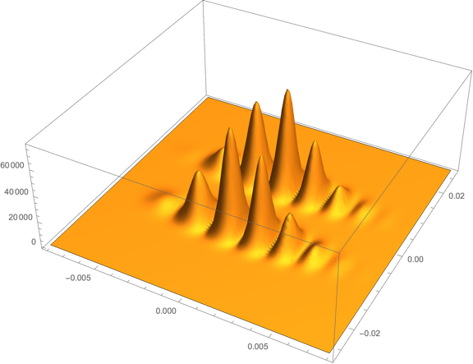
MAGIS-100 Phase Fitting
Mathematica based study
ND-doc-845

Slide 2
Mathematica-based simulation described last week
Start with (Jeremiah: ND-doc-767)
analytically derived wavefunction → atom population in the imaging region at end of interferometer sequence
Simulation ingredients (SG: ND-doc-845)
photon emission rate & imaging time
Atom diffusion during imaging
optics: geom. acceptance & magnification
CCD pixel geometry & quantum efficiency
pixel readout noise: Gaussian fluctuations
Atom statistics: Poisson fluctuations
Photon emission statistics: Poisson fluctuations

Slide 3
Fitting the Simulated Image to Extract a Phase
1
500
photons/bin (x1000)
pixel z-index
1000
Asymmetry
1
200
400
pixel x-index

Slide 4
Some numbers to keep in mind
Statistical precision of each measurement depends upon the number of atoms in the cloud N and the average number of photons per atom imaged and recorded f_{γ}
We anticipate that initially MAGIS will operate with N ~ 10⁶.
To estimate f_{γ} assume:
  the CCD camera lens accepts 0.4% of the solid angle
  Photon emission rate per atom is 10⁸ / sec
  QE = 0.5
which yields f_{γ} = 2 for an imaging time t = 10μs .

Slide 5

Setting expectations: Toy Model
Establish what to expect by simulating and fitting a simple model.
Consider a Gaussian envelope modulated by a cosine fringe pattern:
Set φ = 0, center the atom cloud and chose a distance scale so that the pixel plane extends from x=0 to x=1.
With N=10⁶, for a given λ & σ, fit for the phase φ.
Repeat many times to extract the variation in the fitted φ → phase resolution.
Example:
λ = 0.1
σ = 0.1
x

Slide 6
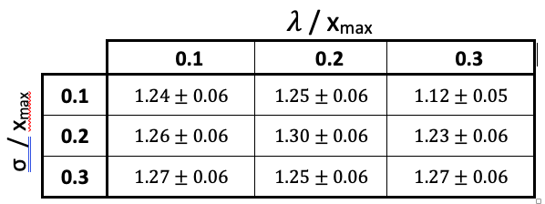
Toy Model Fit Results
Phase resolution (mr) for N = 10⁶ tabulated as a function of the cosine wavelength λ and the RMS of the Gaussian envelope σ :
For 10⁶ atoms we obtain a phase resolution of ~ 1mr which, if we had estimated analytically, is what we expect.

Slide 7


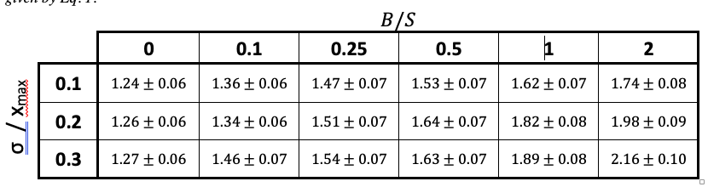
Adding Readout Noise
Analytically we expect the phase resolution
where B is the integrated background and S = N x f_{γ} is the integrated signal

Slide 8

FIND: (Eq. 8)

Slide 9
Fitting the Simulated Images
1
Fitting modules in the package offer a number of OPTIONS:
fit the entire pixel plane or restrict the fit to the image regions
fit a single interferometer or two interferometers as a gradiometer
fit two ports separately or together or the two-port asymmetry
weighted or unweighted fits
The toy-model (Gaussian + Cosine + Background) is used as the fit-function → provides an adequate description of the simulated images → good fits
Parameters varied in the fit:
φ , B, S, cloud position(s) & width(s), λ
500
pixel z-index
1000
1
200
400
pixel x-index

Slide 10
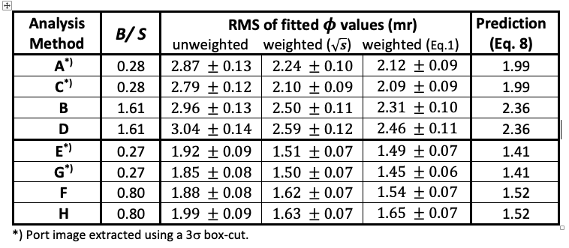
Fitting the Simulated Images
Analysis methods described in ND-doc-845
Method G weighted is the one where everything is nominally done optimally
All methods with weighted fits yield results consistent with our simple
Gaussian + Cosine + Background expectations for that method

Slide 11
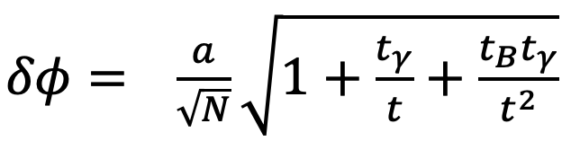
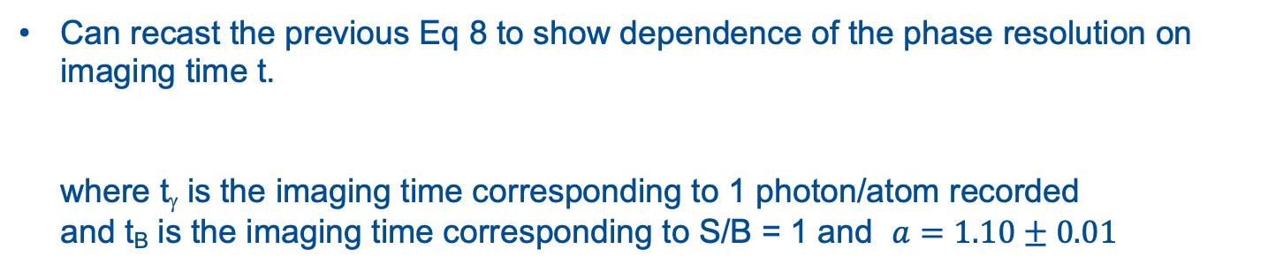
Imaging Time
Can recast the previous Eq 8 to show dependence of the phase resolution on imaging time t.
where t_{γ} is the imaging time corresponding to 1 photon/atom recorded
and t_{B} is the imaging time corresponding to S/B = 1 and $a=1.10±0.01$

Slide 12
Contrast
Stray paths not yet implemented in the simulations for the fitting study (Leonie – in progress) ... Hence we do not yet have a model for the image contrast.
Assume something unrealistically bad ... that the contrast loss is uniform over the image. Contrast factor f_{c}:
Plan to repeat this study once we have at least a parametric model for the impact of stray paths on the position-dependent contrast.

Slide 13
Two-Port Asymmetry
So far the fits have been to the 1D-fringe distributions. Can also fit the two-port asymmetries ... statistically equivalent.
Nothing in the simulations (so far) favors asymmetry fits over 1D-fringe fits although in the future we may discover the systematics associated with these alternative are different.

Slide 14
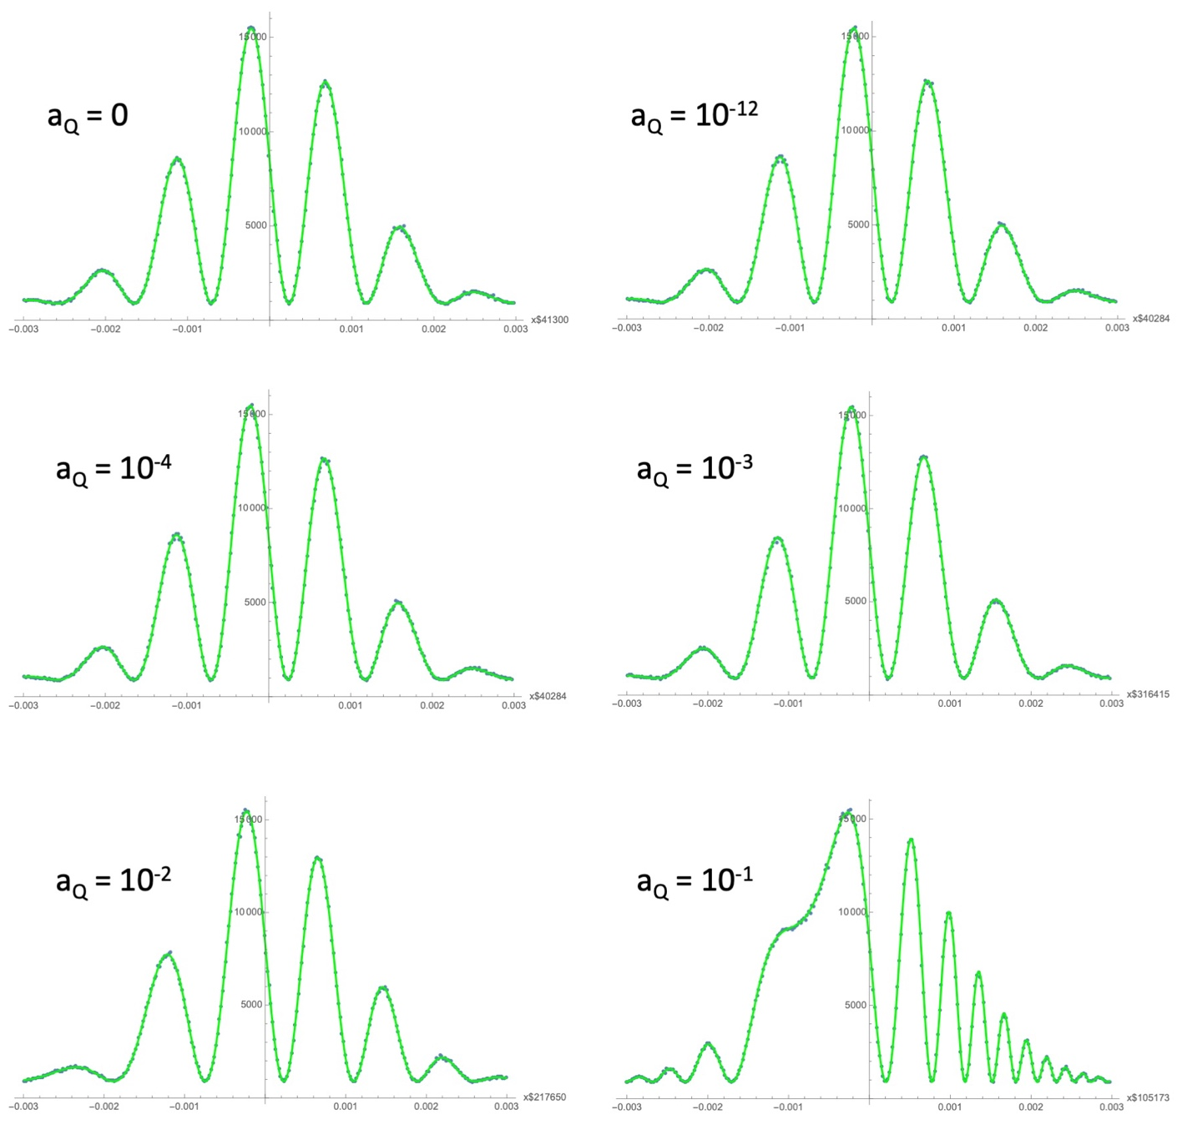
A more complicated wavefunction
Add a quadratic term to the wavefunction (Jeremiah ND-doc-767) at the input of the simulation & also to the fitting function:
a_{Q} = 0
a_{Q} = 10⁻¹²
a_{Q} = 10⁻⁴
a_{Q} = 10⁻³
a_{Q} = 10⁻²
a_{Q} = 10⁻¹

Slide 15

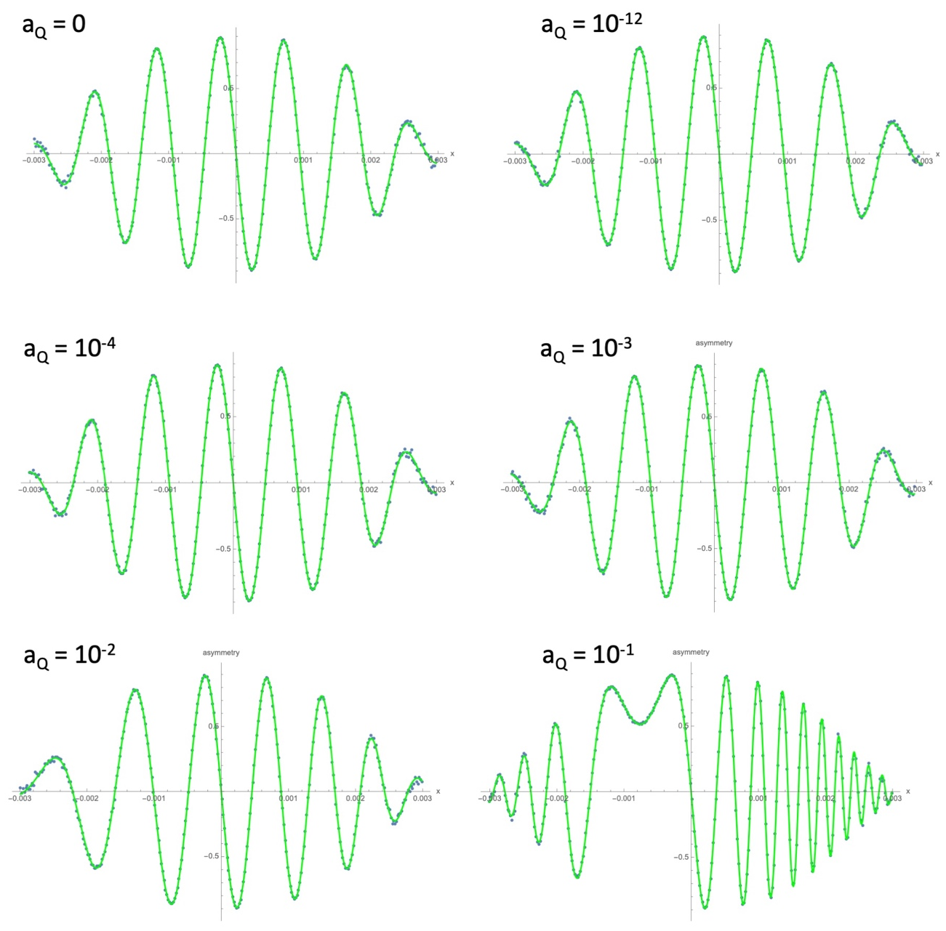
A more complicated wavefunction: Asymmetry Fits
a_{Q} = 0
a_{Q} = 10⁻¹²
a_{Q} = 10⁻⁴
a_{Q} = 10⁻³
a_{Q} = 10⁻²
a_{Q} = 10⁻¹

Slide 16
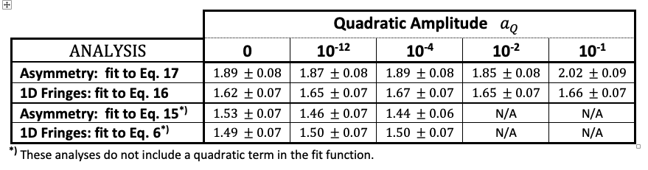
A more complicated wavefunction: Fit Results
Phase resolution as a function of the dimensionless quadratic amplitude a_{Q}
There is a penalty for using a more complicated fit function ... So don’t use it unless you have to [for a_{Q} > O(10⁻⁴)].
Using a fit function w/o the a_{Q} term seems to be the best strategy for a_{Q} < O(10⁻⁴).

Slide 17
FINAL REMARKS
Things will become more interesting as the simulations become more realistic
  optics, stray paths ...
I think we should plan to fit the acquired images in real time as a high-level monitor of data quality
  fit for phase, background level & contrast, cloud amplitude, center & width ...
  if we can’t fit every image, we can still sample (robust online fitting that monitors all relevant parameters may be more rewarding than fast fitting)

