Slide 1
Overview of an Example Measurement Sequence for the EP experiment
Tim Kovachy
Simulation Workshop 2/2/2022

Slide 2
Overview of Experimental Steps: Example of Dual Isotope Sequence
EP uses Rb, MAGIS uses Sr—but still many similarities
-Cool and trap Rb-87 and Rb-85 atoms in MOT
- “snap up” strong magnetic trap that can provide tight confinement for evaporative cooling
- 1st stage lensing in magnetic trap to reduce velocity spread of atoms
- Release atoms, state preparation, and lattice launch
- Pre-interferometry pulses for kinematically overlapping the two isotopes
- Apply sequential Bragg pulses for interferometry
- Imaging
- Implement slow digital feedback

Slide 3
Dual Isotope MOT
2D MOT loads 3D MOT
Different isotopes require different laser frequencies for cooling (and repumping)
Typically load 4 x 10⁹ Rb-87 atoms and 3 x 10⁸ Rb-85 atoms in a total time of ~5 seconds
Due to lower collisional cross sections between Rb-85 atoms, Rb-87 atoms acts as the refrigerant for both themselves and the Rb-85 atoms during subsequent evaporative cooling
- need more Rb-87 atoms than Rb-85 atoms
Before “snapping up” magnetic trap, optically pump atoms into magnetically trappable states:
F=1, mF = -1 for Rb-87, F=2, mF = -2 for Rb-85
Later switched to F=2, mF = 2 for Rb-87, F=3, mF = 3 for Rb-85

Slide 4
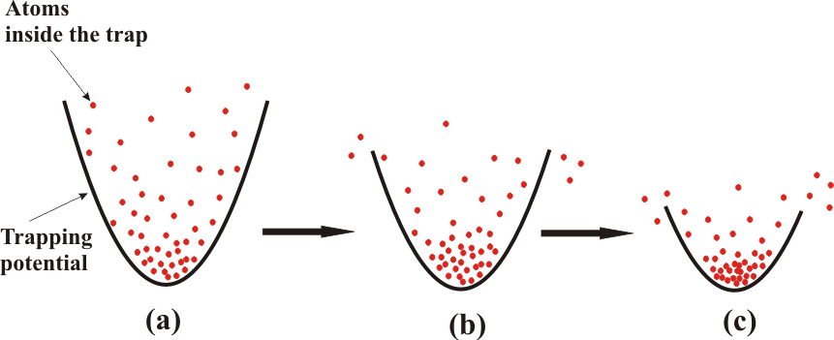
Evaporative Cooling
https://cold-atoms.physics.lsa.umich.edu/projects/bec/evaporation.html
Some atoms escape trap, carrying away energy from remaining atoms
Atoms re-thermalize with each other through collisions
Throughout ~13 second evaporation sequence, adjust trap parameters to optimize gain in phase space density for a given fraction of atoms lost
EP uses magnetic trap, MAGIS uses an optical dipole trap

Slide 5
“Snap up” of Magnetic Trap
Want to rapidly “snap up” current flowing through coils that generate magnetic field for trap after switching off MOT so that atom cloud does not expand too much before trap is on
Inductance of coils poses a challenge to fast switching
Use LC circuit with a pre-charged capacitor to transfer large current into coils on timescale of ~1 ms
Subsequently, power supply takes over
Similarly, can use a separate LC circuit to rapidly “snap off” current through coils when releasing atoms into free space

Slide 6
Atom Lensing
Optics: allow beam to expand and then apply a lens, can trade off larger beam size for smaller angular spread
Analogous idea for atoms: trade off larger cloud size for smaller effective temperature/velocity spread
In EP experiment, first applied magnetic lens
Atom cloud expands against nominally harmonic trapping potential, switch off trapping potential when atoms have expanded to reach turning point in the oscillations
Complications: anharmonicites, gravitational sag in trap which is different for the two isotopes
Optimizing dual isotope lensing was trickier than optimizing single isotope lensing
position
time

Slide 7
Atom Lensing
Dual isotope lensing involved finding an oscillation time and trap parameters for which both isotopes were reasonably close to a turning point in both the radial and vertical size oscillations
Also want vertical velocities of two isotopes to be matched to ease lattice launching
After magnetic lensing, effective temperatures of both isotopes in all dimensions ~ 1 uK
After lattice launch, applied lensing from optical dipole lensing potential, reduced transverse effective temperature to ~250 nK
~1 x 10⁶ atoms per species remain after evaporation
Black: Rb-87, Red: Rb-85

Slide 8
State Preparation
After finished with magnetic manipulations, want to prepare atoms in m_{F} = 0 state to eliminate linear Zeeman shifts during interferometer
Use sequences of microwave pulses
“Blow away” (using resonant light) residual atoms that were not transferred by microwave pulse after pulse

Slide 9
Lattice Launch
Adiabatically load atoms into optical lattice
Accelerate lattice to deliver ~14 m/s vertical velocity kick to atoms
Similar approach used in MAGIS

Slide 10
Bragg vs. Raman Atom Optics
Both are two-photon transitions
Raman: change internal hyperfine state as well as external momentum state
Bragg: internal state stays the same
Both have their own advantages, and we made use of both in EP

Slide 11
Kinematic Overlap of Isotopes
To reduce systematics, want to kinematically overlap two isotopes as well as possible
Velocity overlap: use a long Bragg pulses to select a nearly overlapping vertical velocity slice from the two clouds/isotopes
Position overlap:
Due to different hyperfine splittings, can independently address isotopes with Raman pulses
Use a Raman pulse to give momentum kick to Rb-87 atoms
Allow Rb-87 atoms to move with respect to Rb-85 atoms until two clouds are overlapped in position
Finally, apply Raman pulse to Rb-85 so that velocity matches that of Rb-87 (adjust Raman pulse detuning to fine tune velocity overlap)
Overlapped positions to within <100 um, velocities to within < 100 um/s

Slide 12
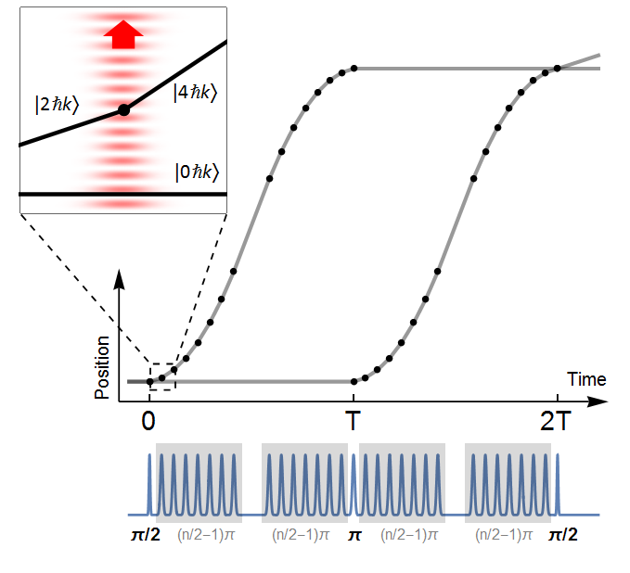
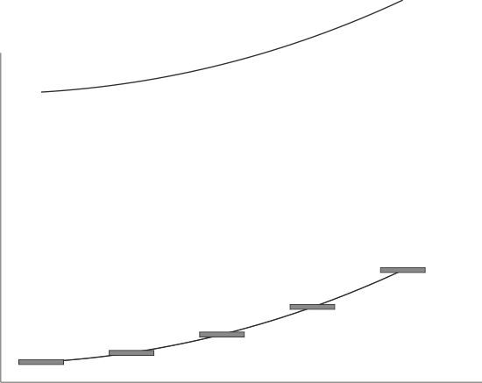
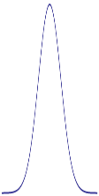
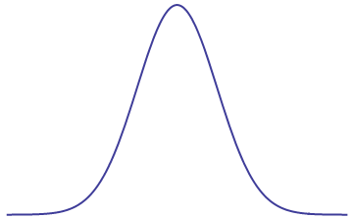
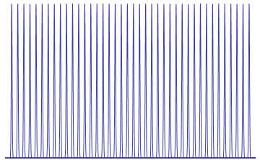
Sequential Bragg Atom Optics
Excited state
Δ=30 GHz
90 ħk
energy
- Need to adjust frequency for each pulse to meet resonance condition
8 ħk
6 ħk
4 ħk
2 ħk
momentum
Intensity
60 μs
time
Notes:
In general, can use different base units for the individual pulses, such as 6 hk.

Slide 13
Tunable Frequency Offset for Gravity Gradient Compensation
Leading systematic/noise source for dual species experiments: initial kinematic offsets between the two species couple to gravity gradient, causes local g experienced by two species to differ
Roura PRL 2017: proposes jumping frequency for middle interferometer pulses
Appropriate choice of frequency jump
compensates gravity gradient phase shift
Overstreet et al., PRL 2018

Slide 14
Gravity Gradient Compensation Results
- Calibrate frequency shift needed to null out sensitivity of differential phase between isotopes to kinematic offsets
- Factor of 100 reduction in phase
shift from coupling of gravity gradient
to initial kinematic offsets
0 MHz
343 MHz
510 MHz
Overstreet et al., PRL 2018

Slide 15
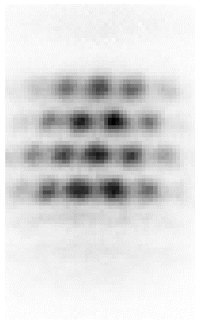
Imaging
Apply resonant light for Rb-85, rapidly brings atoms to rest
Wait 1 ms for Rb-87 atoms to fall to separate part of CCD array
Apply resonant light for Rb-87
Rb-85 and Rb-87
are in phase
Rb-85
2T = 1.8 s
Rb-87

Slide 16
Slow Digital Feedback Loops
Sometimes, would use analog inputs to make measurements of experimental quantities and apply feedback in between experimental shots
Example: stabilization of spectrum of interferometry lasers (ratio between different phase modulation sidebands could be tuned by adjusting temperature of frequency doubling crystal)

