Slide 1



PASAIG-LWFA:
Linear collider based on laser-plasma accelerators
Carl Schroeder
BELLA Center, Berkeley Lab
AF6 Contributed Paper Update Meeting — Feb 15, 2022
Work supported by the U.S. DOE, Office of Science, Office of High Energy Physics, under Contract No. DE-AC02-05CH11231

Slide 2
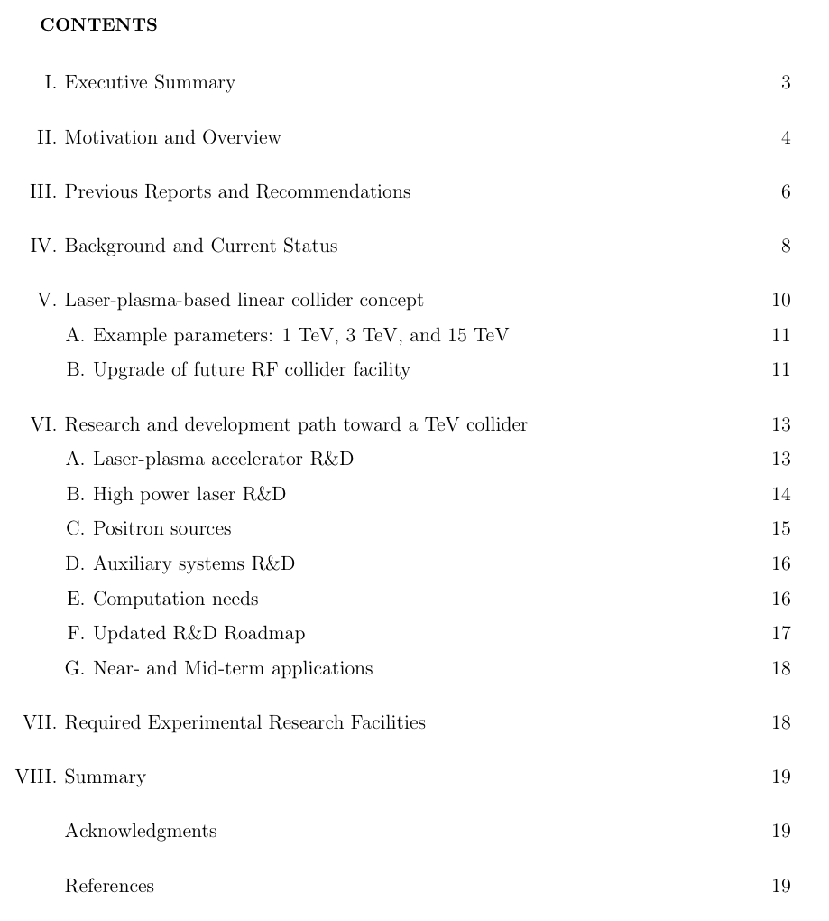
Whitepaper Outline
Exec. Sum. = 1 page
Primary advantages of LWFAs:
  High gradient (>1 GV/m geometric) – compactness
  Short bunches – beamstrahlung reduction = power savings: P ∝ (L)^{1/2}
Use facility (e.g., ILC) infrastructure (tunnel, site power, dump, etc.)
Discuss progress since last P5 & 2015 HEPAP subpanel report
Required R&D to realize LWFA-based TeV-class e+e- collider
Efficient high-power lasers
Staging LWFAs
Positron accel.
Integrated Design Study (IDS) needed
Laser driver whitepaper (L. Kiani)
BDS whitepaper (S. Gessner)
Research facilities required to perform R&D:
  High-average power LWFA demonstration
Near-term application whitepaper
(C. Emma & J. van Tilborg)
Facilities whitepaper (J. Power)
20 pages w/ refs
2

Slide 3
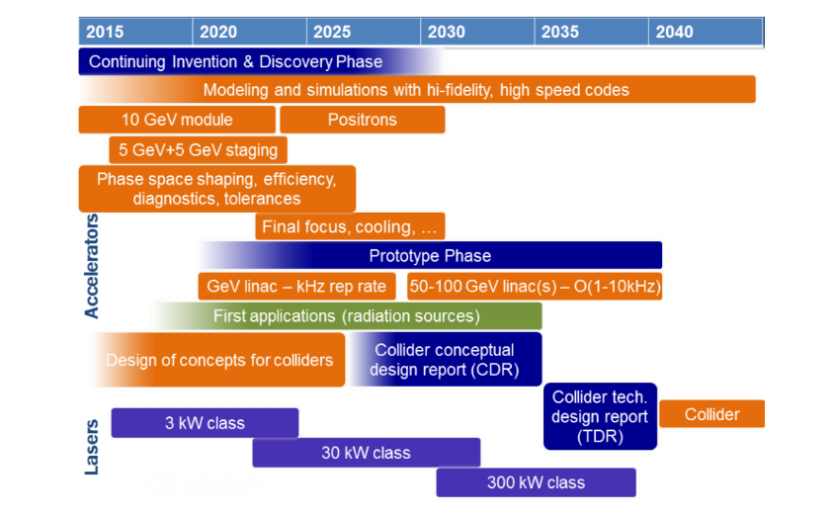
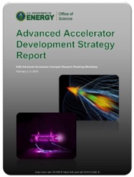
2016 AAC R&D Roadmap
  US AAC community outlined R&D goals in 2016 DOE Report
  Progress has been made on all R&D goals
  Address updated R&D roadmap as part of Snowmass process
DOE HEP Advanced Accelerator Development Strategy Report (2016)
3

Slide 4
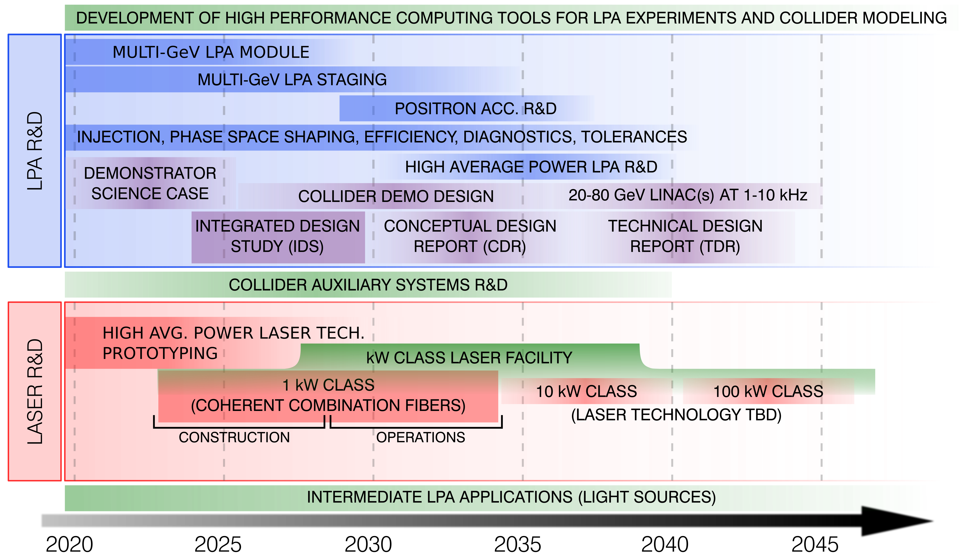
High-level R&D toward a collider (under development)
4

Slide 5
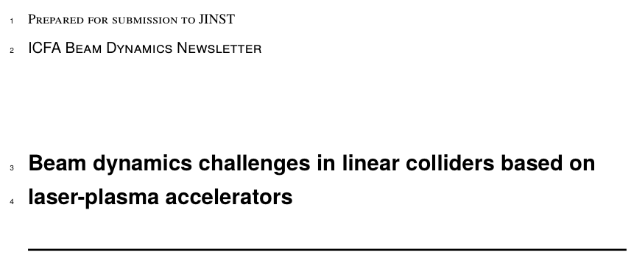
ICFA beam dynamics article submitted
Article submitted to ICFA Beam Dynamics Newsletter – “Beam dynamics challenges in linear colliders based on laser-plasma accelerators”
    Detailed discussion of unique beam dynamics issues using plasma accelerators:
        BBU/hosing – mitigated by ion motion
        Coulomb scattering – mitigated by strong focusing in plasma
        Limits from synchrotron radiation from transverse fields.
5

Slide 6
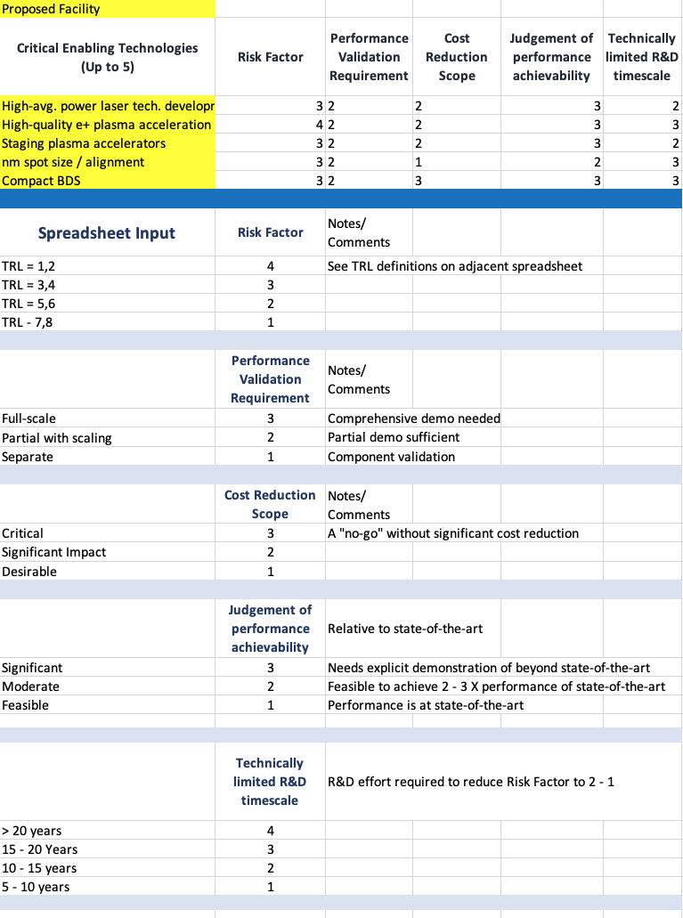
Collaborating with PASAIG: ITF technical risk tables
  In coordination with PASAIG–SWFA and PASAIG– PWFA
    Risk table for LWFA-based collider to be submitted to the Implementation Task Force (ITF)
6

Slide 7
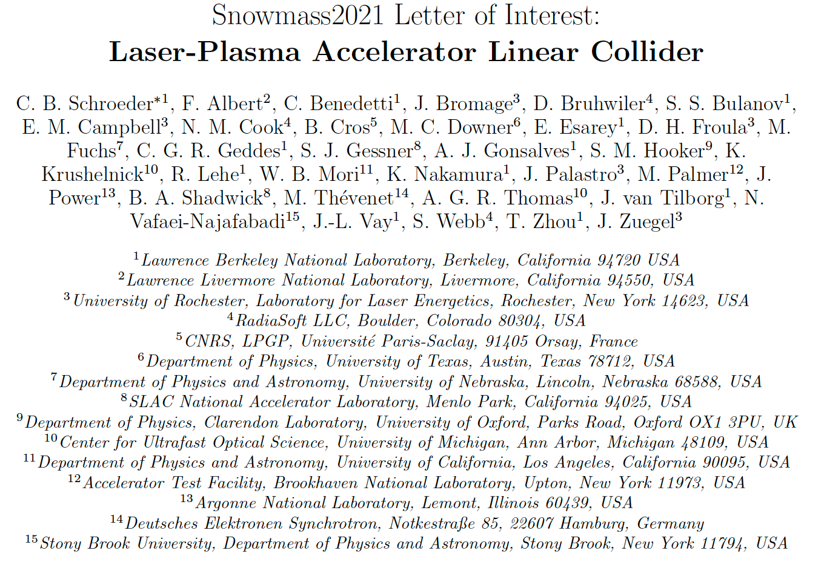
Conclusion / discussion
~20 page white paper “Linear collider based on laser-plasma accelerators”
To do:
  Distribute to broader laser-plasma accelerator community — Letter of Interest (LOI) co-authors & colleagues
  Integrate feedback into whitepaper
7

