Slide 1
72 Hour Summary
Kevin P McDonough
Monday 09:00 Meeting
January 31, 2022

Slide 2
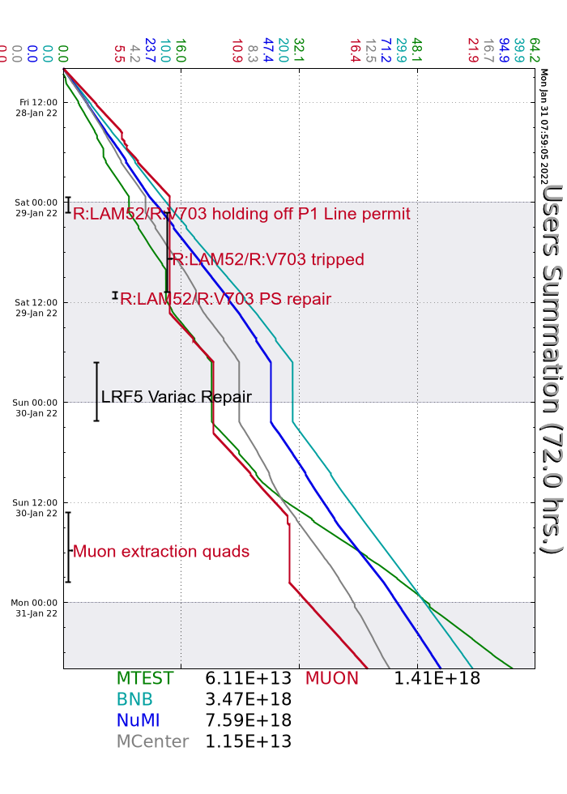
Weekend
Column 3 brought online, Rem System filled
MC1 controlled access at end of shift
Ops accessed the Source A HV cabinet to reset the boiler heater power supply many times over the weekend
R:V703 and R:LAM52 tripped off with Interlock and Magnet Over Temp Faults. had it fixed 11:30. Saturday.
LRF5 tripped off on a Driver Anode Overload. Reset but gradient would not go up. Smell of smoke required a call in to On call and Machine Coordinator.
Linac experts recovered LRF5 at 02:12.Sunday morning.
BRF2 tripped off and would not reset. The Bias Supply had a ground fault. Bypassed it and turned BRF20 in it's place. John Kuharik came in and re-balanced the orbit.
Muon had some power supplies in MC1 /M5 line trip off. They could not get beam to experiment. They have been off ever since. Power supply techs and interlock tech have been here all day.. Fixed a blown 480 volt fuse.
Beam to Munon by 21:35 Sunday
Beam tuning all weekend..
Current conditions:
Beam to NUMI and BNB. Beam to Meson Experiments when available.

