Slide 1
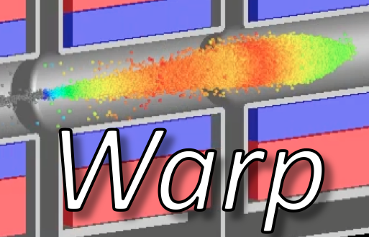
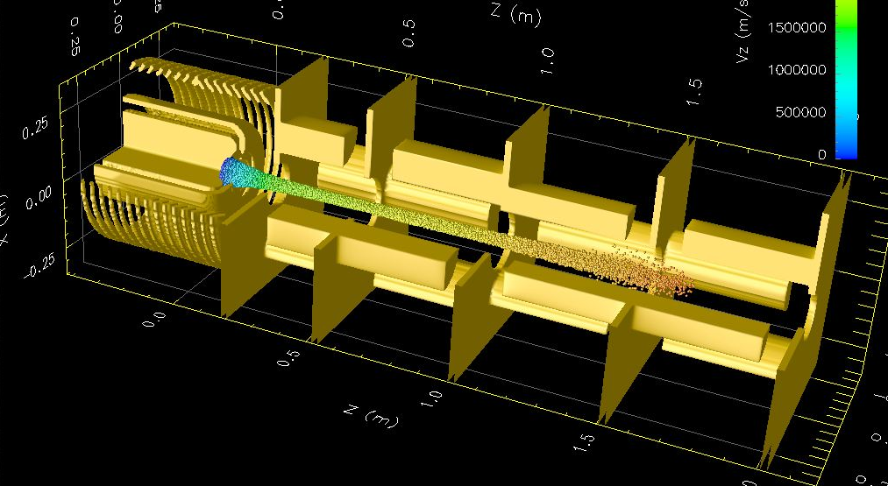
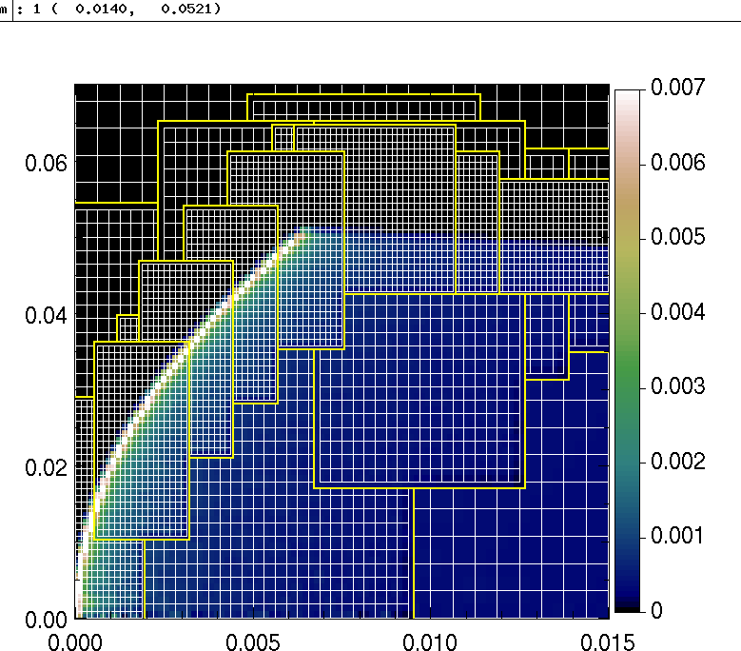
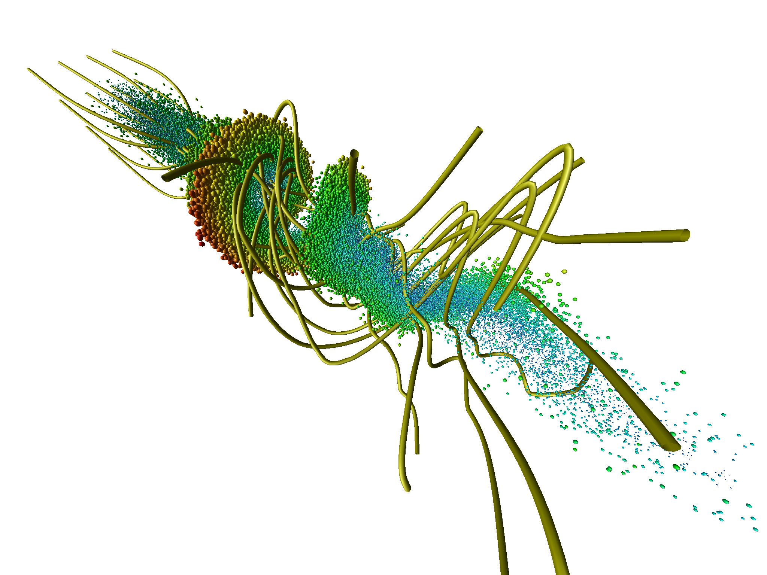
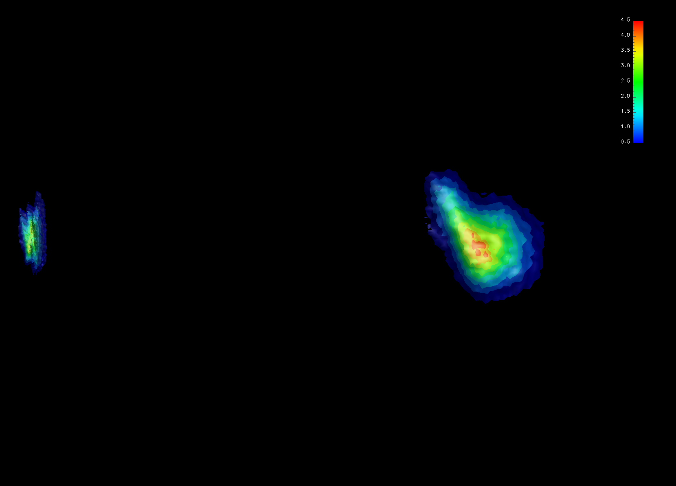
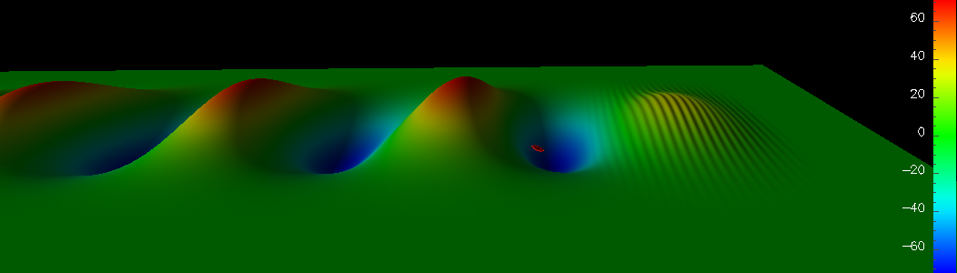
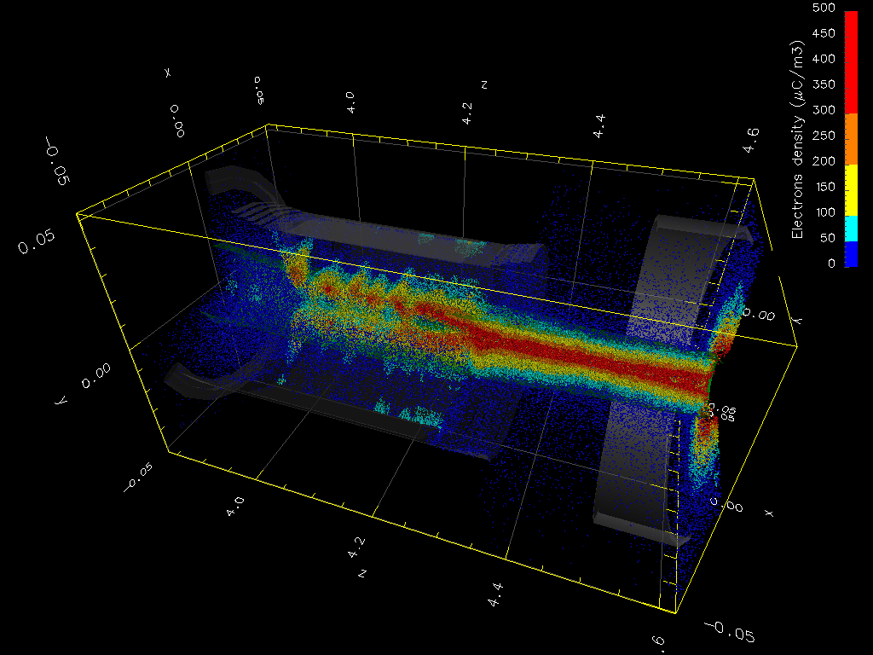
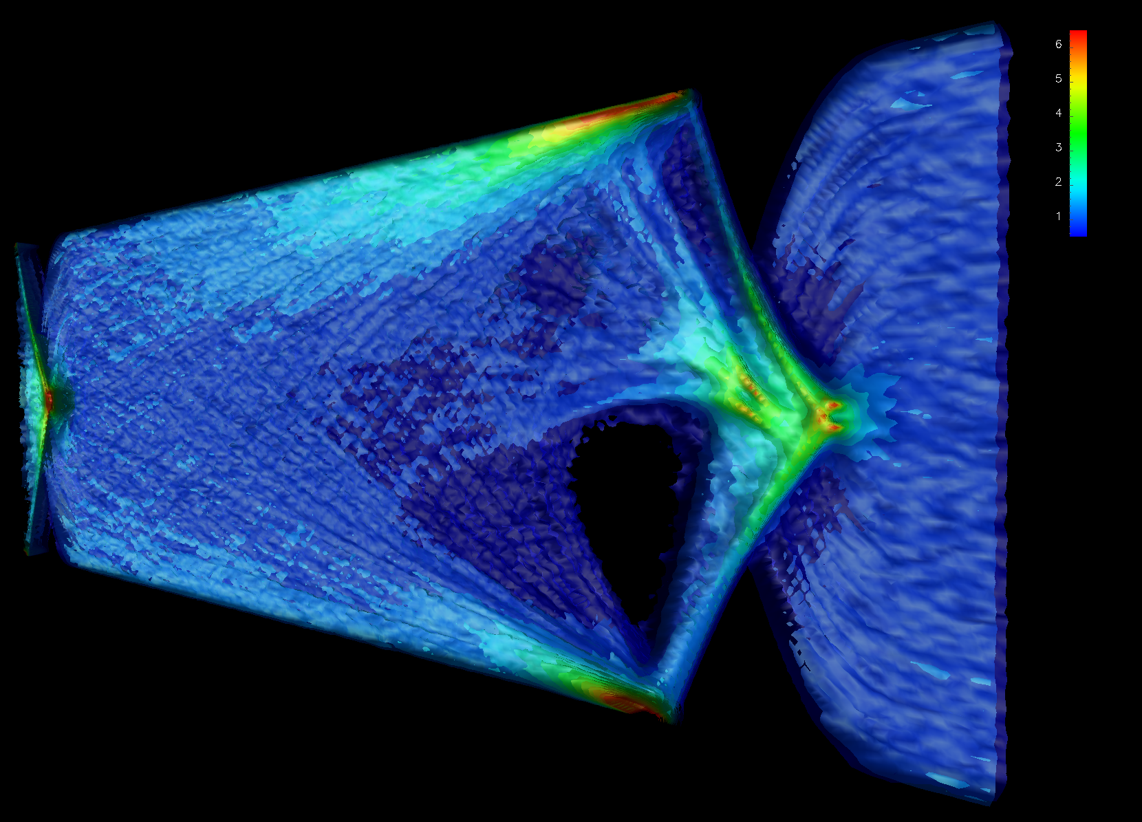
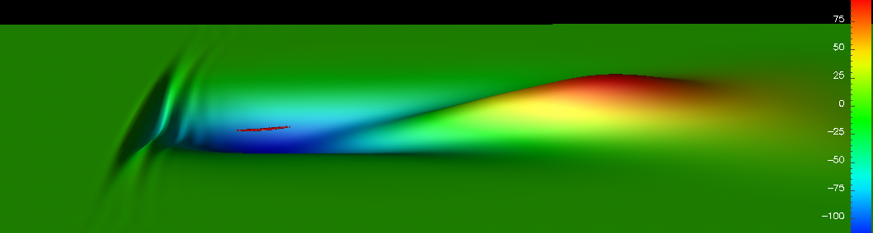



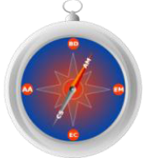

The Particle-In-Cell Framework Warp
D.P. Grote
Lawrence Livermore National Laboratory, CA, USA
J.-L. Vay
Lawrence Berkeley National Laboratory, CA, USA
R.H. Cohen, A. Friedman
Lawrence Livermore National Laboratory, CA, USA
I. Haber
U. Maryland, MD, USA
2012 Project X Collaboration Meeting
10-12 April 2012 Lawrence Berkeley National Lab
The Heavy Ion Fusion Science Virtual National Laboratory
SciDAC-II
Compass

Slide 2
Outline
Warp overview
  origins (Heavy Ion Inertial Fusion)
  geometry, particle pushers, field solvers, etc
Extra Features
  Ionization
  Interactivity
  Visualization
Summary

Slide 3
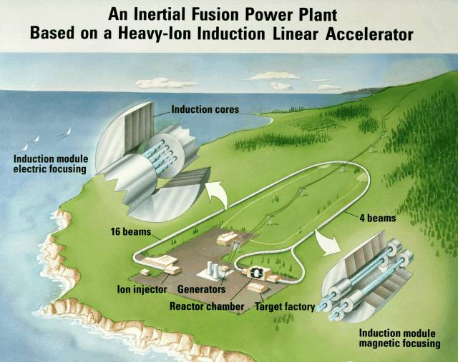
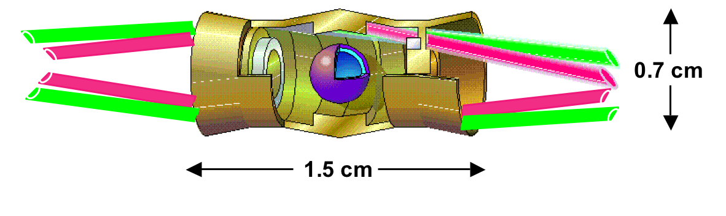
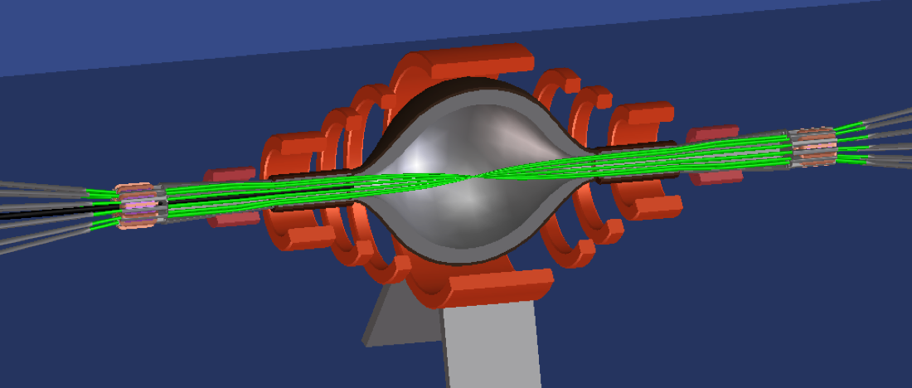
Goal of Heavy Ion Inertial Fusion (HIF) program is to develop an accelerator that can deliver beams to ignite a D+T target
Artist view of a
Heavy Ion Fusion driver
D+T
Target requirements:
3-7 MJ x ~ 10 ns ⇒ ~ 500 Terawatts
Ion Range: 0.02 - 0.2 g/cm² ⇒ 1-10 GeV
dictate accelerator requirements:
A~200 ⇒ ~10¹⁶ ions, 100 beams, 1-4 kA/beam
…or perform High-Energy Density Physics (HEDP) studies.

Slide 4
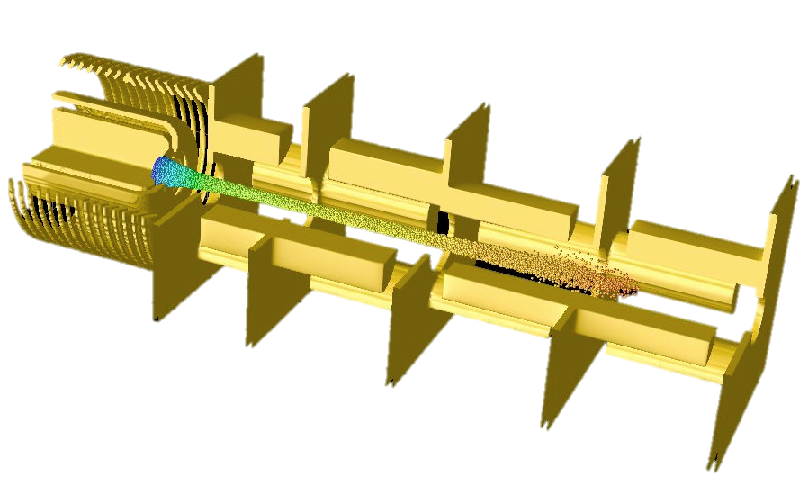
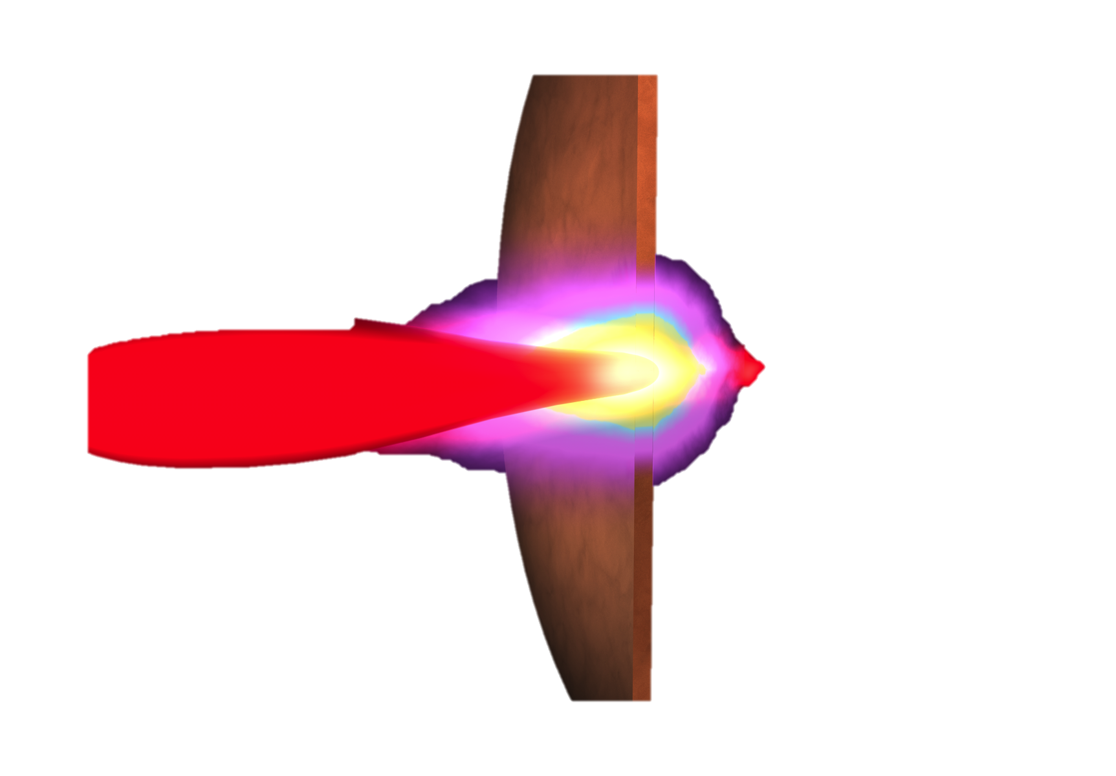
Simulation goal - predictive capability for HIFS
End-to-End 3-D self-consistent time-dependent simulations of beam
including:
  acceleration, focusing and compression along accelerator,
  Particle loss at walls, interaction with desorbed gas and electrons, halo
  neutralization from plasma in chamber.
from source…
…to target

Slide 5
Challenging, as time and length scales span a wide range
(8 orders of magnitude)
Time scales:
depressed betatron
betatron
τ
pb
≈
electron drift out of magnet
transit thru fringe fields
lattice
electron cyclotron in magnet
period
beam residence
pulse
log (seconds)
-12
-11
-10
-9
-8
-7
-6
-5
-4
Length scales:
electron gyroradius in magnet
beam radius
machine length
λ_{D,beam}
log (meters)
-5
-4
-3
-2
-1
0
1
2
3

Slide 6
Warp workflow
is based on standard Particle-In-Cell loop
Push particles
Add external forces
Absorption/Emission
Gather forces
Deposit charge/current
Filtering
Filtering
Field solve
+ external forces for accelerator elements
+ absorption/emission for injection, loss at walls, secondary emission, ionization, etc.
+ optional filtering of charge/currents and potential/fields

Slide 7
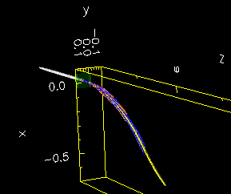
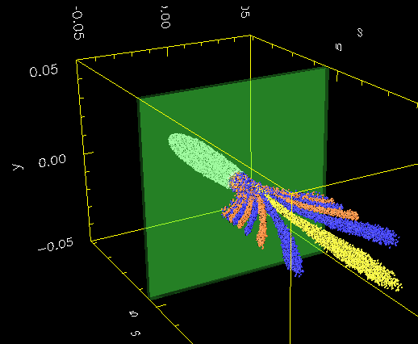
Geometry and reference frames
Geometry: 3-D (x,y,z) axisym. (r,z) 2-D (x,z) 2-D (x,y)
Reference frame: lab moving-window boosted
        Z z-vt γ(z-vt); γ(t-vz/c²)
Bends: “warped” coordinates (no “reference orbit”)
see A. Friedman, D. P. Grote, and I. Haber, Phys. Fluids B 4, 2203 (1992)
x
y
z
Example: beam stripping through a foil & charge selection in a chicane.
Lab frame view
Warp frame view
Foil
Q=+1
Q=+1
Q=+3
s
Q=+2

Slide 8
Particle pushers
Boris pusher is the default (push position x and massless momentum u=γv):
  Position push:
  Velocity push:
Improved rotation angle correction “tan(α)/α” available
Two variations are used for pushing the massless moment:
  for ultra-relativistic particles (for good cancellation of self E and v×B),
  for magnetized electrons (for taking large time steps > cyclotron period).

Slide 9
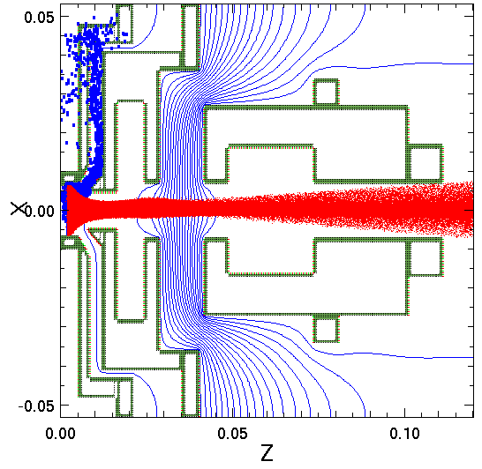
Main code is Warp - a parallel framework combining features of plasma (Particle-In-Cell) and accelerator codes
Field solvers:
Electrostatic and Magnetostatic
- FFT, multigrid, AMR; implicit
Electromagnetic
- Yee mesh, PML, MR
Boundaries: “cut-cell” --- no restriction to “Legos”
Lattice: general; non-paraxial; can read MAD files
  solenoids, dipoles, quads, sextupoles, linear maps, arbitrary fields, acceleration
R (m)
Adaptive meshing around HCX ion beam source emitter from Warp (r,z) simulation
Z (m)
Modeling of injector
Versatile conductor generator accommodates complicated structures
Applies to Poisson solve and particle loss

Slide 10
Warp has a steerable, interactive interface
Python on top and Fortran underneath
  Python provides a high-level user interface
    It has a clean syntax, designed for clarity
    There is a large selection of standard packages available
  Compiled Fortran for fast computations
  Forthon (http://hifweb.lbl.gov/Forthon) connects the Python and Fortran
Steerable – input decks are main programs, controlling simulation progress
Interactive – Python gives the user a prompt
  Full access to run-time database
  Allows steering by hand, diagnostics on the fly
from warp import *
…
nx = ny = nz = 32
dt = 0.5*dz/vbeam
…
generate()
step(zmax/(dt*vbeam))
…
Import Warp modules and routines in memory
Sets # of grid cells
Sets time step
Initializes internal Fortran arrays
Push particles for N time steps with Fortran routines

Slide 11
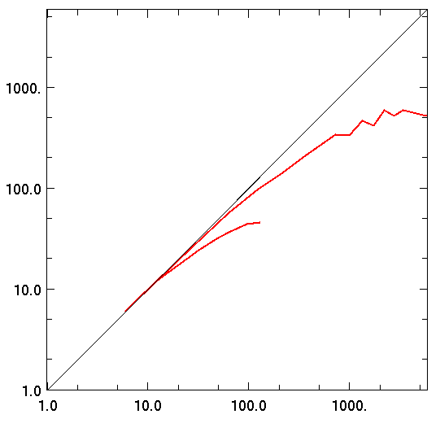
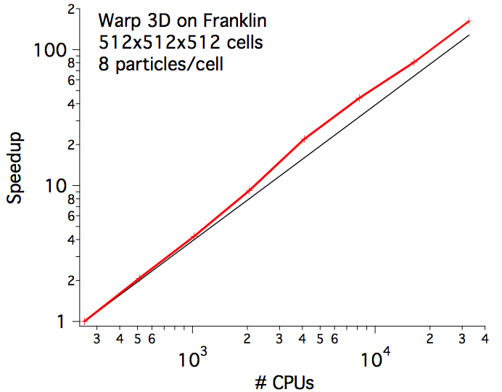
Warp is a parallel code
Parallel
    MPI (1, 2 and 3-D domain decomposition)
Parallel interactivity available
Good scaling seen
Parallel scaling of Warp 3D
ES solver on Hopper supercomputer (NERSC)
Global solve limits scaling
Parallel scaling of Warp 3D
PIC-EM solver on Franklin supercomputer (NERSC)
Good scaling since operations local
512x512x512 cells
Speedup
3-D
1-D
# CPUs

Slide 12
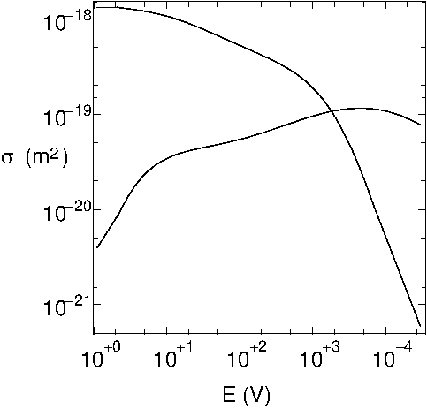
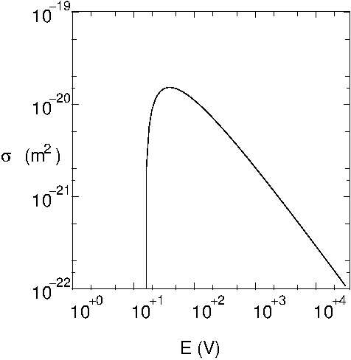
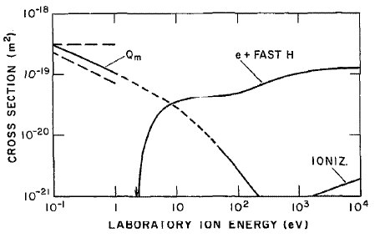
Ionization, with energy dependent cross sections
Being further developed to support PXIE
Includes multiple interactions
For example:
  Charge exchange H⁻ + H ➔ H + H⁻
  Detachment H⁻ + H₂ ➔ H + H₂ + e⁻
  Ionization e⁻ + H₂ ➔ H₂⁺ + 2e⁻
  Ionization H⁻ + H₂ ➔ H⁻ + H₂⁺ + e⁻
Resulting H⁻, H₂⁺ and e⁻ included in the
simulation
If H and H₂ include, density can be obtained
from the simulated particles
From Aladdin cross section database
http://www-cfadc.phy.ornl.gov/home.html
NIST Electron impact cross sections
http://physics.nist.gov/PhysRefData/Ionization/Xsection.html
Via TxPhysics library
A. V. Phelps, J. Phys. Chem. Ref. Data, 19, 653(1990).

Slide 13
Visualization
Python access to OpenDX visualization library
Chopper
Solenoid
Beam dump
H⁻ H₂⁺ e⁻

Slide 14
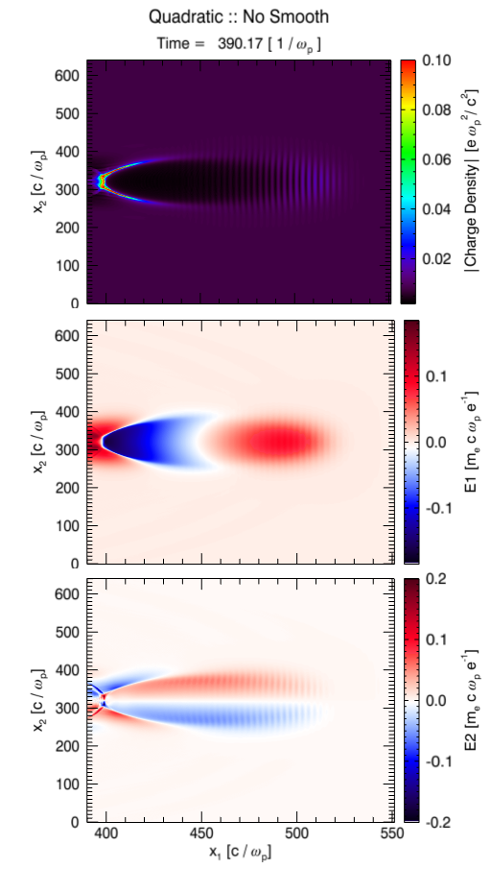
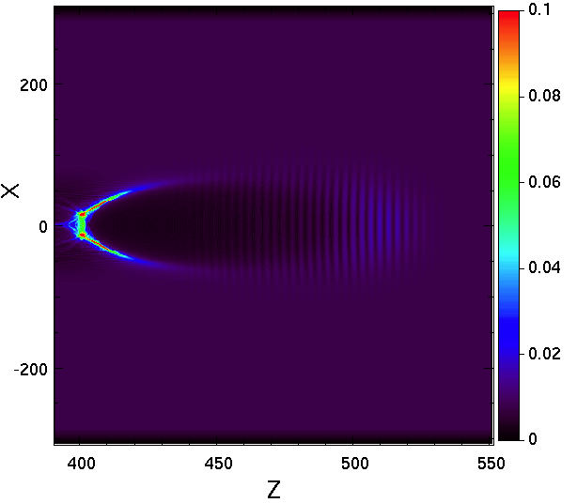
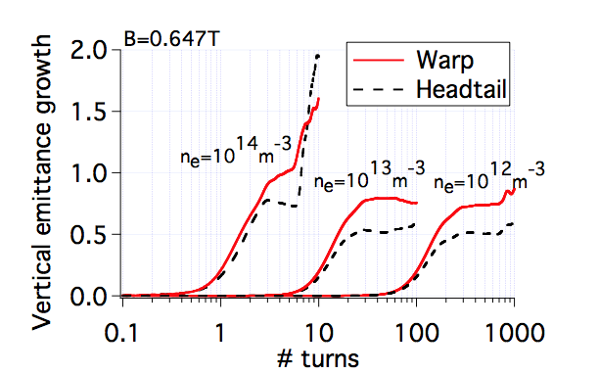
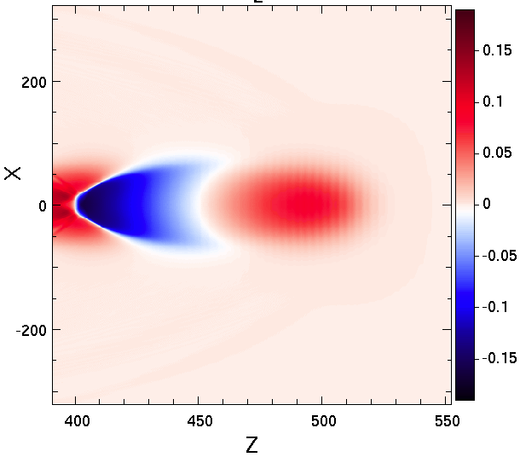
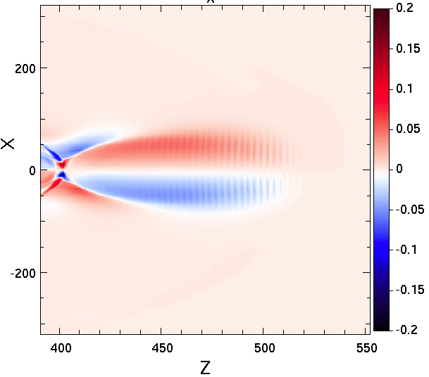
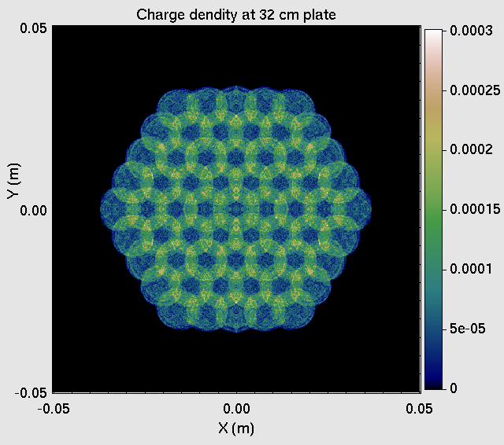
Warp benchmarked against experiment and other codes
Longitudinal dynamics on UMER experiment
(Tim Koeth, U. Maryland)
Laser plasma simulation (J. L. Vay)
Osiris
Warp
E-cloud simulation for LHC (J. L. Vay)
(Dipole)
Beamlet merging experiment (D. P. Grote)
Foil focusing Simulations
(S. M. Lund, R. Cohen
Simulation result
Experiment data
Warp - solid
Theory - dashed
7.2 cm
7.2 cm
original cluster size
150 kV, RF 5.0 kV,
sup -5 kV

Slide 15
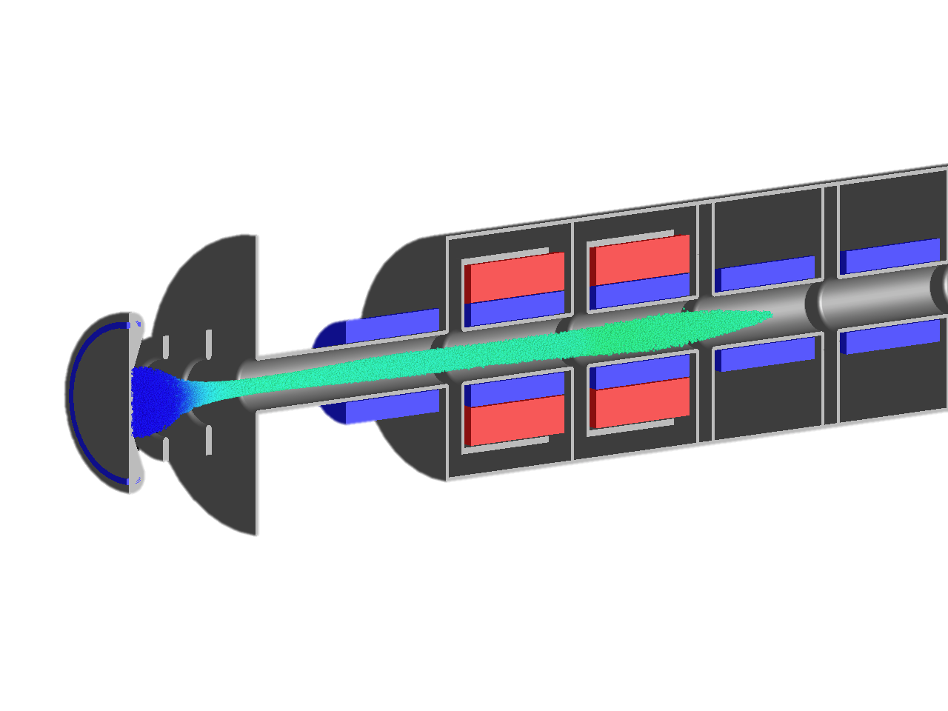
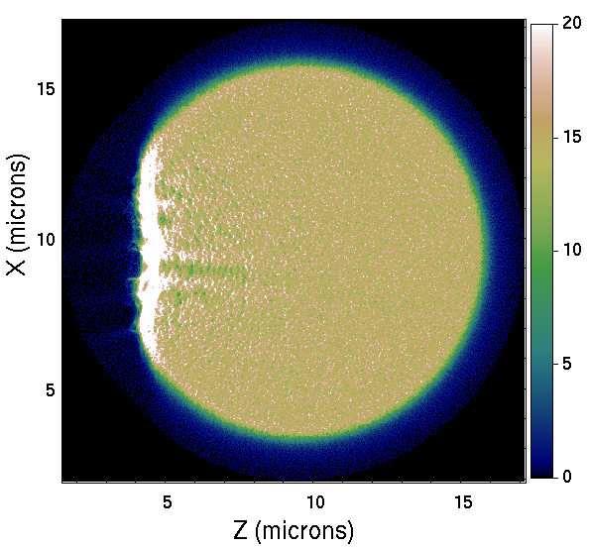
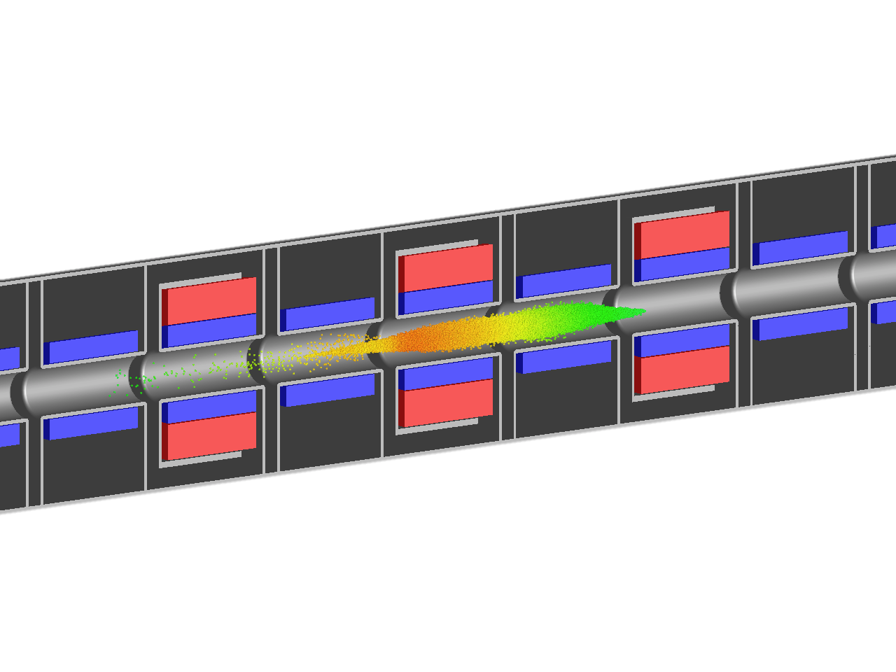
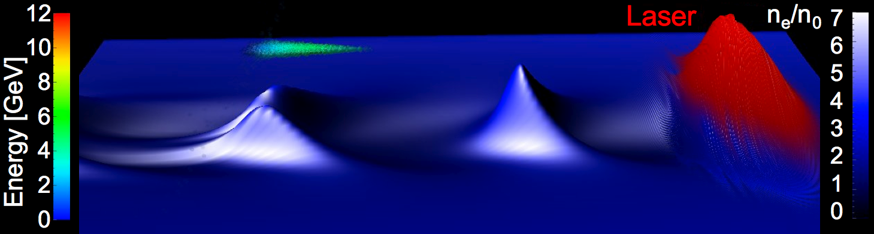
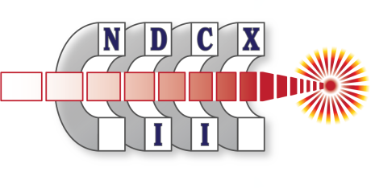

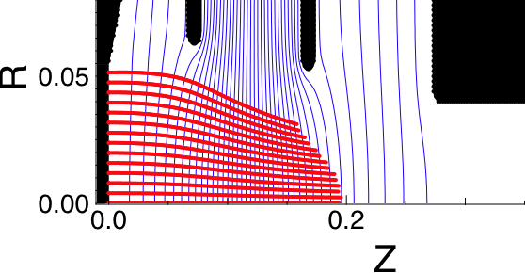
Warp versatile programmable framework allows great adaptability
Standard PIC
Moving window
Laboratory frame
Boosted frame
Example:
Beam generation & transport
Example: Fast ignition
Example:
Laser plasma acceleration
laser
Non-standard PIC
Steady flow
Quasi-static
Example: Injector design
Example: electron cloud studies
2-D slab of electrons
p+ bunches
Markers
s
e- clouds
3-D beam
SPS - CERN

Slide 16
Summary
Warp developed in HIF program
  Designed for space-charge dominated beams
  Other related capabilities have been added
Warp designed for flexibility
  Can handle wide range of beam manipulations and interactions
  Python interface gives users complete control of simulation
Warp is well suited to modeling the LEBT
  High current
  3-D beam manipulations
  Ionization events
  and the resulting 3-D, nonlinear space-charge

Slide 17
Extra slides

Slide 18
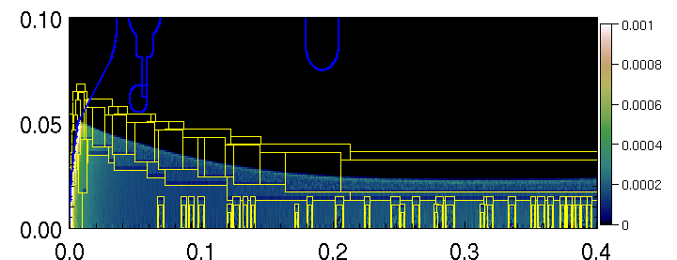
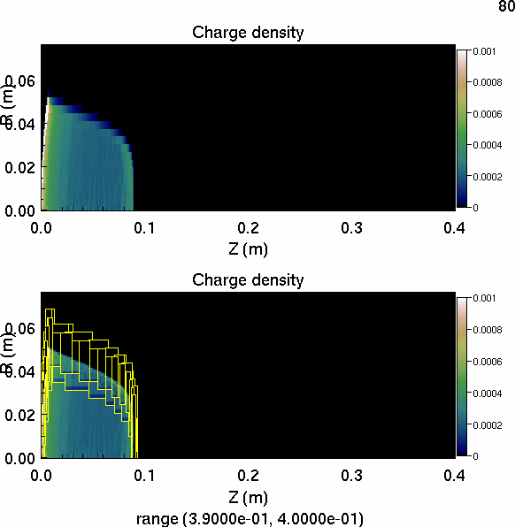
Electrostatic AMR simulation of ion source: speedup x10
Run | Grid size | Nb particles
Low res. | 56 x 640 | ~1M
Medium res. | 112 x 1280 | ~4M
High res. | 224 x 2560 | ~16M
Low res. + AMR | 56 x 640 | ~1M
R (m)
zoom
R (m)
Z (m)
1
.
0
Low res.
Medium res.
High res.
Low res. + AMR
0
.
8
Emittance (mm.mrad)
0
.
6
0
.
4
Z (m)
Z (m)
0
.
2
Automatic mesh refinement follows gradients:
emitting area, beam edge and front.
0
.
0
0
.
1
0
.
2
0
.
3
0
.
4
Z
(
m
)

Slide 19

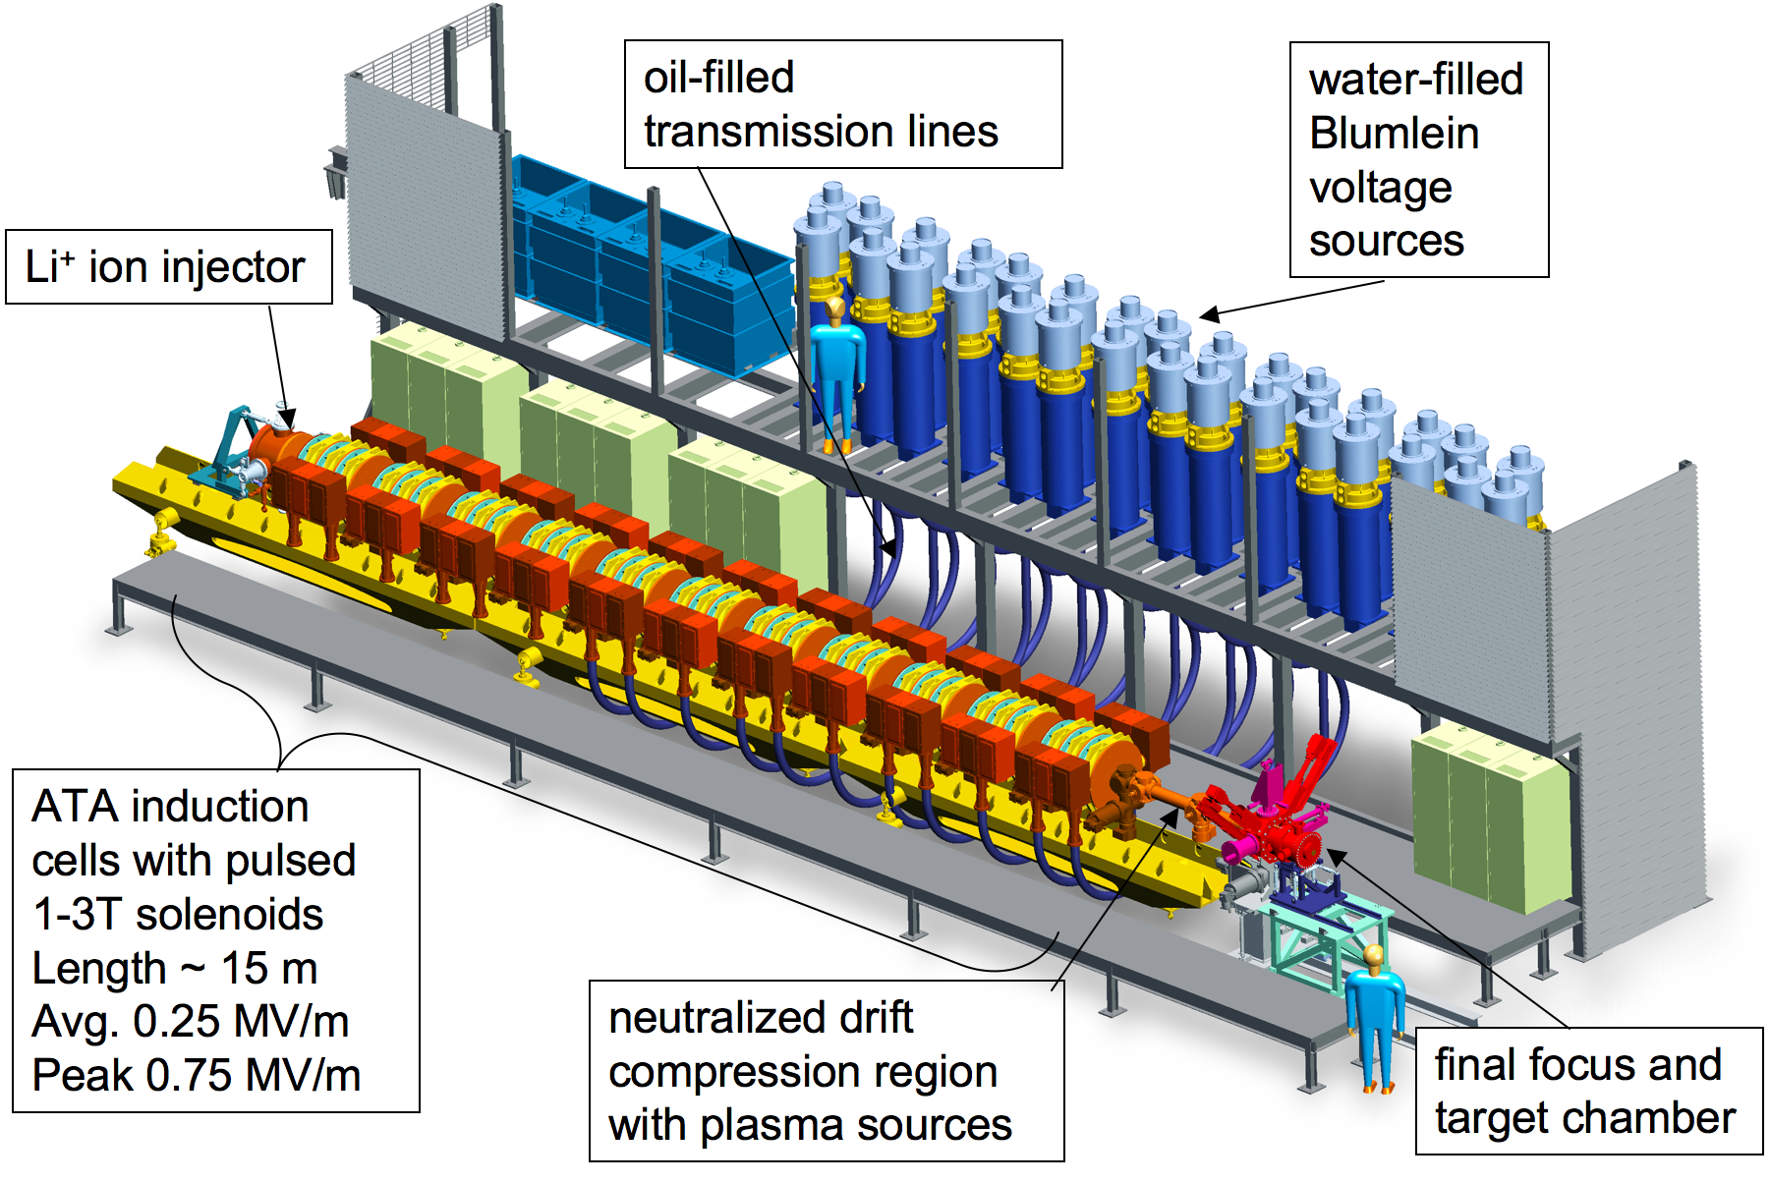
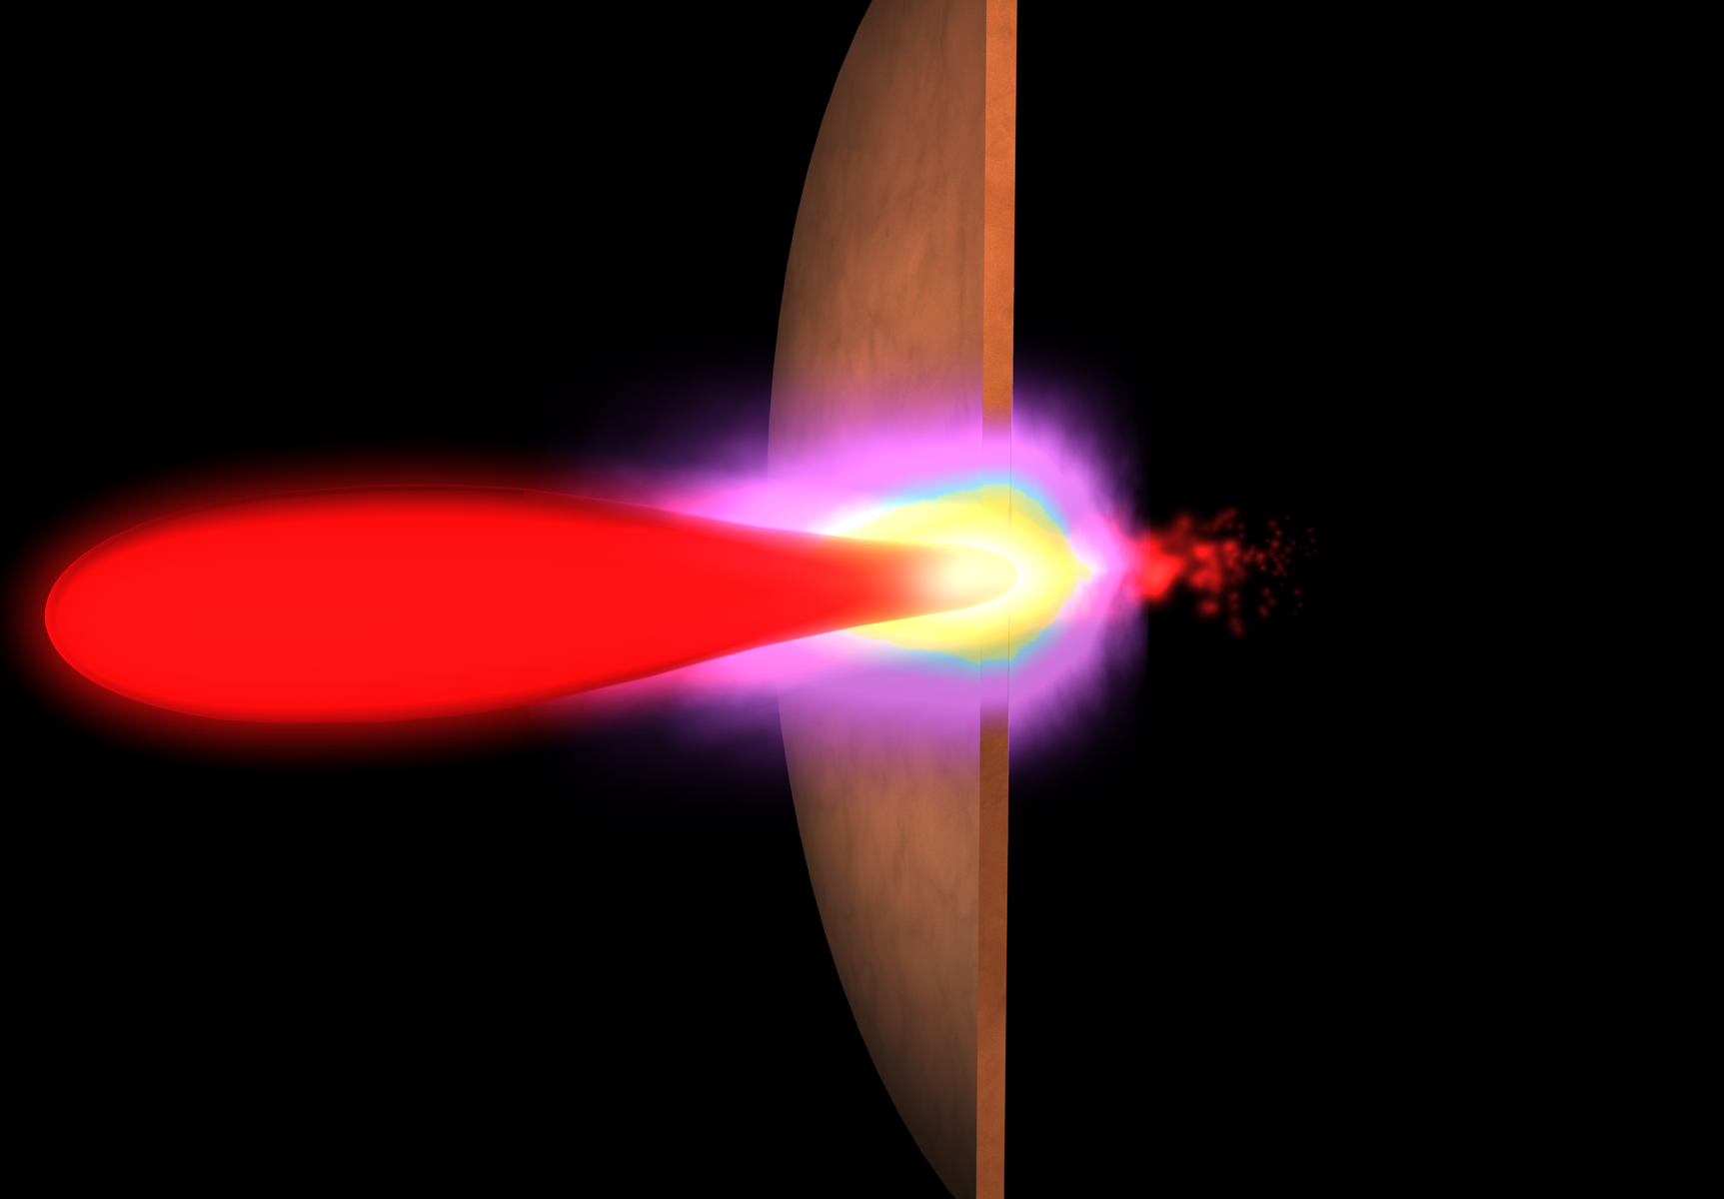
NDCX-II, A Short-pulse Ion Beam Driver for Near-term WDM and Target Physics Studies is under construction
NDCX-II will enable studies of warm dense matter…
LITHIUM ION BEAM BUNCH (ultimate goals)
Final beam energy: > 3 MeV
Final spot diameter : ~ 1 mm
Final bunch length : ~ 1 cm or ~ 1 ns
Total charge delivered: ~ 30 nC
TARGET
μm foil or foam
…and key physics for ion direct drive.
30 J/cm² isochoric heating
→ aluminum temperature ~ 1 eV
Exiting beam available
for measurement

