Slide 1
PX Chopper Driver Development at SLAC
Tao Tang

Slide 2
Outline
MEBT Chopper driver requirements
Hybrid Switch Module (HSM)
Development plan
Development update

Slide 3
PX chopper driver requirement
Driver load impedance: 200 ±5 Ohm
Flattop voltage: >550 V (assuming 90% plate efficiency)
Base voltage for passing bunches: 0±25 V
Frequency of incoming bunches 162.5 MHz
Flattop voltage duration: ≥1.4 ns
Passing bunch duration: ≥1.4 ns
Average (maximum) frequency of switching cycles, averaged over a 1μs interval: 33 MHz
Coupling: DC
Input level LVDS or PECL

Slide 4
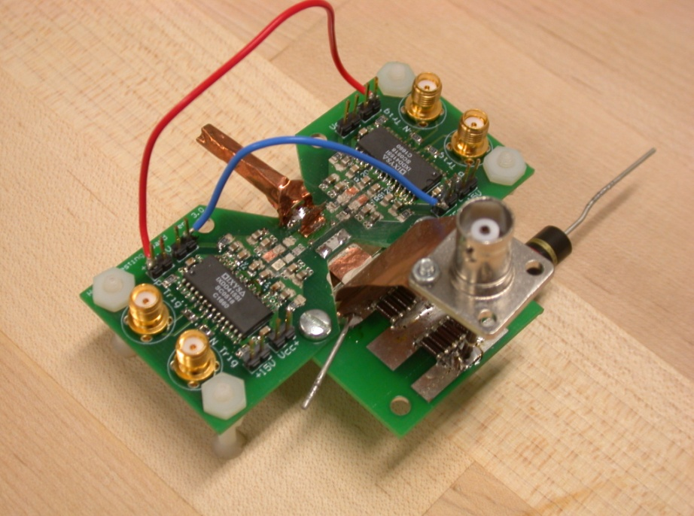
Hybrid Switch Module (HSM)
Hybrid FET/driver
Developed for ILC DR
Ultra-fast switching
  Turn on ~1 ns
  Turn off α RC_{OSS}
Select FET for load
  1.2 kV max
  35 A max
Limitations
  Stability, pseudo linear regime
  Average power

Slide 5
MEBT Chopper Driver Development Plan
Test of new HSM for switching speed and average power
  New PCB material and flip chip technique
  Long pulse width (~15ns) fixed frequency operation
  Test new totem pole scheme and Rise and fall time
  Initial investigation on average power consumption (33MHz)
  Simulation for MOSFET driver development
MOSFET driver development
  Interface with low level electronics
  Targeting short pulse width (5ns base to base) and high frequency arbitrary pattern operation
  Test with capacitive load and the HSM from previous step
Integration of MOSFET driver into new HSM
  Variable pulse width operation
  Short pulse width operation

Slide 6
SLAC PX Chopper Driver Development Team
HSM Development
  Tao Tang
MOSFET Driver development
  Dan Van Winkle
External Vendor
  Decapusulation: EAGLabs (SF bay area)
  Ceramic PCB: Hybrid-Tek (New Jersey)
  Flip-Chip assembly: FastSemi (Anaheim, CA)

Slide 7
Circuit Diagram
Totem pole structure

Slide 8
MOSFET Selecting
Broaden the MOSFET selection
  Most MOSFETs are available in die form with ~20 weeks lead time
  Decapusulation packaged MOSFET for prototyping
  Small MOSFET for low C_{oss} loss
NMOS: FQP2N60C
  600V_{ds}, 4.7Ω R_{dson}, 2A,C_{oss} 20pF
  Die Size: 2.6x2.0mm
  Power loss at 33MHz: 102W
  No exact SPICE model → Modify model for FQP1N60C
PMOS: FB1P50TM
  500Vds, 10.5 Ω R_{dson}, 1.5A,C_{oss} 40pF
  Die size: 2.44x2.38mm
  Power loss at 33MHz: 140W

Slide 9
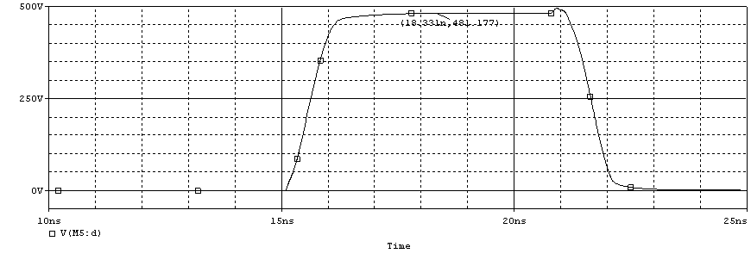
Simulation results
Rise time: 0.86ns
Charging voltage: 500V
Eloss per pulse
  NMOS: 3.1uJ
  PMOS: 4.3uJ
Fall time: 0.79ns
Output voltage: 480V
Power loss at 33MHz
  NMOS: 102 W
  PMOS: 142 W

Slide 10
New PCB
ALN or Al2O3 for high power and temperature operation
  1.5”x1”
Flip chip with high temperature solder
Use dies retrieved from packaged device
  Removal leftovers of bonding wire
  Clean up required
  Convert Al pad to other metal for solder attaching
Design to use as testing load for MOSFET driver

Slide 11
Development progress
Funding for CY12 received early March.
Schedule:
  Test of new HSM for switching speed and average power (Mid May 2012)
  MOSFET driver development (July 2012)
  Integration of MOSFET driver into new HSM (Mid Nov 2012)
Overall progress: 25%
Overall expending: 27%

Slide 12
Question and Discussion

Slide 13
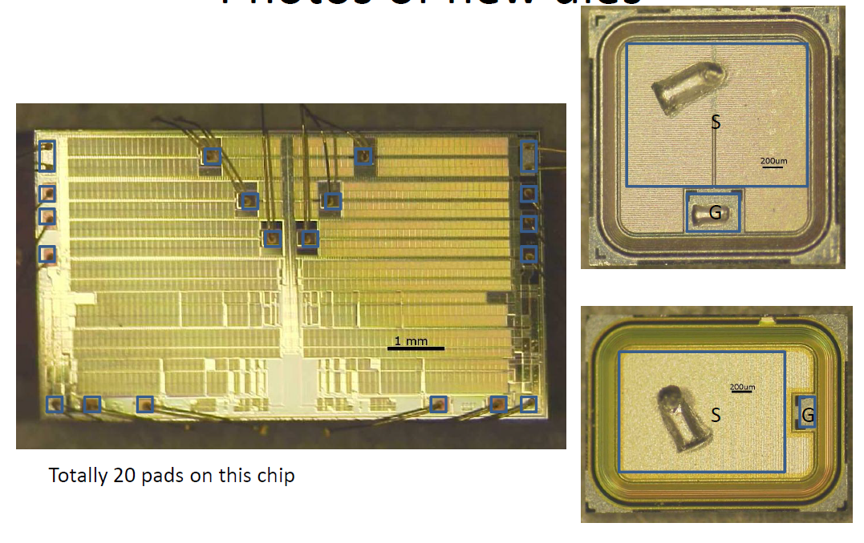
MOSFET Decapsulation

Slide 14
New PCB

