Slide 1
Main couplers for Project X
S. Kazakov
04/11/2012

Slide 2
Requirements to Project X couplers
Cavity SSR1 (325MHz):
Max. energy gain - 2.1 MV,
Max. power , 1 mA case - 4.2 kW,
Max. power , 5 mA case ~ 11 kW
Cavity SSR2 (325MHz):
Max. energy gain - 4.4 MV
Max. power ,1 mA case - 4.4 kW,
Max. power , 5 mA case ~ 22 kW
325 MHz coupler has to provide reliable operation at power level of ~ 30 kW, CW
Cavity LE650 (650MHz):
Max. energy gain - 11.2 MV,
Max. power , 1 mA case - 25.2 kW,
Max. power , 5 mA case ~ 56 kW
Cavity LE650 (650MHz):
Max. energy gain - 17.3 MV,
Max. power , 1 mA case - 24.5 kW,
Max. power , 5 mA case ~ 87 kW
650 MHz coupler has to provide reliable operation at power level of ~ 100 kW, CW

Slide 3
Cryo-losses:
Cryo- loss of SSR1: 0.3 W – 2.2 W
Cryo loss of SSR2: 5.6 W – 7.3 W
Quench power flow limit of 2K coupler input flange > 1W
Requirement for 325 MHz coupler: power flow to 2 K < 1W
Cryo- loss of LE650: 14.6 W – 24 W
Cryo loss of HE650: 24 W
Quench power flow limit of 2K coupler input flange ~ 0.7W
Requirement for 650 MHz coupler: power flow to 2 K < 0.5W

Slide 4
Design approaches:
325 MHz couple has to have 3’’ output coaxial to fit existing SSR1 cavity
As much as possible of common parts/technologies for both types of couplers, 325MHz and 650 MHz
Single warm window
Vacuum part is simple as possible (no bellows; if possible, no coating)
Coupler vacuum part is assembled with cavity in clean room and then installed in cryomodule
Impedance of coupler coaxial has to be as much as possible to reduce dynamic cryo-losses and shift multipactor threshold
Possibility to apply HV bias to suppress multipactor
Cooling media is air

Slide 5
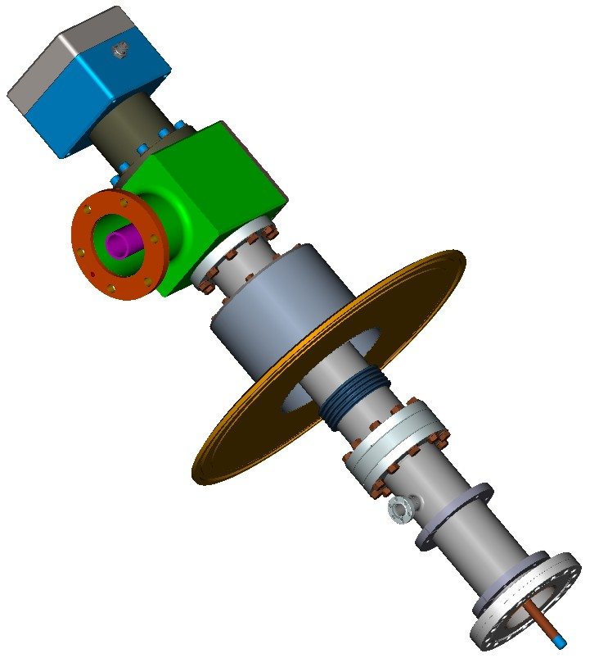
View of 325 MHZ coupler

Slide 6
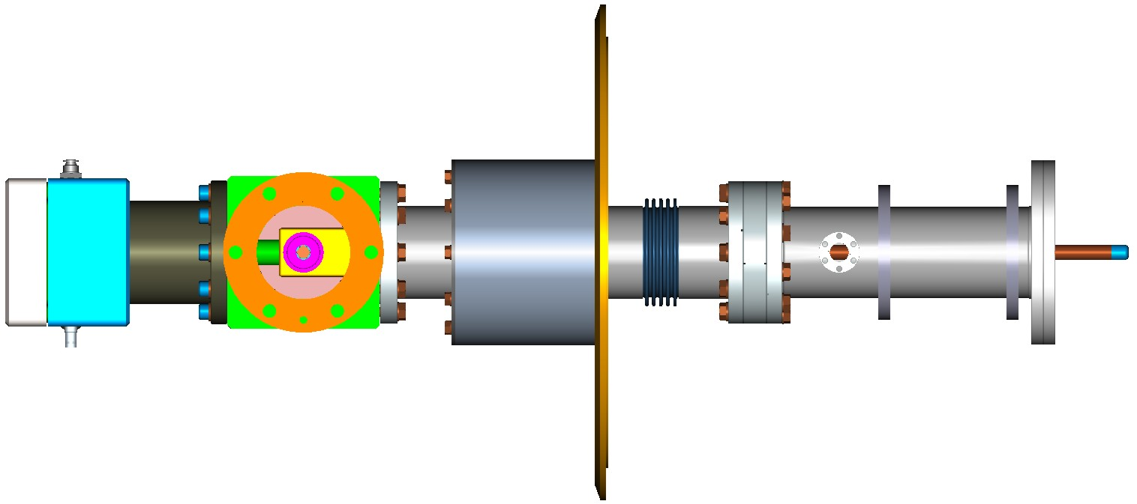
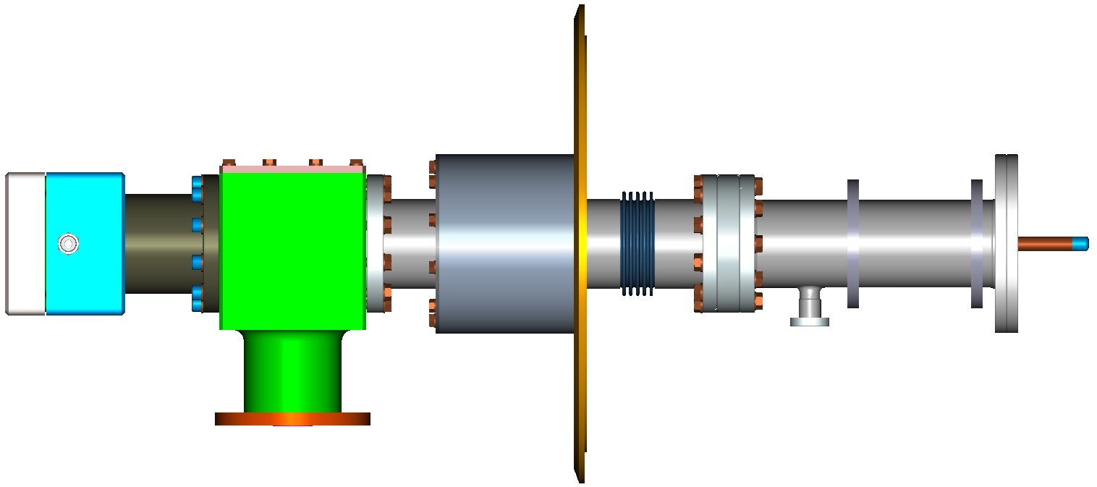
Views of 325 MHz coupler

Slide 7
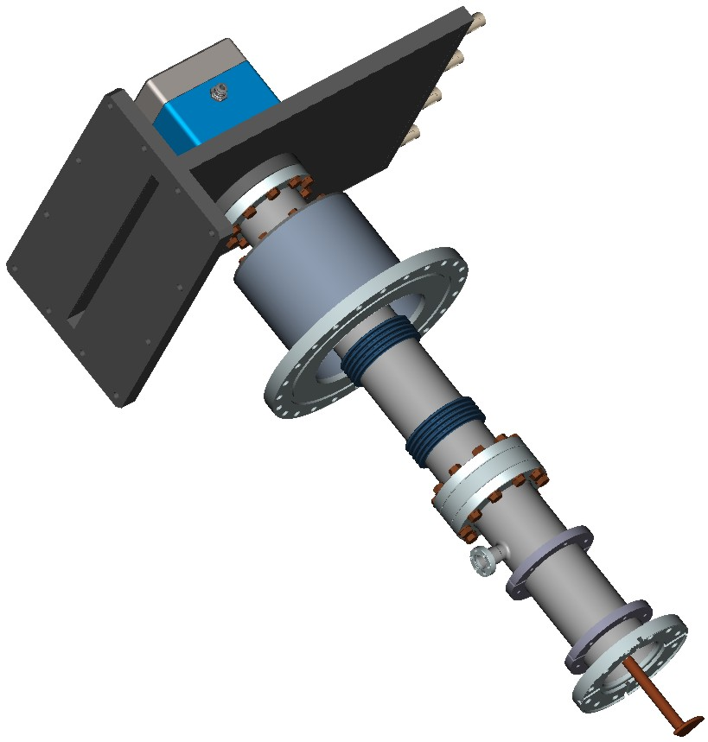
View of 650 MHZ coupler

Slide 8
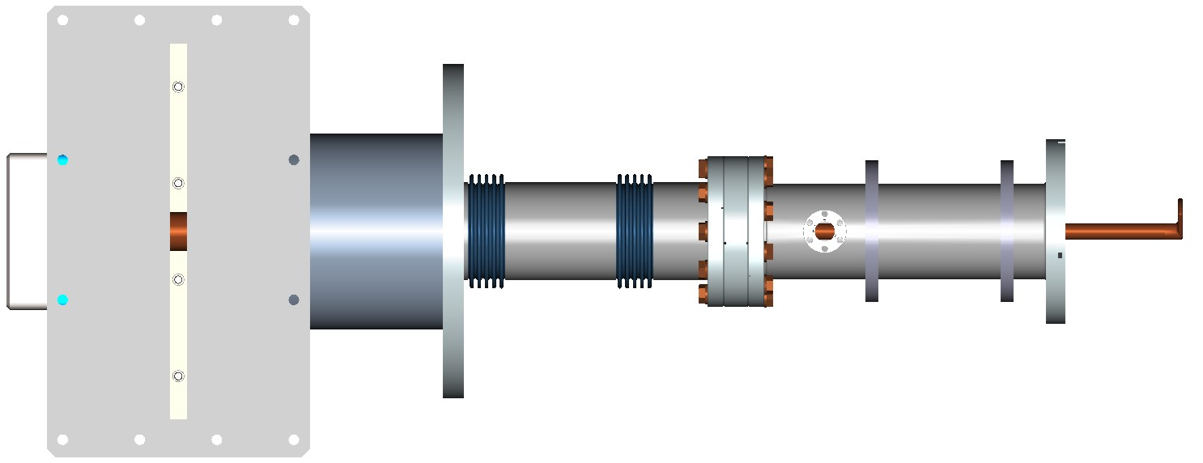
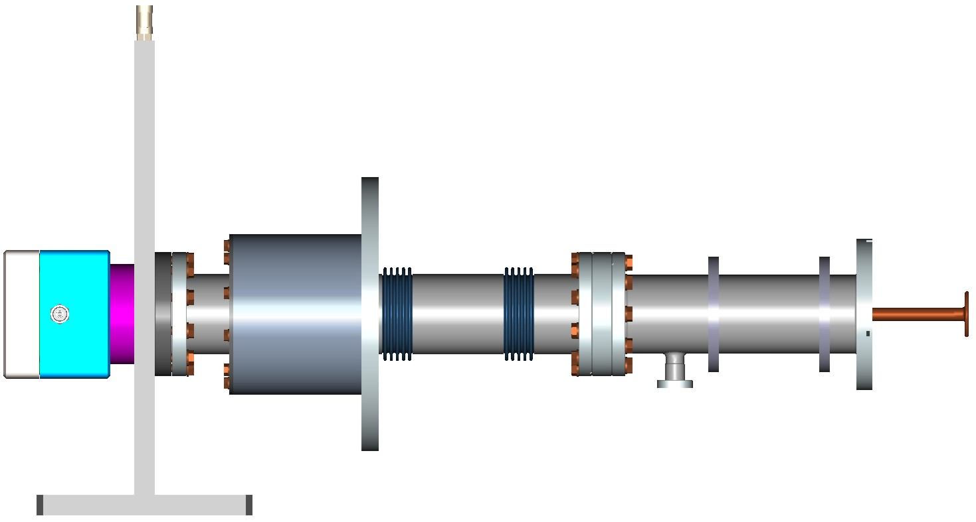
Views of 650 MHZ coupler

Slide 9
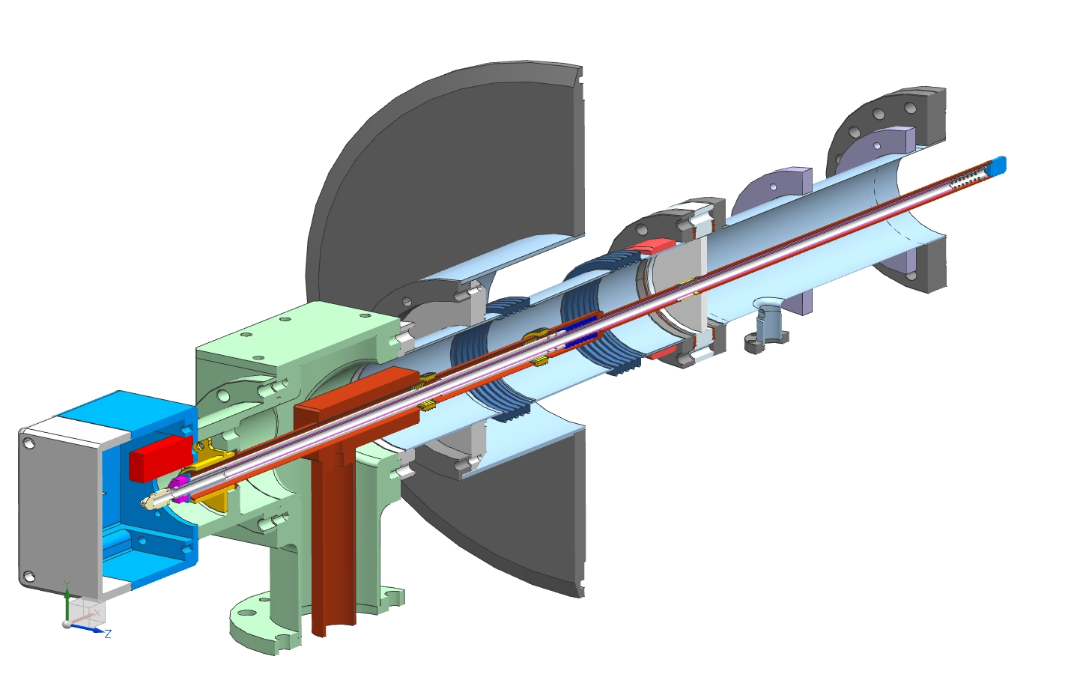
Cryomodule flange
Spring to compensate
thermal expansion
“5K” intercept
Cut view of 325 MHz coupler
“80K” intercept
Ceramic window
Antenna
Matching bump
Arc detector
Cold flange
e-pickup port
3’’x 0.0158’’
stainless steel tube
Bronze bellows
Heater
Air inlet
3-1/8’’ coaxial input

Slide 10
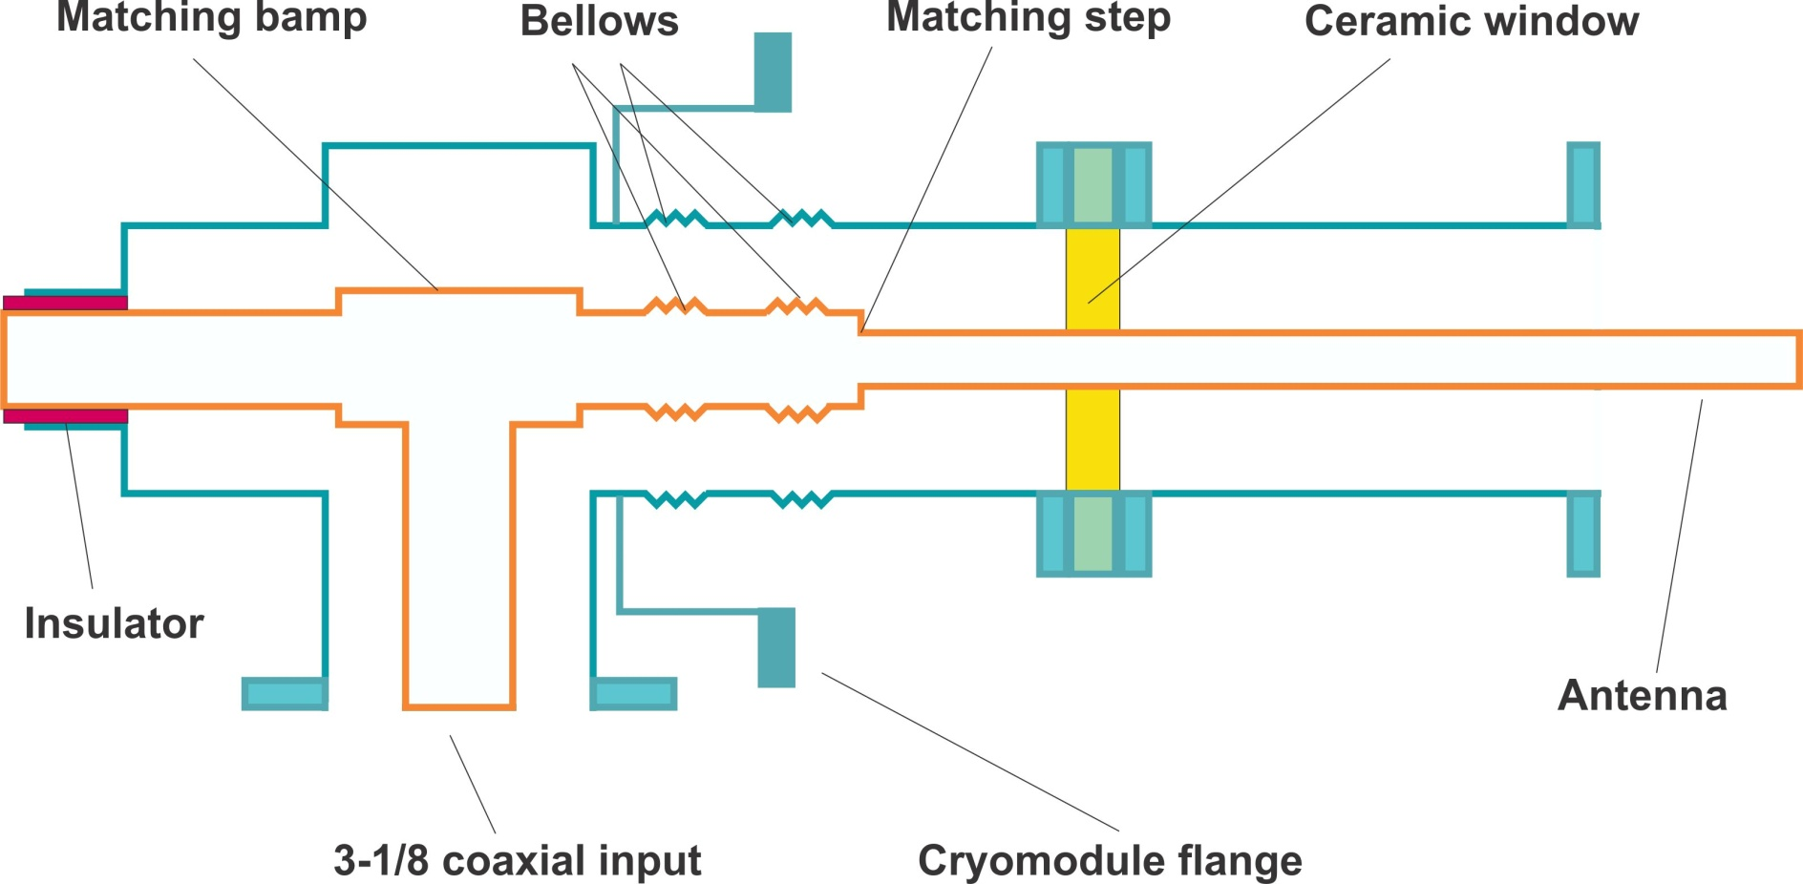
325 MHz coupler structure

Slide 11
Electrical parameters of 325MHz coupler
Design CW power ~ 30kW
Pulse power (breakdown in air) ~ 0.4MW
Multifactor threshold > 6 kW SW (>25kW TW)
Pass band (S11 < -20dB) ~ 50MHz, (15%)

Slide 12
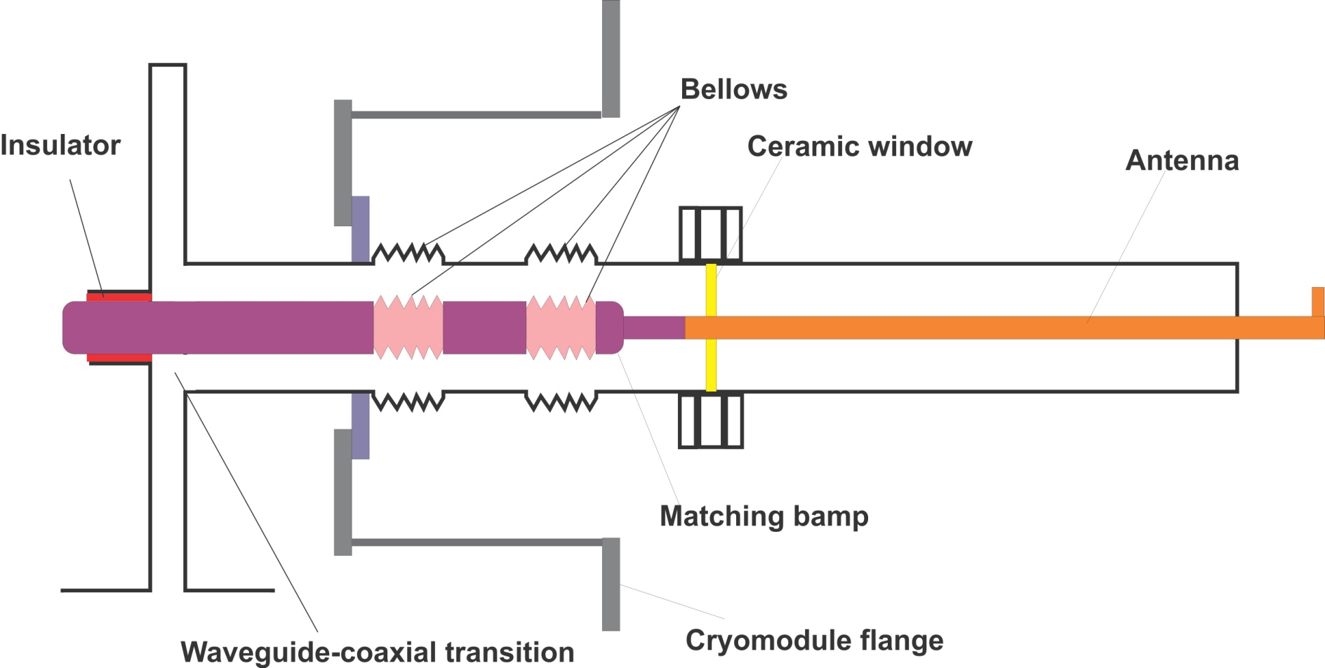
650 MHz coupler structure

Slide 13
Electrical parameters of 650MHz coupler
Design CW power ~ 120kW
Pulse power (breakdown in air) ~ 3.0MW
Multifactor threshold ~ 250 kW SW (~1MW TW)
Pass band (S11 < -20dB) ~ 30MHz, (5%)

Slide 14
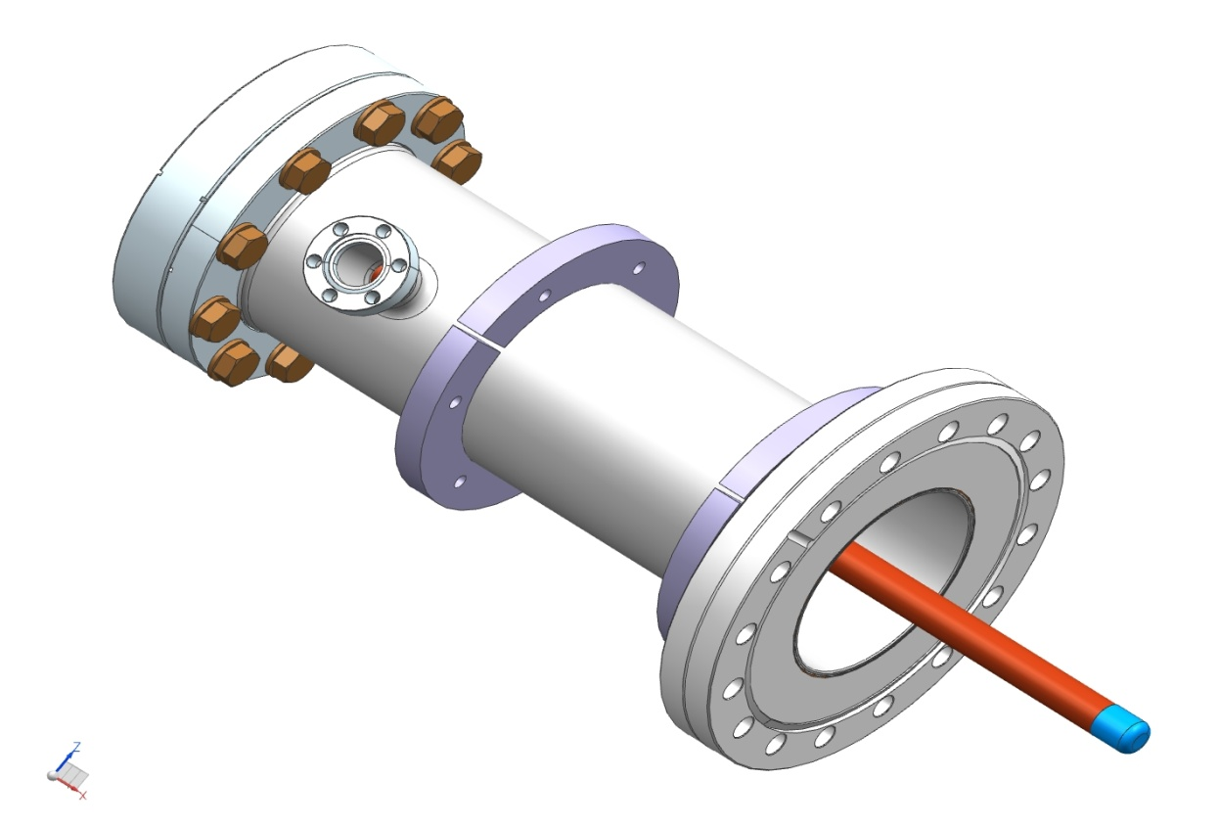
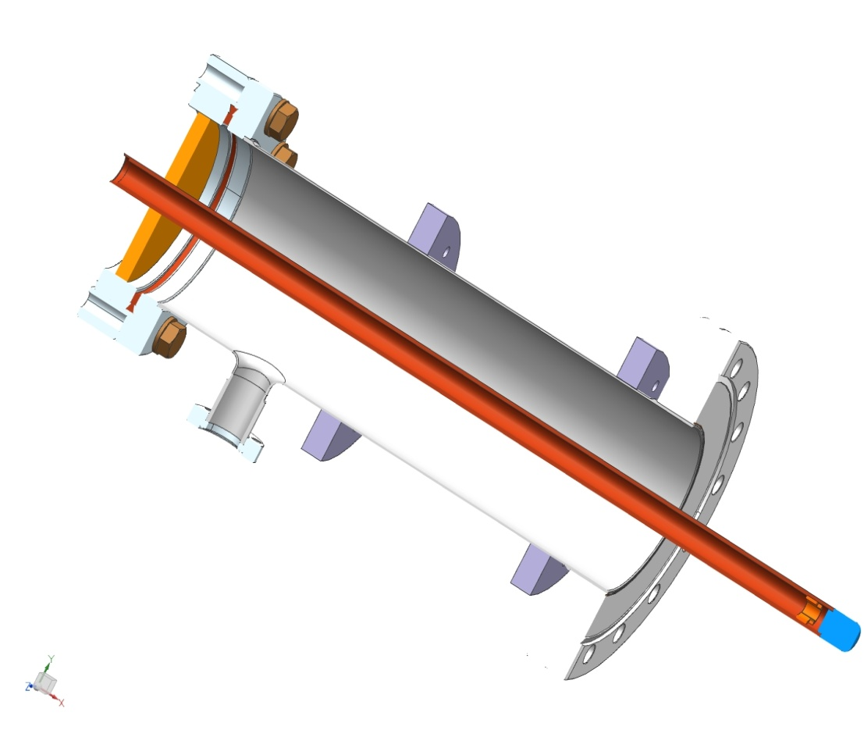
Thermal properties of couplers
Vacuum parte of couplers:
Ceramic window
80K interception
5K interception
E-pickup port
0.5’’ copper tube
3’’ x 0.4mm stainless tube
Copper tip
Bayonet connection

Slide 15
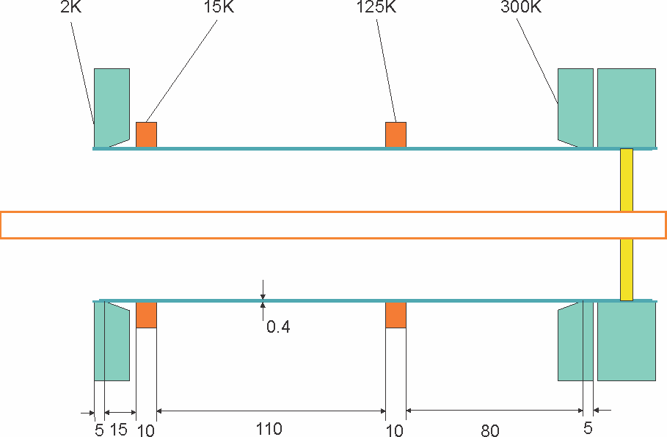
Outer conductor: 0.4mm SS, no cupper coating,
interceptors 15K, 125K
325 MHz coupler
 | P_2K / P_pl, W | P_15K / P_pl, W | P_125K / P_pl, W | P_pl total, W
Pin = 0kW | 0.06 / 52 | 0.58 / 151 | 2.02 / 40 | 243 | Static loss
Pin = 3kW | 0.10 / 86 | 0.81 / 211 | 2.35 / 47 | 344 | PXIE
Pin = 6kW | 0.15 / 129 | 1.03 / 268 | 2.68 / 54 | 451 | PX , 1mA
Pin = 20 kW | 0.35 / 301 | 2.07 / 538 | 4.25 / 85 | 924 | PX, 5mA, no overhead
Pin = 30 kW | 0.50 / 430 | 2.82 / 733 | 5.36 / 107 | 1270 | PX, 5mA, with overhead

Slide 16
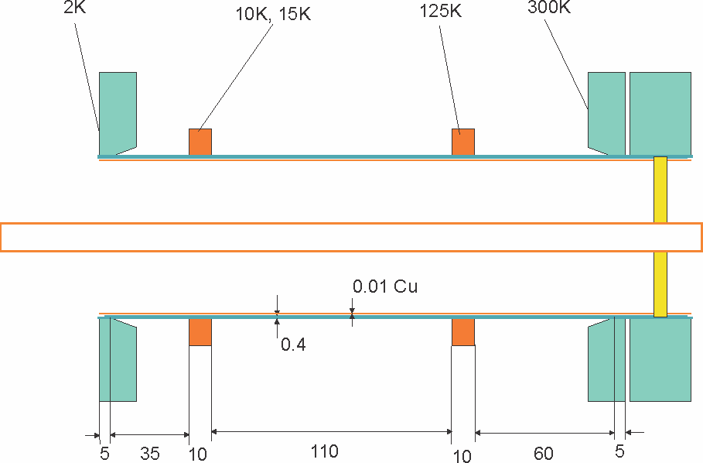
Outer conductor: 0.4mm SS, 10um cupper coating,
interceptors 15K, 125K
325 MHz coupler
 | P_2K / P_pl, W | P_15K / P_pl, W | P_125K / P_pl, W | P_pl total, W
Pin = 0kW | 0.24 / 206 | 1.76 / 458 | 4.33 / 87 | 751 | Static loss
Pin = 3kW | 0.25 / 215 | 1.77 / 460 | 4.36 / 87 | 762 | PXIE
Pin = 6kW | 0.25 / 215 | 1.79 / 465 | 4.38 / 88 | 768 | PX , 1mA
Pin = 20 kW | 0.27 /232 | 1.86 / 484 | 4.52 / 90 | 806 | PX, 5mA, no overhead
Pin = 30 kW | 0.28 / 241 | 1.91 / 497 | 4.63 / 93 | 831 | PX, 5mA, with overhead

Slide 17
650 MHz coupler
Inner tube – copper
Outer tube – SS coated by Cu
 | P_2K / P_pl, W | P_15K / P_pl, W | P_125K / P_pl, W | P_pl total, W
Pin = 0kW | 0.24 / 207 | 1.76 / 458 | 4.46 / 89 | 754
Pin = 30kW | 0.30 / 258 | 1.97 / 512 | 4.74 / 95 | 865
Pin = 70kW | 0.36 / 310 | 2.26 / 588 | 5.31 / 106 | 1004
Pin = 120kW | 0.45 / 387 | 2.65 / 689 | 6.03 / 121 | 1197

Slide 18
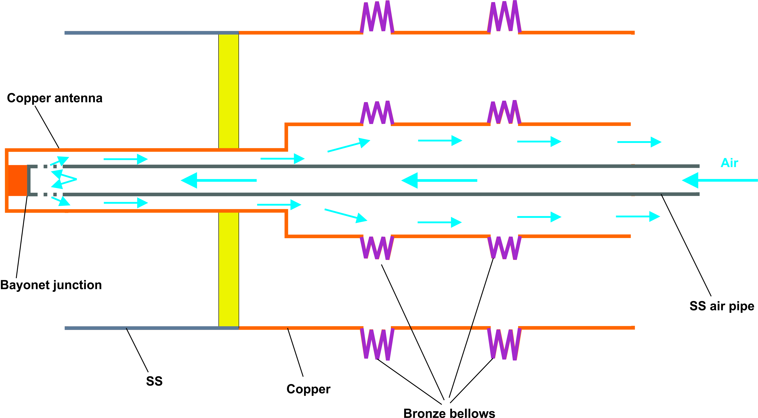
Air cooling scheme
Air cooling

Slide 19
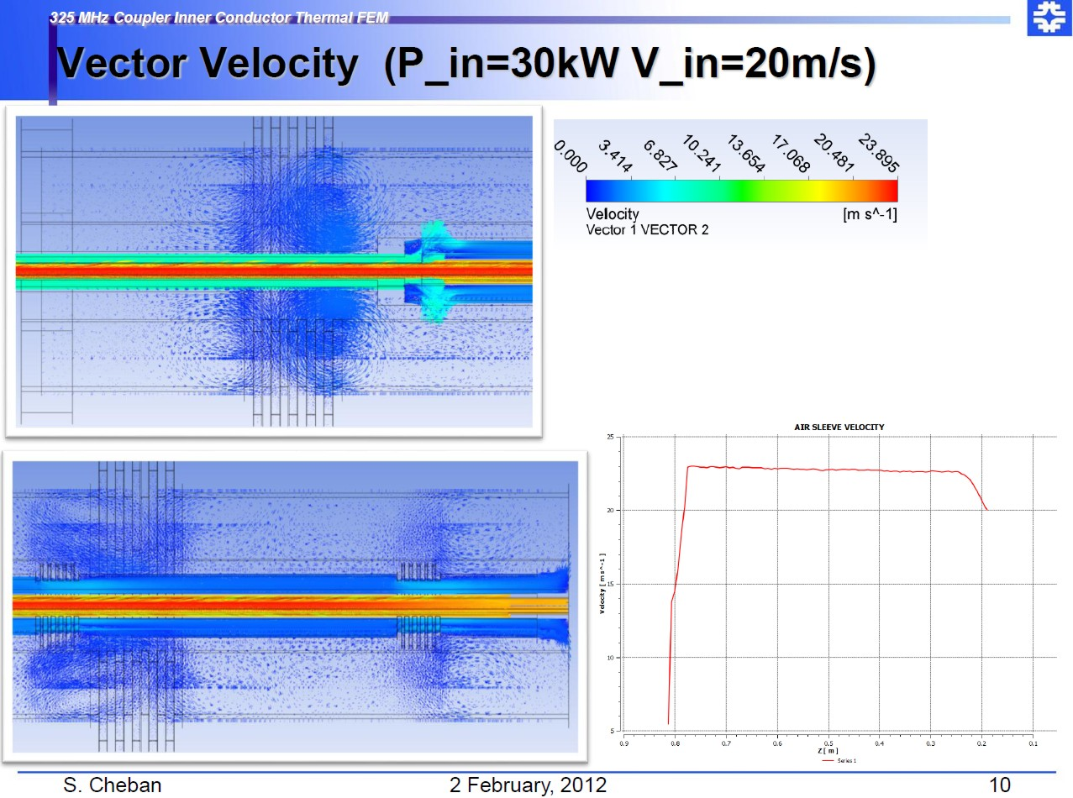

Slide 20
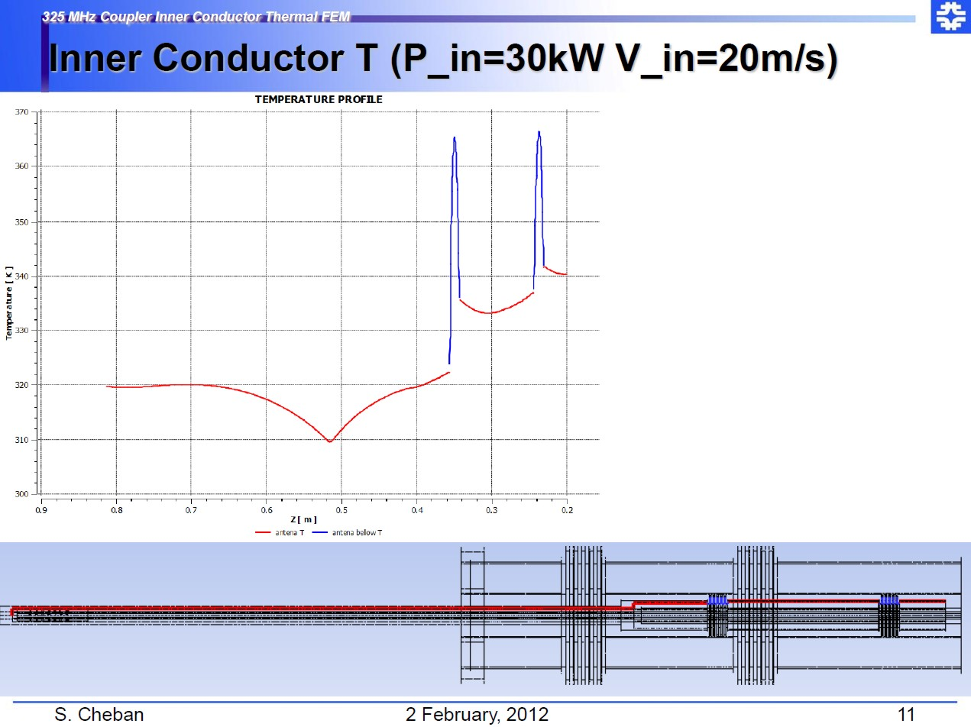

Slide 21
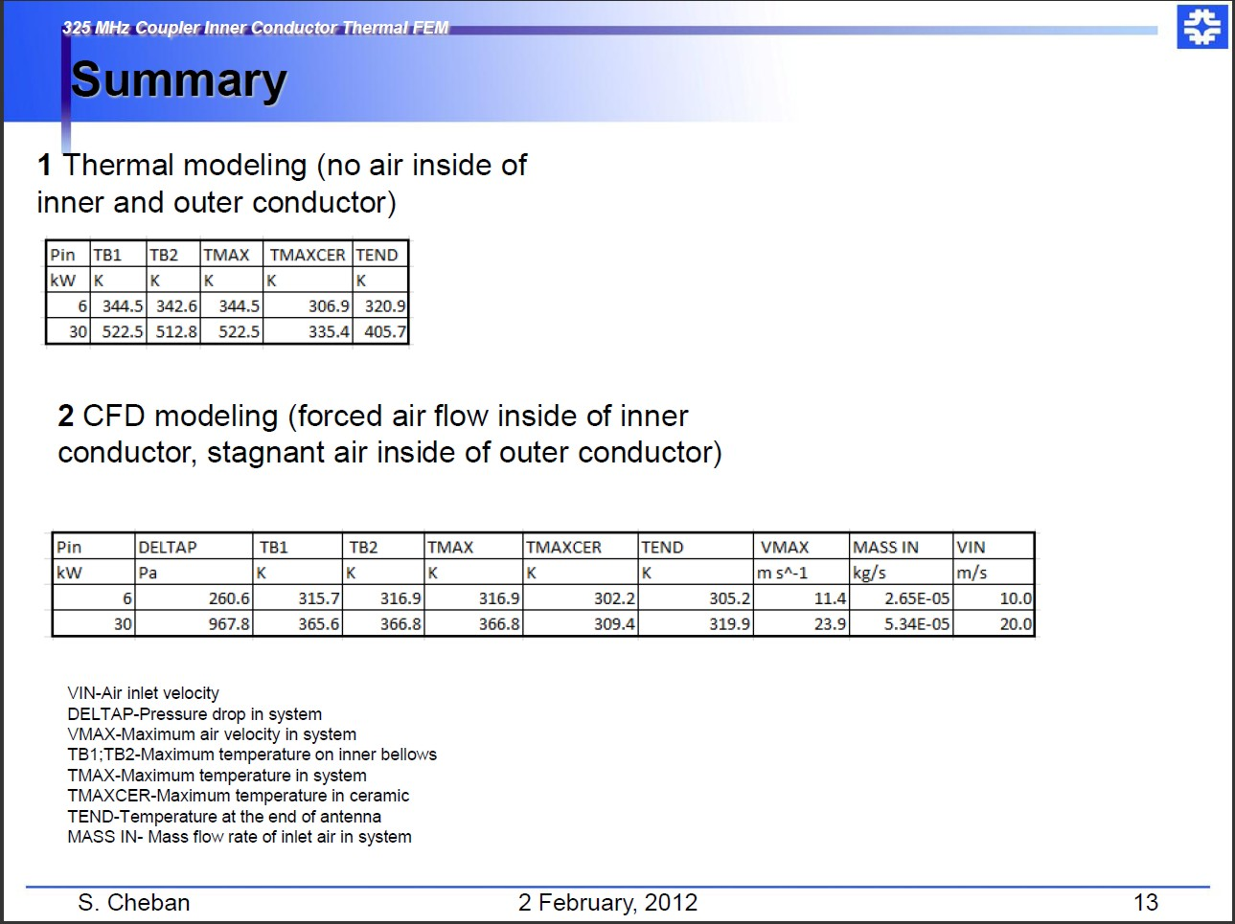
Prad = 0.09W
6 kW, TW - can work without air cooling
Prad = 0.22W
Prad = 0.07W
Prad = 0.09W
Prad – thermal radiation of antenna tip in SC aria

Slide 22
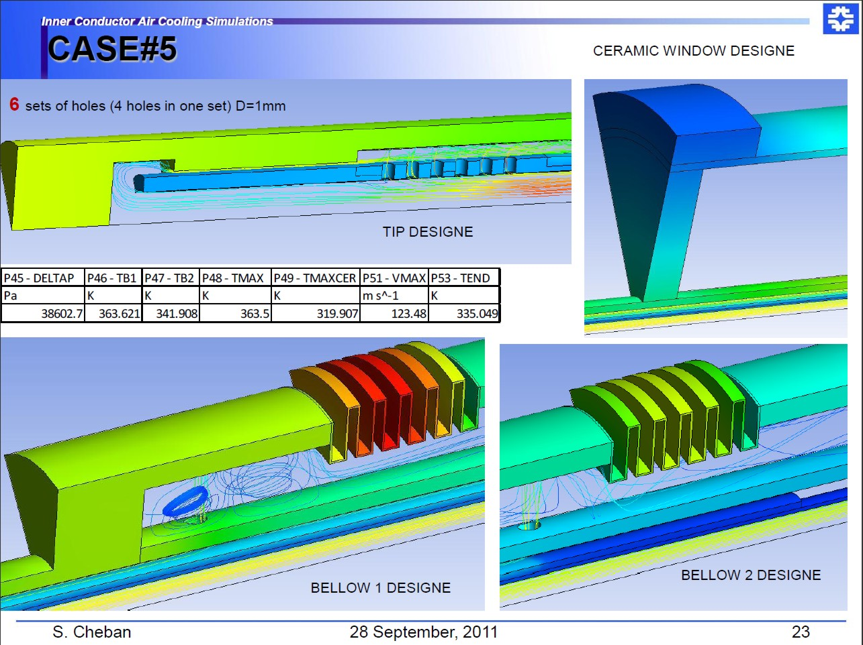
Example of air cooling simulations of 650 MHz coupler

Slide 23
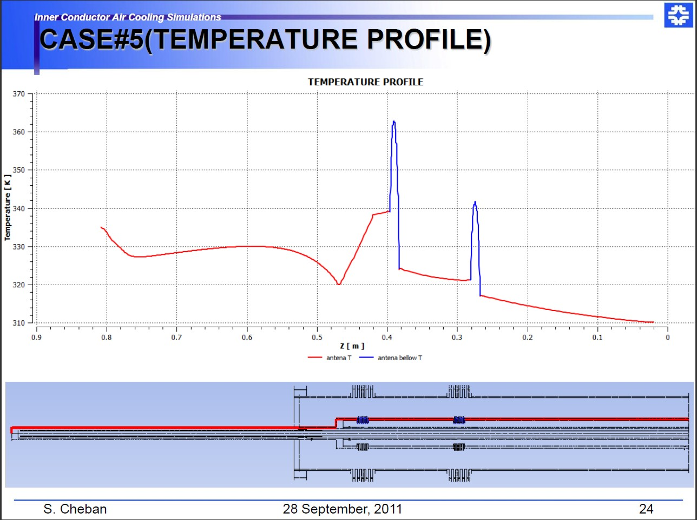
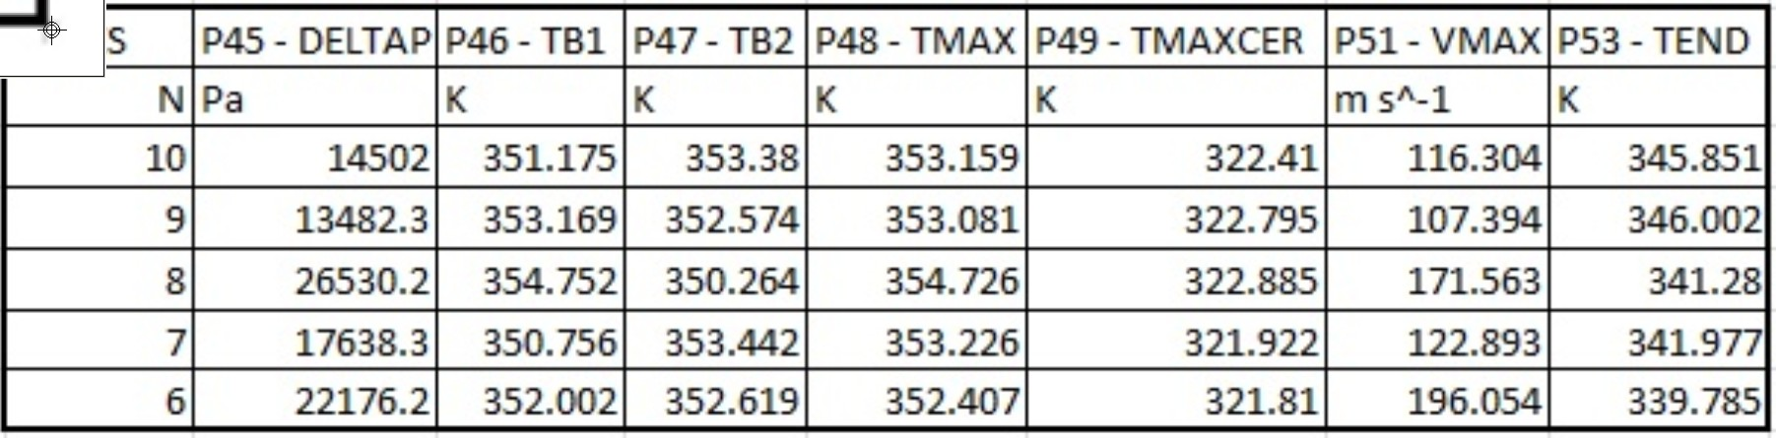
Prad ~ 0.1W

Slide 24
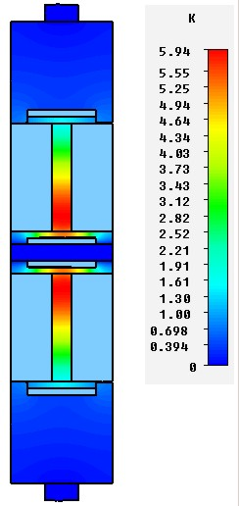
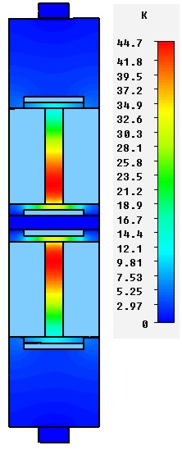
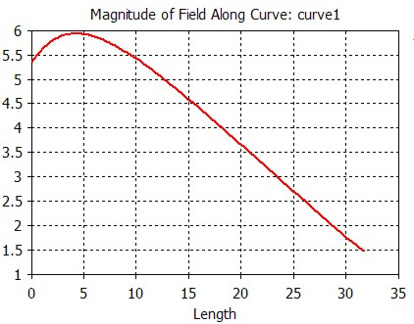
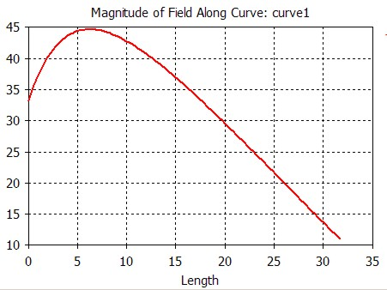
Ceramic temperature.
650 MHz, P = 120 kW, CW
Loss tangent = 1e-4
Loss tangent = 1e-3
Max. grad T ~ 0.31 C/mm
Loss in ceramic ~ 9.2 W
Max. grad T ~4.4 C/mm
Loss in ceramic ~ 92.4W

Slide 25
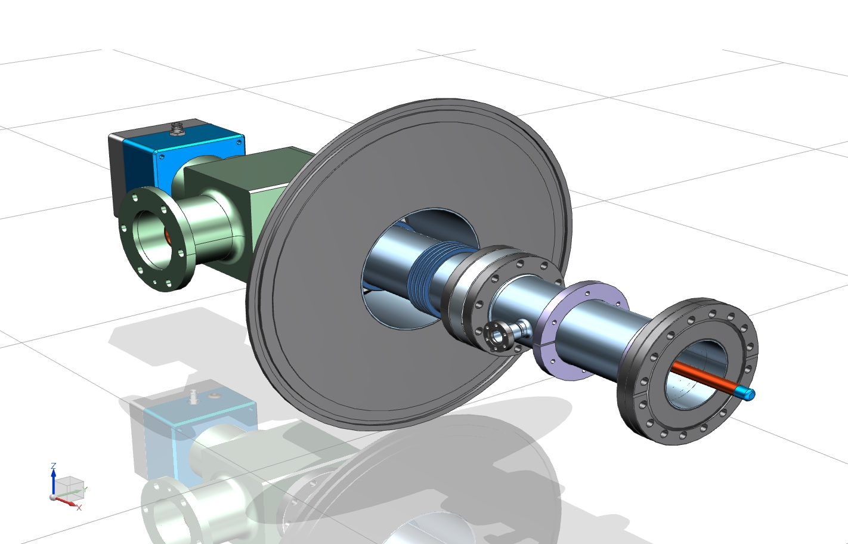
325 MHz COUPLER
Mechanical
Design

Slide 26
Cryomodule flange
Spring to compensate
thermal expansion
“5K” intercept
“80K” intercept
Ceramic window
Antenna
Matching bump
Arc detector
Cold flange
e-pickup port
3’’x 0.0158’’
stainless steel tube
Bronze bellows
Heater
Air inlet
3-1/8’’ coaxial input

Slide 27
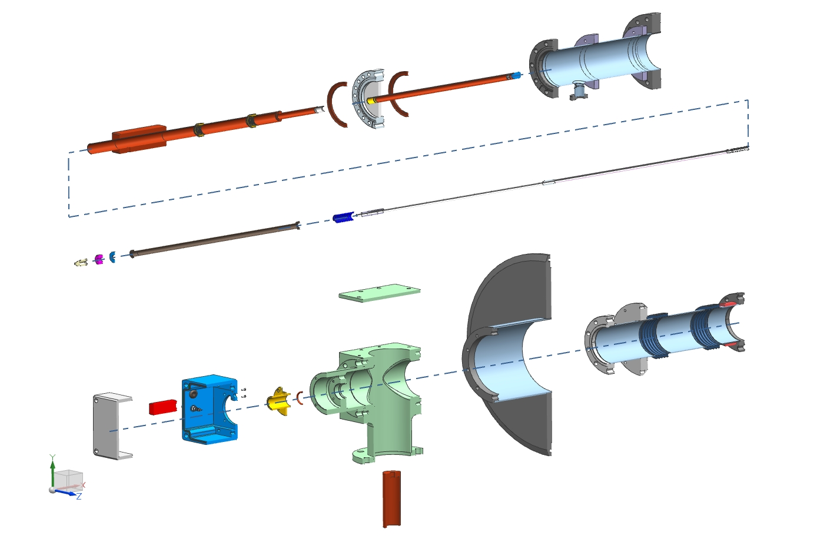
325 MHz Coupler
Main components
Cold End Assembly
Air inlet
Warm End Assembly

Slide 28
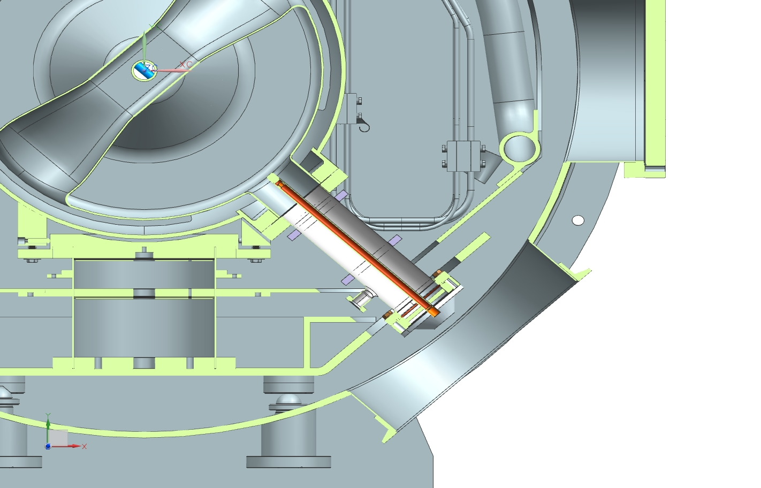
Vacuum part of coupler assembled with cavity can be installed in cryomodule

Slide 29
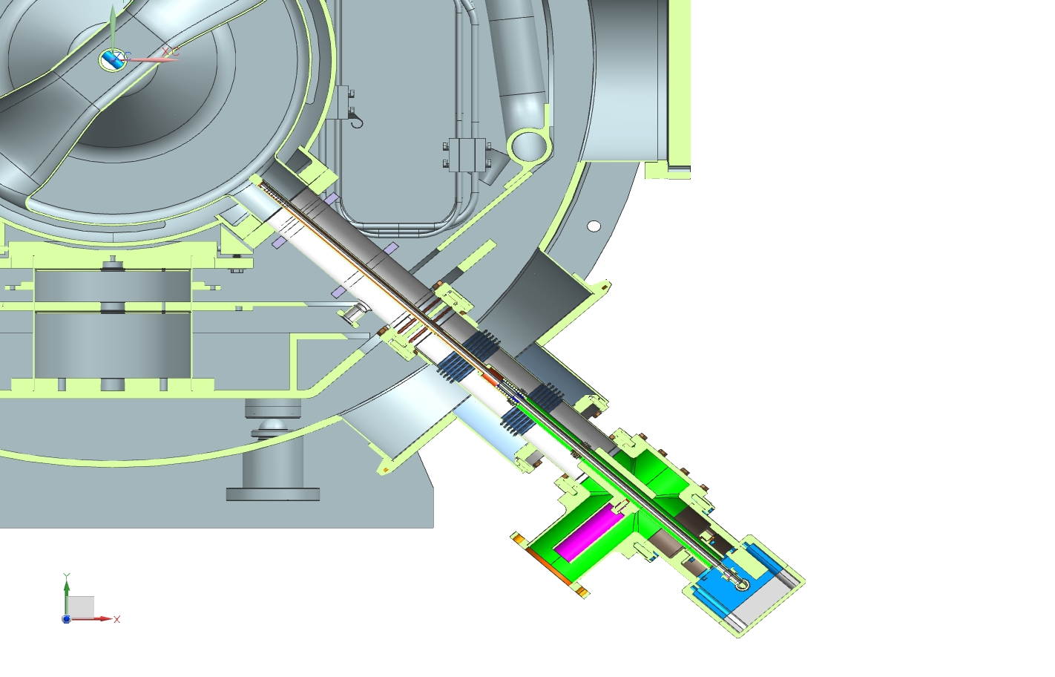
Coupler bellows accommodate cavity displacement +- 3mm

Slide 30
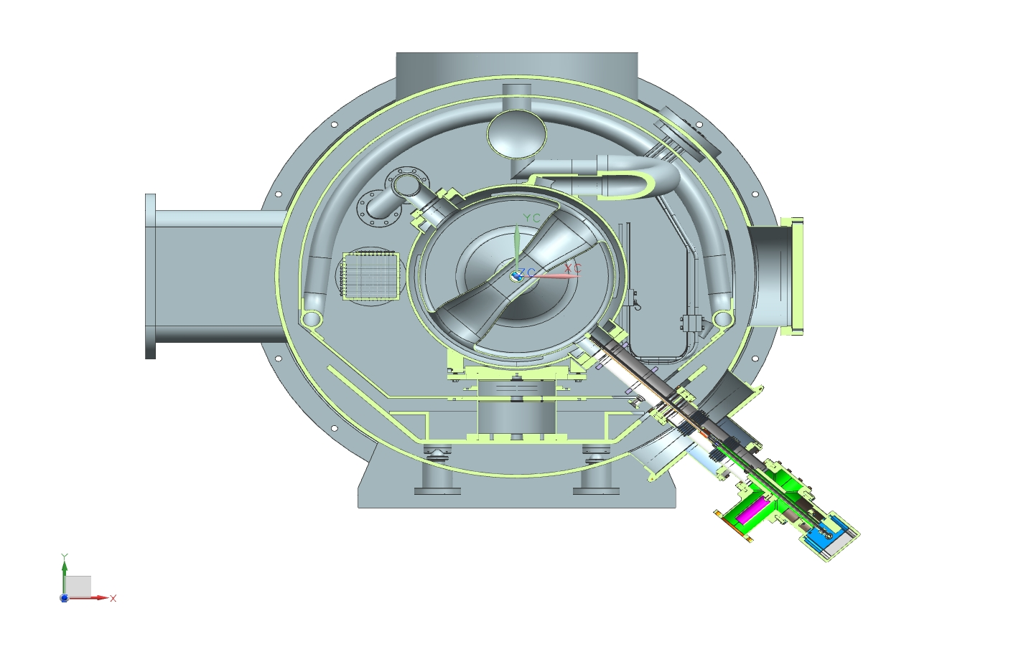
SSRx cryomodule with coupler

Slide 31
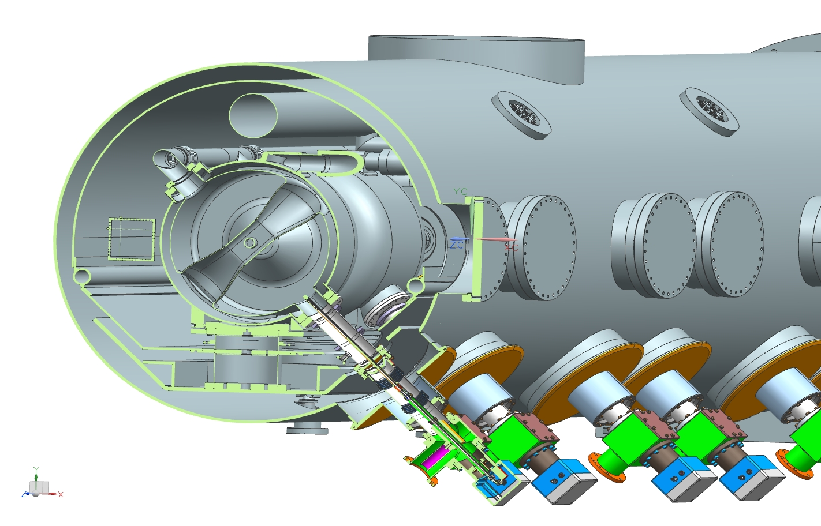
325 MHz Coupler
Coupler and Cryomodule

Slide 32
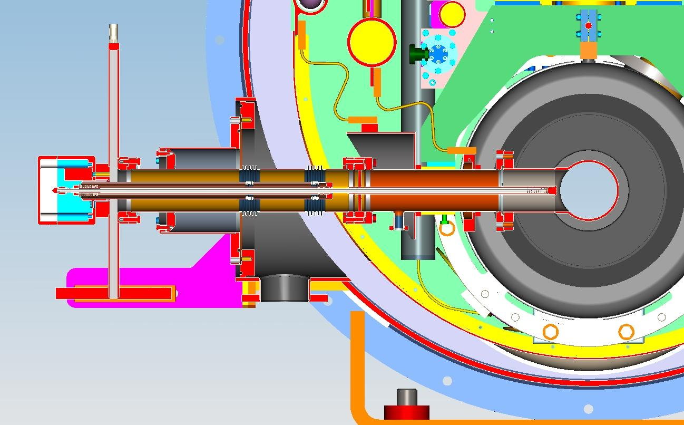
650 MHz coupler installed in cryomodule

Slide 33
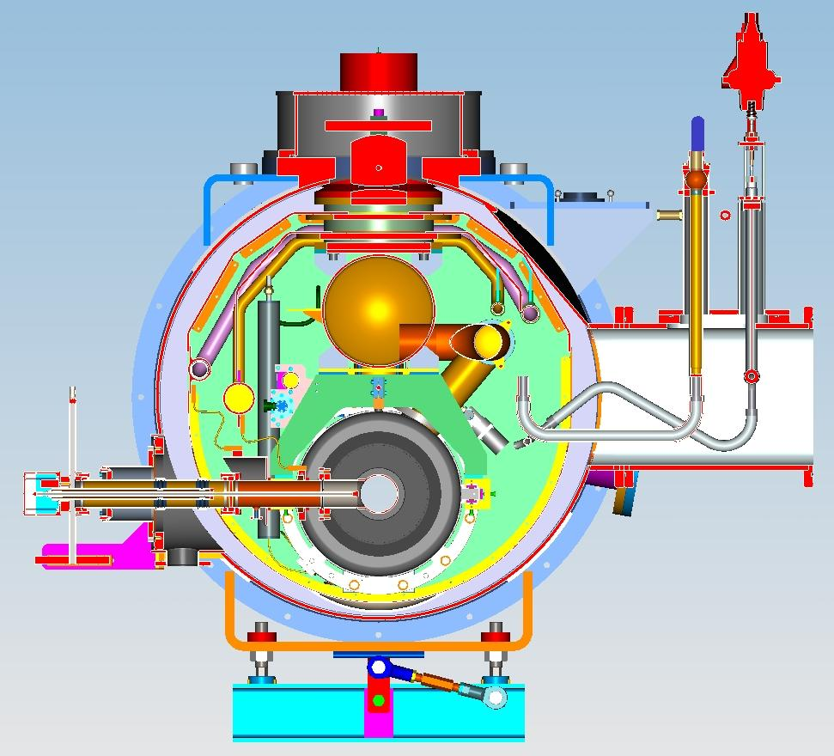
650 MHz coupler installed in cryomodule

Slide 34
Current situation:
Electrical, thermal, mechanical designs are finished for 325 MHz and 650 MHz couplers.
Drawings of 325 MHz coupler are ready.
Production of 325 MHz will be started in near future.

Slide 35
Test stands

Slide 36
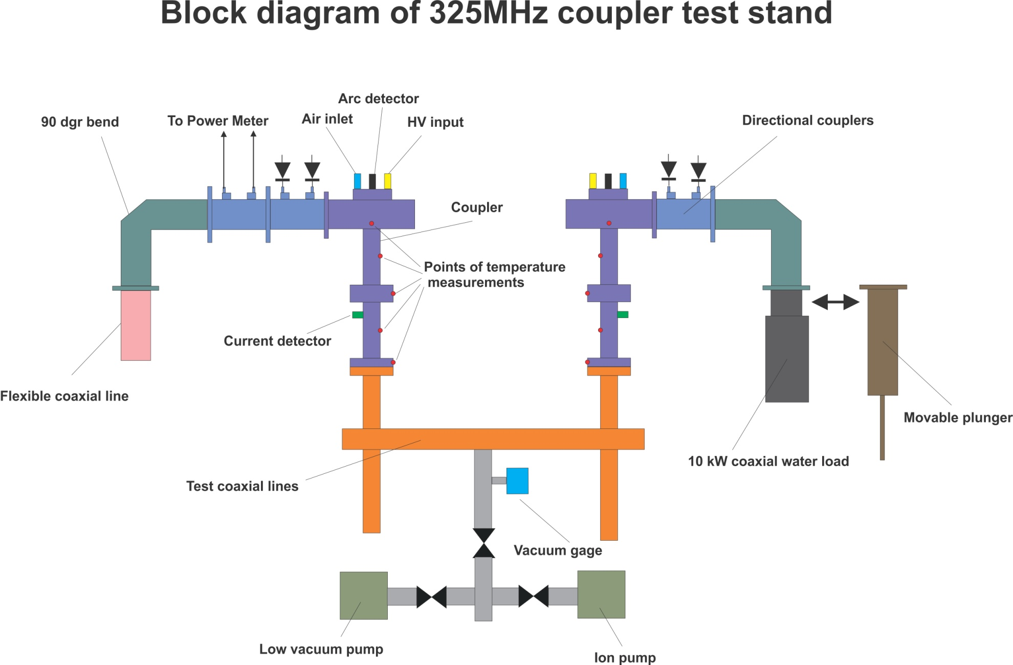

Slide 37
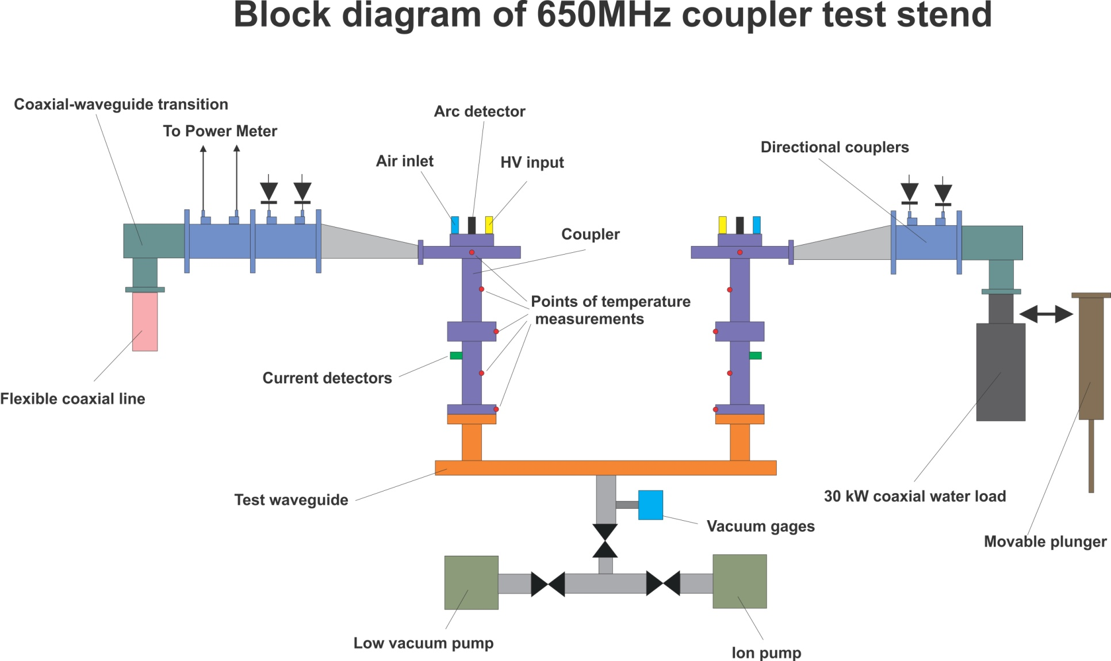

Slide 38
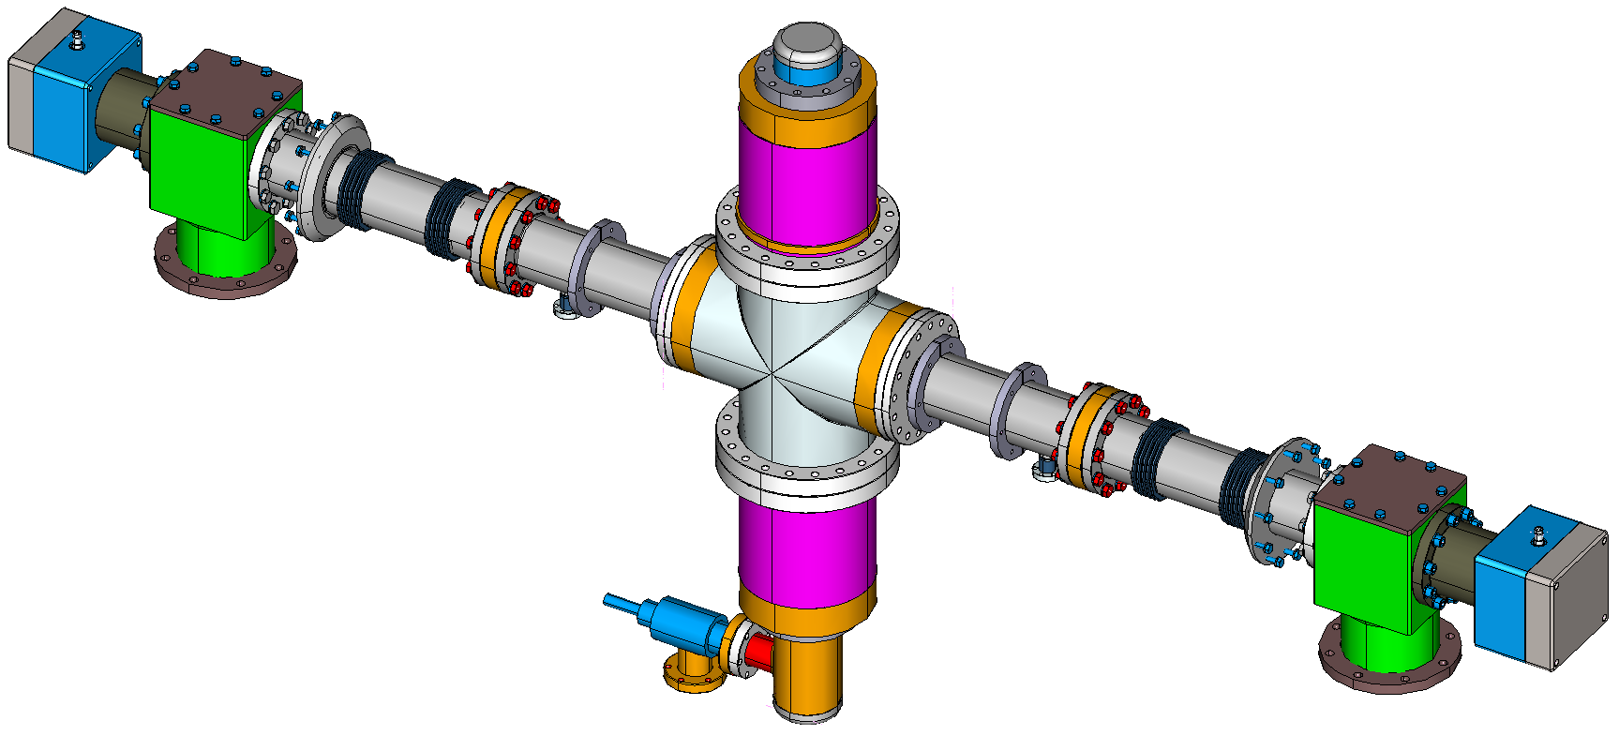
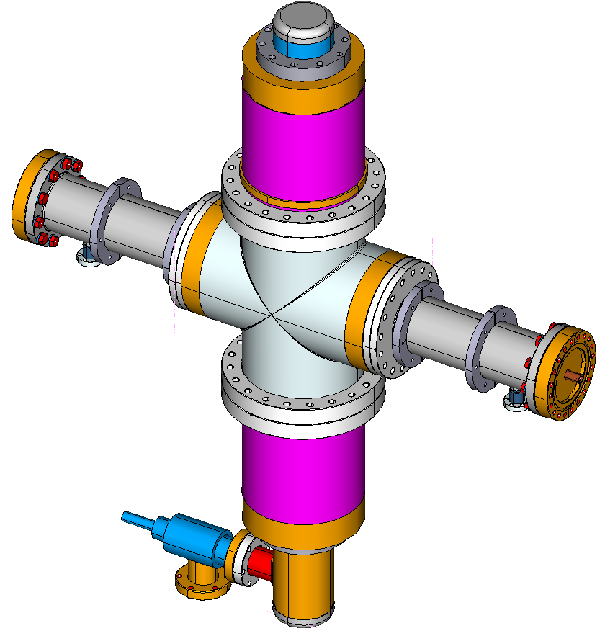
The Test Cavity with the Couplers
Test cavity
78in
1980mm
Coupler
Coupler
30.3in
770mm
Cold Portion of the Coupler
35.5in
902mm
Cold Portion of the Coupler
Test cavity
The Test Cavity with Coupler Cold Portions
Assembled in a Clean Room
Fasteners and sealing rings are not shown

Slide 39
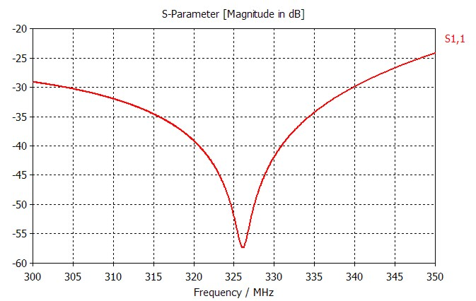
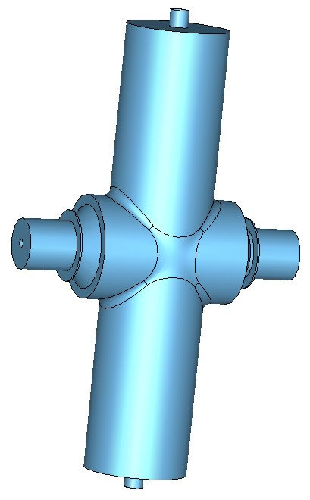
Sizes of cavity were chosen to avoid multifactor in operating zone of power.
Couplers’ antennas couple with cavity trough vacuum gap (capacitive coupling) without mechanical contacts. Antennas’ surfaces are untouchable.

Slide 40
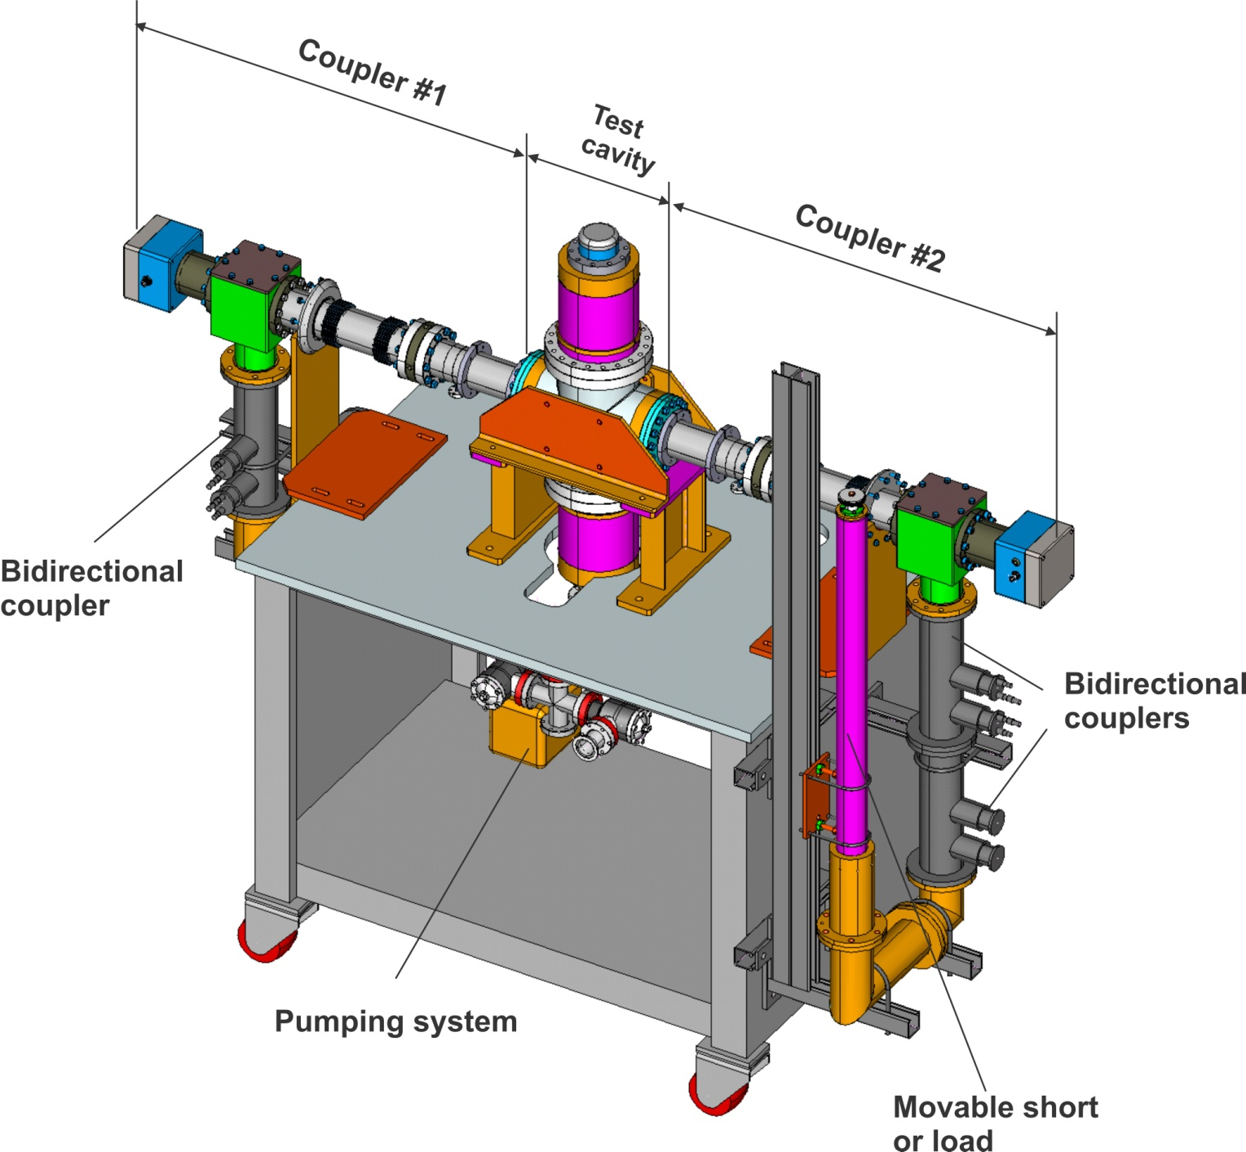
350 MHz coupler test stand

