Slide 1
Polarized nuclear target based on parahydrogen induced polarization
D. Budker^{1,2}, M. P. Ledbetter¹, A. Appelt³,
L. S. Bouchard⁴, and B. Wojtsekhowski⁵
¹UC Berkeley-²LBNL-³Aachen-⁴UCLA-⁵JLAB

Slide 2
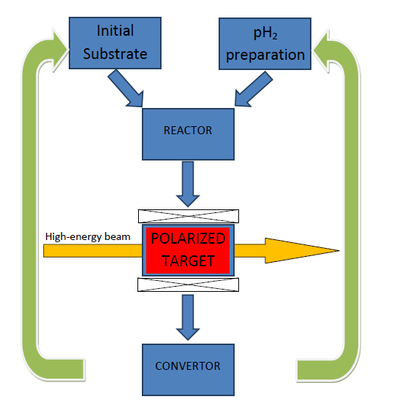
Novel concept for polarized nuclear targets
Fast reversal (~100 Hz)
Near-zero magnetic field
Based on a revolutionary NMR technique
Competitive FOM
arXiv:1203.2712

Slide 3
From yeV to TeV: Search for the Neutron Electric Dipole Moment ASU, Berkeley, Boston, Brown, Caltech, Duke, HMI, Illinois, Indiana, Kentucky, MSU, LANL, Maryland, MIT, NCSU, ORNL, SFU, Yale
D. Beck, D. Budker, and B. K. Park
ArXiV; to appear in N. Cimento
Presented for Douglas H Beck (UIUC)
Outline
EDM 101
nEDM experiments
Principle of the SNS experiment
Berkeley involvement:
Kerr effect, magnetometry
No conclusion (yet)
by Dmitry Budker (UC Berkeley)
PAVI 2011, Roma

Slide 4
Permanent EDM of a particle contradicts both P- and T-invariance
d
T
J
P
T violation was not understood
in the first EDM experiments!

Slide 5
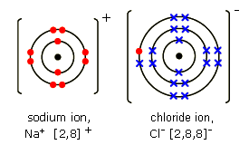
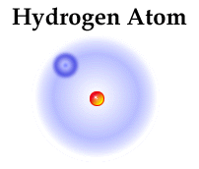
But what about polar molecules?
No EDM in a state with a well defined rotational quantum number!

Slide 6
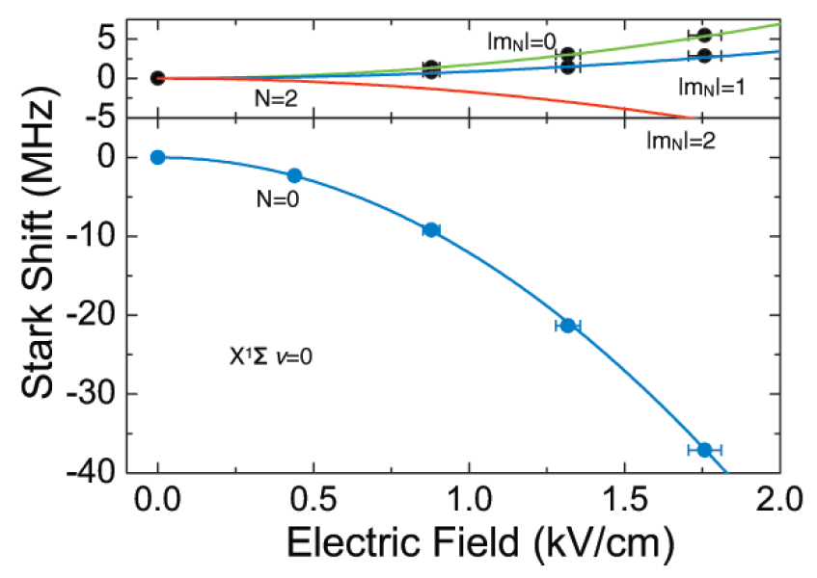
“Permanent” EDM of KRb
“Given the measured B, the fit of the Stark shift (line in lower panel) gives a permanent electric dipole moment of 0.566(17) D.” K.-K. Ni, et al. Science 322 (2008) 231.

Slide 7
T violation and EDM
Existence of particle EDM implies T reversal invariance violation
T reversal violation implies CP violation if CPT symmetry preserved
Std. model  immeasurably small EDM

Slide 8
Beyond Std. Model
Simple extensions like 2 Higgs doublets, more gauge particles
still preserve CP for real couplings
multi-Higgs models can have explicit CP violation in L_{Higgs} term
SUSY preserves CP
in broken SUSY, complex couplings arise which naturally violate CP
Attractive in general to have underlying theory be CP invariant
generate CP violation by spontaneous symmetry breaking

Slide 9
EDM causes spin to precess in an electric field
z
E
y
x

Slide 10
Universal Statistical Sensitivity Formula
Electric field Number of Particles Coherence Time
Lifetime of Experimentalist

Slide 11
EDM limits: state-of-the-art
London
Seattle

Slide 12
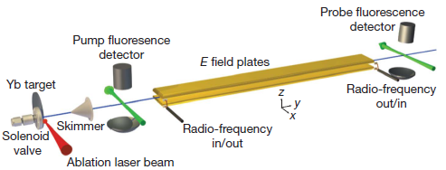
EDM of the Electron
Heavy atoms and molecules amplify the EDM (d_{at}/d_{e}~ Z³α² P.G.H. Sandars, Oxford, 1960s)
Best limit (until 2011) |d_{e}|<1.5·10⁻²⁷ e·cm from E.D. Commins et al (1985-2001), Tl
New from Ed Hinds’ group:

Slide 13
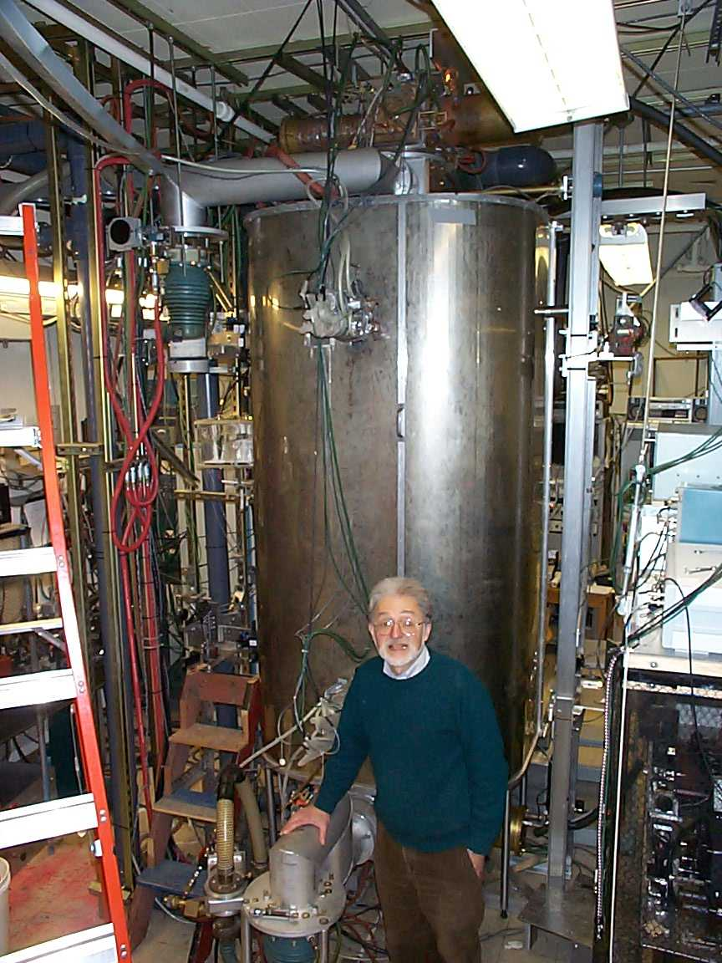
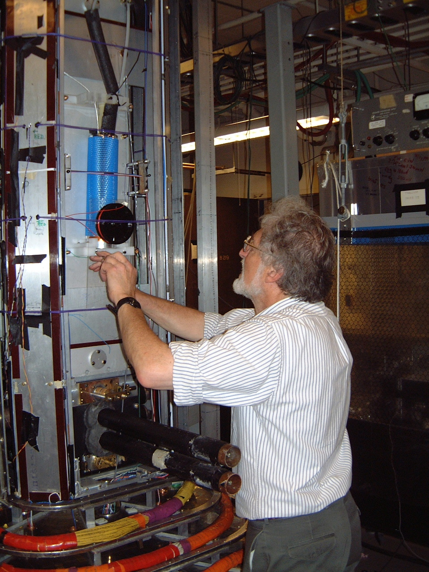
Professor Eugene D. Commins

Slide 14
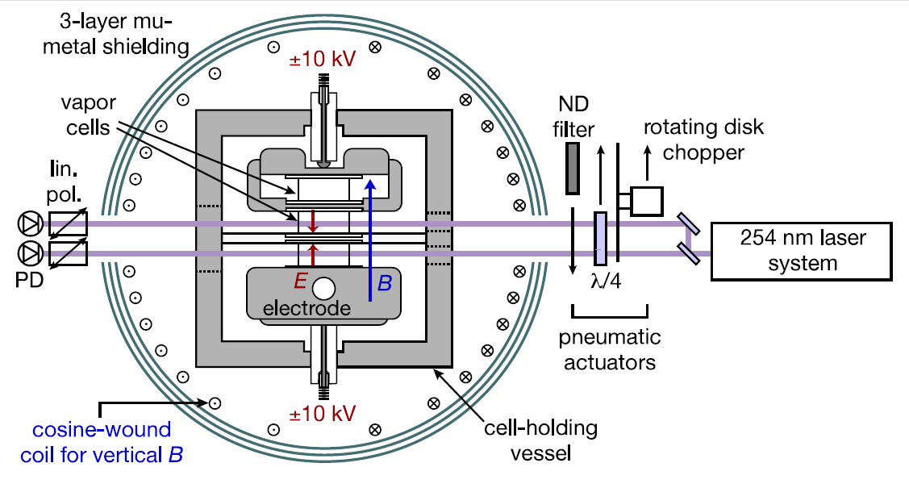
Nuclear EDM
In diamagnetic atoms, EDM dominated by nuclear contribution
magnetic effects not so important, dominated by finite size effects (Schiff moment)
R ~ 10 for ¹⁹⁹Hg (¹S₀ electron config’n)
Sensitivity to motional fields reduced
μ_{N} << μ_{e}
Vapor-cell apparatus
smallest EDM limit
Griffith, et al. PRL 102 (2009) 101601
Seattle 199 Hg experiment

Slide 15
Neutron EDM
Particle Data Group says:

Slide 16
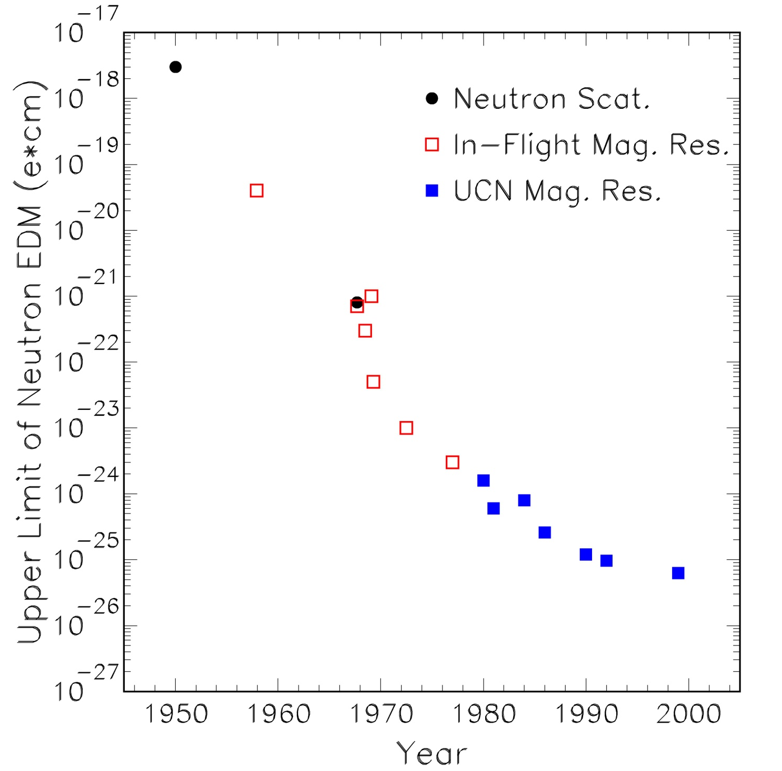
Neutron EDM: the time line
?
Prof. N. F. Ramsey
Retires

Slide 17
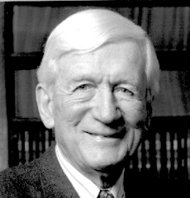
Prof. Norman F. Ramsey (1915–2011)
“What if we see an EDM?”

Slide 18
Ultra-Cold Neutrons (UCN)
Proposal: Ya. B. Zel'dovich, Sov. Phys. JETP, 9, 1389 (1959)
First realizations: 1969, Dubna and Garching
Problem with production -- tiny fraction in Maxwellian distribution (~10⁻¹¹ at T=30 K)
Materials used for UCN storage:
The ILL UCN Source

Slide 19
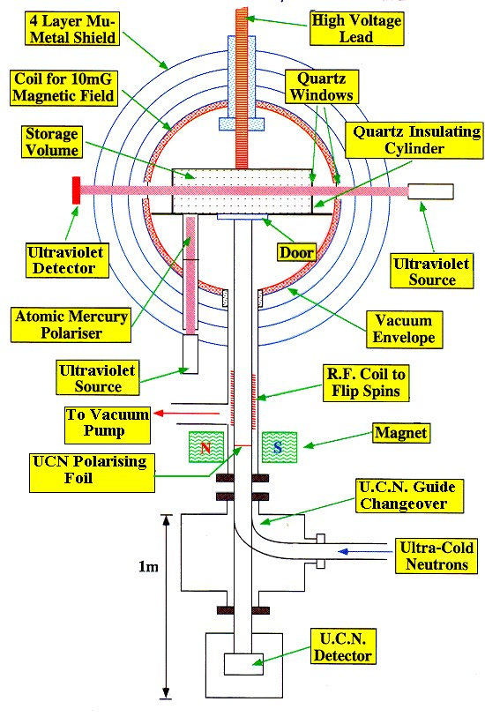
The ILL n-EDM Experiment
Ramsey separated-field method
N = 13,000; n~1/cm³
Storage time: τ = 130 s
E = 4.5 kV/cm
¹⁹⁹Hg co-magnetometer
Statistics-limited

Slide 21
UCN Source

Slide 22
Neutron EDM Experiment: Trapping Neutrons
Incident neutrons have same energy and momentum as phonons
in superfluid helium: they interact and stop
n
n
polarized neutron
v = 440 m/s
phonon
Superfluid helium

Slide 23
Neutron EDM Experiment: Neutron Precession
B₀
n
n
n
n
n
B_{pulse}
n
Superfluid helium

Slide 24
Neutron EDM Experiment: Precession Measurement
Add polarized ³He atoms
(nearly same magnetic moment as neutrons)
B₀
n
³He
³He
n
³He
³He
n
³He
n
³He
³He
n
³He
n
Superfluid helium

Slide 25
Neutron EDM Experiment: Precession Measurement
³He, n spins parallel: “no” interaction
B₀
³He
³He
n
n
Superfluid helium

Slide 26
Neutron EDM Experiment: Precession Measurement
p and ³H give off scintillation light
B₀
³He
³H
p
n
³He, n spins anti-parallel – large reaction probabilty → p + ³H
Superfluid helium

Slide 27
Neutron EDM Experiment: EDM Measurement
B₀
n
n
E₀
n
n
n
n
Superfluid helium

Slide 28
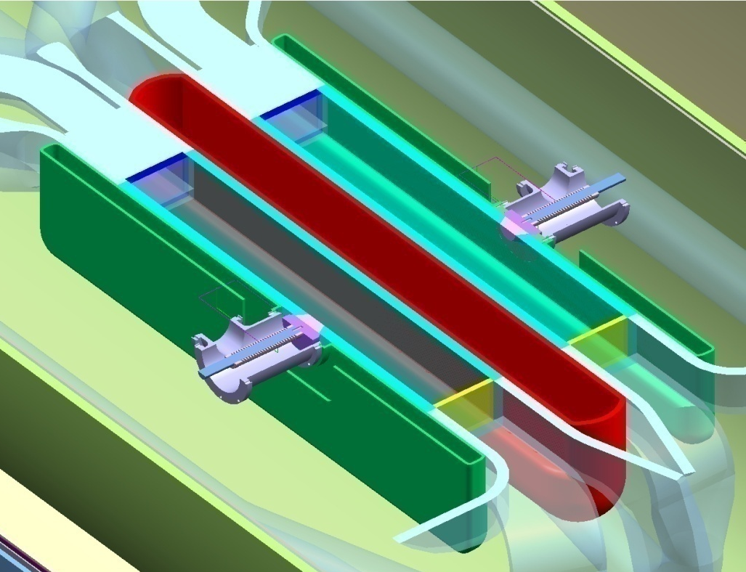
nEDM@SNS: Experiment Overview Concept: Golub and Lamoreaux, Phys. Rep. 237 (1994) 1
B
Measurement
Cells (7.6x10x40 cm³)
E
Ground
HV
Measurement cell cutaway
Polarize 9 Å (= 1 meV) neutrons in beam guide
Produce UCNs in place
downscattering in He II, T ~ 0.5 K (UCN not in thermal equilibrium)
Two cells: E parallel, anti-parallel to B
Notes:
Magnetic field ~ x50 lower in signal than in experiment

Slide 29
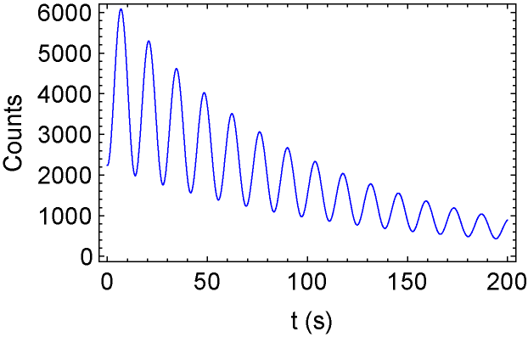
nEDM@SNS: Experiment Overview Concept: Golub and Lamoreaux, Phys. Rep. 237 (1994) 1
B
E
Scintillation signal (B/40)
Monitor precession frequency by neutron capture
add polarized ³He
σ (n + ³He) ~ 0, σ (n + ³He) ~ 2 Mb
p,T scintillate in He II
80 nm → 400 nm in cell wall coating: deuterated fluor (dTPB)
light detected by PM tube at low temperature
Notes:
Magnetic field ~ x50 lower in signal than in experiment

Slide 30
Experiment Statistics
Incident neutron fluence | φ_{cold} ~ 3x10⁸ n/s: Δλ ~ 0.3 Å FWHM
UCN density at beginning of measurement | n_{UCN} ~ 100 cm⁻³
Polarized ³He density | n₃ ~ 10¹² cm⁻³, n₃/n₄ ~ 5x10⁻¹¹
Cell volume | x·y·z = 7.6·10·40 cm³ = 3100 cm³
Holding field | B₀ ~ 10 mG x
Electric field | E₀ ~ 50 kV/cm x
Precession frequencies | f_{n} ~ 30 Hz, |f_{n} – f₃| ~ 3 Hz
Operating temperature | T_{op} = 0.45 K
Refrigeration | ~80 mW @ 0.3 K
Official sensitivity (300 live days) | Δd = 7.8x10⁻²⁸ e·cm (90% CL)

Slide 31
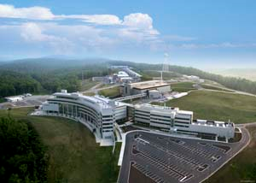
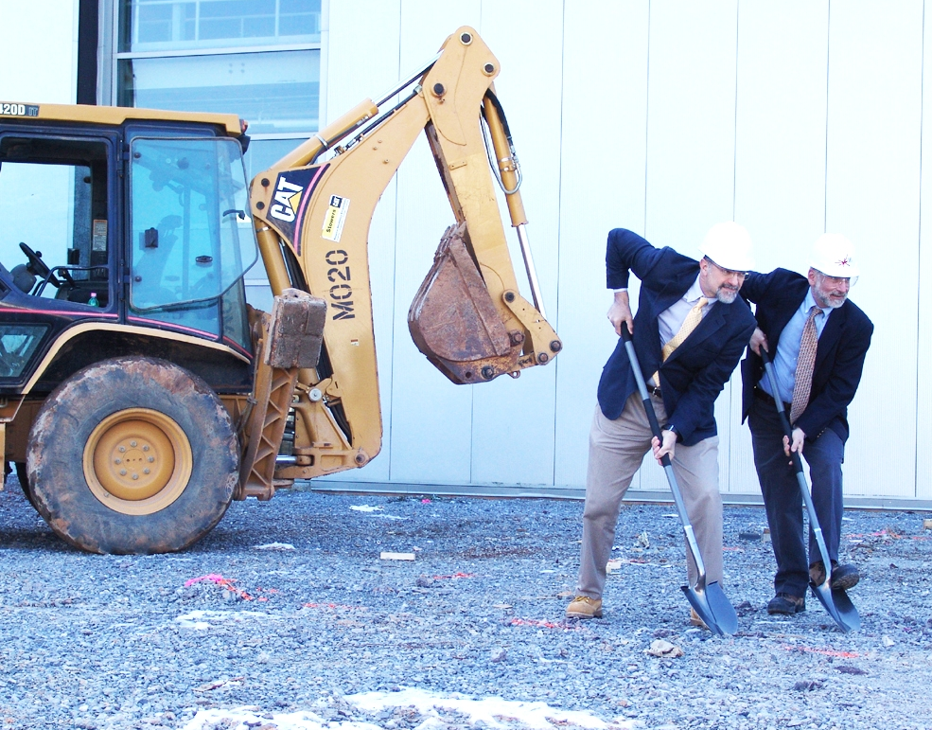
nEDM at SNS
Spallation Neutron Source
Oak Ridge National Laboratory
nEDM Hall Ground Breaking
(ORNL, 6 Feb. 09) “Shovel Ready”

Slide 32
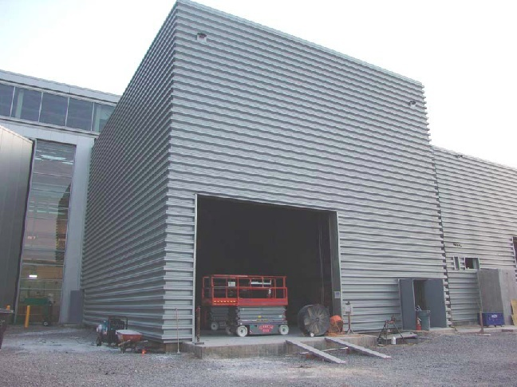
nEDM at SNS
Spallation Neutron Source
Oak Ridge National Laboratory
nEDM Hall July 09 (now complete)

Slide 33
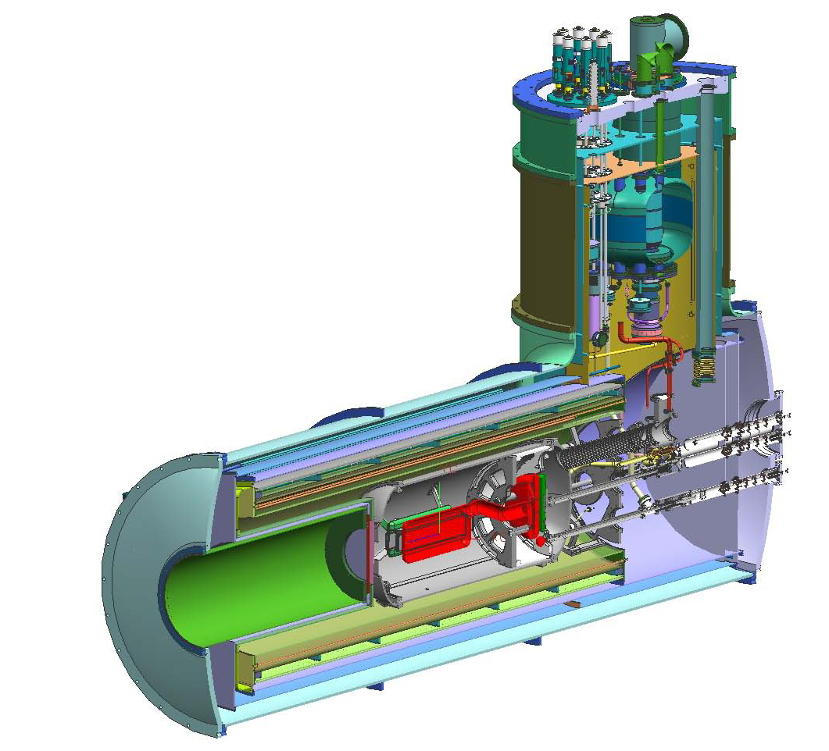
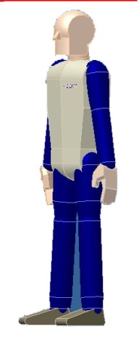
Apparatus Overview
³He injection volume
DR LHe volume (~300 liters)
Dilution refrigerator mixing volume
Central LHe volume (~1000 Liters)
Re-entrant insert for neutron guide
Measurement cell/electrode assembly
Notes:
*** New picture

Slide 34
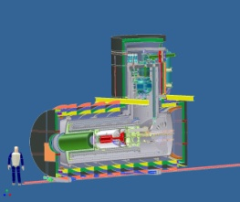
little Hadron Collider

Slide 35
Sensitivity Estimates
Δd = 7.8x10⁻²⁸ e·cm (90% CL)
Expected statistical sensitivity
limited by neutron density in cell
Systematic uncertainty estimates
Source | δd_{n} (e cm) | Comments
Linear v×E (geometric phase effect) | < 2 x 10⁻²⁸ | Uniformity of B₀
Quadratic v×E | < 0.5 x 10⁻²⁸ | E-field reversal to 1%
Pseudomagnetic field effects | < 1 x 10⁻²⁸ | π/2 pulse, comparing two cells
Gravitational offsets | < 0.1 x 10⁻²⁸ | With 1 nA leakage currents
Leakage currents | < 1 x 10⁻²⁸ | < 1 nA
Miscellaneous | < 1 x 10⁻²⁸ | alignments, β asym., etc.

Slide 36
Doug Beck’s Summary
Experiment relies on several key pieces of physics
stop neutrons in superfluid helium, trap in plastic cell
measure precession frequency with capture reaction
polarized ³He also provides co-magnetometry, opportunity for spin-dressing
Progress on several technical challenges
uniform magnetic (and electric) fields
including dressing, gradient coils
handling polarized ³He
source, relaxation, plumbing, spin-dressing
many materials challenges
advanced stage of design with good materials

Slide 37
Berkeley involvement
Graduate student B.-K. Park
Undergraduate Geoffrey Iwata
Post-doc Brian B. Patton
Kerr monitor of HV field
Atomic magnetometer

Slide 38
Accurate E-reversal, stability and field-monitoring are essential!
The E×v systematics:
~3 Hz
Motional magnetic field
τ_{c}~L/v
~5·10⁻⁸ Hz for both n and ³He
S. K. Lamoreaux, PRA 53(6), R3705, 1996
D. Budker, D. F. Kimball, and D. P. DeMille, “Atomic physics: Exploration in Problems and Solutions,” Oxford, 2003&2008

Slide 39
E-field requirements
Homogeneity over cell volume
Stability over 500 s < 1 %
Reversibility
This reduces E-field-related systematics to < 5⋅10⁻¹⁰ Hz,
i.e. one tenth of the EDM shift for d_{n}=10⁻²⁸ e ⋅cm
Electric field monitoring ~ 0.1% -1%

Slide 40
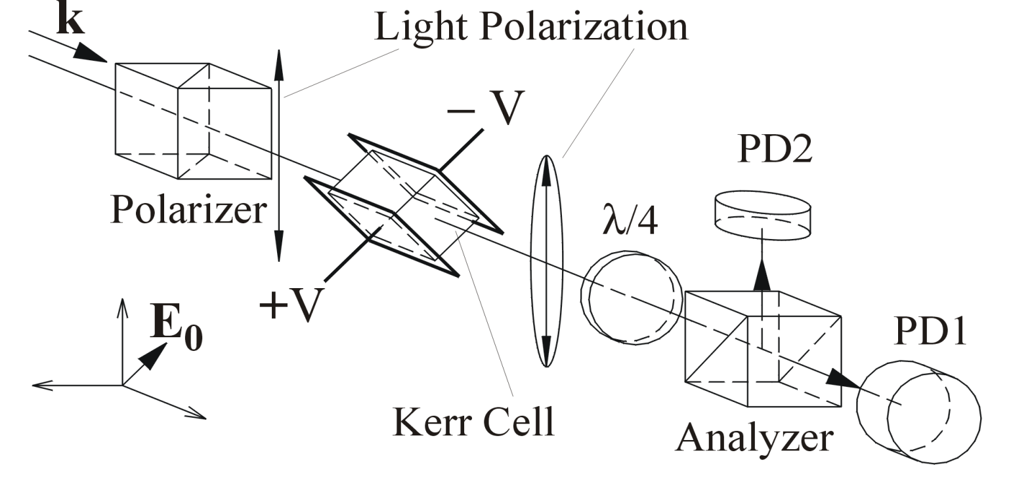
The Kerr Effect
Uniaxial E-field-induced anisotropy:
Δn = n||-n⊥= KE₀²
For input light polarized at 45º to E, the induced ellipticity:
Circular analyzer
Achievable sensitivity: δε ≈ 10⁻⁸ rad Hz^{-1/2}

Slide 41
Electric Field Measurement
Kerr constant for LHe estimated from experimental data for He at 300K: K ≈ 1.7·10⁻²⁰(cm/V)²
Electric field: E₀ = 50 kV/cm
Sample length: L = 10 cm
Induced ellipticity: ε ≈ 10⁻⁵ rad
A 1s measurement gives accuracy (δε ≈ 10⁻⁸ rad Hz^{-1/2}):
δE₀/E₀ ≈ 5·10⁻⁴
? Kerr constant for superfluid He ?

Slide 42
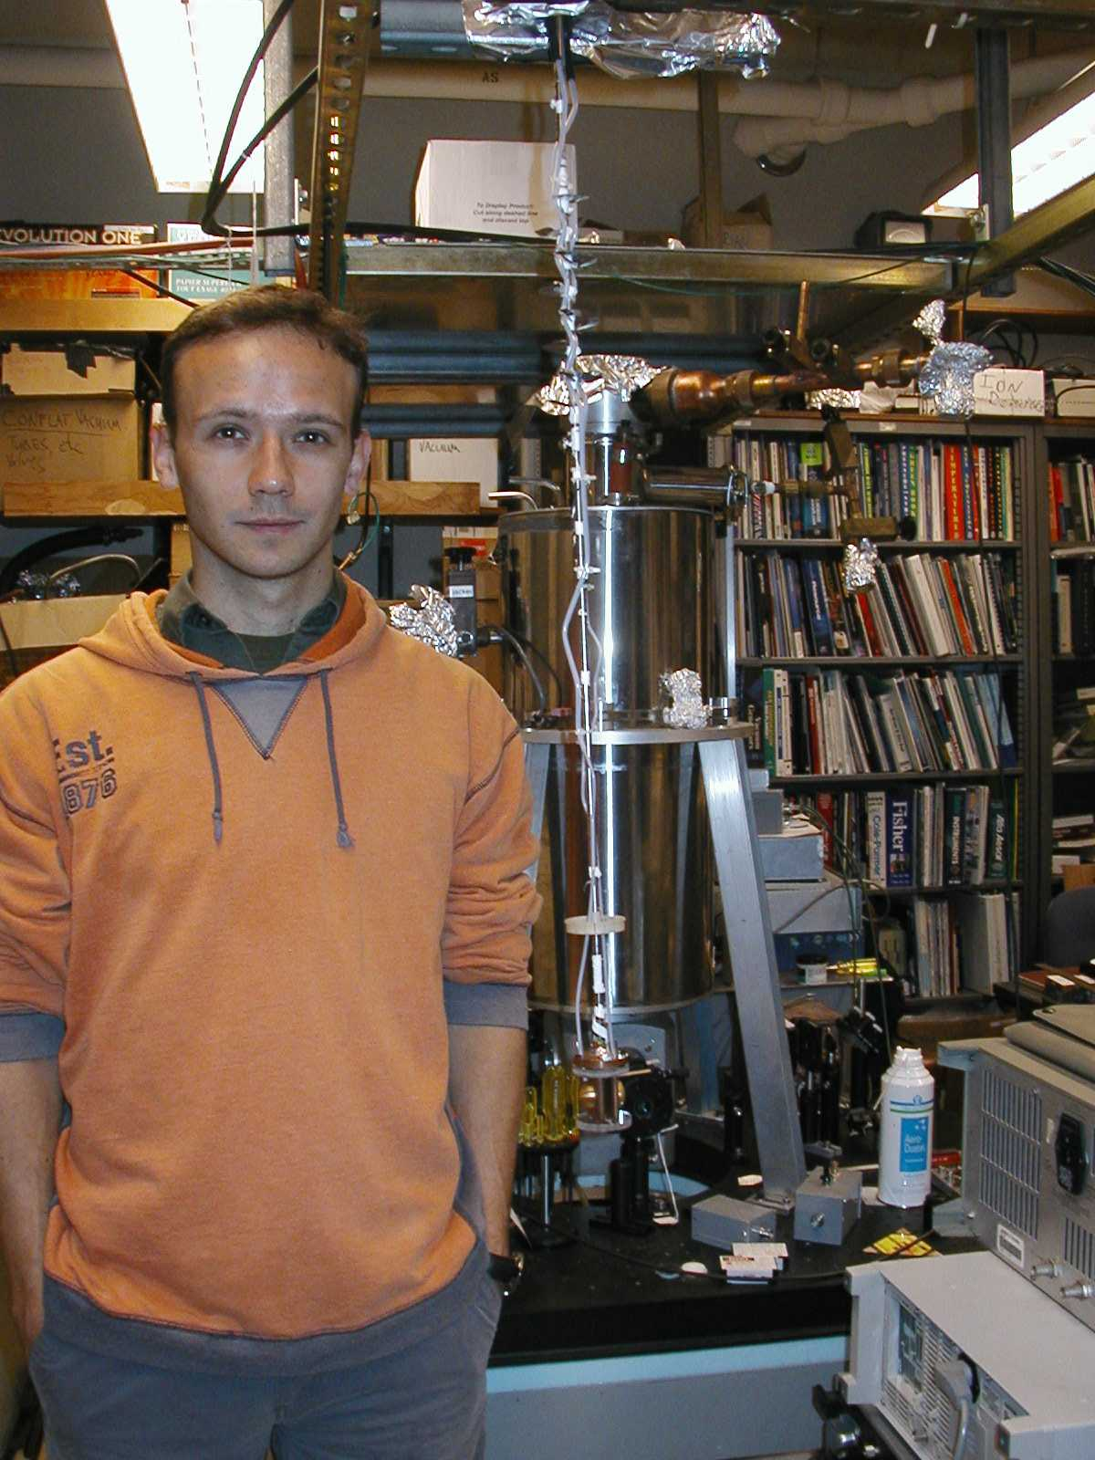
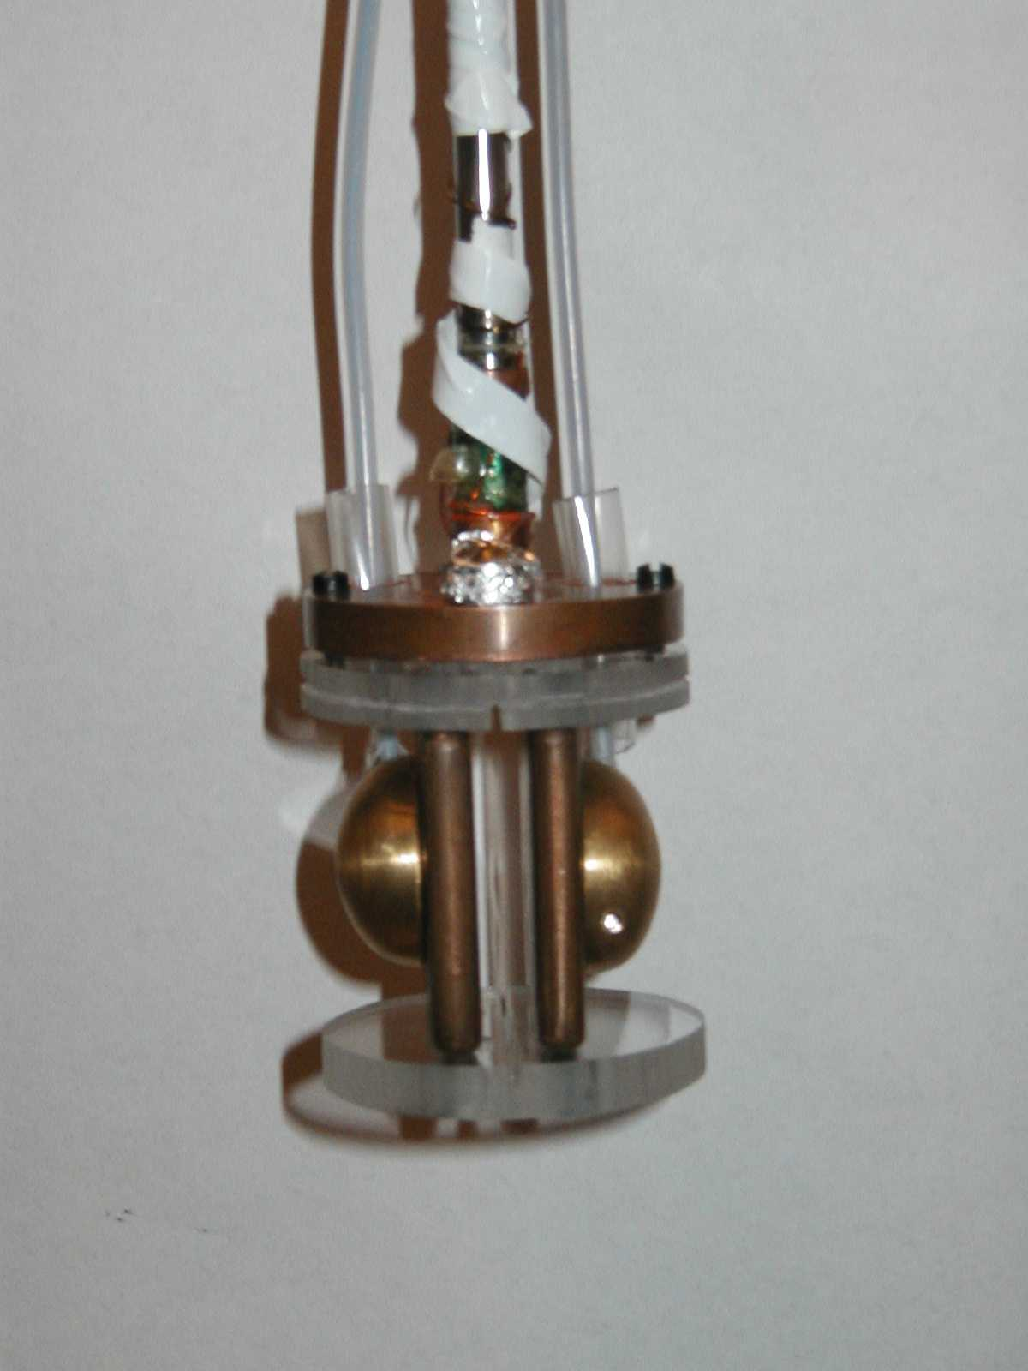
Test set-up at Berkeley
Cryostat (T 1.4 K)
with optical access
Laser
Thin-wall st. steel tube
Home-made cryogenic HV cable
Copper electrodes l=38 mm gap=6 mm
HV cable- connector
Graduate student A. Sushkov (BerkeleyYaleHarvard)
Electrode Assembly

Slide 43
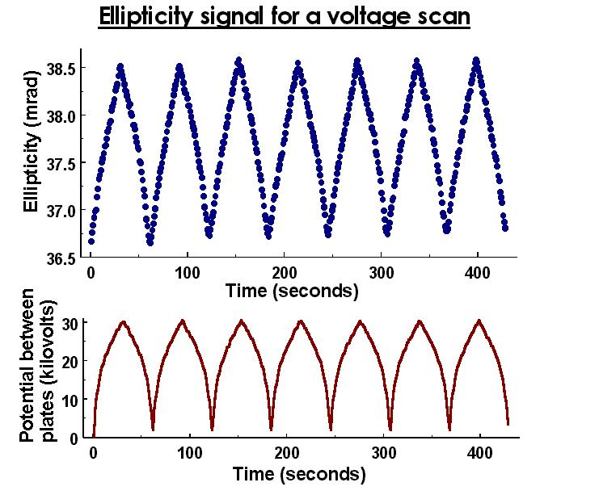
Results: LN₂ Kerr constant
Measurement:
K = 4.2(1)·10⁻¹⁸ (cm/V)²
Literature result:
K = 4.0·10⁻¹⁸ (cm/V)²
K.Imai et. al., Proceedings of the 3rd Int. Conf. On Prop. and App. Of Diel. Mat., 1991 Japan)
E = 60 kV/cm
max

Slide 44
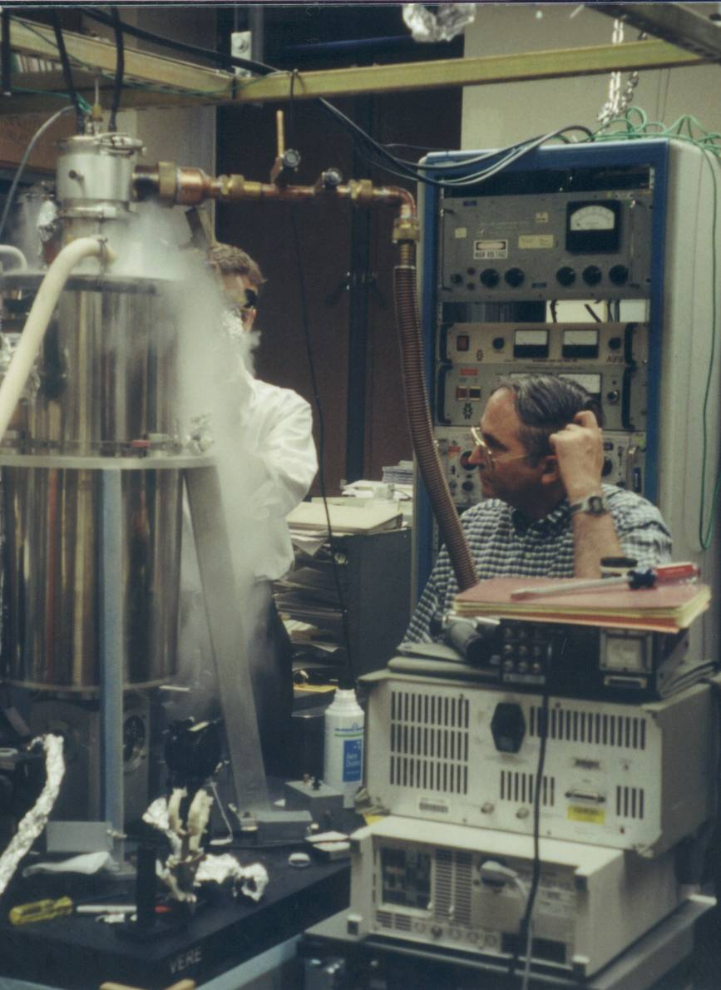
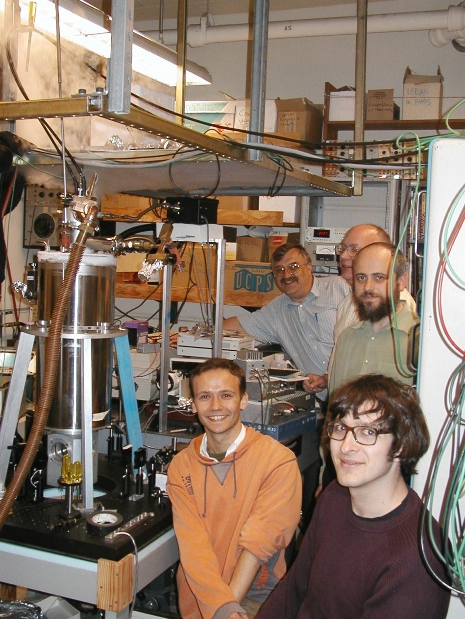
LHe Kerr Constant Measurements
Eric Williams
Martin Cooper
A. Sushkov, Val Yashchuk, S. Lamoreaux

Slide 45
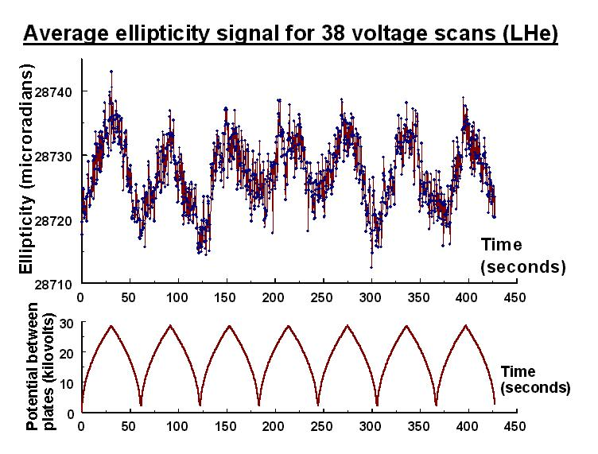
Results: LHe Kerr constant (T≈1.4 K)
Measurement:
K = 2.45(13)·10⁻²⁰ (cm/V)²
Theoretical value:
(1s, 2s, 2p levels)
K = 2.0·10⁻²⁰ (cm/V)²
Temperature dependence!
E = 50 kV/cm
max

Slide 46
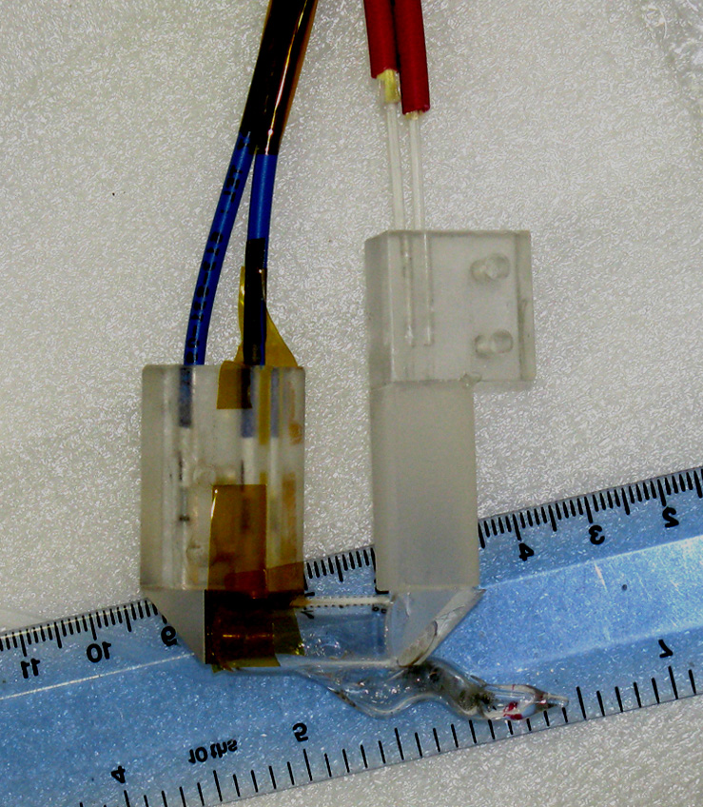
Fiberized Magnetometer for nEDM
All-optical, alignment-based fiberized magnetometer:
Large-core fibers
(output)
Polarization-
maintaining fibers
(input)
Polarizing beamsplitter
Cs cell
probe
Magnetic field
pump
1 cm

Slide 47
Performance:
cm-scale alekene-coated cell has T₁ = 0.122 s:
Driven oscillation indicates 2.4 nG field resolution with 12.5-Hz ENBW:
Sensor also operates in self-oscillating mode with high sensitivity
Initial tests limited by ambient field noise
Acoustic noise not observable at frequencies above 2 kHz, even when sensor in motion
Larmor frequency ~7 kHz in experiment.

Slide 48
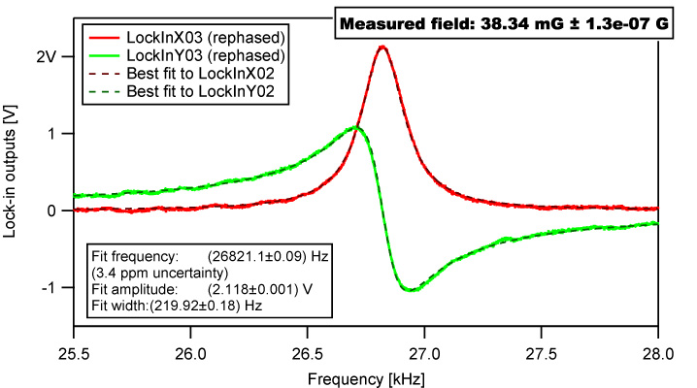
Performance (in actual noisy environment@CalTech)

Slide 49
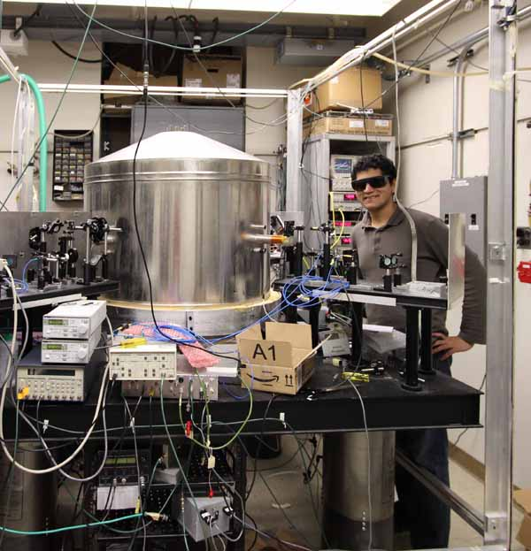
nEDM magnetometer people
Chris Hovde SWS
Brian Patton
UCB
Mohammed Sheikh
Undergraduate

Slide 50
UCN sources for nEDM: a view of a (well connected) dilettant with thanks to: Peter fierlinger, tim chupp, douglas beck, and Geoff greene

Slide 51
UCN sources for nEDM
Sources
Spallation
lD₂
lHe
Reactor
sD₂
_{Crystal}
_{lHe}

Slide 52
Paul Huffman

Slide 53
UCN sources for nEDM
In helium the life-time of neutrons is long and neutrons can be accumulated for 100s of seconds, but the production cross section is small
In deuterium the production cross section is large but the life-time is ~150 ms so the UCN must leave the source quickly
Solid deuterium is operated at 6 K, so it is easier to cool (e.g.
inside a reactor)

Slide 54
UCN sources for nEDM
- Production in solid deuterium at spallation target, UCN extraction in vacuum and experiment in vacuum (PSI, TUM)
- Production in liquid deuterium+Doppler deceleration, UCN extraction in vacuum and experiment in vacuum at room-temperature (Serebrov at ILL, previous Sussex-RAL-ILL experiment that is now at PSI)
- Production in superfluid helium + accumulation of UCN inside helium, extraction of UCN to vacuum, experiment in vacuum at room temperature (Masuda/J. Martin + TRIUMF, Shimizu + KEK)
- Production in superfluid helium + accumulation of UCN in helium + transport to experiment inside helium, experiment in helium. Main advantage is high voltage. (new RAL-Kure-Oxford-ILL at ILL)
- Production in superfluid helium + accumulation of UCN in helium + experiment directly where UCN are produced (SNS)
- Others: crystal EDM: use of dynamical theory of diffraction with thermal neutrons and strong electric fields inside solids (ILL)

Slide 55
UCN sources for nEDM
Intrinsic UCN production
SNS,"cryo-edm" at ILL
Downscattering 8.9A neutrons in sf-He, in EDM apparatus
Detector doubles as UCN source
Such experiments require most intense beam possible of 8.9A neutrons, preferably pulsed so that only the special wavelength reach the apparatus
UCN created elsewhere
All other expts
UCN transported to the EDM apparatus
This process is inefficient
Losses in transmission diminish initial advantage of higher flux created at the source
Need cold neutrons, not UCN
from the facility

Slide 56
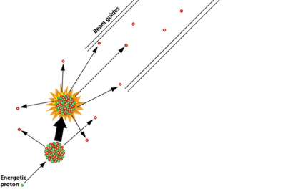
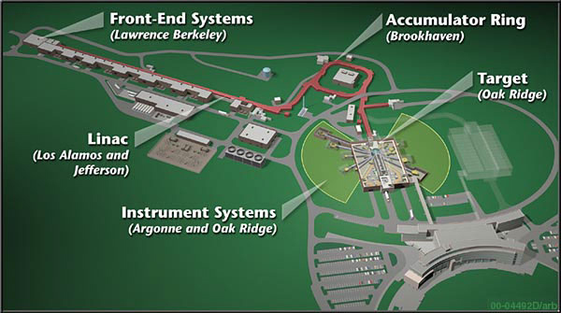
Spallation Neutron Source (SNS)
H⁻ ions (a proton with two electrons) are first generated in pulses;
Accelerated to 1 GeV (almost 90 percent of the speed of light) by a linear accelerator using both standard and superconducting techniques;
Stripped of electrons and concentrated into a 2 MW proton beam of less than 1 μs pulses at 60 Hz in an accumulator ring;
Directed at a liquid mercury target (chosen for mercury's large nucleus containing many neutrons and its liquid form at ambient conditions capable of absorbing rapid temperature rise and intense bombardment shock) in the target building, which ejects 20 to 30 neutrons per mercury nucleus hit by a proton (spalling in all directions);
Which are slowed down by moderators to useful energies;
And applied through 18 surrounding beam lines to various materials and interfaces;
Where up to 24 instruments chosen by users record the results for interpretation

Slide 57
UCN sources for nEDM
SNS experiment: expected loading ≈0.25 UCN/cm³/s
⇒ ≈125 UCN/cm³
TUM: hoping for ≈1000 UCN/cm³ in cells
For PSI, the hope was ≈100 UCN/cm³ but currently a factor of 10 or more below that
SNS status: The 8.9A flux with the original, double monochromator design measured to be 1.8x10⁶ n/s/cm²/A at the end of a long beamline (≈ 2/3 of the way to nEDM). This is ≈60% of expected. New plan: instead use the ‘cold’ beamline with a chopper for the nEDM experiment, which should boost the flux by a factor of 4.5 over that measured on the monochromator line

Slide 58
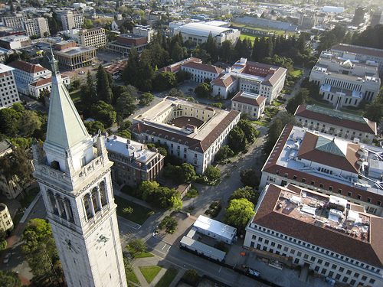
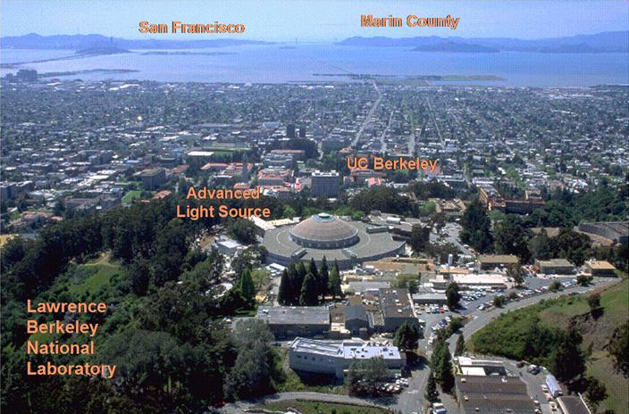
Advertisement:
looking for visiting students/interns/postdocs/sabbatical faculty
preferably with funding
will train!

Slide 59
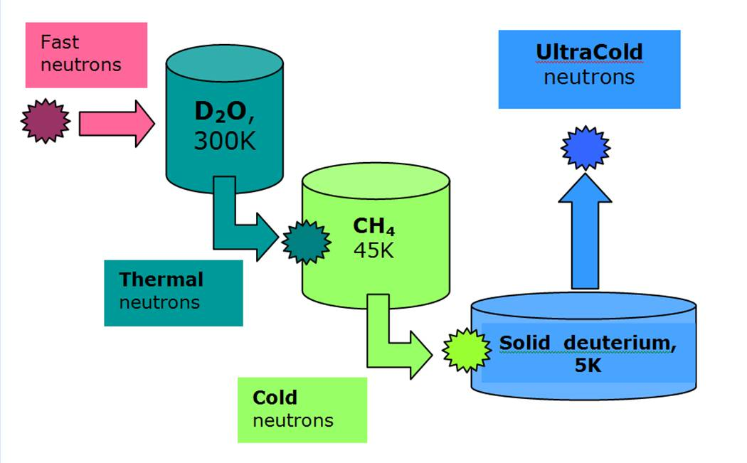
UCN sources for nEDM
The PULSTAR reactor source at North Carolina

Slide 60
UCN sources for nEDM
The PSI spallation UCN source:
Neutrons are produced in a short pulse of the full 2 mA, 590 MeV PSI proton beam on a spallation target. The fast neutrons are moderated, cooled, and finally down-scattered into UCN in solid ortho-deuterium. UCN are extracted from the solid deuterium and guided into a diamond-like carbon (DLC) coated large storage volume from which they can be extracted into experiments. After the proton beam pulse, the production and storage volumes are separated by a shutter, allowing for UCN storage times of the order of magnitude comparable to the lifetime of the free neutron.

