Slide 1

Beta = 0.61, 650 MHz Cavity Development at JLAB
Andrew Burrill for the JLab Team

Slide 2
Goals of the JLab Program
Provide an alternative 650 MHz, β=0.61, 5 cell SRF cavity design with a complete set of fabrication drawings based on a comprehensive RF and engineering analysis.
FY11 Deliverables
650 MHz, β=0.61, SRF single cell and 5 cell cavity RF design
Fabrication, processing and testing of 3 single cell cavities was completed
FY12 Deliverables
Design report for 5 cell cavity
Drawing package for fabrication of a 5 cell JLab cavity
Cost estimate for in-house fabrication of a 5 cell prototype
Notes:
Goal is commonality, so our cavity will be designed to utilize the FNAL He vessel, tuner as well as the same coupler ports.

Slide 3
Single Cell Cavity Program
Jefferson Laboratory has designed, fabricated and tested three single cell 650 MHz β = 0.61 cavities based on a JLab 5 cell cavity design.
The cavities were fabricated from 4 mm RRR>250 niobium sheet.
The cavities were chemically etched using 1:1:2 BCP to remove ~250 μm of material.
Hydrogen degassing at 600 °C for 10 hours
Cavity-A exceeded Qo value >1x10¹¹ at 1.6 K corresponding to a residual resistance of < 1.5 nΩ.
Eacc of all three cavities has exceeded 18 MV/m.
Additional information may be found in:
MOPO007 Proceedings of SRF 2011
MOPC114 Proceedings of IPAC 2011

Slide 4
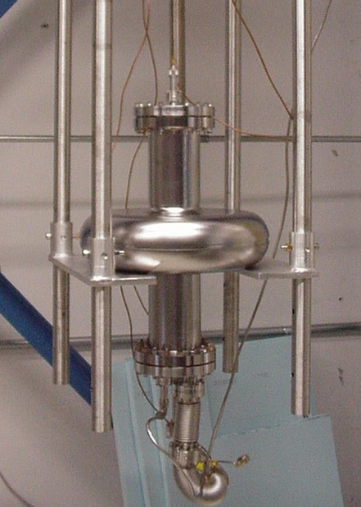
Operating Regime
16-19 MV/m
Predicted multipacting barrier
For center cell geometry

Slide 6
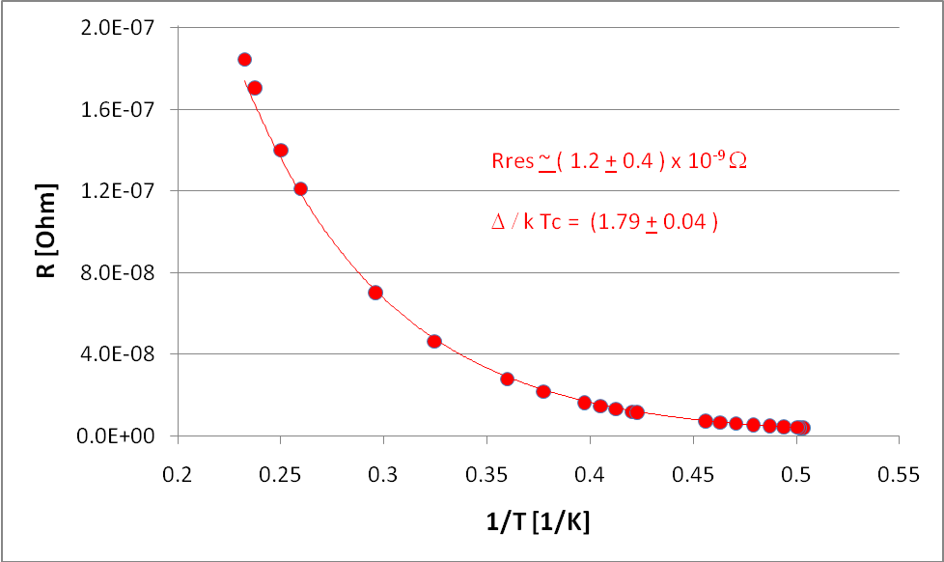
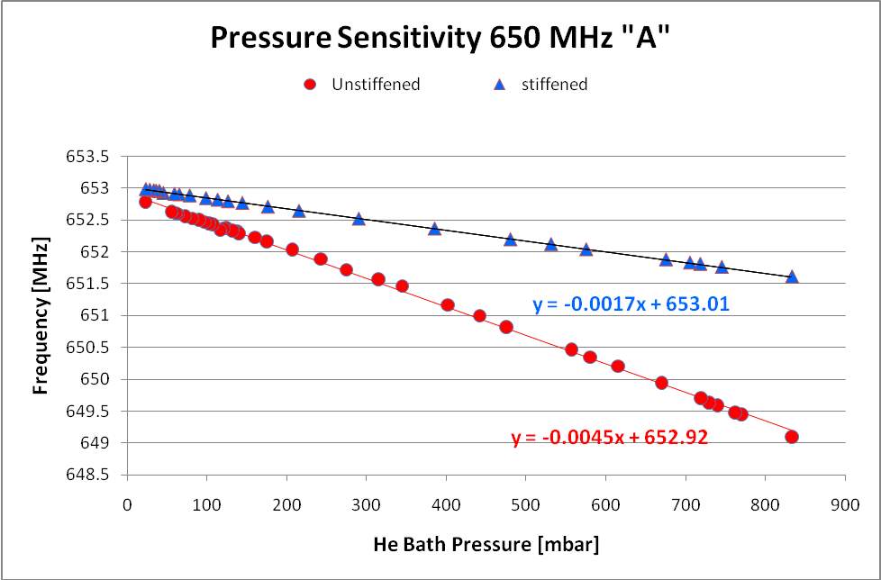
Cavity Test Results
Temperature dependence of the surface resistance
Δf/Δp of 4.4 kHz/mbar unstiffened and 1.7 kHz/mbar
Lorentz Force detuning for the unstiffened (Cavity A), and stiffened (Cavity B)

Slide 7
Single Cell Future
One cavity delivered to FNAL for testing
  Preliminary results are in, further analysis needed
Electropolish single cell and look at performance improvement
  Horizontal EP – our work horse tool for ILC and CEBAF 12 GeV upgrade work
  Vertical EP – our development tool, preliminary results are encouraging
CBP and EP – further our development of CBP
Use existing 3 single cells to build a multicell cavity for testing and to exploit some of the ideas listed above?
  This has been done before at Jlab, but is the payoff worth it?

Slide 8
5 cell β=0.61 R&D Efforts
Design and analysis of stiffening ring and end group attachment to minimize df/dp while utilizing the FNAL He vessel and tuner design.
  Ensure compliance with FNAL interpretation of ASME pressure vessel code
Produce fabrication drawings and specifications for the production of a 5 cell prototype.
Develop and in-house cost estimate for the 5 cell prototype

Slide 9
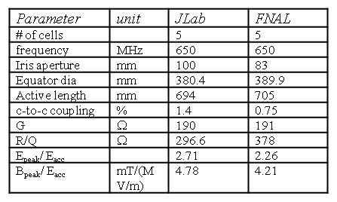
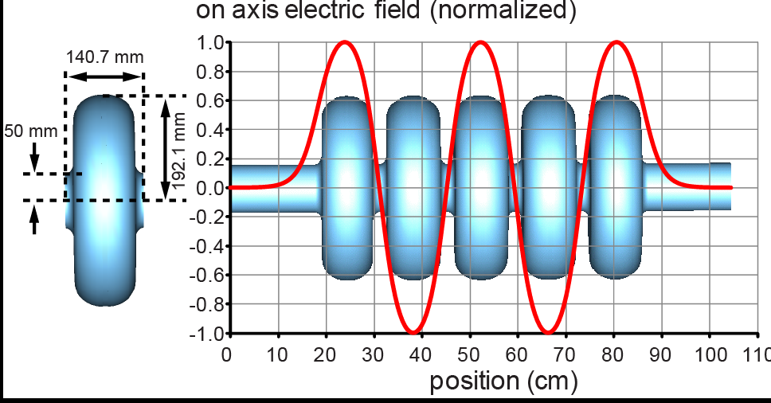
Cavity Design
5 cell design based on β=1 high average current cavity shape fabricated at 748.5 MHz & 1497 MHz
Cavity Features:
Single die cavity design
Same iris aperture as HB cavity
Increased cell-to-cell coupling
Improves mechanical stability
Aid in field flatness sensitivity
less HOM trapping and field tilts
reduced post-fabrication tuning
Reduced electron impact energy - multipacting
Courtesy of Frank Marhauser

Slide 10
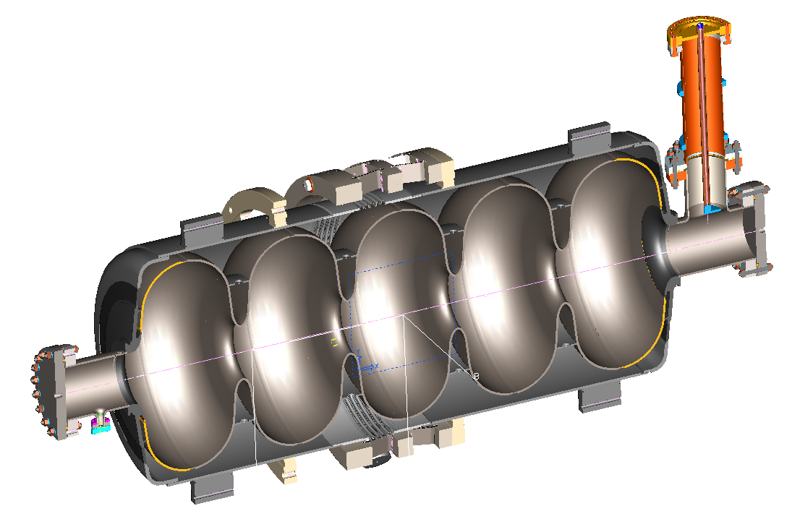
Pressure Sensitivity and Stress Analysis
Our starting point – FNAL β=0.9 dressed cavity
Model courtesy of FNAL

Slide 11
High Beta Cavity Pressure Sensitivity
High beta cavity pressure sensitivity (df/dp) was optimized by S. Barbanotti et al. with df/dp controlled to 4.5 Hz/mbar.
No indication from S. Barbanotti’s report that tuner’s stiffness, bellows stiffness, and bellows thrust force are considered in df/dp calculations. These factors may affect the df/dp result.
JLAB’s investigate started with confirming high beta cavity df/dp with consideration of tuner stiffness, bellows stiffness, bellows thrust force, and boundary conditions are set on helium vessel bearing lugs per FNAL Charles Grimm’s suggestions.
The blade tuner for high beta cavity is estimated to have a cold stiffness of 428 kN/mm.
The helium vessel bellows axial stiffness is estimated per ASME Boiler & Pressure Vessel Code, Section VIII, Division 1, Appendix-26 procedure to be 0.403 kN/mm (2300 lbf/in). For 1 bar pressure, bellows thrust force is 572 N (129 lbf).

Slide 12
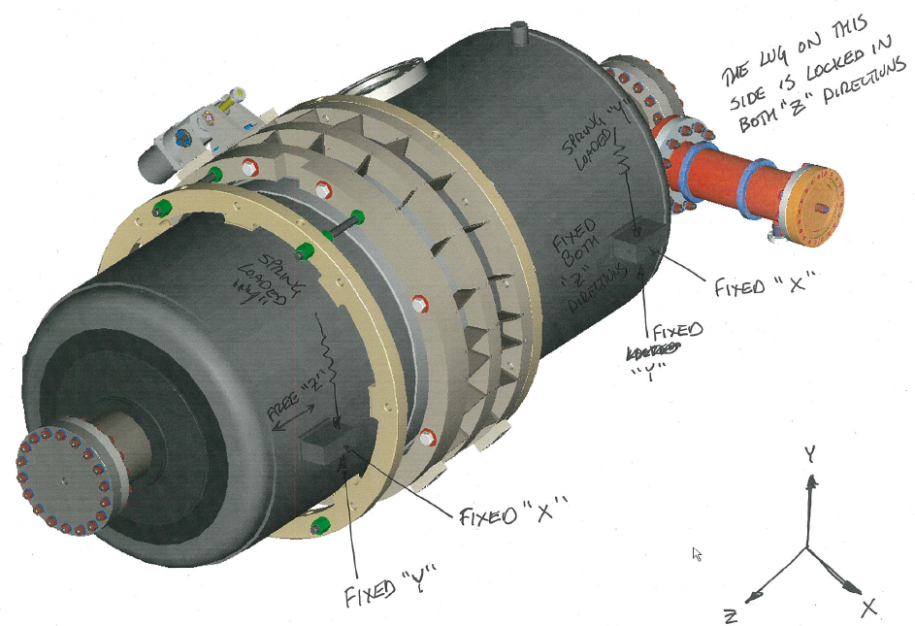
High Beta Cavity Pressure Sensitivity
Front view of boundary conditions on HV bearing lugs from FNAL Charles Grimm. Spring loads are omitted in finite element model.

Slide 13
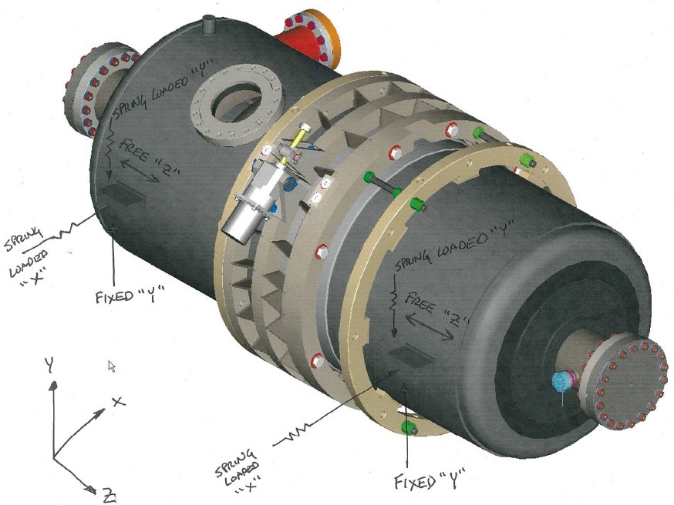
High Beta Cavity Pressure Sensitivity
Back view of boundary conditions on HV bearing lugs from FNAL Charles Grimm. Spring loads are omitted in finite element model.

Slide 14
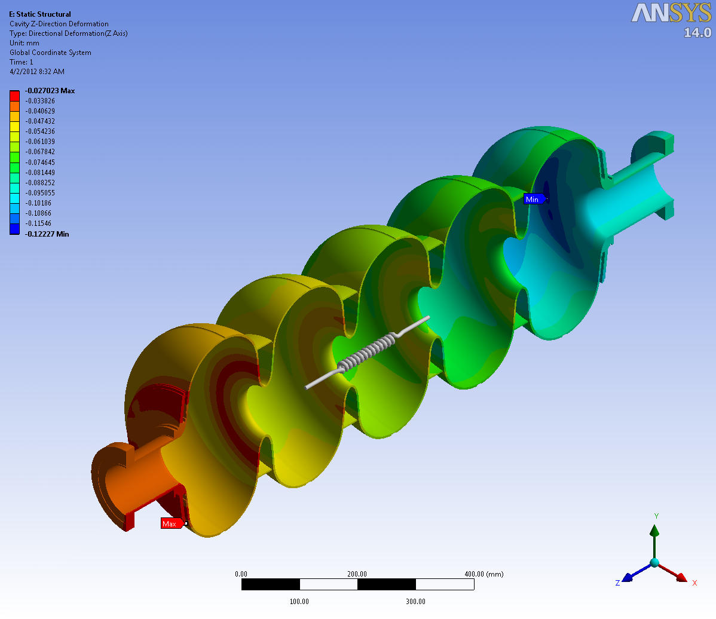
High Beta Cavity Pressure Sensitivity
This picture shows cavity longitudinal deformation under 1 bar pressure. The df/dp is calculated to be 4.2 Hz/mbar.
There are 2 springs in the model: one for blade tuner and the other for HV bellows

Slide 15
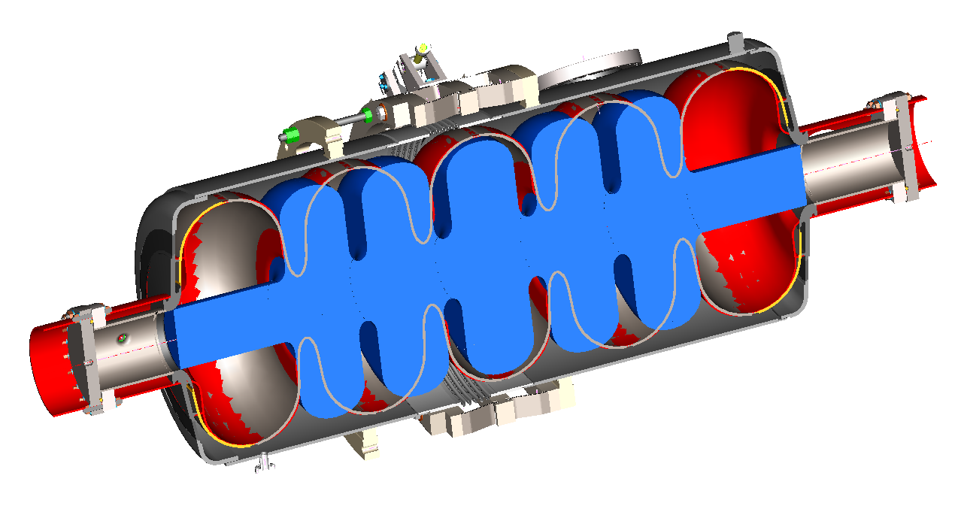
Comparison of the β= 0.9 and β= 0.61

Slide 16
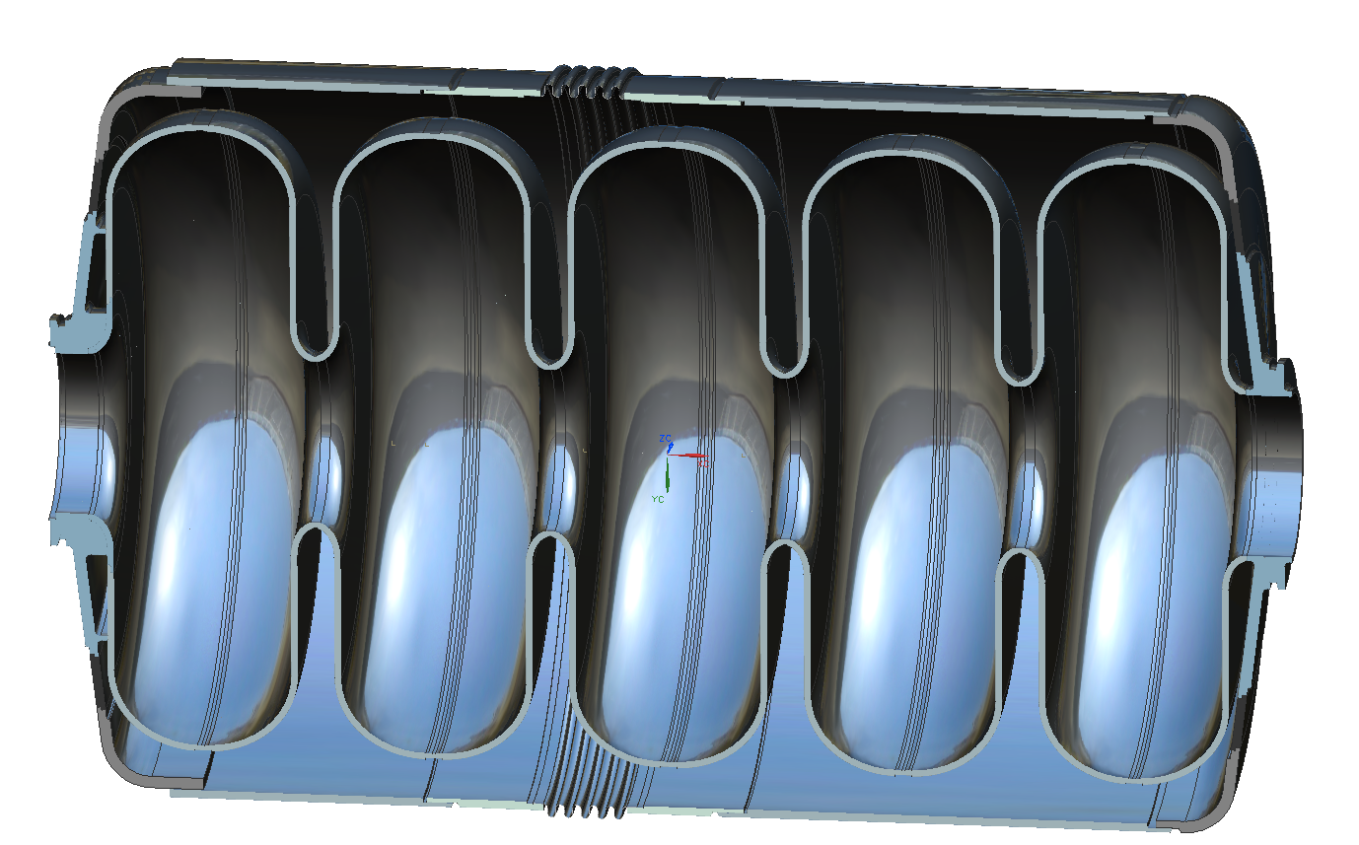
Hub design Change
JLab hub based on past fabrication experience
  Reduces amount of RRR material required
  Eliminates electron beam weld on cell wall
  Stiffener ring not integral to hub
JLab Hub
FNAL Hub

Slide 17
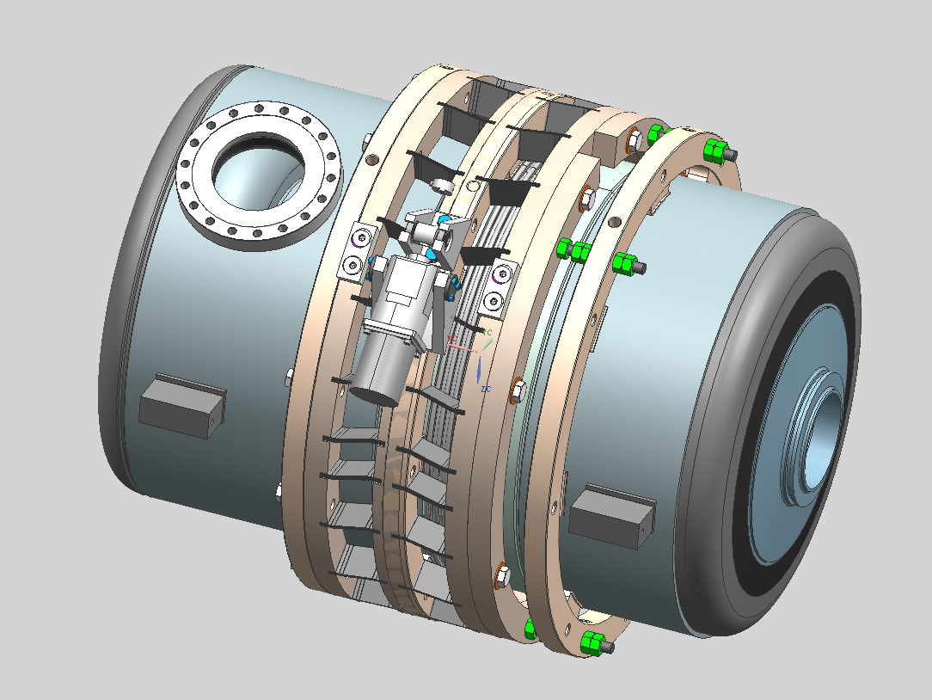
Medium Beta Cavity Pressure Sensitivity
JLAB’s 5-cell medium beta cavity is much shorter than FNAL’s high beta cavity.
  the HV is shortened and the 4 stainless steel safety rods for blade tuner are shortened.
  The blade tuner’s overall stiffness at cold is re-estimated to be 589 kN/mm, compared to 428 kN/mm for the HB design.

Slide 18
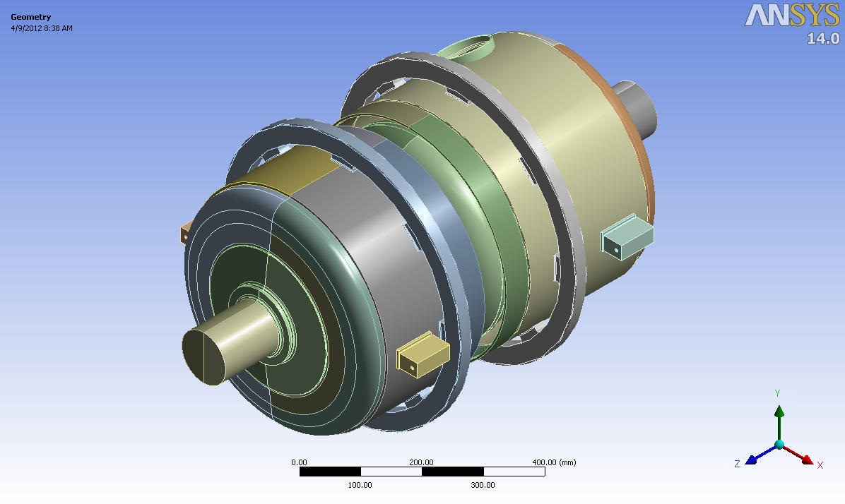
Medium Beta Cavity Pressure Sensitivity
Vacuum volumes for RF analysis
Model for medium beta cavity df/dp optimization: tuner and helium vessel bellows are simplified and represented as springs.

Slide 19
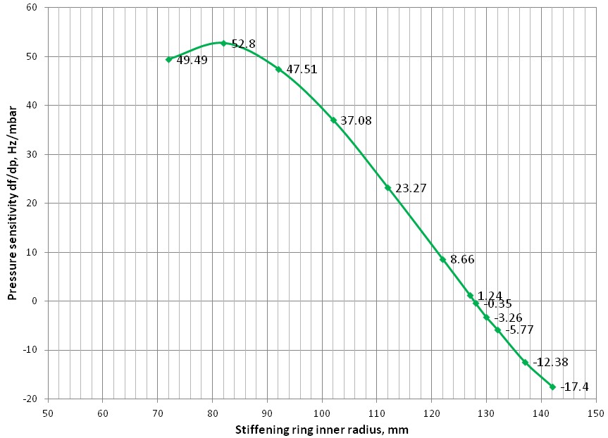
Medium Beta Cavity Pressure Sensitivity
The optimal stiffening ring inner radius is 128mm, which gives -0.35 Hz/mbar pressure sensitivity in the medium beta cavity. Note that the vacuum in this cavity has iris radius of 50 mm and equator radius of 192mm.

Slide 20
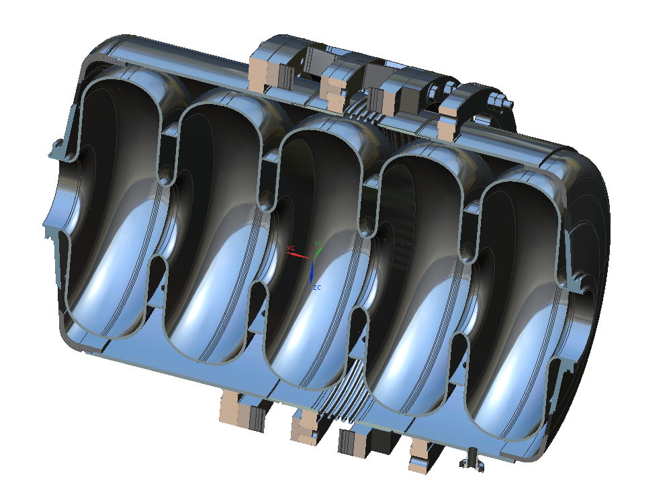
Stiffener Ring Optimization
The stiffening rings for medium beta mimic those for high beta.
  Each end ring consists of 12 segments separated with a 10° azimuthal angle evenly.
  Middle rings have 10x 0.5" diameter vent holes and a 10 mm wide interval between two half rings.
  All rings are 0.125" thick and have chamfers at the ends of the cross section. EBW thickness between rings and cavity wall is typically 0.062".

Slide 21
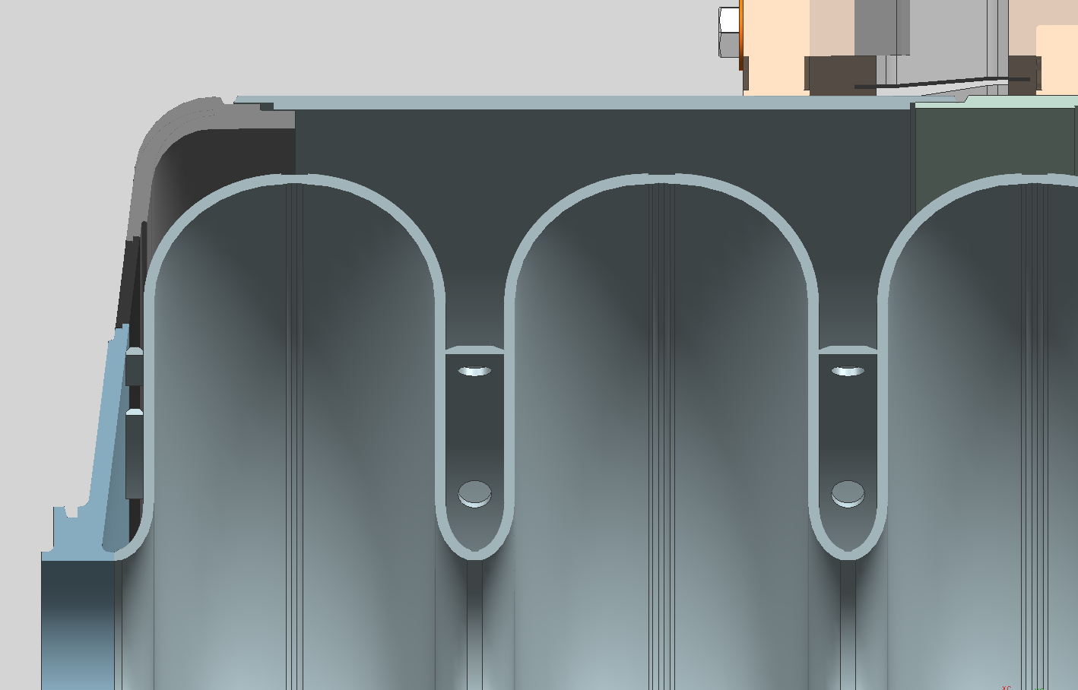
Stiffener Ring Optimized Location

Slide 22
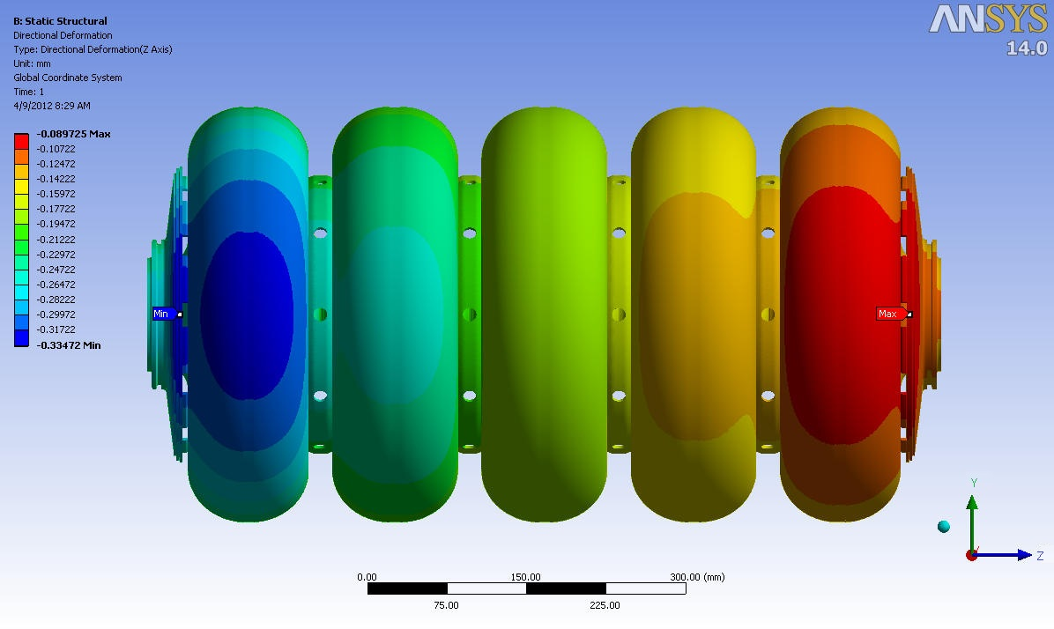
Medium Beta Cavity Pressure Sensitivity
This picture shows the longitudinal deformation of the medium beta cavity, with optimal stiffening ring inner radius of 128mm, subjected to 1 bar pressure load.

Slide 23
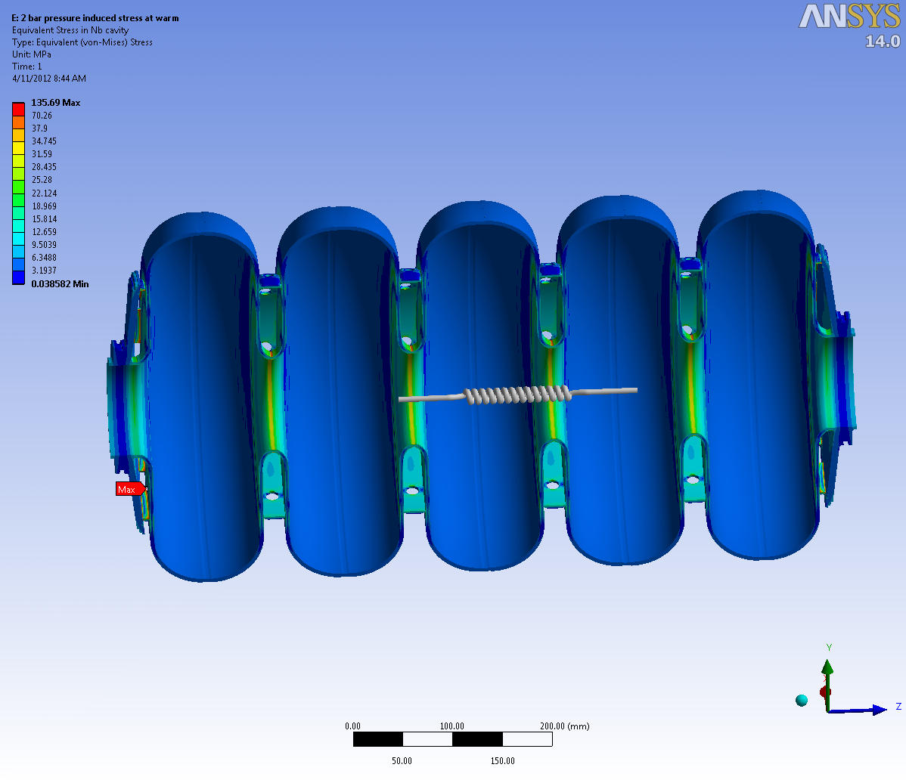
Preliminary Stress in Warm Medium Beta Cavity under 2 bar Pressure
It is noticed that stresses at some local sites exceeded the allowable stress of 37.9 Mpa. Typically at stiffening ring to cavity joints. Iris outer surfaces also show high stresses.

Slide 24
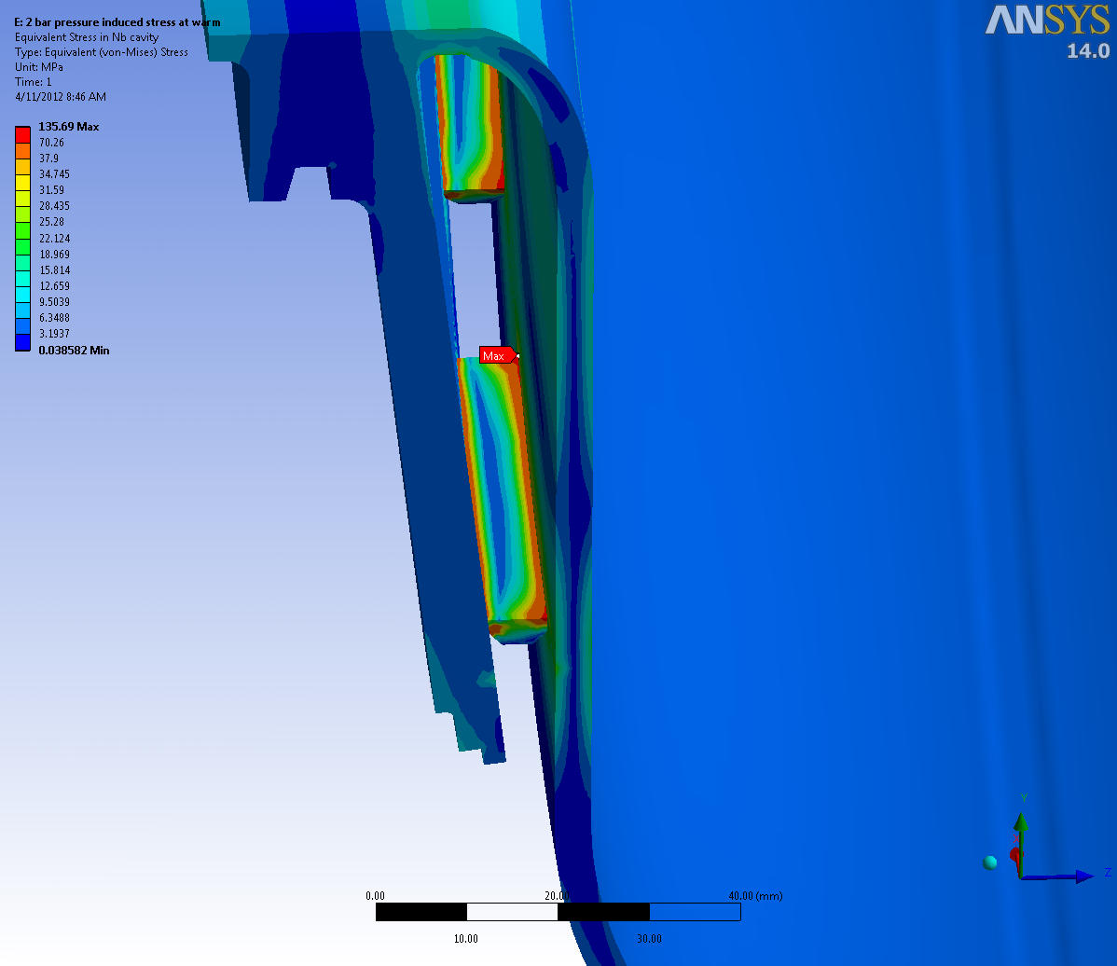
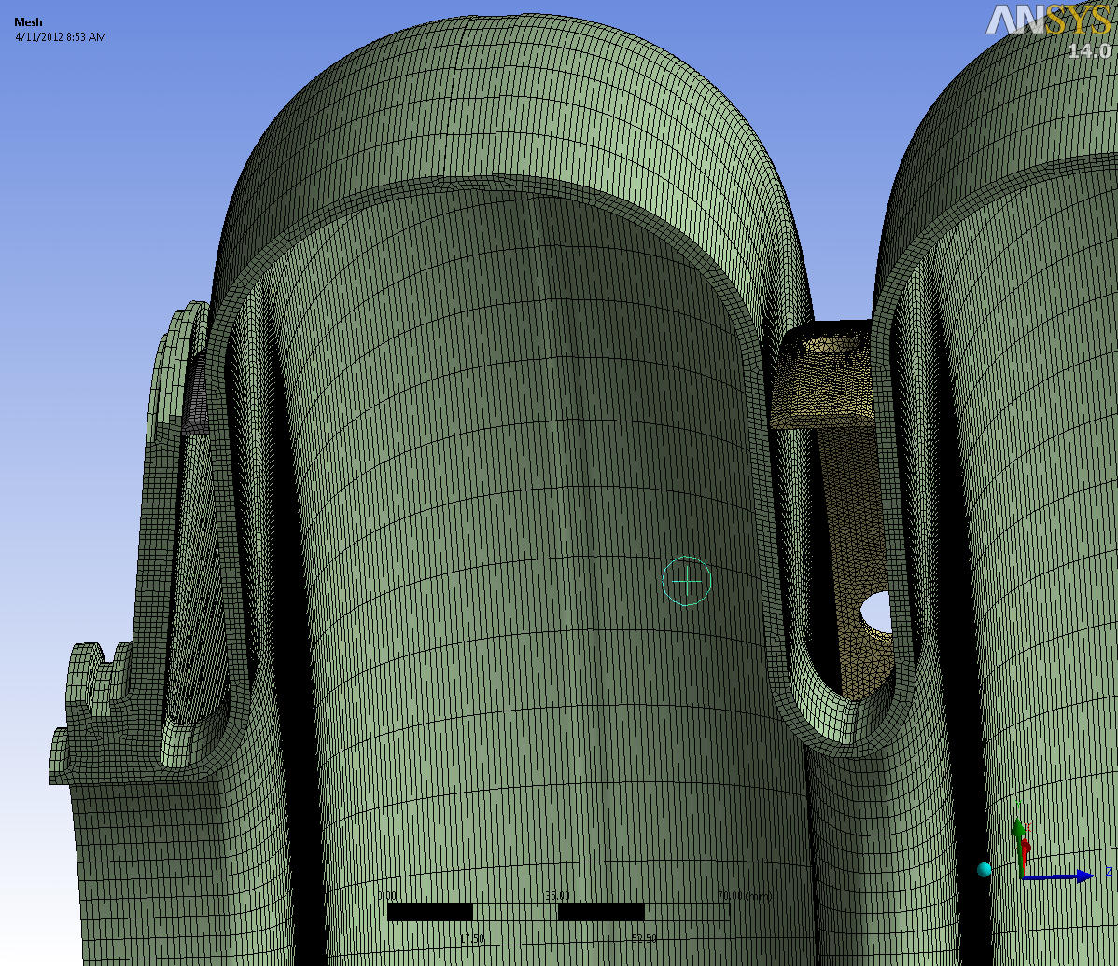
Stress in Warm Medium Beta Cavity under 2 bar Pressure
The high stress at ring to cavity joints is suspected to be singularities at sharp corners. Fine meshes are used to capture the propagation of stress magnitude in the cavity.

Slide 25
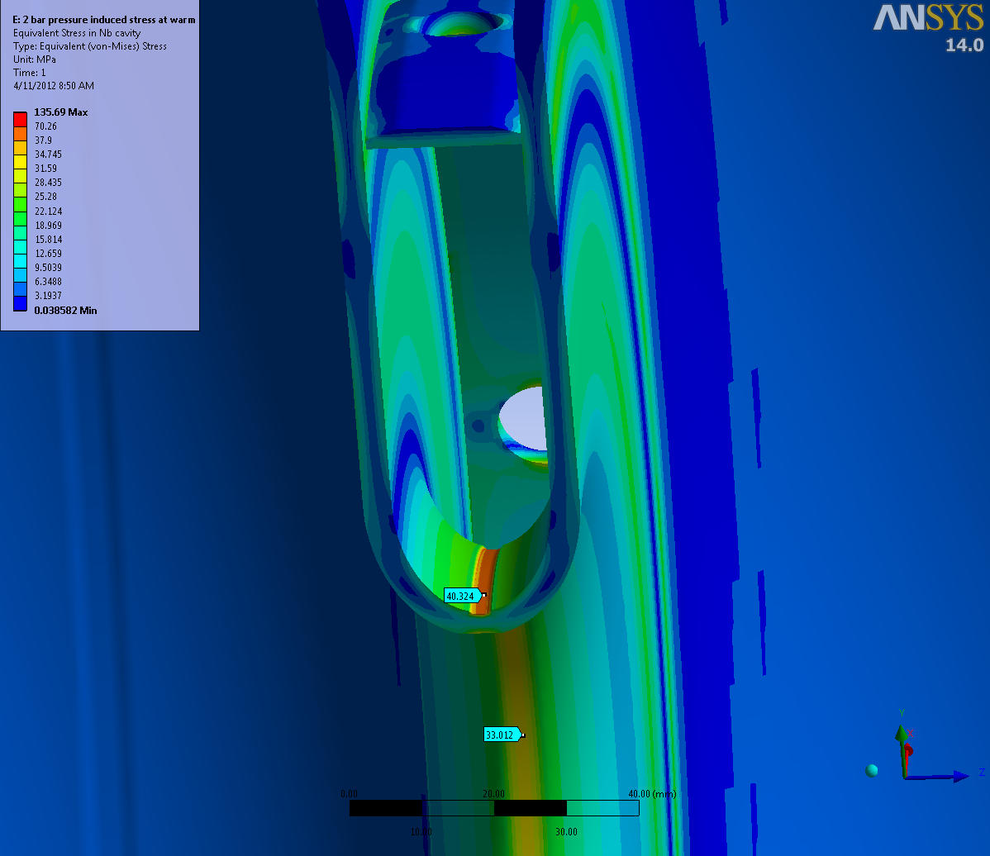
Stress in Warm Medium Beta Cavity under 2 bar Pressure
The high stress at iris occurs within a shallow layer off the outer surface and the stress magnitude is below Nb’s yield stress of 70.26 MPa. On the inner surface, which forms the vacuum space, the stress is below the allowable stress of 37.9 Mpa.

Slide 26
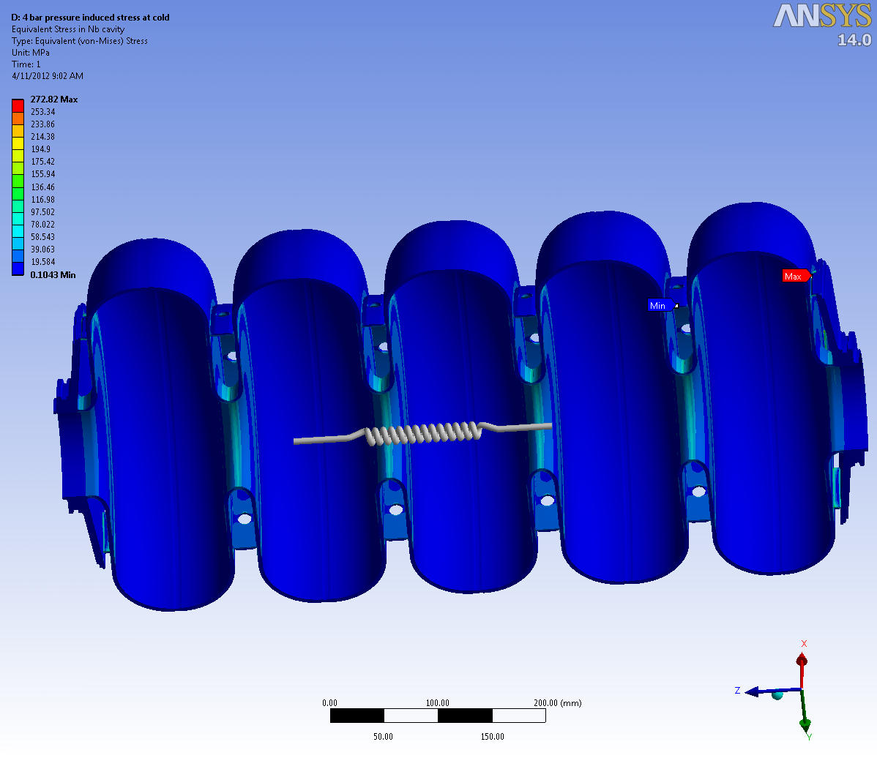
Stress in Cold Medium Beta Cavity under 4 bar Pressure
Stress in cold cavity under 4 bar pressure is far below the 4K yield stress of 699 MPa. There is no concern for cavity stress at cold.

Slide 27
Future Plans
Complete the engineering analysis and design report
Develop a complete set of fabrication drawings
Develop and in-house cost estimate to fabricate a 5 cell β = 0.61 prototype

Slide 28
Summary
Successful single cell cavity program has been completed
Engineering analysis is well underway for the β = 0.61 5 cell cavity
Stiffener ring location optimization is complete and looks very good
Stress analysis is on-going, expected to be completed in the next week
Drawing package should be completed by July 2012

Slide 29
Acknowledgements
Gary Cheng – Engineering Analysis
Jim Henry – Mechanical Design
Fermi Lab Team for providing the β=0.9 model
Thank you for your time!

Slide 30
Extra Slides

Slide 32
JLab β=0.61 dressed cavity

Slide 33
JLab β=0.61 dressed cavity

