Slide 1
LLRF for PXIE
Brian Chase
For the Project X
LLRF Collaboration

Slide 2
Outline
Recent results
NML
Six Cavity test
PXIE control requirements
Preliminary design
High efficiency solid state PA LLRF interface

Slide 3
NML CM1 LLRF Racks
Receivers and Up-converter
3 Digital Controllers
(MFCs)
- Probe, Fwd, Ref
Master Oscillator
Power Supplies

Slide 4
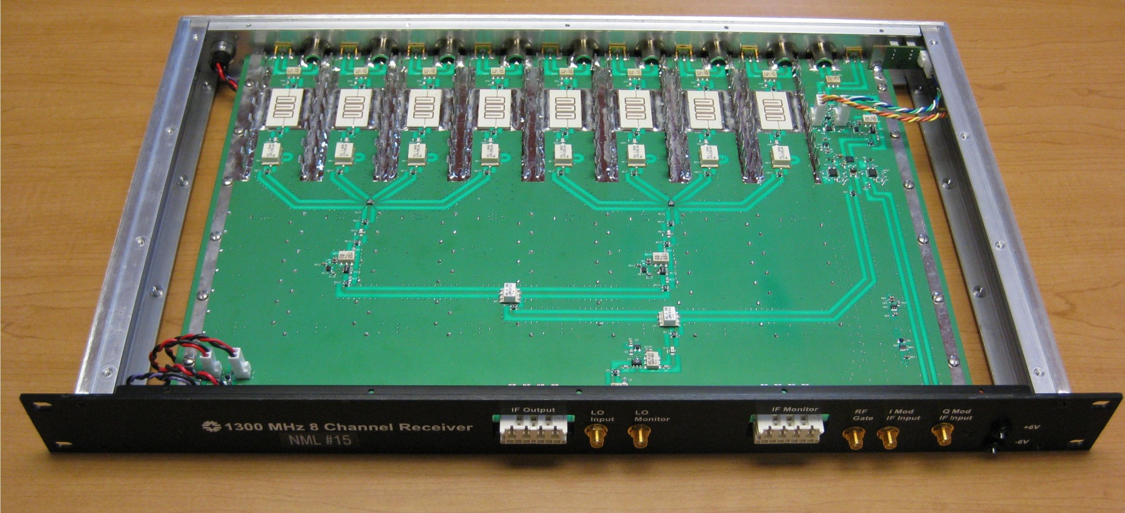
8 Channel Receiver / Transmitter
8 Channels of 1.3 GHz to 13 MHz down converters
1 transmitter with 13 MHz IQ modulation and 1.3 GHz output
Minimum 76 dB of channel to channel isolation
RF to IF conversion loss of 4 dB
IF output noise floor of -153 dBm/sqrt(Hz)
RF input 1 dB compression of 12.5 dBm
Type-N RF input connectors, Harting 8 coax IF output connector
Phase temperature stability of 0.06 degrees/ degree C
Amplitude Temperature stability of 0.008 dB / degree C

Slide 5
MFC - 32 Chanel Controller
Technologies of interest:
-Multi-channel ADCs
-Low Voltage Differential Signaling (LVDS) high speed serial connections
-Differential IF signal paths
-8 channel coax connectors
-Shielded enclosure
-Low cost per channel
8 Ch ADCs
DSP
AD 9010 Clk
FPGA
8 Ch ADCs

Slide 6
Controller Firmware
Adjustable notch filter at 8pi/9 (F,Q)
Fixed notch filter at 7pi/9
PI controller
Control System Schematic

Slide 7
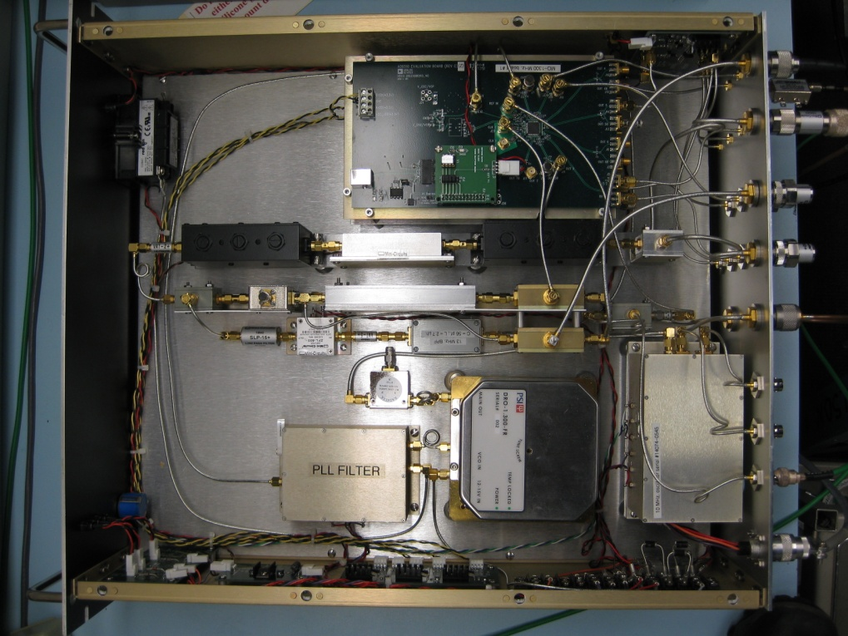
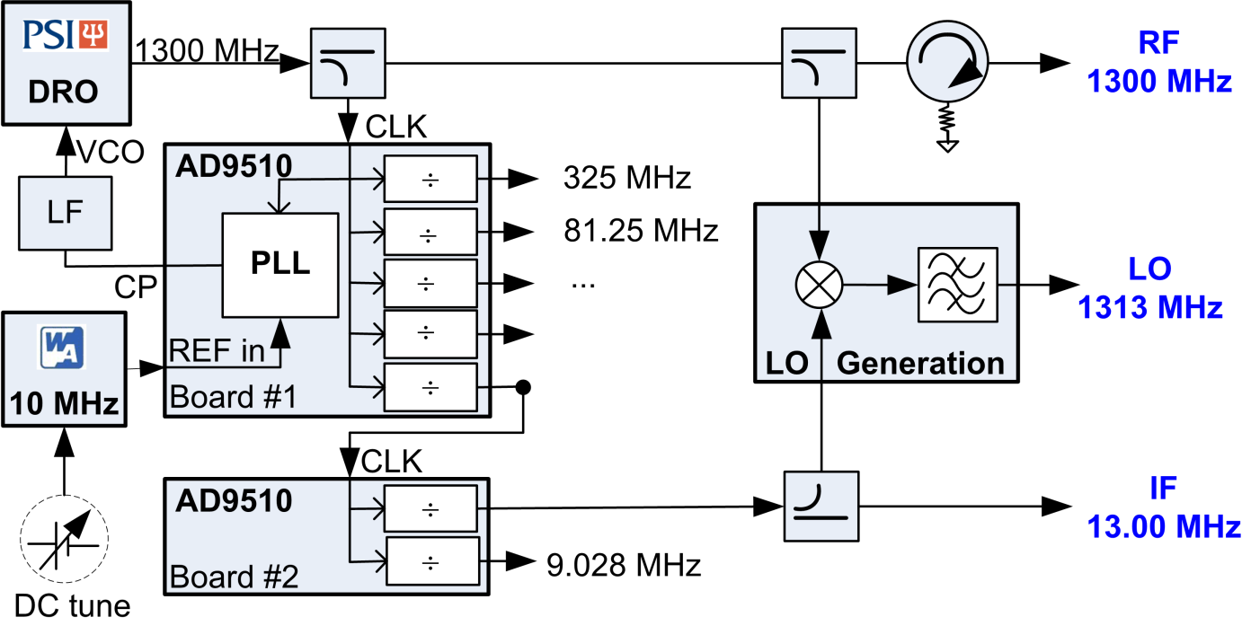
Master Oscillator
RMS jitter 46.1 fs (0.0216 deg)
integrated from 100 Hz to 100 kHz
RF, LO, IF
Programmable outputs
Timing reference
1.3 GHz
<140 fs integrated jitter (1Hz–10MHz)

Slide 8
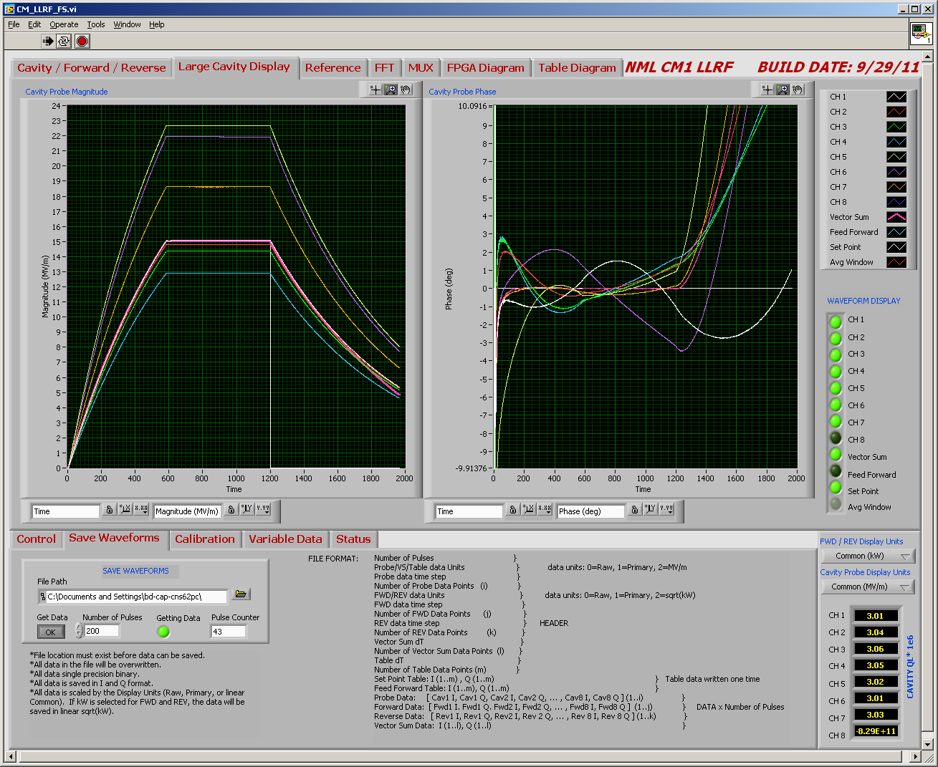
NML CM1 Field and Resonance Controllers
Notes:
Piezo and feedback operating together. Cav 1 is not under piezo control after phase shifter control

Slide 9
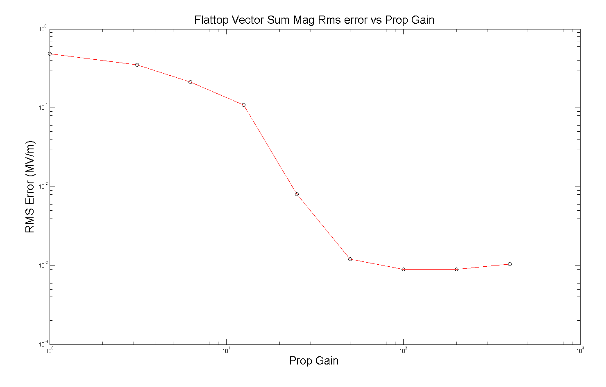
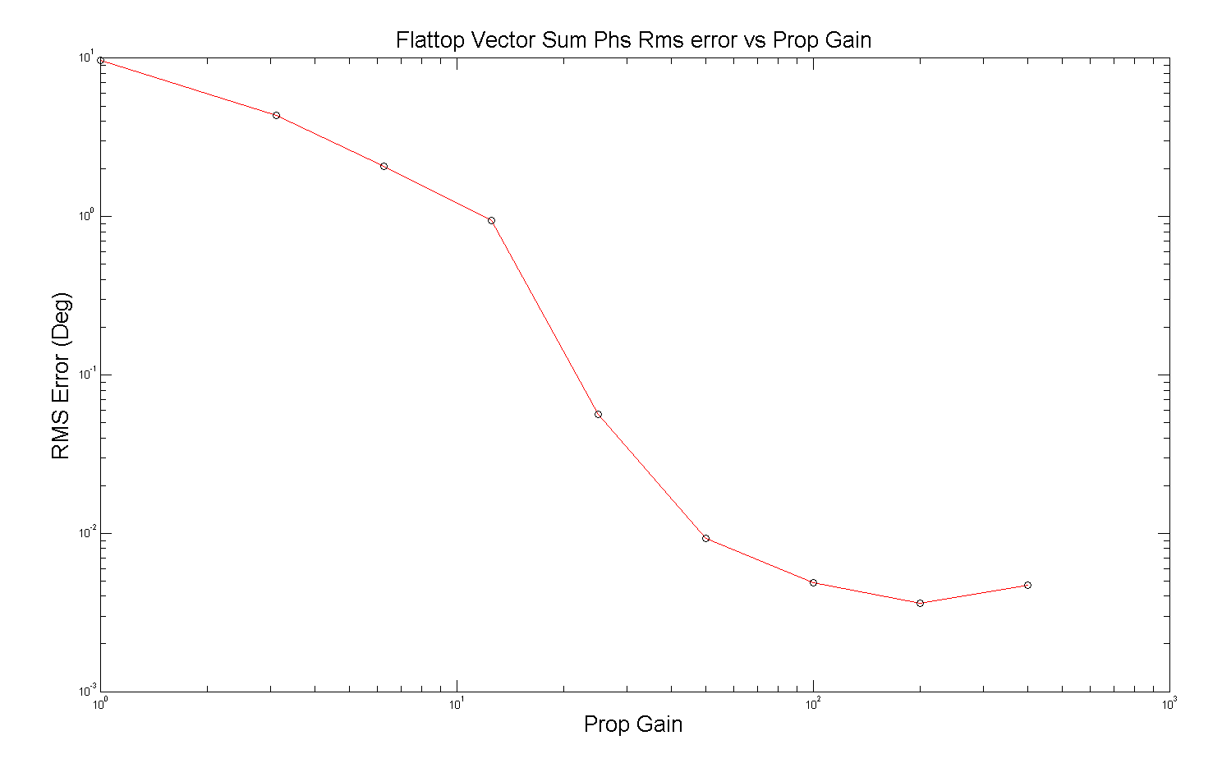
Flattop Vector Sum RMS Error vs Gain
(Igain = Pgain x 7.5e4)
Best regulation at;
Pg= 200, Ig=1.5e7
Internal measured loop error
Receiver noise is below this level
RMS error at low gain is dominated by static errors and cavity tilts
0.007% RMS
0.004 deg RMS

Slide 10
HINS with Ferrite Vector Modulators: Individual Cavity Feedback Control

Slide 11
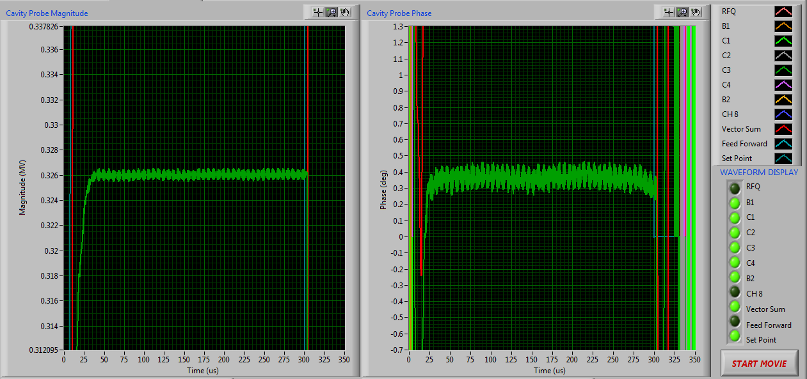
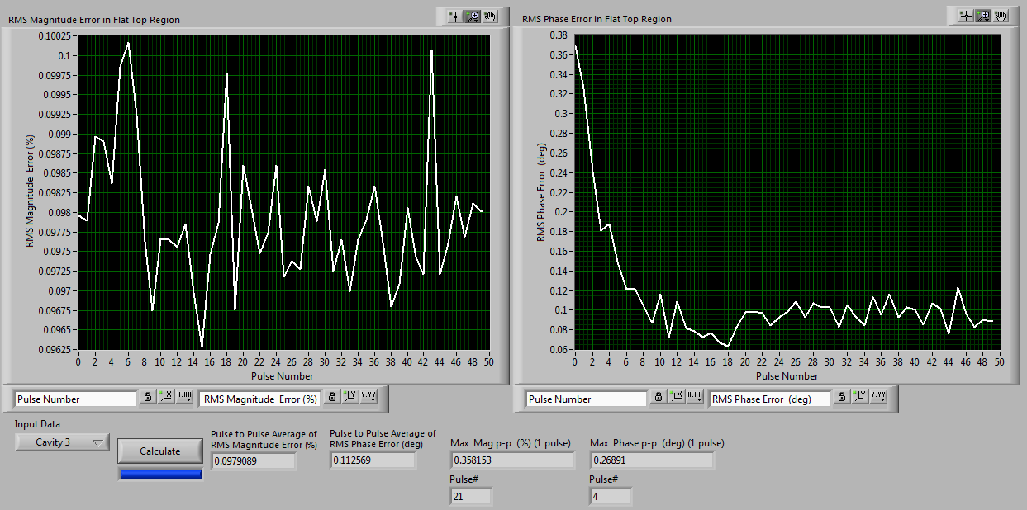
Cavity 3 (highest gradient) Cavity Regulation
RFQ RF Feedback ON
FVM Control ON
Beam OFF
Cavity 3 Magnitude
Cavity 3 Phase
+/-4%
+/-1˚
Pulse to Pulse Average of RMS Error (flat-top)
(50 Pulses)
Pulse to Pulse Average of RMS magnitude Error = 0.0979%
Pulse to Pulse Average of RMS
phase Error = 0.1126 degrees

Slide 12
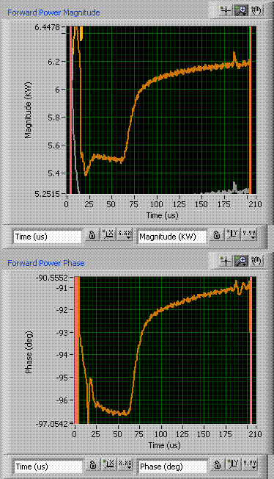
FVM Step Response
2% step in magnitude
5 degree step in phase
Rise ~ 27 us -> bandwidth ~37 kHz
• Further studies could easily be performed using phase shifter legs in a stub tuner configuration
• Provide wideband resonance control and optimal loaded Q match

Slide 13
PXIE RF Control Requirements
Requirement |  | Comments
Cavities per RF Amplifier | 1 | Suggests a new controller design
Beam Pulse width | ~1µS to CW | Pulsed mode for systems commissioning
Beam Rep rate | 60 Hz, CW
Beam current | 1mA | Upgradable to 2mA
RF Cavity Frequencies | 162.5, 243.75 325 MHz | Many sub-harmonics in Chopper And beam structure
Field Regulation | < 1%, < 0.5˚ @325MHz | Limits are in beam based calibration
Resonance control HWR , SSR1 | < 40 Hz | PZT experience is very good Reliability TBD

Slide 14
PXIE RF Subsystem Parameters
Cavity type | Frequency (MHz) | Quant. | Slow Tuner | PZT | Power | Q_{l}
RFQ | 162.5 | 1 | Yes | No | <130 kW
MEBT Buncher | 162.5 | 3 | Yes | No | 2 kW | 2336
LEBT &MEBT Chopper ARBs | 3.9 GHz | 4 | NA | NA | TBD | NA
HWR | 162.5 | 8 | Yes | ? | 5 kW | 2E+6
SSR1 | 325 | 8 | Yes | Yes | 5 kW | 3.8E+6
Deflecting Cavity | 243.75 | 1 | Yes | no | 6 kW | TBD

Slide 15
PXIE Cavity Parameters

Slide 16
Master Oscillator Output Frequencies (Phased Aligned)
1300 MHz reference
DRO generated master frequency
1313 MHz MFC distributed clock reference
3.9 GHz (1300 * 3) ARB Clock
325 MHz (1300/4) SSR1
338 MHz L0
243.75 MHz (81.25 * 3) Deflecting mode cavity
256.75 MHz LO
162.5 MHz (1300/8) HWR
175.5 MHz LO
81.25 MHz (1300/16) Beam Diagnostics
10.156 MHz (1300/128) Clock system

Slide 17
PXIE RF Reference and Clock Generation
Master Oscillator
LEBT and MEBT Chopper Waveform Generator
3900 MHz
Clk
• 81.25 MHz is the beam
fundamental after the RF splitter
• 101.5 kHz is a suggested fundamental frequency for the chopper
• Pulsed operation is selected from the Chopper fundamental
1300 MHz
325 MHz
LLRF
162.5MHz
81.25 MHz
Beam Diag.
Controls
Clock
Transmitter
10.156 MHz
~1 kHz
Booster Simulator
46.? MHz
Enable
Trig in
Beam pattern generator

Slide 18
Project X LLRF Concept - 8 Cavity Controller

Slide 19
PXIE Digital Controller Options
Use existing MFC 32 Channel card
Outdated parts, backplane BW limited
Upgrade MFC for VXI 4.0
Lower noise ADCs, Cyclone 5 FPGA, High speed Switched fabric backplane
Collaborate with LBNL and ANL on a new controller design

Slide 20
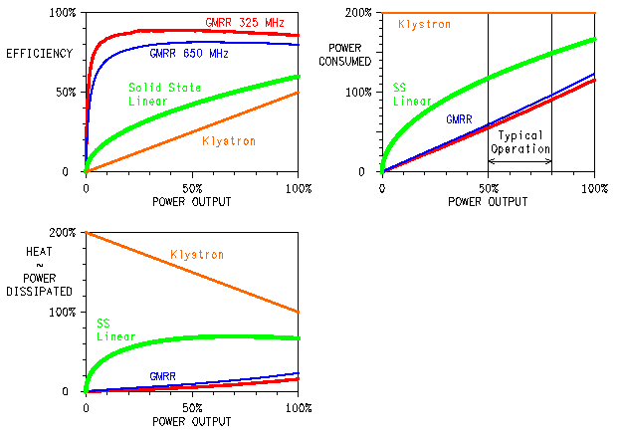
EFFICIENCY - WHY?
 | SIDE 2
Operating cost
Cooling requirements
Reliability
GMRR VG12-1
20

Slide 21
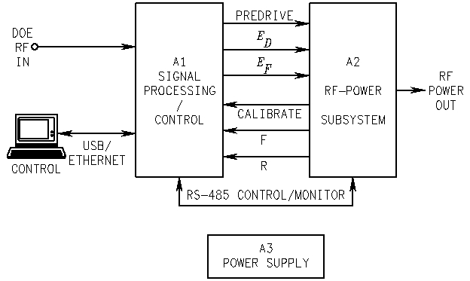
HIGH-EFFICIENCY PA SYSTEM
DSP + HIGH-EFFICIENCY RF PAs
Max efficiency for given amplitude
Phase errors corrected
Control and monitoring
GMRR VG12-1
21

Slide 22
Tightly Coupled LLRF – SSPA – RC
LLRF Integrated Control
• Beam Loading
• Resonance control
• Field control
High Efficiency
RF Power System
Cavity
Resonance Control
Combine some elements of process control of both LLRF and PA to allow for:
• Single points for RF detection
• Single point phase and amplitude control
• Direct Feedforward for both AM and PMl
• Integrated resonance control
• Reduce component cost
22

