Slide 1
Microphonics Suppression in SRF cavities for Project X
Yuriy Pischalnikov Warren Schappert
Project X Collaboration Meeting
Berkeley, April 11, 2012

Slide 2
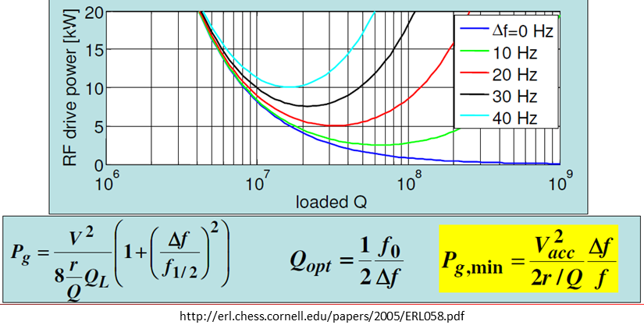
RF Power Requirements for Narrow Bandwidth Cavities
Narrow BW cavities with high microphonics levels require more RF power
Beam can be lost if sufficient reserve RF power to compensate for detuning is not available
RF plant must be able to accommodate PEAK (not average) detuning levels
For machines with very low beam loading (XFELs, ERLs) microphonics can actually drive the cost of the entire RF system
Power required to maintaining the gradient in a detuned cavity proportional to the square of the detuning
Goal is to keep PEAK detuning <= cavity bandwidth

Slide 3
Microphonics Mitigation Strategies
Passive
Reduce pressure variations
Reduce df/dP
Reduce vibration levels
Provide more RF power overhead
Active
Use fast or slow tuner to stabilize dynamically resonant frequency of cavity
Microphonics need to be taken into account from inception of machine

Slide 4
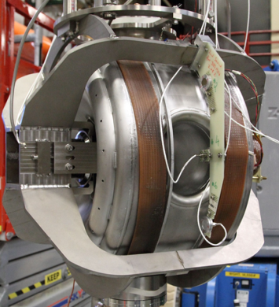
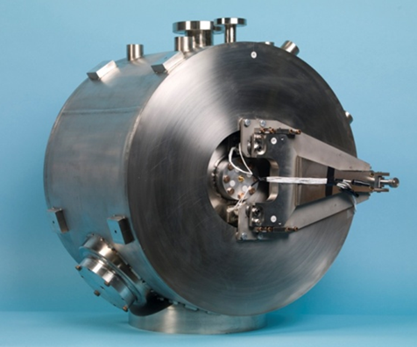
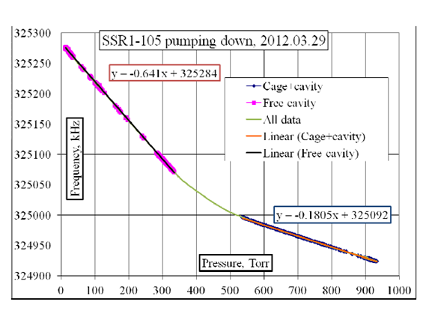
Passive Microphonics Control
Cavity and cryomodule should be designed to minimize df/dP and low frequency resonances
Lever Tuner for SSR1 prototype
df/dp=640Hh/torr(free cavity)
df/dP=140Hz/torr
(cavity constrained F=1200kg)
&df/dP=290Hz/torr
(for unconstrained)
df/dp=180Hz/torr(Cage+cavity)
Courtesy of Timergali Khabibouline

Slide 5
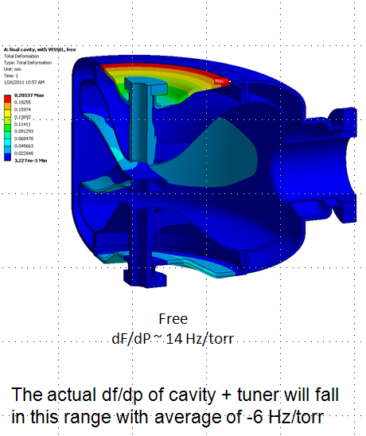
Passive Microphonics Control
Excellent progress by TD/SRF in minimizing df/dP in spoke (325MHz) and 650MHz cavities over the last year
(see presentations by L.Ristori and T. Peterson)
Current design leads to very stiff cavity
Should also reduce susceptibility to vibrations in addition to reducing df/dP
At the same time very stiff cavity/vessel system create challenge for slow/fast tuner
Courtesy of Leonardo Ristori

Slide 6
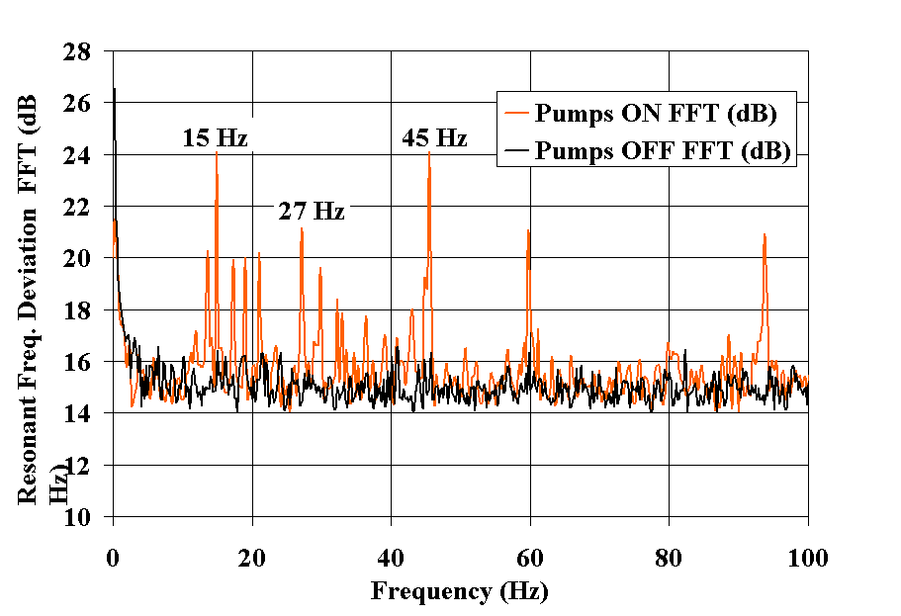
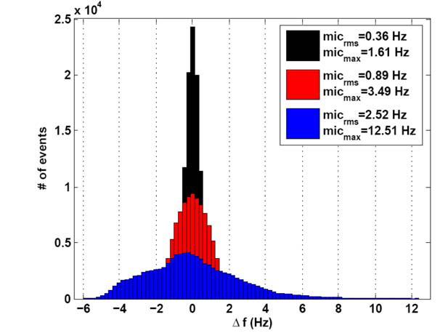
Active Compensation
Piezo actuators used to reduce microphonics in CKM cavities by 20 dB
(Carcagno et al. 2003)
Bessy able to limit pressure related detuning in1.3 GHz CW cavities to less than 1 Hz
(Axel Neumann Thesis, Helmholz-Zentrum Berlin, 2008)
Other work by groups at MSU, Cornell, Argonne, JLab, …

Slide 7
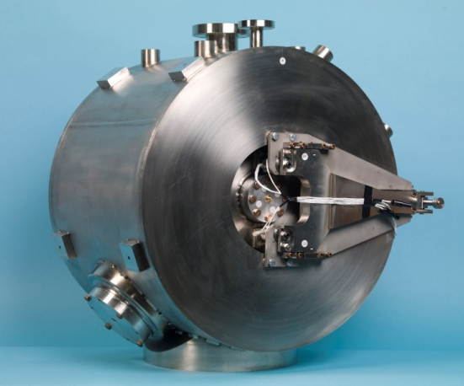
Microphonics Compensation for SSR1 with Narrow Bandwidth Coupler
Initial cold tests of SSR1 using CW provided an opportunity to gain experience with a very narrow bandwidth cavity
Test Conditions
4.5K
Coupler bandwidth of ~ 1.5 Hz
df/dP ~= 140 Hz/torr
dP_{PTP}~=5 torr
LLRF tracking resonant frequency of cavity
Detuning control system
100 kHz digitizer measured RF frequency offset from an arbitrary set point
FPGA fed Δf back to fast tuner

Slide 8
Microphonics Compensation for SSR1 with Narrow Bandwidth Coupler
Reduced pressure related variations in cavity frequency from several hundreds Hz
to
f <= 1.3 Hz RMS

Slide 9
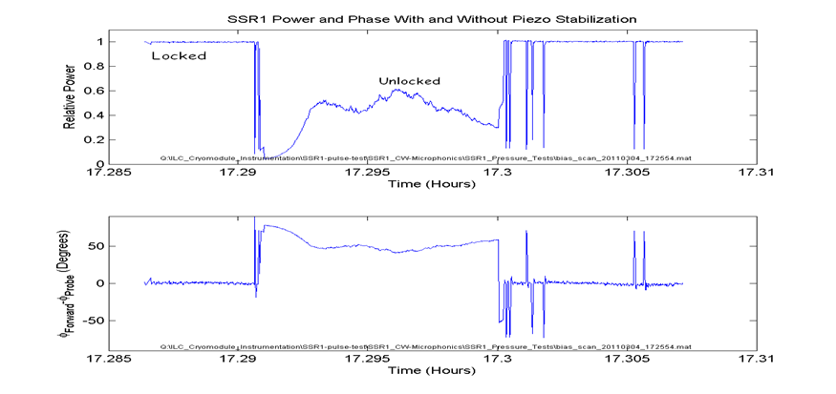
Microphonics Compensation in SSR1 Using a Wide Bandwidth Coupler
Second round of CW tests provided an opportunity to gain experience with a wider bandwidth cavity and fixed RF drive frequency
Test Conditions
4.5K
Cavity bandwidth ~100 Hz
RF drive frequency fixed ~325 MHz
Detuning control system
104 MHz digitizer measured RF phase difference between forward and probe signals
CPU fed Δφ back to fast tuner
Able to limit pressure related variations
Gradient <= 0.2% RMS
Phase <= 1.2º RMS

Slide 10
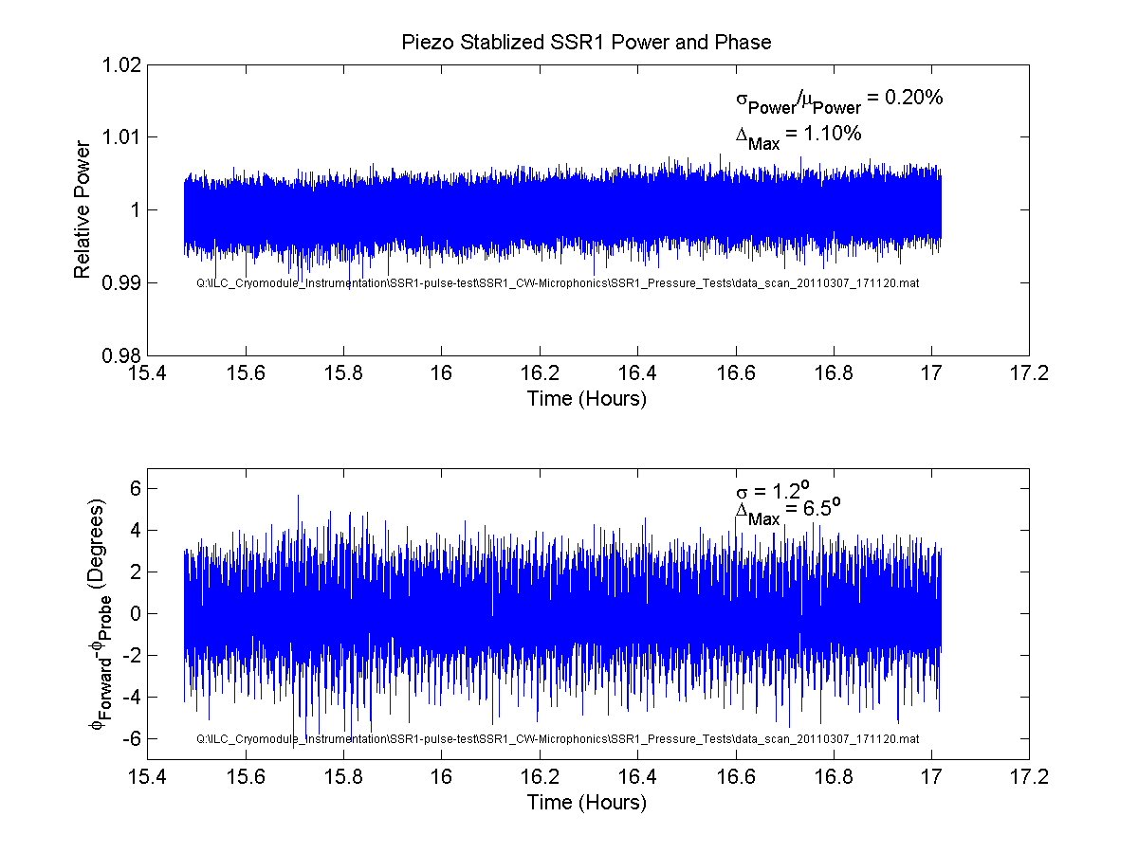

Slide 11
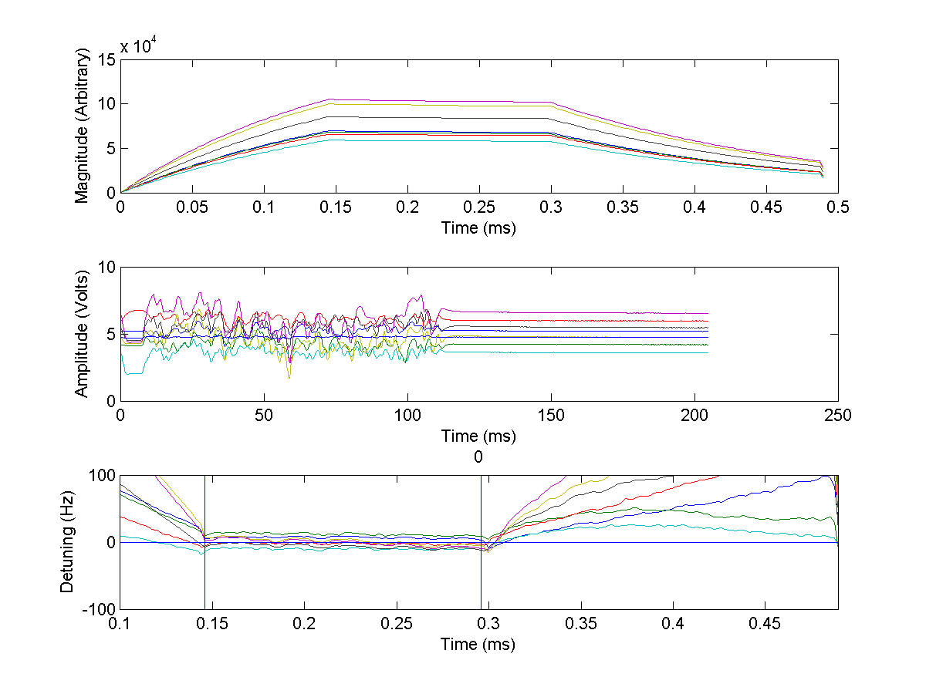
Long Term Resonance Stabilization
NML CM1
(7 cavities) resonance stabilization.
1.3GHz (ILC-style elliptical cavities) operated at 5Hz rep-rate with 1.3ms RF pulse (Eacc~25MV/m)
Compensation of dynamic LFD & microphonics
Piezo Pulses
0.8ms

Slide 12
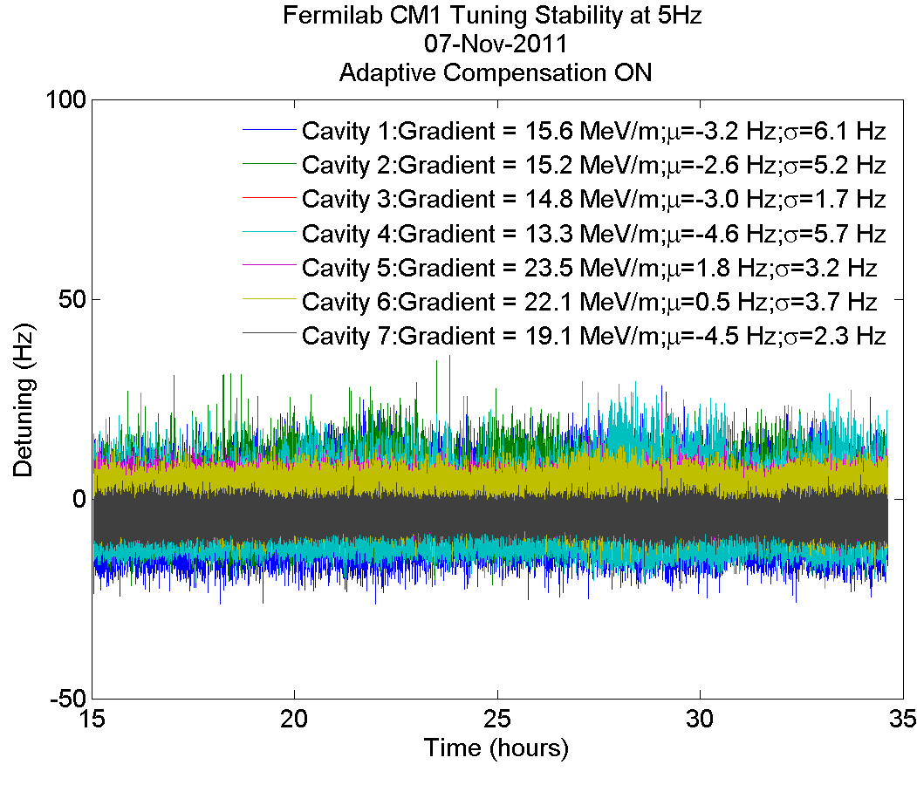
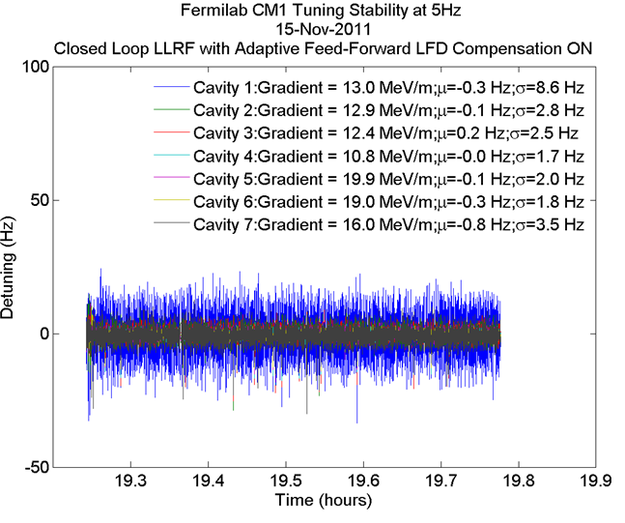
Long Term Resonance Stabilization
20hours

Slide 13
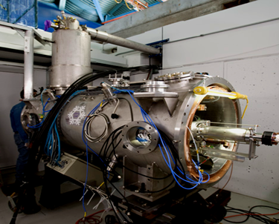
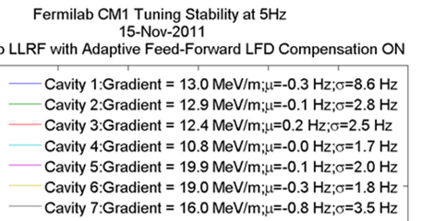
Reduction of vibration from external sources
Example of successful passive reduction of vibration level at CCII.
Cavities located at the ends of the CM1 (location of the pumps?)

Slide 14
Reduction of vibration from external sources (active compensation)
Active compensation of mechanical vibration (150-165 Hz) induced by external sources on the CC2 (ILC-style cavity)
Piezo OFF
Piezo ON
The Piezo tuner actively damped vibrations induced by external sources.
An IIR filter bank was used to isolate and reverse the phase of the particular spectral line. The phase reversed signal then fed back to the piezo tuner.
Active damping reduces the vibration at this frequency by 15db

Slide 15
Summary
Microphonics can drive the overall design of a machine and should be taken into account from the inception
Moderate SSR1 cavity bandwidths (70 Hz) mean microphonics is not as critical but still important
Excellent progress by TD/SRF group in passive control over last several years
At the same time stiffening cavity/vessel system create the challenges in designing reliable slow/fast tuners (motor/actuator & piezo-actuators) for cavity/vessel systems with K~30N/um
Good results (~1.5 Hz sigma) using active control
SSR1 with narrow bandwidth CW coupler at 4K
SSR1 with wide bandwidth CW coupler at 4K
CCII during pulsed operation at 4K
Significant further improvement should be possible
Good results gained at NML with resonance control (active piezo control) of several cavities (CM1) for extended period of time.
PIXIE/SSR1 microphonics objectives have been demonstrated already in SSR1 prototype in MDB
Care at EVERY level (civil, cryogenic, mechanical, electrical) will be still be required to control detuning in multiple cavities for extended periods of operation

