Slide 1
PXIE Accelerator Physics
N.Solyak, V. Lebedev
Project-X collaboration meeting, LBNL,
April 10-12, 2012

Slide 2
Outline
Goals
PXIE Optics
  Concept
  Major limitations
  Failure analysis
Non-standard hardware
Non-standard instrumentation
Conclusion

Slide 3
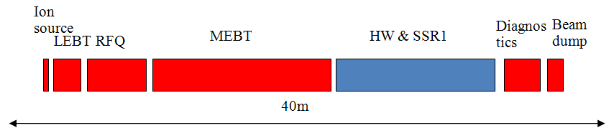
PXIE - Project X Injector Experiment
PXIE should deliver 1 mA CW beam to ~25 MeV energy
  Arbitrary bunch pattern (5 mA from Ion Source -> 1 mA at the beam dump)
PXIE includes
  5 mA ion source
  2.1 MeV 162.5 MHz RFQ
  MEBT with bunch-by-bunch chopper and 11 kW beam dump
  Two SC cryo-modules: HWR -162.5 MHz & SSR1 – 325 MHz
  Beam diagnostics, spectrometer and 50 kW beam dump

Slide 4
PXIE Goals
Validate the Project X concept and eliminate technical risks
  CW RFQ
  Bunch-by-bunch chopper
  Initial stage of acceleration in SC linac – never tested in experiment
    Complications can be due to beam loss of RFQ tails in SC linac
  Extinction for the removed bunches better than
    10⁻⁴ – specified by the PXIE FRS and determined by multi-experiment operation
    <10⁻⁹ – as desired by μ-to-e experiment
Obtain experience in design and operation of SC proton linac
  HWR cryomodule and cavities will be designed and build by ANL
  SSR1 cryomodule will be designed and build by Fermilab

Slide 5
Major PXIE Features
“Adiabatic optics” – small beta-function variation (smoothness)
  Mitigation of space charge
LEBT
  LEBT chopper
    Supports machine tuning in pulsed mode: Δt ~ 1 – 10 μs, f_{rep}=60 Hz
RFQ
  162.5 MHz RFQ
    Reducing frequency reduces RF power,
    but the major reason is a possibility of bunch-by-bunch chopping,
    T ≈ 6.2 ns, bandwidth of ~ 1 GHz
MEBT
  “Two-kickers chopping” makes chopping possible with present technology
  11 kW beam dump for chopped-out beam
    Large pumping speed to achieve sufficiently good reducing H⁻ stripping on the residual gas
  Differential pumping to minimize H₂ leakage to the SC cryomodules and RFQ

Slide 6
Major PXIE Features (continue)
SC cryomodules operating at 2 K
  Solenoidal focusing
  Warm gap between cryomodules
  Fast vacuum valves at both sides of the cryomodules
RF separation at the top energy for beam extinction studies, f=1.5*162.5 MHz
  Can help in measurements of bunch length and longitudinal tails
Instrumentation (not a complete list)
  Single bunch beam position and beam current measurements averaged over micro cycle (~1 μs); it is not required for all BPMs
  Built-in synchronous detection:
    optics measurements in the course of operation
    suppression of dispersion and reflections in MEBT chopper
    loss detection
    required for laser profile monitors with detection of H⁻ beam current variations
Spectrometer at the end of the machine
50 KW beam dump
  can support operation up to 2 mA beam current

Slide 7
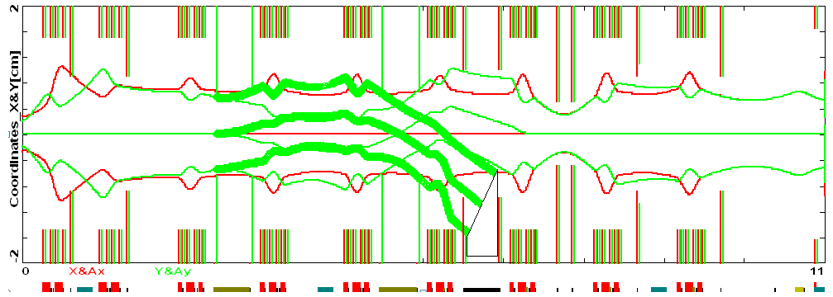
Optics in MEBT
DC corrector
Kicker
Kicker
green –Vertical plane
red-Horizontal plane
RFQ
Kicker
Kicker
RF1 Kick1 RF2 Kick2 Dump RF3 → HW
Coll_1 Coll_2 Coll&DifPumping
3σ beam envelopes (ε_{rms_n}=0.25 mm mrad); v. kick is excited by kickers (U=±200 V, 13 mm gap, 2*0.5 m)
Use of 2 kickers with 180 deg. phase advance reduces kicker voltage
  Bunch by-bunch current regulation is anticipated in Project X
  ⇒ 2 additional kickers, increased MEBT length
Sufficient space for diagnostics and differential pumping
16 mm gap between kicker plates protects them from the direct beam hit
⇒ ±250 V effective voltage on the kicker
DC correctors to minimize vertical displacement for passing beam

Slide 8
Optics in SC cryomodules
Structure of Half-wave cryo-module
  8 cavities, 8 solenoids ( S C S C S C S C S C S C S C S C )
  Starts with a solenoid to mitigate H₂ influx from MEBT
Structure of SSR1 cryo-module
  8 cavities, 4 solenoids ( C S C C S C C S C C S C )
Both cryomodules have
  X & Y & S BPM near each solenoid
  Transverse (x, y) correctors are located in every solenoid
  Solenoid polarity is changed in each next solenoid (simplifies orbit correction)
  Vacuum valves at each end
HW-to-SSR1 interface
  HW-to-SSR1 transition goes through room temperature vacuum chamber
    Good from engendering and repair points of view but complicates beam dynamics
  Both cryomodules face interface with cavities – improves long. dynamics
  Small space allocated (~20 cm) for
    Laser profile monitor, Pumping port

Slide 9
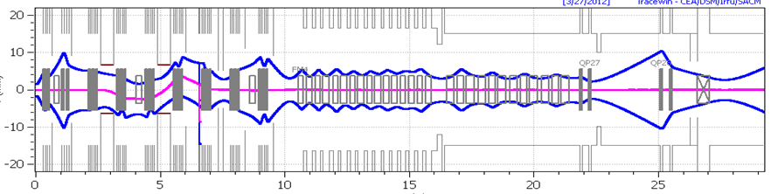
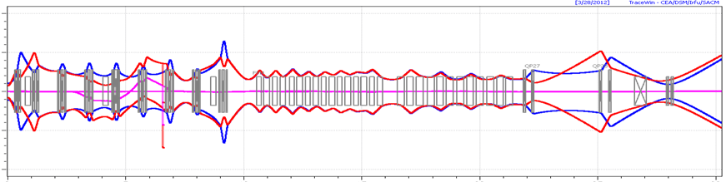
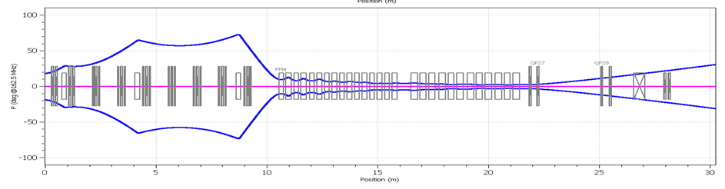
Optics in PXIE (passing beam)
(kickers: ±185 V; Asymmetric dump aperture: 5 mm)
swiping magnets (2°)
X & Y (mm)
| MEBT | HW cryomodule | | SSR1 cryomodule | Diagnostics line | Dump
Phase (deg)
Doublet/Triplet focusing in MEBT, Solenoidal focusing in HW and SSR1 cryomodules
…S-C – C-S... focusing at CM transition reduces nonlinearities of Long. motion
Bending magnet in diagnostics line for momentum spread measurements
Beam dump with X&Y swiping magnets (angle ~2°)

Slide 10
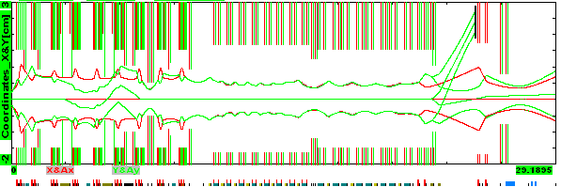
PXIE Optics (continue)
3σ beam envelopes (ε_{rms_n}= 0.25 mm mrad)
Apertures:
MEBT – 30 mm (13 mm - kickers, 10 mm - dif. pumping with L=200 mm)
HWR – 33 mm
Interface box between cryomodules – 25 mm
SSR1 – 30 mm
Diagnostic section – 30 mm (20mm – RF kicker, 15 mm – diff. pumping with Length=300 mm)

Slide 11
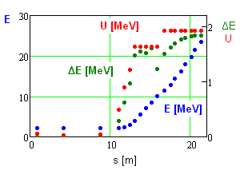
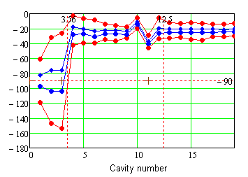
Acceleration in SC Cryomodules
1σ and 4σ bunch ends relative to the accelerating phase [deg]
Accelerating gradient of the first 3 SC cavities is reduced due to longitudinal over-focusing.
Design intent for operating voltages are: 1.7 MV – HWR & 2 MV - SSR1
To support reliable operation the accuracies of RF voltage and phase should be better than 1% and ~0.5 deg (misalignment and RF errors studies)

Slide 12
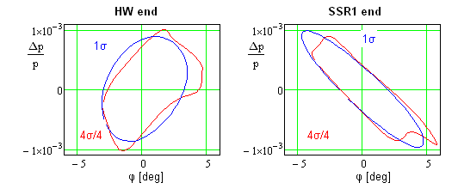
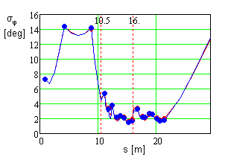
Optics for Longitudinal Degree of Freedom
Transformation of 1s and 4s envelopes to the end of HW (left) and SSR1 (right) CM; ε_{L_rms n}=0.25 mm mrad or 0.782 eV μs
Bunch length (deg) for 1σ initial ellipse from RFQ to the beam dump
Three NC cavities in MEBT provide longitudinal focusing and match RFQ to SC linac
  Present voltages are 65, 30 and 45 kV
  100 kV is specified as maximum voltage. It results in sufficient freedom for longitudinal optics
Amplitude motion in MEBT is sufficiently linear
  4σ beam envelopes are within ~ ±70 deg
Focusing nonlinearity of different cavities is compensated by appropriate phase advance
In SC sections RF synchronous phase is chosen to have acceptance > 5 σ_{ϕ} to reduce nonlinearity

Slide 13
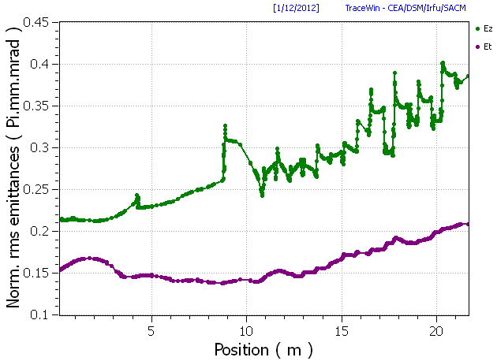
Focusing and Beam Transport in SC Cryomodules
N. Solyak & B. Shteynas
Defocusing in SC cavities is RF phase dependent
    That sets minimum focusing strength of the SC solenoids
Transverse and longitudinal focusing are adjusted to compensate space charge effects.
  Space charge does not produce harmful effects and does not produce noticeable beam loss
  However growth of longitudinal emittance is not negligible

Slide 14
Quadrupole fields in HW Cavities
Asymmetry in cavity geometry produce quadrupole components in defocusing field
Ways to reduce asymmetry: elliptical beam pipe or donut geometry in beam pipe region.
Donut geometry is more effective in reduction of quadrupole field to an acceptable level

Slide 15
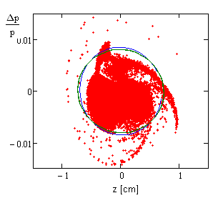
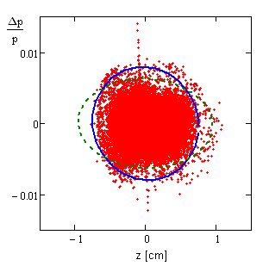
RFQ produced tails
G. Romanov (Track-3D, MWS field map, water-bag initial transv. distr)
J. Staples (Parmteq, Gaussian-like initial transverse distribution)
Two different simulations produce not-negligible difference of the tails behavior
We launched additional studies to understand this difference and possible ways for reduction of the loss

Slide 16
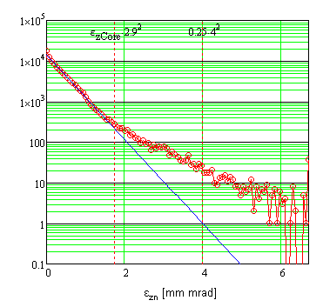
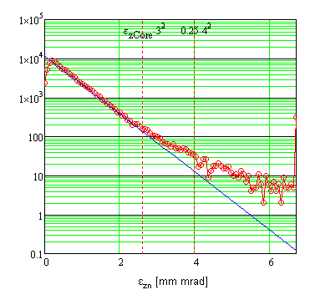
RFQ tails (continue)
G. Romanov (water bag tr. Distr.) J. Staples (Gaussian tr. distr.)
Although z-p_{z} distributions look different the particle distributions over action look very similar
RFQ tails will result in additional loss in further acceleration in PrX linac.
Characterization of tails in PXIE and ways of possible mitigation tails related problems are important part of PXIE program

Slide 17
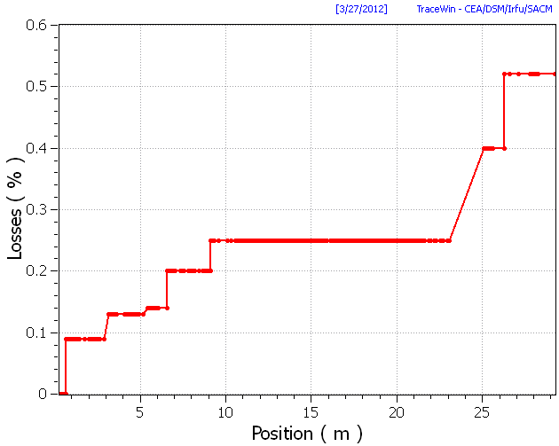
Beam loss in SC Cryomodules
Loss due to intra-beam stripping is expected to be < 0.5 W
Non-Gaussian tail of RFQ longitudinal distribution is the major source of particle loss,
<3·10⁻⁴ (<10 W).
Loss interception with good efficiency is impossible
  Too large relative energy change in a single SC cavity
  => loss in one lattice period
Collimators in NC sections will mostly intercept the lost beam
Small fraction of total beam loss will be intercepted by warm interface between cryomodules
Some fraction will be lost at 2 K
  < 10 W total particle loss
  It is still small relative to the loss due to e.-m. fields (~50 W)
Losses (TraceWin)

Slide 18
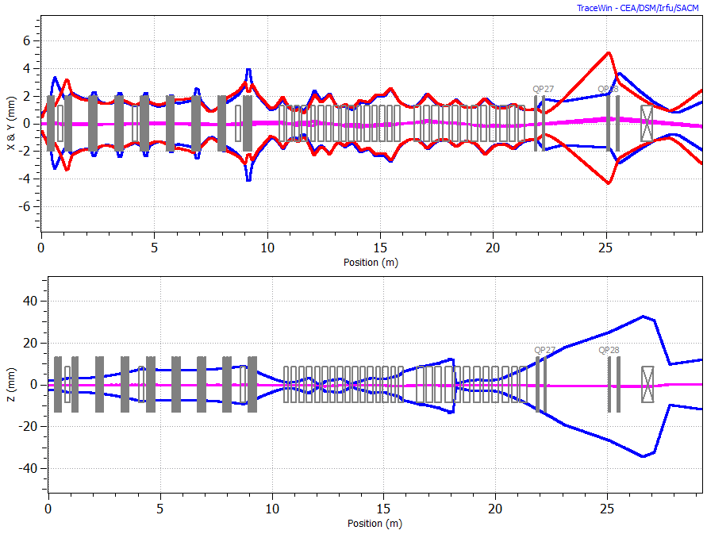
Failure Analysis for the PXIE
(failed 1st cavity or solenoid in HWR)
Initial Parameters
E_{initial} | 2.12 | MeV
ε_{z} | 0.211 | π∙ mm mrad
ε_{y} | 0.153 | π∙ mm mrad
ε_{x} | 0.152 | π∙ mm mrad
Bunching Cavity+ Triplet
Sol
2 periods in HWR section
Failed Cavity
6σ Gaussian beam distribution is used.
10 K macro particles are used for study
MEBT
HWR+ SSR1
Neighboring elements in the vicinity of failed cavity / solenoid are retuned in order to achieve
  designed beam energy
  smooth L. and T. envelopes
  100 % transmission i.e. no beam losses after applying local compensation.
1 σ_{rms} beam envelope
A.Saini
Both Choppers are switched off.
PXIE_7 (03-22-12) lattice is used for study

Slide 19
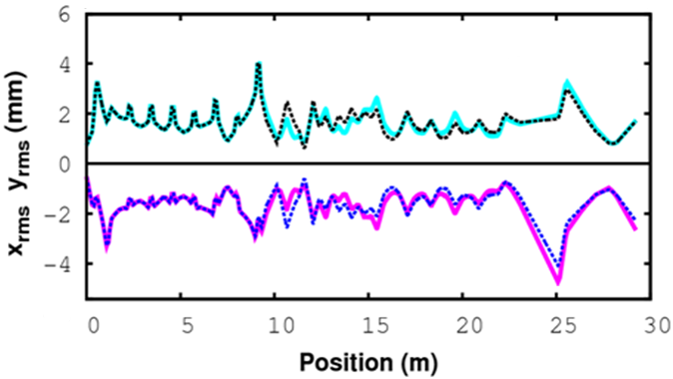
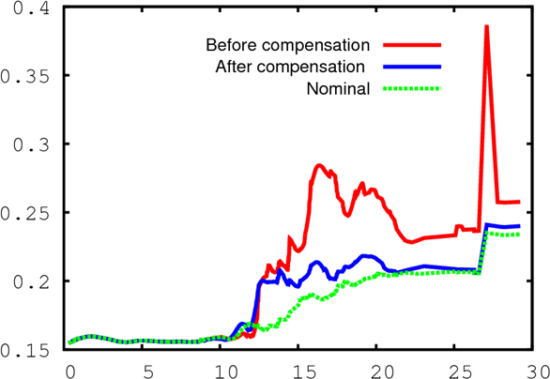
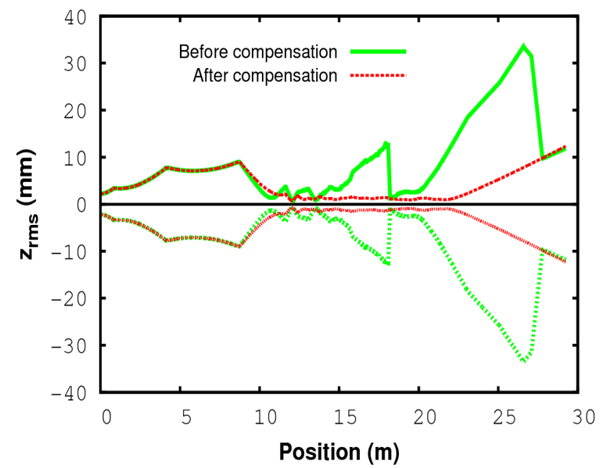
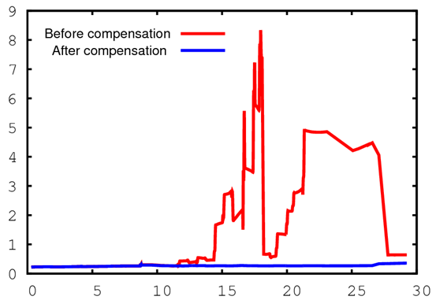
Compensation of the failed 1st cavity:
Transverse & Longitudinal Beam Dynamics
X-before compensation
X- after compensation
ε_{t n (}mm·mrad)
Y-before compensation
Y- after compensation
Losses
ε_{z n (}mm·mrad)
1 σ_{rms} beam sizes
Failed cavity dramatically changes L. dynamics; small disturbance in T. dimensions

Slide 20
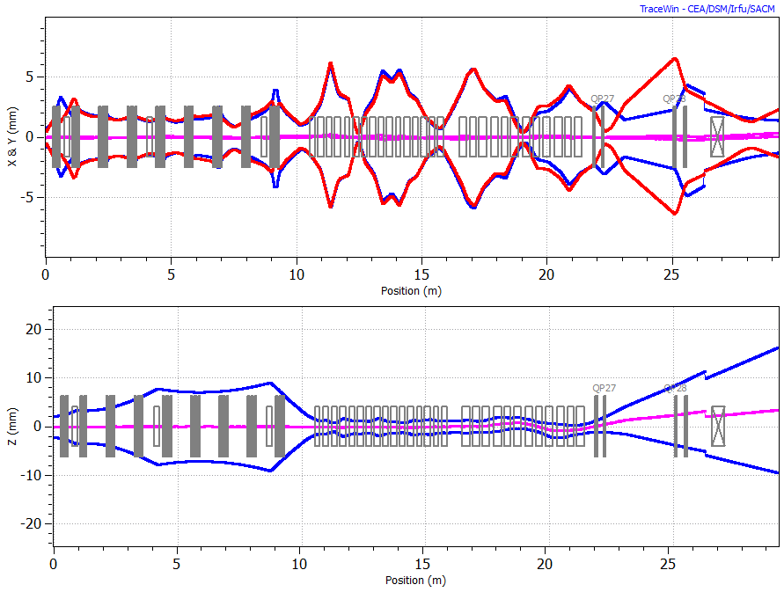
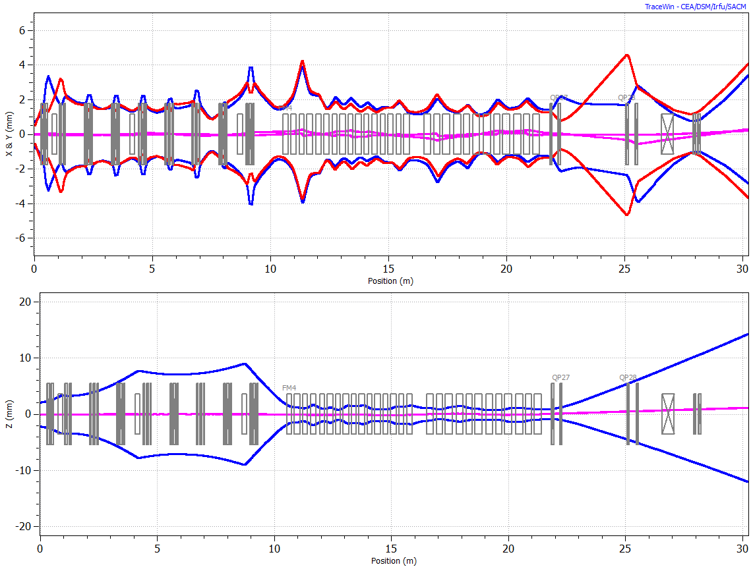
Failure of 1st solenoid in HWR section
Before compensation
After local compensation
Failed Solenoid
Triplet
Cavity
2 periods in HWR section
1 σ_{rms} beam envelope
40% of the beam is lost (incl.15% between CM’s)
~0.5% additional losses(vs.nominal lattice) mostly at the end of beam-line, no losses in SC sections

Slide 21
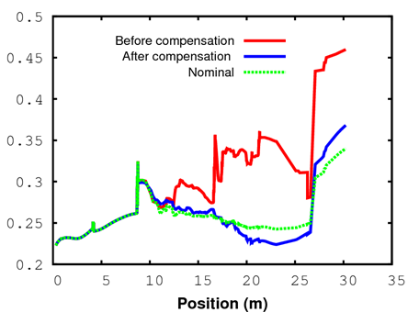
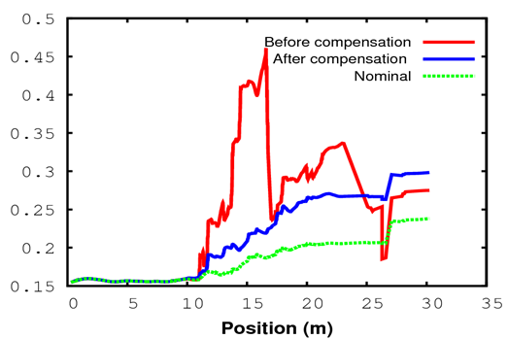
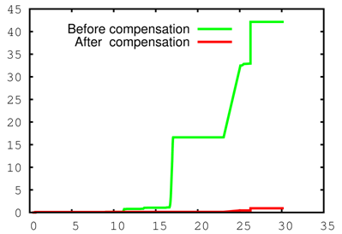
Failure of 1st solenoid (continue):
Beam Emittances and Losses
Longitudinal Emittance
Transverse Emittance
ε_{z n,} π·mm·mrad
ε_{t n,} π·mm·mrad
Losses
Without compensation failure of 1st solenoid causes huge mismatch and ~40% beam losses
Local compensation scheme allow to re-tune linac and reduce losses to a < 1% level.
Losses (%)

Slide 22
Summary of failure analysis
Failed 1st HW cavity
(*Parameters at the end of PXIE Lattice)
 | Baseline | After Failure | After local compensation
Energy (MeV) | 23.52 | 23.24 | 23.25
ε_{z} (π∙ mm mrad) | 0.326 | 0.639* | 0.359
ε_{t} (π∙ mm mrad) | 0.234 | 0.258* | 0.240
Failure of 1st cavity in HWR section is locally compensated.
No additional losses are obtained after compensation.
Failed 1st solenoid
 | Baseline | After Failure | After local compensation
Energy (MeV) | 23.52 | 23.52 | 23.61
ε_{z} (π∙ mm mrad) | 0.340 | 0.459* | 0.368
ε_{t} (π∙ mm mrad) | 0.238 | 0.275* | 0.298
Failure of 1st solenoid in HWR section is locally compensated.
There are some additional beam losses (0.5 %) even after local compensation

Slide 23
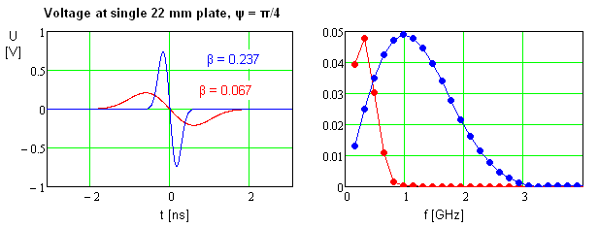
BPMs
Button type BPMs: four electrodes, three coordinates (x, y, s)
  Better sensitivity and smaller size than strip-line BPMs
Used for: beam position measurements & optics measurements with differential orbits
Duration of the signal is determined by BPM radius and particle velocity
  Bunch duration is shorter and can be neglected
Bunch-by-bunch measurements are very attractive
  Looks tough but doable
Sensitivity will be determined by preamplifier noise. Shot noise is smaller.
Averaging over micro-cycle (~1 μs) should deliver a few μm-scale sensitivity

Slide 24
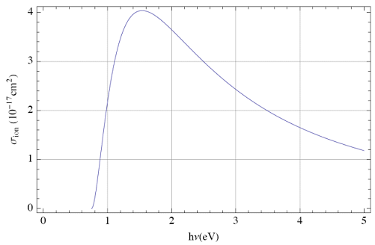
Laser Profile Monitor
Plans to have 3 Laser Profile monitors
  MEBT; Transition HWR-SSR1, Diagnostic section at the end.
Measurements of all 3 beam profiles is possible
At least 1 MEBT profile monitor will have an electron detection.
1 W laser strips ~3.5e-6 relative charge. Signal is large enough to measure change in current of H⁻ beam
  Synchronous detection of resistive wall monitor signal or sum BPM signal
  Measurement time ~ 10 s per degree of freedom in CW regime

Slide 25
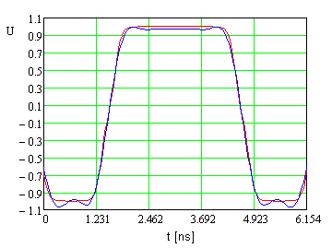
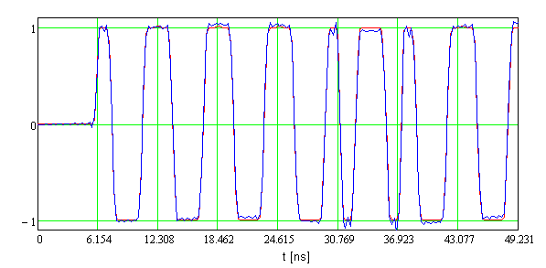
Bunch-by-bunch Chopper Kicker
See V. Lebedev and G.Saewert Presentation
Two variants of chopper kicker are being developed: 50 & 200 Ω wave impedance
  Each includes kicker and high voltage/power pulser/amplifier
Experience accumulated over last 2 years assures that a full scale demonstration for 50 Ω kicker is realistic by the FY end
  Satisfies FRS
    Amplifier 1 kW, ±300 V, 50 – 1000 MHz band – available at the market
    2 W beam power can be lost at single plate (50 W at the kicker)
  Success is based on pulse pre-distortion (will allow compensation of reflections and dispersion in kicker)
200 Ω kicker
  Work on a 500 V pulser proceeds

Slide 26
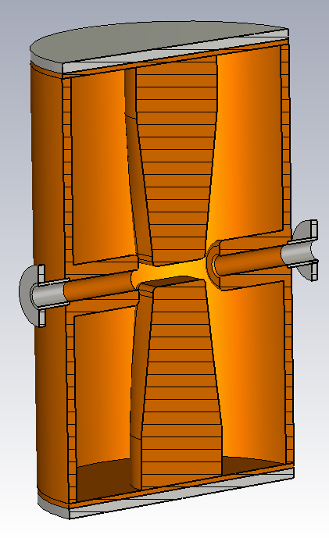
RF Splitter
Inner radius 130 mm
Gap 20 mm
Plate side 65 mm
Drift tube to drift tube 100 mm
Radius of stem base 50 mm
Required effective kick voltage is 250 kV
Deflection – 5.1 mrad
Power – 6 kW
Cavity parameters
Half wave coaxial cavity
Frequency, MHz | 243.75
E_surf_max, MV/m | 13.75
Power losses (average), kW | 6.0
Q | 13420
Kick voltage, | 250 kV
Proton β | 0.22
Preliminary design
(G.Romanov)

Slide 27
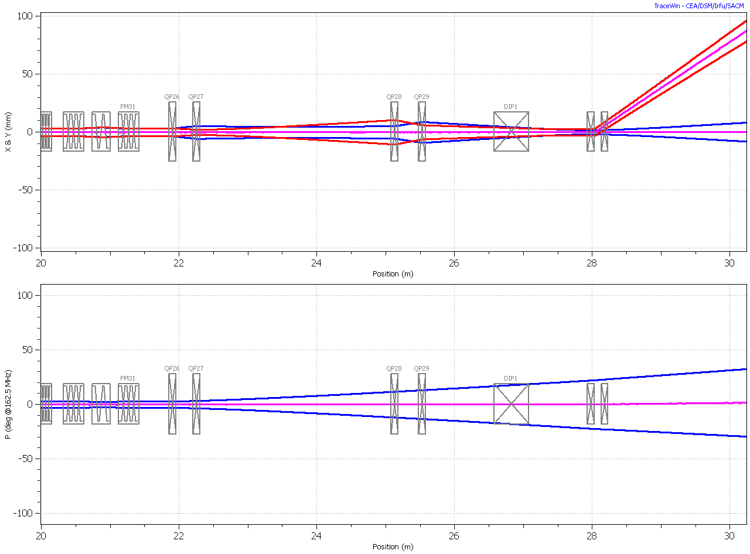
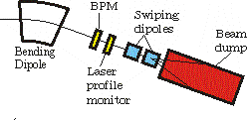
Beam Diagnostics and Dump
Swiping
Dipole
Bending
Dipole
Power rating – 50 kW at beam energy 25 MeV
Local radiation shielding of the beam dump and the bending dipole
Start conceptual design

Slide 28
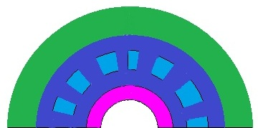
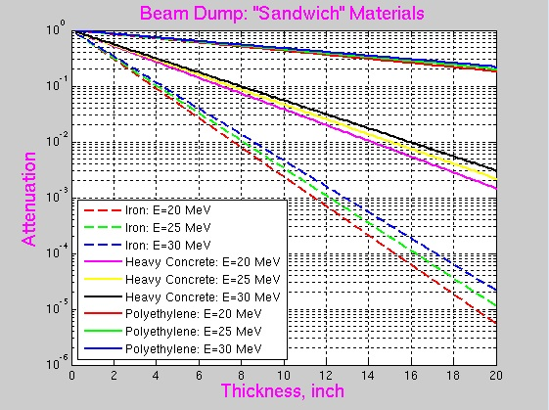
Beam Dump: Sketches of the Dump + Radiation Shielding
Dump Layout
Cross Section of the Beam Dump
Local
Shielding
Radiation Shielding
Y.Eidelman
Last
Sweep
Magnet
~2°
Front Section of the
Beam Dump and Radiation Shielding
~ 50 cm
~120 cm
Radiation
Shielding
Heavy concrete
Attenuation as a function of thickness d of material and energy E (GeV) of the beam:
Polyethylene
Iron
Polyethylene Filler
Beam
Absorber
Iron
Cooper
Water
Cooper
Nickel
Proton Beam
*not in the scale !

Slide 29
Conclusions
We have good understanding of the PXIE concept
Optics was designed and studied (first order approximation)
  Ongoing program for LEBT and RFQ beam physics studies
Design work of HWR and SSR1 cryomodules is proceeding well
  Expect to have conceptual design by the end of this year
    ANL - HWR
    FNAL – SSR1
No obvious showstoppers

