Slide 1
Accelerator R&D at SLAC: Finding answers to questions we know and those we don’t
N. Holtkamp
SLAC National Accelerator Laboratory
DESY
Nov 15, 2011

Slide 2
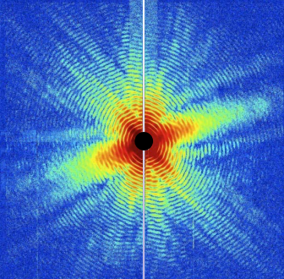
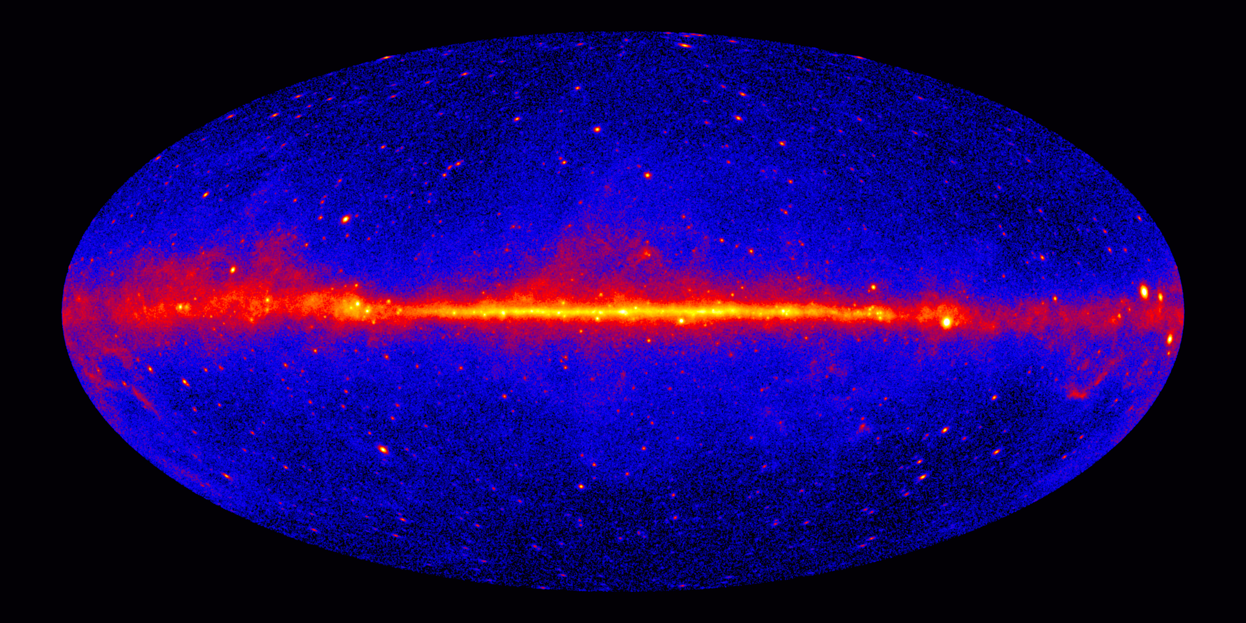
Mission of SLAC
Grow into the premier Photon Science Laboratory
  Build and operate world leading facilities
  Perform world leading science at these facilities
Maintain our position as the premier accelerator laboratory
Pursue strategic programs in particle physics, particle astrophysics and cosmology

Slide 3
Lab-at-a-Glance
Total FY2011: $351M
Recovery Act Obligated from DOE: $92.7M
  Location: Menlo Park, CA
  Type: Multi-program Laboratory
  Contract Operator:
  Stanford University
  Human Capital:
    Employees: 1,579 FTE
    205 Postdocs, Undergrad + Grad Students
    3,142 Facility Users & Visiting Scientists

Slide 4
Over last 5 years, SLAC has shifted its focus away from particle physics

Slide 5
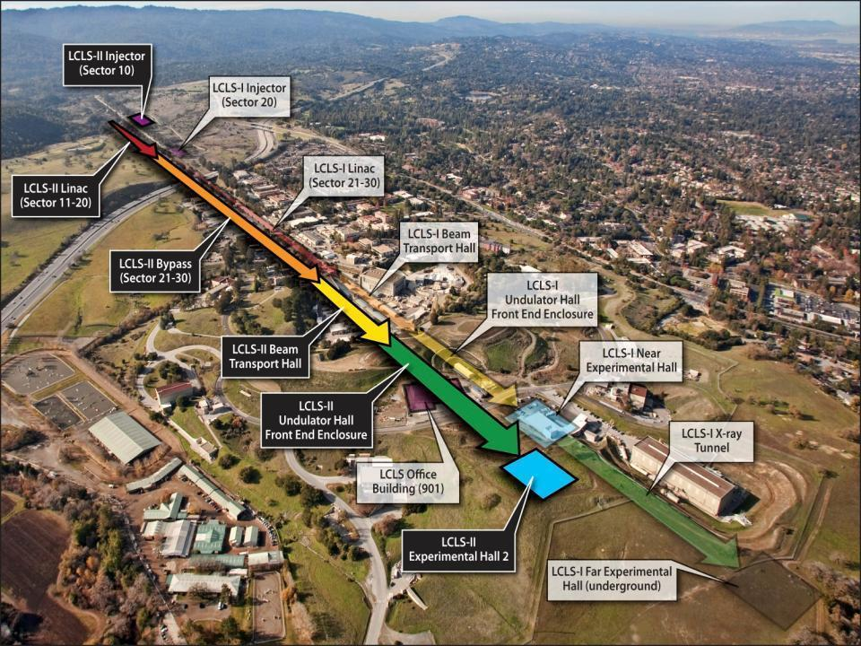
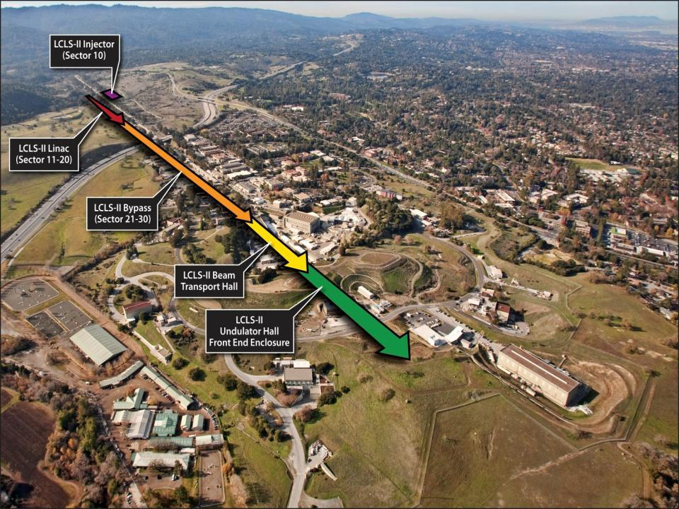
…Here is where we accomplish the Mission?
FACET National User Facility
ASTA
SSRL
ESTB
NLCTA
(Acc. R&D)
Notes:
Message: investing at SLAC is the cheapest way for DOE to stay at the forefront. Since we don’t see growing budgets for new project, we give DOE the solution.

Slide 6

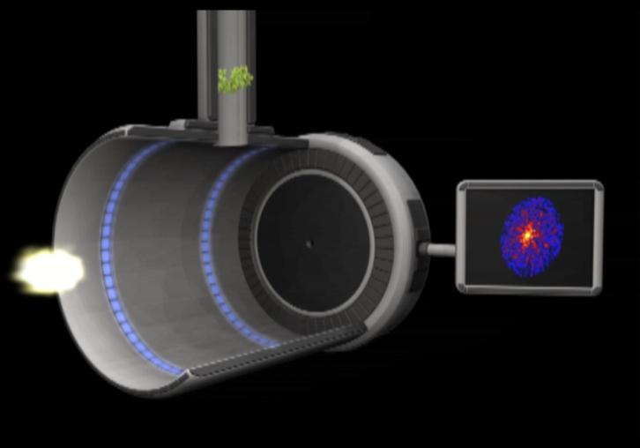
An Example: Atomic-Resolution Imaging of Nano-structured Periodic and Non-Periodic Objects
V=10-100 m/sec = 10-100 nm/nsec
⇒ ~1 diam /10 nsec
Hit rate: 5%– 30% ⇒ use multi bunch mode 10-100nsec
separation

Slide 7
Beyond HEP: The SLAC Multi-Program Environment
PPA
AD
LCLS,SSRL & Photon Science
Detector R&D
Computing
Data acquisition & management
Beam Dynamics
Technology infrastructure
Test Facilities
Research on future colliders
Computation
LCLS Operations
LCLS Experiments
  Data acquisition
  Data storage
High brightness beams
Low Emittance Beam Acceleration
New light source concepts
…and back

Slide 8
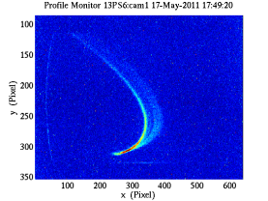
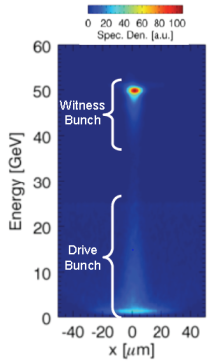
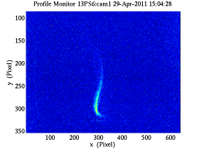
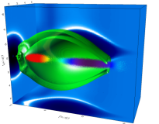
Objective: Maintain our status as the Premier Accelerator Laboratory
SLAC accelerator research key to our future
  World leaders in FEL R&D
  World leader in Advanced Accelerator R&D. Provide facilities but also perform science
  World leader in High Power RF and NC Linac Design and construction
Goal to provide accelerator technology to SLAC and the nation
FACET
Tcav- is working nicely

Slide 9
Leader in FEL Operation and FEL R&D for LCLS, LCLS II and FELs for the next generation

Slide 10
Accelerator R&D for the future of FELs
Brighter e- beams
fsec diagnostics
Seeding
Multi bunches
Polarization control
Fast x-ray switching
Push a factor of 10 or more in many directions…..
Cathode Test Facility
Microbunching beam
physics; rf gun LDRD
More photons in <5fsec
More photons per phase space
More photons per ΔE/E
More photons per pulse
More photon control
T-Cavities
fs-timing
CCT
Science Needs:
# of γ’s
Short pulses
Rep Rate
Detector & X Ray
R&D
Echo
HXRSS
SXRSS
ITF
APPLE undulator
RF undulators
SLAC and LBNL working together to optimize an R&D program for LCLS-II and future FELs …..
360 Hz ops
Bunch trains; fast kickers
Notes:
Message: SLAC has the capability, the infrastructure and the manpower to lead the FEL field for a decade to come if we can successfully pull off even half of the elements in the program. The program is complete and if we do it right we will do it first.-Give two key examples to introduce message of the next slide. :Namely: a) HXRSS we can do at LCLS-ECHO 7 /15 we can do now ECHO 100 needs new facility. Need ITF.
NOT NLCTA

Slide 11
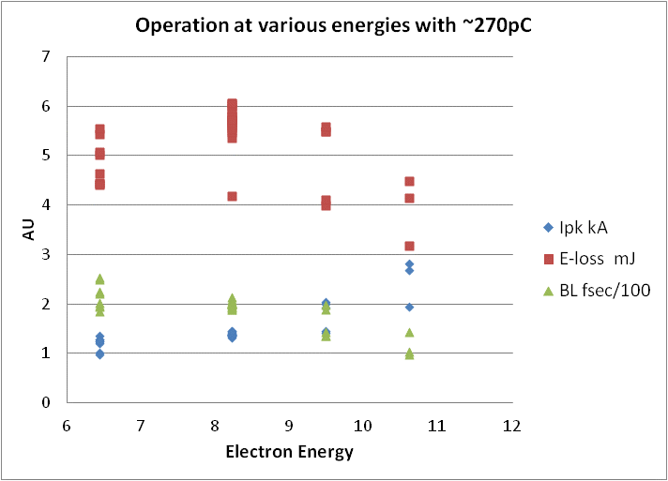
LCLS Peak Performance and new records during Run IV
 | LCLS baseline | Current performance
Photon energy range | 800 to 8000 eV | 0.4 to >9.0 keV (16keV)
FEL pulse length | 230 fs | <10 - 500 fs
FEL pulse energy | up to 2 mJ | up to 4 mJ-> 6mJ
fs
eV
mJ
Most significant event:
  Achievement of new photon pulse energy record (Aug. 24^{th,} 2011, 00:01 h)
  > 6 mJ at 3 keV

Slide 12
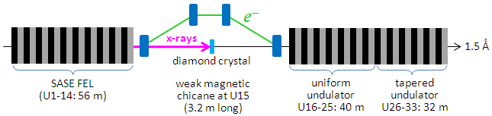
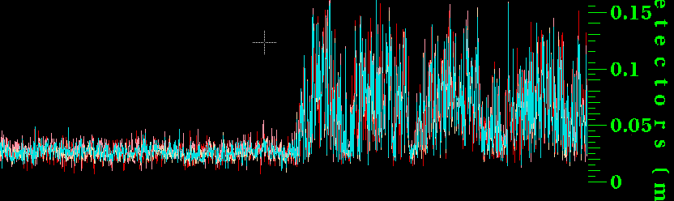
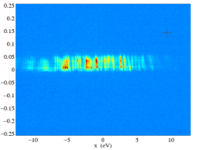
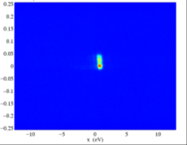
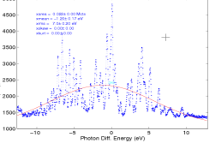
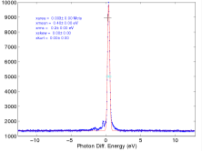




What can SLAC’s brain trust deliver? First Demonstration of Hard X-ray Self Seeding at LCLS
Pulse energy (mJ)
SASE FEL spectrum
Seeded FEL spectrum
SASE
Seeded
~ 20 eV
~ 0.5 eV
Fourier Transform limited
Single shot pulse energy from the gas detectors
Concept developed by Geloni, Kocharyan and Saldin, DESY 10-053 (2010).
Demonstrate 8 GW mean seeded FEL power with 2.5 GW SASE background at 8 keV photon energy for 40 pC operation. Observe peak seeded power in excess of 15 GW, comparable to normal SASE power but with a spectral bandwidth reduction more than a factor of 10.
Next steps include system optimization of the LCLS undulator beamline which should increase seeded power and reduce intensity fluctuation.
Provide a path towards Terrawatt-level FEL.
SASE and Seeded spectra recorded on single shots. The left panels are SASE with 150 pC, 3kA peak current, un-seeded. The FWHM of the SASE spectrum is 0.2 % Bandwidth. The right panels are the seeded beam with the same electron beam parameters. The FWHM of the seeded beam is 0.5 eV (5x10⁻⁵ bandwidth)
SLAC-Argonne-TISNCM Collaboration
D. Wang et al., Science 324, 5931 (2009) •
Notes:
TISNCM Technical Institute for Superhard and Novel carbon materials

Slide 13
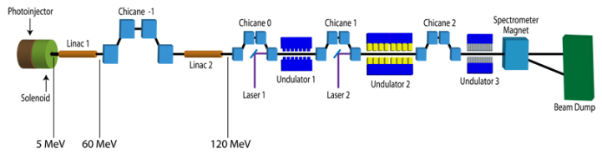
Seeding R&D outside of LCLS
Echo-7 @ NLCTA
  During the past months we
    upgraded the beam spectrometer
    installed a new high resolution in vacuum spectrometer
    Installed 2 transverse deflecting cavities
      to increase the slice energy spread in order to reduce HGHG
      to measure longitudinal phase space, laser energy modulation and slice parameters
T11
T27
In Vacuum Spectrometer

Slide 14
Exploiting existing experience and broadening the agenda - Particle Physics and Detectors

Slide 15
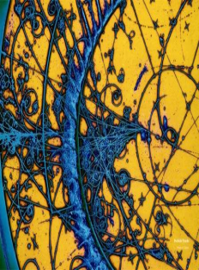
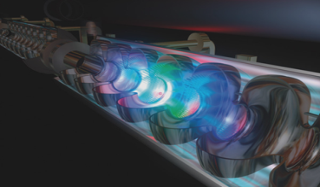

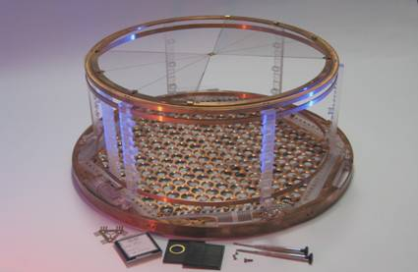
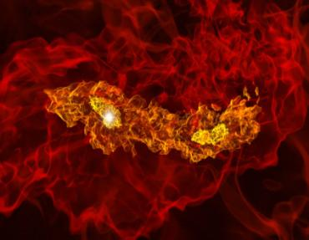
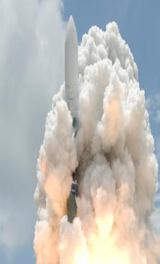
Particle Physics & Astrophysics
Accelerator research:
LHC, ILC, high-gradient,
plasma-wakefield, laser
Particle Physics Theory
Accelerator-based
particle physics:
ATLAS & BABAR
Underground physics:
EXO-200, CDMS
Particle Astrophysics & Cosmology Theory
Astrophysics &
Cosmology:
Fermi GST, DES, LSST, CTA

Slide 16
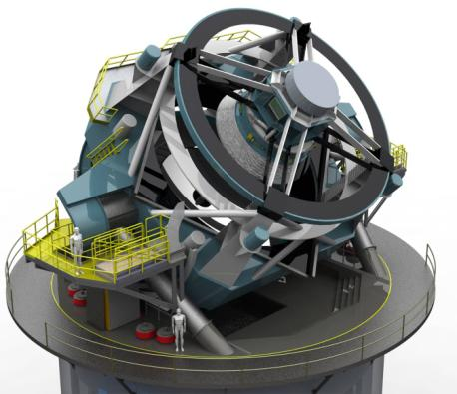
Seeking to understand Dark Energy
Provide a sensitive survey of the entire sky at visible wavelengths every few nights
  Tight constraints on cosmic expansion history, and thus on the nature of Dark Energy
Envisioned as a collaborative NSF and DOE-HEP project
  NSF: Telescope & data system
  DOE: 3.2 Gigapixel camera
SLAC role
  Lead-lab for DOE project, principally the consortium to design and construct the camera
Large Synoptic Survey Telescope (LSST)

Slide 17
Unique capabilities and in Accelerator Physics –Storage Rings,Collider Rings and MDI expertise

Slide 18
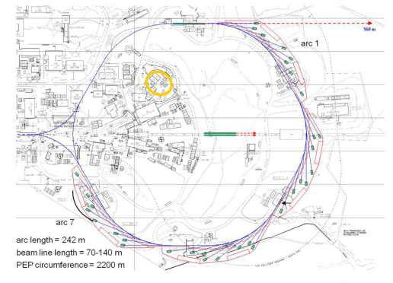
Collider Rings - Storage Ring Design
USR: an ultimate storage ring
Energy, GeV 4.5
Circumference, km 2.2
Beam current, mA 200
Emittance at 200 mA, x/y, pm 12 / 12
Touschek lifetime, hour 10
Submitted proposal to MC collaboration for MDI & Storage ring
Notes:
It is extremely hard to achieve 12 pm-rad emittance and 10 mm dynamic aperture.
We have a strong design team, looking for new challenges.
3) Tune scan of dynamic aperture (two plots) is in unit of sigma of the equilibrium beam size. The key of the improvement is the cancellation of 3rd and 4th order resonances in the 2011 design

Slide 19
Targeted Programs in Accelerator R&D

Slide 20
Theoretical and Simulation Expertise for Studying RF Breakdown Phenomena at SLAC
SLAC has a long history for simulating the multi-physics breakdown phenomena in a self consistent manner, in particular:
  A Joint MAP & High Gradient RF Collaboration Workshop was held in November 1-4th, 2011 at Lawrence Berkeley National Laboratory
  Phenomena related to the breakdown events, the effect of the breakdown current on the electromagnetic field distribution and the energy deposited on the cavity walls.
Measurements of a breakdown event in a waveguide
3D PIC simulation of the breakdown event

Slide 21
The Importance of “high gradient”
Many paths towards high gradients
  RF source driven superconducting structures
  RF source driven metallic structures
  Beam-driven metallic structures
  Laser-driven dielectric structures
  Beam-driven dielectric structures
  Laser-driven plasmas
  Beam-driven plasmas
Where are the Muons?
They are not here –
and we are not there. Yet!
FNAL/JLAB
~50 MV/m
NLCTA
~100 MV/m
CERN
E-163
~1 GV/m
FACET
BELLA
~10 GV/m
FACET

Slide 22
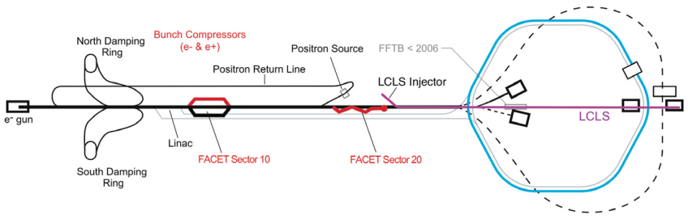
Facility for Advanced Accelerator Tests a National User Facility
FACET uses the first two-thirds of the SLAC Linac
Electron and positron beams
Energy 20 to 23 GeV
Charge 3.2 nC (=2*10¹⁰ particles)
Sigma x = 14 μm
Sigma y = 6 μm
Sigma z = 14 μm minimum (20 μm typical)
@ IP

Slide 23
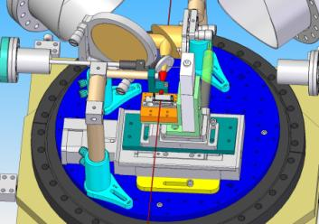
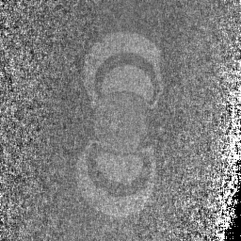
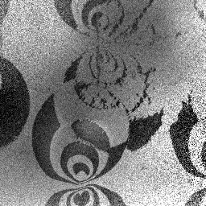
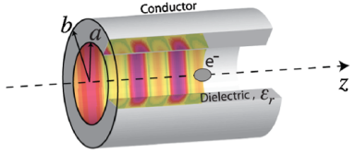
FACET Science: E-201 and E-205 Wakefield Acceleration in Dielectric Structures & E-202 Ultrafast Magnetic Switching
The FACET beam is sent through prototype dielectric wakefield acceleration structures
Investigation of magnetic switching processes by exposing samples to electron bunches then image with spin-sensitive scanning electron microscope
a = 100um to 800um
MAP 2012 Winter Meeting
CoFe/MgO, σ_{t}=230fs
Fe/W(110)

Slide 24

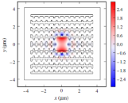
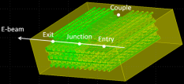
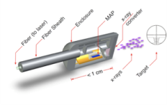
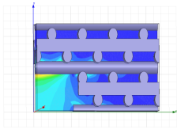
Other Areas: Direct LASER Acceleration
Working with optical wavelengths necessarily means that components built to confine fields in this range achieve nanometer and attosecond scale performance.
Further applications of DLA
  Optical undulators (T. Plettner, KLA-Tencor)
  Optical BPMs (Z. Wu, K. Soong, SLAC),
  Optical Structure Based beam focusing (B. Cowan, Tech-X)
  Optical kickers and steering elements (K. Soong, C. McGuinness, Stanford)
  Attosecond-scale timing diagnostics
  Internal-Beam Radiotherapy (G. Travish, R. Yoder, UCLA)
  Optical BPMs (L. Schächter, IIT-Technion)
  THz sources (Z. Wu, SLAC)
Grating-based optical undulator– T. Plettner, PRST-AB, 11, 030704 (2008).
Woodpile structure designed with focusing field—B. Cowan, PRST-AB, 11, 011301, (2008).
Woodpile structure simulations as a BPM—Z. Wu
MAP structure for IBRT. -- G. Travish, R. Yoder, UCLA.
Woodpile structure designed to support deflecting mode—C. McGuinness

Slide 25
Maintain our position as a premier Accelerator Laboratory - but how?
Working in a multi-program environment

Slide 26
Accelerator R&D Inventory
Courtesy: M. Procario; from a recent briefing to Bill Brinkman
SC Program Participation by labs and thrusts
Key: 100<<300; 300<<1,000; >1,000 (FY11 $k) Color code: ASCR; BES ; HEP ; NP
Thrust Inst. | Beam Physics | Beam Instr/ctl | New concept | NC high grad. RF | Particle sources | RF sources | SC magnet | SC RF
ANL |  |  |  |  |  |  |  | 
BNL |  |  |  |  |  |  |  | 
FNAL |  |  |  |  |  |  |  | 
JLAB |  |  |  |  |  |  |  | 
LBNL |  |  |  |  |  |  | 
PPPL | 
SLAC |  |  |  |  |  | 
UNIV. |  |  |  |  |  |  |  | 
Notes:
This is a familiar graph which was used in an R&D briefing with Bill Brinkman

Slide 27
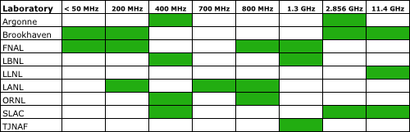
A Service to the Complex and the Nation
DOE Accelerator Facilities Are Heavily Dependent on High Power RF Technology
Many of these accelerators will operate for decades, but have no or very limited in house capability
  Continued operation depends on the availability of products from a risk-averse industry that has downsized to 1.5 US companies over the past 2 decades.
Summary of high power RF sources and technology used at DOE laboratories to power accelerators. Green boxes denote the approximate frequencies

Slide 28
SLAC’s Involvement in PX
CW Linac
Working on 650 MHz solid state rf sources and high speed chopper modulator
Other possibilities: LLRF system, cavity power couplers, beam dynamics and beam absorbers
Pulsed Linac + MI
Linac similar to that for ILC, for which SLAC has been developing the rf system
Worked on long-pulse modulator design and 53/106 MHz MI cavity designs
Other possibilities: klystrons, rf distribution and power coupler development and MI e-cloud studies

Slide 29
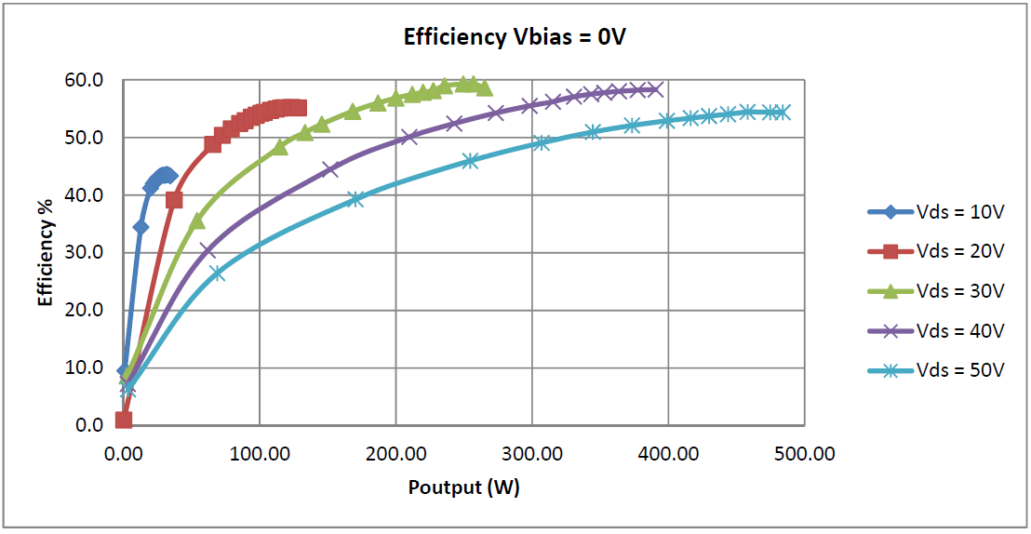
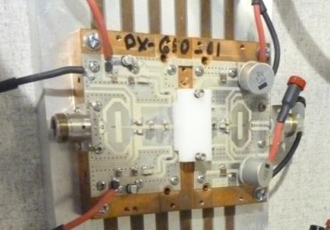
650 MHz CW RF Source Development
Freescale 650 MHz / 500W
Board Tests

Slide 30
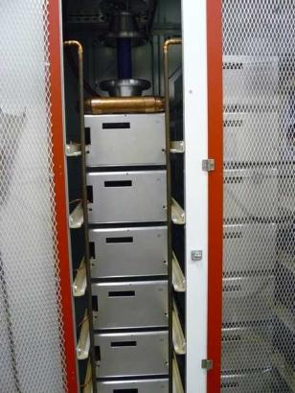
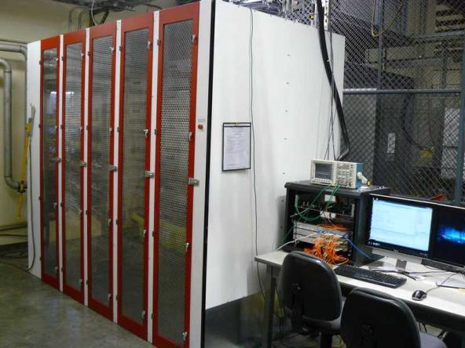
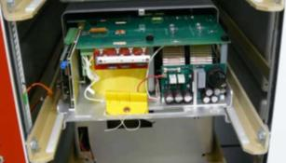
SLAC’s P2 Marx Modulator (120 kV, 1.6 ms, 5 Hz)
Can be readily reconfigured for 5 ms or 25 ms pulses for the PX pulsed linac

Slide 31
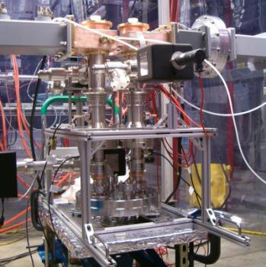
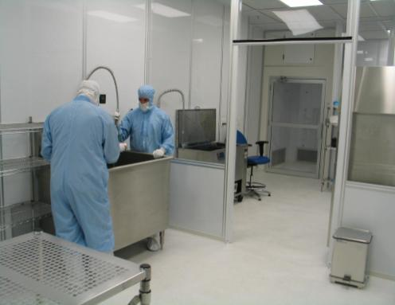
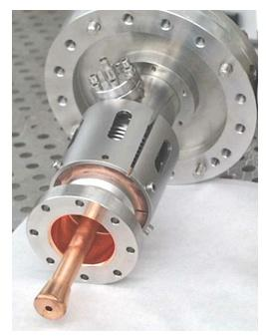
SC Cavity Power Couplers
Have facilities and expertise to design, build, and rf process couplers

Slide 32
Summary
SLAC is on its way to become a fully integrated Multi purpose laboratory
HEP is an important piece of SLACs mission
Accelerator Science and Technology is fundamental to the laboratory
The laboratory has core technologies that are unique and mission critical to Science Community, other laboratories and the DOE complex
SLAC would very much like to be part of MAP and make a unique contribution

Slide 33
Conceive, Design, Build, Test, & Operate RF Sources, Pulsed Power Systems, and Accelerators
  The leader in NC linear accelerator design (any frequency) and the development of high power systems:
    Lifecycle stewardship of RF sources, accelerators, and systems, that power the SLAC facilities from 0.2 to 90 GHz
    World’s only integrated capability to conceive, design, build, test, and operate high power rf systems
    Backup capability for other Laboratories in the DOE Complex!!!!
  Support the design of accelerators for application (MaRIE, MEGA RAY, etc…)
  Support the component development necessary for other accelerators
Notes:
Crisis response, machine upgrades, detailed knowledge of operating characteristics, quality, and risk and their impact on accelerator performance.
That define the state of the art
No commercial facilities for testing high power sources (high power modulators).

