Slide 1



NuMI Beam Monitoring Simulation and Data Analysis
Yiding Yu
Don Athula Wickremasinghe
Pavel Snopok
Eduardo Ossorio
Jennifer Thomas
Katsuya Yonehara
Sudeshna Ganguly
Thomas Carroll
NuFact 2022
Slat lake City, Utah
Aug 05, 2022

Slide 2
Outline
Overview of NuMI beamline Monitoring system
New technique for muon monitor simulation
Machine Learning based on measurement data
Summary
Introduction to muon monitor simulation
Machine Learning based on simulation
Beam parameter effect on pxiels at MMs
Measurement data vs simulation

Slide 3
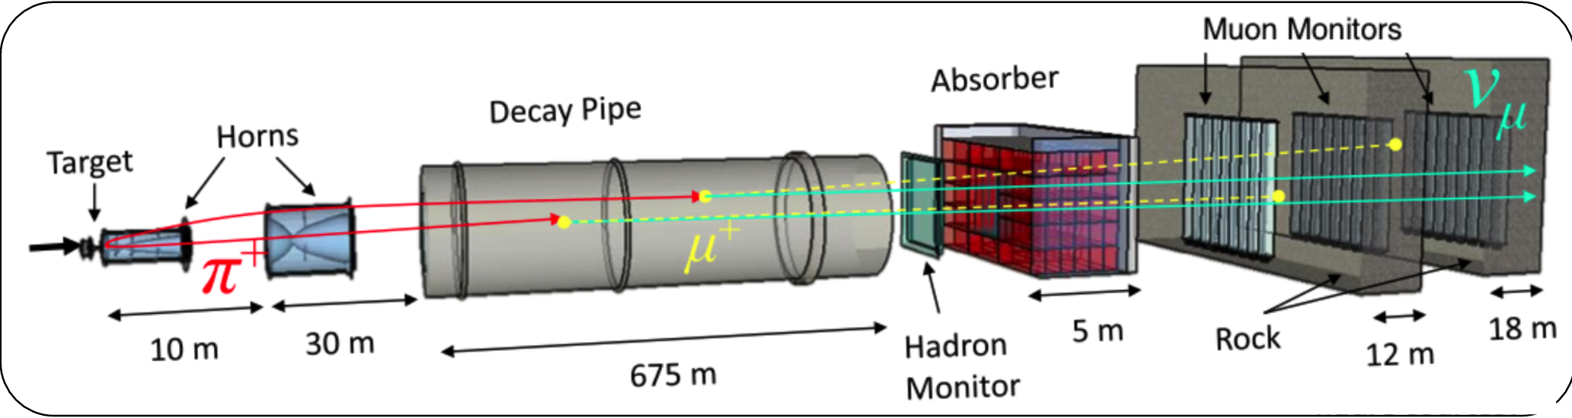
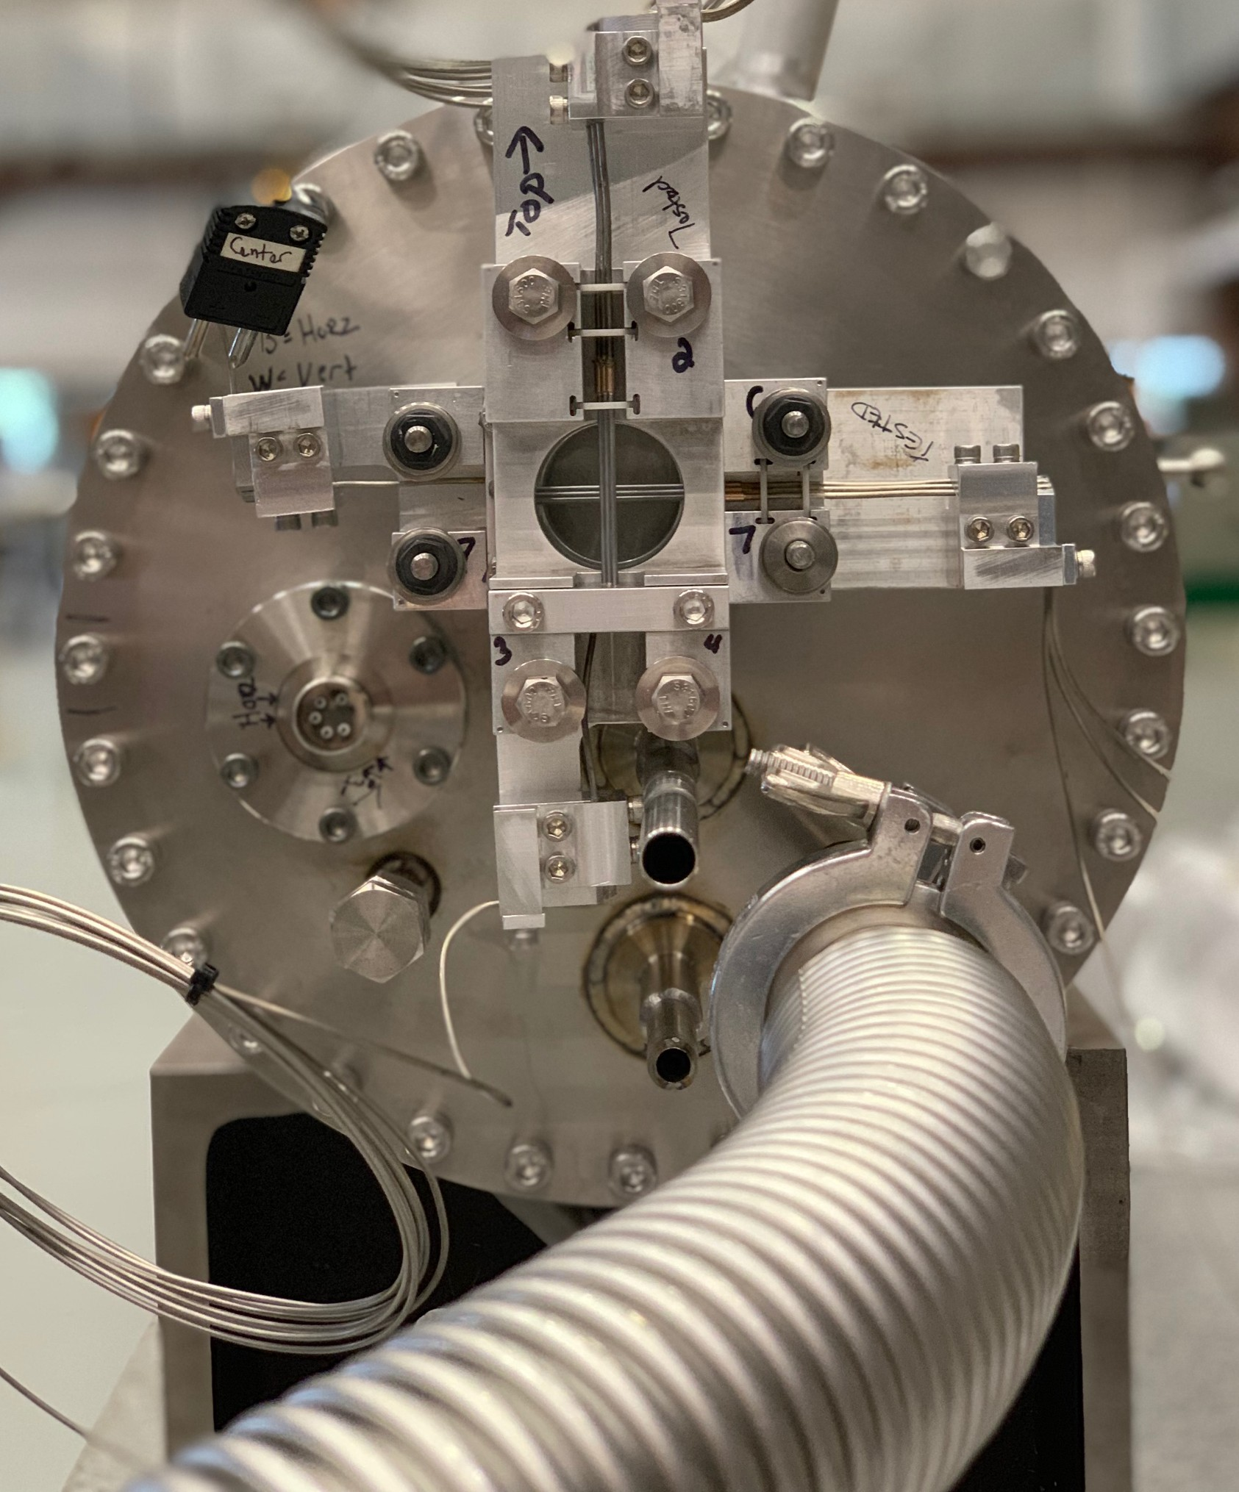
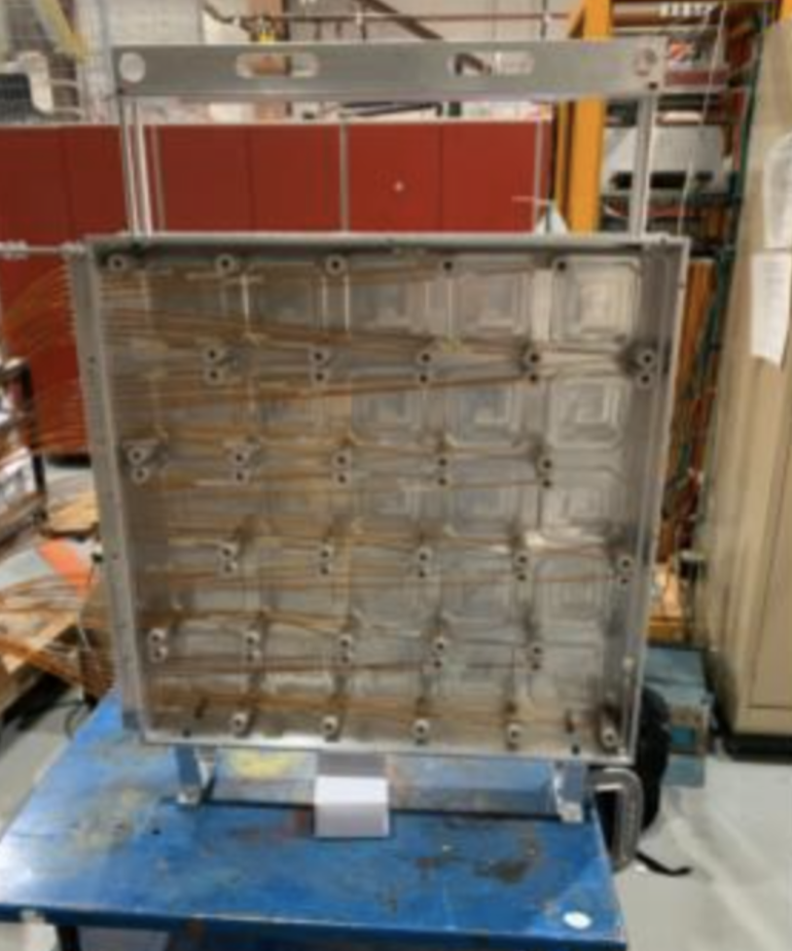
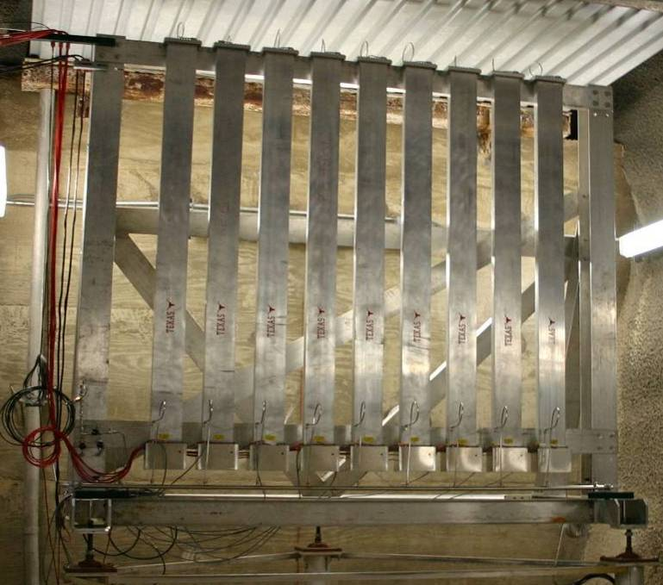
Overview of NuMI beamline Monitoring system
Motivation:
With MINOS detector shut down in 2019, the muon monitors now provide essential information to monitor the beam and target
The goal of this study is to maintain the quality of the monitor signals and to establish correlations with the neutrino beam profile
Thermocouple detector
(3+3 Be wires)
Hadron monitor
( 5x5 pixels)
Muon monitor
(2x2 m2, 9x9 pixels)

Slide 4
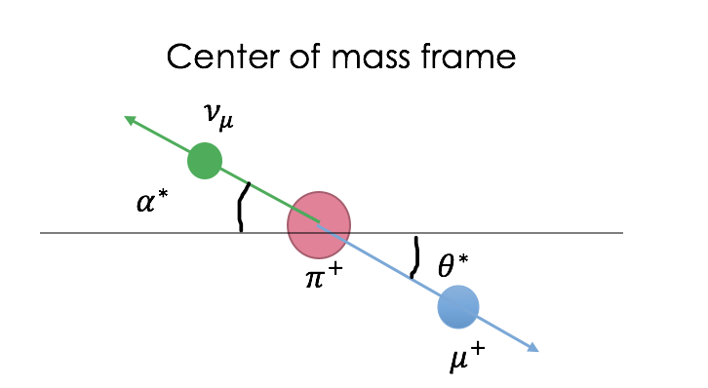



Introduction to muon monitor simulation
G4NuMI is the main tool that we use to run simulations for NuMI beam and muon monitors. It is based on Geant4
The procedure of muon monitor simulation:
1. Generate neutrinos by running G4NuMI
2. Convert neutrinos back to their parent particles
3. Generate muons based on those parent particles
4. Feed those muons into a separate G4NuMI simulation
to generate muons at the muon monitors
$$π$$
Separate
G4NuMI
G4NuMI
$$μ$$
$$v_{μ}$$

Slide 5
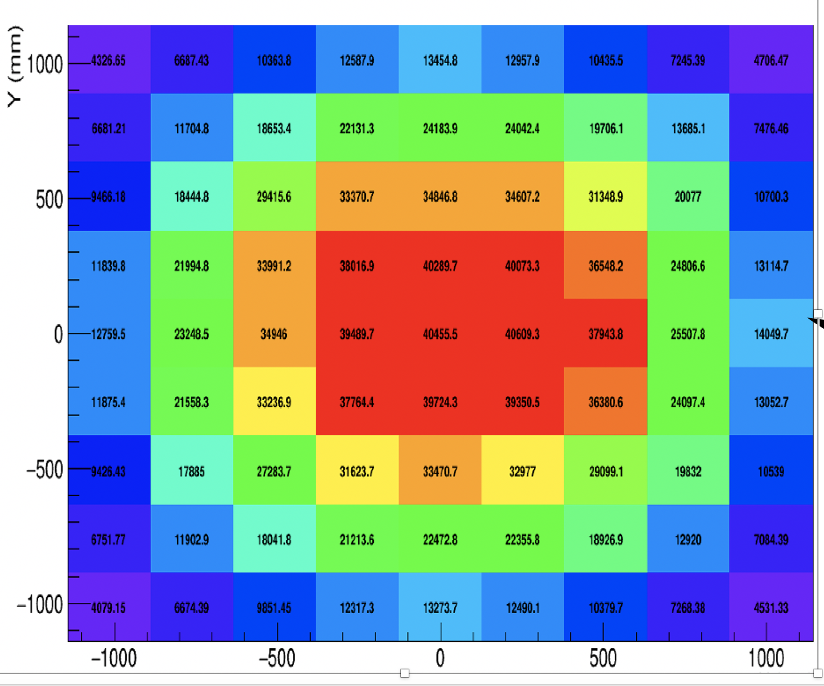
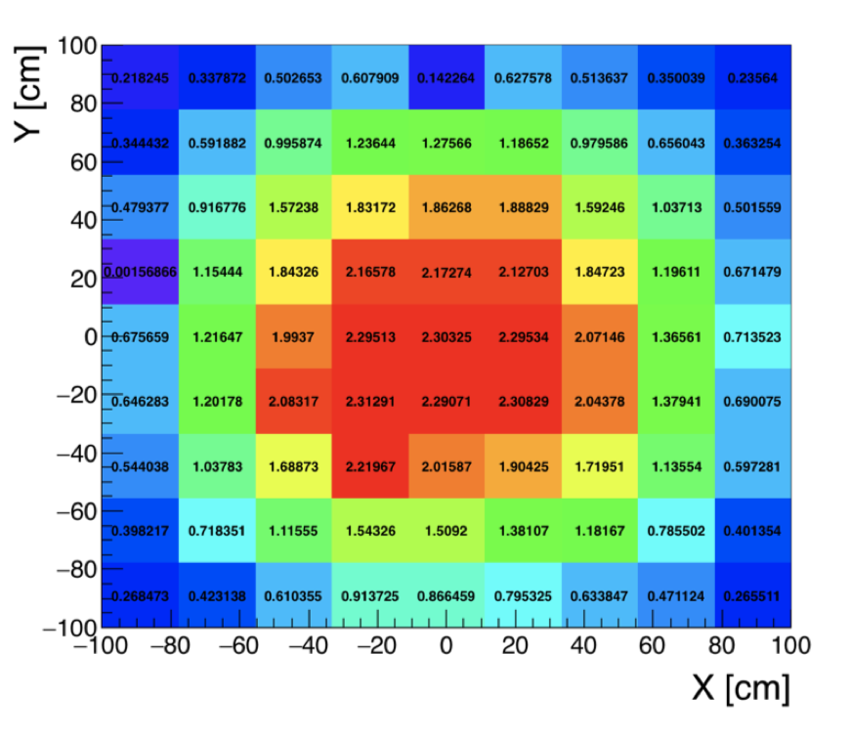

A general result muon monitor simulation
2D histogram of simulation
2D histogram of data
The numbers in pixels are the voltage signal
The number on each pixel is the number of events

Slide 6
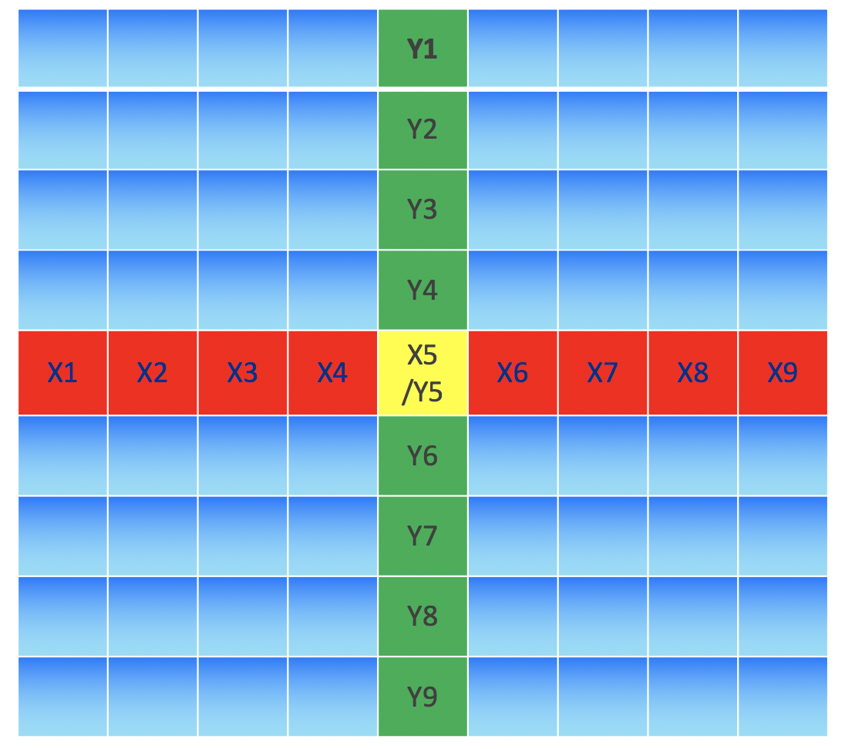
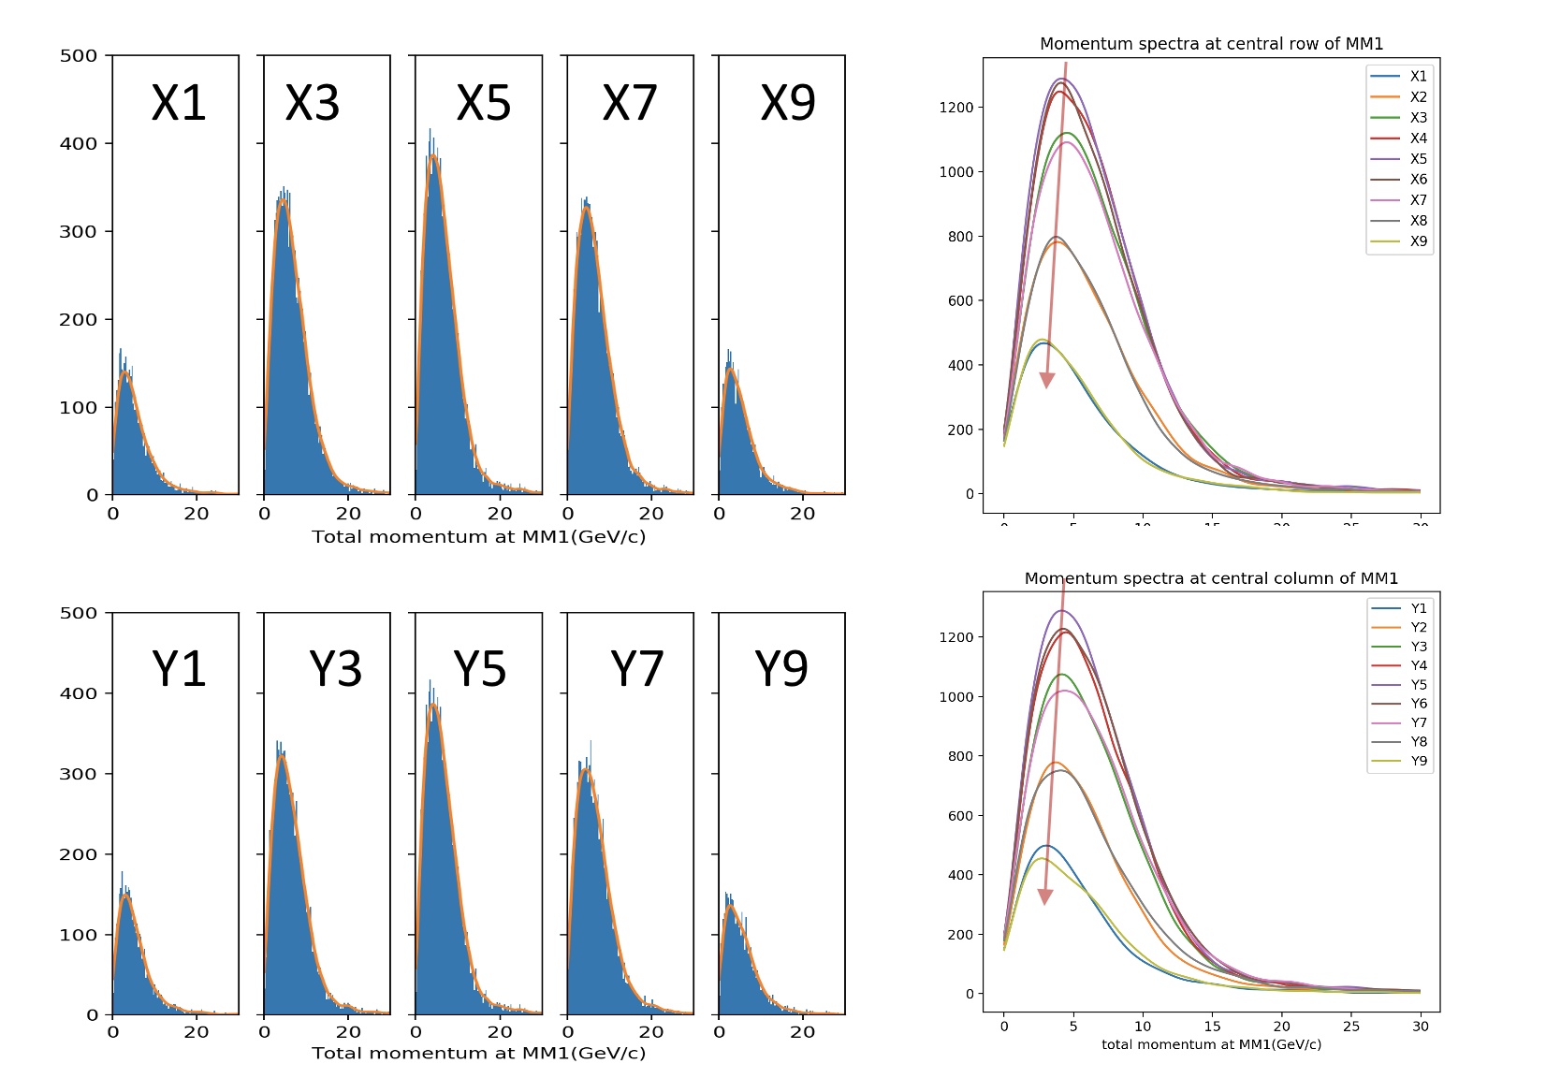
Muon monitor simulation( pixels information)
MM11
Different pixels have different muon spectra
The peaks of the spectra move to low momentum from center to edge of MM1

Slide 7
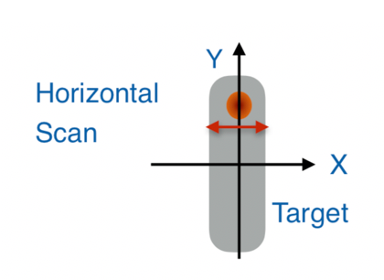
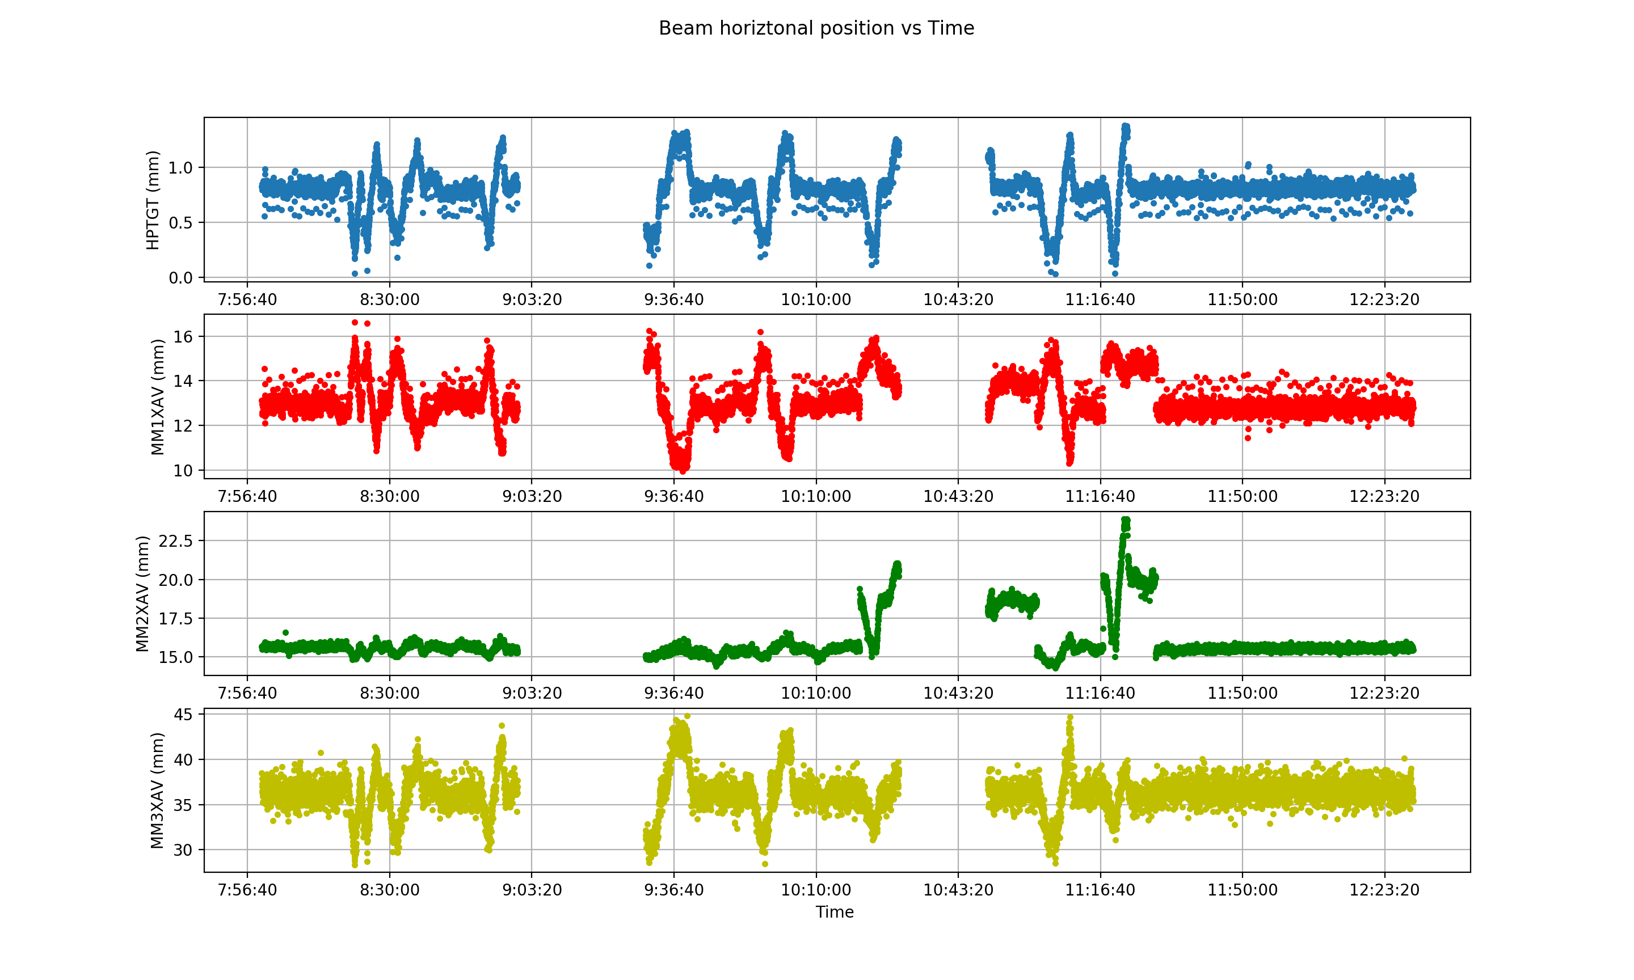
Muon monitor data analysis(Target beam scan data)
Proton_x
To understand the behavior of the N beam and be able to predict the effect of the changes in the key beam parameters, multiple beams scans are carried out
Beam parameters are changed:
the beam position on target
the beam spot size
the focusing horn currents
MM1_x
MM2_x
MM3_x

Slide 8
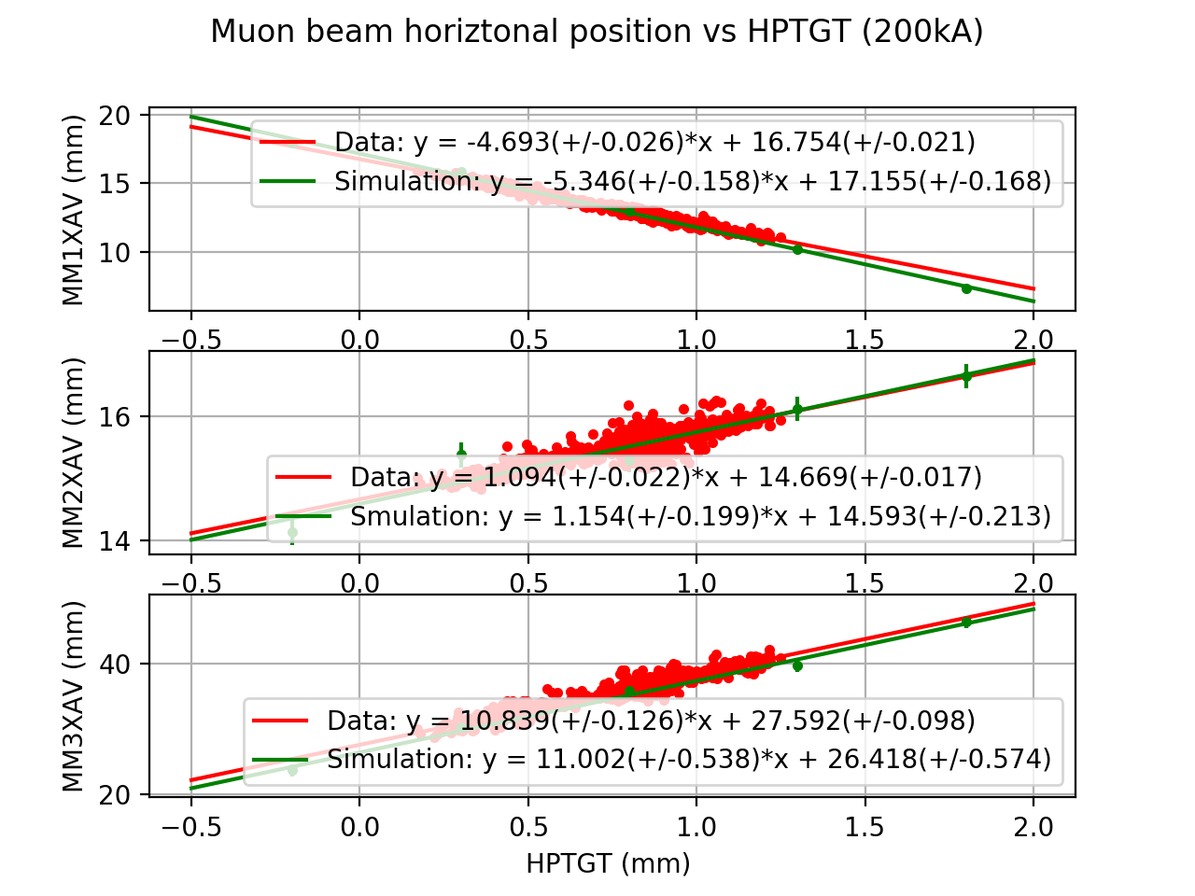
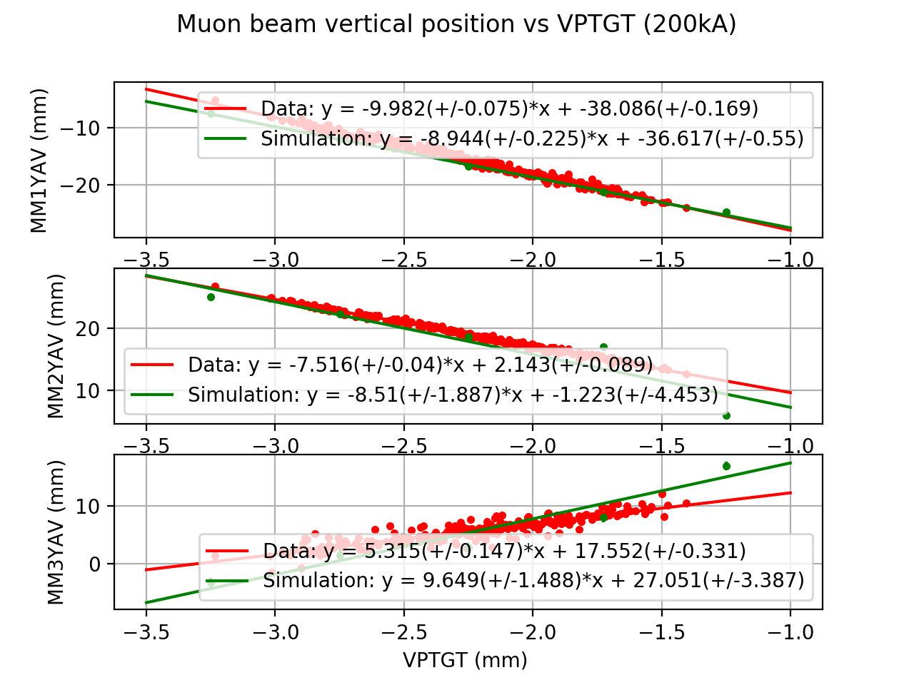
Muon beam centroid vs proton beam position at MMs
We can see three muon monitors are responding differently to the proton beam variations from the different slopes
Simulation results are consistent with data

Slide 9
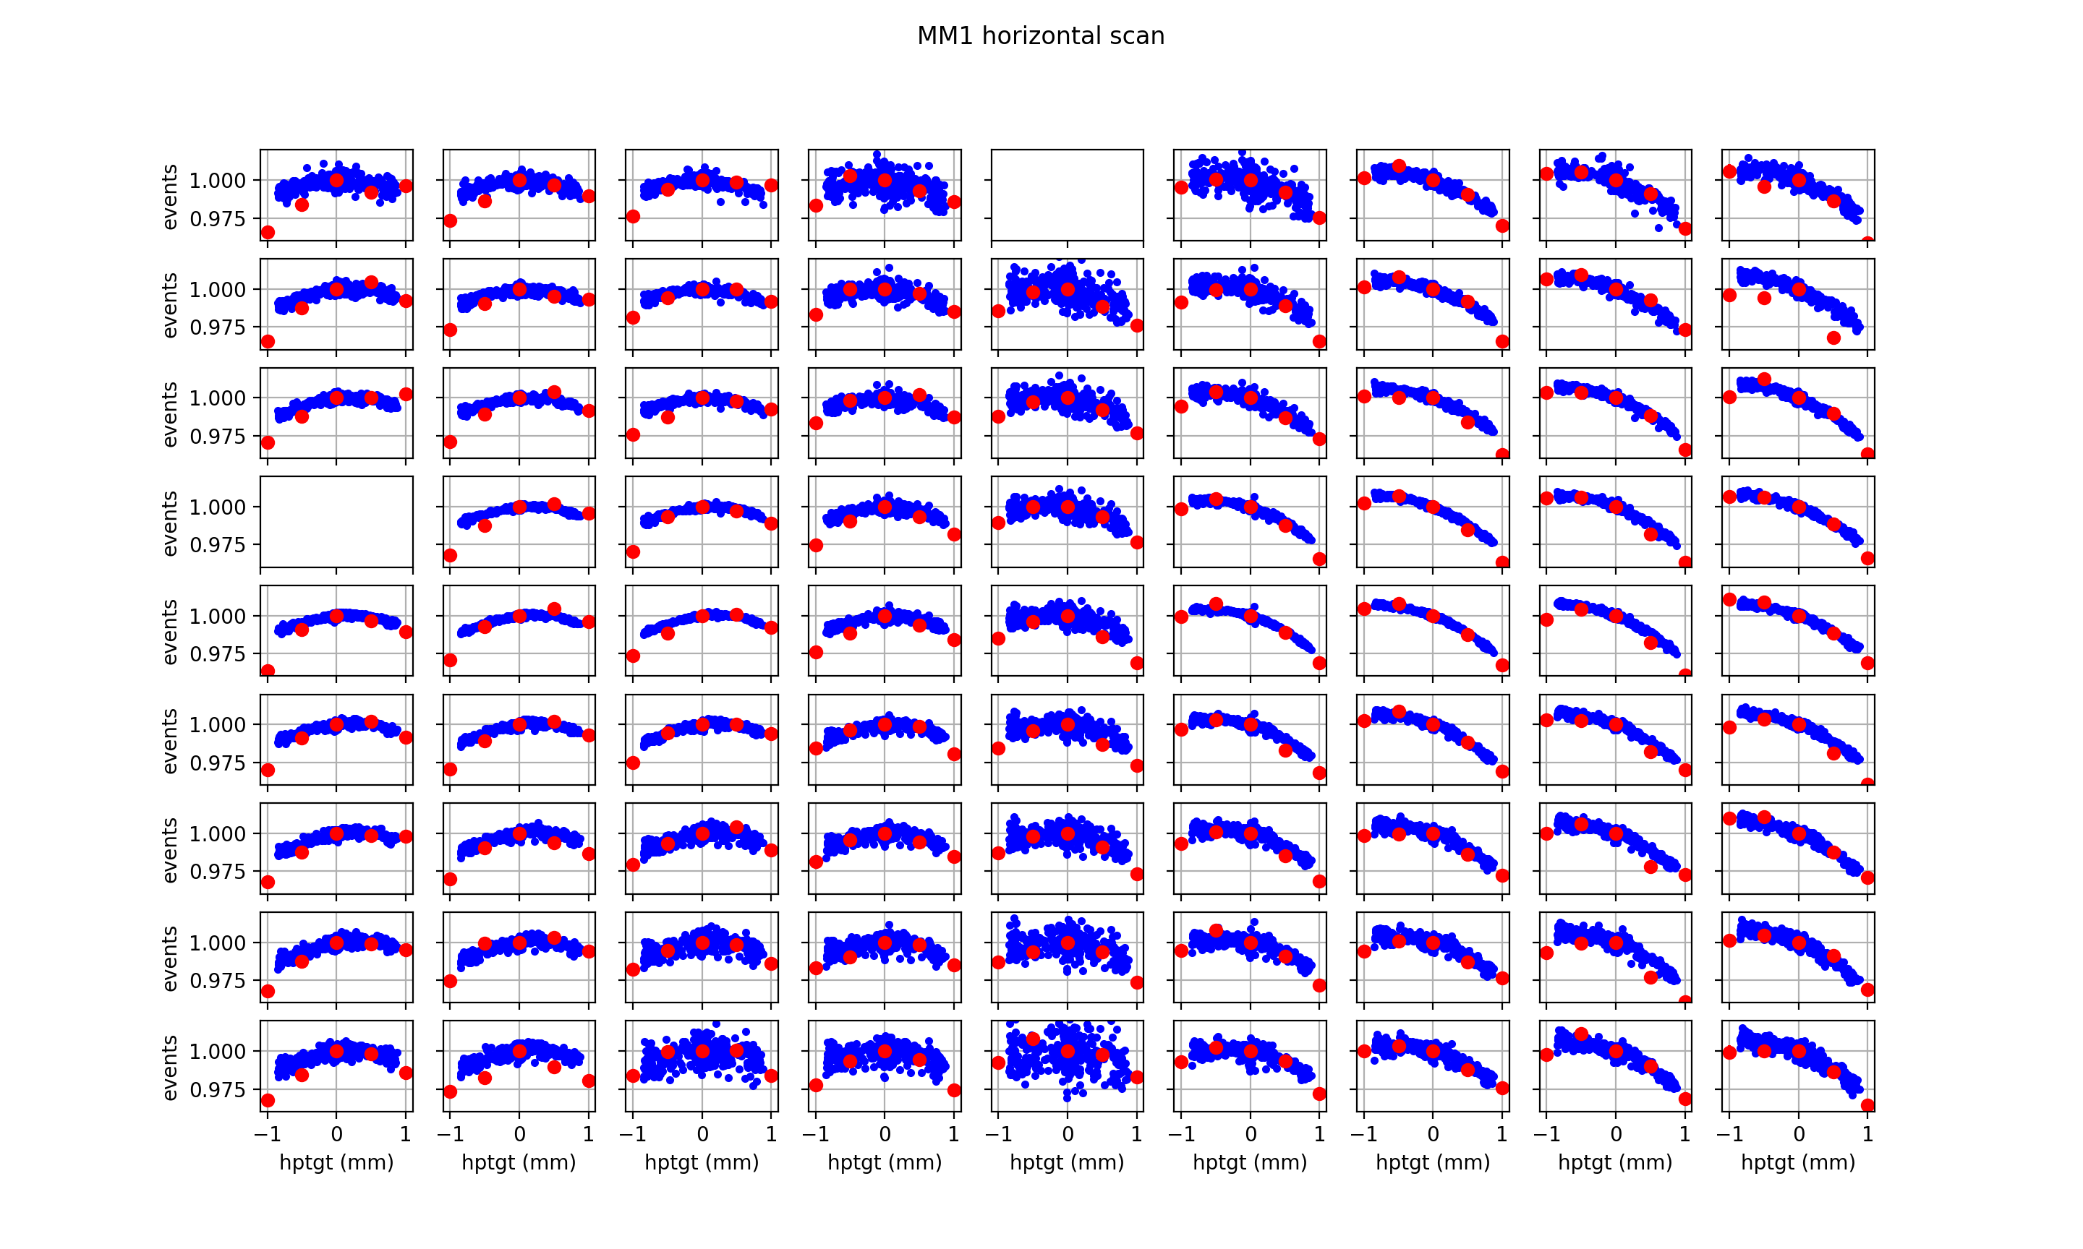
DATA VS SIM
Muon monitor pixel study
The simulation shows similar trends with some quantitative differences with data in some key pixels
Blue: data of latest beam scan
Red: simulation
The events of data and simulation are normalized by the value of signal/events of 0 mm.
The simulation works very well at rights pixels but not the left ones

Slide 10
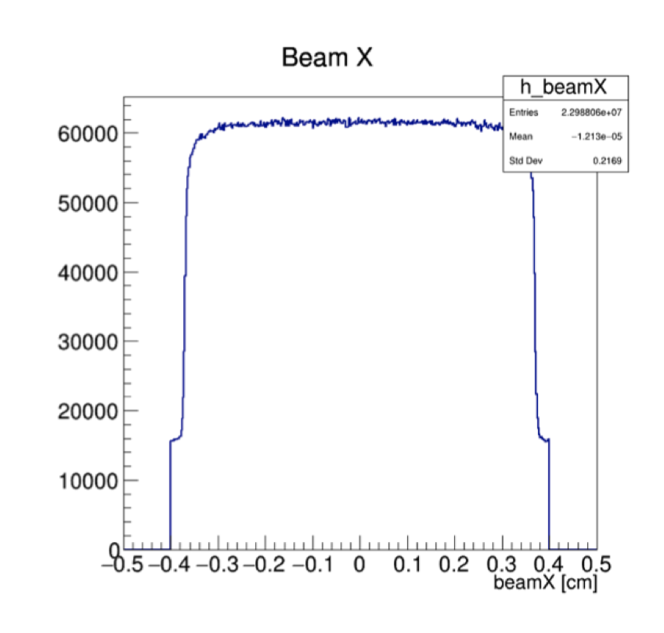
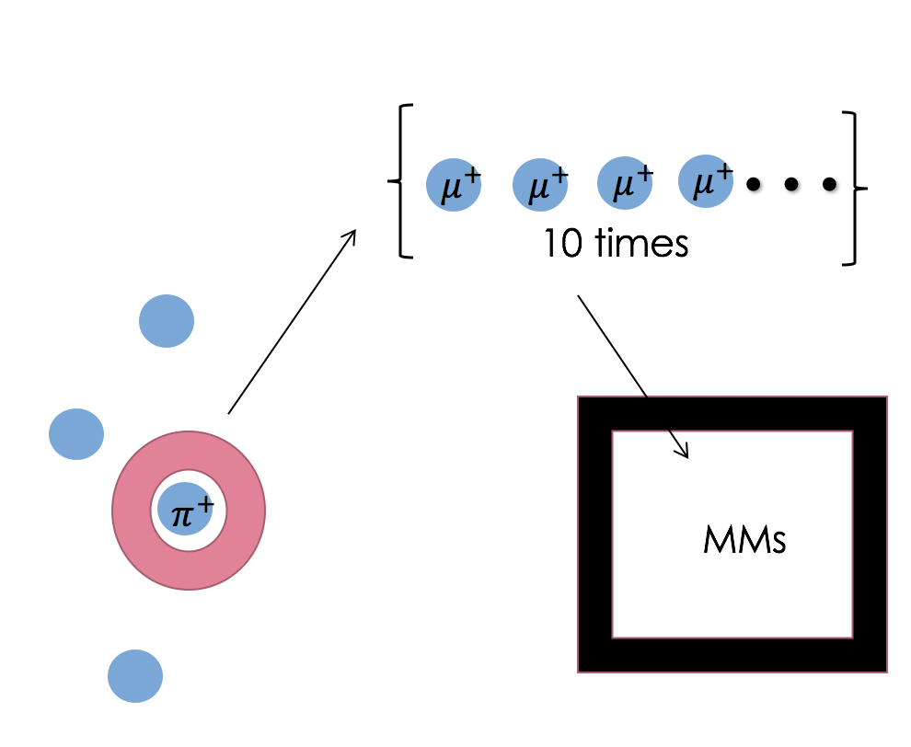
Uniform beam simulation + multiple decay
Uniform beam simulation*
Start by simulating a uniformly distributed proton beam hitting the target
Then apply Gaussian weights to the protons based on position when analyzing to simulate different beam positions
Useful for neutrino flux and muon monitor studies
Multiple decay
Make the pions decay to multiple muons
Then simulate those muons through the absorbers and muon monitors
*by Athula Wickremasinghe (nova-doc-49610, nova-doc-51702)

Slide 11
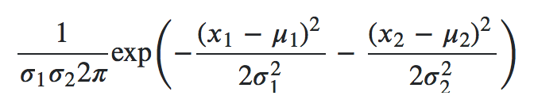
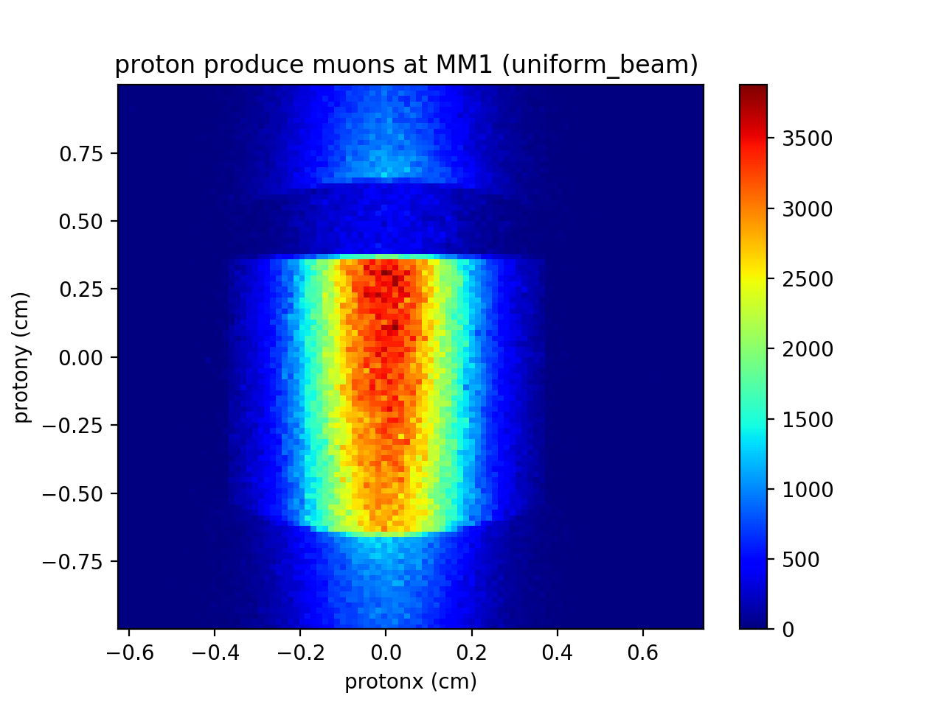
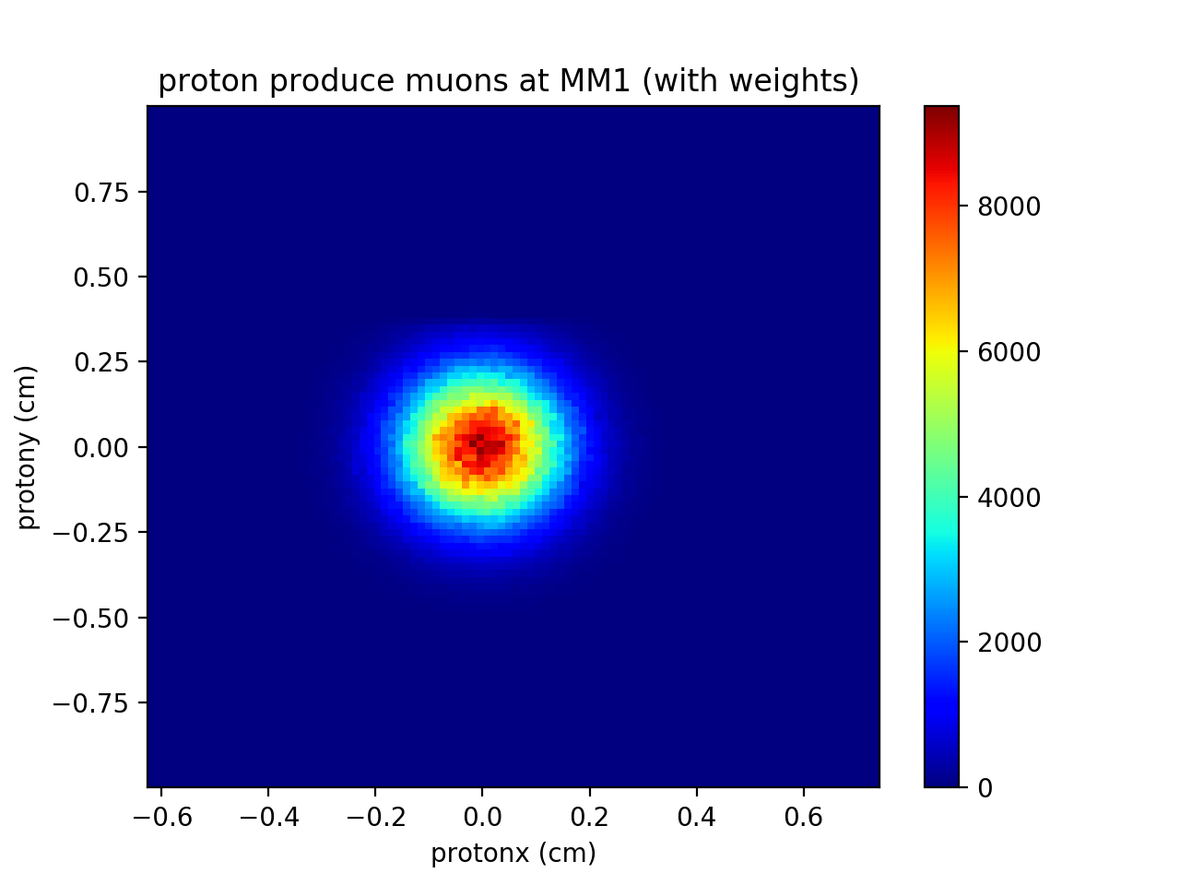
Uniform beam simulation
Gaussian weights

Slide 12
Beam parameter effect on pixels at MMs
The study about the effect of some parameters at pixels of MMs
  Horn tilt:
  −3 mrad, −2 mrad, −1 mrad, +1 mrad, +2 mrad, +3 mrad
  Target offset:
  −1 mm, −0.5 mm, −0.1 mm, +0.1 mm, +0.5 mm, +1 mm
  Target density:
  1.76 g/cm3 (−1% from the nominal)
  1.744 g/cm3 (−2% from the nominal)
  Horn current change effect:
  −2 kA
  −0.2 kA
Each simulation has 50 MPoT and each pion and kaon multiple-decays to 20 muons
Horn current: 200 kA

Slide 13
Horn1 tilt

Slide 14
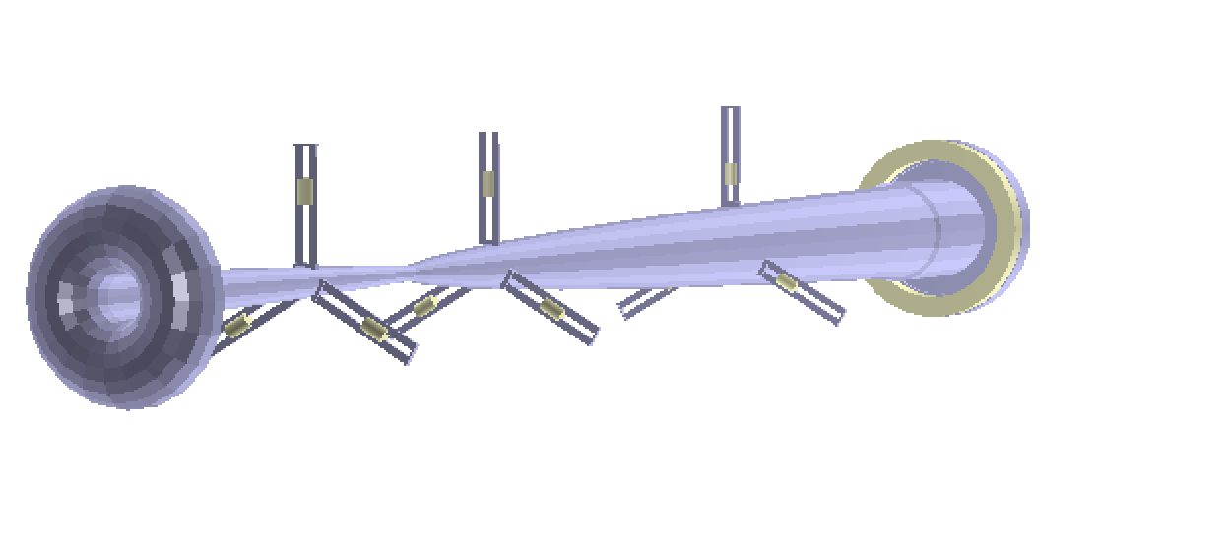
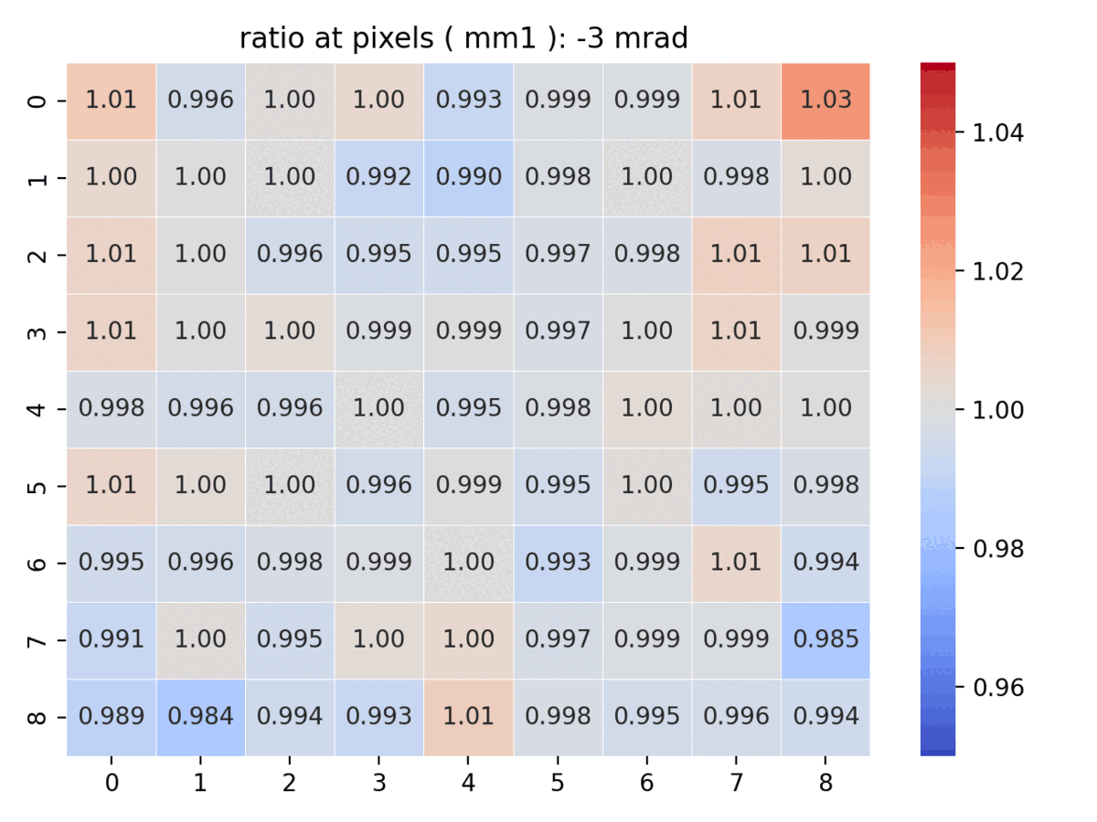
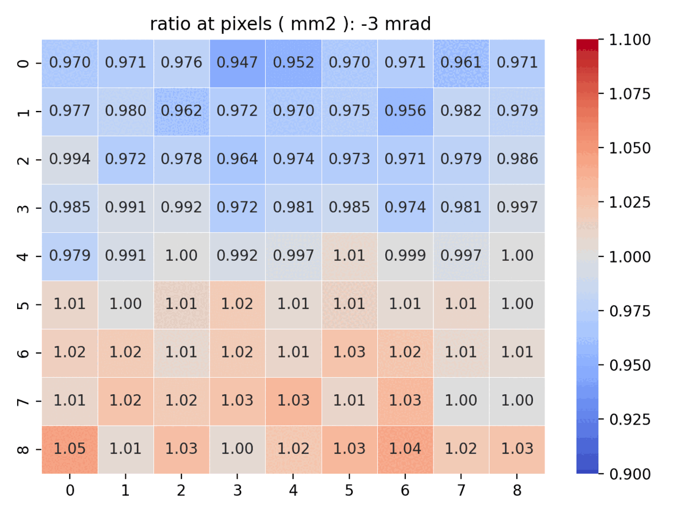
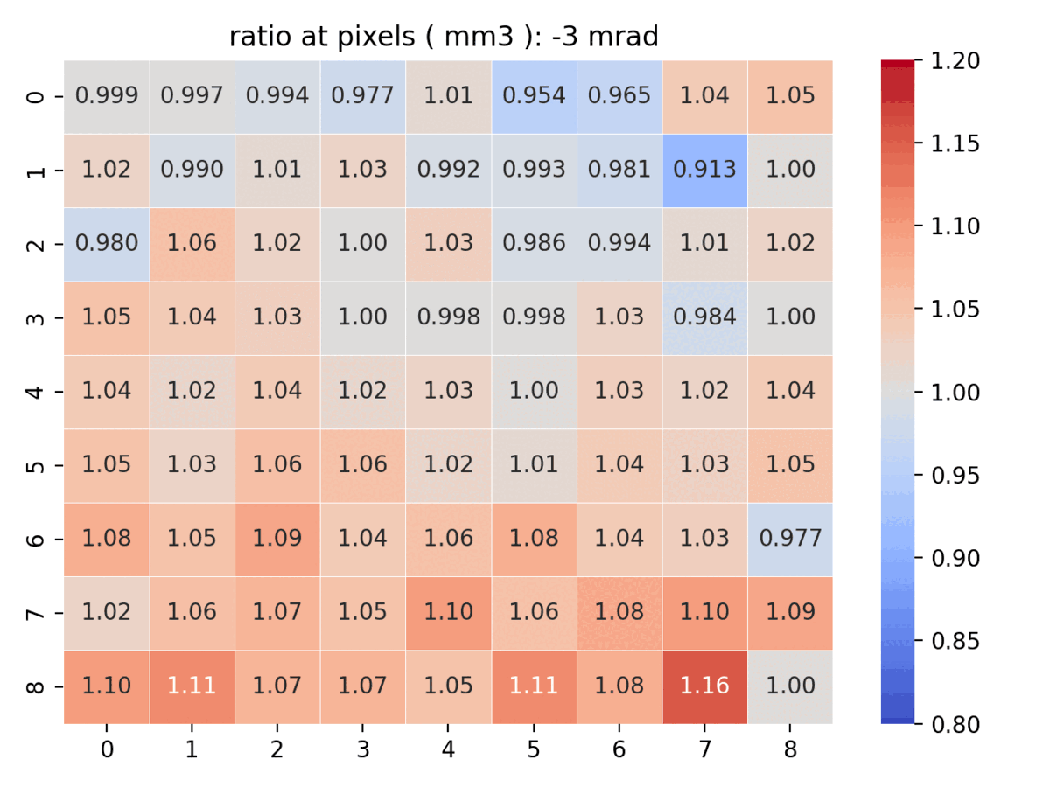
Horn1 tilt angle (x axis) effect
y
x
MM2 and MM3 are more sensitive to the Horn1 tilt angle change
z
MM1:
average error : 0.3%
MM2:
average error : 1.0%
MM3:
average error : 2.5%

Slide 15
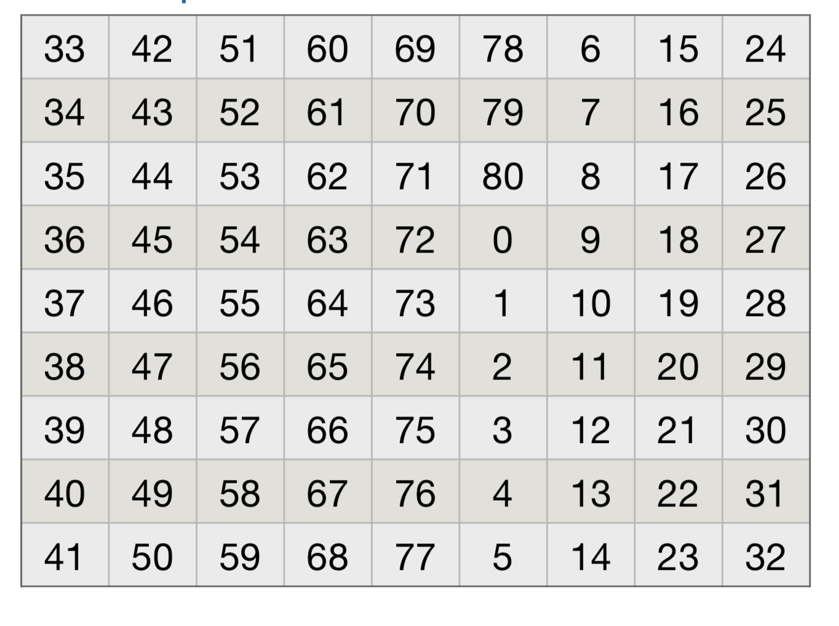
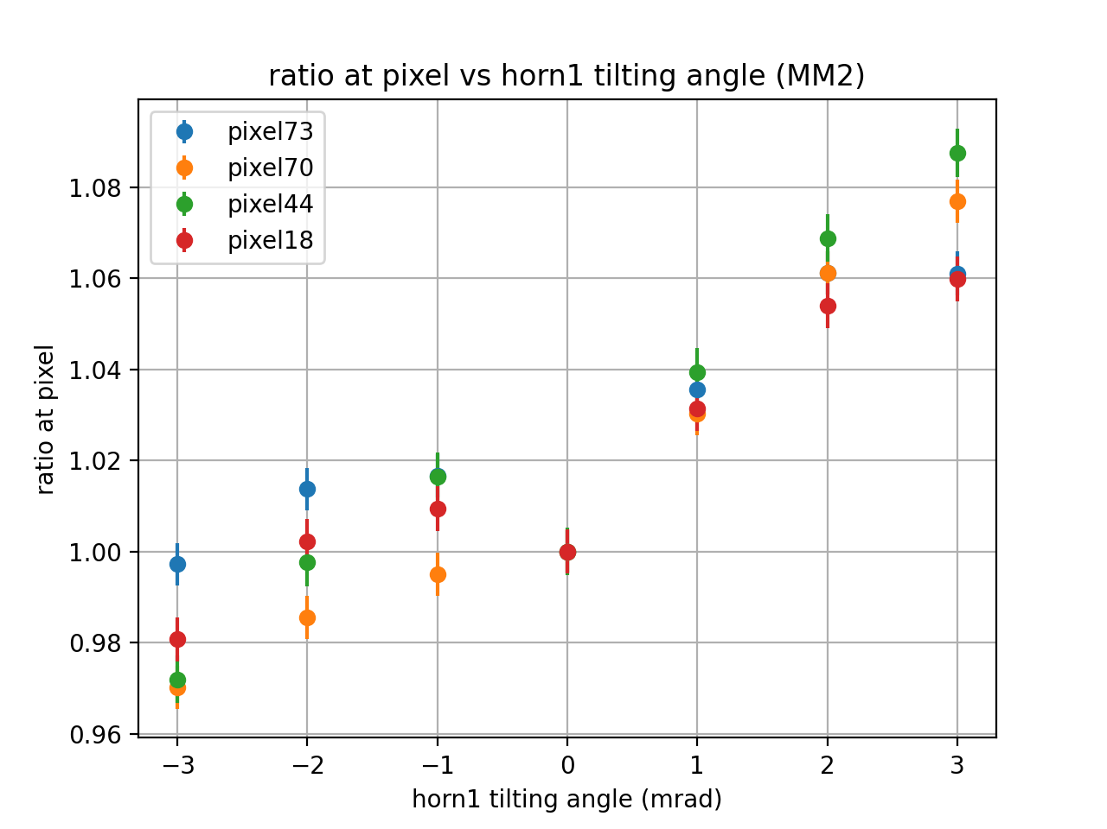
Horn1 tilt angle(x axis) effect
x
y
z
Top pixel are more sensitive to the change

Slide 16
Target offset in vertical direction

Slide 17
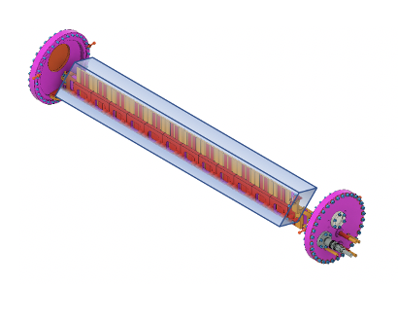
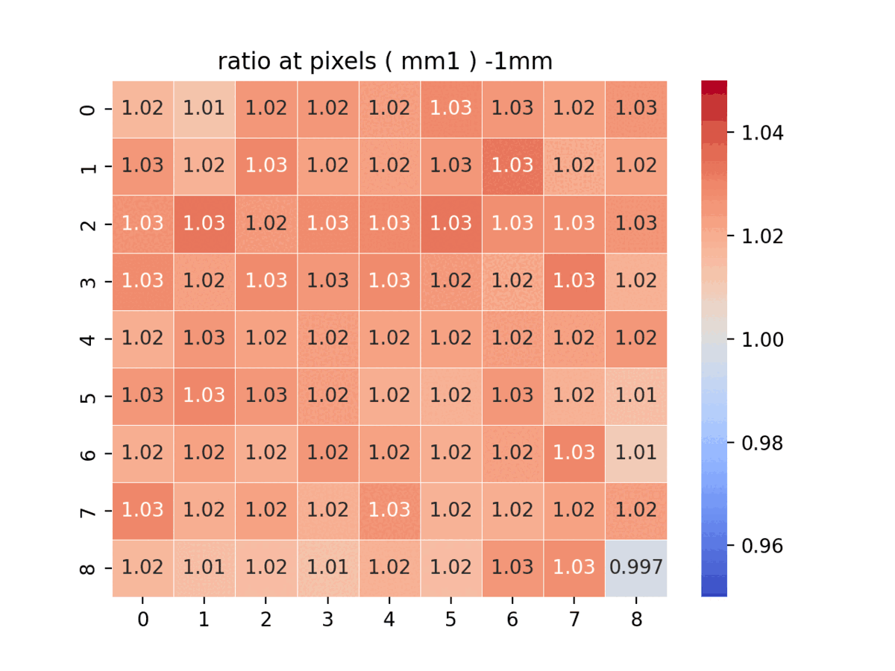
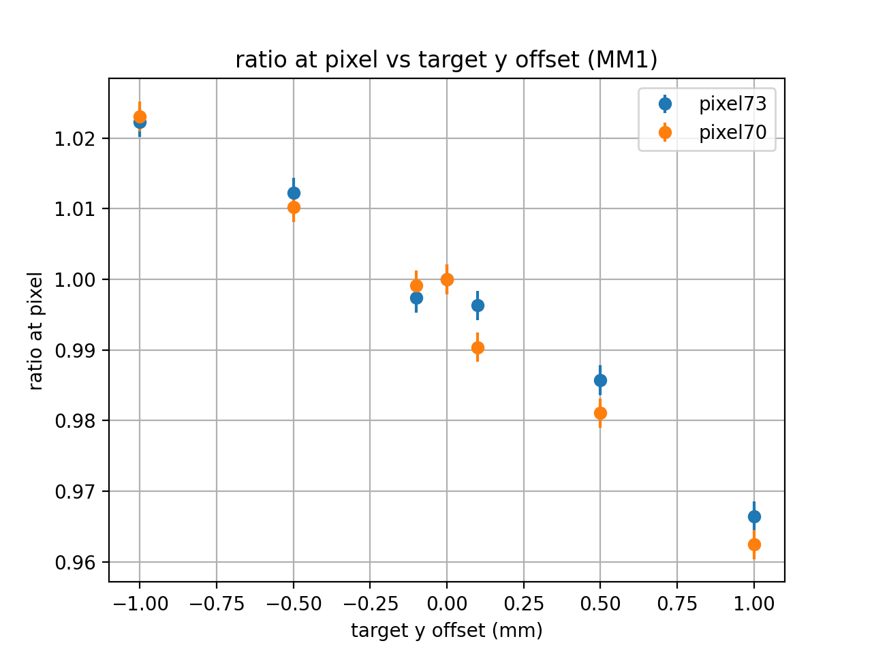
Target offset effect (vertical direction)
Y

Slide 18
Target density change

Slide 19
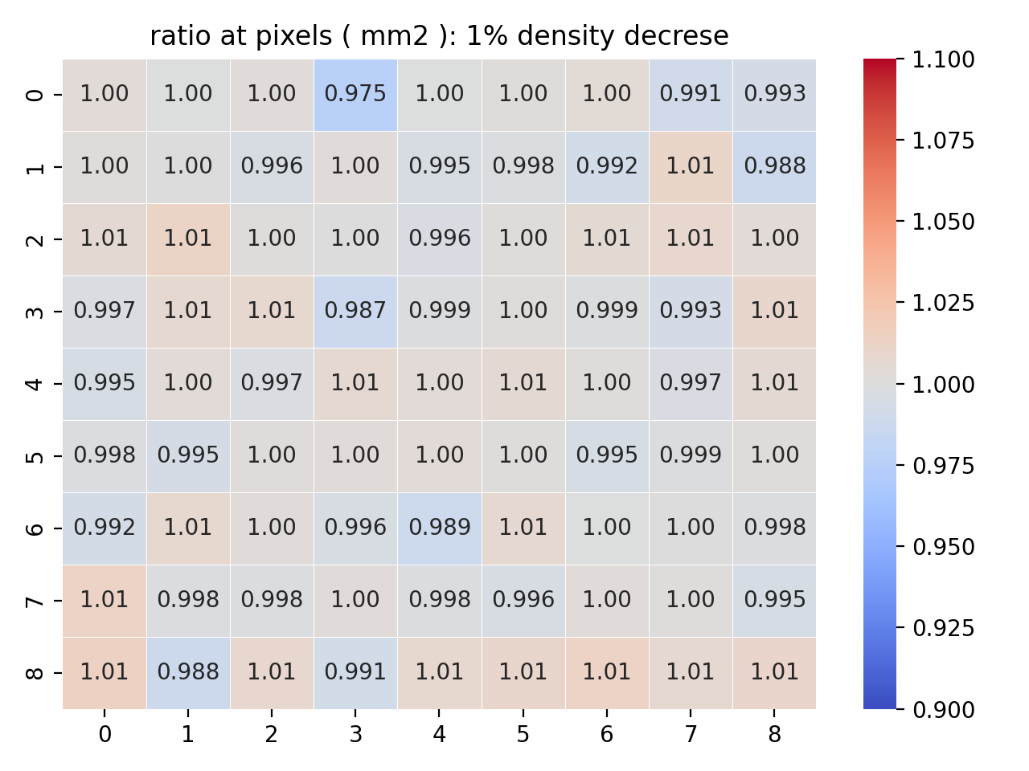
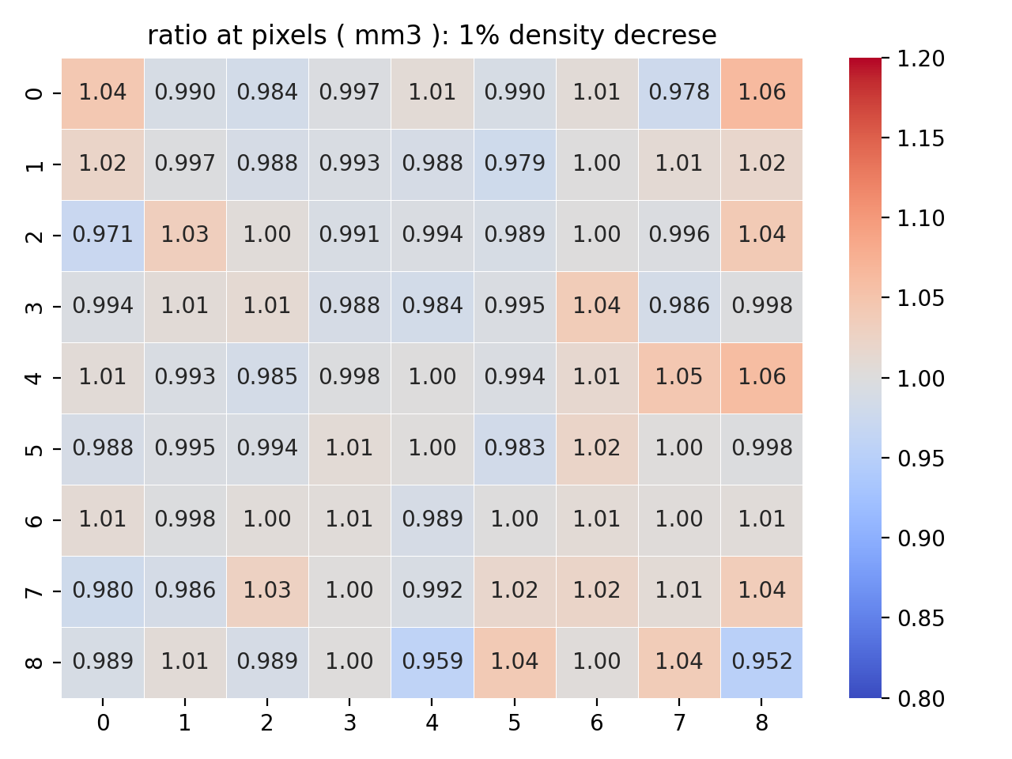
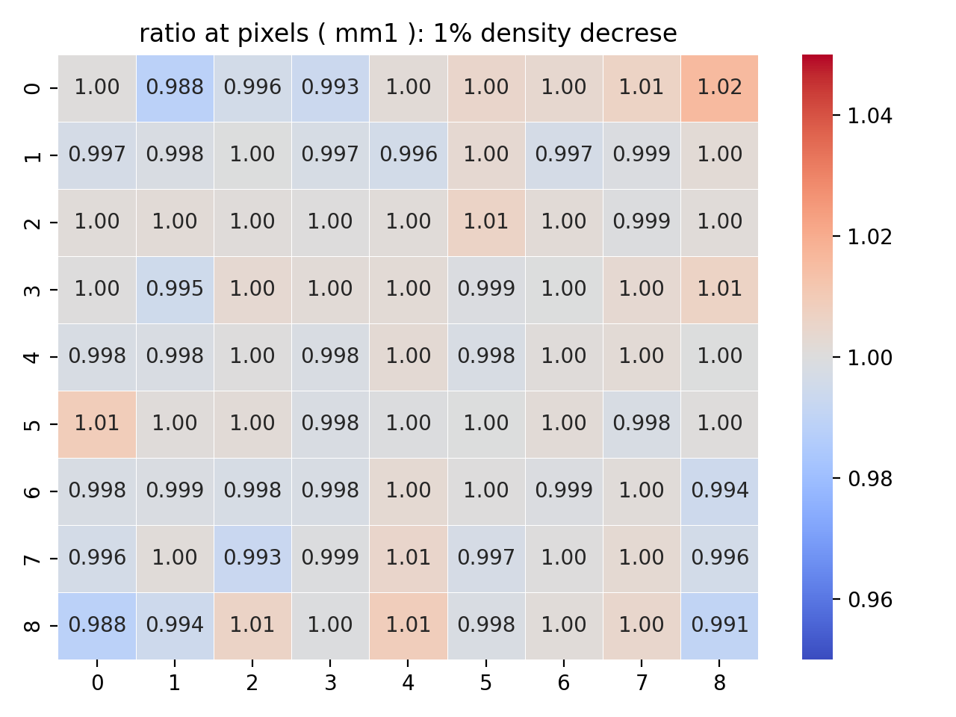
Target density change effect (1.78 => 1.76 g/cm³)
1% density decrease does not have much effect on the simulation results
MM1:
average error 0.3%
MM2:
average error 1.0%
MM3:
average error 2.5%

Slide 20
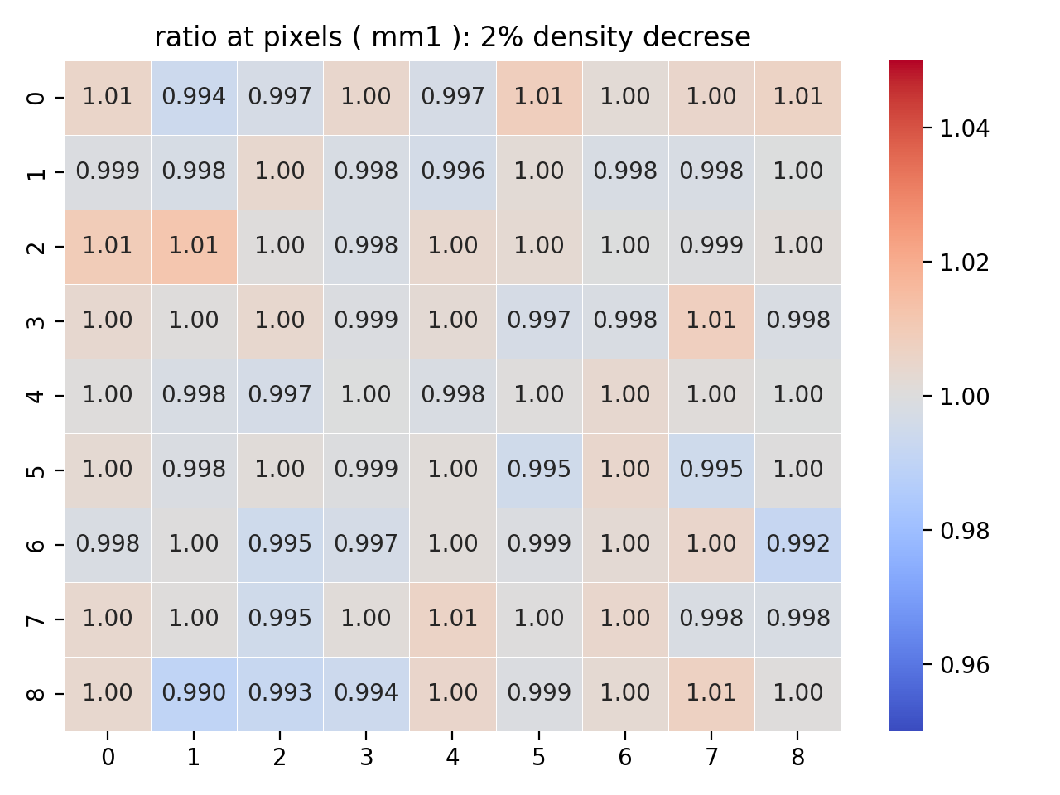
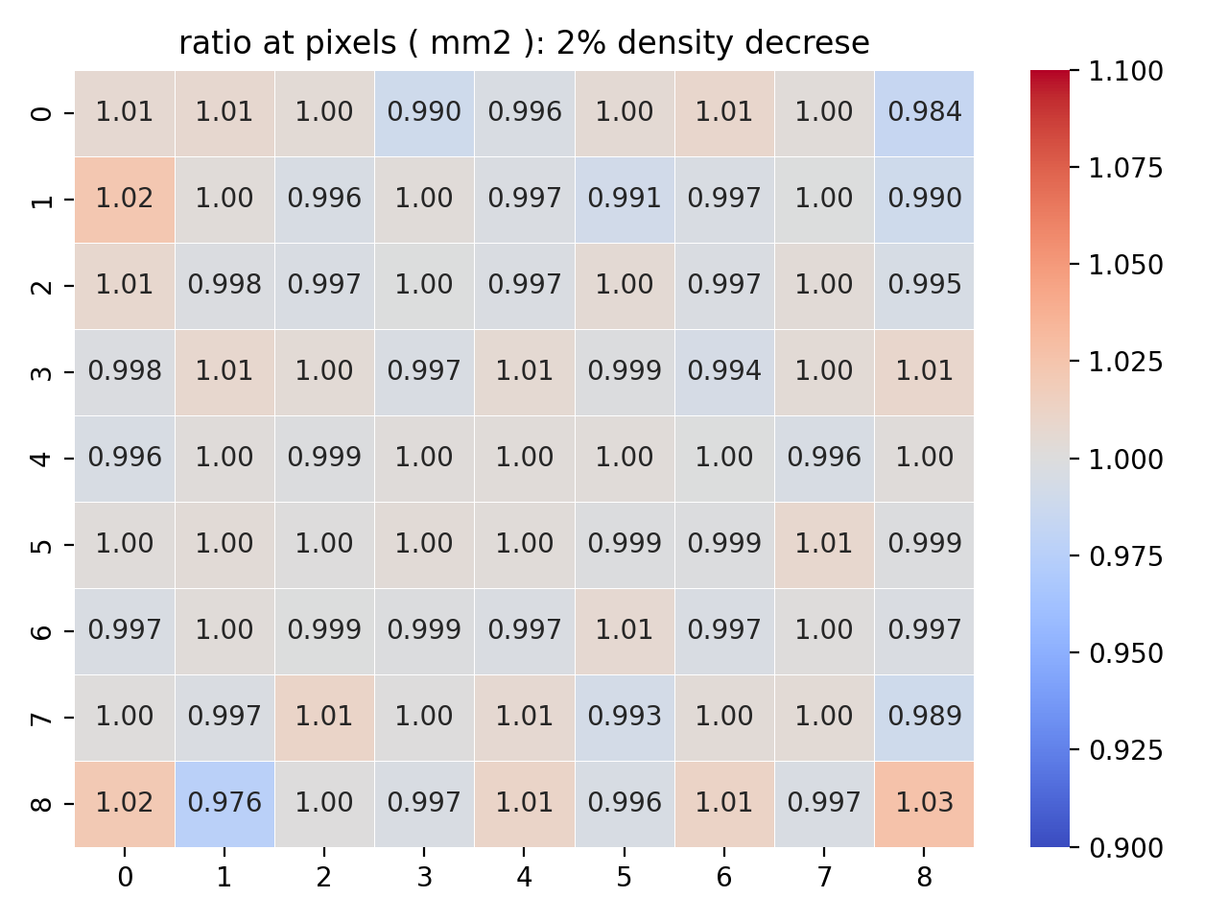
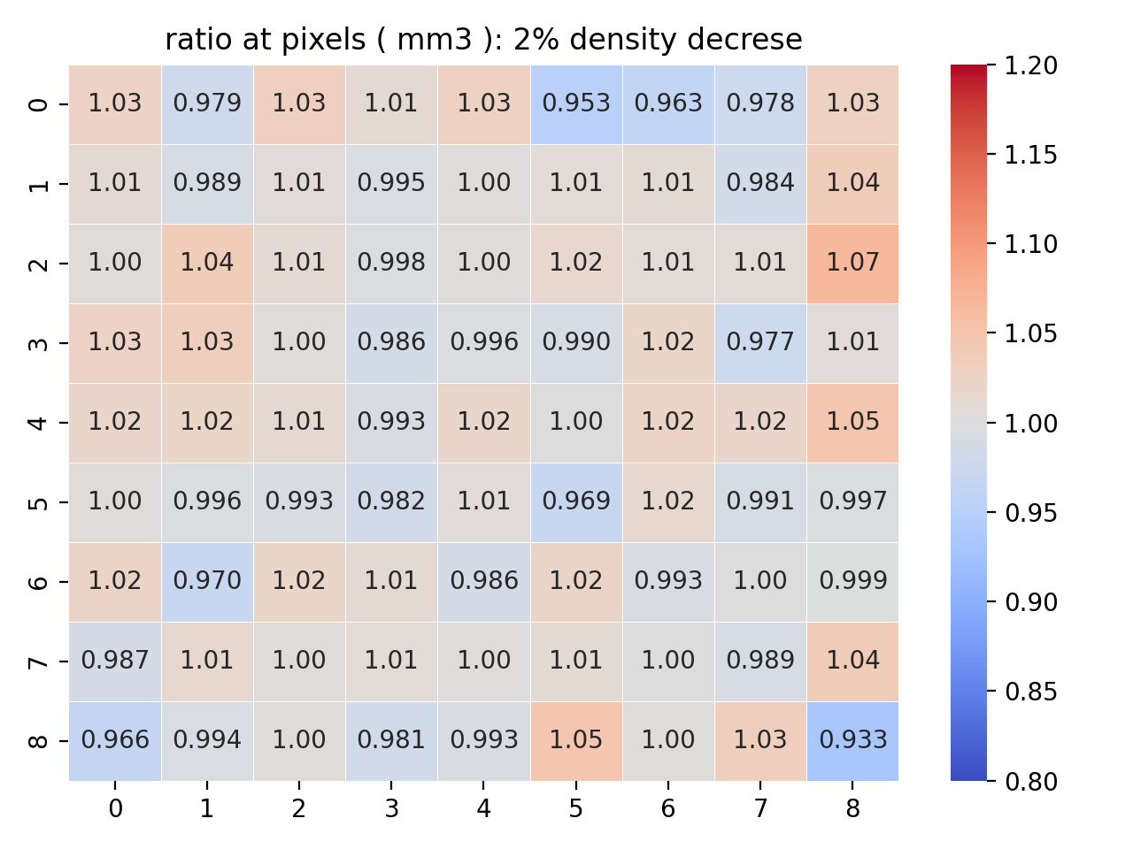
Target density change effect(1.78 => 1.744 g/cm³)
2% density decrease: we start seeing some difference at MM1
MM1:
average error 0.3%
MM2:
average error 1.0%
MM3:
average error 2.5%

Slide 21
Horn current change

Slide 22
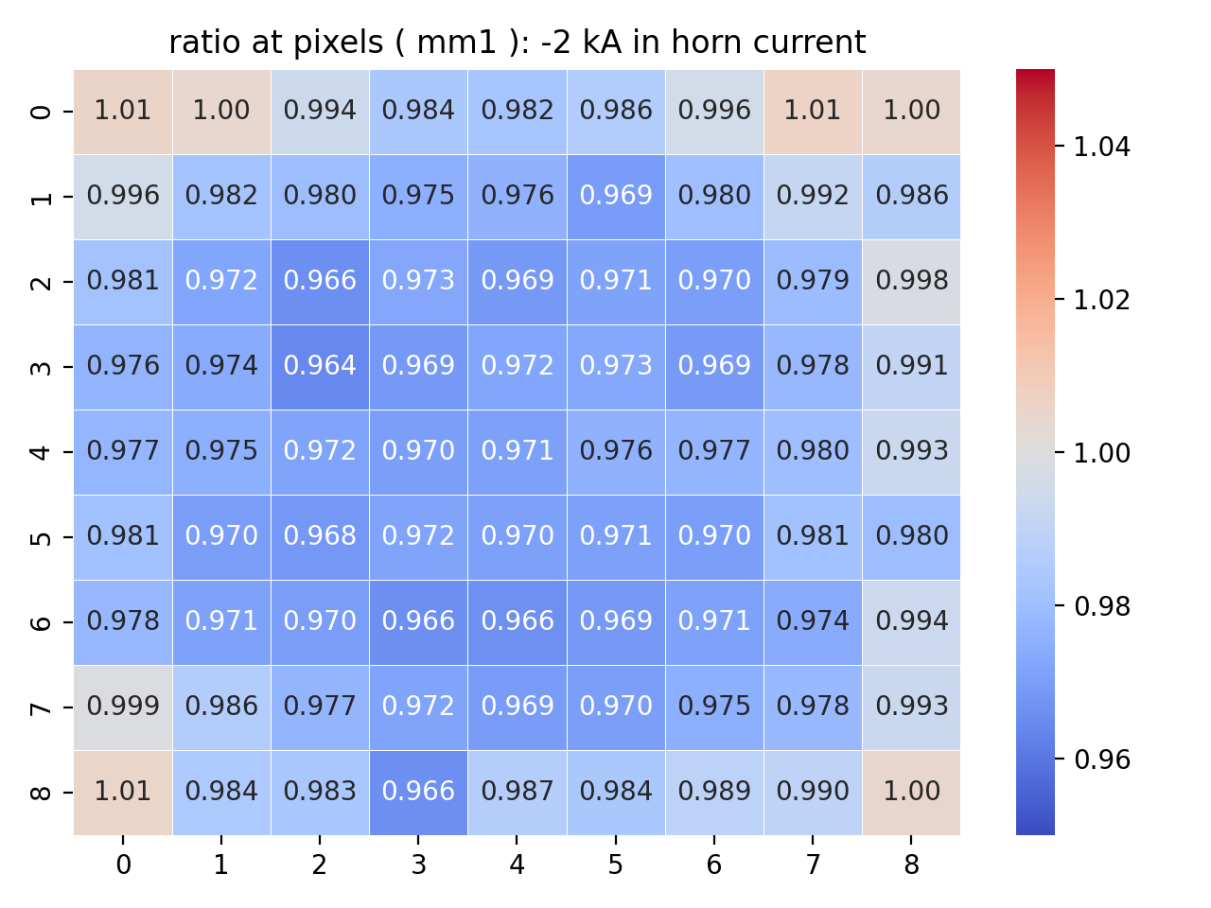
Horn current effect (198 kA)
Past studies indicate that the moun monitors can catch the change in horn current 1~2 kA.
(The # of events reduces by 3% in some pixels of MM1)
Now with the new simulation technique, we can look at the effect of a much smaller change in horn current

Slide 23
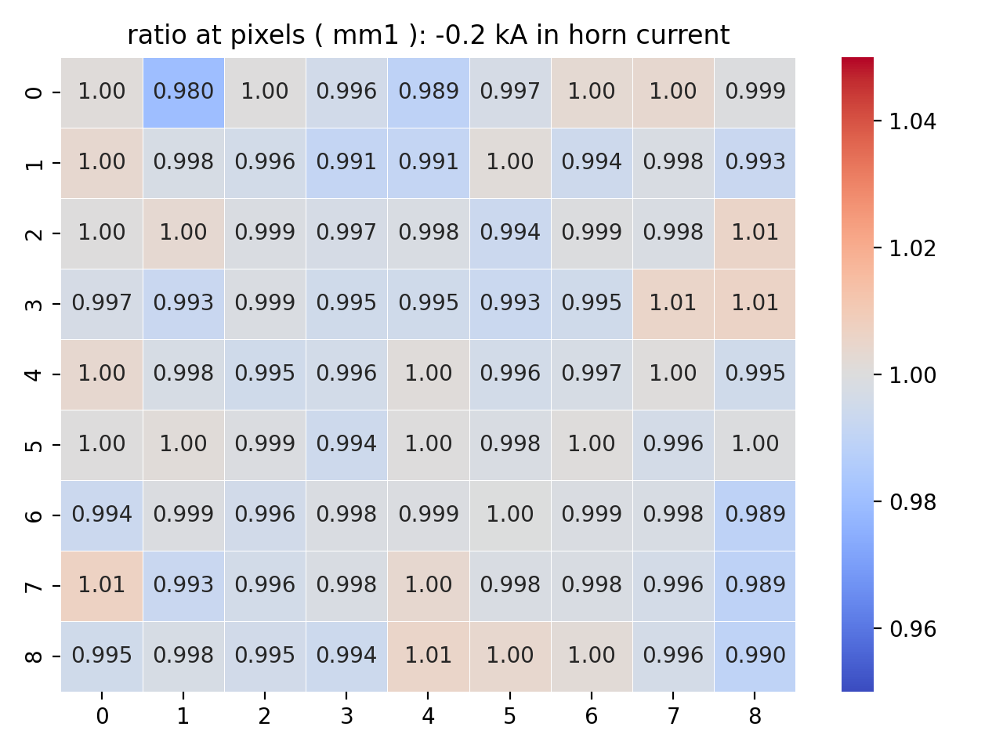
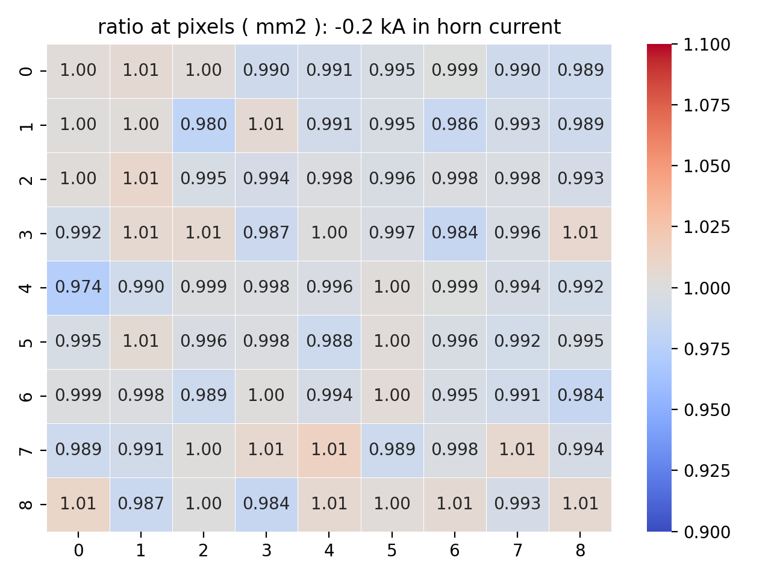
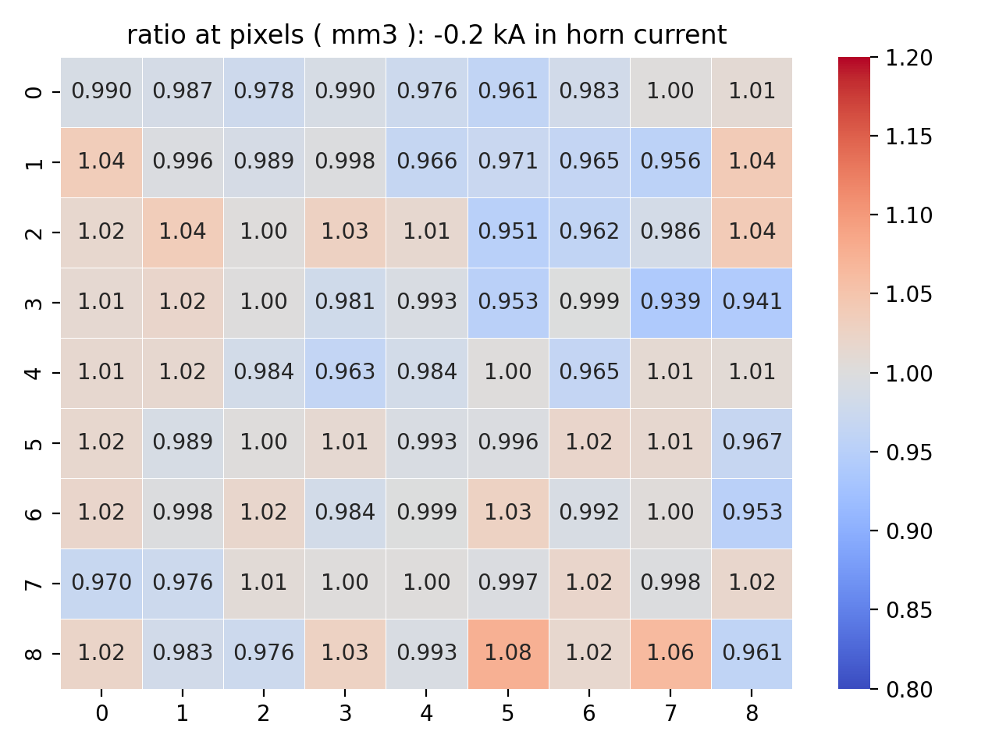
Horn current effect (199.8 kA)
MM1:
average error 0.3%
MM2:
average error 1.0%
MM3:
average error 2.5%
The difference at some pixels of MM1 is about 1 sigma (0.3%)

Slide 24
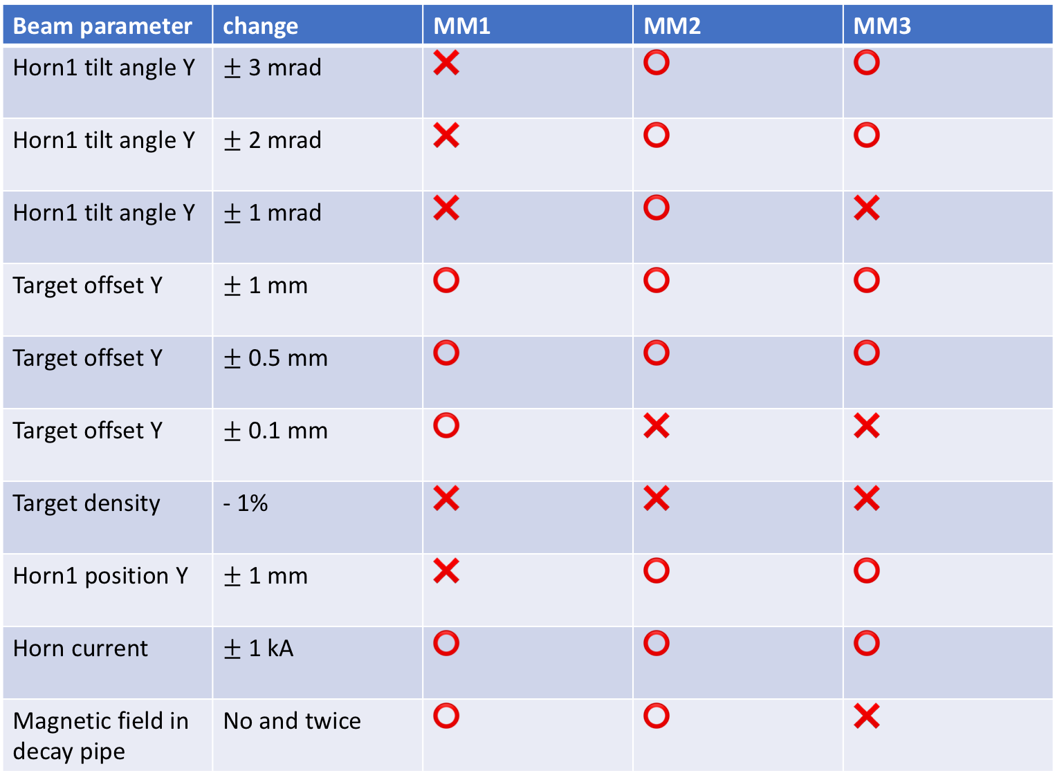
Beam parameter | change | MM1 | MM2 | MM3
Horn1 tilt angle Y | $±$ 3 mrad | ❌ | ⭕️ | ⭕️
Horn1 tilt angle Y | $±$ 2 mrad | ❌ | ⭕️ | ⭕️
Horn1 tilt angle Y | $±$ 1 mrad | ❌ | ⭕️ | ❌
Target offset Y | $±$ 1 mm | ⭕️ | ⭕️ | ⭕️
Target offset Y | $±$ 0.5 mm | ⭕️ | ⭕️ | ⭕️
Target offset Y | $±$ 0.1 mm | ⭕️ | ❌ | ❌
Target density | - 1% | ❌ | ❌ | ❌
Horn1 position Y | $±$ 1 mm | ❌ | ⭕️ | ⭕️
Horn current | $±$ 1 kA | ⭕️ | ⭕️ | ⭕️
Magnetic field in decay pipe | No and twice | ⭕️ | ⭕️ | ❌
⭕️: difference is over 3 sigma at some pixels
❌: difference is within 3 sigma

Slide 25
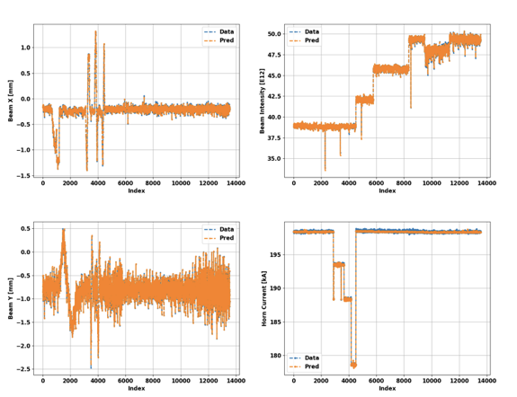
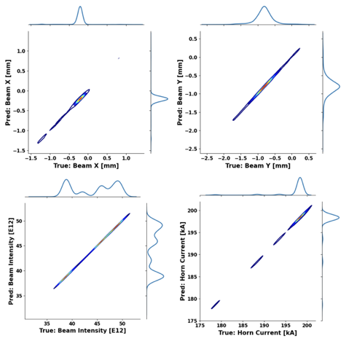
Predicting beam variables with Machine Learning
Athula Wickremasinghe
Building a Machine Learning tool to predict / reconstruct upstream beam parameters and horn current by using muon monitor data
  Muon monitors are giving an external measurement to understand the quality of the beam delivery
  In this approach, we are trying to untangle the correlations of muon monitor signal measurements to the beam and horn current behaviors

Slide 26
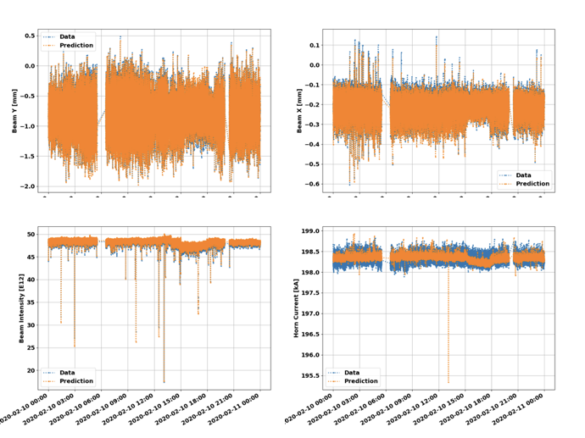
Predicting beam variables with Machine Learning
Athula Wickremasinghe
An example of testing the model for normal operations
  Spill-by-spill ML prediction gives an extra monitoring to check the performance of the beam parameters and horn current
  ML predictions can be used to monitor the beamline issues in the future
  Planning to implement the ML model predictions for daily NuMI beamline data monitoring

Slide 27
Data sample from the simulation
#Id | hornI(kA) | hptgt(cm) | vptgt(cm) | spot_size(cm) | pixel1 | pixel2
1.0 | 200.0 | -0.0134 | -0.0756 | 0.0809 | 18178 | 28009
2.0 | 200.0 | 0.0695 | -0.0719 | 0.0797 | 17000 | 27049
3.0 | 200.0 | -0.0165 | 0.107 | 0.0615 | 20081 | 28869
4.0 | 200.0 | 0.173 | 0.131 | 0.193 | 17231 | 26905
5.0 | 200.0 | -0.140 | 0.0725 | 0.0534 | 20040 | 31803
6.0 | 200.0 | -0.0517 | 0.0404 | 0.156 | 19227 | 30047
Content:
# of events at 81 pixels
(mm1,mm2,mm3)
Horn current
proton x
proton y
spot size
100 points took 133 s
Each point correspond to a spill in the measurement data

Slide 28
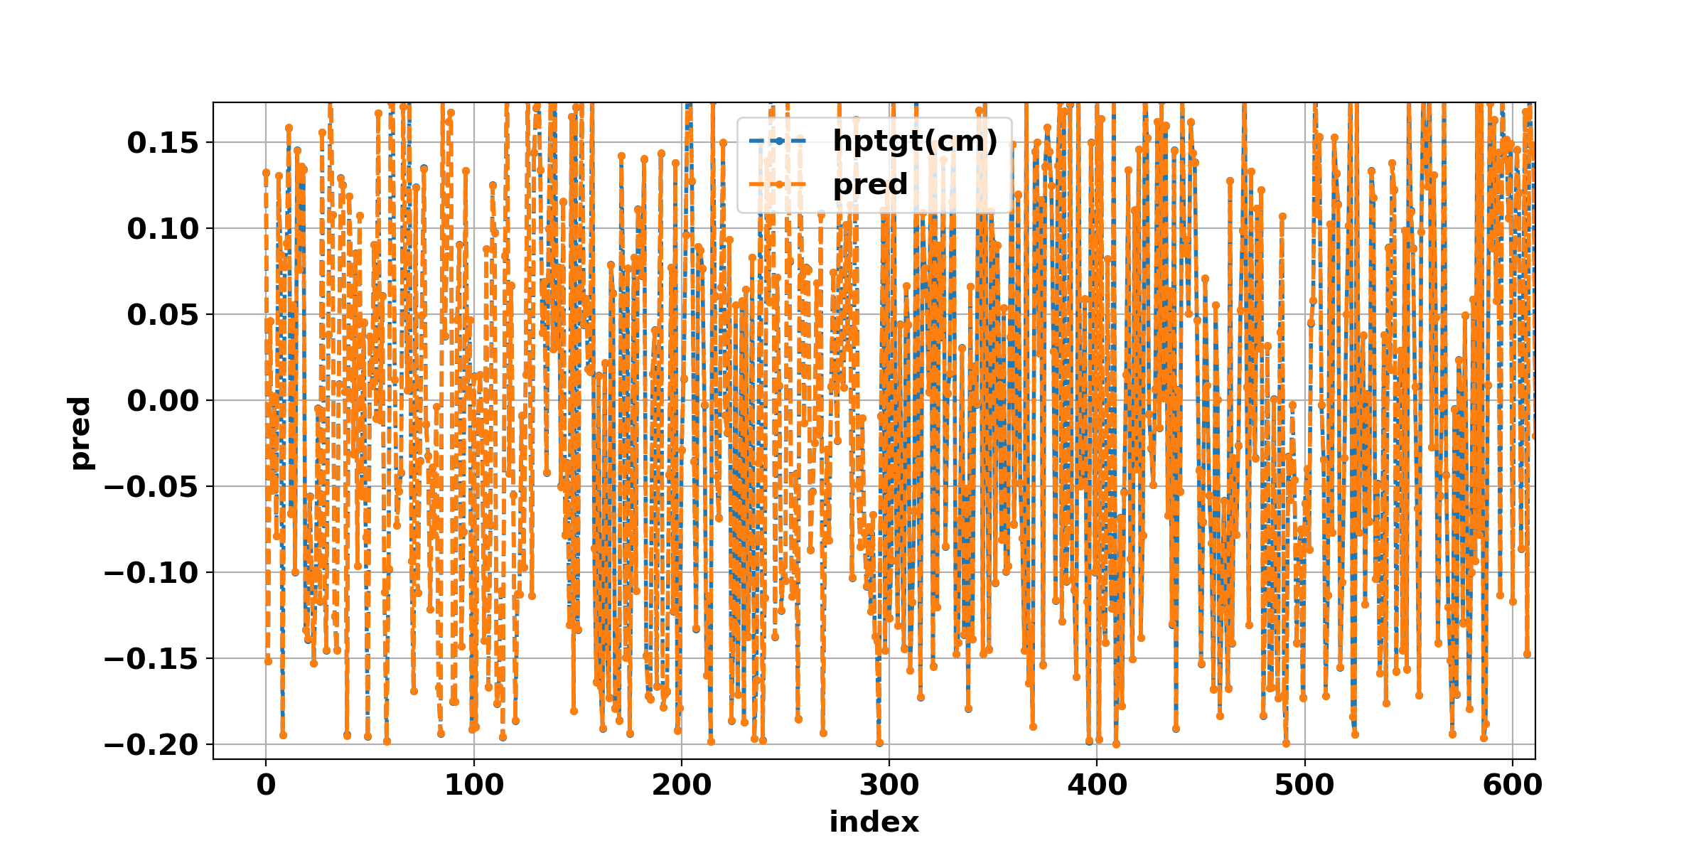
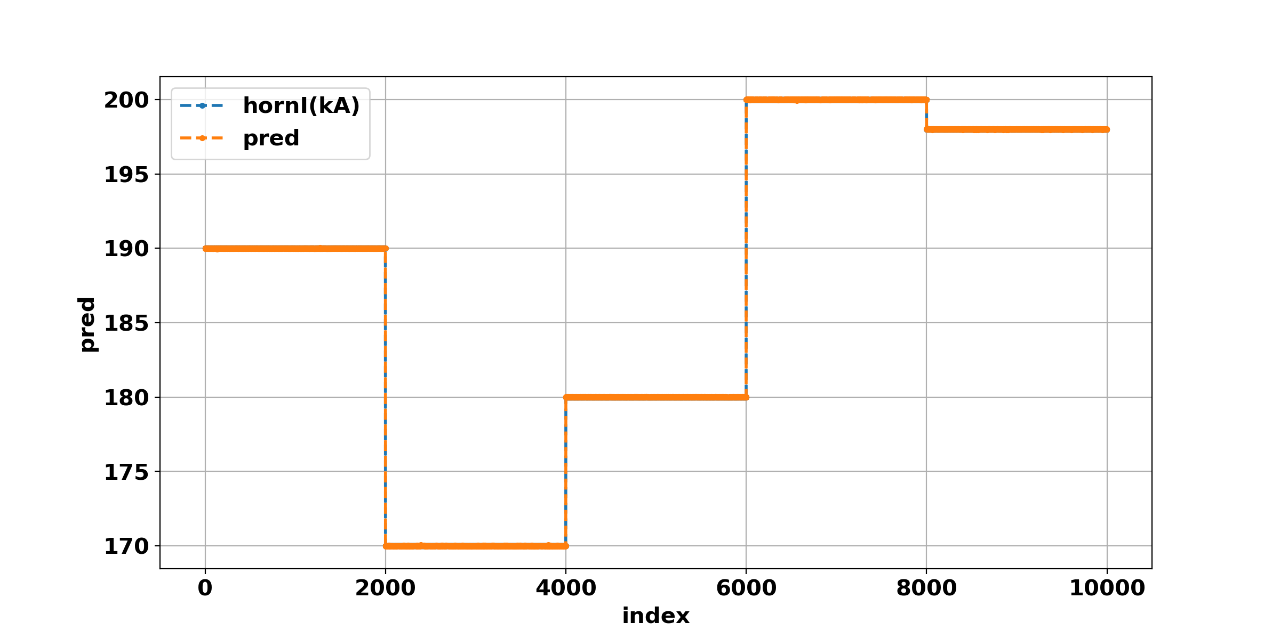
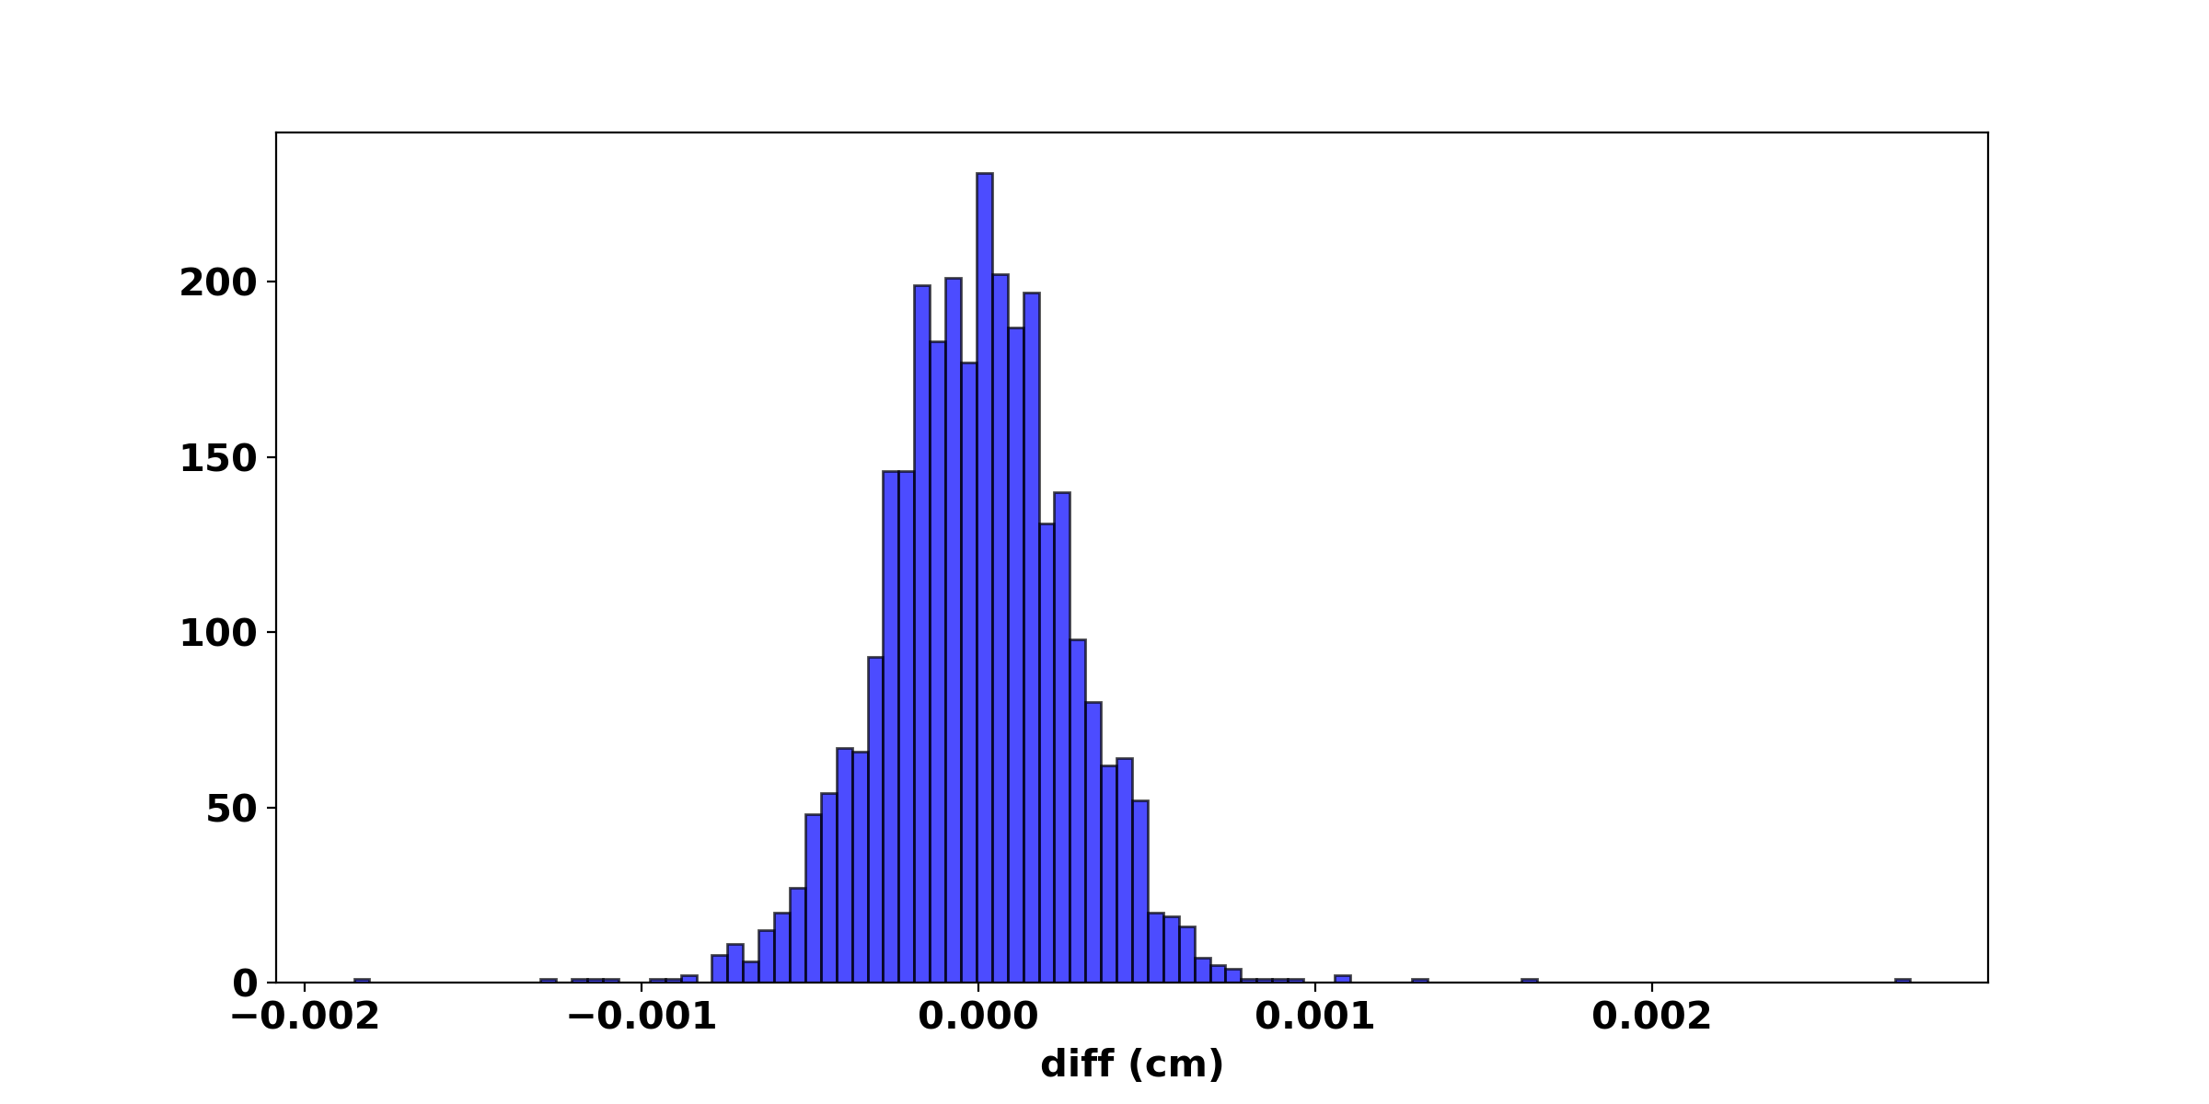
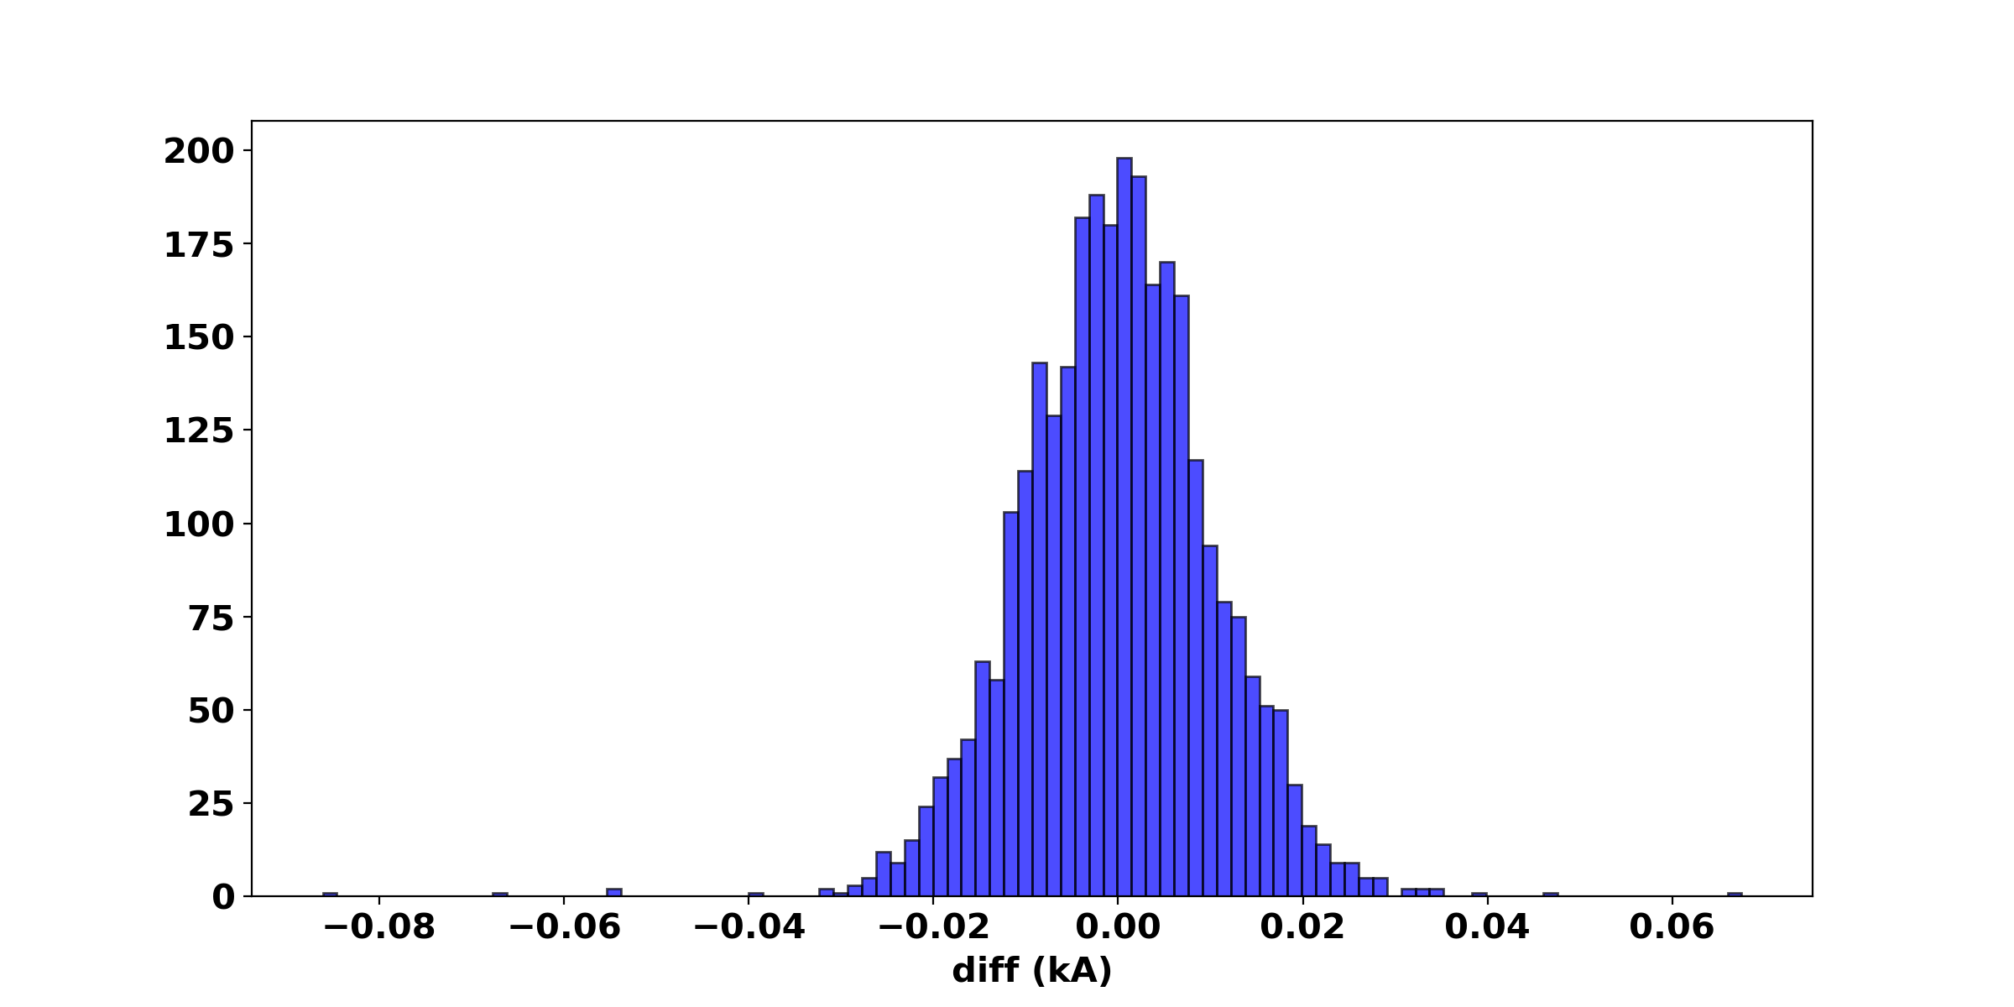
Machine Learning based on simulation
rms of the error is 0.0003 cm
rms of the error is
0.01 kA

Slide 29
Plans for ML based on simulation
  Include other beam parameters such as: horns tilt angles,, target offset and arget density
  →combined with measurement data to predict the beam parameters which can not be monitored
  Include neutrino flux: neutrino spectra at NOvA ND (50 bins within the [0, 10] range).
  →combined with measurement data to predict neutrino flux
  Produce data samples that we can not get in reality: horn off.

Slide 30
Summary
We combined the uniform beam simulation and multiple decay simulation to increase the efficiency of the simulation => able to produce very high stat samples
Muon monitor pixel study was improved, we can use the information of pixels of MMs to find the effect of varying the beam parameters => systematic study underway
We built a Machine Learning tool to predict / reconstruct upstream beam parameters and horn current by using muon monitor data => extending its capabilities now
Now we are generating the samples for ML using the new simulation and test the ML

Slide 31
Back up

Slide 32
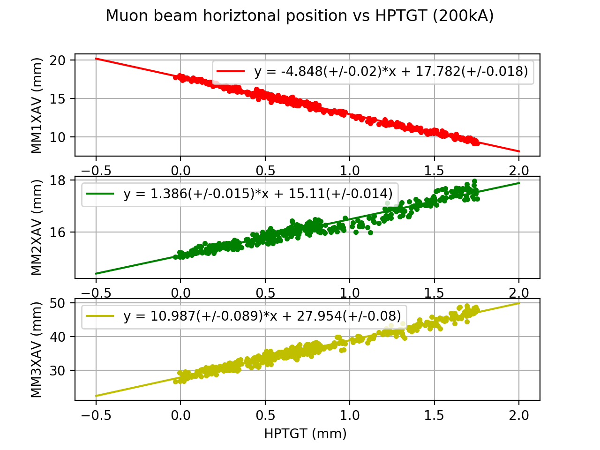
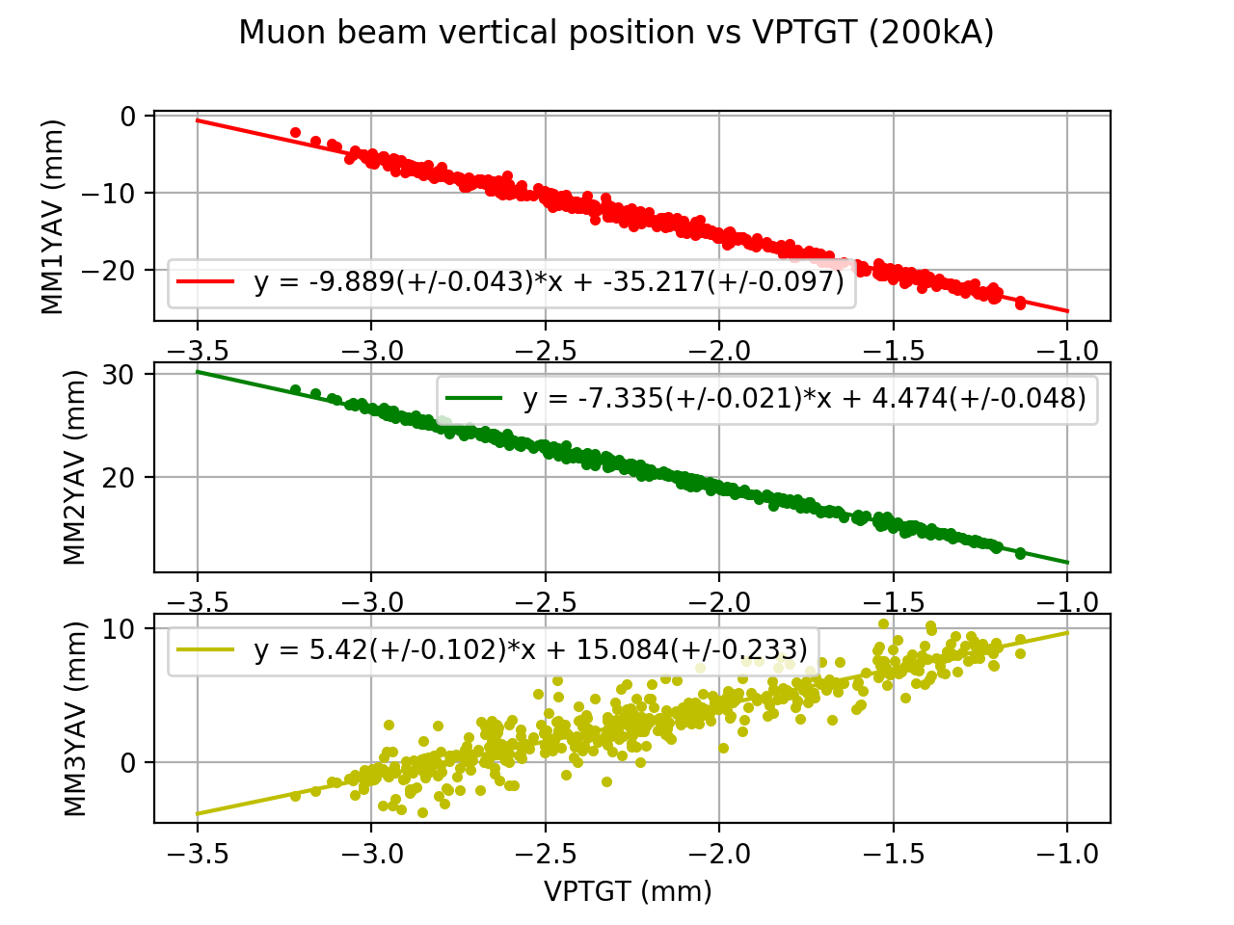
Muon monitor data analysis(Slopes at muon monitors)
Target scans show how each muon monitor responds to beam position variations in horizontal and vertical directions
The observed beam centroid on muon monitors shows a linear response. Different slopes show the focus effect for different energy range of muons

Slide 33
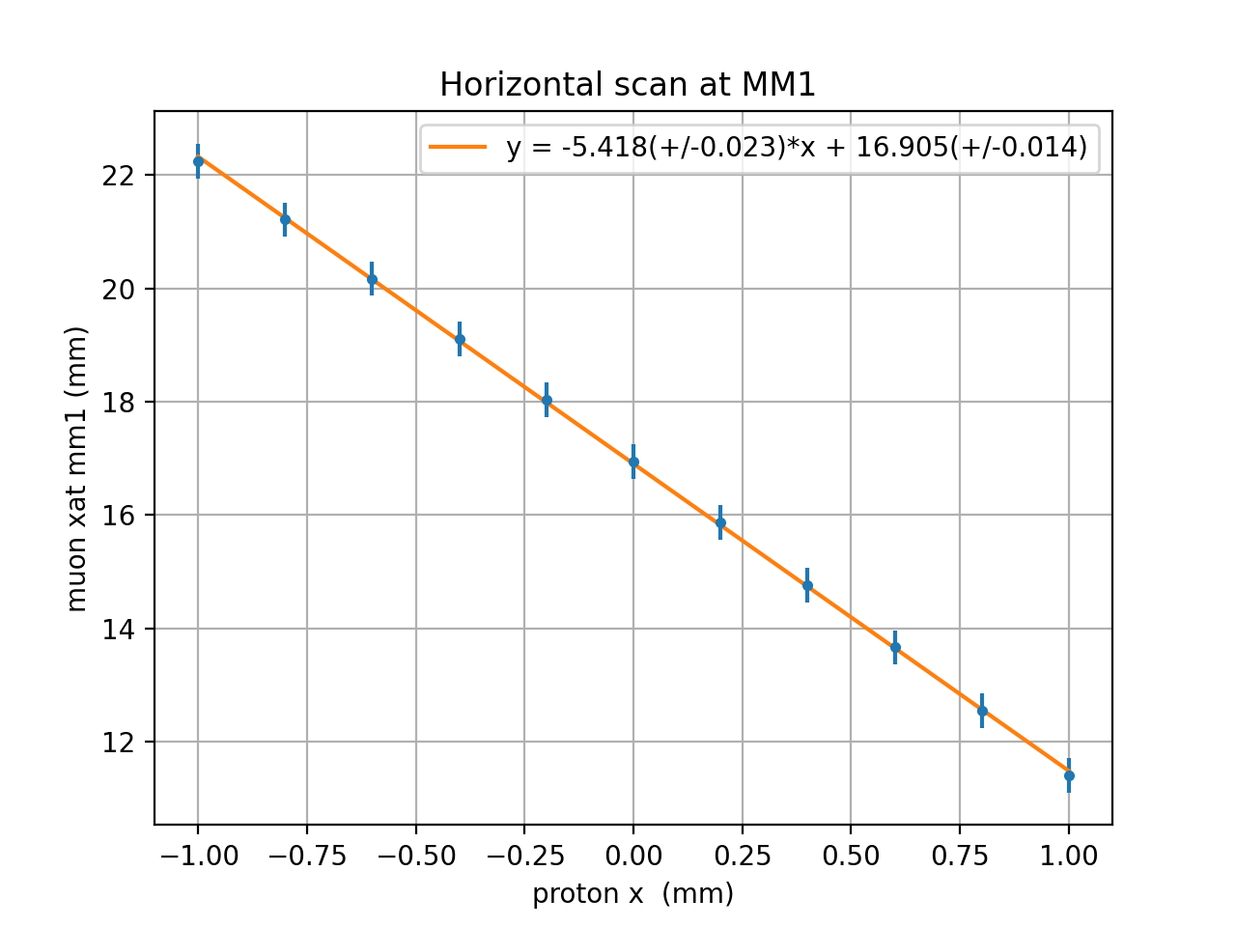
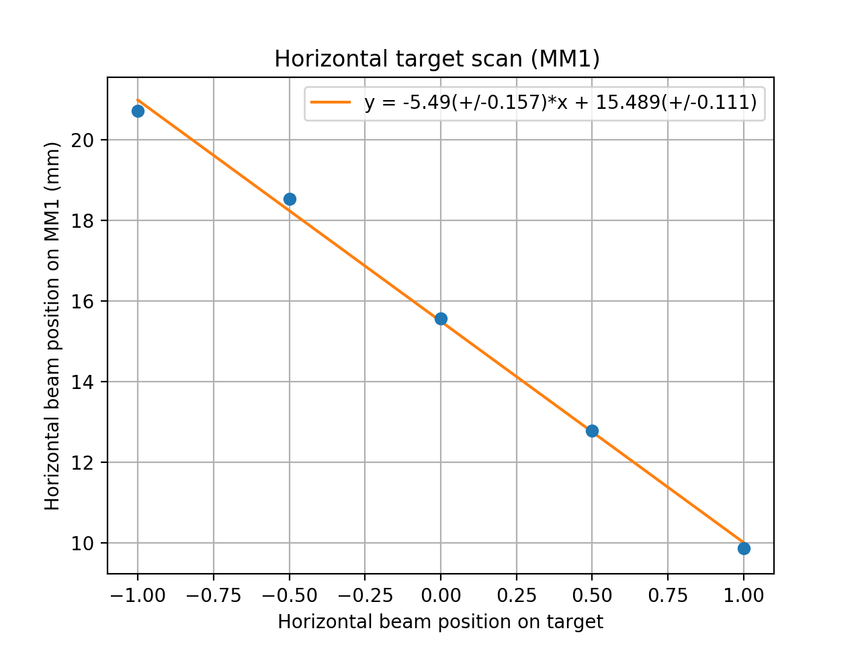
Slope at MM1X (with virtual detectors)
nominal
uniform

Slide 34


Muon distribution at virtual detectors (z5)
Protonx:0mm
Protonx:1mm

Slide 35


Muon distribution at virtual detectors (z6)
Protonx:0mm
Protonx:1mm

Slide 36


Muon distribution at virtual detectors (z7)
Protonx:0mm
Protonx:1mm

Slide 37



Muon production momentum

Slide 38


Muon momentum at MM1 and MM2

Slide 39







Slide 40







Slide 41







Slide 42
Magnetic field in decay pipe
Magnetic field in decay pipe: Bx = 0.1 Gauss, By = −0.3 Gauss, Bz = −0.07 Gauss

Slide 43



MM events change for no magnetic field in decay pipe
The MM1 is most sensitive to the change of madnetic fields in decay pipe(low enerfy muons)
Nominal: Magnetic field in decay pipe: Bx = 0.1 Gauss, By = −0.3 Gauss, Bz = −0.07 Gauss

Slide 44



MM events change for twice magnetic field in decay pipe
The pattern change at MM1 is opposite to no field
Nominal: Magnetic field in decay pipe: Bx = 0.1 Gauss, By = −0.3 Gauss, Bz = −0.07 Gauss
Twice the field in x and y: Bx = 0.2 Gauss, By = −0.6 Gauss, Bz = −0.07 Gauss

Slide 45

Bx= 0.1 gaus
By= -0.3 gaus
Data / nominal
No field
2 *field

