Slide 1



Muon Acceleration for Future Neutrino and Higgs Factory
Alex Bogacz
NuFact 2022
Snowbird, UT
Aug. 5, 2022

Slide 2
Overview
Accelerator Topologies: ‘Racetrack vs Dogbone’
Muon Acceleration for 5 GeV Neutrino Factory
  Linac + ‘Dogbone’ RLA: Beam Dynamics Issues
    Full bucket acceleration, Longitudinal compression
    Longitudinal RF frequency shift: Matching chicane to accommodate μ±
    Transverse Optics: Bi-sected linacs + ‘Droplet’ Arcs
Extending accelerator complex to 63 GeV Higgs Factory
  RLA (5 − 63 GeV ) 5-pass
  Beam loading considerations
  Dogbone RLA with FFA Arcs

Slide 3
‘Racetrack’ vs ‘Dogbone’ RLA
ΔE/2
1.5 ΔE
ΔE/2
ΔE
3 ΔE
  Twice the acceleration efficiency
  Better separation of passes
  Simultaneous acceleration of both charge species
  Linac traversed in both direction ⇨ bi-sected linac optics

Slide 4
Muon Acceleration − Choice of Technology
Acceleration of short-lived muons requires high average gradient, while maintaining very large transverse and longitudinal accelerator acceptances.
  The above requirement drives the design to low RF frequency, e.g. 325 MHz, 650 MHz
  If normal-conducting cavities at that frequency were used, the required high gradi­ents would demand uneconomically high peak RF sources.
  Superconducting RF is a much more attractive solution − the RF power can then be delivered to the cavities over an extended time, and thus RF source peak power can be reduced.
While recirculation (RLA) provides significant cost savings over a single linac, it cannot be used at low energy since the beam is not sufficiently relativistic and will therefore cause a phase slip for beams in higher passes

Slide 5
State of Thought for Multi GeV Muon Acceleration (Circa 2017)

Slide 6
Choice of Linac Repetition Rate
For optimum performance – to maximize number of events (μ → ν decays NF, μ± collisions MC) – the linac repetition rates should scale inversely with the laboratory lifetime of the muon in its storage ring:
  Repetition rates as high as 10 kHz for a 5 GeV Neutrino Factory
  Repetition rates as low as 10 Hz for a 5 TeV Muon Collider.

Slide 7
Initial 325 MHz Linac − Transverse Acceptance

Slide 8
Initial 325 MHz Linac – Longitudinal Compression

Slide 9
Longitudinal Compression

Slide 10
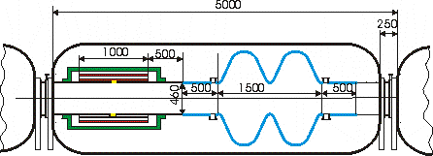
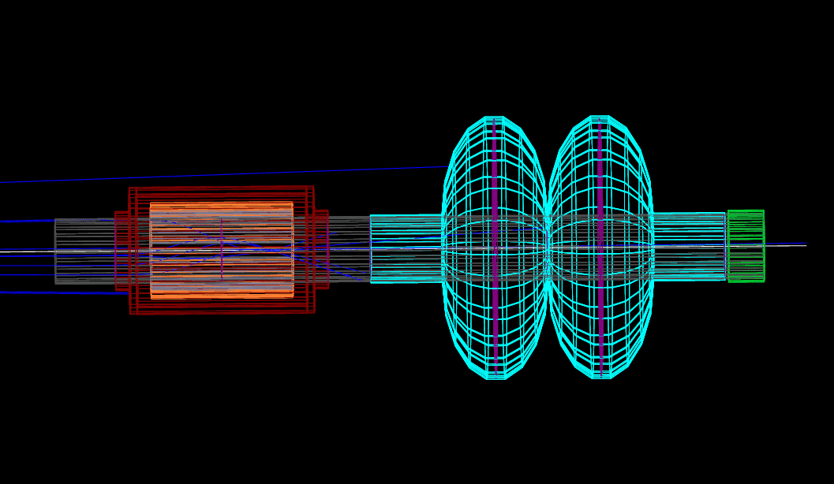
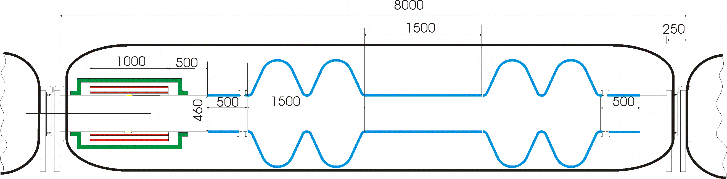
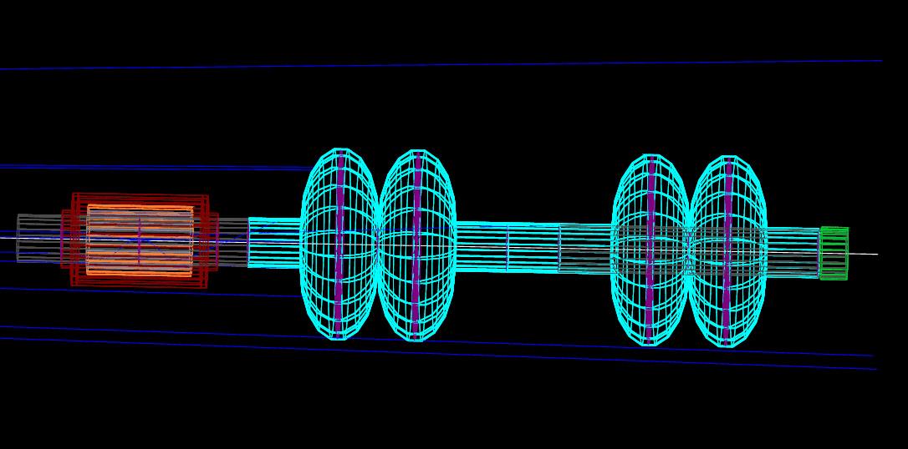
Single Pass Linac – RF Components

Slide 11
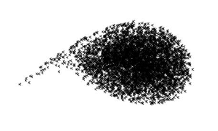
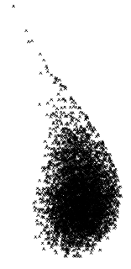
325 MHz – 650 MHz Transition
p = 255 MeV/c
1.25 GeV
5
5
beta functions
BETA_X&Y[m]
DISP_X&Y[m]
A_{325 MHz} = 20 MV/m
A_{650 MHz} = 25 MV/m
0
0
0
BETA_X
BETA_Y
DISP_X
DISP_Y
240
325 MHz linac
650 MHz linac
μ± time structure
RF bucket

Slide 12
Longitudinal Compression via M₅₆ chicane + RF chirp
15
2
BETA_X&Y[m]
DISP_X&Y[m]
0
-2
0
BETA_X
BETA_Y
DISP_X
DISP_Y
173.953

Slide 13
‘Dogbone’ RLA Linac

Slide 14
‘Dogbone’ RLA 1 – RF Components

Slide 15
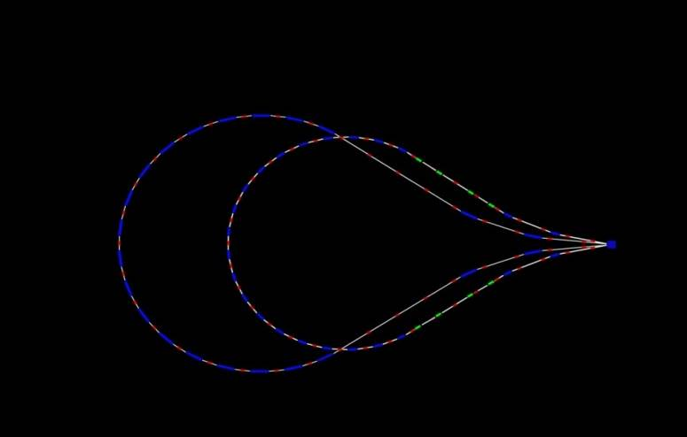
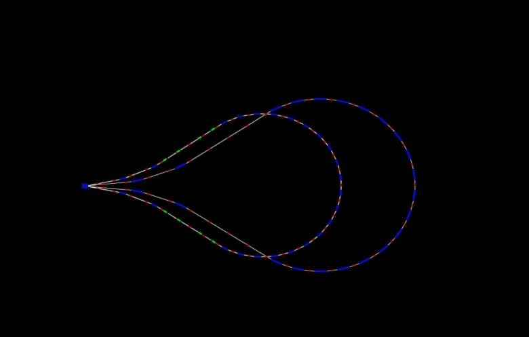
Higgs Factory: 5-pass RLA (5 − 63 GeV)
5 GeV
28.2 GeV
16.6 GeV
51.4 GeV
63 GeV
39.8 GeV
829 m
11.6 GeV/pass

Slide 16
Multi-pass Linac – Bisected Optics

Slide 17
Beam Loading Consideration

Slide 18
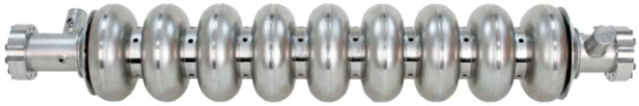
‘Dogbone’ RLA 2 – RF Components

Slide 19
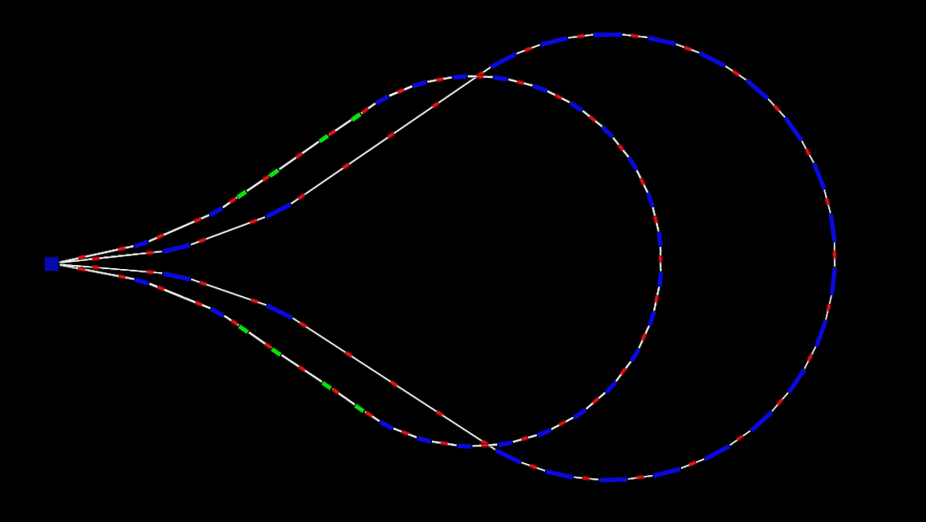
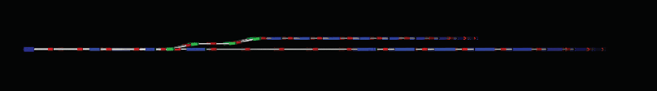
Single- vs Multi- pass Droplet Arcs
top view
16.6 GeV
39.8 GeV
side view
16.6 GeV
↑ 1 m
39.8 GeV

Slide 20
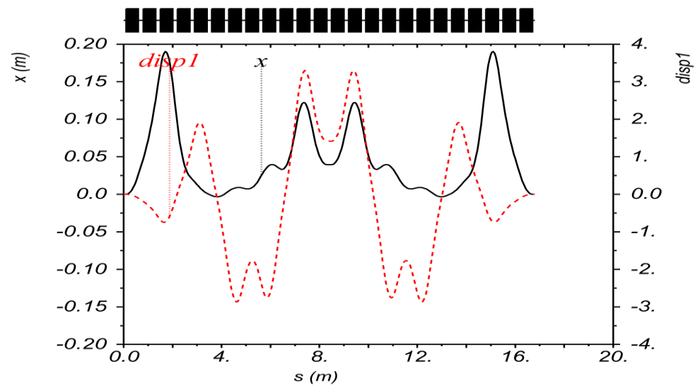
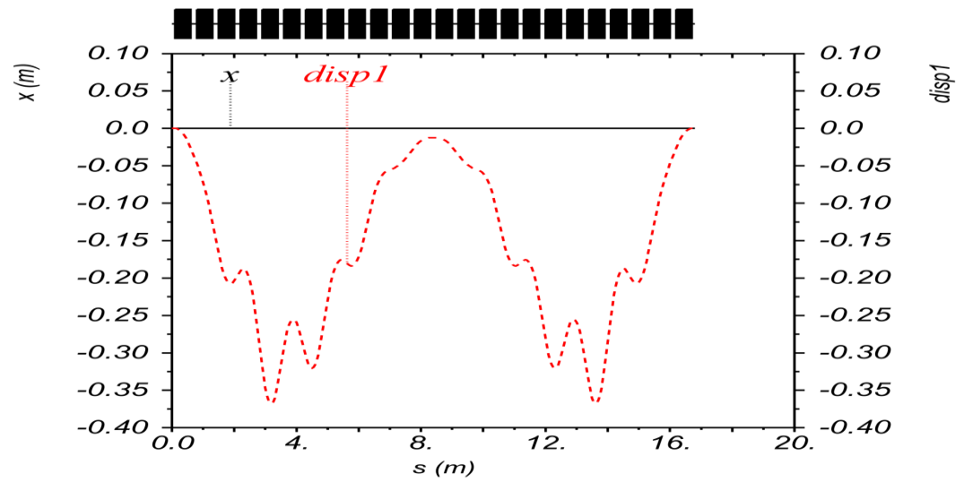
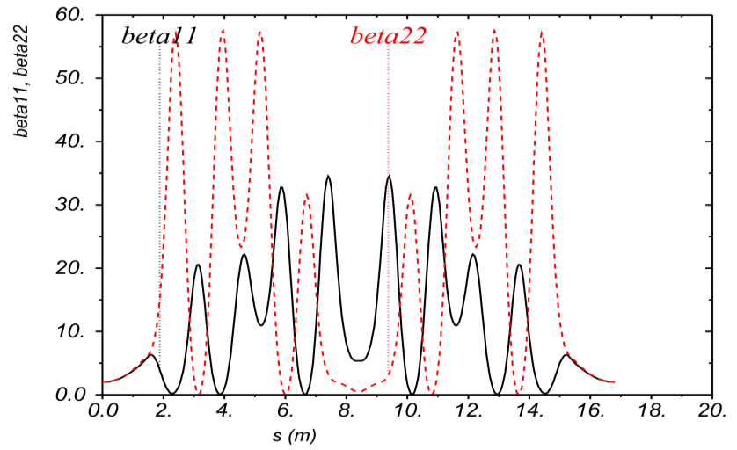
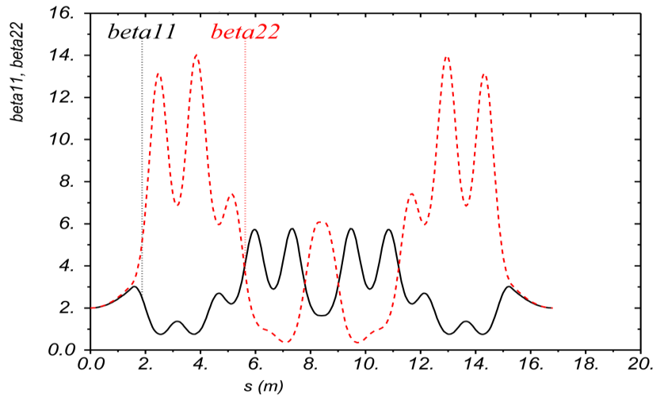
Super-Cell Optics for P₂/P₁ = 2
Each arc is composed of symmetric super cells consisting of linear combined-function magnets (each bend: 2.5⁰)
P
2xP
θ = 60⁰

Slide 21
Summary
RF system specs for low energy acceleration stages:
  Linac (255 MeV − 1.25 GeV) 1-pass
  RLA 1 (1.25 − 5 GeV ) 4.5-pass
  RLA 2 (5 − 63 GeV ) 5-pass
Next step….
  Optimized Linac + RLAs scheme for Higgs Factory and beyond…

Slide 22

Thanks for your
for attention

