Slide 1
2.4 MW Upgrade Paths for the Fermilab Accelerator Complex
Jeffrey Eldred
NuFACT 2022
August 2nd, 2022

Slide 2
2
Acknowledgements & White Paper
You can read the Snowmass White papers
“A Cost-Effective Upgrade Path for the Fermilab Accelerator Complex”
Sergei Nagaitsev and Valeri Lebedev
“An Upgrade Path for the Fermilab Accelerator Complex”
Rob Ainsworth, Joe Dey, Jeff Eldred, Roni Harnik, Jonathan Jarvis, Dave Johnson, Ioanis Kourbanis, David Neuffer, Eduard Pozdeyev, Mike Syphers, Sasha Valishev, Vyacheslav Yakovlev and Bob Zwaska
“Design Considerations for Fermilab Multi-MW Proton Facility”
Jeff Eldred, Sergei Nagaitsev, Vladimir Shiltsev, Mike Syphers, Sasha Valishev, and
Bob Zwaska
2
Jeffrey Eldred | 2.4 MW Upgrade with RCS
Notes:
2
2
2

Slide 3
3
3
Proton Complex
And PIP-II upgrade
3
Jeffrey Eldred | 2.4 MW Upgrade with RCS

Slide 4
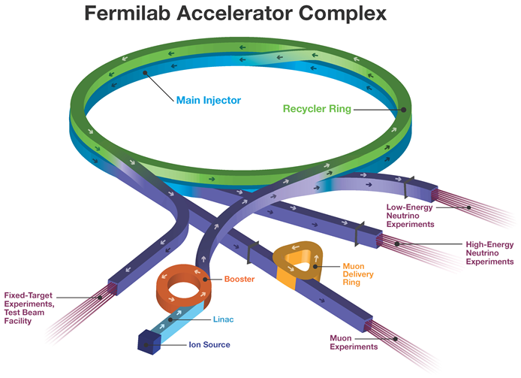
4
4
Fermilab Upcoming Upgrades 700-900 kW
H- Injection Location
Record Main Injector power 893kW, Booster power 89 kW
4
Jeffrey Eldred | 2.4 MW Upgrade with RCS
Notes:
4
4
4
4
4
4

Slide 5
5
5
Fermilab Upcoming Upgrades PIP-II 1.2MW
1.2 MW LBNF
Neutrinos
to DUNE
PIP-II SRF
Linac
0.8 GeV
H- Injection Location
New SRF linac raises Booster injection energy, new LBNF beamline.
5
Jeffrey Eldred | 2.4 MW Upgrade with RCS
Notes:
5
5
5
5
5
5

Slide 6
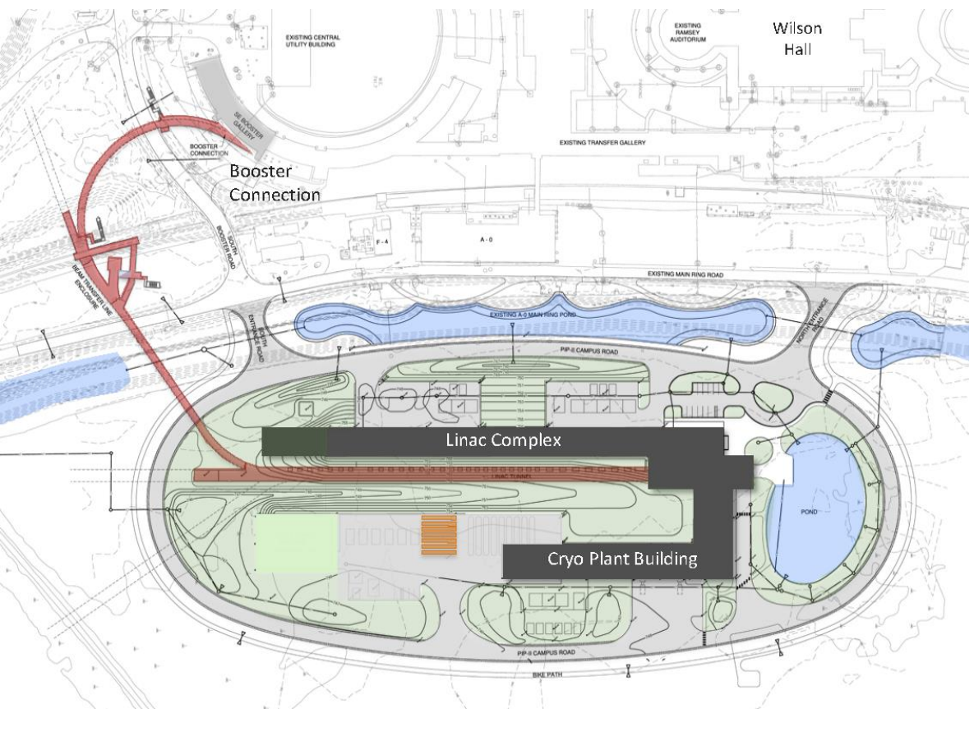
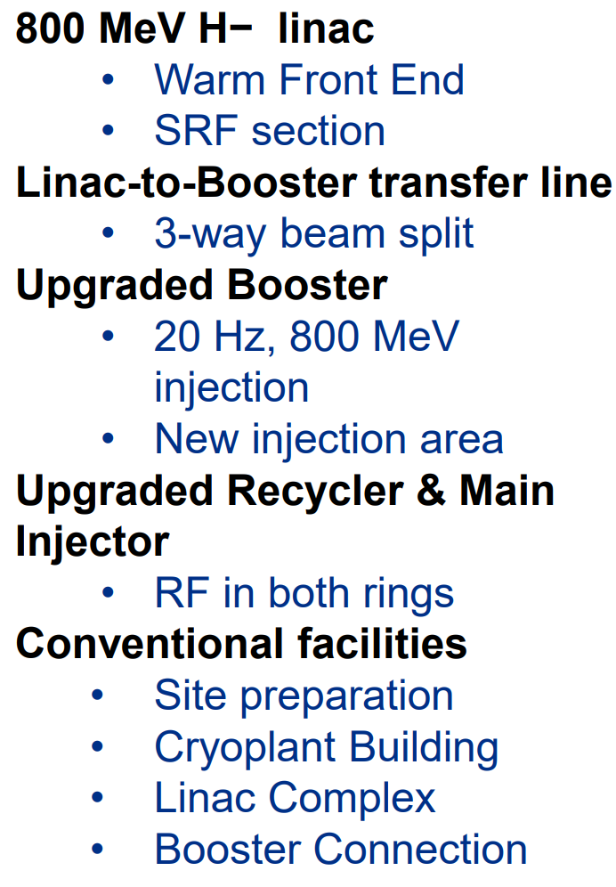
6
6
PIP-II Linac & Upgrade
E. Pozdeyev, SpaceCharge19
Project started in 2016 (CD0)
First beam in Booster: 2028 (plan)
MI 1.2 MW beam on target: 2032 (projection)
6
Jeffrey Eldred | 2.4 MW Upgrade with RCS
Notes:
6
6
6
6
6
6

Slide 7
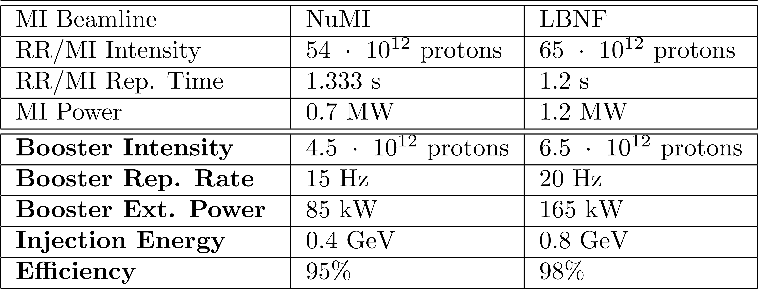
7
PIP-II Booster Power
PIP PIP-II
The primary purpose of the PIP-II is to inject into the Booster, and in turn power the high-energy proton complex including DUNE/LBNF program.
However, the PIP-II Linac is also designed to be CW-capable
and the Booster only uses ~1.2% of the CW beam power!
- What will form the GeV-scale experimental program?
- Do we need H- injection into an accumulator ring?
7
Jeffrey Eldred | 2.4 MW Upgrade with RCS
Notes:
7
7
7

Slide 8
8
Proposed “PIP-II Era” Accumulator Rings
PIP-II Accumulator Ring (PAR)
0.8-1.0 GeV proton storage ring.
474m folded figure eight, designed to match Booster circumference.
Dark Sector:
100kW hadron-absorber beam dump program that sets new exclusion limits.
Booster-MI Program:
Does not interfere with PIP-II Booster commissioning,
Enables later 1 GeV upgrade to Booster.
Compact PAR (C-PAR)
~0.8-1.2 GeV proton storage ring
~100m ring optimized for low duty factor, intense proton beam experiments.
Dark Sector:
Allows order of magnitude superior limits compared to PAR version.
Muon CLFV program:
Allows 140 kW, 20ns pulses for subsequent muon CLFV AMF program
Related Snowmass White Papers
1) PAR accelerator design ArXiv 2203.07339
2) PIP2-BD Dark Sector program (PAR, C-PAR) ArXiv 2203.08079
3) AMF CLFV Muon program (related to C-PAR) ArXiv 2203.08278
8
Jeffrey Eldred | 2.4 MW Upgrade with RCS
Notes:
8
8
8

Slide 9
9
9
Proton Intensity Upgrade
after PIP-II
(construction complete ~2036)
9
Jeffrey Eldred | 2.4 MW Upgrade with RCS

Slide 10
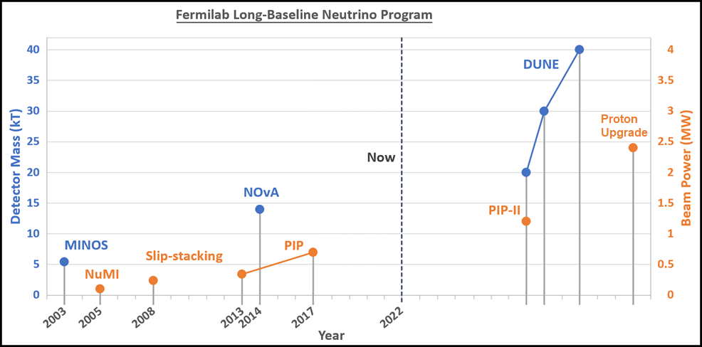
10
Beam Power and Detector Size
DUNE long-baseline neutrino program calls for 2.4 MW
J. Eldred, JINST 2019
10
Jeffrey Eldred | 2.4 MW Upgrade with RCS
Notes:
10
10
10

Slide 11
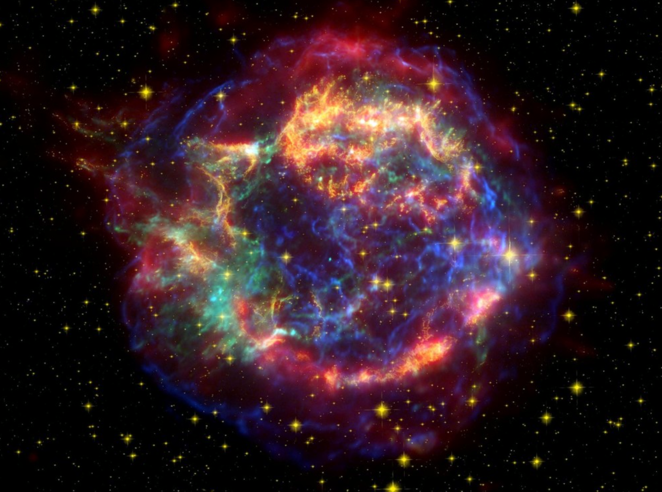
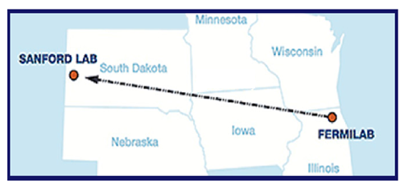
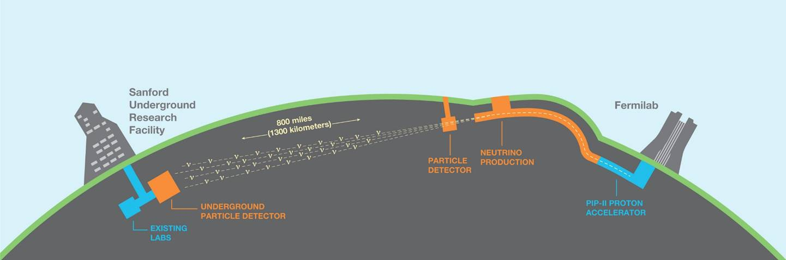
DUNE physics program
δ_{CP} Discovery, sigmas over time
Unambiguous, high precision measurements of Δm²₃₂, δ_{CP}, sin²θ₂₃, sin²2θ₁₃ in a single experiment
Discovery sensitivity to CP violation, mass ordering, θ₂₃ octant over a wide range of parameter values
Sensitivity to MeV-scale neutrinos, such as from a galactic supernova burst
Low backgrounds for sensitivity to BSM physics including baryon number violation
1.2 MW
2.4 MW
starts ~2032
11
Jeffrey Eldred | 2.4 MW Upgrade with RCS

Slide 12
12
12
Fermilab Upcoming Upgrades Future 2.4MW
2.4 MW LBNF
Neutrinos
to DUNE
Recycler?
Replace
Booster
PIP-II SRF
Linac
1-3 GeV
Booster prevents x2 PIP-II power, injection energy and transition-crossing limits
12
Jeffrey Eldred | 2.4 MW Upgrade with RCS
Notes:
12
12
12
12
12
12

Slide 13
13
Upgrade Design History & Process
In 2008, Project X: 8 GeV SRF Linac, directly into Main Injector.
In 2010, Project X ICD-2: 2 GeV Linac, New 2-8 GeV RCS.
In 2018, S. Nagaitsev and V. Lebedev: updated version of ICD-2.
In 2019, J. Eldred, V. Lebedev, A. Valishev: parametric study of RCS design.
In 2021, Committee for Fermilab Booster Upgrade an integrated design effort:
Science Working Group chaired by R. Harnik
“Physics Opportunities for the Fermilab Booster Replacement”
Accelerator Working Group chaired by M. Syphers
“An Upgrade Path for the Fermilab Accelerator Complex” (RCS Scenario)
“An 8 GeV Linac as the Booster Replacement in the Fermilab Power Upgrade”
Bottom Line:
Technical considerations are well understood at this point,
we know how to get to 2.4 MW we just have to decide which way to go.
13
Jeffrey Eldred | 2.4 MW Upgrade with RCS
Notes:
13
13
13

Slide 14
14
Upgrade Design History & Process
In 2008, Project X: 8 GeV SRF Linac, directly into Main Injector.
In 2010, Project X ICD-2: 2 GeV Linac, New 2-8 GeV RCS.
In 2018, S. Nagaitsev and V. Lebedev: updated version of ICD-2.
In 2019, J. Eldred, V. Lebedev, A. Valishev: parametric study of RCS design.
In 2021, Committee for Fermilab Booster Upgrade an integrated design effort:
Science Working Group chaired by R. Harnik
“Physics Opportunities for the Fermilab Booster Replacement”
Accelerator Working Group chaired by M. Syphers
“An Upgrade Path for the Fermilab Accelerator Complex” (RCS Scenario)
“An 8 GeV Linac as the Booster Replacement in the Fermilab Power Upgrade”
14
Jeffrey Eldred | 2.4 MW Upgrade with RCS
Notes:
14
14
14

Slide 15
15
8 GeV Linac Option, direct to Recycler
Main Injector
(MI)
Recycler
Optional
Accumulator
Ring
PIP-II
Linac
8 GeV Linac
H- Injection Location
15
Jeffrey Eldred | 2.4 MW Upgrade with RCS
Notes:
15
15
15

Slide 16
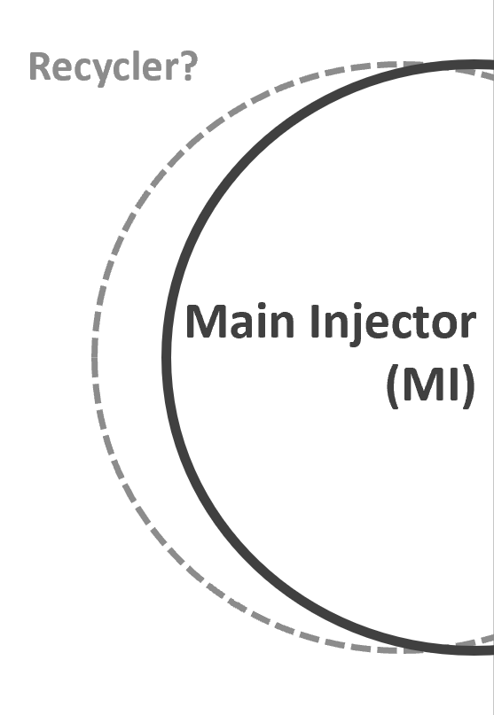
16
8 GeV Linac Option, with Accumulator
8 GeV
Accumulator
Ring
Optional
Accumulator
Ring
PIP-II
Linac
8 GeV Linac
H- Injection Location
16
Jeffrey Eldred | 2.4 MW Upgrade with RCS
Notes:
16
16
16

Slide 17
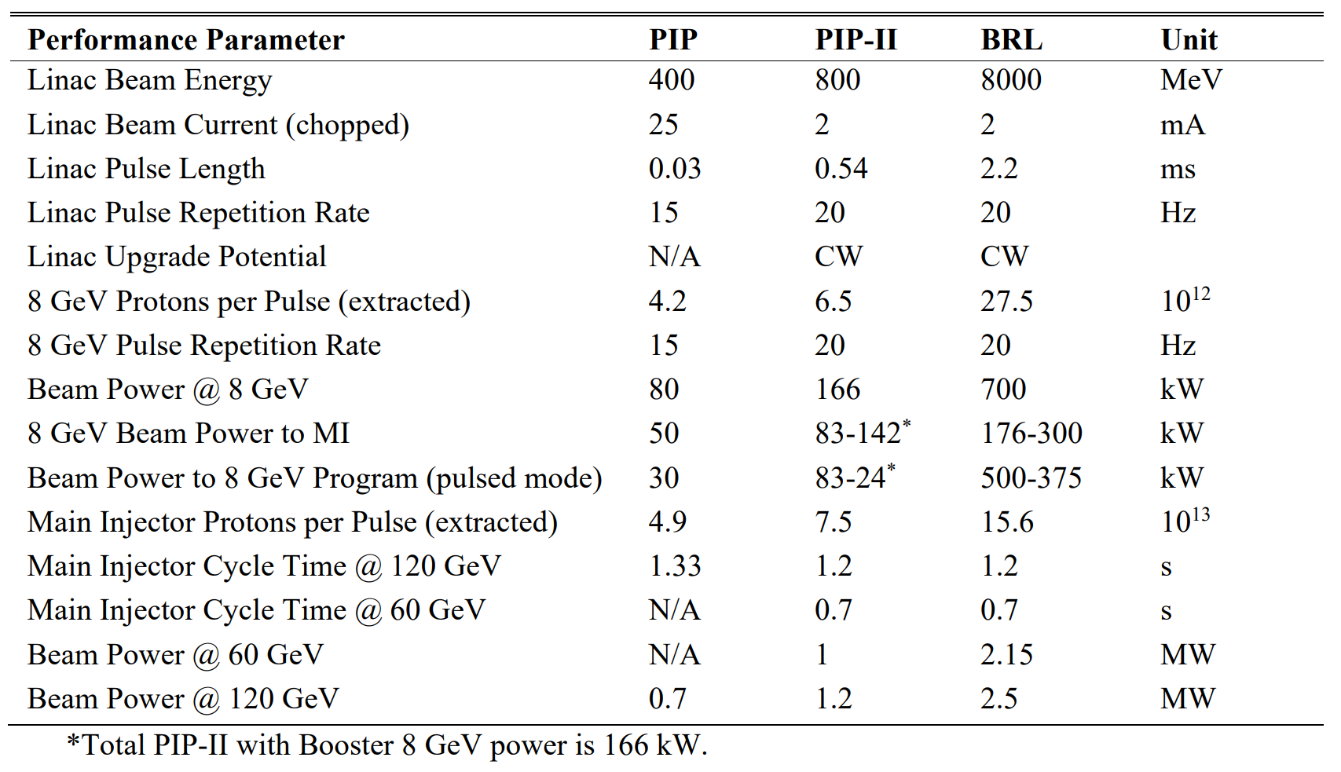
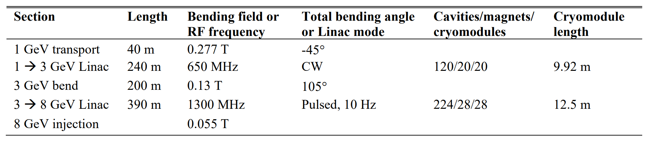
17
8-GeV Linac Program (MI program)
Injects at 20Hz into MI over six 2.2ms pulses
17
Jeffrey Eldred | 2.4 MW Upgrade with RCS
Notes:
17
17
17

Slide 18
18
8-GeV Linac Program (8-GeV program)
8-GeV pulsed,
2μs with AR
18
Jeffrey Eldred | 2.4 MW Upgrade with RCS
Notes:
18
18
18

Slide 19
19
Upgrade Design History & Process
In 2008, Project X: 8 GeV SRF Linac, directly into Main Injector.
In 2010, Project X ICD-2: 2 GeV Linac, New 2-8 GeV RCS.
In 2018, S. Nagaitsev and V. Lebedev: updated version of ICD-2.
In 2019, J. Eldred, V. Lebedev, A. Valishev: parametric study of RCS design.
In 2021, Committee for Fermilab Booster Upgrade an integrated design effort:
Science Working Group chaired by R. Harnik
“Physics Opportunities for the Fermilab Booster Replacement”
Accelerator Working Group chaired by M. Syphers
“An Upgrade Path for the Fermilab Accelerator Complex” (RCS Scenario)
“An 8 GeV Linac as the Booster Replacement in the Fermilab Power Upgrade”
There are actually two scenarios here, which I will discuss.
“Design Considerations for Fermilab Multi-MW Proton Facility” white paper
“ICD-2”
“BSR”
19
Jeffrey Eldred | 2.4 MW Upgrade with RCS
Notes:
19
19
19

Slide 20
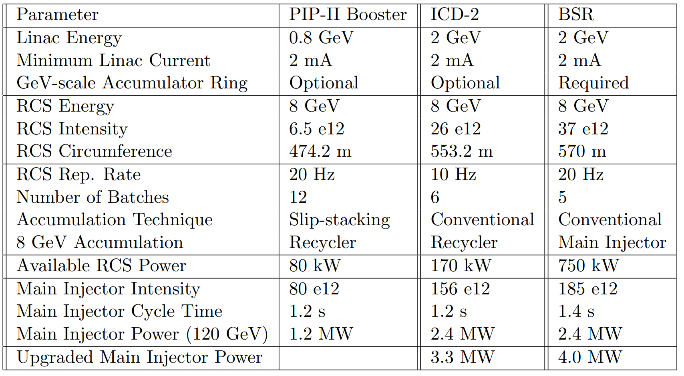
20
RCS Scenarios
“Design Considerations for Fermilab Multi-MW Proton Facility” white paper
20
Jeffrey Eldred | 2.4 MW Upgrade with RCS
Notes:
20
20
20

Slide 21
21
RCS Scenarios (ramp rate and 8 GeV program)
“Design Considerations for Fermilab Multi-MW Proton Facility” white paper
ICD-2 RCS is more cost-effective, BSR RCS is more ambitious.
BSR delivers much more for 8 GeV program,
Also enables path to 4 MW at 120 GeV! But for whom?
21
Jeffrey Eldred | 2.4 MW Upgrade with RCS
Notes:
21
21
21

Slide 22
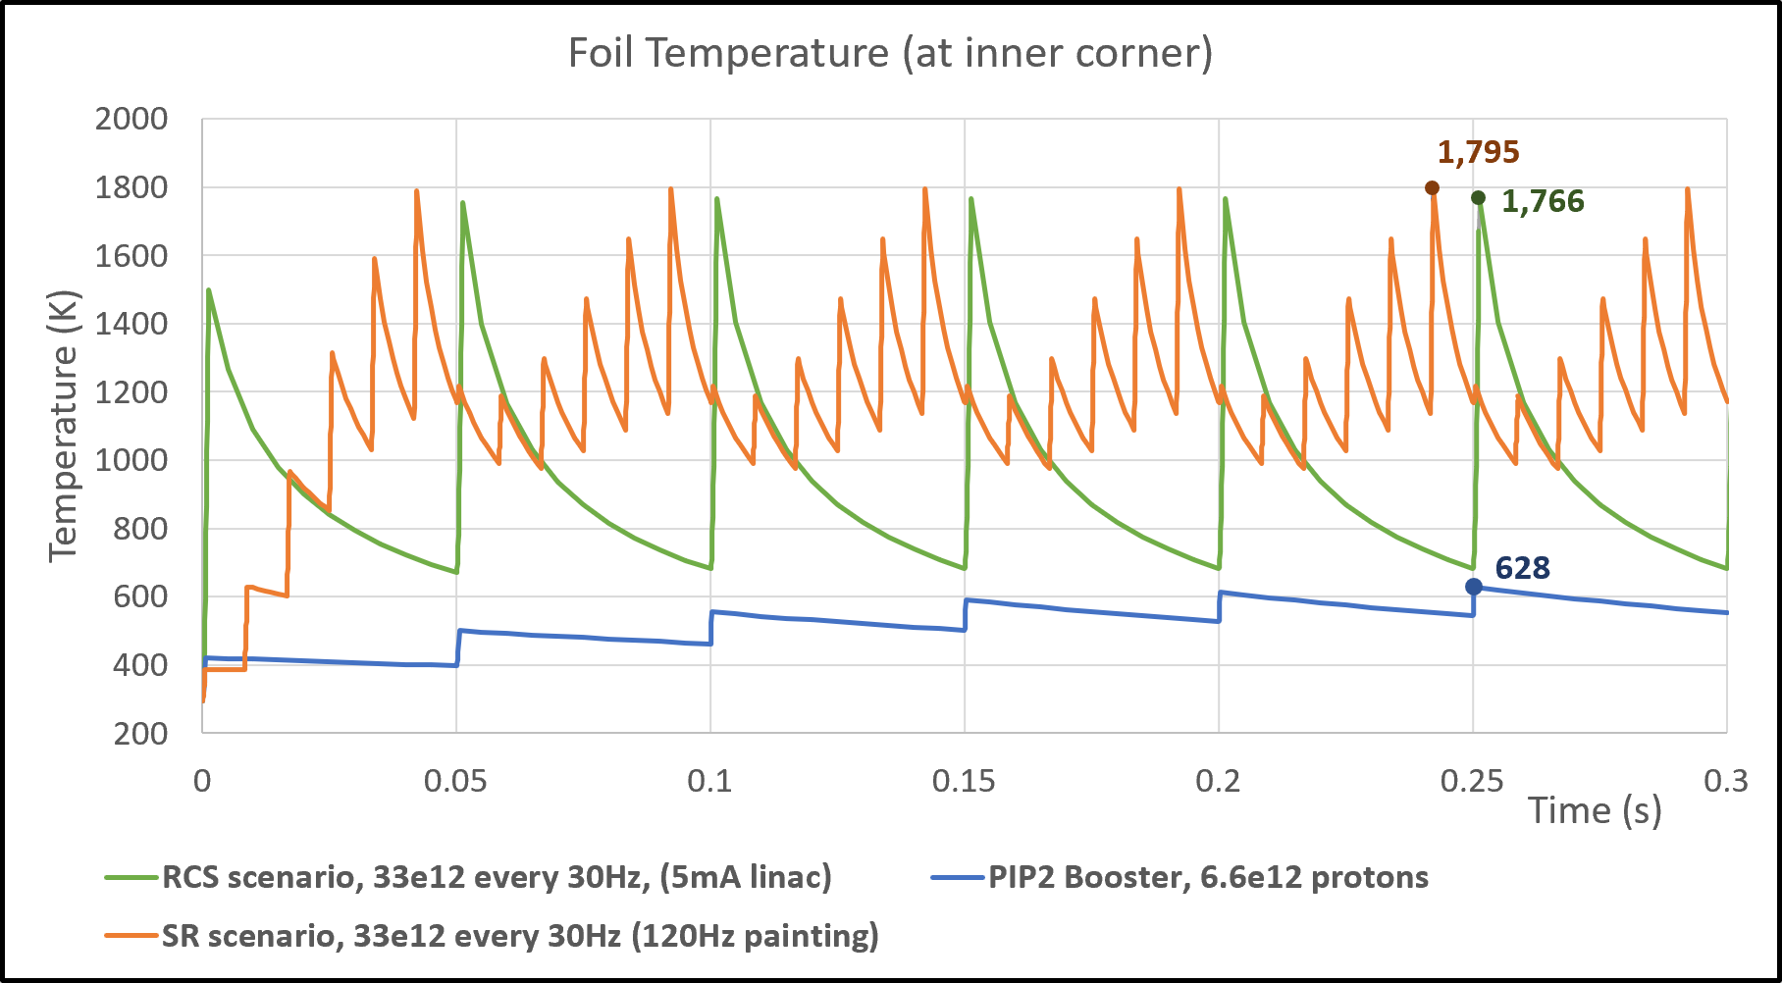
22
Beam Accumulation and H- Stripping in a Storage Ring
BSR Injection Scenario 1: Retrofit PIP-II linac to 5mA pulsed.
BSR Injection Scenario 2: Use six 120 Hz painting cycles to collect full charge in a 2-GeV accumulator ring every 20 Hz.
22
Jeffrey Eldred | 2.4 MW Upgrade with RCS

Slide 23
23
RCS Scenarios (required rings)
“Design Considerations for Fermilab Multi-MW Proton Facility” white paper
ICD-2 scenario require Recycler (or similar), maintains RR experimental program.
BSR scenario requires either a 2 GeV Accumator Ring or 5 mA linac upgrade.
23
Jeffrey Eldred | 2.4 MW Upgrade with RCS
Notes:
23
23
23

Slide 24
24
RCS Scenarios (required rings)
“Design Considerations for Fermilab Multi-MW Proton Facility” white paper
ICD-2 scenario require Recycler (or similar), maintains RR experimental program.
BSR scenario requires either a 2 GeV Accumator Ring or 5 mA linac upgrade.
24
Jeffrey Eldred | 2.4 MW Upgrade with RCS
Notes:
24
24
24

Slide 25
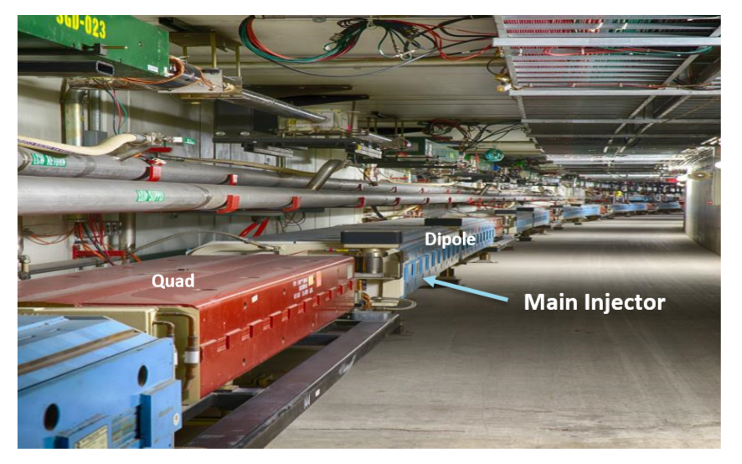
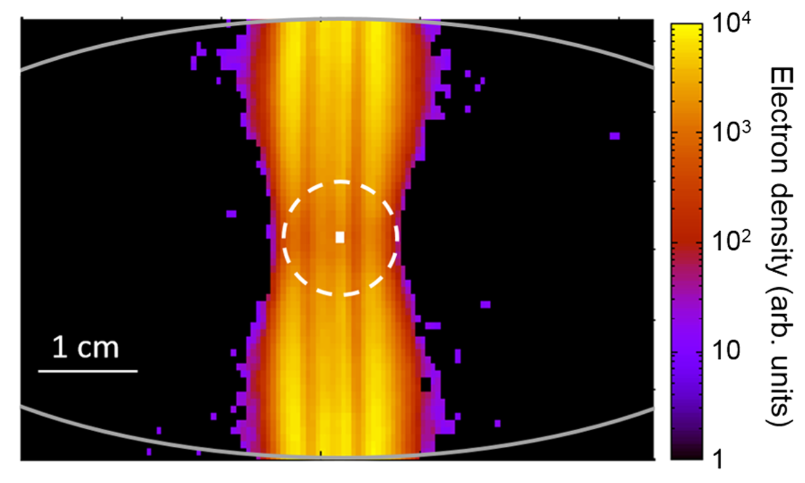
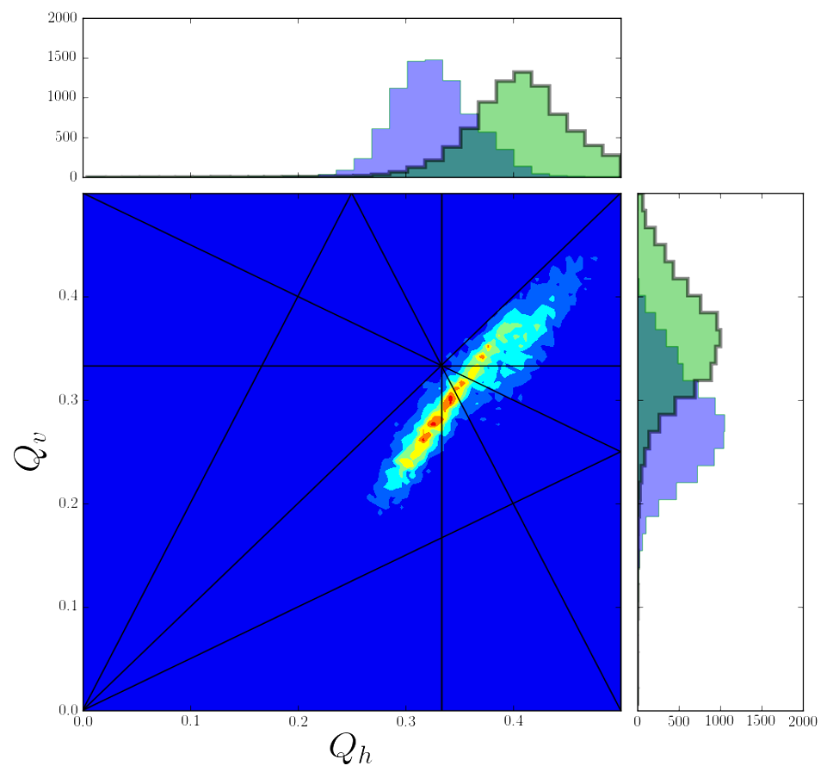
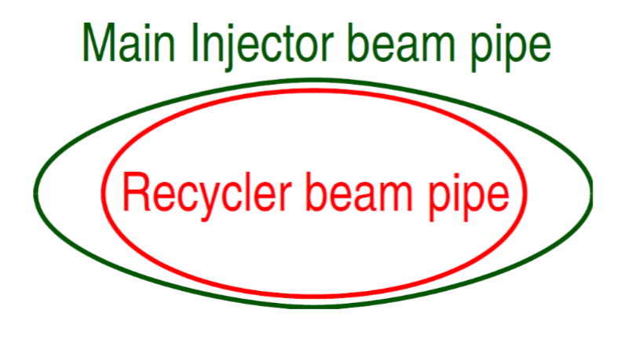
25
Recycler Ring - Challenges
Shared tunnel space with Main Injector
Electron cloud instability amplified Recycler in gradient dipoles
Recycler Ring
Main Injector
PIP-II Era Space-Charge
S. Antipov et al.
PRSTAB 2017
Smaller aperture
R. Ainsworth et al.
PRAB 2019
25
Jeffrey Eldred | 2.4 MW Upgrade with RCS
Notes:
25
25
25

Slide 26
26
Recycler Ring - Advantages
Using the Recycler to collect batches (from RCS or from 8-GeV-Linac-AR) reduces the Main Injector cycle time – increasing beam power
- Improving cycle time vs intensity, better for neutrino target.
Recycler currently rebunches beam and sends it to Delivery Ring, currently a critical part of our muon campus research infrastructure.
- Will we miss that capability when its gone?
We will learn a lot more about Recycler limits in PIP-II era operation. Slip-stacking in PIP-II era may be more taxing than high-charge 2.4 MW era.
Recycler Ring was very cheap to build- it can be rebuilt with large aperture, better optics, low-SEY coating, large momentum acceptance as needed.
8-GeV Linac scenarios can use Recycler or avoid it.
26
Jeffrey Eldred | 2.4 MW Upgrade with RCS
Notes:
26
26
26

Slide 27
27
RCS Option, “ICD-2” 10 Hz Ramp
Main Injector
(MI)
Recycler
RCS
Optional
Accumulator
Ring
PIP-II
Linac
~2 GeV Linac Upgrade
H- Injection Location
27
Jeffrey Eldred | 2.4 MW Upgrade with RCS

Slide 28
28
RCS Option, “BSR” 20 Hz Ramp
Main Injector
(MI)
Recycler?
RCS
Accumulator
Ring
PIP-II
Linac
~2 GeV Linac Upgrade
H- Injection Location
28
Jeffrey Eldred | 2.4 MW Upgrade with RCS

Slide 29
29
Upgrade Design History & Process
In 2008, Project X: 8 GeV SRF Linac, directly into Main Injector.
In 2010, Project X ICD-2: 2 GeV Linac, New 2-8 GeV RCS.
In 2018, S. Nagaitsev and V. Lebedev: updated version of ICD-2.
In 2019, J. Eldred, V. Lebedev, A. Valishev: parametric study of RCS design.
In 2021, Committee for Fermilab Booster Upgrade an integrated design effort:
Science Working Group chaired by R. Harnik
“Physics Opportunities for the Fermilab Booster Replacement”
Accelerator Working Group chaired by M. Syphers
“An Upgrade Path for the Fermilab Accelerator Complex” (RCS Scenario)
“An 8 GeV Linac as the Booster Replacement in the Fermilab Power Upgrade”
Recent Ongoing Work:
- Realistic cost assessment and timetables for all scenarios
- Backup plans for DUNE/LBNF power if upgrades fall short of above scenarios
- PAR + Booster transition upgrades + Recycler replacement = 1.8 MW?
29
Jeffrey Eldred | 2.4 MW Upgrade with RCS
Notes:
29
29
29

Slide 30
30
Proton Intensity Upgrade -> Future Muon Collider?
Spending on long-baseline neutrino upgrades is certainly compatible with simultaneous spending on muon collider R&D topics.
With an intense beam power at 2 GeV and/or 8 GeV, unique opportunity for muon collider frontend R&D – pulse compression, muon targets, beam capture & cooling.
For a true proton driver for muon collider parameters are something like
1-4 MW proton power
4-20 GeV proton energy
1-10 ns proton pulses
5-60 Hz pulse rep. rate.
Path to MC with 8-GeV Linac + 8-GeV Accumulator Ring:
1) upgrade linac to x4 duty factor.
2) H- laser-stripping technology to facilitate AR injection.
3) add 8-GeV compressor ring.
Path to MC with 2-GeV Linac + 8-GeV RCS:
1) upgrade RCS for higher aperture/energy
- fast-ramping super-ferric magnets?
2) add high-energy compressor ring.
Alternatively, extend linac to 4 GeV and build independent program there.
30
Jeffrey Eldred | 2.4 MW Upgrade with RCS
Notes:
30
30
30

Slide 31
31
Summary
PIP-II upgrade, massive potential for GeV-scale experimental program
Strategic planning for a subsequent Proton Intensity Upgrade.
- cost and timetable evaluations underway
ICD-2 RCS: Well-developed cost-effective proposal, focused on LBNF.
BSR RCS: More challenging injection, more 8-GeV power.
8-Gev Linac: Most challenging injection, highest 8-GeV potential.
What will be the future 0.8-2 GeV experimental program?
What will be the future 8 GeV experimental program?
- power, beam structure, timeline.
- future role of Recycler Ring and Delivery Ring.
Feedback during Snowmass process
- Dark Sector searches and muon CLFV most popular experiments.
- possible a compressor ring to enhance performance, MC R&D
- How will these PIU upgrade impact/enable future muon collider?
31
Jeffrey Eldred | 2.4 MW Upgrade with RCS
Notes:
31
31
31

Slide 32
32
32
Backup Slides
(Technical Details BSR)
32
Jeffrey Eldred | 2.4 MW Upgrade with RCS

Slide 33
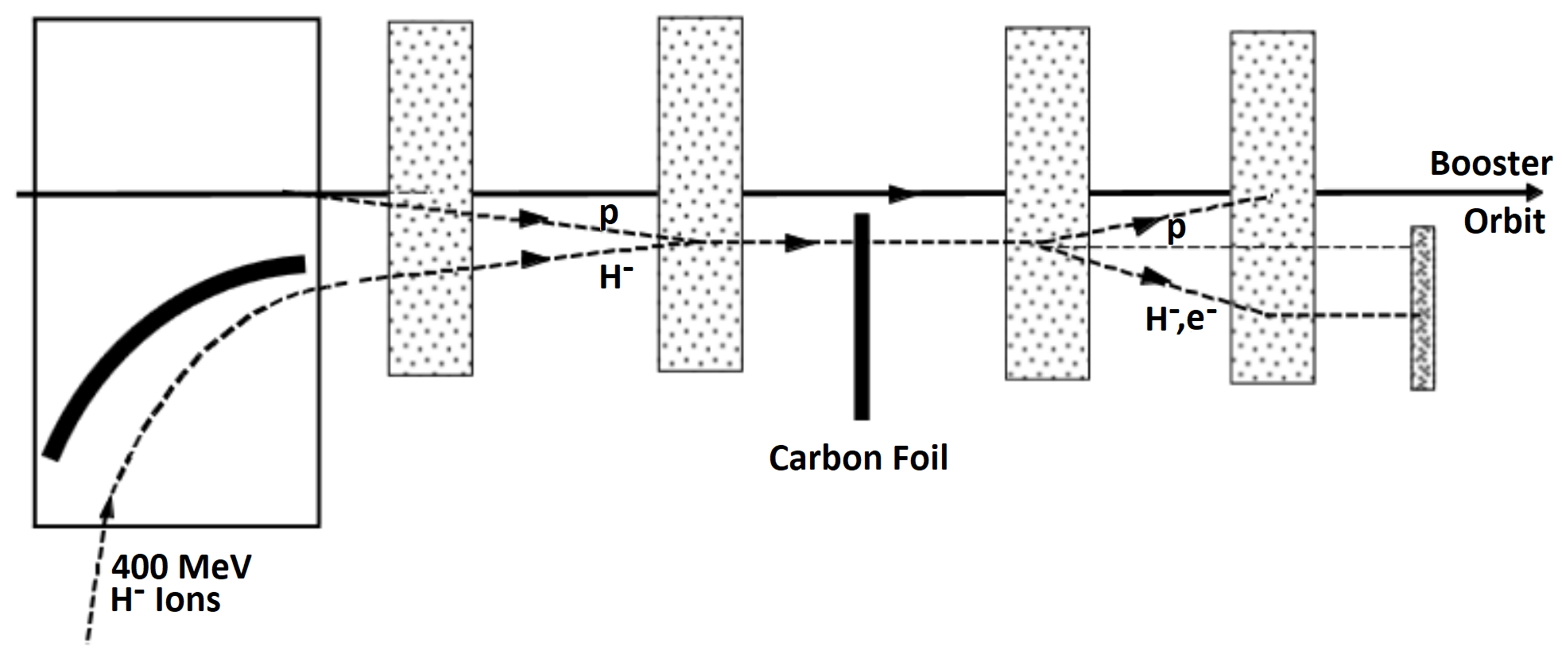
33
H- Injection through Foil, Process
H- linac beam transported into injection chicane.
Carbon foil strips the two electrons from the proton.
Proton beam accumulates in the ring.
Unstripped H- ions are sent to an absorber.
Ring cheats Louiville’s theorem, concentrates beam current by x10-x1000!
Essential for long-baseline program and many experimental programs.
33
Jeffrey Eldred | 2.4 MW Upgrade with RCS
Notes:
33
33
33

Slide 34
34
H- Injection through Foil, Challenges
Challenges:
- Chicane magnets must be sufficiently long (weak) to avoid stripping H- beam while also inflecting the beam towards the stripping foil.
- Losses from protons scattering off injection foil, high radioactivation.
- Thin stripping foil degrades from radiation and extreme heat.
- Losses of unstriped H- particles, requires absorber or extraction line.
- Injection optics interfere with symmetric ring lattice, causing resonances.
- Beam orbit must be maintained precisely over duration of injection.
34
Jeffrey Eldred | 2.4 MW Upgrade with RCS
Notes:
34
34
34

Slide 35
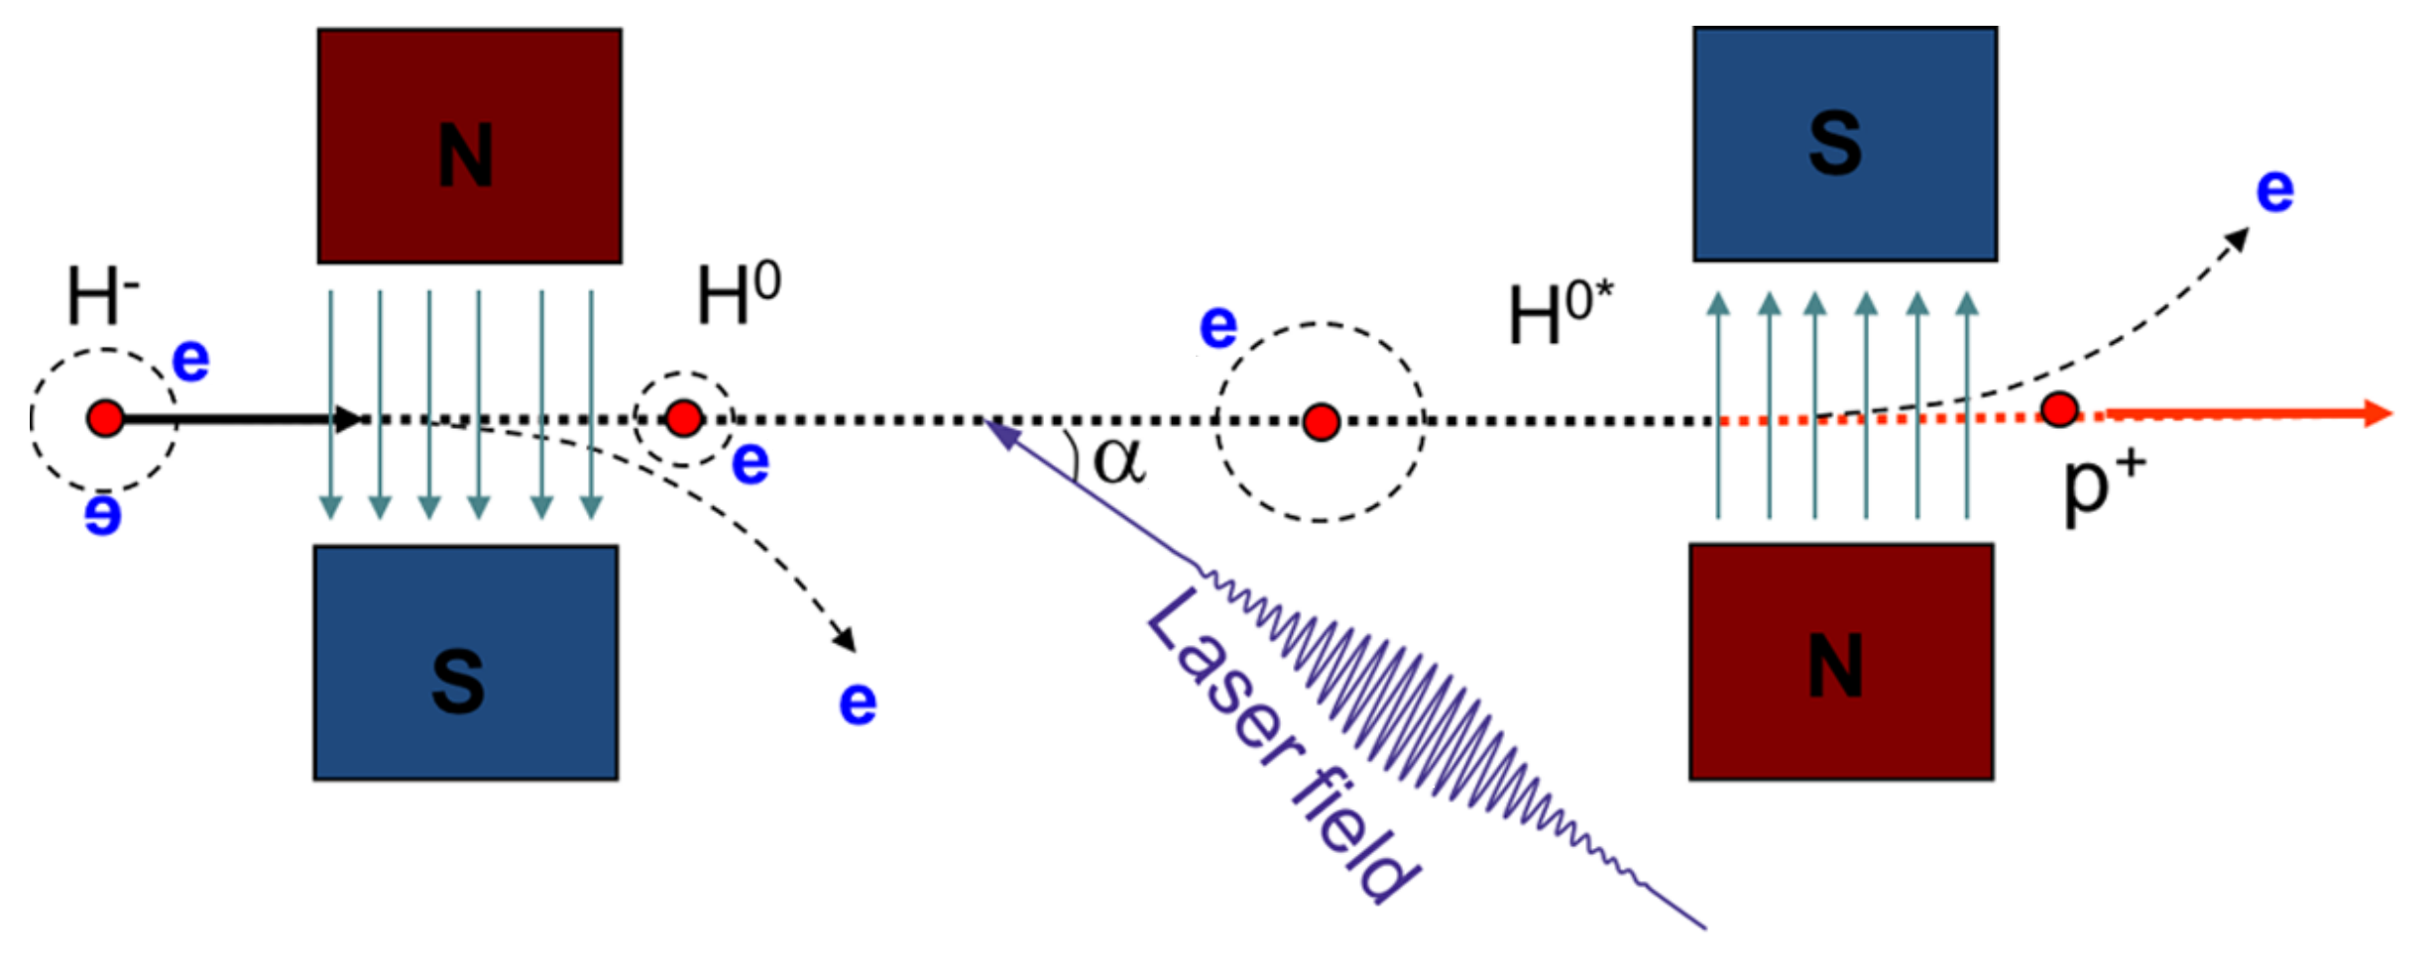
35
H- Injection through Laser
Laser-stripping technology R&D underway to eliminate many of these challenges....
SNS demonstrated 95% stripping efficiency of a 1 GeV H⁻ beam with 10 μs macropulse duration using a UV laser at 1 MW peak power.
However, millisecond duration with 99% efficiency is needed…
Present scenarios must proceed with a plan for H- foil injection (with laser-stripping as a subsequent retrofit).
Cousineau et al.
PRAB 2017
35
Jeffrey Eldred | 2.4 MW Upgrade with RCS
Notes:
35
35
35

Slide 36
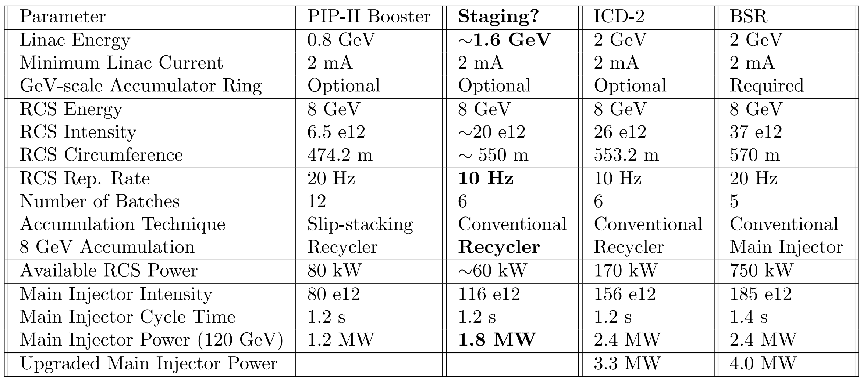
36
RCS Scenarios (possible staging)
“Design Considerations for Fermilab Multi-MW Proton Facility” white paper
Possible Staging with 1.8 MW, smaller Linac upgrade, PIP-II era Main Injector RF.
If we are careful could be designed to be upgradeable to either 2.4 MW scenario.
36
Jeffrey Eldred | 2.4 MW Upgrade with RCS
Notes:
36
36
36

Slide 37
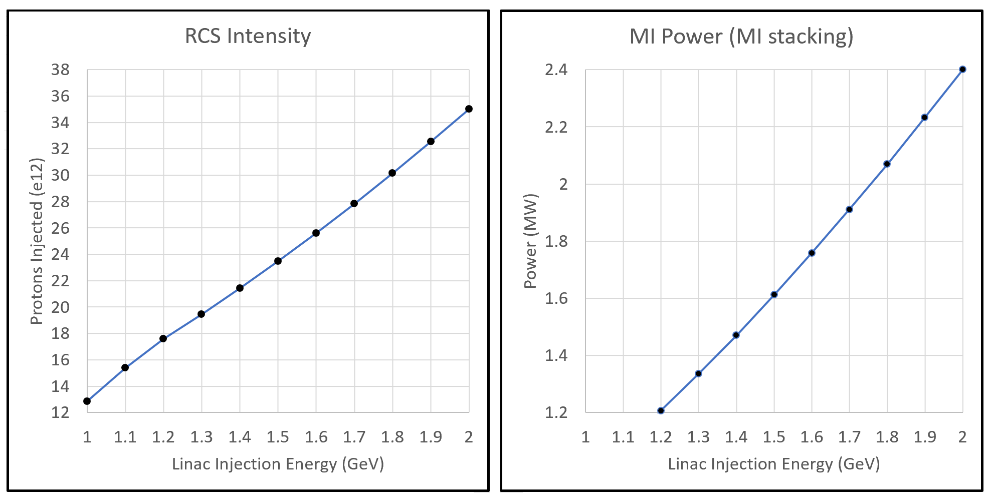
37
Staging RCS with partial upgrade of Linac & MI
Linac can be commissioned concurrent with PIP-II operations, RCS can be commissioned at partial linac energy, etc.
At ~1.2 GeV, the PIP-II Booster 1.2 MW benchmark is crossed.
At ~1.6 GeV, we have 1.8 MW without Main Injector RF upgrade.
- If we can still use Recycler, RCS rep. rate only needs 10 Hz.
37
Jeffrey Eldred | An Upgrade Path toward Multi-MW Beam Power at Fermilab

Slide 38
38
38
More Backup Slides
(Technical Details BSR)
38
Jeffrey Eldred | Snowmass 2.4 MW Upgrade with RCS

Slide 39
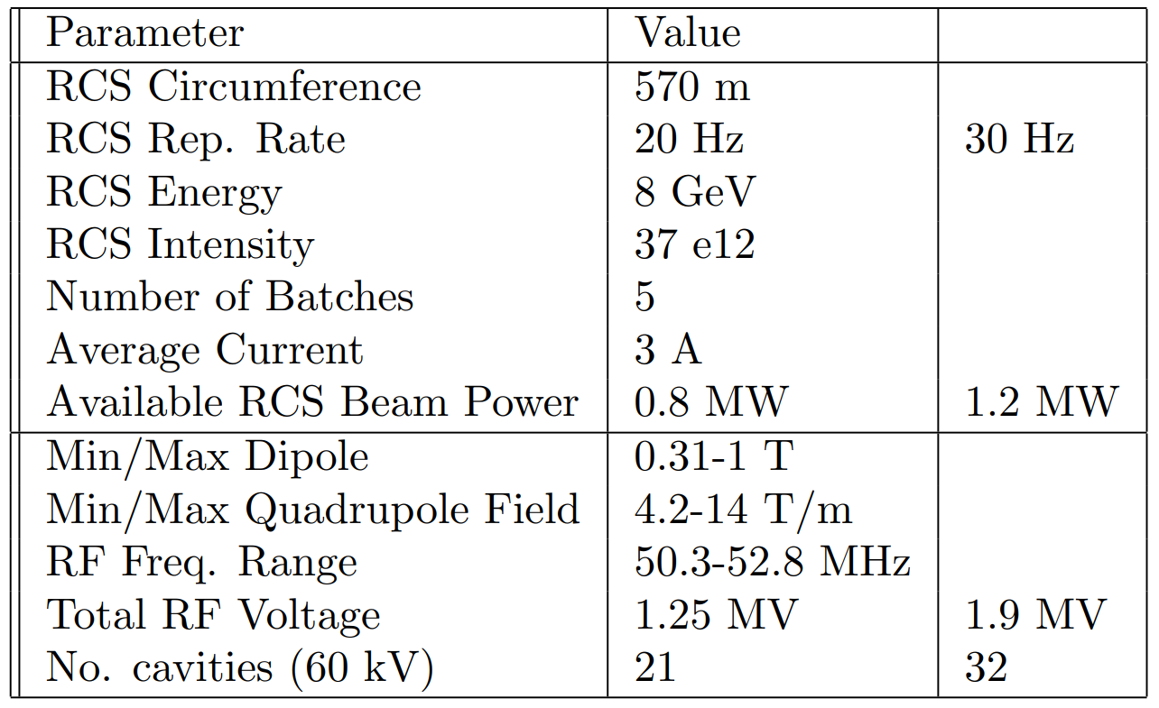
39
Rapid Cycling Synchrotron (RCS)
The RCS would operate at 20 Hz and accelerate from 2 to 8 GeV
A second ring operating at 2 GeV is proposed to be located above the RCS and used to accumulate charge from the upgraded linac.
39
Jeffrey Eldred | An Upgrade Path toward Multi-MW Beam Power at Fermilab

Slide 40
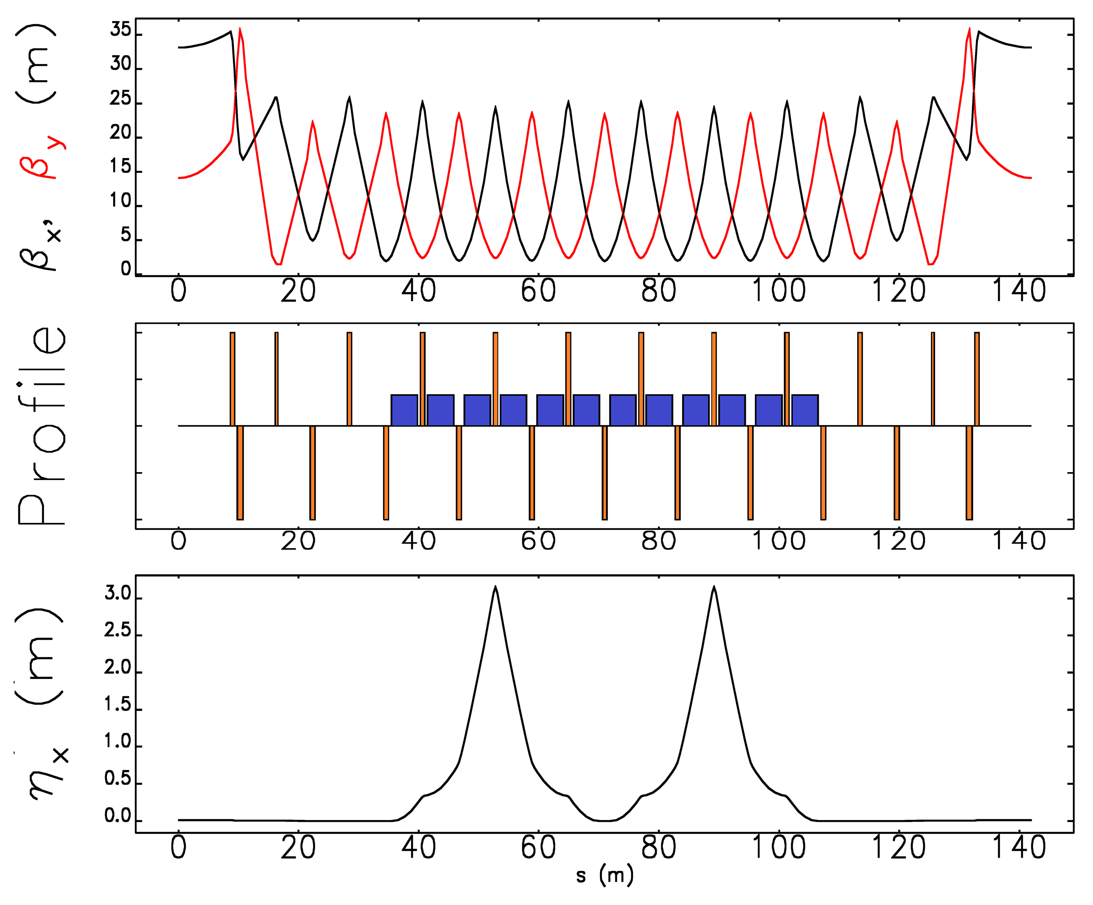
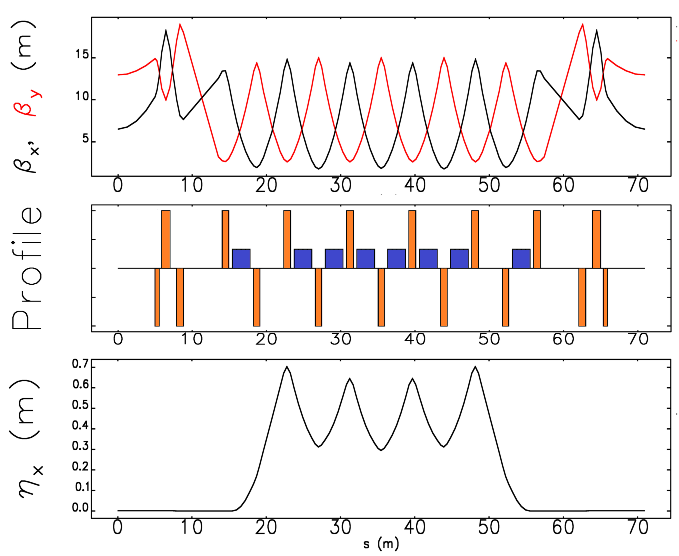
40
Preliminary RCS Lattice Configurations
2 GeV Injection Ring,
one of four periods
2 - 8 GeV RCS Ring,
one of eight periods
2 GeV Ring Optimized for Injection
8 GeV Ring Optimized for Acceleration
40
Jeffrey Eldred | An Upgrade Path toward Multi-MW Beam Power at Fermilab

Slide 41
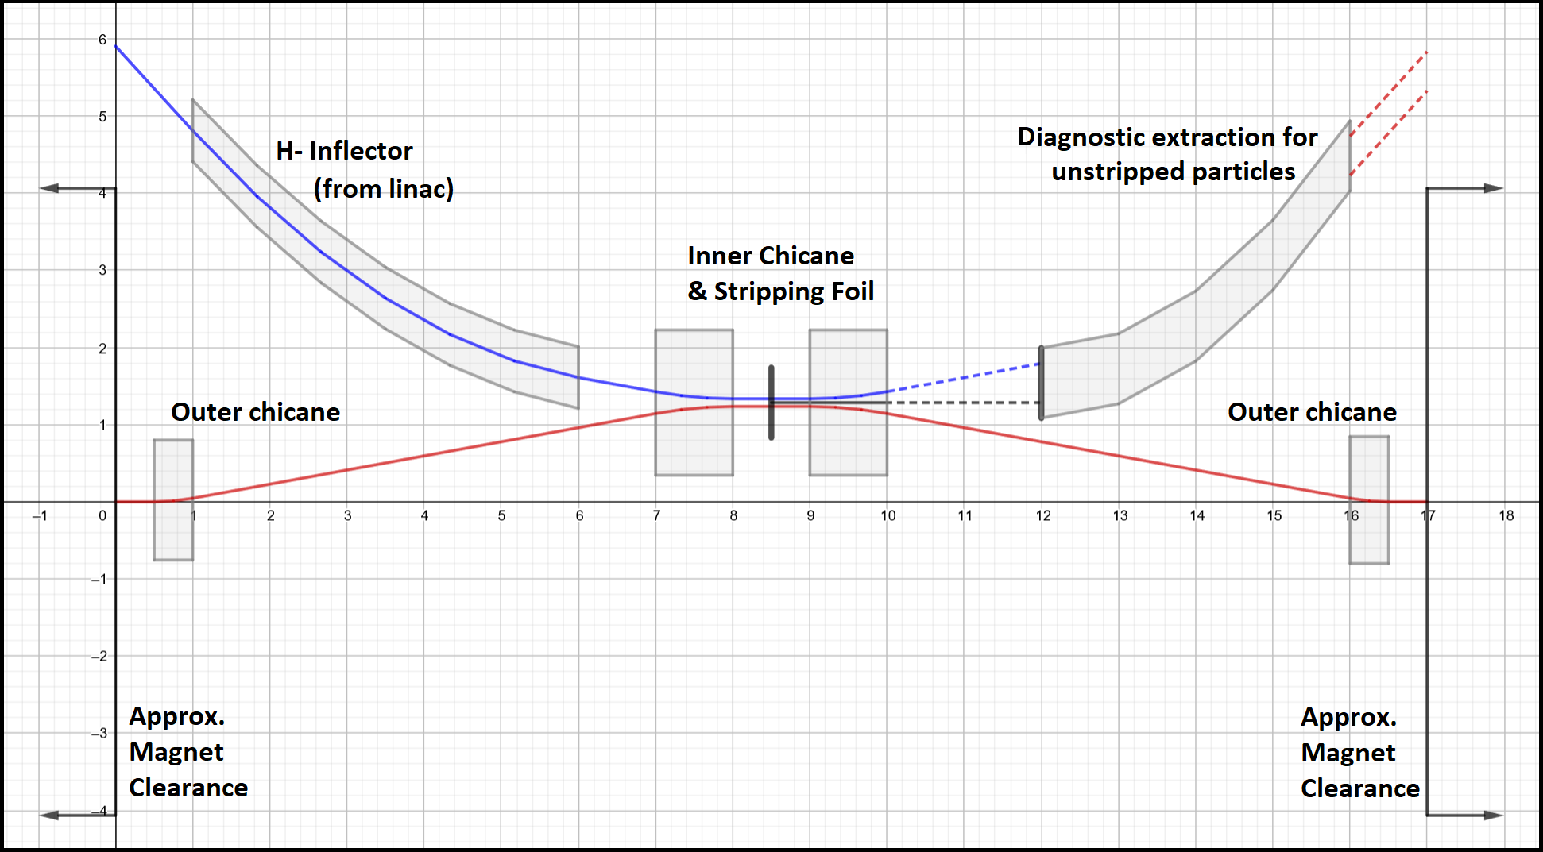
41
Beam Accumulation and H- Stripping in a Storage Ring
SR Circumference | 570 | m
SR Energy | 2 | GeV
Superperiodicity | 4
Injection Insertion Length | 12 | m
Dipoles per Superperiod | 12
Dipole Strength | <0.4 | T
H- Foil Stripping Injection
17 m straight.
41
Jeffrey Eldred | An Upgrade Path toward Multi-MW Beam Power at Fermilab

Slide 42
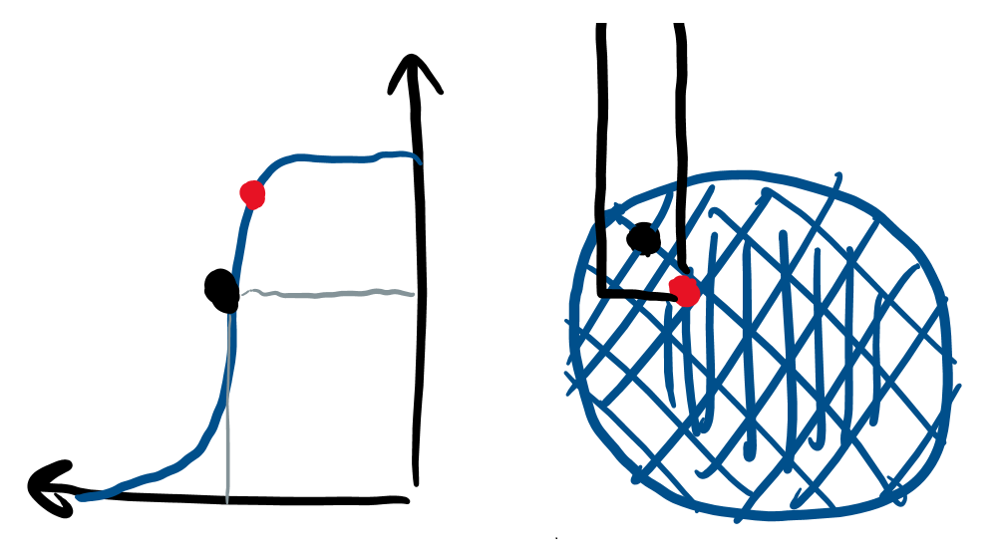
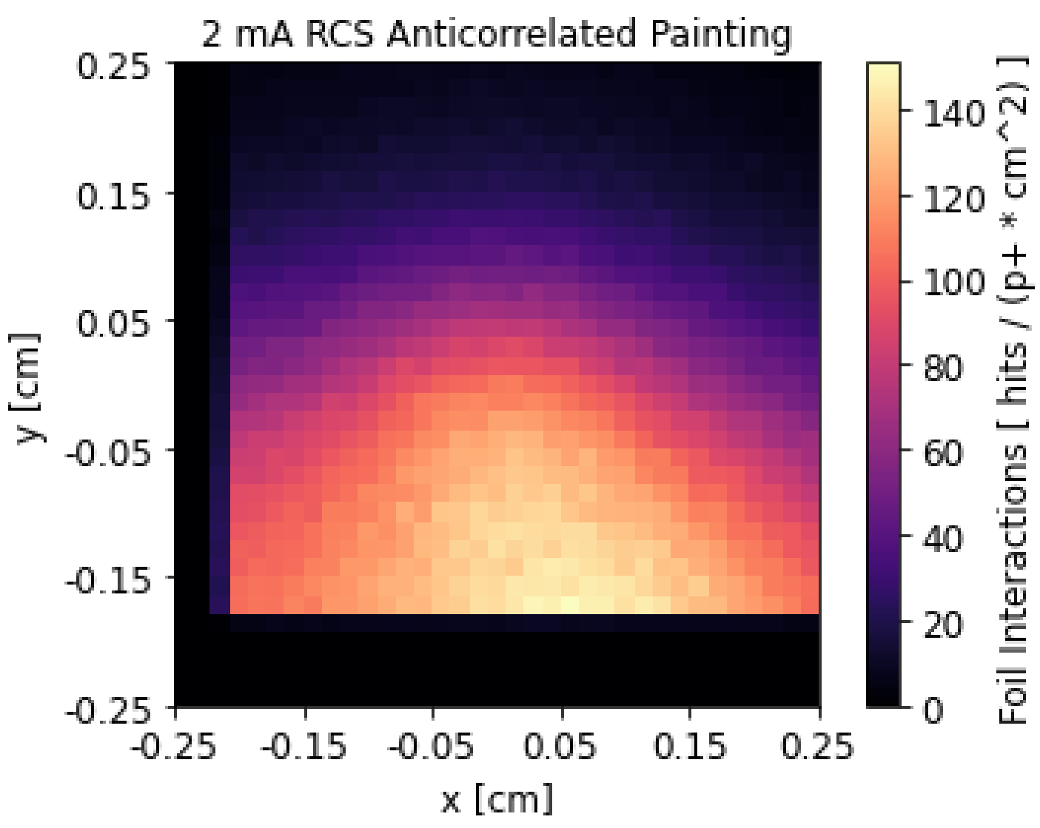
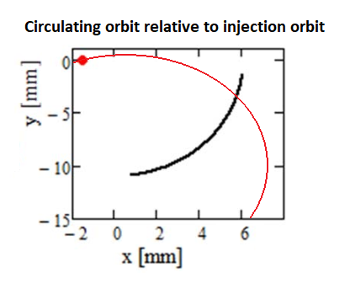
42
Anti-Correlated Painted Injection
Beam Distribution during Injection
Hit Distribution
Anti-correlated Painting Injection
Matthew Hoppesch beams-9123
Injection painting scheme chosen to:
Minimize foil hits from the circulating beam.
Optimize stability of the beam distribution.
42
Jeffrey Eldred | An Upgrade Path toward Multi-MW Beam Power at Fermilab

Slide 43
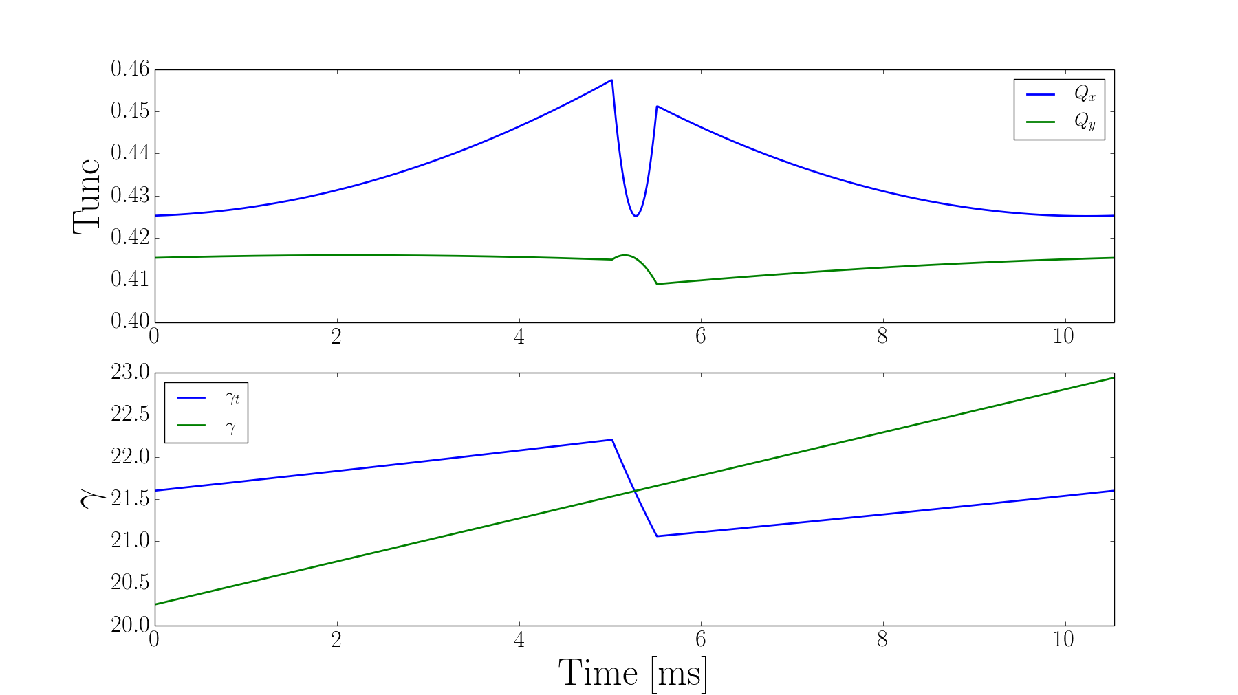
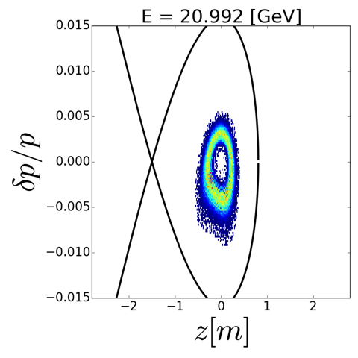
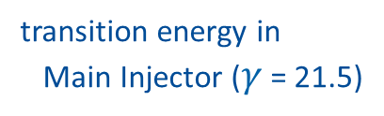
43
Main Injector Operations
Keep 8 GeV injection into MI, re-using portions of Recycler as injection line
Removing slip stacking operation (Recycler) creates lower momentum spread in MI; helps to alleviate issues at crossing of transition energy
“Transition”: energy where revolution frequency is independent of momentum
Special optics manipulation at the transition energy (left; part of PIP-II) and smaller momentum spread provide adequate phase space through transition:
R. Ainsworth, I. Kourbanis
transition energy in
Main Injector ($γ$ = 21.5)
43
Jeffrey Eldred | An Upgrade Path toward Multi-MW Beam Power at Fermilab
Notes:
43
43
43

Slide 44
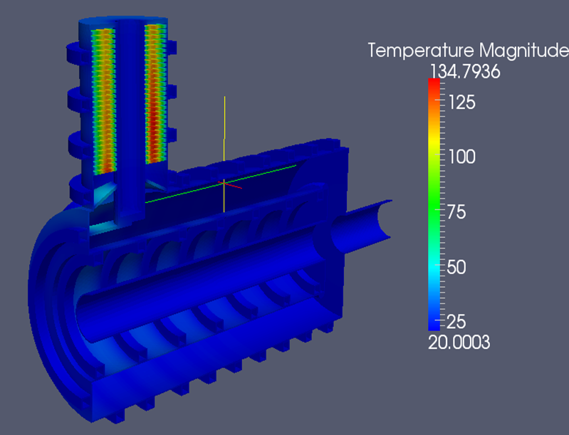
44
Main Injector RF System
MI RF system would be upgraded with new modern RF cavity system
  increases RF power to meet final intensity requirements
  also enables increased ramp rate to achieve higher overall beam power above 2.4 MW
RF System Specifications
Frequency | 52.617 — 53.104 | MHz
Max. Acceleration Rate | 240 | GeV/s
Acceleration Voltage | 2.7 | MV
Peak Beam Power | 7.1 | MW
Average Beam Power | 3.6 | MW
Peak Voltage | 4.8 | MV
Average Beam Current | 2.7 | A
Fundamental RF Current | 4.6-5.2 | A
No. RF Stations required | 31
I. Kourbanis
44
Jeffrey Eldred | An Upgrade Path toward Multi-MW Beam Power at Fermilab
Notes:
44
44
44

Slide 45
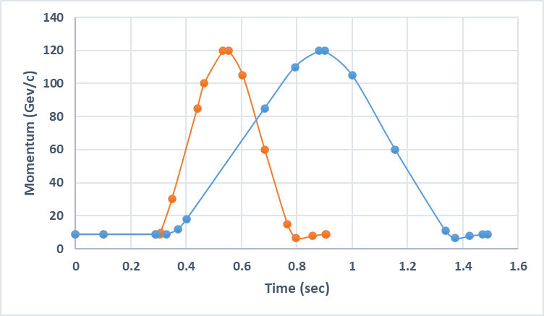
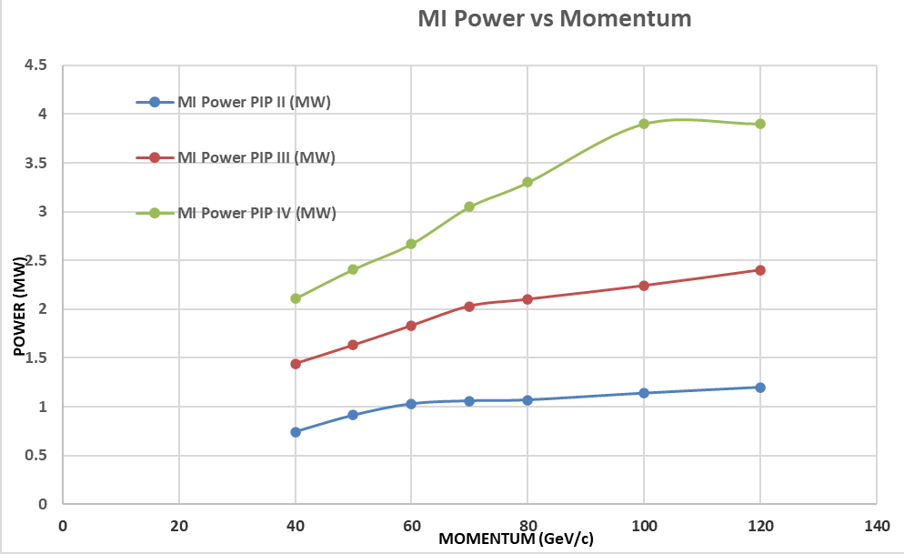
45
Possible MI Upgrade for Higher Power Beyond 2.4 MW
Upgrade magnet power supply system to support higher ramp rate — reduce cycle time from ~1.5 s to about 0.9 s — factor of ~ 5/3
240 GeV/s —> 600 GeV/s
MI PS
upgrade
this
upgrade
PIP-II
I. Kourbanis
45
Jeffrey Eldred | An Upgrade Path toward Multi-MW Beam Power at Fermilab
Notes:
45
45
45

