Slide 1
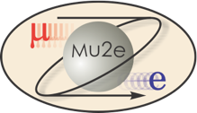
The Mu2e Experiment at Fermilab
NuFact 2022
Craig Group
(University of Virginia)
…on behalf of the Mu2e collaboration.

Slide 2
Where is the new physics?
We know the Standard Model is not complete.
So, where is the rest of the physics we need to complete it?

Slide 3
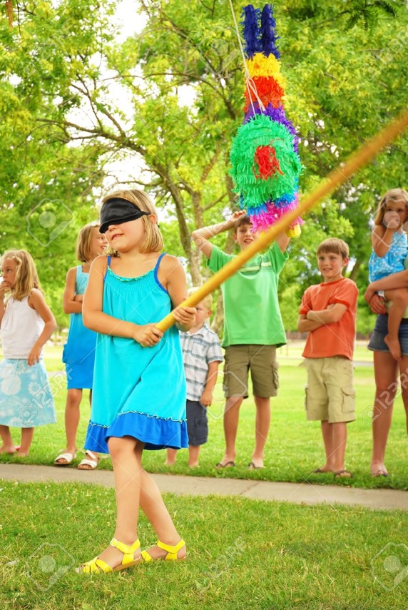
Where is the new physics?
We don’t know!

Slide 4
What is a muon?

Slide 5
What is a muon?
A surprise!
Discovered (by mistake in 1936) while looking for the mediator of the strong nuclear force in cosmic rays…

Slide 6
What is a muon?
Pontecorvo (1947) suggested that the muon may have been some kind of “isomer” of the electron.
  If so, he suggested you would see the decay μ→eγ.
  He and Hincks performed the first search for μ→eγin 1948.

Slide 7
What is a muon?
Pontecorvo (1947) suggested that the muon may have been some kind of “isomer” of the electron.
  If so, he suggested you would see the decay μ→eγ.
  He and Hincks performed the first search for μ→eγin 1948.
By 1950, it was clear that this decay did not occur at the percent level (<10⁻²). Lepton flavor matters!

Slide 8
What is a muon?
Pontecorvo (1947) suggested that the muon may have been some kind of “isomer” of the electron.
  If so, he suggested you would see the decay μ→eγ.
  He and Hincks performed the first search for μ→eγin 1948.
By 1950, it was clear that this decay did not occur at the percent level (<10⁻²). Lepton flavor matters!
The birth of charge lepton flavor conservation!

Slide 9
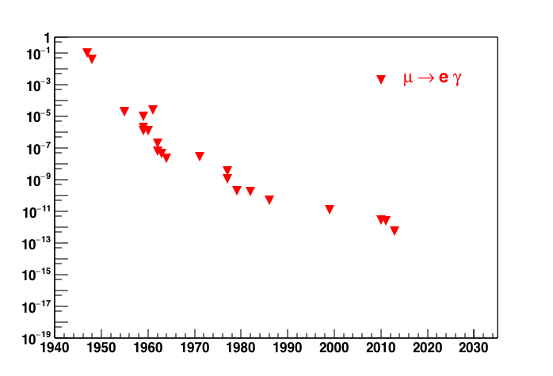
History of CLFV Searches
Cosmic ray muons
Muon beams
MEGA, MEG (PSI), and others…
Notes:
Initial experiments used cosmic rays –but need higher rate of muons so moved to beams.
Search for coincident electron and a gamma. First searches stopped muons in lead absorber
Looked for coincidence between in two Geiger-Muller counters of the electron and photon.

Slide 10
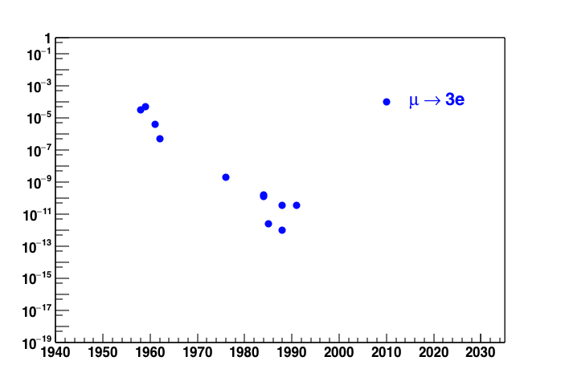
History of CLFV Searches
Mu3e, PSI

Slide 11
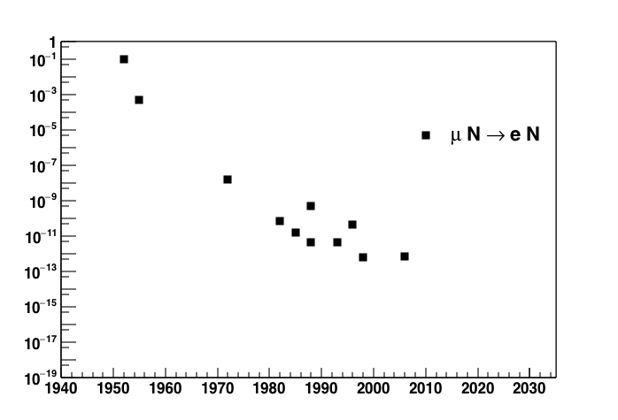
History of CLFV Searches
Cosmic ray muons
Muon beams
Mu2e, SINDRUM II, COMET, DeeMe, and others…

Slide 12
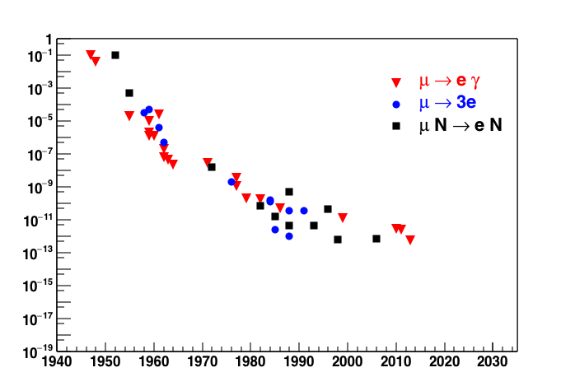
History of CLFV Searches
Cosmic ray muons
Muon beams
We did not observe CLFV so far - why don’t we just give up and do something else?

Slide 13
Future of CLFV Searches?
Cosmic ray muons
?
Muon beams
We did not observe CLFV so far - why don’t we just give up and do something else?

Slide 14

Future of CLFV Searches!!!
Cosmic ray muons
Muon beams
Factor of
10,000!
Mu2e
Experiment
Future CLFV experiments like Mu2e expect huge gains in sensitivity!
So, why is that interesting?

Slide 15
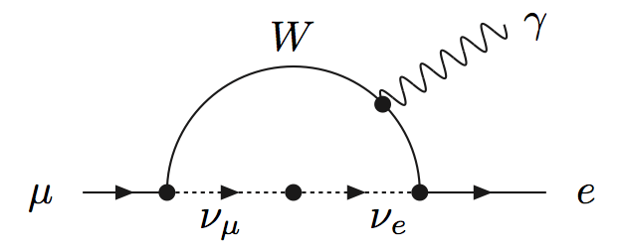
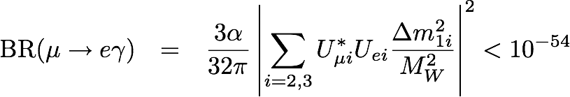
Charged Lepton Flavor Violation (CLFV)
Neutrinos have mass
Individual lepton numbers are not conserved
Therefore, Lepton Flavor Violation occurs in Charged Leptons
NO SM PHYSICS BACKGROUND!
Observation is unambiguous sign of new physics!

Slide 16
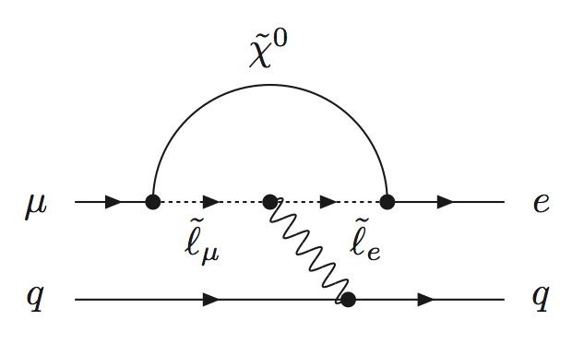
Searching for CLFV with muon-to-electron conversion
Conversion in the presence of a nucleus (N):
μ+N→e+N
Experiments: Mu2e, SINDRUM II, COMET, and others…

Slide 17
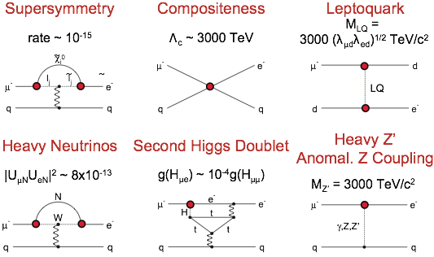
“New physics” may also provide
CLFV signal at higher rate!
Marciano, Mori, and Roney , Ann. Rev. Nucl. Sci. 58

Slide 18


Mu2e
Mu2e is a DOE experiment to take place at Fermilab that is about 90% constructed.
Goal: Search for
  Measure ratio:
  Run 1 (2025-2026) sensitivity to R at 90% C.L. of 6.6*10⁻¹⁶
    3 orders of magnitude better than current limits
      -- R_{μe} < 7 x 10⁻¹³ @ 90% CL (on Au)
      -- SINDRUM II (W. Bertl et al., Eur. Phys. J. C 47, 337–346 (2006))
    Need ~10¹⁷ stopped muons!
      -- ~10²⁹ protons on target (3 year run)
    Need to keep background small and well understood

Slide 19
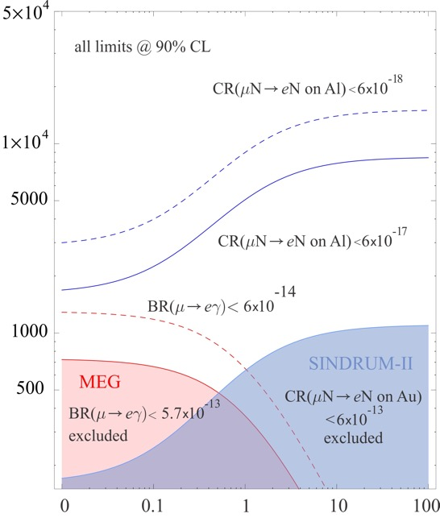
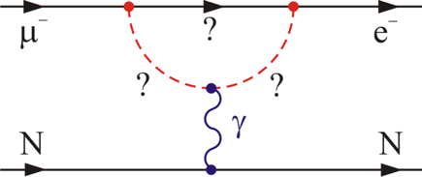
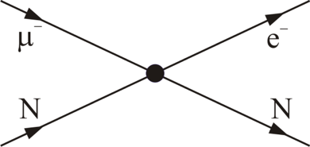
CLFV in μ⁺→e⁺γ and μ⁻N→e⁻N
Model-independent effective CLFV Lagrangian
Loops
Λ (TeV)
Contact Interactions
Mu2e
Mu2e II
κ << 1
magnetic moment type operator
μ→ eγ rate ~300X μN → eN rate
κ >> 1
four-fermion interaction
μN→ eN rate >> μ→ eγ rate
Loops
κ
Contact
A. de Gouvea and P. Vogel
Prog.Part.Nucl.Phys. 71 (2013) 75-92

Slide 20
CLFV in μ⁺→e⁺γ and μ⁻N→e⁻N
Model-independent effective CLFV Lagrangian
Mu2e is most
sensitive over
the full range of κ!
Loops
Λ (TeV)
Contact Interactions
Mu2e
Mu2e II
κ << 1
magnetic moment type operator
μ→ eγ rate ~300X μN → eN rate
κ >> 1
four-fermion interaction
μN→ eN rate >> μ→ eγ rate
Loops
κ
Contact
A. de Gouvea and P. Vogel
Prog.Part.Nucl.Phys. 71 (2013) 75-92

Slide 21
Mu2e Discovery Potential
  Provides information about flavor structure of new physics even if it is not easily accessible at the LHC.
A null Mu2e result at the proposed sensitivity will severely constrain new physics models.
  Discovery potential is high -- CLFV is predicted at observable rates for Mu2e in many models of new physics.
  Mu2e can probe mass scales up to 10⁴ TeV.

Slide 22

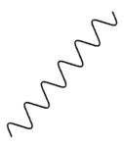
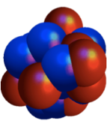

Experimental Signature
A single monoenergetic electron
If N = Al, Ee = 105. MeV
  (Electron E depends on Z)
Nucleus coherently recoils off outgoing electron, no breakup
μ
e

Slide 23
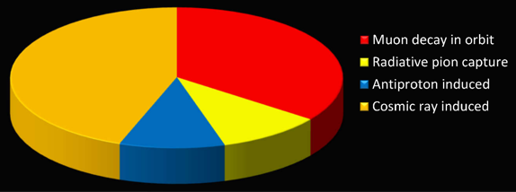
Background Processes
Signal is a single ~105 MeV e-.
Major backgrounds:
  Intrinsic (~40%) – scale with number of stopped muons
    Muon decay in Coulomb orbit (DIO is ~40% of total background)
    Radiative muon capture (photon can convert asymmetrically)
  Late arriving (~10%) – scale with number of late protons
    Radiative pion capture
    Muon/pion decay in flight
  Miscellaneous (~50%):
    Antiprotons and other late arriving particles
    Cosmic-ray-induced (largest - ~45%)
These can all be controlled
and none produce a sharp peak at 105 MeV!

Slide 24
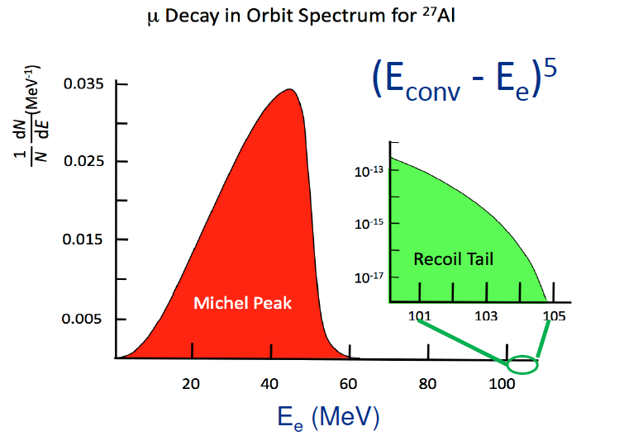
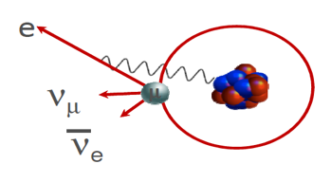
Background Processes
DIO is a large component of the background.

Slide 25
The Mu2e Experiment
Production Solenoid
Transport Solenoid
Detector Solenoid
(about 25 meters end-to-end)

Slide 26
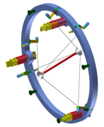
The Mu2e Experiment
Production Solenoid
Transport Solenoid
Detector Solenoid
2.5T
4.7T
Production Target (Tungsten, size of a pencil)
8 GeV proton beam hits Production Target in Production Solenoid.
Pions captured and pushed towards Transport Solenoid by graded field.
Pions decay to muons.
1)

Slide 27
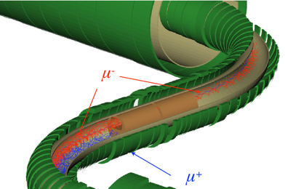
The Mu2e Experiment
Production Solenoid
Transport Solenoid
Detector Solenoid
2.5T
2.0T
2)
Transport solenoid performs sign and momentum selection.
Collimators eliminate high energy negative particles, positive particles, and line-of-sight neutrals.

Slide 28
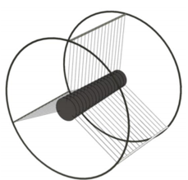
The Mu2e Experiment
Production Solenoid
Transport Solenoid
Detector Solenoid
1.0T
2.0T
Stopping Target
(Aluminum foils)
3)
Muons captured in stopping target foils.
Conversion electron trajectory measured in tracker, validated in calorimeter.
Cosmic Ray Veto surrounds Detector Solenoid.

Slide 29
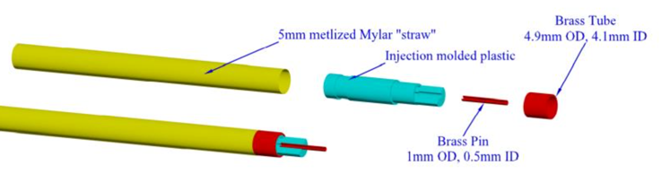
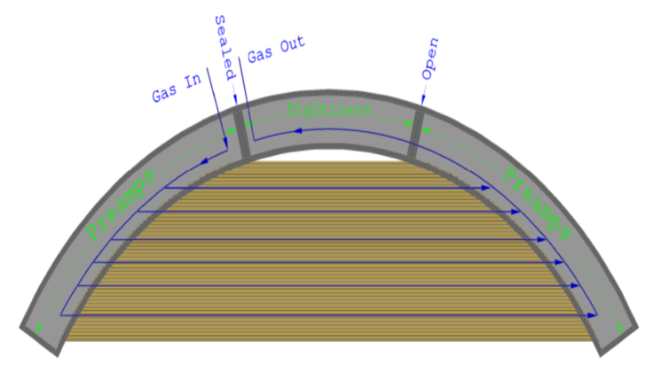
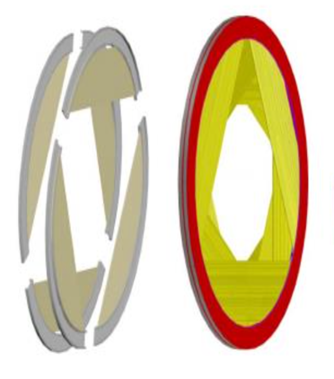
The Mu2e Tracker
straw tube
5 mm diameter straw, spiral wound
Al, Au-coated, 15 μm Mylar
334 – 1174 mm active length
80/20 Ar/CO2 with HV < 1500 V
100 μm hit resolution
panel = 96 straw tubes
plane = 6 panels
station = 2 planes

Slide 30
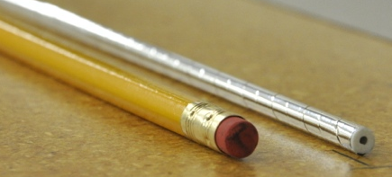
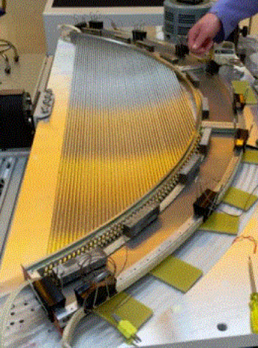
The Mu2e Tracker
straw tube
5 mm diameter straw, spiral wound
Al, Au-coated, 15 μm Mylar
334 – 1174 mm active length
80/20 Ar/CO2 with HV < 1500 V
100 μm hit resolution
panel = 96 straw tubes
plane = 6 panels
station = 2 planes

Slide 31
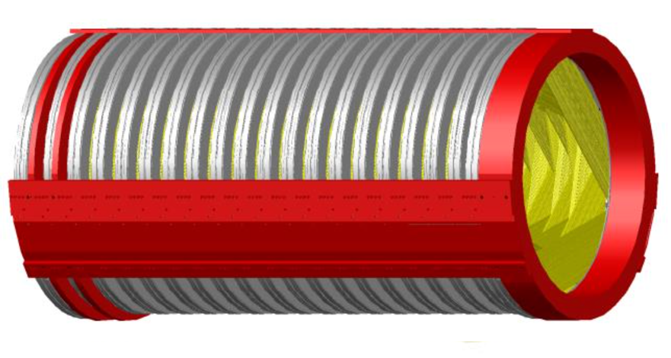
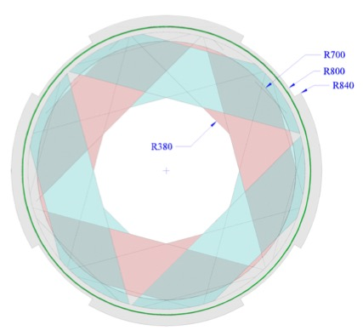
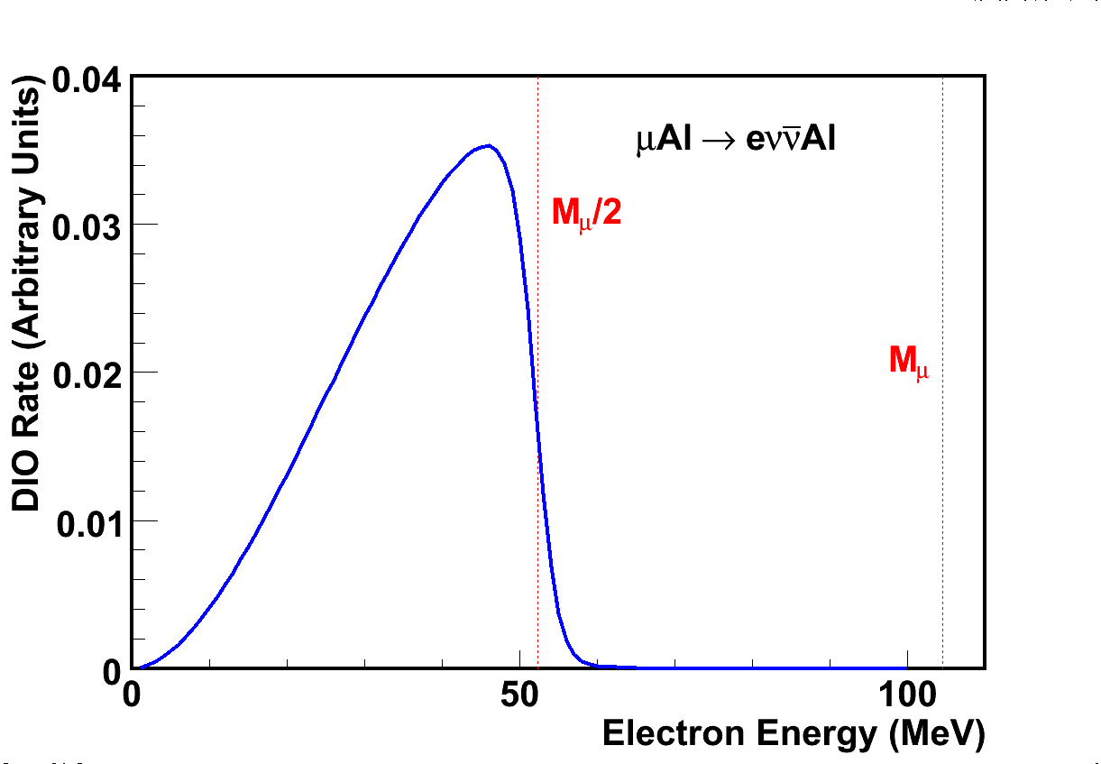
The Mu2e Tracker
detector= 18 stations (3m cylinder)
Detector is in vacuum and inner 38 cm is purposefully un-instrumented
  Blind to beam flash
  Blind to >99% of DIO spectrum
Active tracking region from 38 cm to 70 cm
Services and structure beyond 70 cm
DIO
Escape thru
center of Tracker
Fully
fiducial

Slide 32
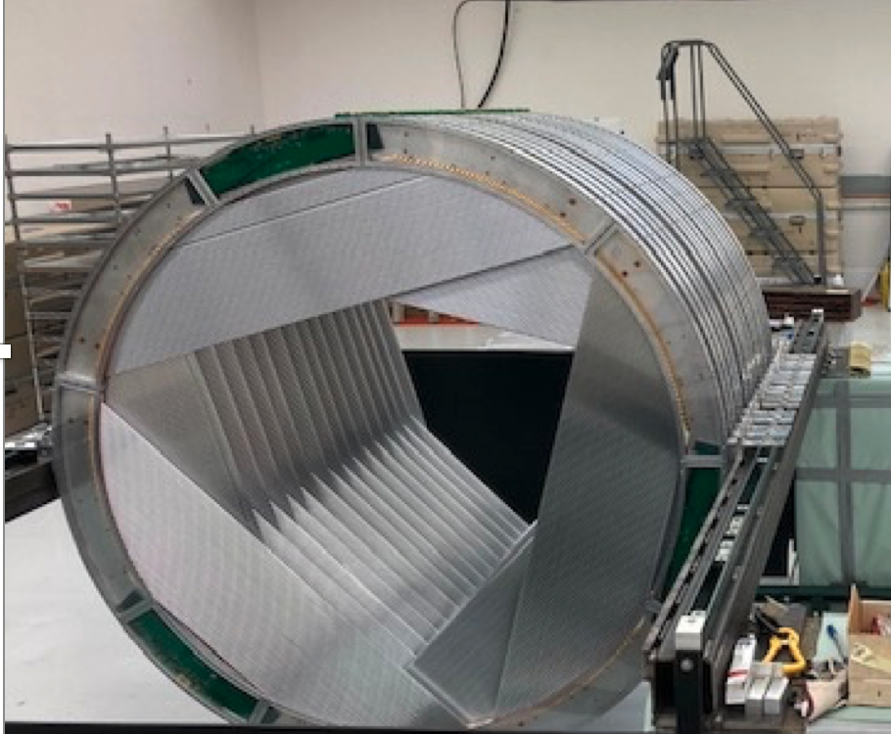
The Mu2e Tracker Status
All straws produced.
167 / 216 panels produced.
16 / 36 planes are built.
Cosmic ray tests with a
single plane!

Slide 33
The Mu2e Calorimeter
Role of calorimeter
  Particle ID (e vs μ)
  Cosmic ray rejection
  Fast/energy - trigger
Crystal calorimeter
  Compact
  Radiation hard
  Good timing (<1 ns) and energy resolution (5%)
Will employ 2 disks
(radius = 36-70 cm)
  ~700 undoped CsI crystals
  Photo-sensors - SiPMs
(20 x 3.4 x 3.4 cm3)

Slide 34
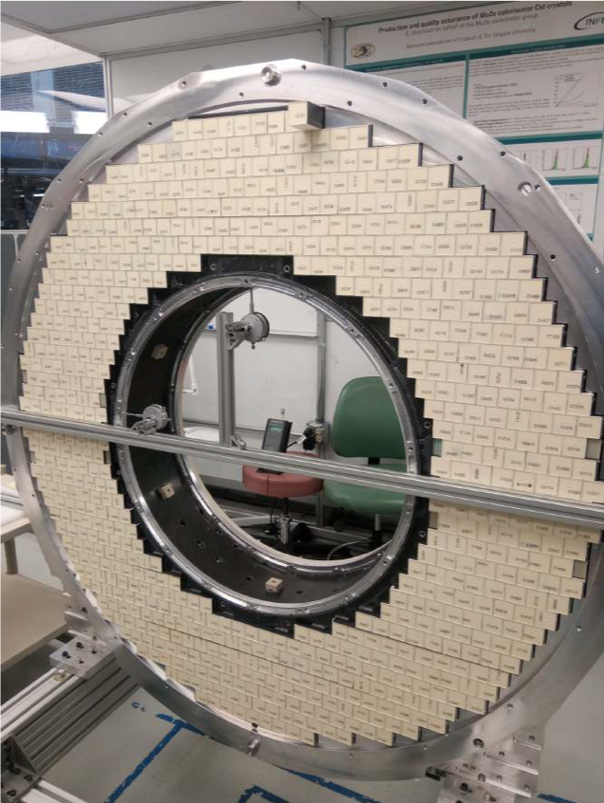
Mu2e Calorimeter Status
All crystals, SiPMs, and FEEs produced.
All mechanical parts in hand to build the first disk.
→ Finished stacking crystals!
Cosmic ray test underway with subset of crystals.

Slide 35
Mu2e Cosmic-Ray Veto
Without the veto system,
expect ~1 cosmic-ray induced
background event per day
Cosmic ray muons can generate background events via decay,
scattering, or material interactions.
Veto system covers entire DS and half TS.

Slide 36
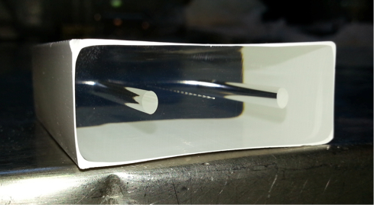
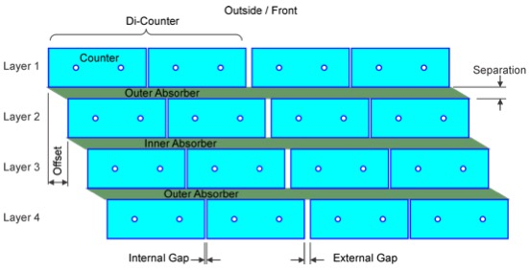
Mu2e Cosmic-Ray Veto
Will use 4 overlapping layers of scintillator bars separated by ~ 10 mm absorber
  Each bar is 5 x 2 x (300 - 660) cm³
  2 wavelength shifting fibers / bar
  Read-out both ends of each fiber with SiPM
  Have achieved > 99.4% (per layer) in test beam

Slide 37
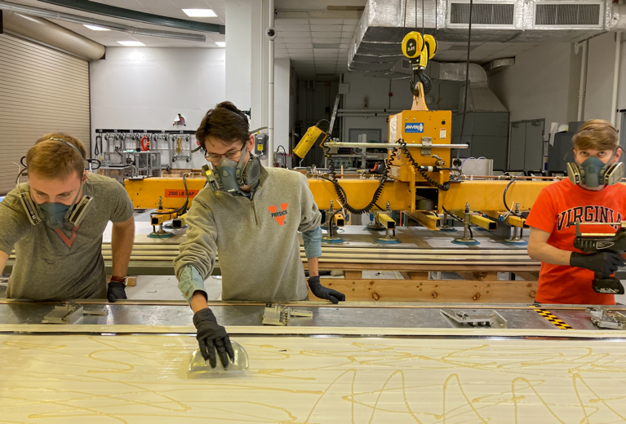
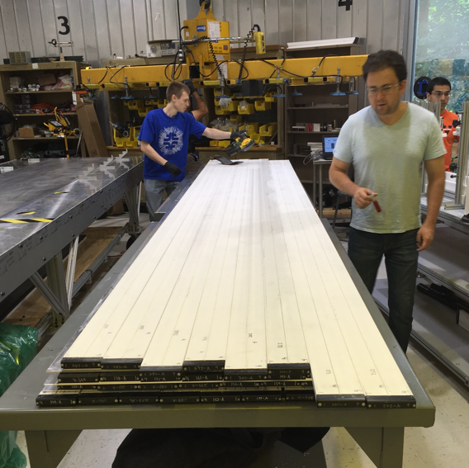
The Mu2e CRV Status
2500 / 2700 di-counters produced.
68 / 83 modules produced.
Cosmic ray tests underway at Fermilab.

Slide 38
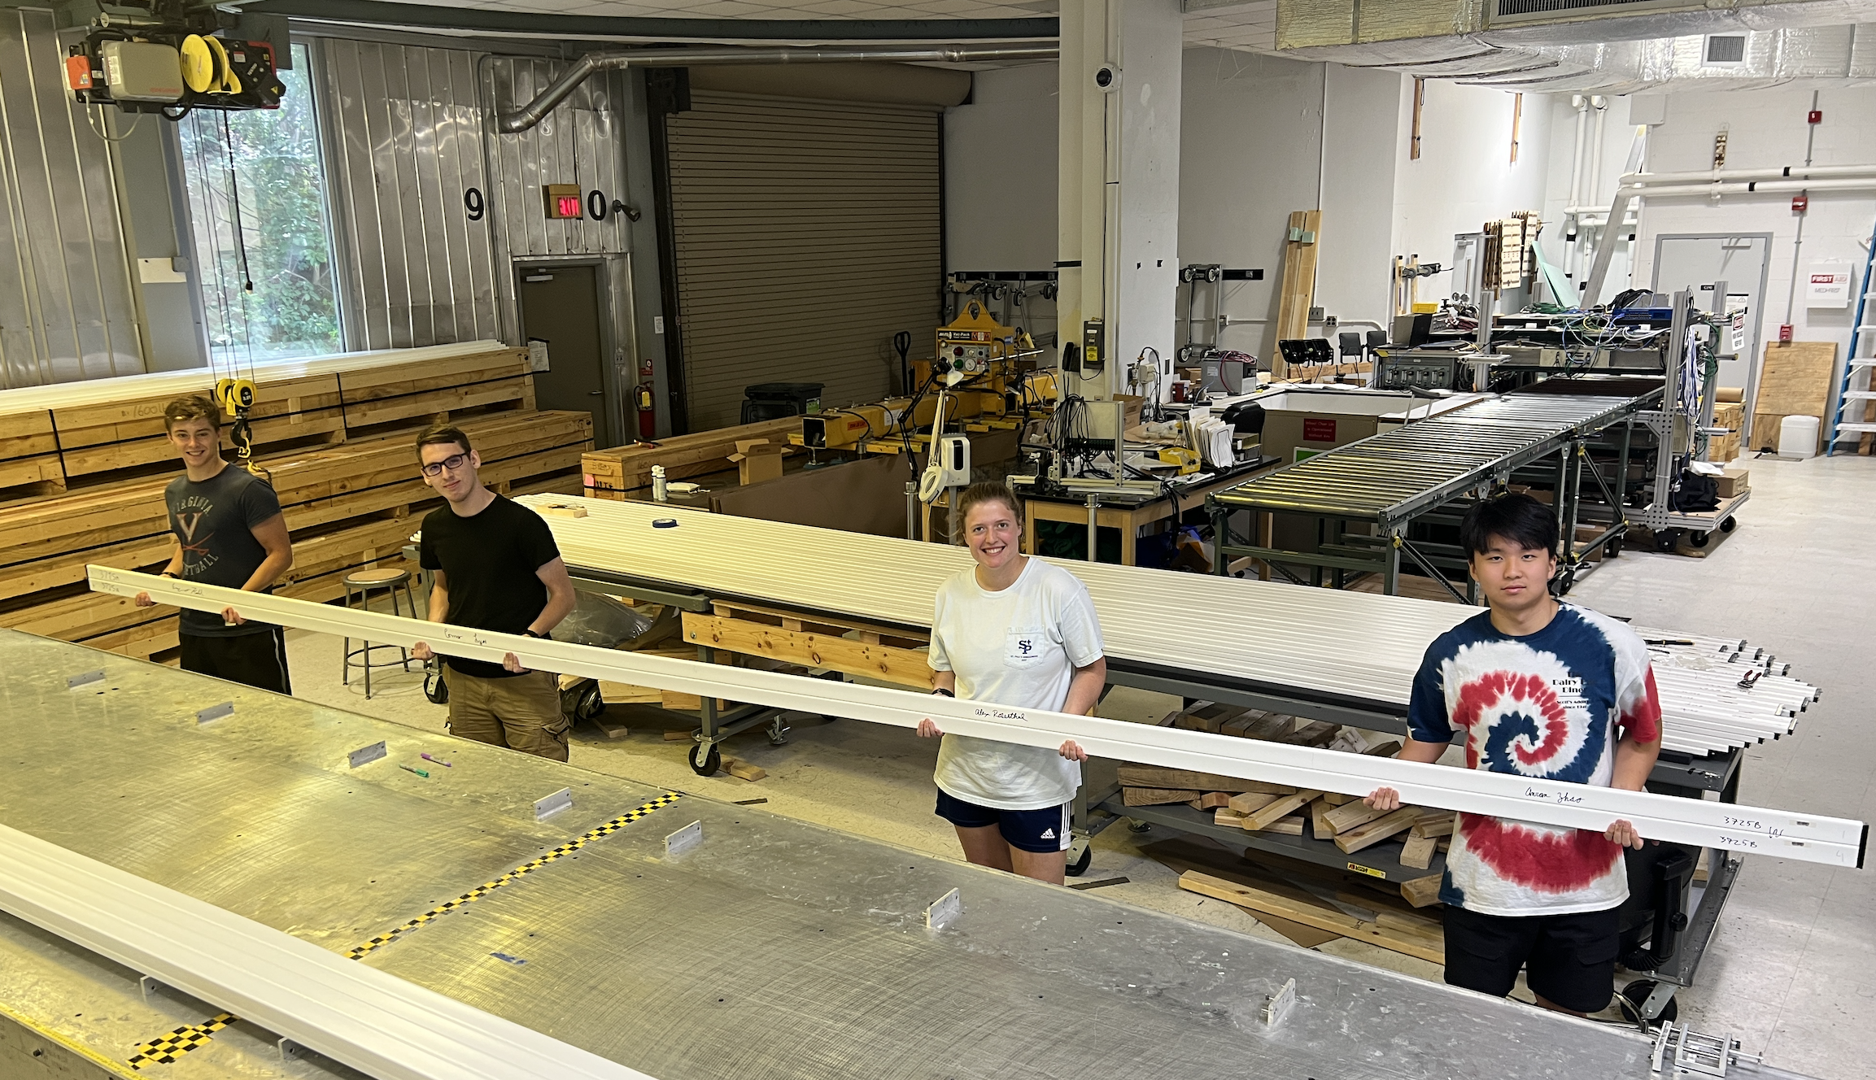
CRV Summer 2022

Slide 39
Other Recent Achivements…
Accelerator:
Recently delivered protons to diagnostic absorber (just upstream of production target).
Solenoids:
All coils for PS and TS are fabricated.
Cold mass fabricated for TS.
Everything else under construction.
Targets:
Production and stopping targets assembled.

Slide 40

Sensitivity Goal
X10000 improvement over current best limit!
How???
Improved efficiency for producing and stopping muons
  Production target in gradient field* (magnetic mirror)
  Mu2e will stop ~10 billion muons per second!
  Expect to stop ~20 muons per 10,000 proton on target.
Reduced backgrounds and detector occupancy due to pulsed beam
Keep backgrounds small!
* Djilkibaev, Lobashev et al.

Slide 41
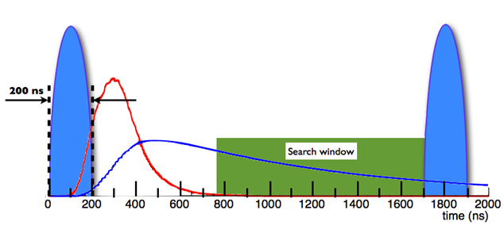
How to get 4 orders of magnitude
We have the best accelerator setup in the world for this measurement! Ideal pulse spacing…
Pulsed beam:
  beam on target – produce and stop muons (detector blinded)
  observe stopped muon decays
(μ lifetime in 1s orbit of AL ~864 ns)
Muon arrival at stopping target
Muon decays and capture
Extinction level of 10⁻¹⁰ between bunches is crucial!
(Removes ‘prompt’ backgrounds!)

Slide 42
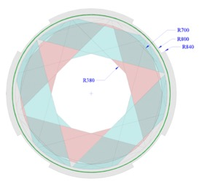
How to get 4 orders of magnitude
Muon decay in orbit spectrum for ²⁷Al
Escape
through center
of Tracker
Fully
fiducial
  → Straw tracker designed such that no acceptance for lower-energy electrons from muon decay in orbit.

Slide 43
Run 1 Sensitivity Estimate
Recently completed a sensitivity
estimate for Run 1:
5σ discovery R = 1.1 x 10⁻¹⁵
90% CL R < 5.9 x 10⁻¹⁶
1000x better than SINDRUM-II
Paper to be submitted to Universe
Total background:
0.11 +- 0.03 (stat.+syst.) events
cosmics = 0.05 +- 0.01 events
DIO = 0.04 +- 0.02 events
Long DIO tail due to
nuclear recoil
Conversion momentum shifted due to material interactions

Slide 44
Mu2e Timeline
Detector commissioning through late 2024.
Take Run 1 data in 2025 and 2026 until LBNF/PIP-II shutdown.
x1000 improvement over SINDRUM-II.
Resume data collection in 2029 after long shutdown.

Slide 45
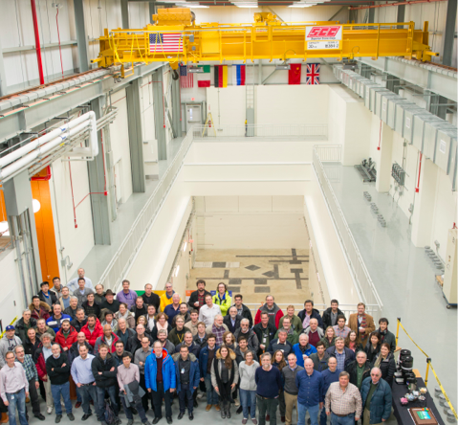
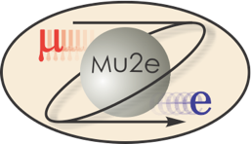




The Mu2e Collaboration
Mu2e Collaboration, November 2013
~160 People, 32 Institutions, 4 Countries

Slide 46
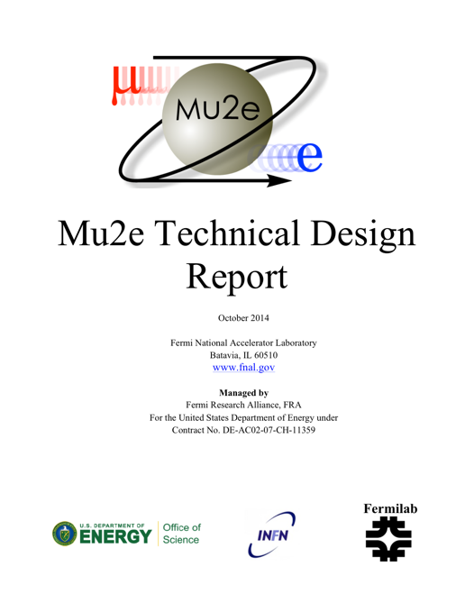
Additional information
Technical Design Report
Experiment web site
arXiv.org > physics > arXiv:1501.05241
  http://mu2e.fnal.gov

Slide 47
Summary
Muon physics may well reveal a sign of exotic physics!
In Run 1, Mu2e will improve sensitivity by 3 orders-of-magnitude relative to past CLFV searches.
Mu2e will provide complementary information relative to the LHC and is sensitive to mass scales many orders of magnitude higher than can be directly probed at colliders.
Much recent progress, and hoping for a discovery in 2026!

Slide 48
Thank you

Slide 49
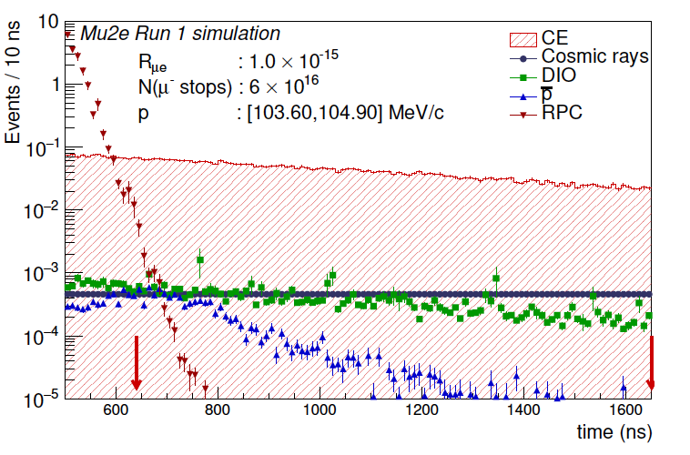
Run 1 Sensitivity Estimate
Recently completed a sensitivity
estimate for Run 1:
5σ discovery R = 1.1 x 10⁻¹⁵
90% CL R < 5.9 x 10⁻¹⁶
1000x better than SINDRUM-II
Paper to be submitted to Universe
Total background:
0.11 +- 0.03 (stat.+syst.) events
cosmics = 0.05 +- 0.01 events
DIO = 0.04 +- 0.02 events

Slide 50
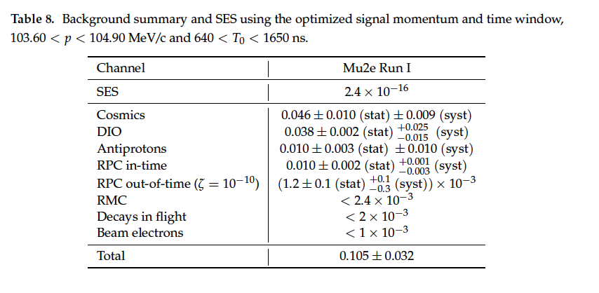
Backgrounds
Background counts expected with 6x10¹⁶ stopped muons.

Slide 51
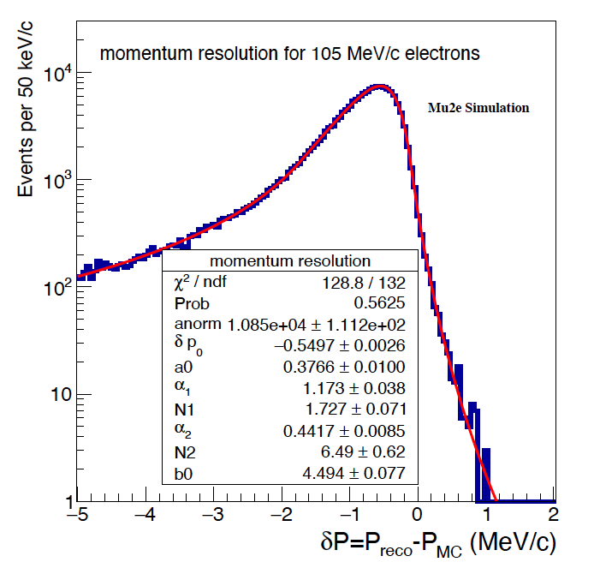
Tracker Performance
Meets all physics requirements
Total efficiency 9.2%
  mostly acceptance
Resolution ~120 keV
Robust against rate increases
Low end is energy loss (lowers efficiency)
High end tail smears DIO into signal region

Slide 52
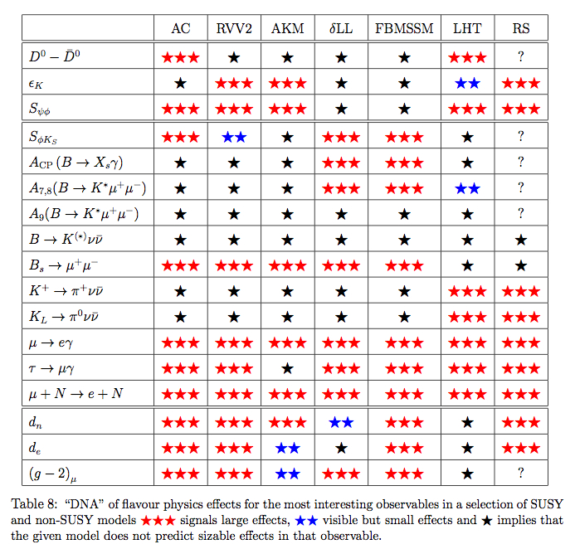
Why this Experiment
It can happen in many New Physics scenarios
W. Altmannshofer, A.J.Buras, S.Gori, P.Paradisi, D.M.Straub
arXiv:0909.1333

