Slide 1



The
Outcome of the
ESSνSB Design Study
2018-2022
A report at the NuFact2022 Workshop on
the achievements of the ESSνSB Design Study 2018-2022

Slide 2
ESSnuSB Design Study ESSνSB January 2018 - March 2022
EU application
submitted in 2017
3 M€ granted for
the period 2018-2022
All results published
in an ESSnuSB CDR
On 6 June 2022
More information on the ESSnuSB site:
http://essnusb.eu/

Slide 3

CDR published on arXive 6 June 2022:
https://arxiv.org/abs/2206.01208
To appear in European Physical Journal
CDR outline:
1. Linac upgrade
2. An accumulator ring
3. A target station and 50 m decay tunnel
4. A near detector placed in the neutrino beam some 250 m downstream of the target statio
5. A far detector 360 km from the target station consisting of 2 large underground tansk filled each with 240’000 m³ of water
6. Physics performance
The European Spallation Source neutrino Super Beam
White Paper to be submitted to the Snowmass 2021
USA Particle Physics Community Planning Exercise
arXiv:2203.08803v1 [physics.acc-ph] 15 Mar 2022
https://arxiv.org/abs/2203.08803

Slide 4
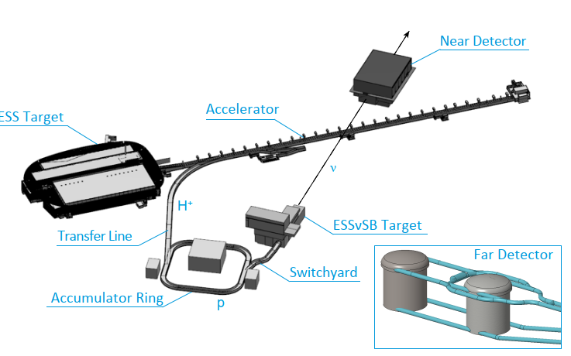
ESSnuSB lay-out

Slide 5
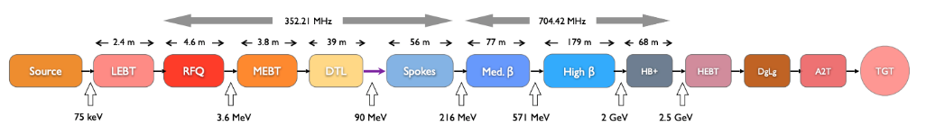
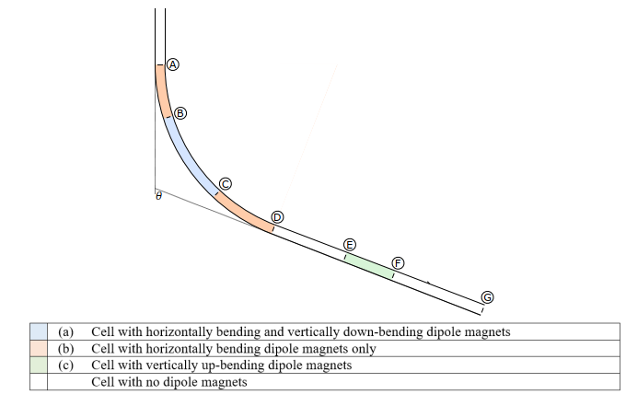
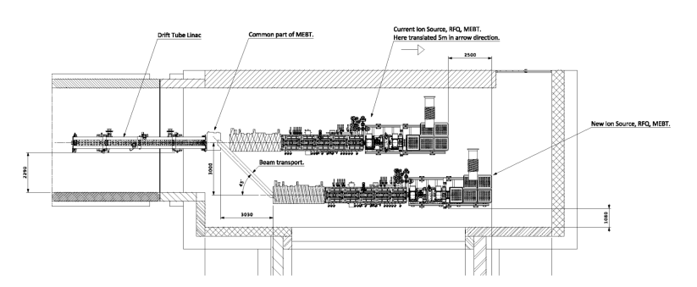
The ESS linac
2.86 ms pulses at 14 Hz pulse frequency increase to 28 Hz, implying an increase of the beam power from 5 MW to 10 MW
Transfer Line to Accumulator
ESSnuSB addition
H⁻
p
ESSnuSB addition
The linac
Normalconducting part
Superconducting part
The merging of the H+ and the H- beams in the MEBT
Transfer Line with bending limited by H⁻ Lorenz stripping

Slide 6
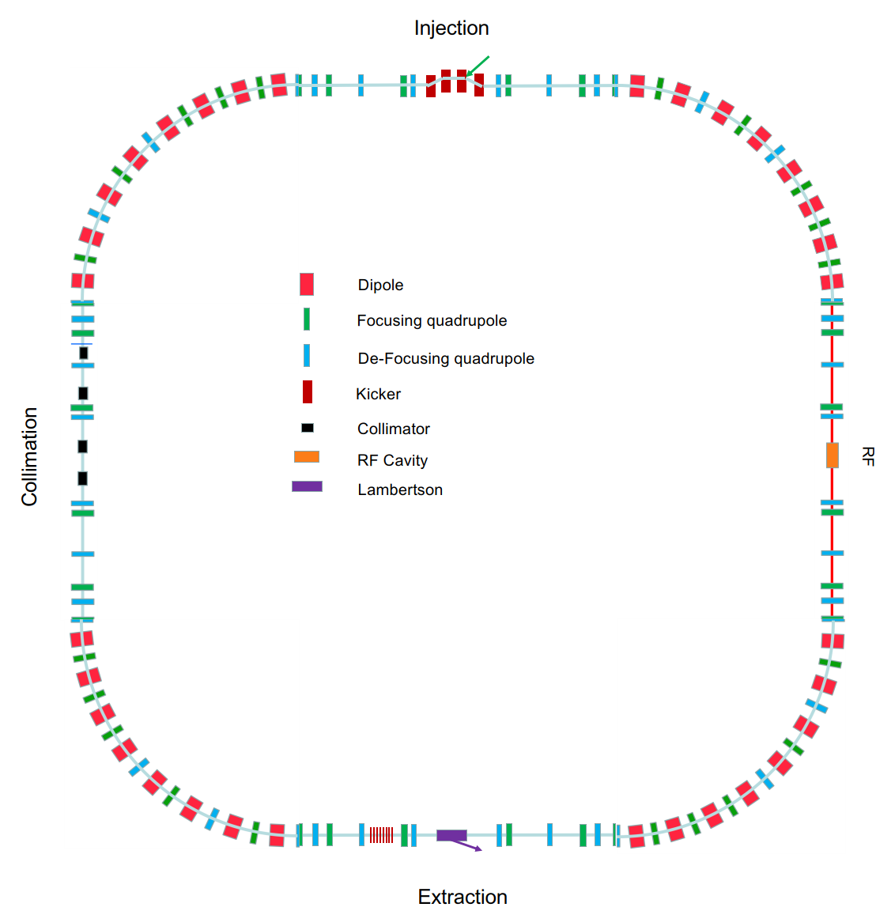
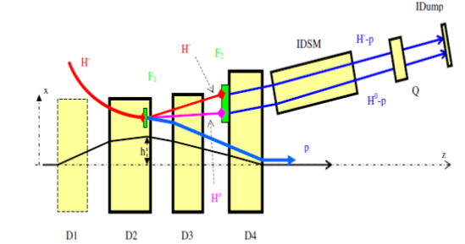
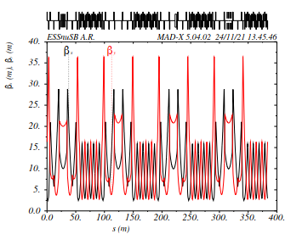
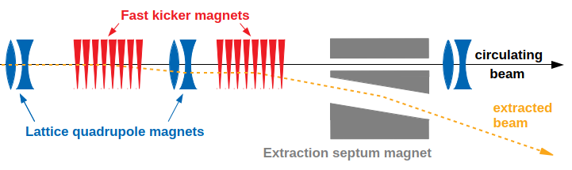
The Accmulator ring
Injection with H- stripping
β funcion
around
the ring
Extraction

Slide 7
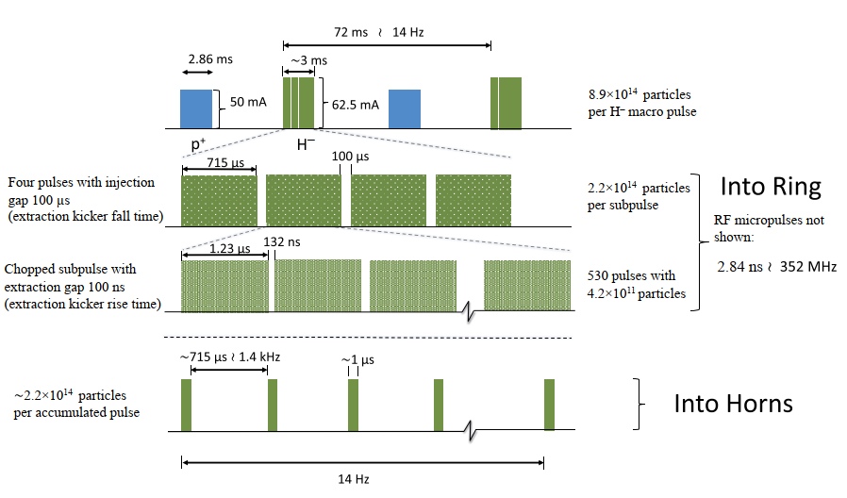
Detailed schematic of the ESSνSB pulsing scheme

Slide 8
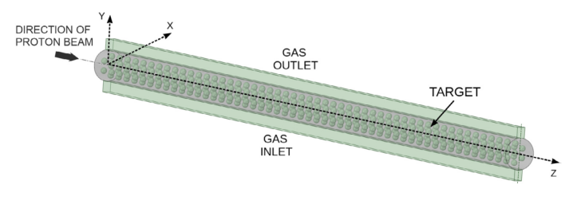
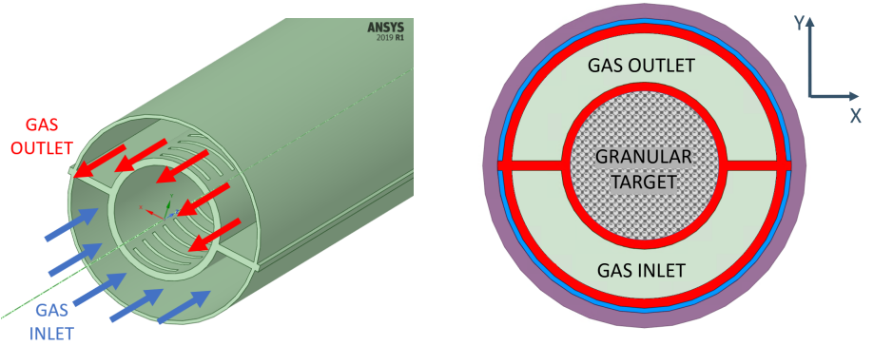
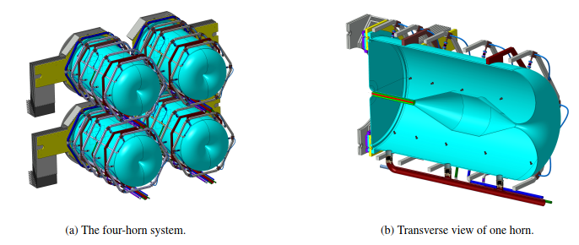
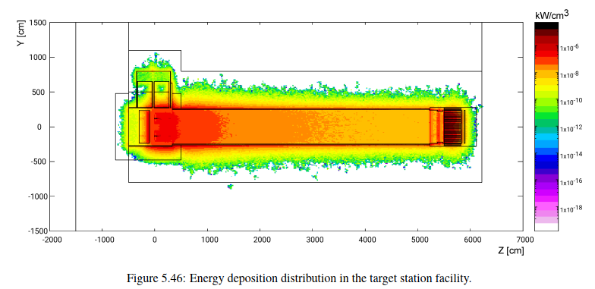
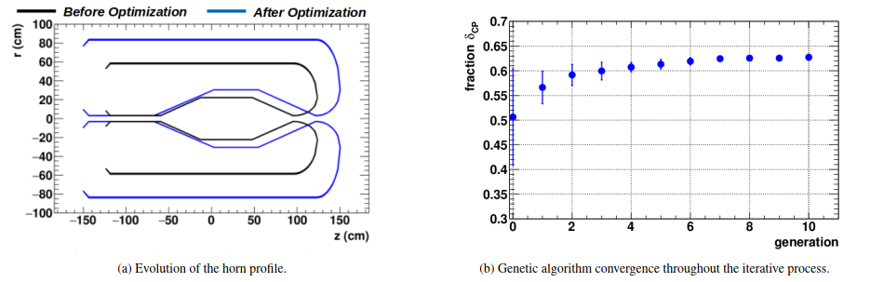
Beam switch-yard and the target station

Slide 9
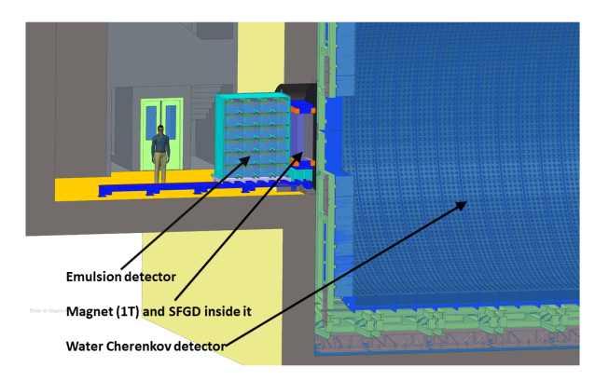
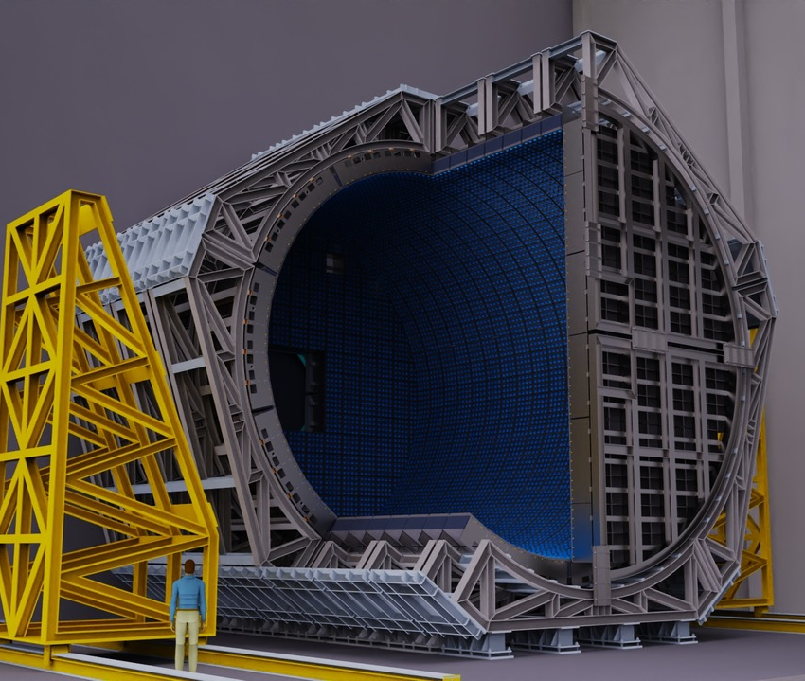
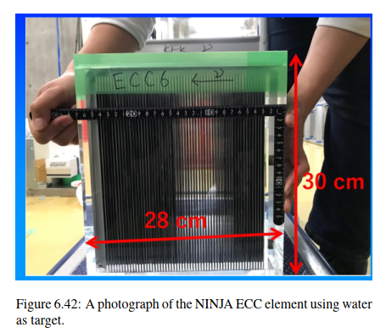
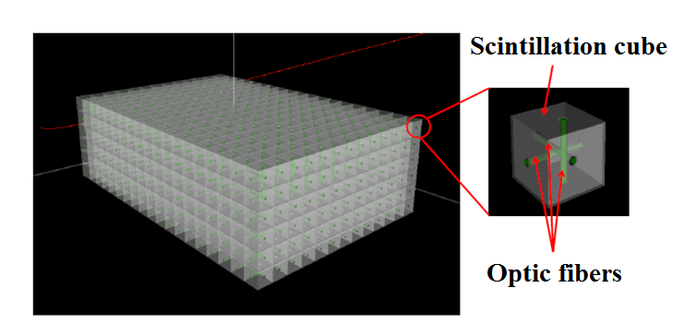
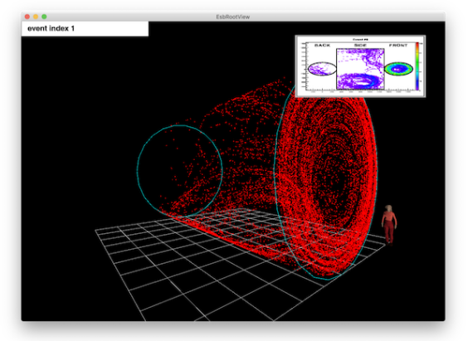
The Near Detector
Near Detector underground station
The super Fine-Grained Detector sFDG

Slide 10
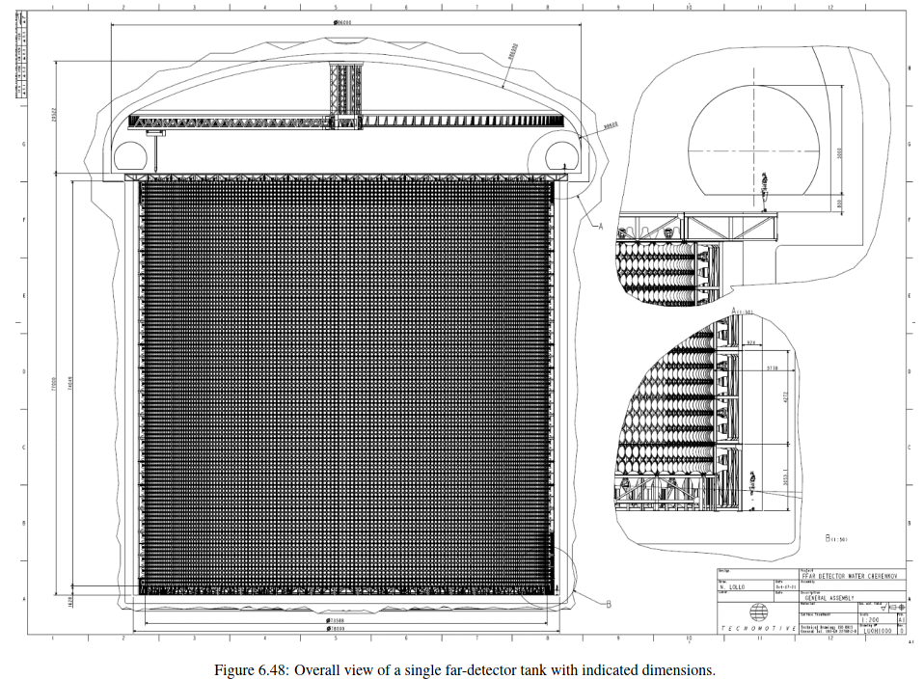
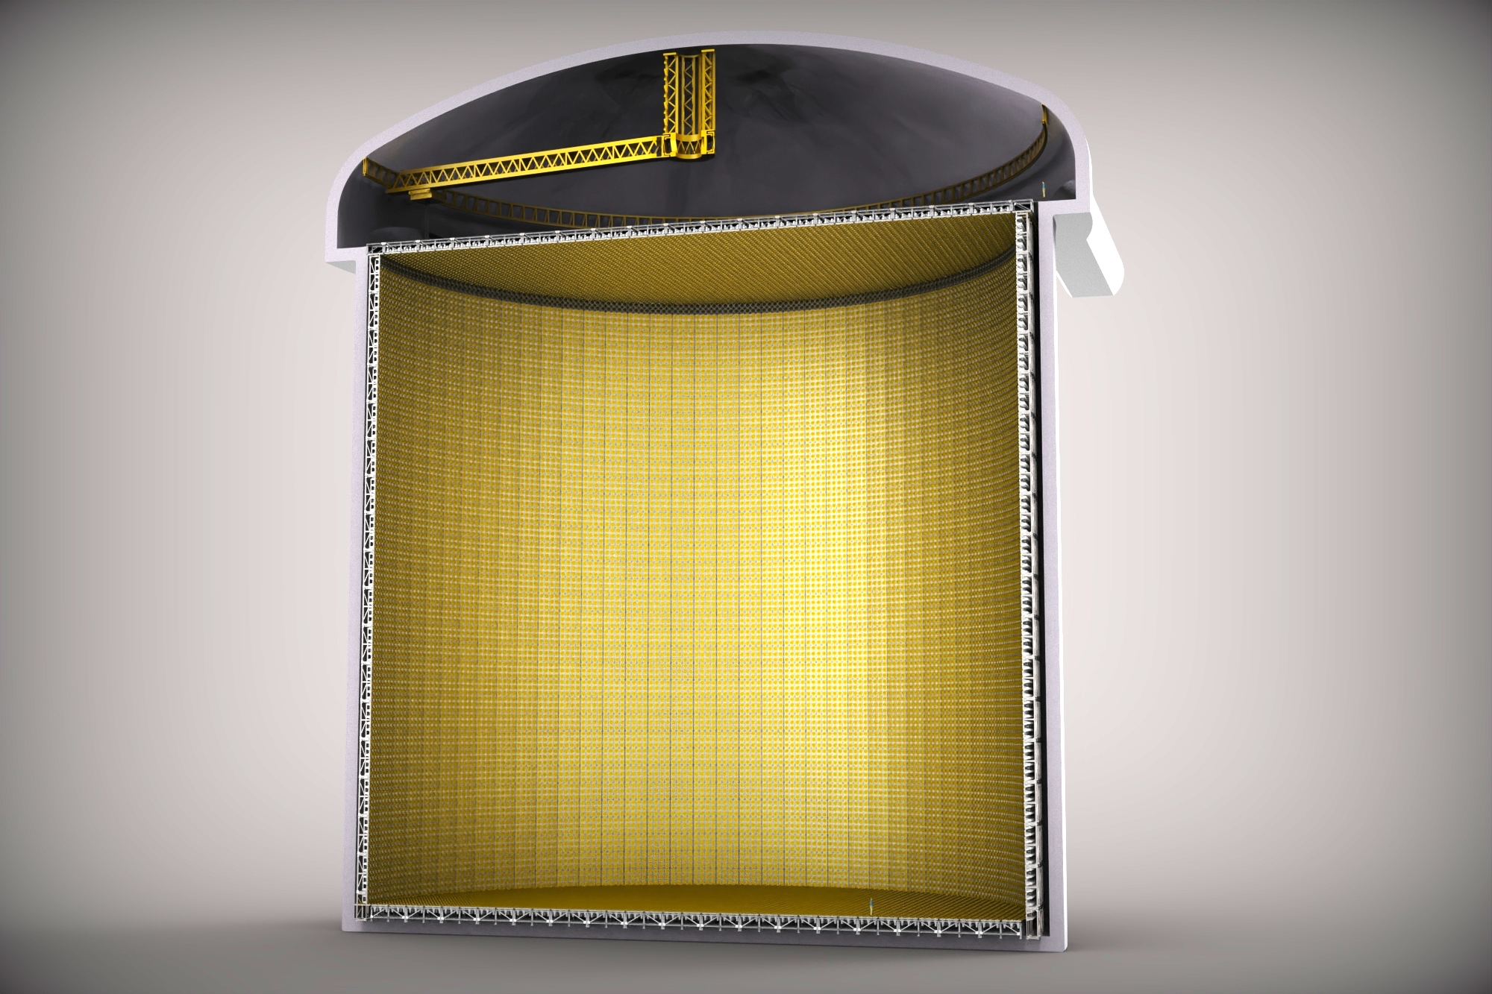
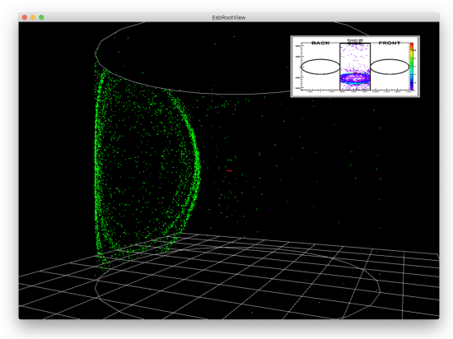
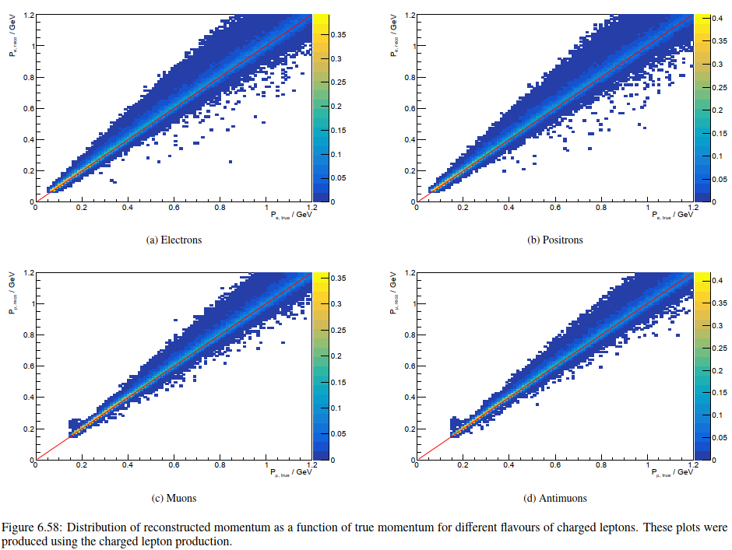
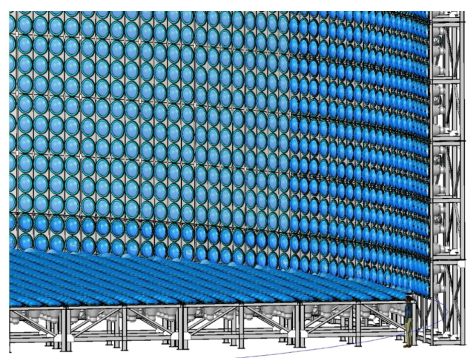
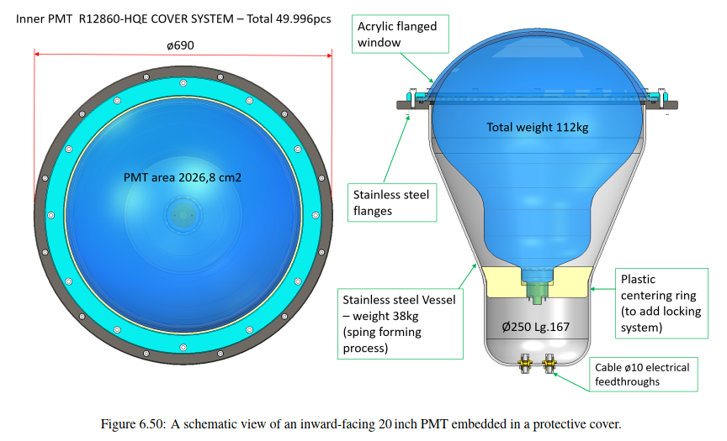
The Far Detector
For Cherenkov imagies in the Far Detector see https://drive.google.com/drive/folders/1DidkJRA05GJtm0vFSqpfpCTAooNWAv22

Slide 11
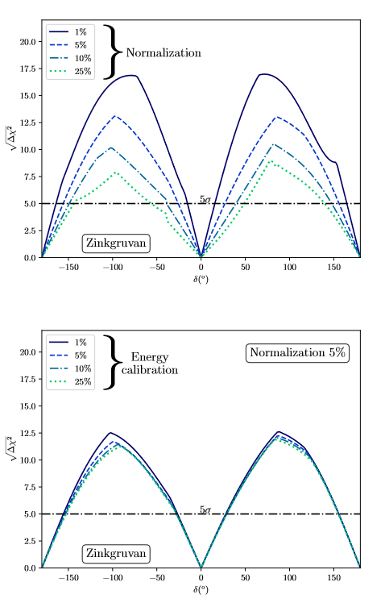
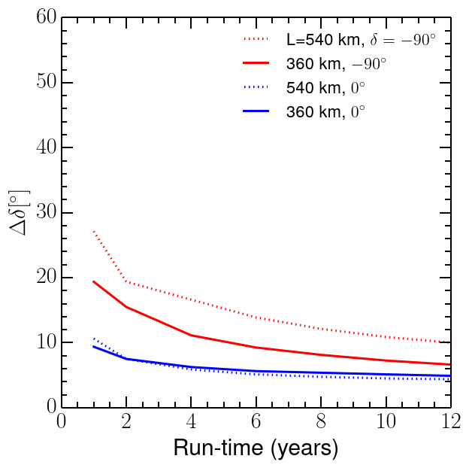
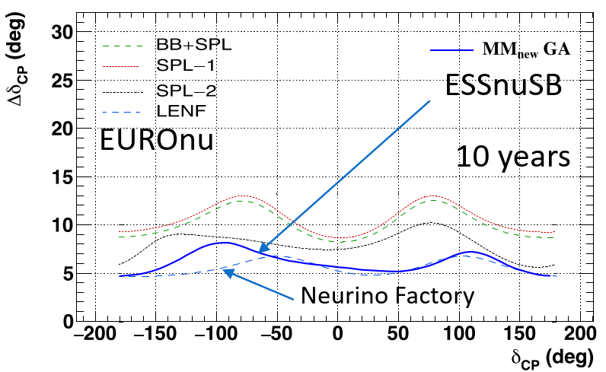
Performance for CPV discovery and δ_{CP} measurement
5%
Discovery potential vs δ_{CP} angle after
10 years with 5% normalization error
providing 70% coverage of all δ_{CP} vaues
Error in δ_{CP} angle vs δ_{CP} angle after
10 years with 5% normalization error
Error in δ_{CP} angle vs run time
with 5% normalization error

Slide 12
ESSnuSB at the second neutrino oscillation maximum
Coverage of the second oscillation maximum
Signal (ν_{e}) and background energy distributions

Slide 13
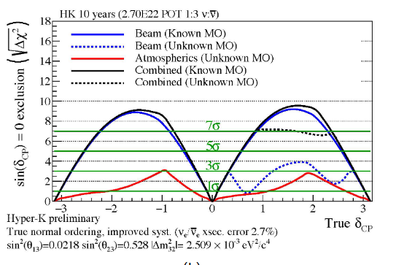
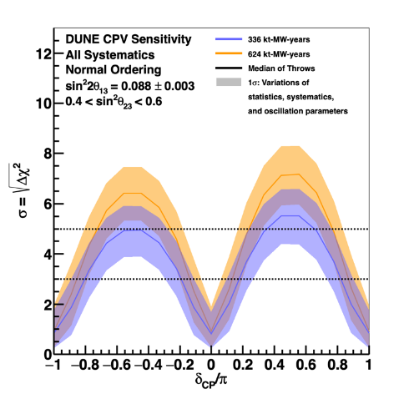
ESSnuSB in the international context – CPV discovery
5%
ESSnuSB March 2022 with 5% normalization error
DUNE Snowmass March 2022
HyperKamokande Snowmass March 2022

Slide 14
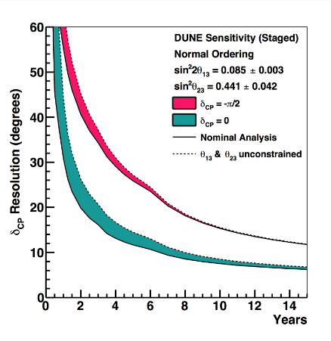
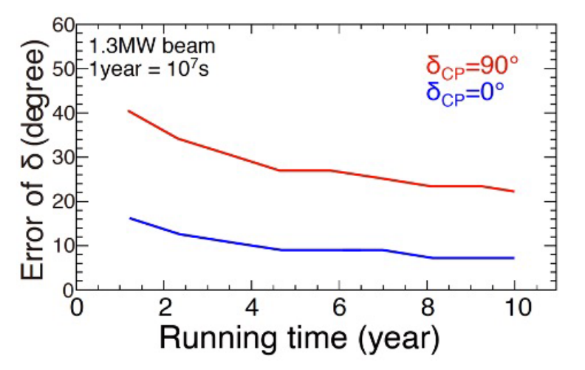
ESSnuSB in the international context – CPV resolution
ESSnuSB March 2022 with 5% normalization error
DUNE Snomass March 2022
HyperKamokandeSnowmass March 2022

Slide 15
ESSnuSB in the international context – precision in δ_{CP}
ESSnuSB 10 years
DUNE 10 years yellow curve
HyperKamiokande 10 years

Slide 16
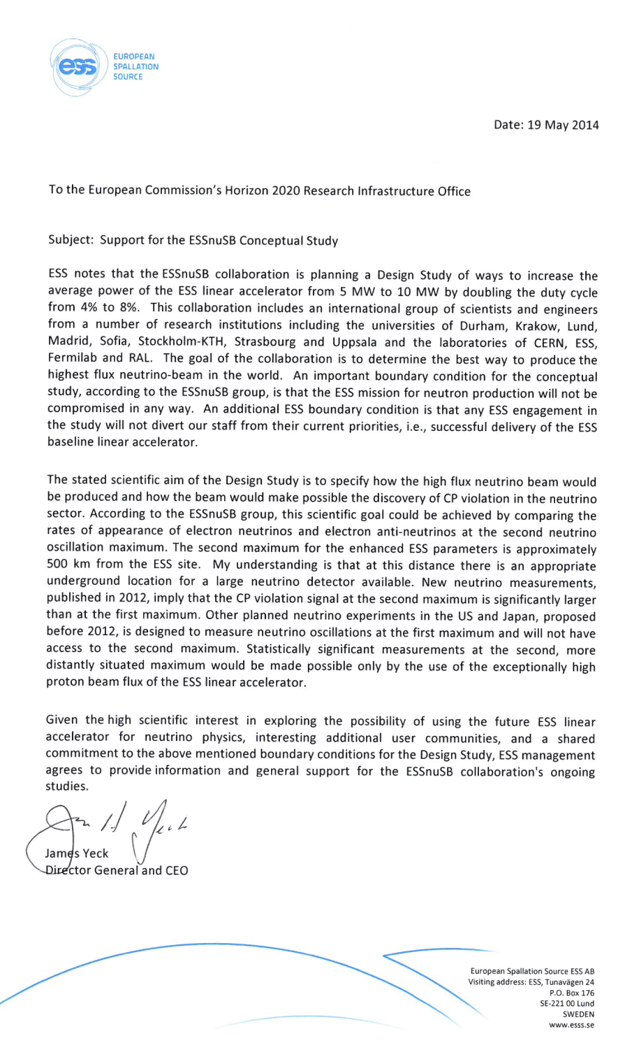
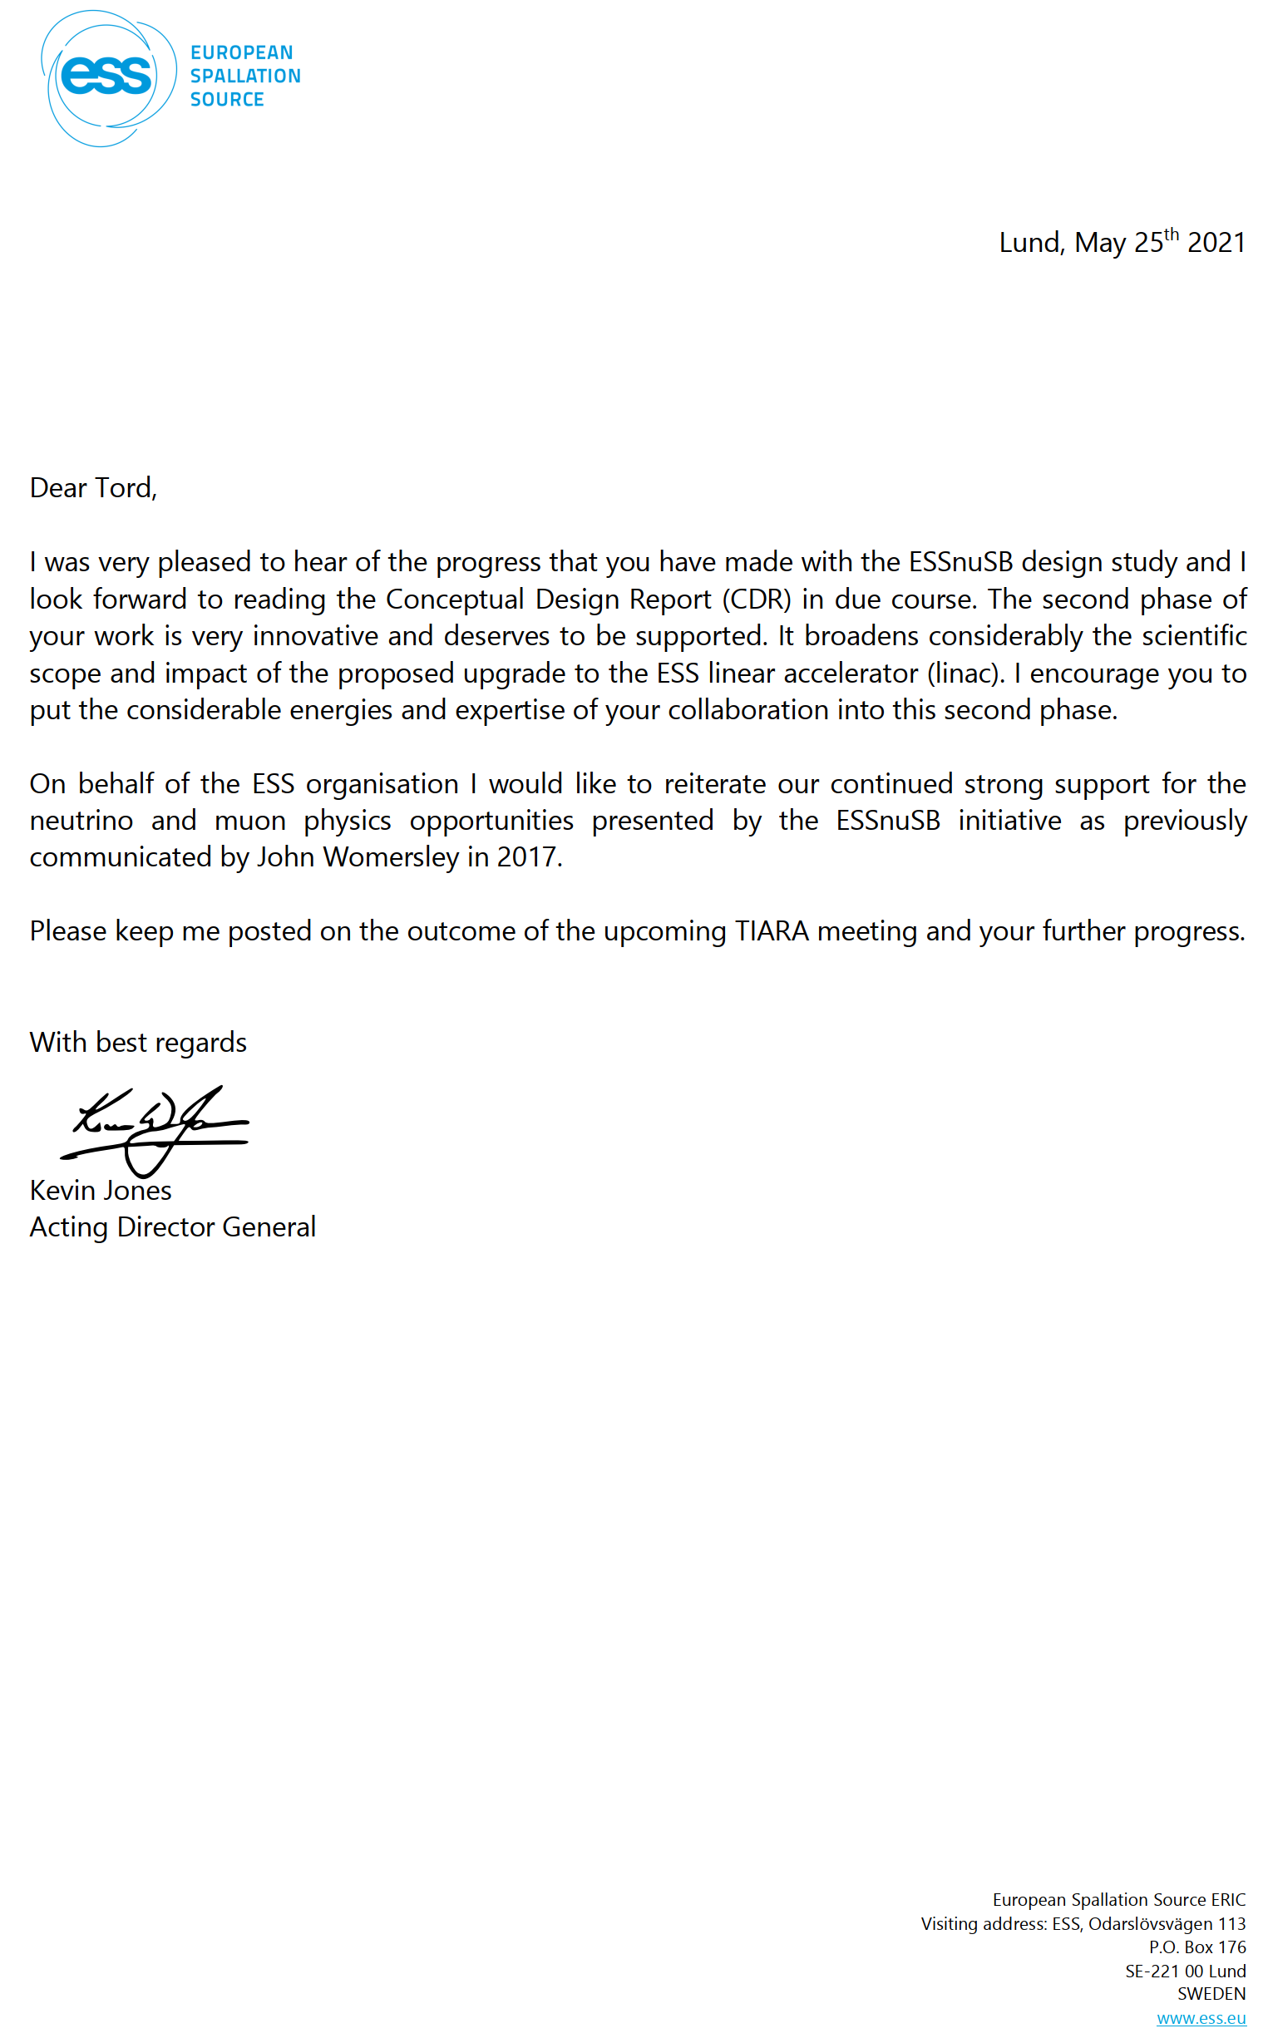
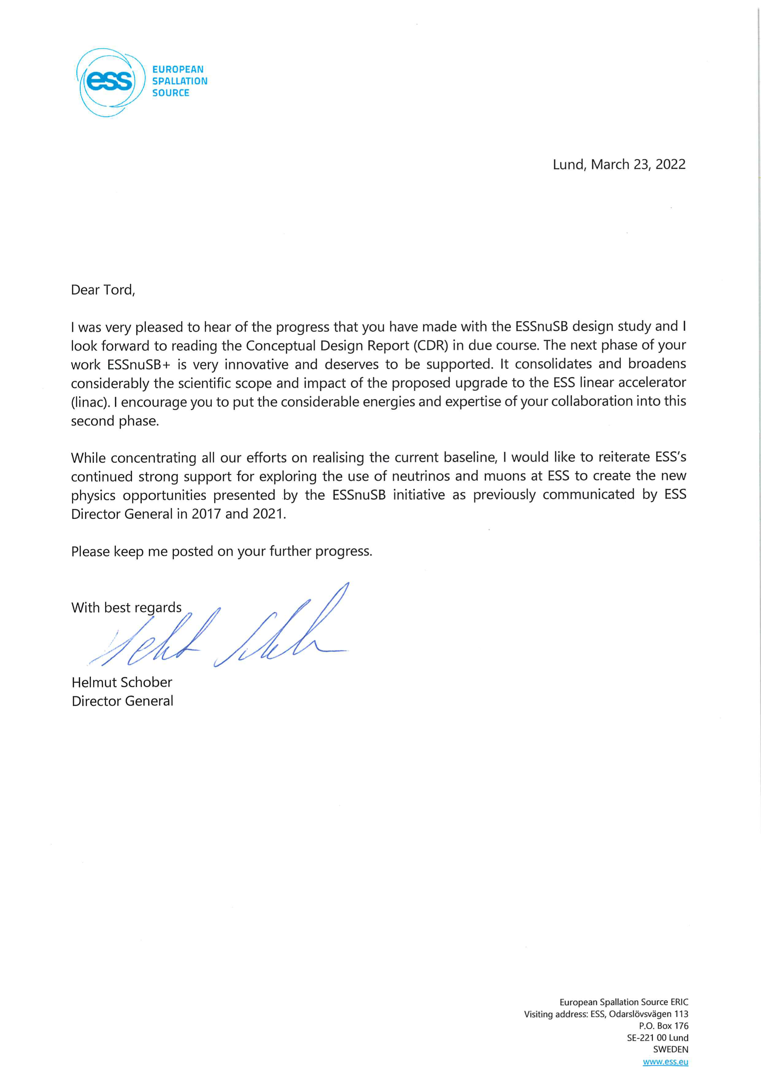
ESSnuSB support letters from 4 ESS Director Generals:
Jim Jeck in 2014
John Womersly in 2017
Kevin Jones in 2021
Helmut Schober in 2022
Helmut Schober: ”I would like to reiterate ESS’s continued strong support for exploring the use of neutrinos and muopns
at ESS to create the new physics opportunities by the ESSnuSB initiative as previousely communicated by ESS Director
Generals in 2014- 2021.”

Slide 17
European Particle Physics Strategy
Conclusions:
"The design studies for next-generation long-baseline neutrino facilities should continue. "
"The first priority is the completion of the programme of measurements of the oscillation parameters, most notably the CP-violating phase of the mixing matrix and the neutrino mass ordering."
"Future European facilities such as FAIR, NICA and ESS envisage research programmes that are of interest to particle physics."
"The European particle physics community should work with the European Commission to shape and establish the funding instruments that are required for the realisation of common R&D projects, e.g. in the Horizon Europe programme."
"A roadmap should prioritise the technology, taking into account synergies with international partners and other communities such as photon and neutron sources, fusion energy and industry."

Slide 18
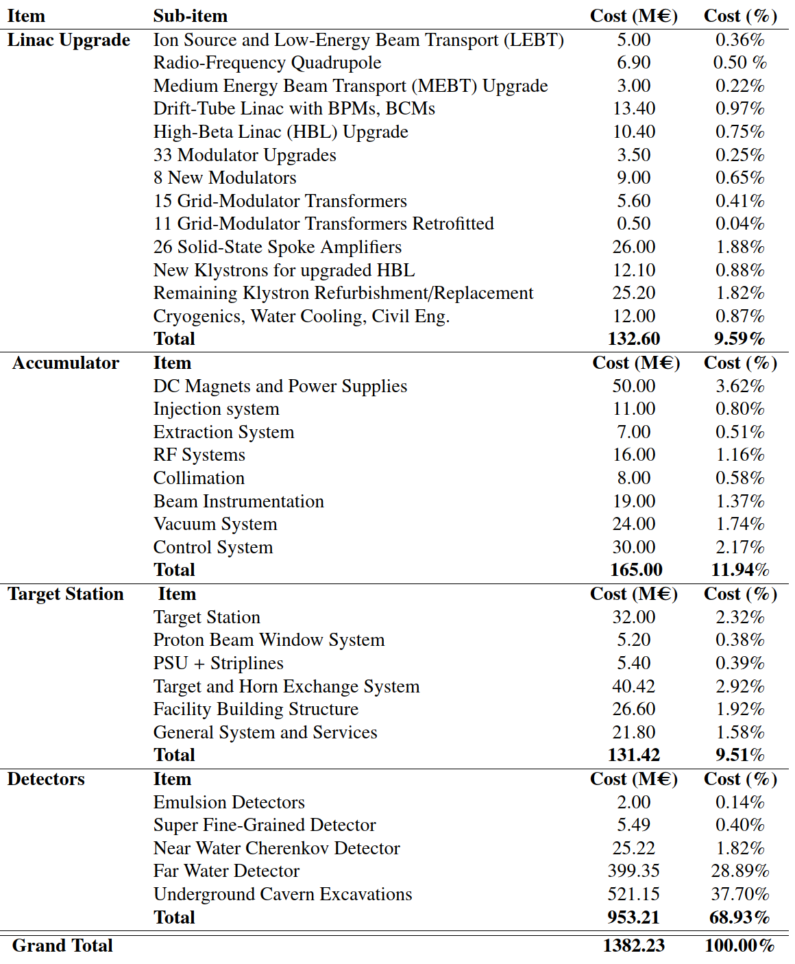
ESSnuSB Cost Esimate
1’382 M€
The cost of civil engineering on the ESS site is not included.
A cost estimate of the civil engineering will require a detailed study of the implementation of the components on the ESS site, that will be made only in the next phase of the study.

Slide 19
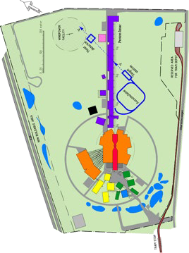
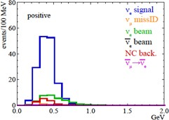












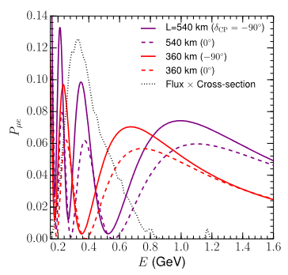








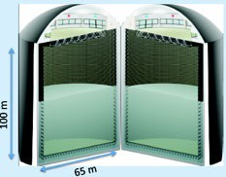

Schedule for a 2nd generation
ESS-based neutrino Super Beam ESSnuSB
2036-:
Start of data taking
2029-2035:
2027-2028:
Construction of the facility and detectors, including commissioning
2023-2026:
Continuation of Design Study, final costing and an TDR to ESFRI
Preconstructi on Phase, International Agreements
2022: End of ESSνSB
Design Study,
preliminary costing and CDR
2018:
Beginning of ESSνSB
Design
Study (EU- H2020)
2016-2019:
Beginning of COST
Action EuroNuNet
2012:
Inception of the project
Nucl. Phys. B 885 (2014) 127
19

Slide 20
Thank you

