Slide 1
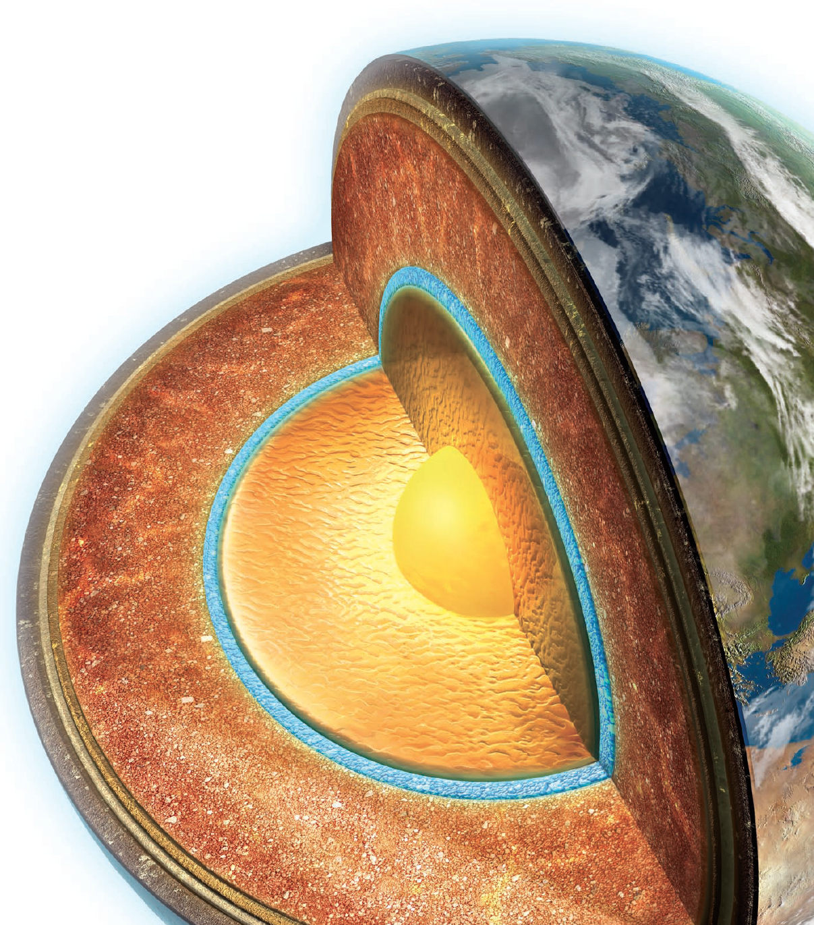
Chemical composition and hydrogen content inside Earth
Kei Hirose
Univ. Tokyo / ELSI-Tokyo Tech

Slide 2

Contents
Mantle composition
– Is the lower mantle different in composition from the upper mantle?
– How much H₂O in the transition zone and the lower mantle?
Core composition
– What is the light element composition of the core?
– Is hydrogen major impurity element in the core?

Slide 3
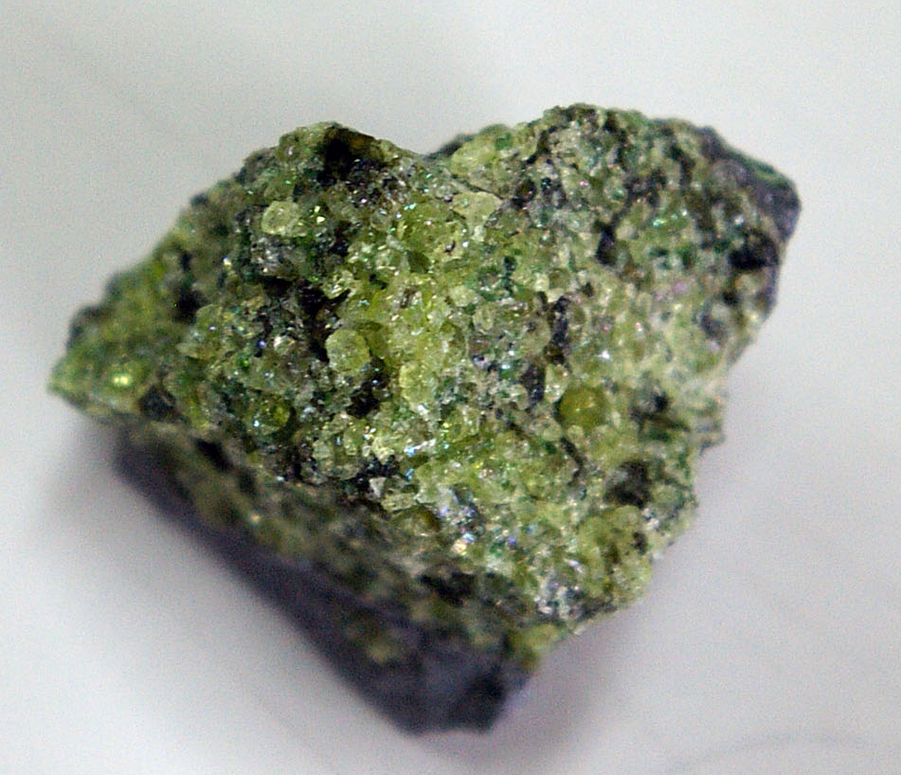
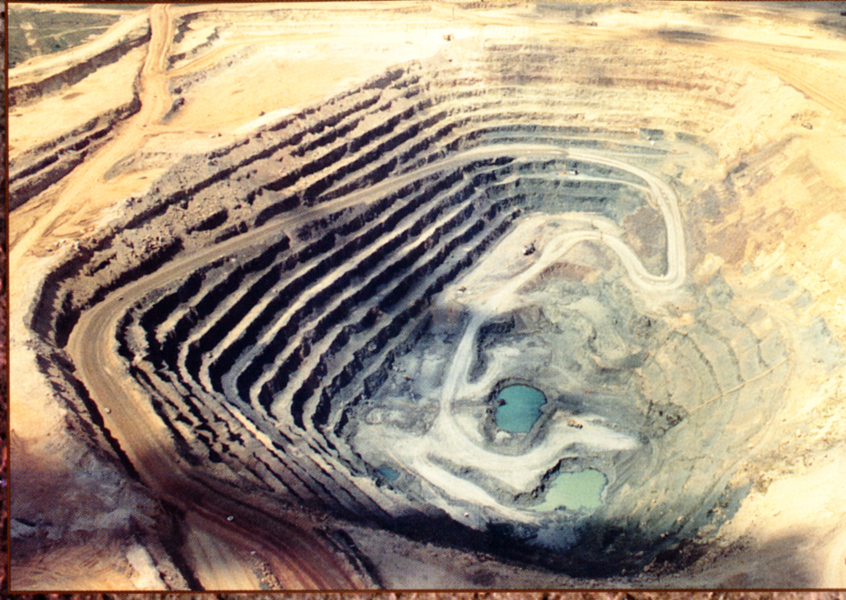
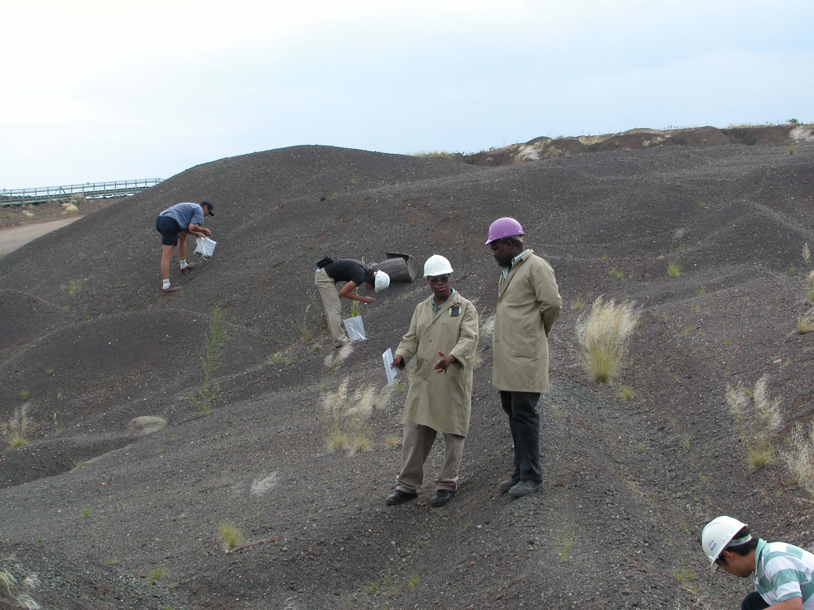
1. Mantle composition
The upper mantle is known to be pyrolitic in composition.
But, we do not have rock samples from the deeper level; transition zone (410–660 km depth) and the lower mantle (>660 km depth).

Slide 4
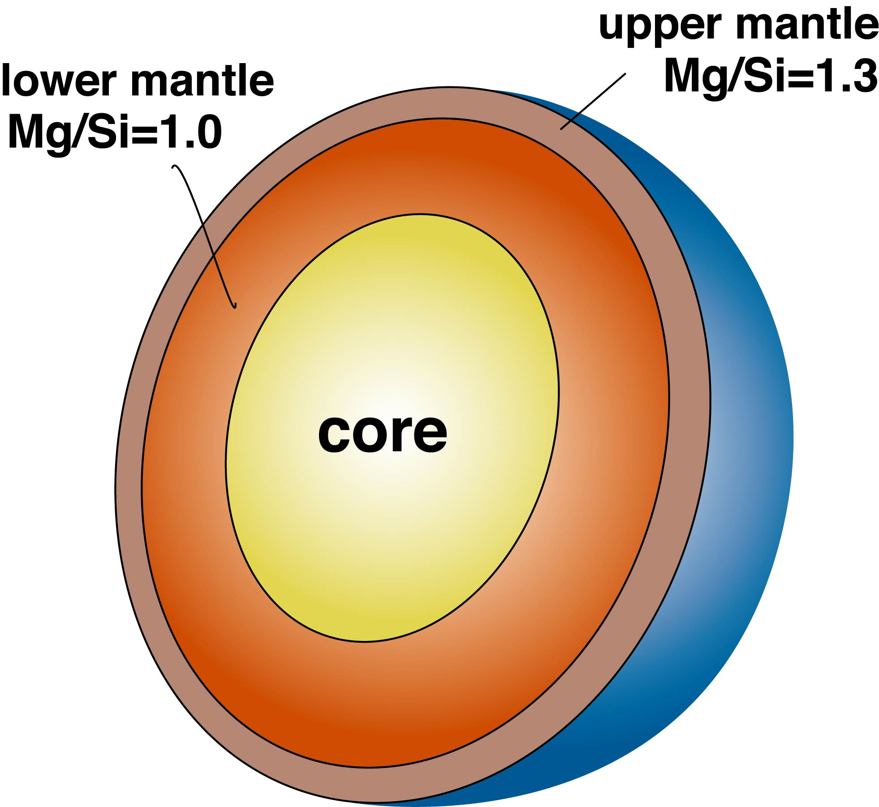
Is the lower mantle different in composition?
“Missing Si problem”
The upper mantle has the higher Mg/Si ratio (~1.3) than the solar composition (~1.1).
Is the lower mantle enriched in Si (Mg/Si ≈ 1.0)?

Slide 5
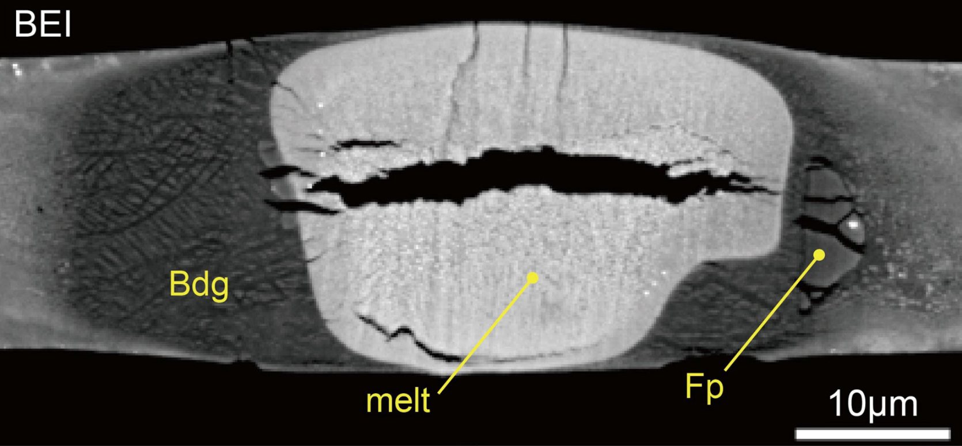
Is the lower mantle different in composition?
Is the lower mantle enriched in Si (Mg/Si ≈ 1.0)?
Possible. Deep magma ocean could have crystallized only MgSiO₃ bridgmanite until >60% crystallization under the lower-mantle pressure range.
A large part of the lower mantle could consist only of MgSiO₃ bridgmanite right after the solidification of a magma ocean.
Caracas et al. (2019 EPSL)

Slide 6
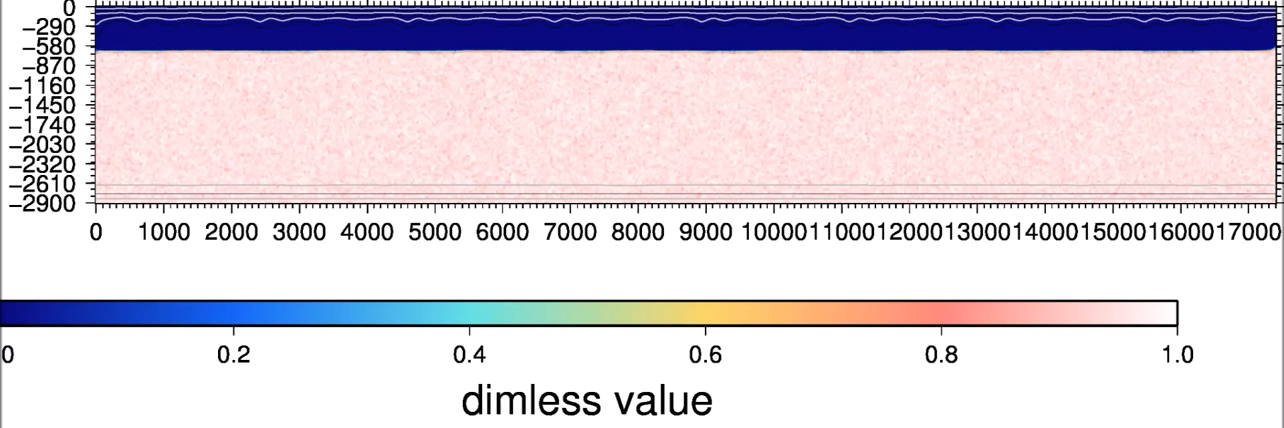
Is the lower mantle different in composition?
The rigid bridgmanite-enriched ancient mantle structure (BEAMS), originally formed upon crystallization of a magma ocean, may be preserved until today.
Ballmer et al. (2017 Nature Geosci.)

Slide 7
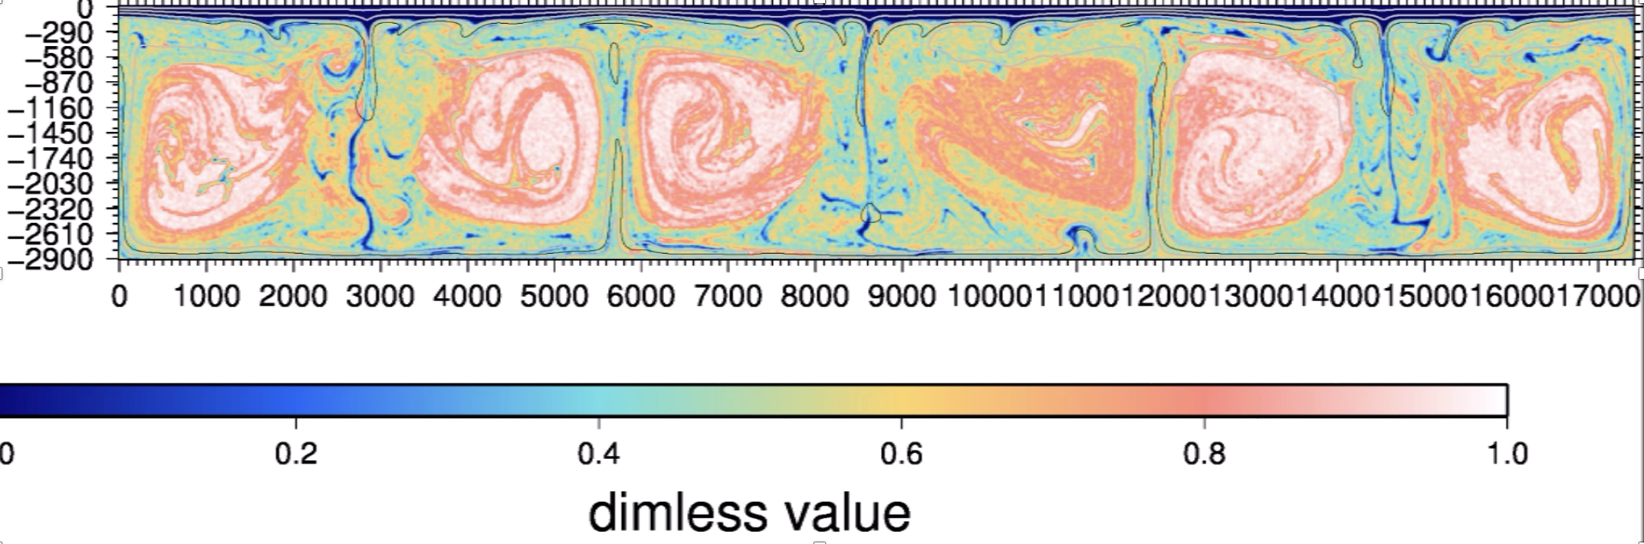
Is the lower mantle different in composition?
The rigid bridgmanite-enriched ancient mantle structure (BEAMS), originally formed upon crystallization of a magma ocean, may be preserved until today.
Ballmer et al. (2017 Nature Geosci.)

Slide 8
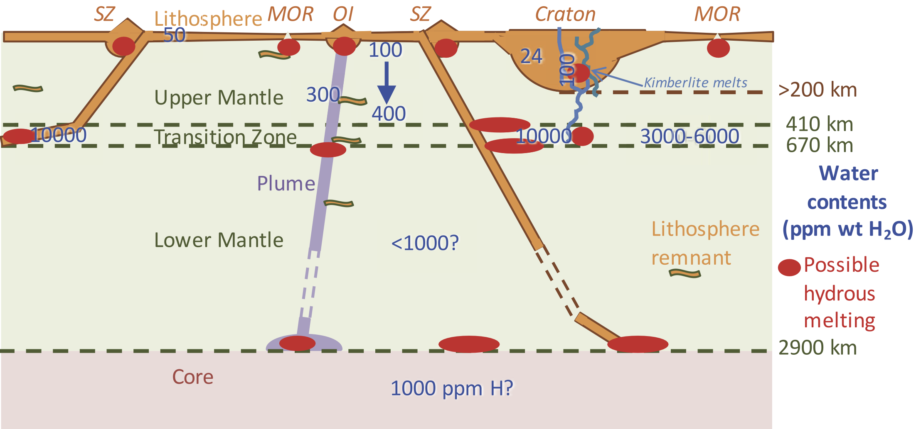
How much H₂O in the deep mantle?
While the upper mantle includes 100–200 ppm H₂O, the transition zone and the lower mantle should contain more H₂O.
Peslier et al. (2017 Space Sci. Rev.)

Slide 9
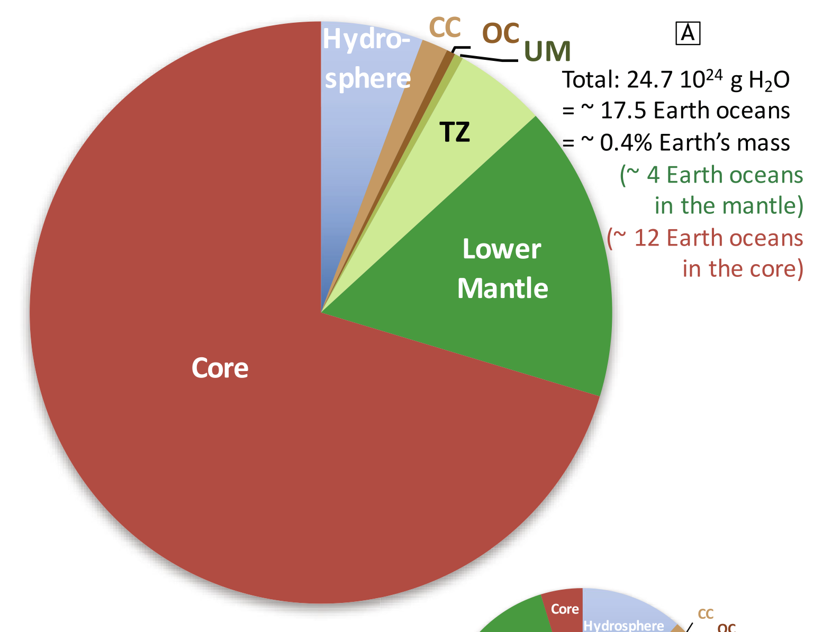
How much H₂O in the deep mantle?
The deep mantle could be relatively enriched in H₂O.
But, the core is likely to be more important H reservoir.
Peslier et al. (2017 Space Sci. Rev.)

Slide 10
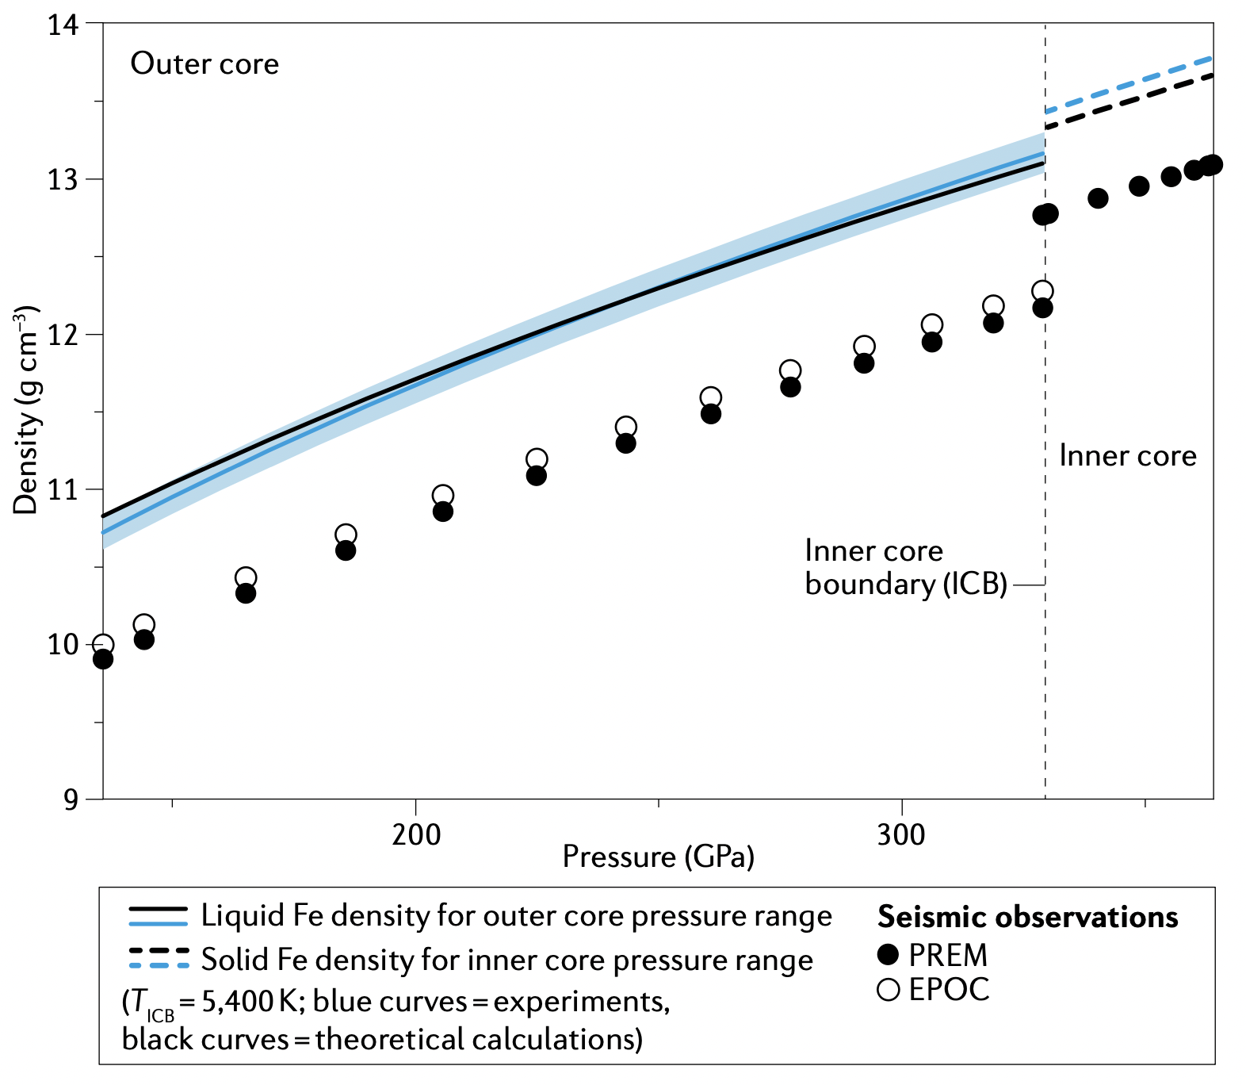
2. Core composition
Solid Fe
The core is not pure Fe nor Fe-Ni alloy.
The outer core includes large amounts of light elements; less dense than Fe by ~8%.
(the liquid outer core constitutes 95% of the entire core by volume)
Inner
core
Liquid Fe
Outer Core
Hirose, Wood & Vočadlo
(2021 Nature Reviews Earth & Environ.)

Slide 11
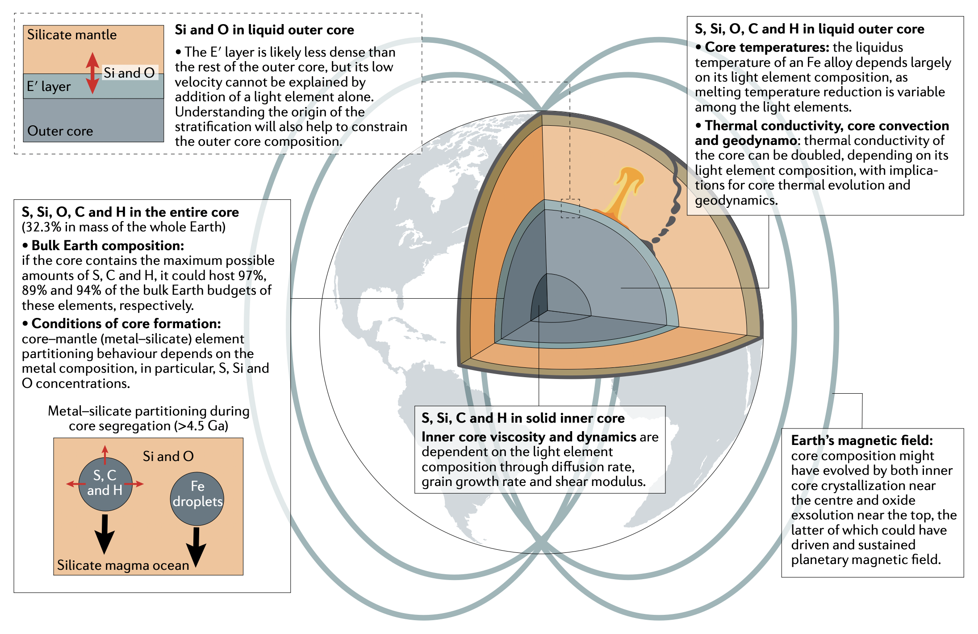
Why do we explore the core composition?
Core structures
Core properties
Bulk Earth composition
Hirose, Wood & Vočadlo,
2021 Nature Reviews Earth & Environ.
Magnetic field
Core formation
Inner core dynamics

Slide 12
Why do we explore the core composition?
It gives 1) core properties; thermal conductivity, viscosity, melting temperature, etc.
Depending on the light element composition,
core thermal conductivity can be doubled. Mechanism of core convection and geodynamo?
estimates of core temperature based on melting temperatures of Fe alloys can change by >1000 K
Present state and evolution of the core

Slide 13
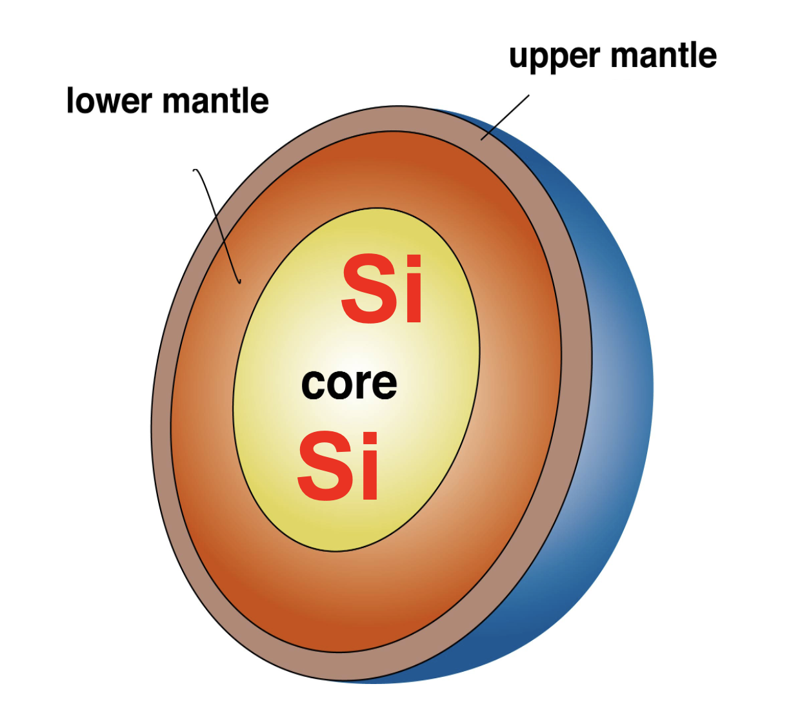
The core composition also gives 2) the bulk Earth composition including the amount of highly volatile elements (H, C, O) & the Mg/Si ratio
When and how much water and organic materials were delivered to the Earth?
Does Si in the core reconcile the bulk Earth Mg/Si ratio with the solar value?
“Missing Si problem”
Origin of the Earth

Slide 14
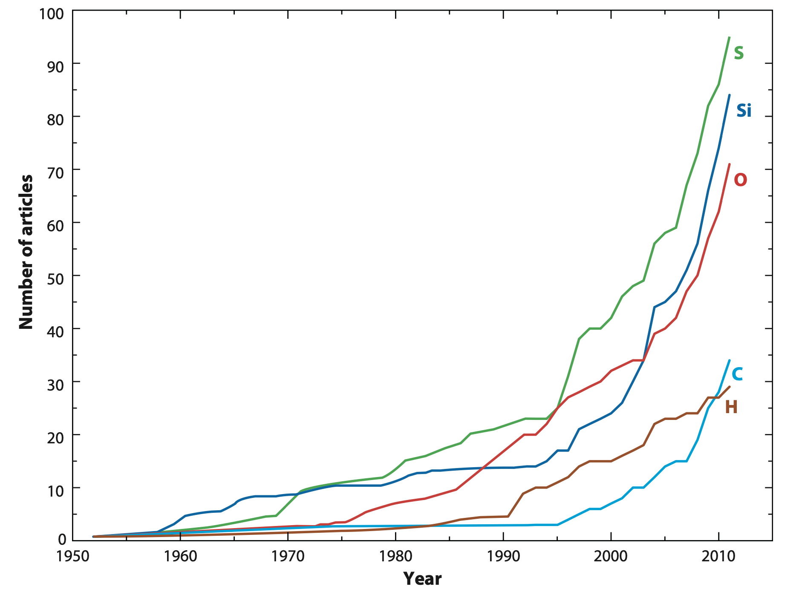
Core light elements unidentified for 70 years
Hirose et al., 2013 Annu. Rev. Earth Planet. Sci
Can we really reveal the core light elements?
Five candidates:
S, Si, O, C, and H

Slide 15
Constraints on core light element composition
Cosmochemical and geochemical estimates:
— Calculated from 1) chondrite & mantle compositions
Five candidates:
S, Si, O, C, and H
Seismological observations:
— Outer core 2) density & 3) V_{P}
— Inner core 4) density, 5) V_{P} & 6) V_{S}
Phase relations:
— 7) Crystallization of solid Fe at the inner core boundary
— 8) Si + O simultaneous solubility limit
Metal-silicate (core-mantle) partitioning:
— 9) Calculated from metal/silicate partition coefficients & BSE abundance
Neutrino observations:
— 10) Z/A ratio

Slide 16
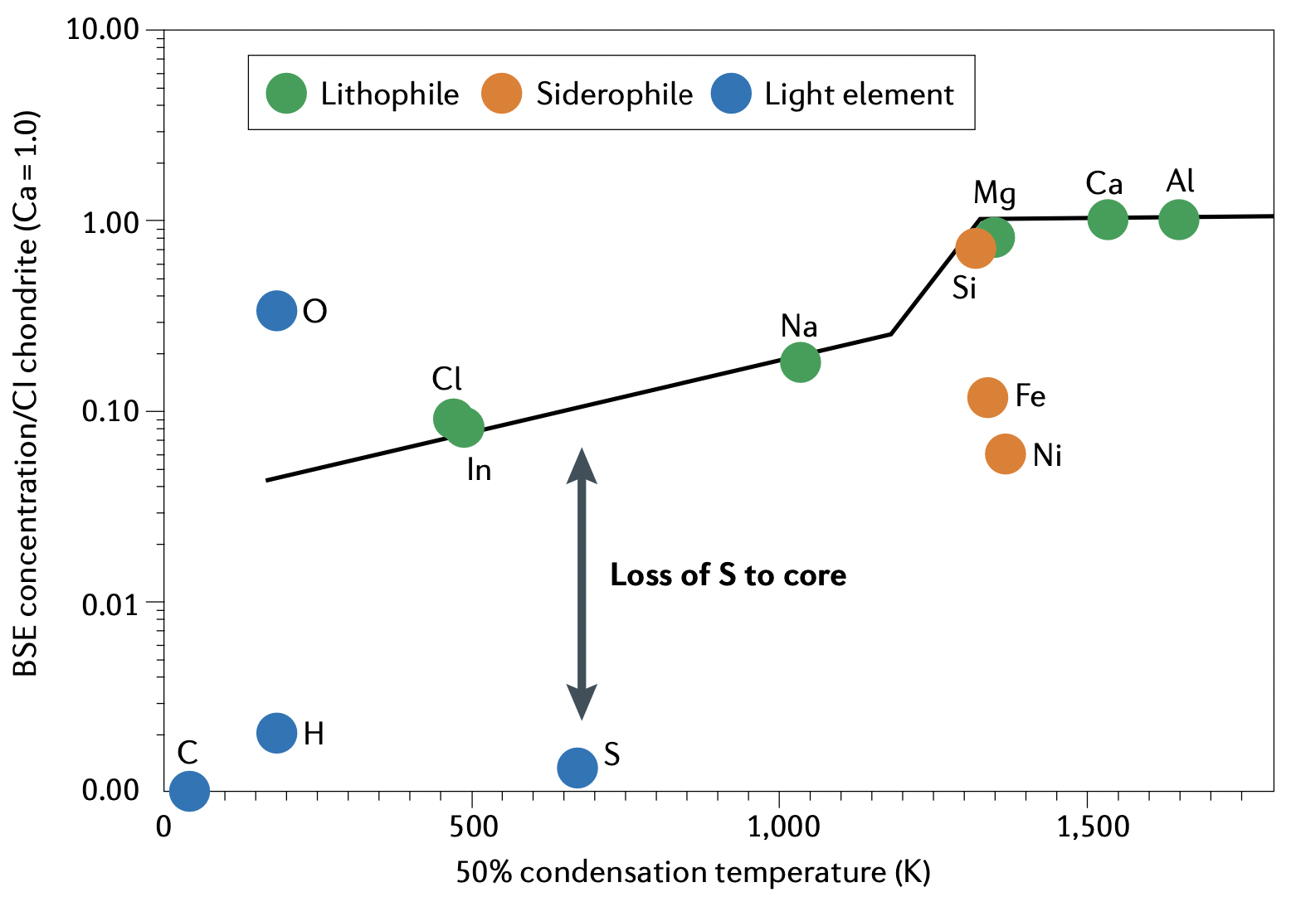
I. Cosmo-/geochemical constraints
We may employ cosmochemical and geochemical estimates of 5 wt% Ni & 1.7 wt% S in the core.
Difficult to estimate the amounts of highly volatile elements; H, C, & O.
bulk Earth abundance
mantle abundance
Hirose, Wood & Vočadlo,
2021 Nature Reviews Earth & Environ.
McDonough, 2014 Treatise Geochem.

Slide 17
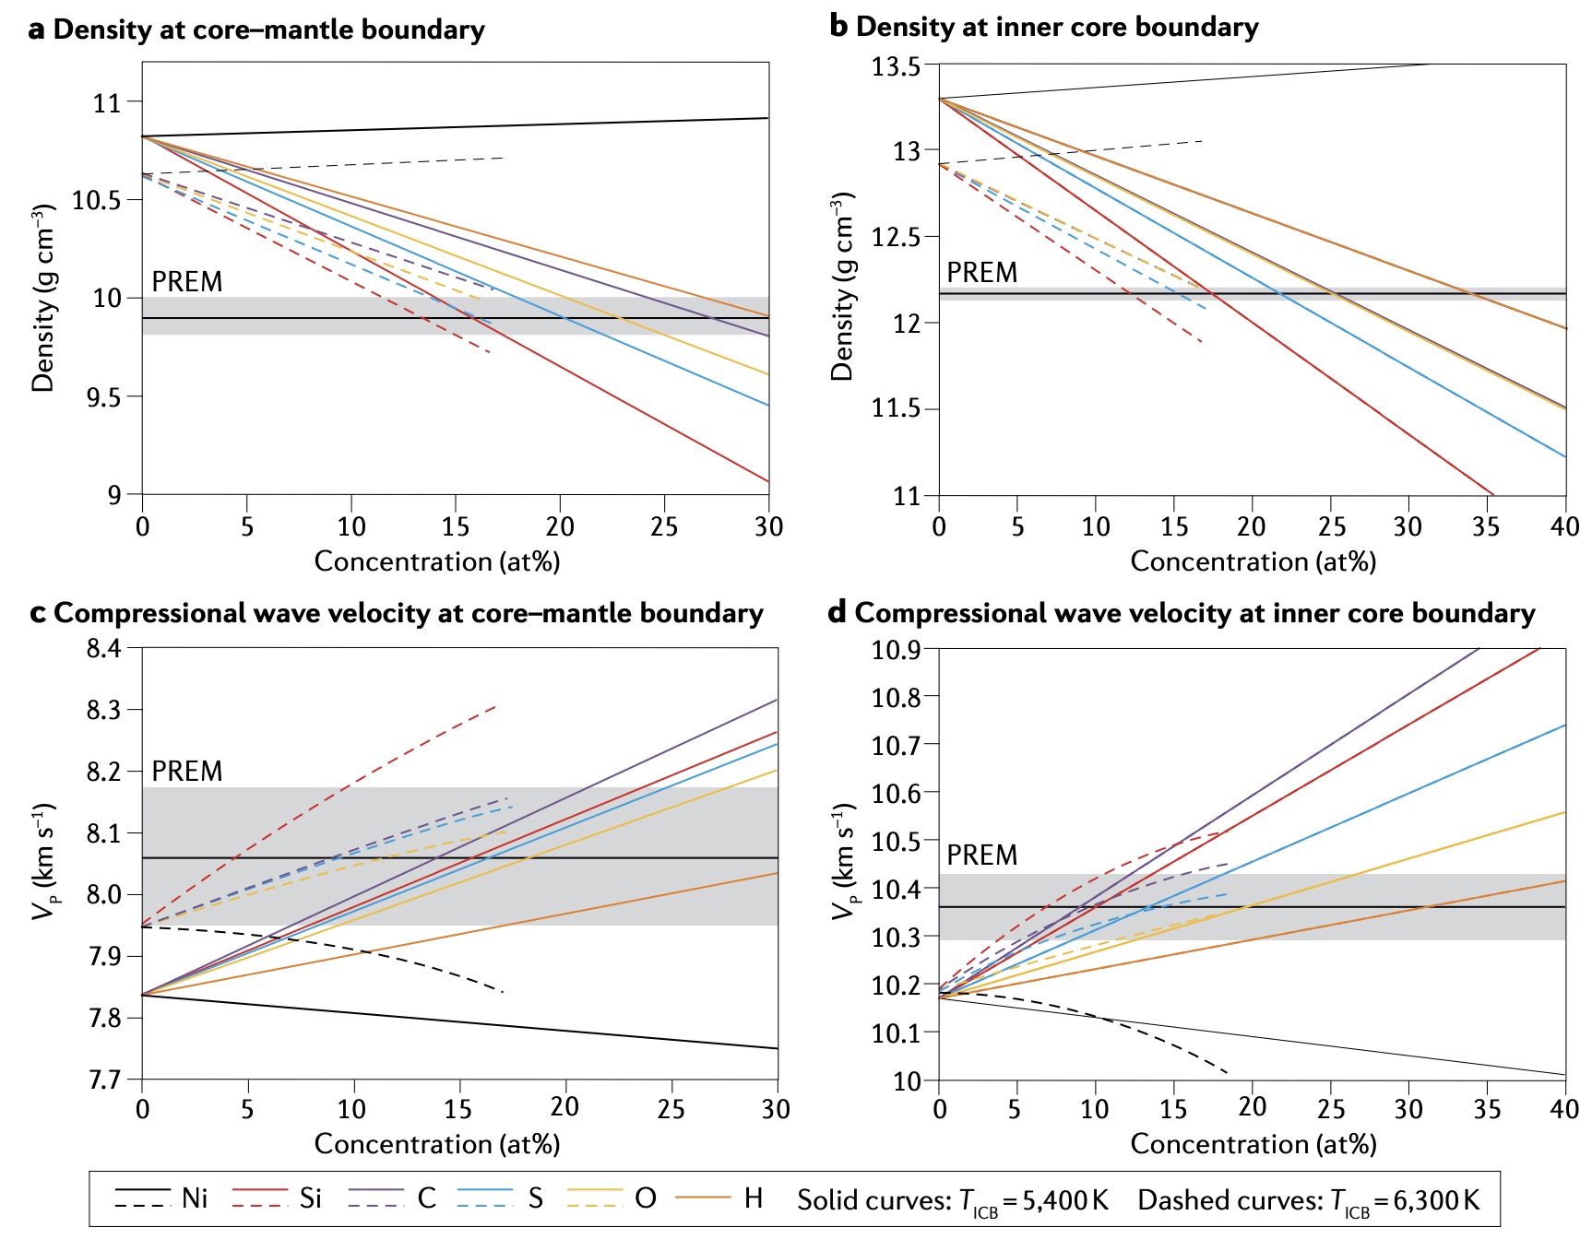
II. Constraints from seismological OC observations
Ni
Ab initio calculations explored the range of possible outer core composition in Fe-Ni-S-Si-O-C-H that explains the observed density and V_{P}.
H
O
C
S
Si
Badro et al., 2014 PNAS
Umemoto & Hirose, 2020 EPSL

Slide 18
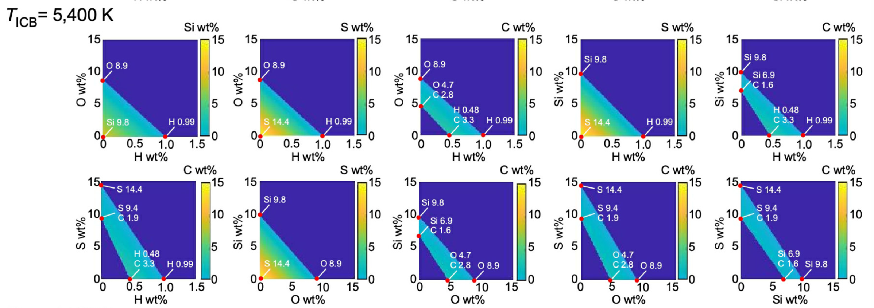
These calculations concluded that H and O are major outer core light elements when T_{ICB} = 5400 K and >6000 K, respectively.
Badro et al., 2014 PNAS; Umemoto & Hirose, 2020 EPSL

Slide 19
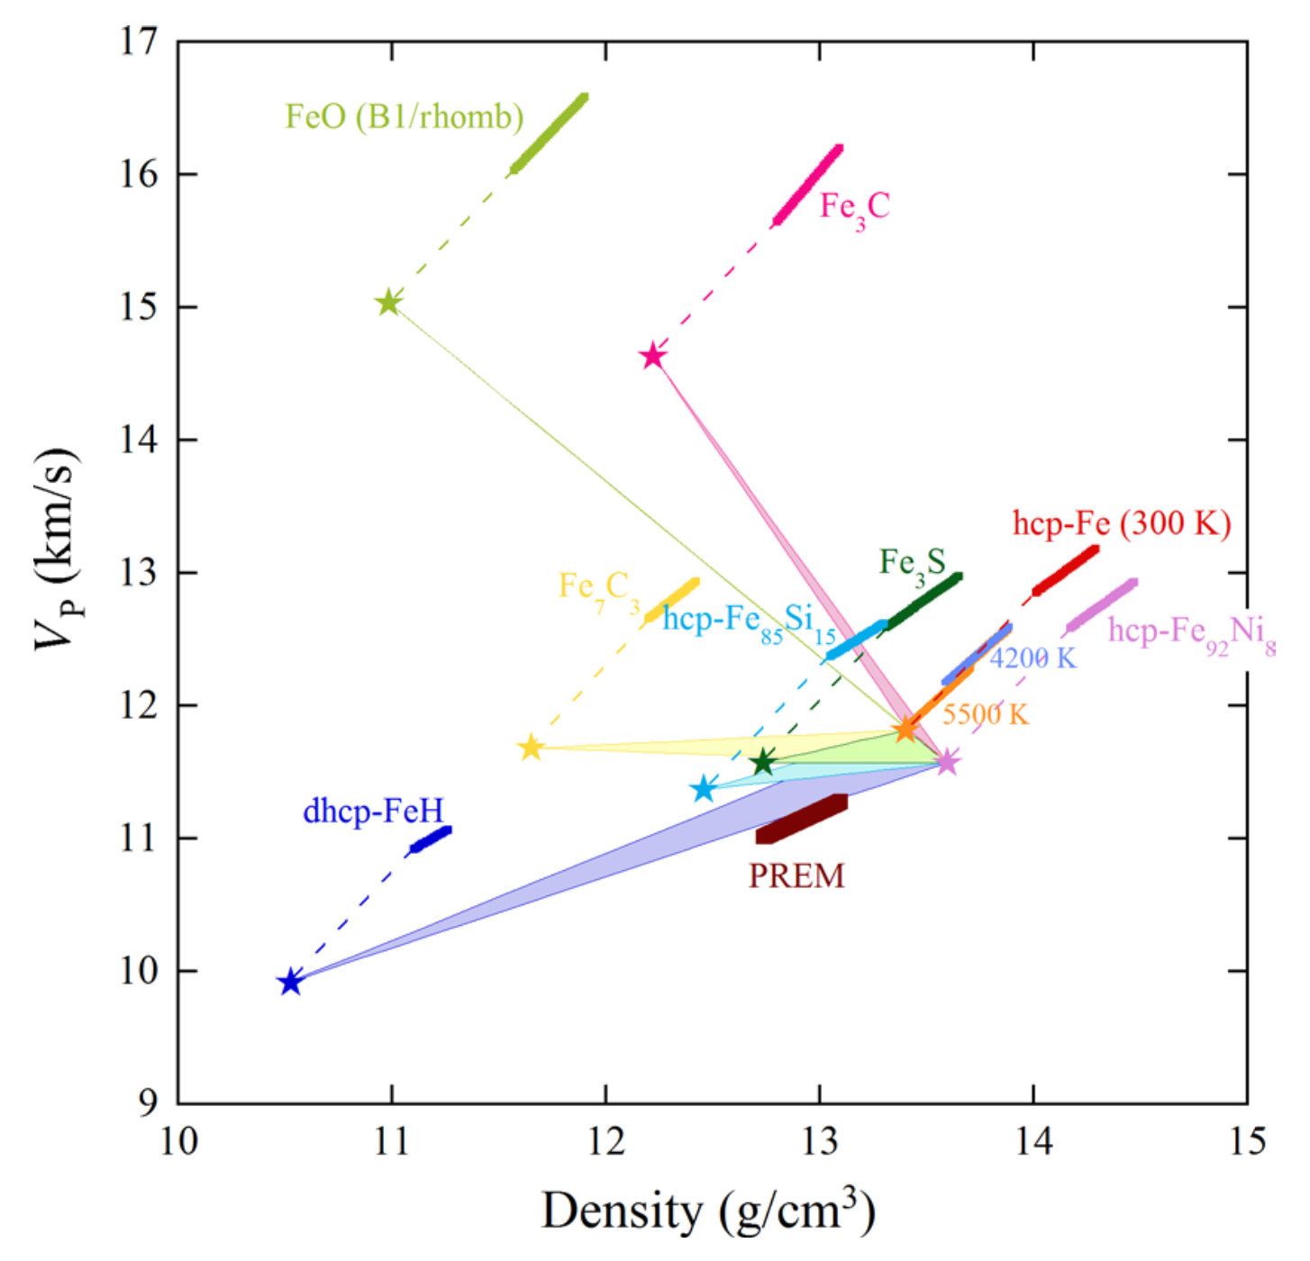
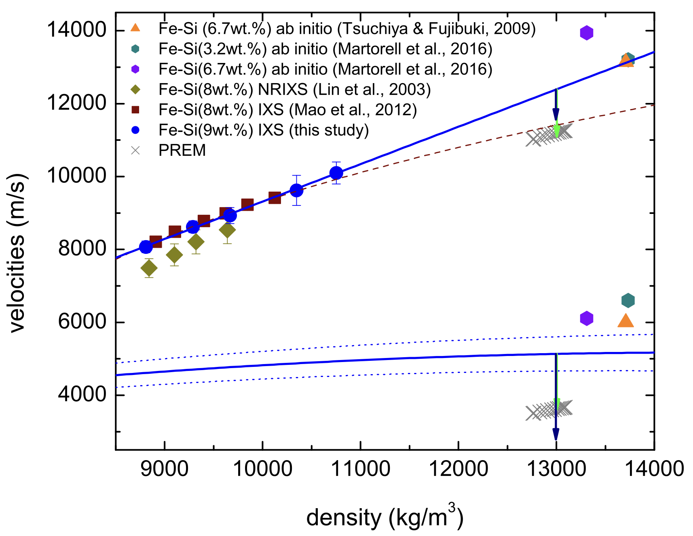
III. Constraints from seismological IC observations
Sakamaki et al., 2016 Sci.Adv.
Antonangeli et al., 2018 EPSL
The measured density & Vp of solid Fe and Fe alloys suggest that H and/or Si are important inner core light elements.

Slide 20
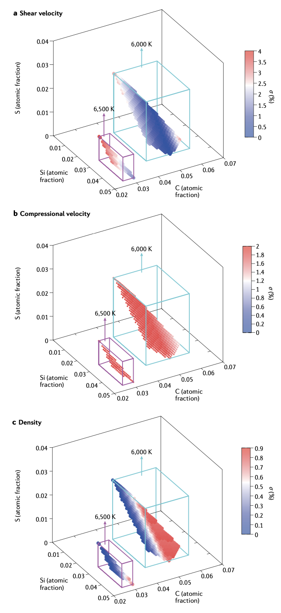
III. Constraints from seismological IC observations
Ab initio calculations proposed the possible range of inner core composition that explains density, V_{P} & V_{S}.
C or H are important to account for the high V_{P}/V_{S} ratio of the inner core.
Li et al., 2018 EPSL; Wang et al., 2021 EPSL

Slide 21
III. Constraints from seismological IC observations
Solid Fe
Density jump across the boundary b/w liquid outer core and solid inner core gives the max O content in the former because O is not soluble into solid Fe.
Inner
core
Liquid Fe
Outer Core
Hirose, Wood & Vočadlo, 2021 Nature Reviews Earth & Environ.
Kuwayama et al., 2020 PRL

Slide 22
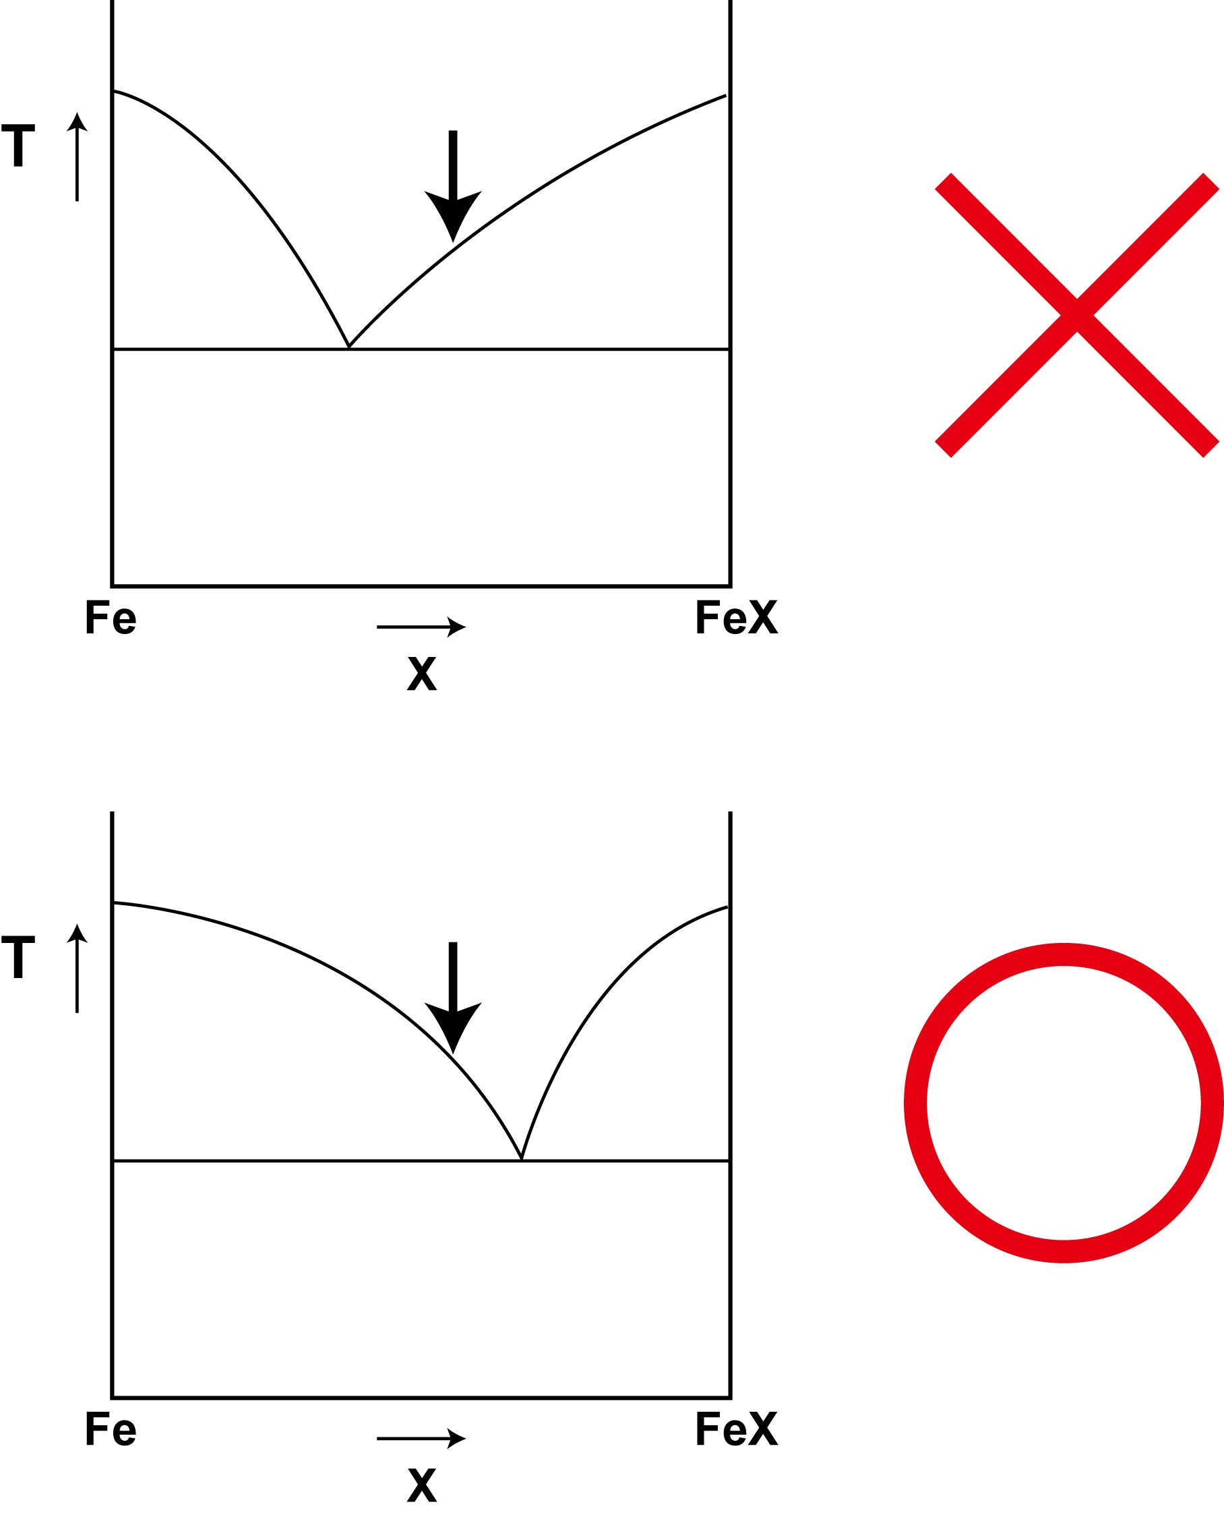
IV. Liquidus phase constraints on OC composition
outer core liquid comp.
The inner core must be solid Fe that is depleted in light elements. Thus, the outer core liquid should be on the Fe-rich side of the eutectic at inner core pressures.
eutectic comp.

Slide 23

High-pressure melting experiments
Sample cross-section by FIB
Melting texture & composition by SEM-EDS &
FE-EPMA
Determine eutectic liquid composition
Diamond-anvil cell

Slide 24
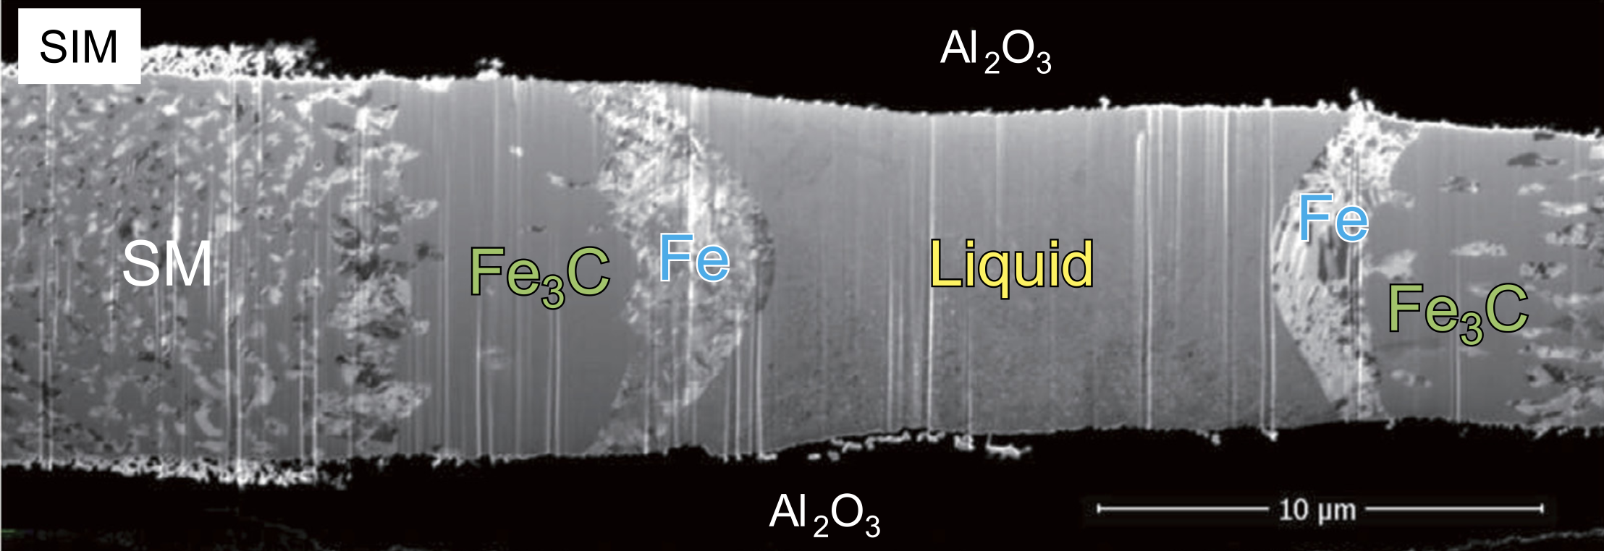
Fe-C
Mashino et al., 2019 EPSL
40 GPa
Fe-C binary eutectic liquid coexisting with Fe and Fe₃C

Slide 25
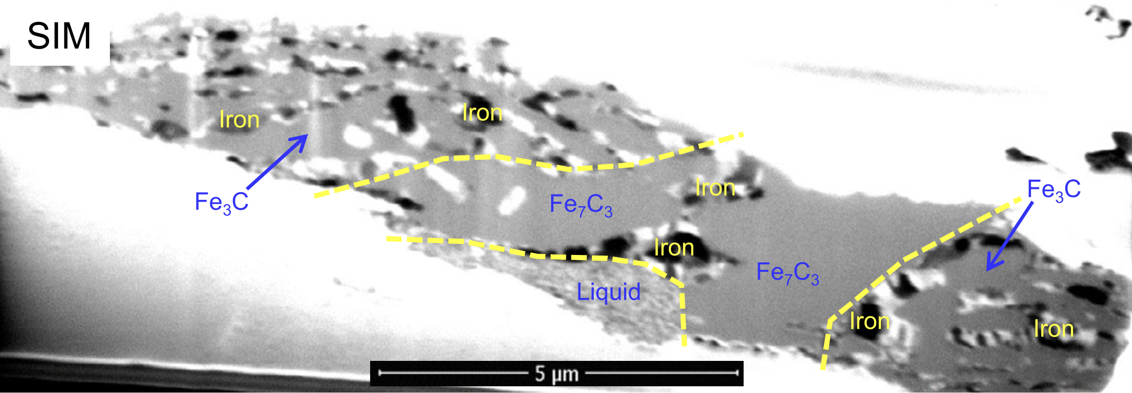
Fe-C
Mashino et al., 2019 EPSL
255 GPa
Fe-C binary eutectic liquid coexisting with Fe and Fe₇C₃

Slide 26
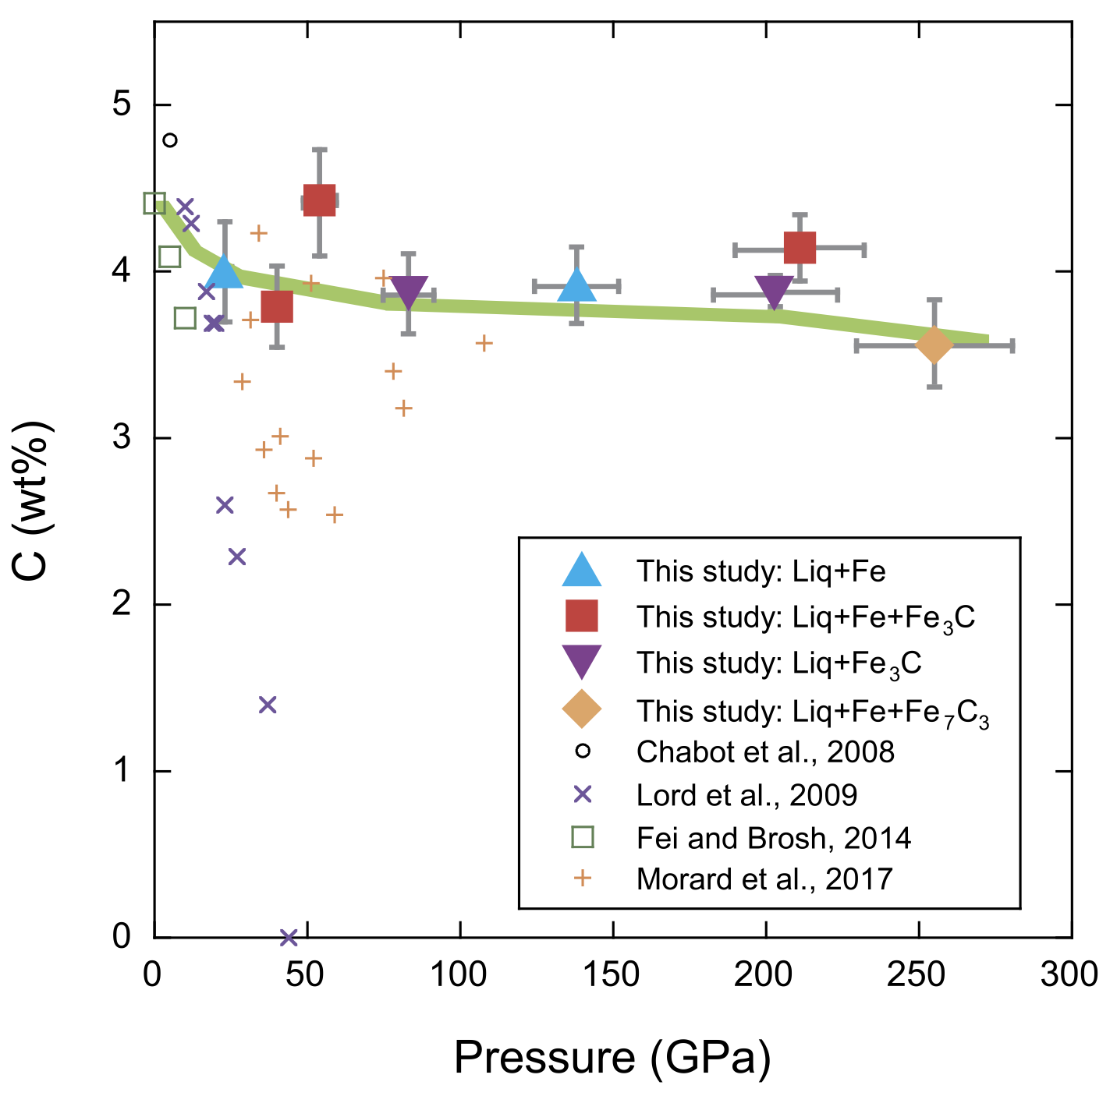
Fe-C
~3 wt% C in the Fe-C eutectic liquid at inner core pressures
It gives the max C content in the outer core
Mashino et al., 2019 EPSL
Eutectic liquid composition
outer core liquid comp.
3 wt% C
Fe₇C₃
C

Slide 27
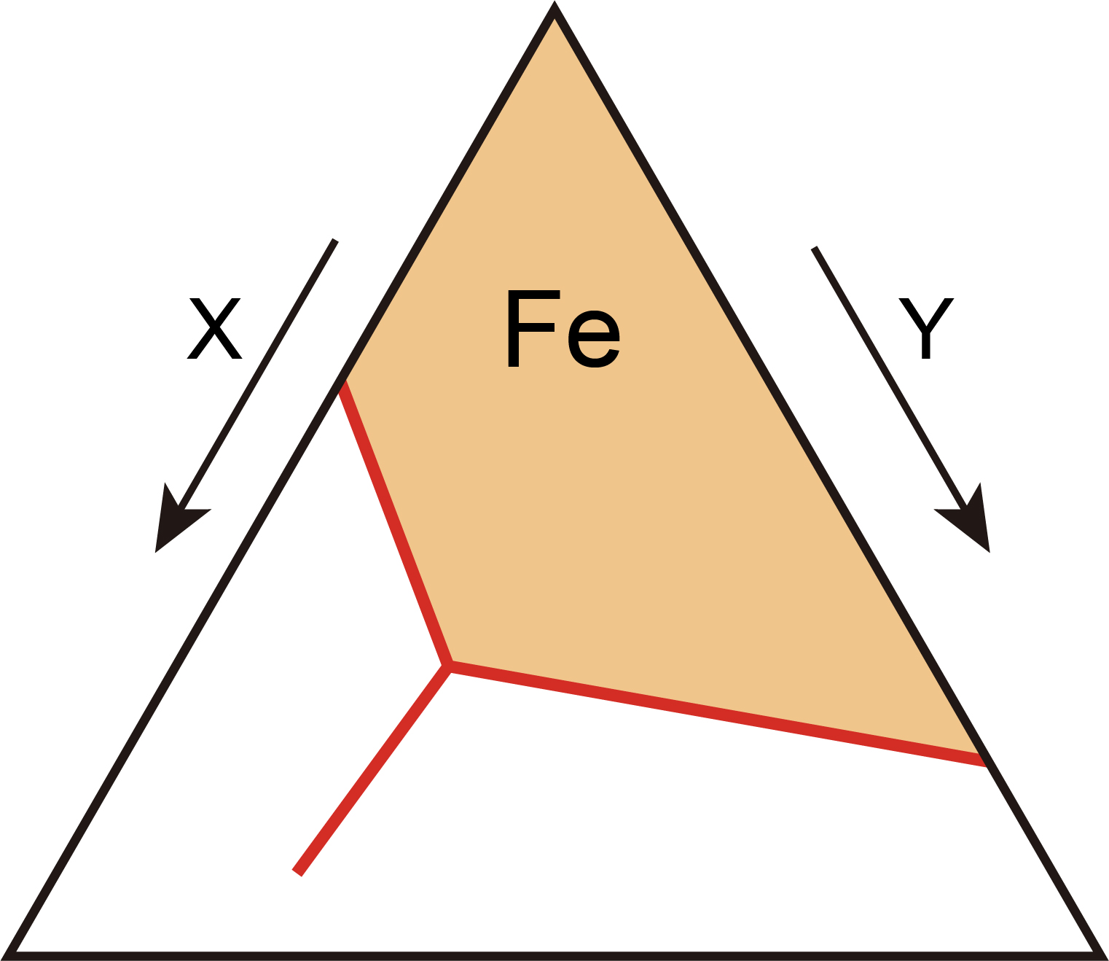
Fe
Max amount of each light element:
<5 wt% S
<8 wt% Si
<15 wt% O
<3 wt% C
<0.8 wt% H
Mori et al. 2017 EPSL
Hasegawa et al. 2021 GRL
Oka et al. 2019 Am. Mineral.
FeX
FeY
Mashino et al. 2019 EPSL
The liquidus field of Fe (the Fe-rich side of any eutectics) in Fe-S-Si-O-C-H will narrow down the possible range of the outer core composition.
Hikosaka et al. 2022 Sci. Rep.

Slide 28
V. Constraints from core-mantle partitioning
Li and Agee, 1996 Nature
Core-forming metals chemically equilibrated with silicate in a deep magma ocean.
Wood et al., 2006 Nature

Slide 29
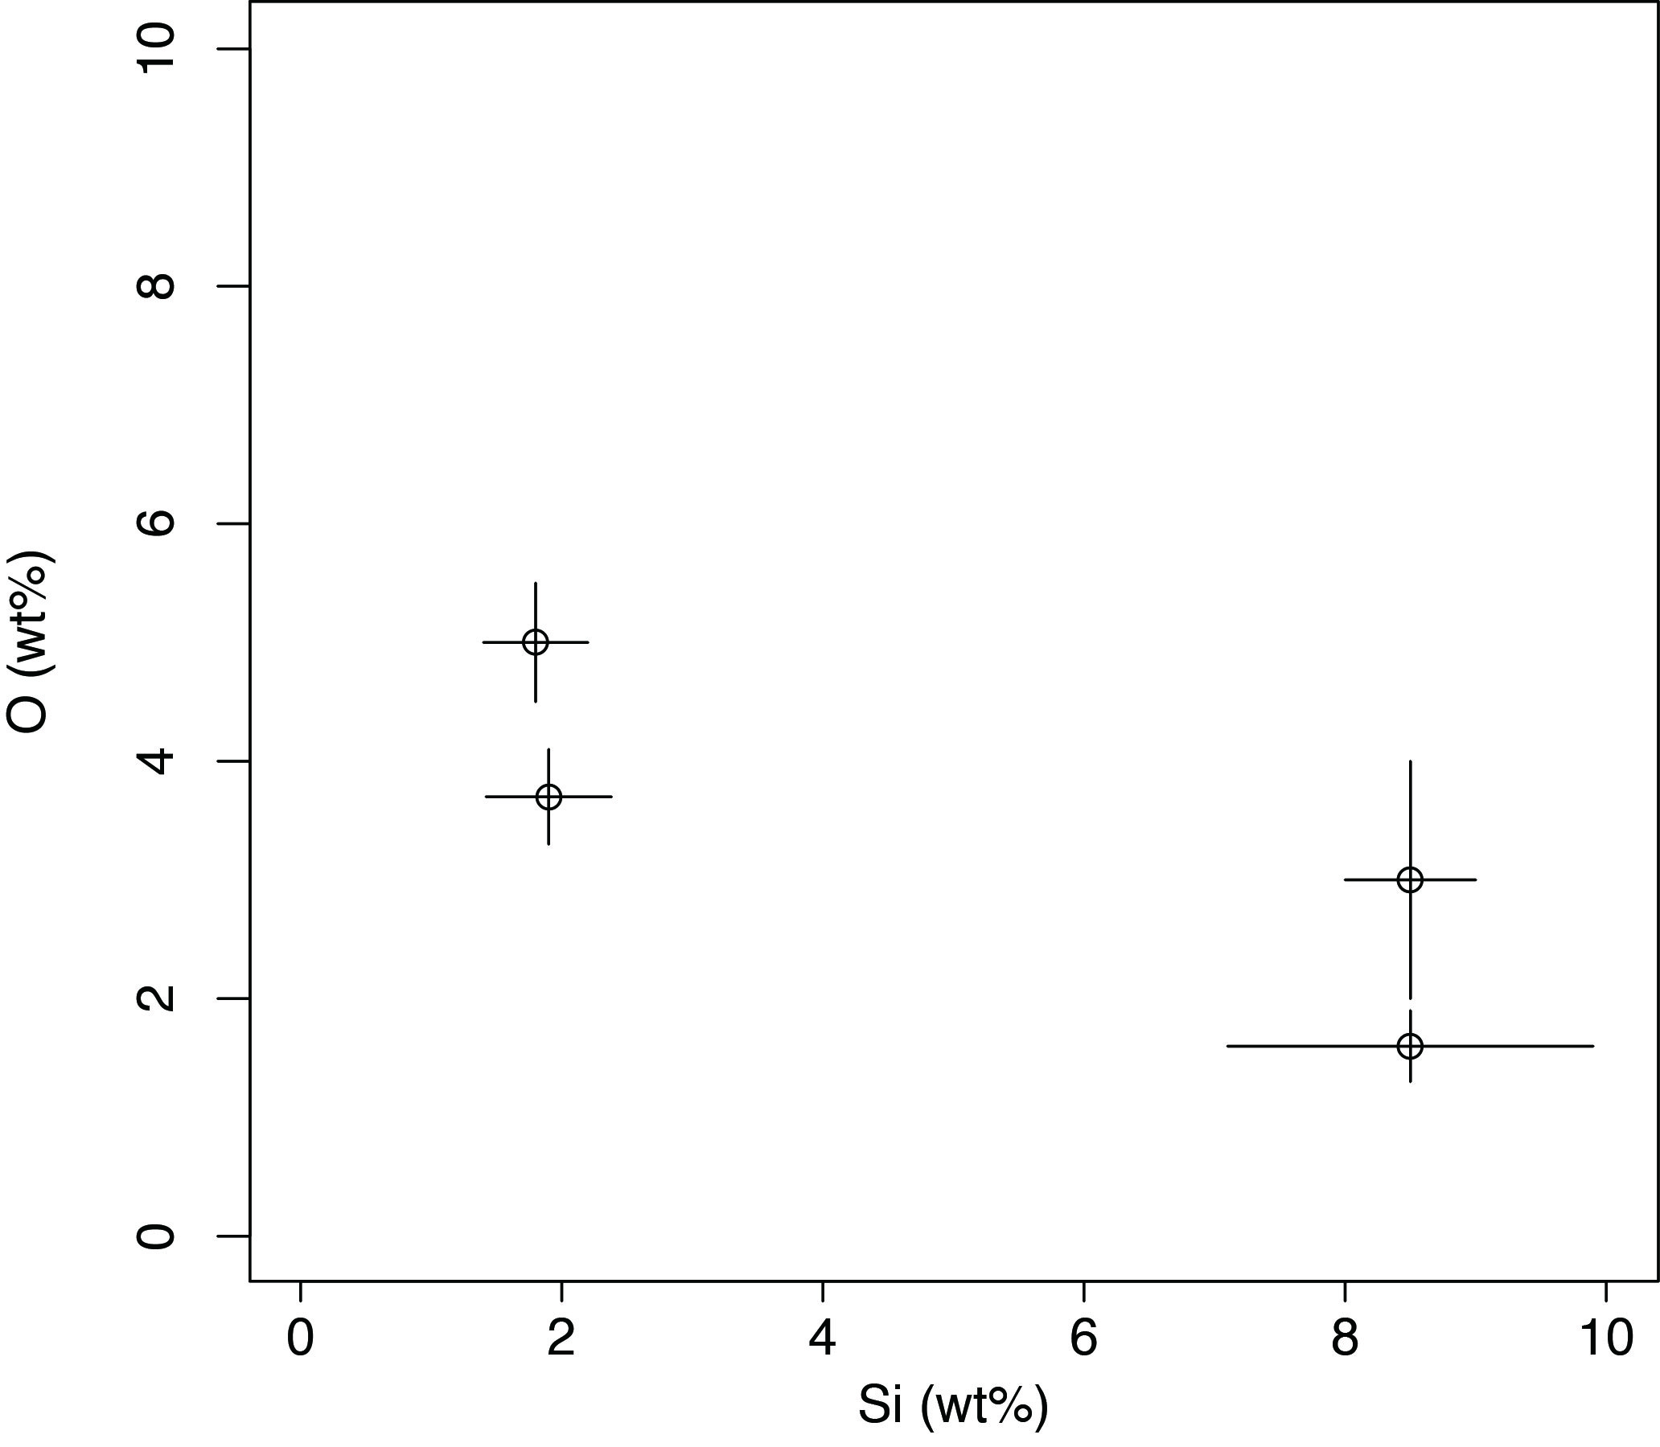
Metal-silicate partitioning of Si & O
Metal-silicate partitioning at high P-T in a deep magma ocean should have led to high Si & O contents in core-forming metals.
O (wt%)
Siebert et al., 2013
Rubie et al., 2015
Fischer et al., 2015
Si (wt%)

Slide 30

Metal-silicate partitioning of Si & O
Metal-silicate partitioning in a deep magma ocean should have led to high Si & O contents in the initial core.
O (wt%)
Siebert et al., 2013
Rubie et al., 2015
Already full, no room for other light elements
required to explain outer core density & V_{P}
Fischer et al., 2015
Si (wt%)

Slide 31
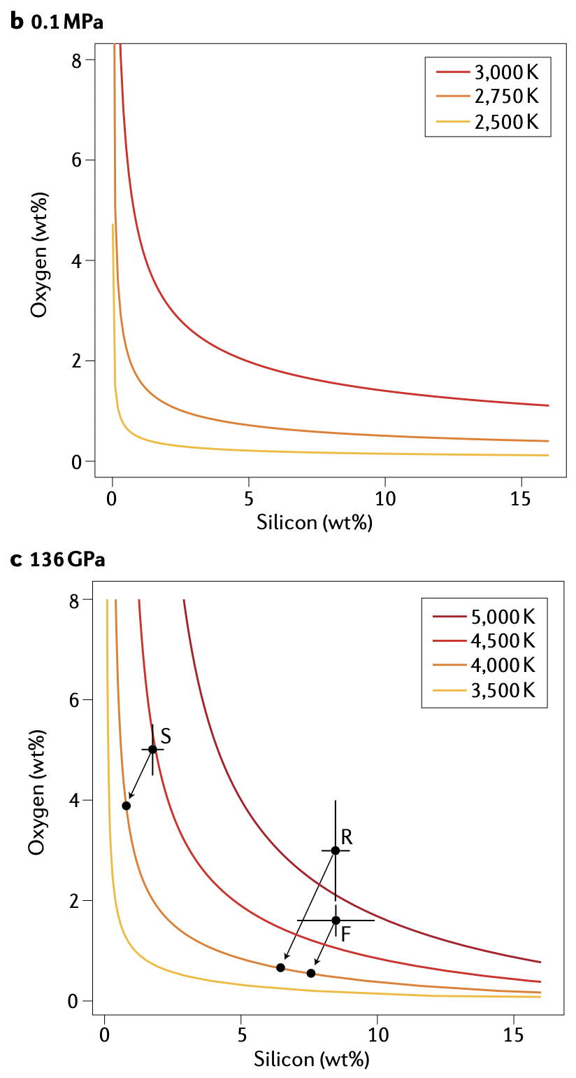
SiO₂ saturation in liquid core
Hirose et al., 2017 Nature
Si & O solubility curves (well-known in steel-making industry)
Si & O contents in initial core
Solubility of Si+O in liquid Fe is limited.
Present-day liquid core may be saturated in Si + O.

Slide 32
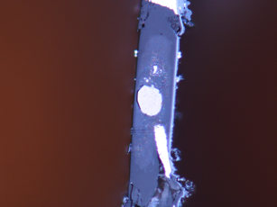
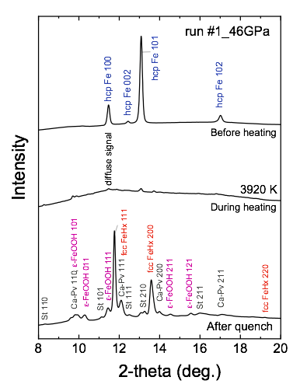
Metal-silicate partitioning of H
Cross section of sample
XRD
10μm
30–60 GPa / 3100–4600 K
fcc FeHx
Ca-pv
Silicate
melt
V_{FeHx}−V_{Fe}
H
x =
Liquid Fe
H₂O
ΔV_{H}
10μm
Tagawa et al., 2021 Nat. Commun.

Slide 33
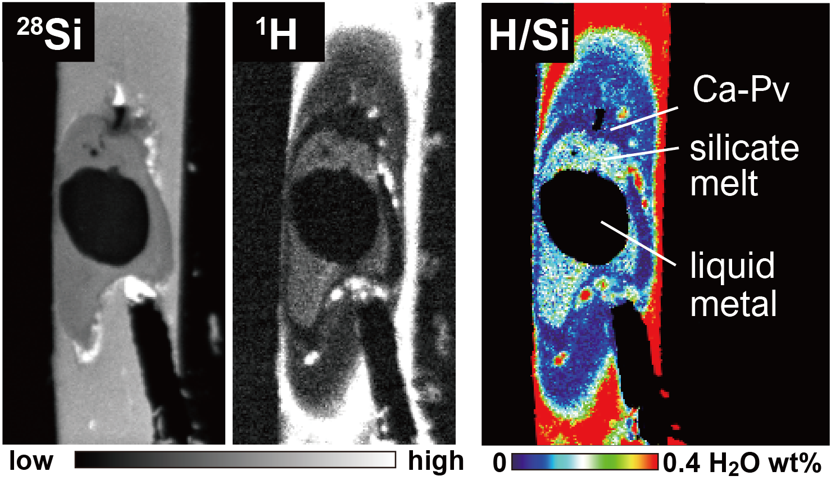
Metal-silicate partitioning of H
Cross section of sample
SIMS
10μm
30–60 GPa / 3100–4600 K
Ca-pv
Silicate
melt
H
Liquid Fe
H₂O
10μm
Tagawa et al., 2021 Nat. Commun.

Slide 34
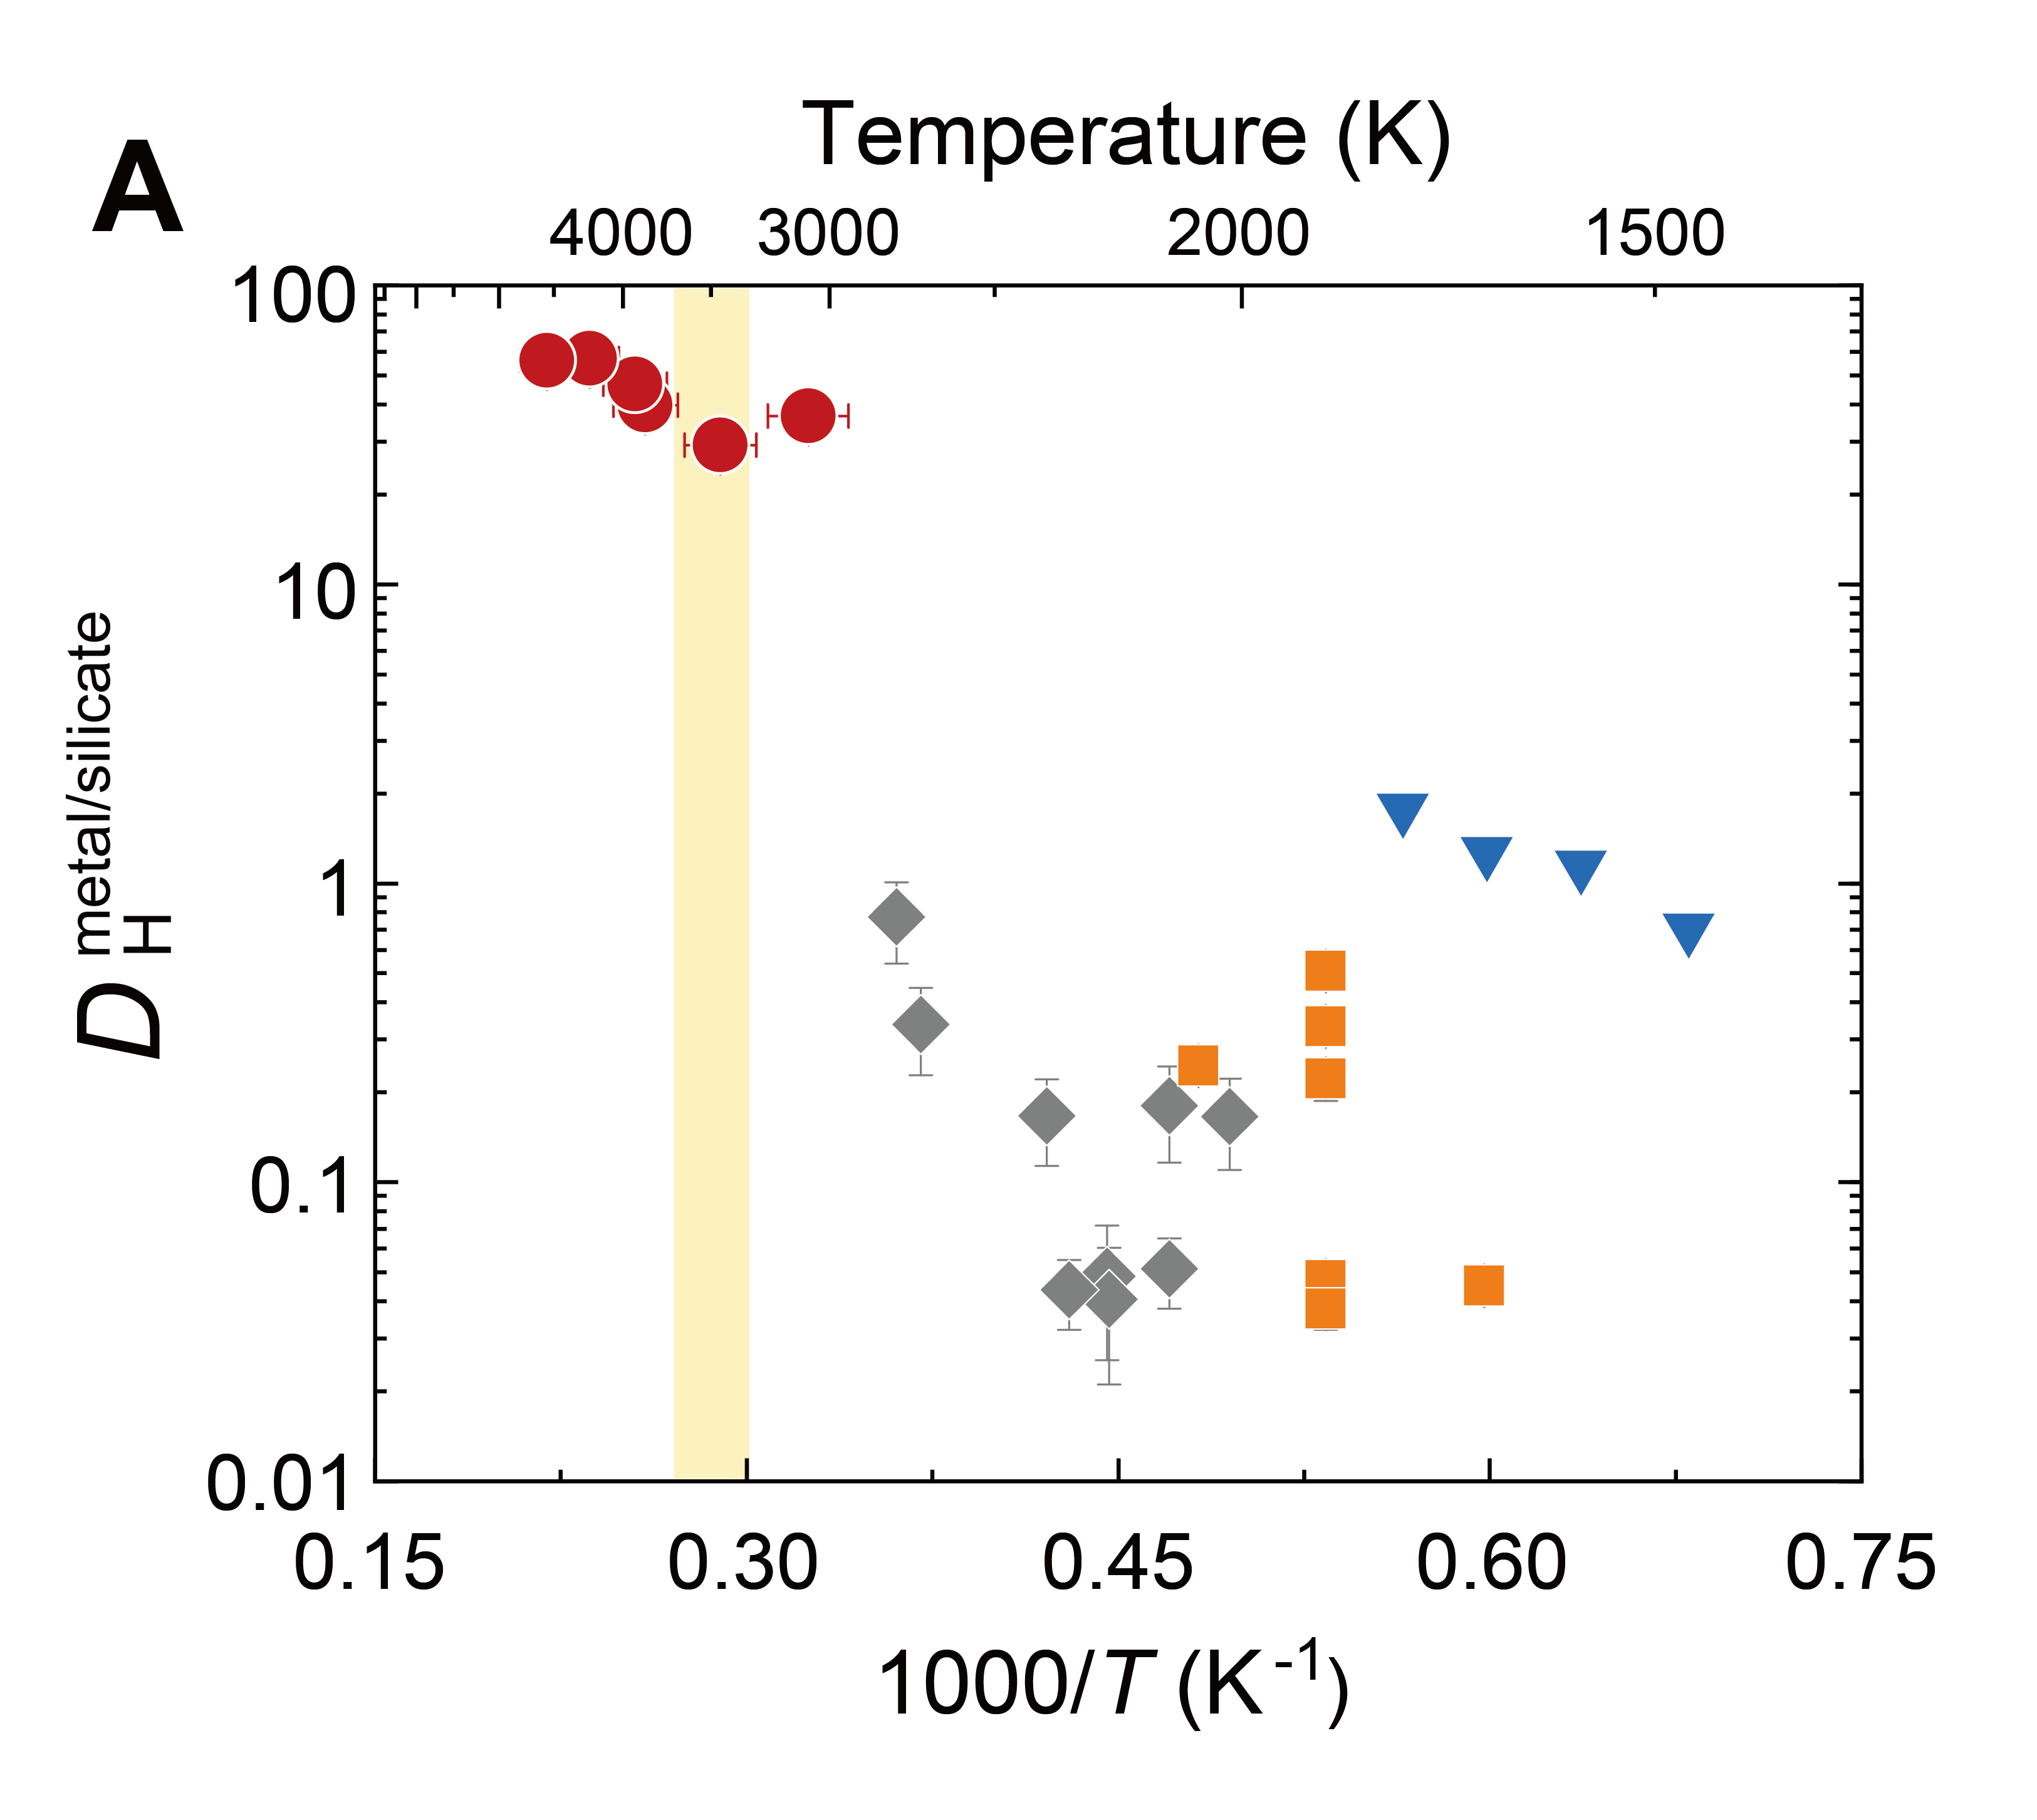
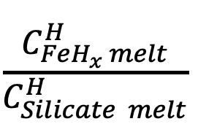
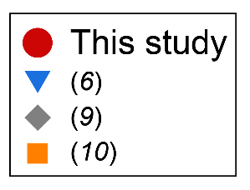
Metal-silicate partitioning of H
D_{H} =
= 29 – 56
30–60 GPa / 3100–4600 K
Hydrogen is siderophile under high P-T conditions of core formation
Okuchi
Clesi+
Malavergne+
Tagawa et al., 2021 Nat. Commun.

Slide 35
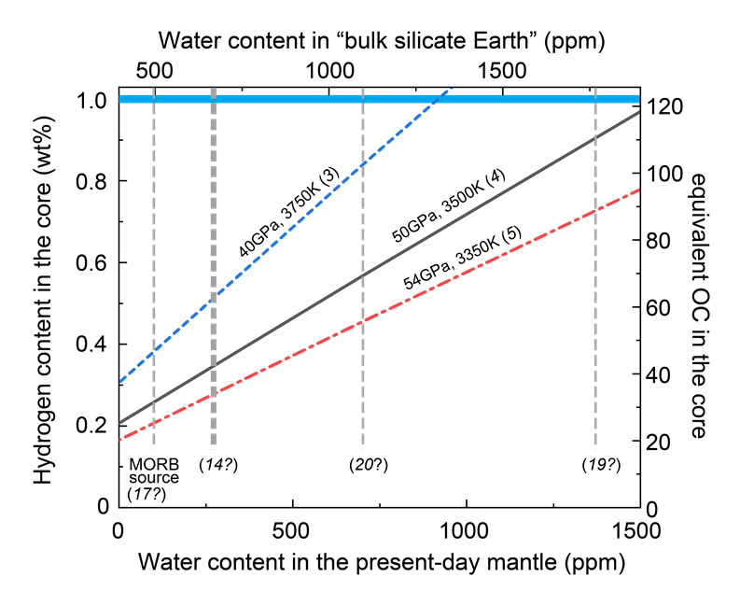
How much H in the core?
Core may include 0.29–0.53 wt% H
(explains ~30–50% of outer core density deficit and velocity excess)
Such amount is equivalent to H in 35–63 times ocean water
Upper mantle
Hirschmann
(2016)
Palm +
(2012)
Pesiler +
(2013)
Tagawa et al., 2021 Nat. Commun.

Slide 36
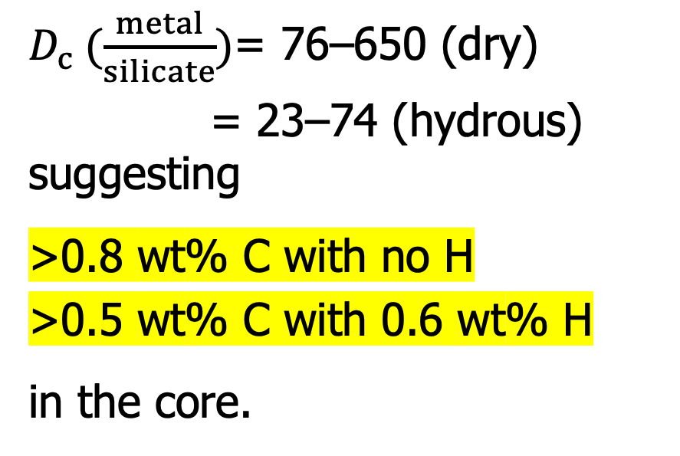
Metal-silicate partitioning of C
$D_{c} (\frac{metal}{silicate})$= 76–650 (dry)
= 23–74 (hydrous)
suggesting
>0.8 wt% C with no H
>0.5 wt% C with 0.6 wt% H
in the core.
Blanchard et al.,
2022
this study w/o H₂O
this study with H₂O
Fischer et al., 2020
Tsutsumi et al., OL01_5 IMA 2022

Slide 37
VI. Possible range of outer core composition
Assume T_{ICB} = 5400 K, corresponding to ~4000 K at CMB
(T_{ICB} is the liquidus T of the
outer core liquid and thus
constrained simultaneously
with liquid core composition)

Slide 38
VI. Possible range of outer core composition
Employ cosmo- /geochemical estimate of 1.7 wt% S in the core
Dreibus & Palme, 1996 GCA

Slide 39
VI. Possible range of outer core composition
Employ the possible range of liquid core composition that explains outer core density & V_{P}
Umemoto & Hirose, 2020 EPSL

Slide 40
VI. Possible range of outer core composition
Solid Fe
Inner
core
Employ max 3.8 wt% O in the outer core to explain the density jump across the ICB
Liquid Fe
Outer Core
Kuwayama et al., 2020 PRL
Hirose, Wood & Vočadlo, 2021 Nature Reviews Earth & Environ.

Slide 41
VI. Possible range of outer core composition
Employ Si + O saturation limit
at T_{CMB} = 4000 K
Hirose et al., 2017 Nature

Slide 42
VI. Possible range of outer core composition
Employ core-mantle partitioning of C that depends on metal H concentration
Blanchard et al.,
2022
this study w/o H₂O
this study with H₂O
Tsutsumi et al., OL01_5 IMA 2022
Fischer et al., 2020

Slide 43
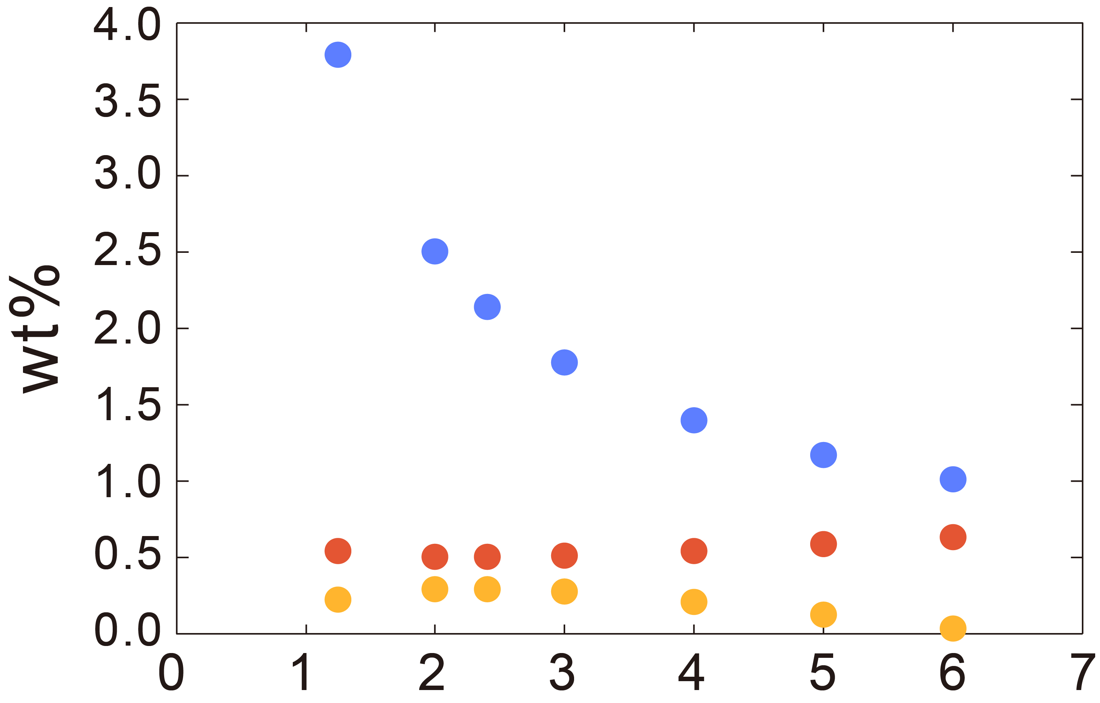
VI. Possible range of outer core composition
S = 1.7 wt%
S = 1.7 wt%
wt%
O
O
C
C
H
H
Si (wt%)

Slide 44
VI. Possible range of outer core composition
If we employ ≥0.3 wt% H in the core from the core-mantle partitioning study,
Tagawa et al., 2021 Nat. Commun.

Slide 45
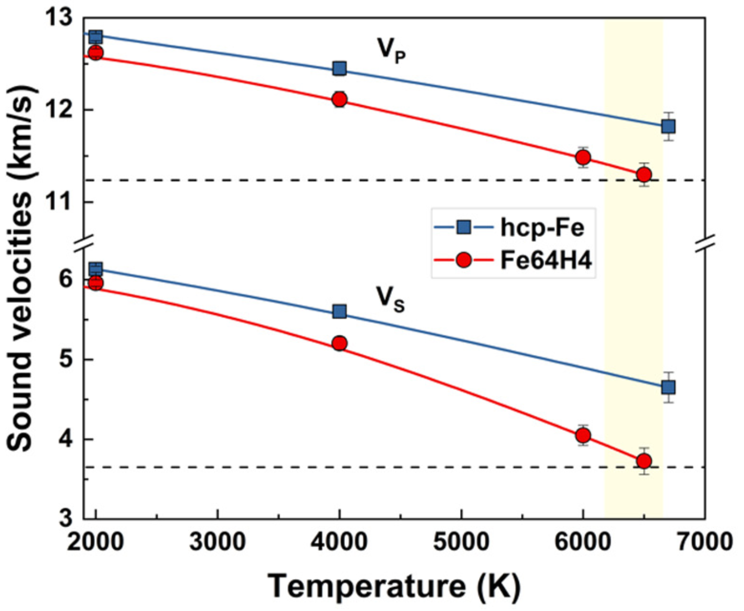
Hydrogen is important for both OC & IC
Density & V_{P} of liquid Fe-H are compatible with outer core observations when T_{ICB} = 5400 K.
Super-ionic solid Fe-H explains high V_{P}/V_{S}, characteristic of the inner core.
Large amount of H₂O may have been delivered to the growing Earth and mostly sequestrated in the core.
Umemoto & Hirose, 2020 EPSL
Wang et al., 2021 EPSL He et al., 2022 Nature
Wang et al., 2021 EPSL
Walsh et al., 2011 Nature
Raymond et al., 2007 Astrobiology

Slide 46
VI. Possible range of outer core composition
If we employ ≥0.3 wt% H in the core, the outer core may include:
S = 1.7 wt%
wt%
2.0–2.4 wt% Si
2.1–2.5 wt% O
0.6 wt% C
0.3 wt% H
with 1.7 wt% S
O
C
H
Si (wt%)

Slide 47

VI. Possible range of outer core composition
If we employ ≥0.3 wt% H in the core, the outer core may include:
H & O may largely contribute to the outer core density deficit.
2.0–2.4 wt% Si
2.1–2.5 wt% O
0.6 wt% C
0.3 wt% H
with 1.7 wt% S
O
C
H

Slide 48
Reservoirs of hydrogen
Oceans 1
Mantle + Crust 2 – 10
Core 37
Hirschmann, 2016 Am. Mineral.
Peslier et al., 2017 Space Sci. Rev.
Most of hydrogen (77–93%) on Earth may be present in the core.
Note, however, that this estimate is strongly dependent on the Earth accretion scenario. More observational constraints, possibly from neutrino observations, are necessary.

Slide 49
Reservoirs of hydrogen
Oceans 1
Mantle + Crust 2 – 10
Core 37
Hirschmann, 2016 Am. Mineral.
Peslier et al., 2017 Space Sci. Rev.
Most of hydrogen (77–93%) on Earth may be present in the core.
Note, however, that this estimate is strongly dependent on the Earth accretion scenario. More observational constraints, possibly from neutrino observations, are very welcome!

Slide 50
Conclusions
H (H₂O) concentrations in the deep Earth still remain largely unknown.
Nevertheless, large amounts of H, equivalent to H in >2 and ~40 ocean mass of water, may be present in the mantle and the core, respectively.
It is supported by recent planet formation theories.

