Slide 1



Measuring the Earth's outer core composition using neutrino oscillations
João Coelho
APC Laboratory
31 July 2022

Slide 2
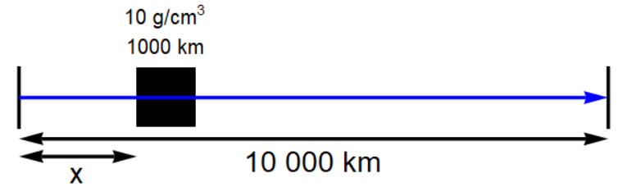

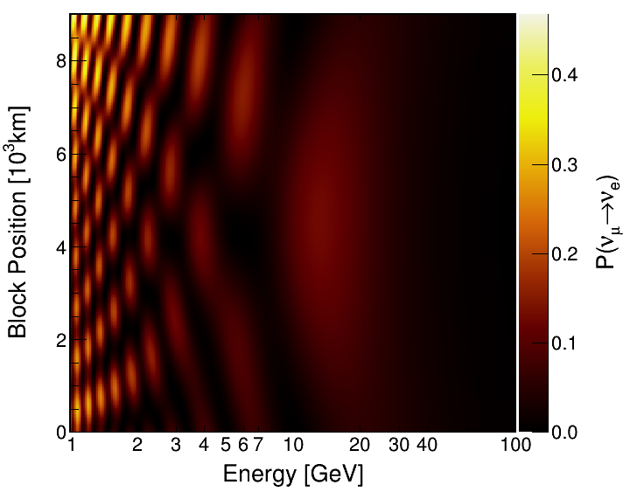
Why Oscillation?
ν_{μ}
ν_{e}

Slide 3
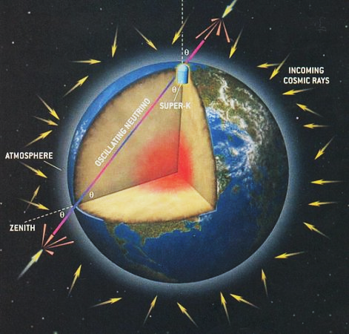
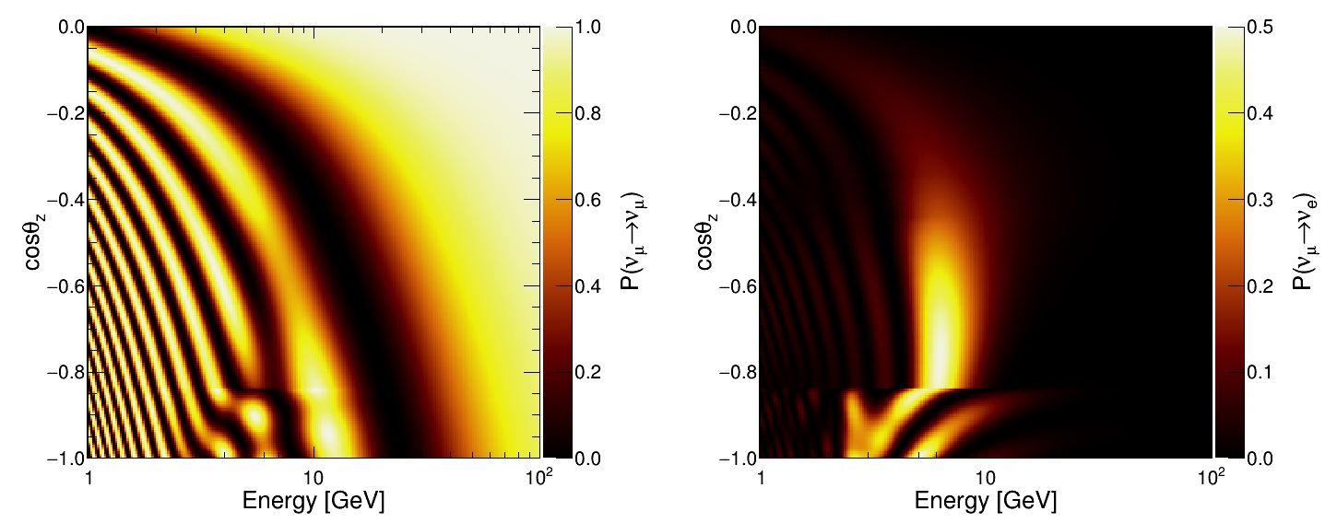
Atmospheric Neutrinos
Very long baselines available
Strong matter effects give sensitivity to electron density
Resonances occur at a few GeV

Slide 4
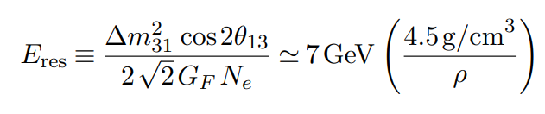
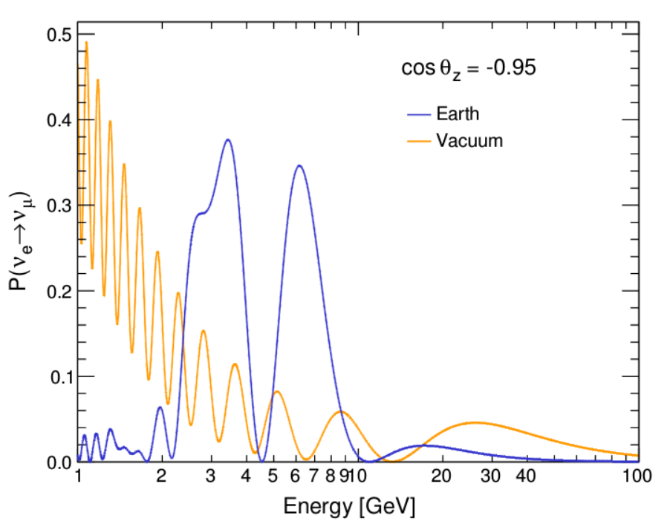
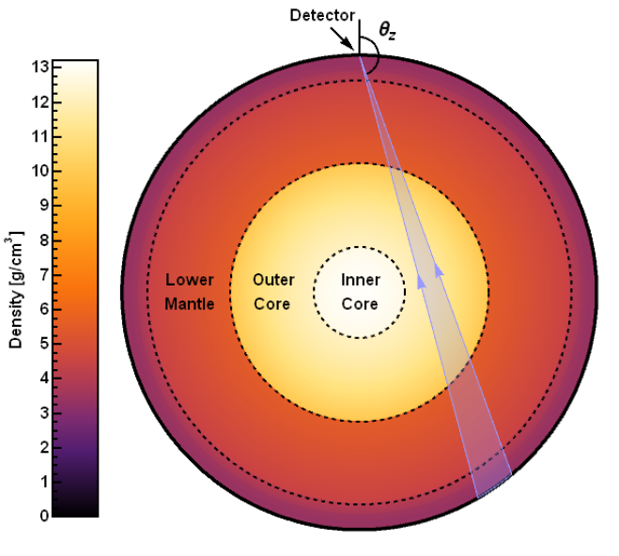
Resonances
Very large deviations from vacuum oscillations at resonance energies
Core
Mantle

Slide 5
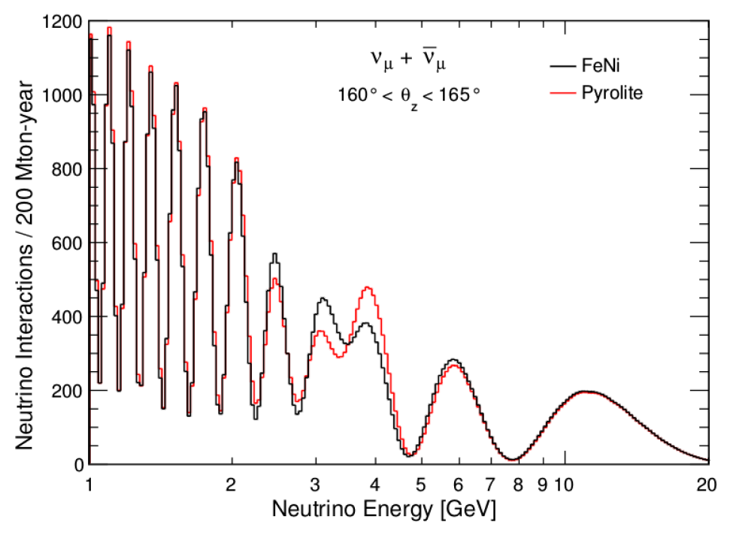
Observables
In reality we observe:
Φ_{e} * P(ν_{e}  ν_{μ}) + Φ_{μ} * P(ν_{μ}  ν_{μ}) + antineutrinos
Extreme example:
  Pyrolite outer core with a 10 Mton detector after 20 years (perfect resolution)

Slide 6
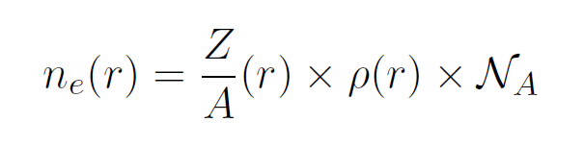
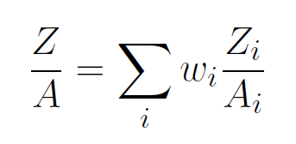
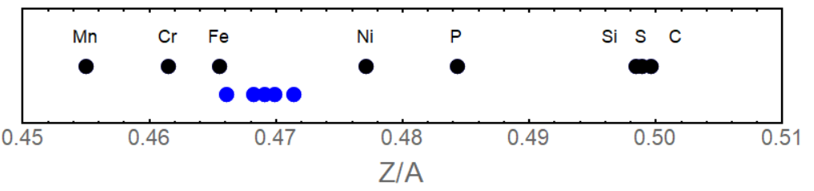
Outer Core Models
Focus on a few reasonably motivated models
  FeNiSi2O4 (Badro et al., 2015)
  FeNiSi7O2 (Kaminski and Javoy, 2013),
  FeNiSiH (Tagawa et al., 2016)
  FeNiH (Sakamaki et al., 2016)
Ranging from 0.4661 to 0.4714 in Z/A
FeNi
FeNiH
FeNiSi₂O₄
FeNiSi₇O₂
H
FeNiSiH

Slide 7
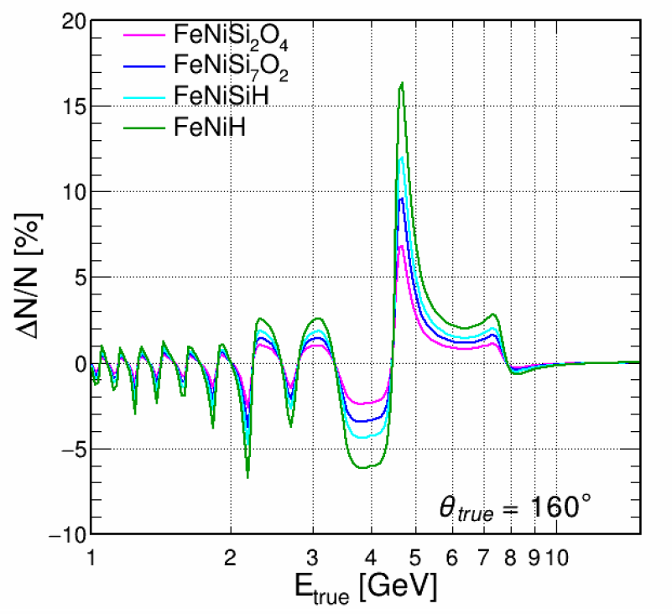
Signal Maps
Signal is very sensitive to neutrino direction
Need to work in 2D

Slide 8
Detector Blurring
Energy and direction measurements are imperfect
Detector is less efficient at lower energies
20%
ν_{μ}
ν_{e}
Perfect
Detector
1%
ν_{μ}
ν_{e}
Realistic
Detector

Slide 9
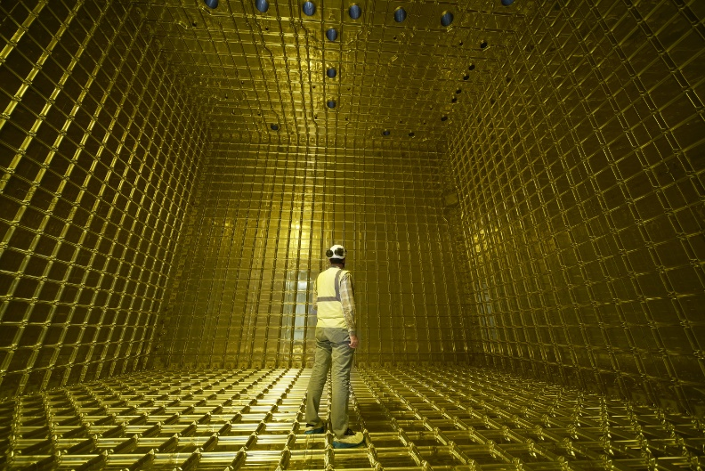
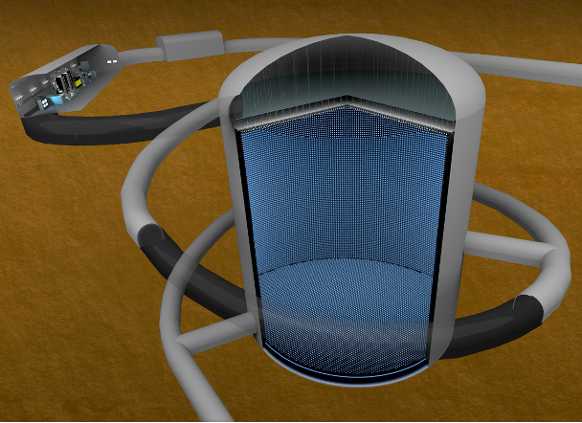
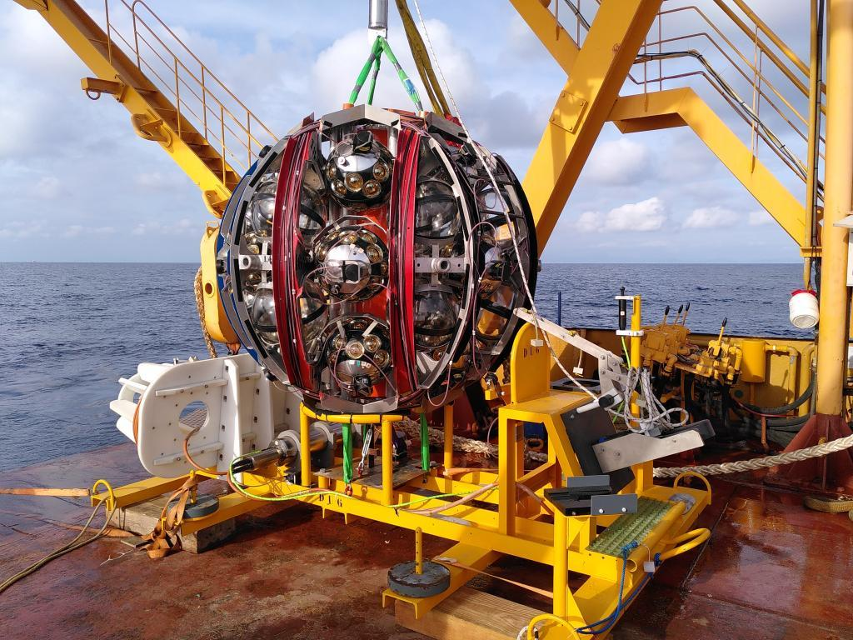
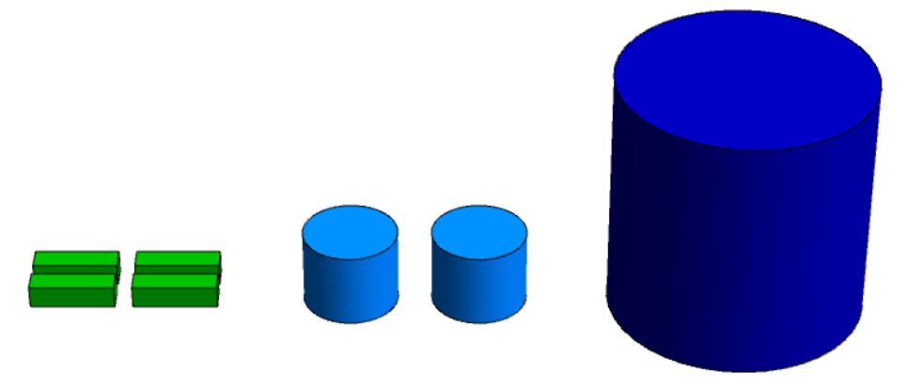
3 Detector Examples
KM3NeT/ORCA
7 Mton
Hyper-K
400 kton
DUNE
40 kton

Slide 10
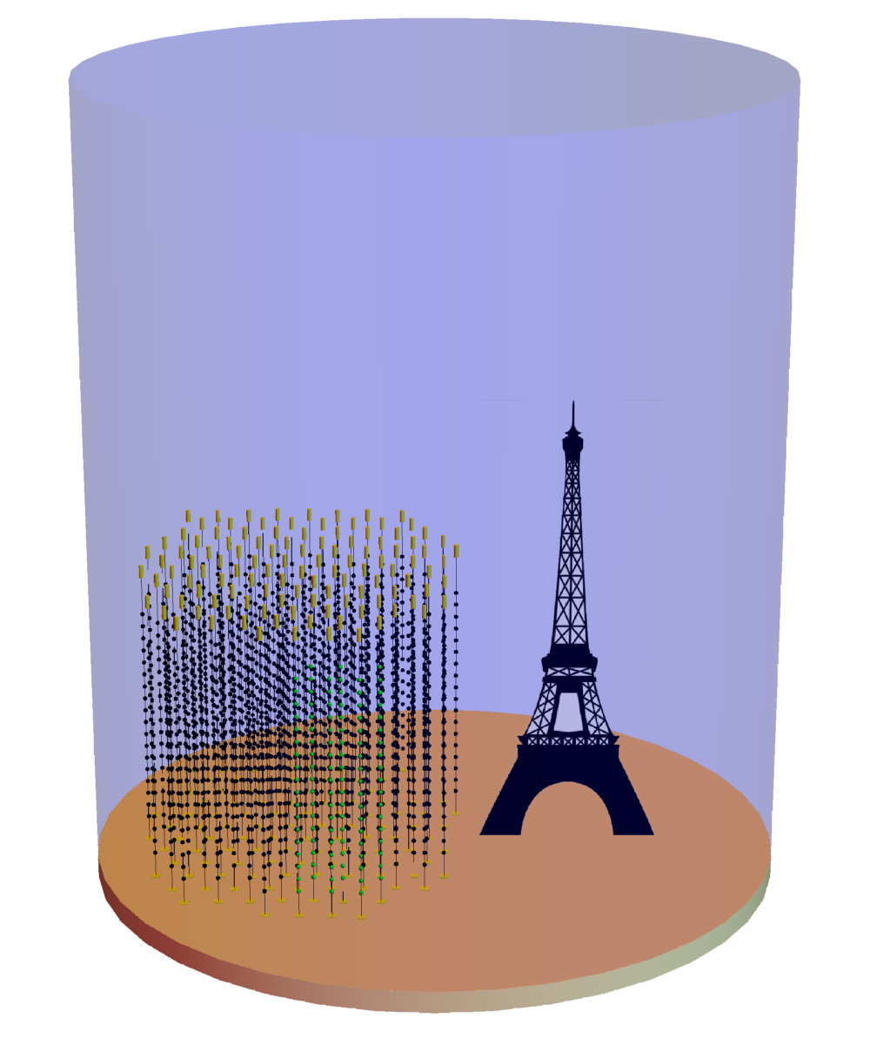
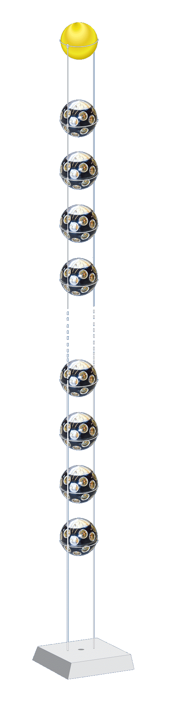
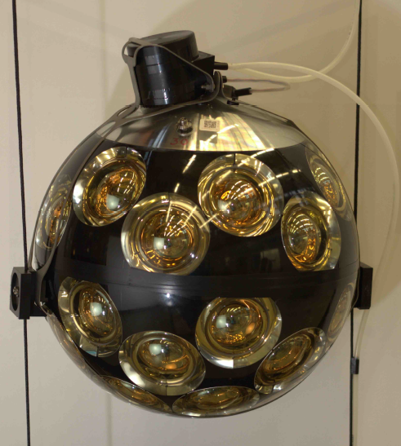
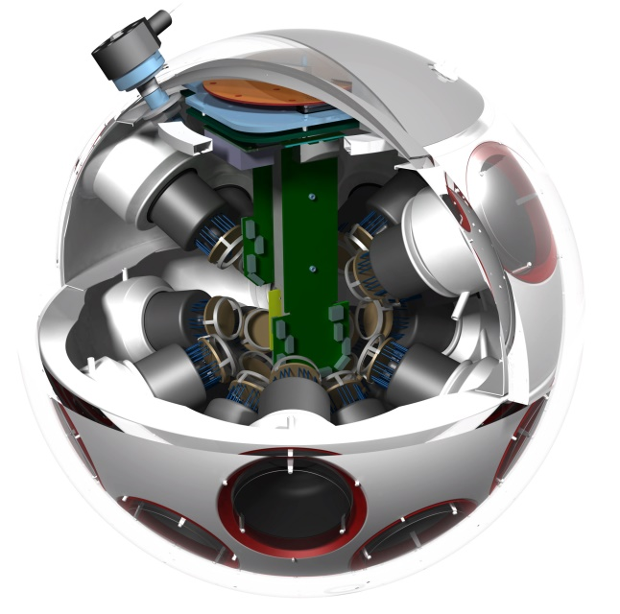
The ORCA Detector
~7 Mt instrumented
115 strings
18 DOMs / str
31 PMTs / DOM
Total: 64k PMTs
~200 m
43 cm
9 m
Optimized for matter resonance

Slide 11
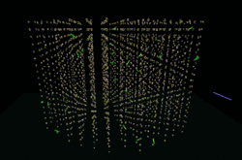
The ORCA Detector
~7 Mt instrumented
115 strings
18 DOMs / str
31 PMTs / DOM
Total: 64k PMTs
~200 m
43 cm
9 m
Optimized for matter resonance
http://www.cherenkov.nl/

Slide 12
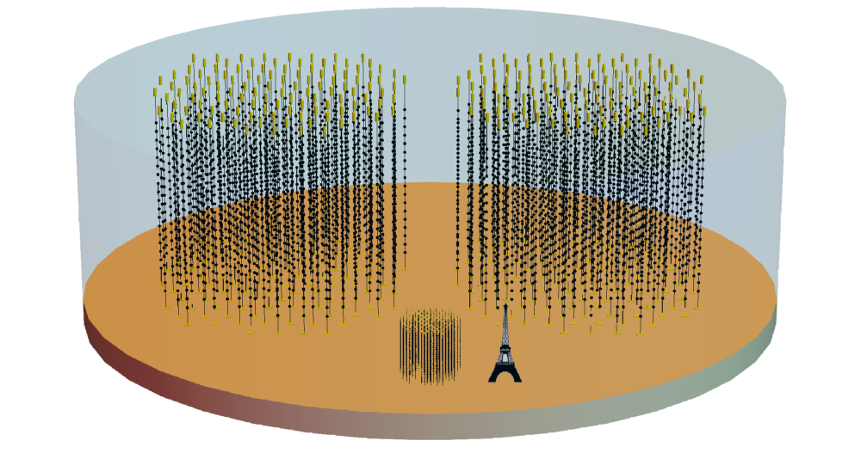
Two Detector Scales
36m vert. x 90m horiz. spacing
TeV - PeV
ARCA BB1
ARCA BB2
ORCA
9m vert. x 20m horiz. spacing
GeV - TeV

Slide 13
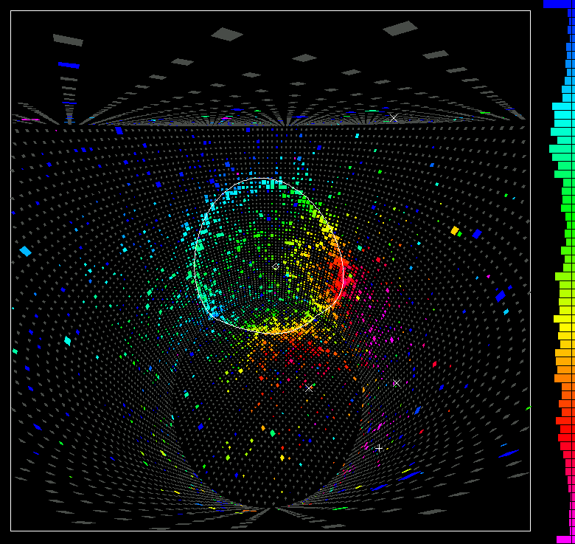
Hyper-Kamiokande
400 kton Water-Cherenkov detector
Good energy resolution but 10x smaller than ORCA

Slide 14
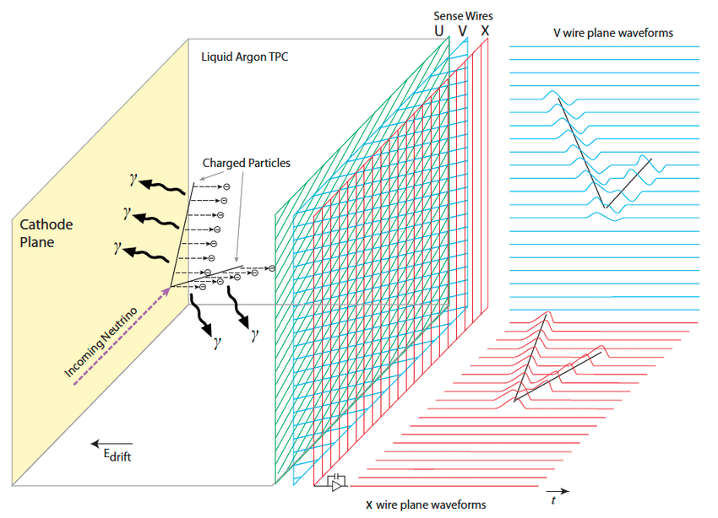

DUNE
40kton Liquid Argon TPC
Excellent resolution, but 10x smaller than HK

Slide 15
Detector Modelling
Parametrized detector responses
Energy/direction resolution
Detection efficiency
Nu flavour identification

Slide 16
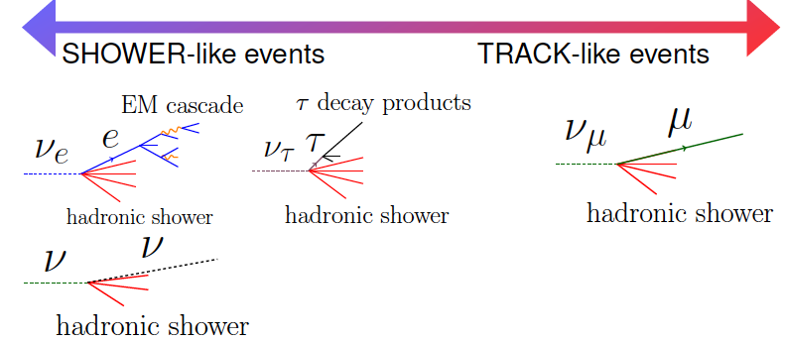
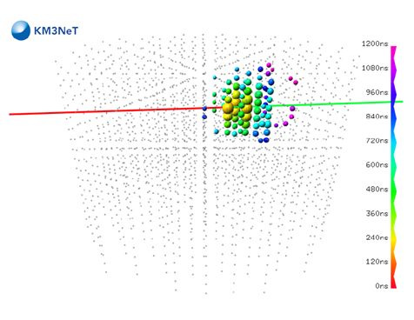
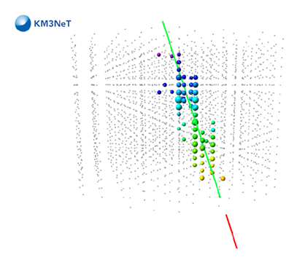
Simplified Particle ID
Track-like
Shower-like

Slide 17
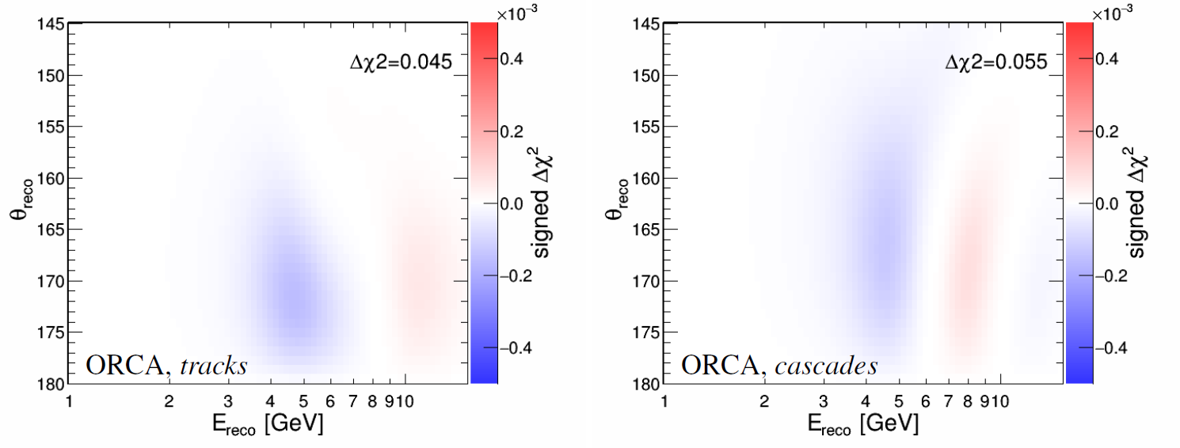
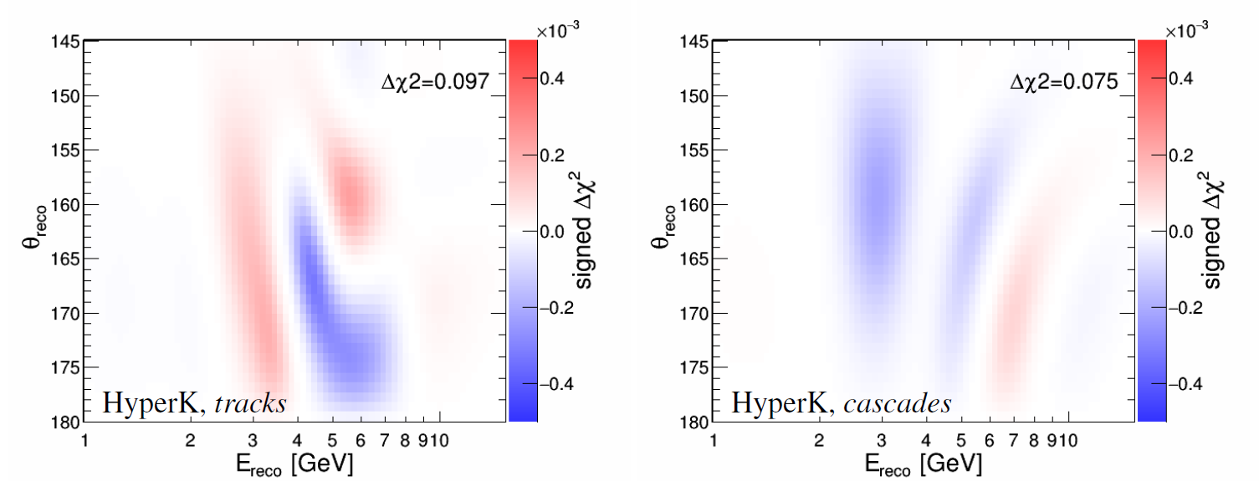
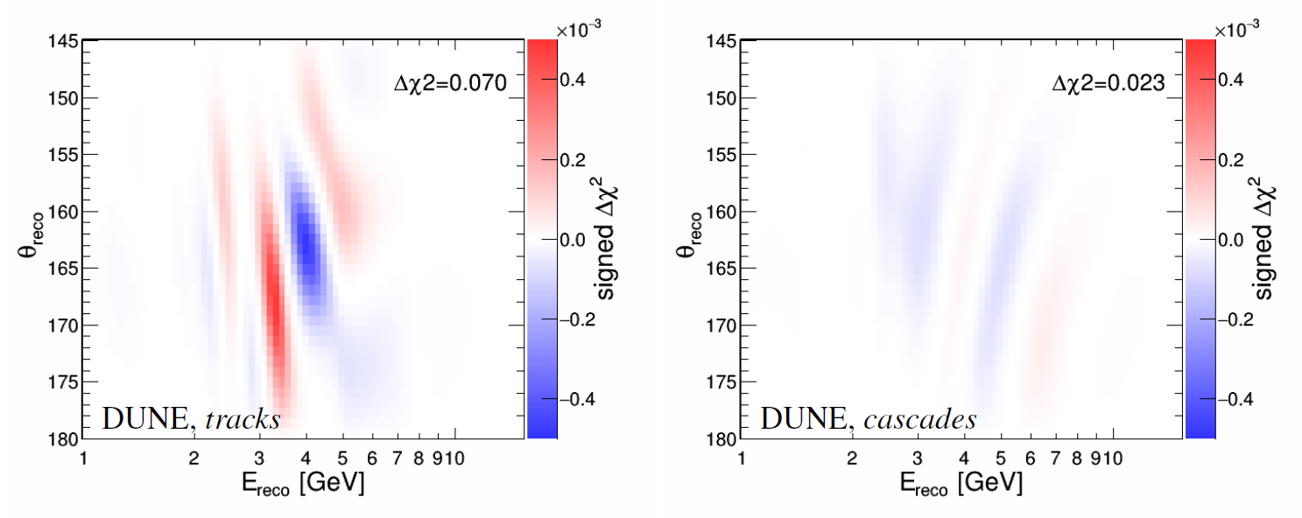
Statistical Significance Maps
Separation between two extreme models:
  FeNi (Z/A = 0.4661)
  FeNiH (Z/A = 0.4714)
Similar significance from all 3 detectors
  ~0.1 units of Δχ²
Balance between size and detector performance

Slide 18
Sensitivity Results
Upcoming generation of experiments will measure the outer core Z/A with precision between 0.01 and 0.02
Hyper-K has the strongest power
ORCA and DUNE achieve similar sensitivity
This will be shy of resolving even most extreme models
20 years

Slide 19
What would be required?
What are the requirements on a detector to improve on upcoming generation
NextGen detector needs Mton scale and HK resolution
FeNiSi₂O₄ vs FeNiH

Slide 20
Prospects for NextGen
The combination ORCA+DUNE+HK would take 50 years to resolve 1wt% H vs pure FeNi at 1σ level
A NextGen detector may reach this level in 2-3 years
Even a more realistic FeNiSi₂O₄ model could be separated from FeNiH within 10 years
20 years

Slide 21
Potential Z/A Resolution
Within a span of 50 years, a NextGen detector would be able to probe meaningful outer core models
The most challenging models (FeNiSi₇O₂ vs FeNiSiH) would require 1200 Mton-years to resolve at 1σ

Slide 22
Summary
The upcoming generation of neutrino detectors will start to probe the composition of the Earth’s outer core
Discriminating realistic models will likely require a detector beyond the capability of the existing projects
A 10 Mton detector with HK-like resolution would be able to measure Z/A to the per mille level and provide the first direct information on the outer core composition
CAVEAT: We have not yet considered systematic uncertainties in detail. These will have some impact, but initial checks indicate no show-stoppers

Slide 23
Some Advertisement
Our paper will appear on arXiv this week. Stay tuned!
The software used to reproduce these results will also be freely available alongside our paper. Hopefully it can be useful to this community for additional studies.
We are looking for a post-doc to further develop this project. Let me know if you or someone you know may be interested

Slide 24

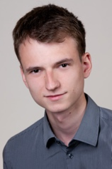
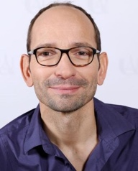
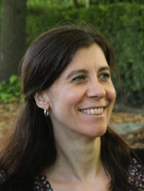
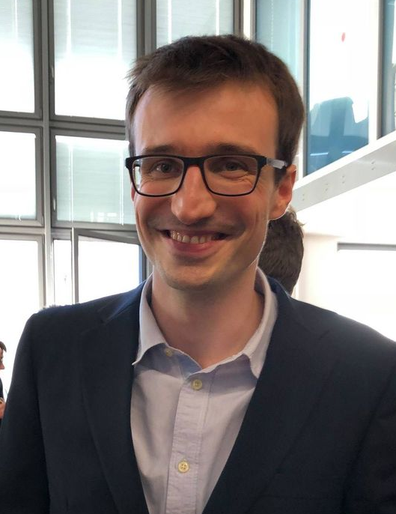
Thank you!
Lukas Maderer
Edouard Kaminsky
Veronique Van Elewyck
Simon Bourret

Slide 25
NextGen Δχ² Maps
FeNiSi₂O₄ vs FeNiH

Slide 26
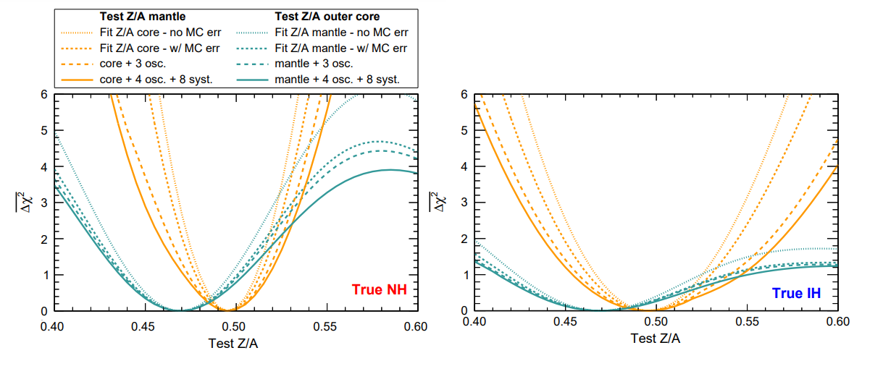
ORCA Systematic Studies

