Slide 1
Current Understanding of Inner Core Structure and Open Questions
Keith D. Koper
University of Utah
31 July 2022
Notes:
1

Slide 2
Earth’s Core
OUTER CORE
fluid (viscosity similar to water)
radius of 3480 km (bigger than Mars)
~90% Fe/Ni, 10% (Si, S, ??)
INNER CORE
solid-ish (viscosity of 10¹⁰⁻²⁰ Pas, Possion’s ratio of 0.42)
radius of 1221 km (bigger than Pluto)
~95% Fe/Ni, 5% (Si,S,??)
elastically anisotropic (conductively too ??)
May be rotating faster or slower than the rest of the Earth
Notes:
CMB contrast more extreme than contrast at surface (density jump).

Slide 3
Size Analogy
966 × 966
Inner Core
Earth
Notes:
radius of golf ball is 2.134 cm; radius of NBA basketball is 12.0 cm ; ratio is 0.178
radius of inner core is 1221 km; radius of Earth is 6371; ratio is 0.191

Slide 4
Notes:
Metallic cores are common, Earth is not unique is transition idea.

Slide 5
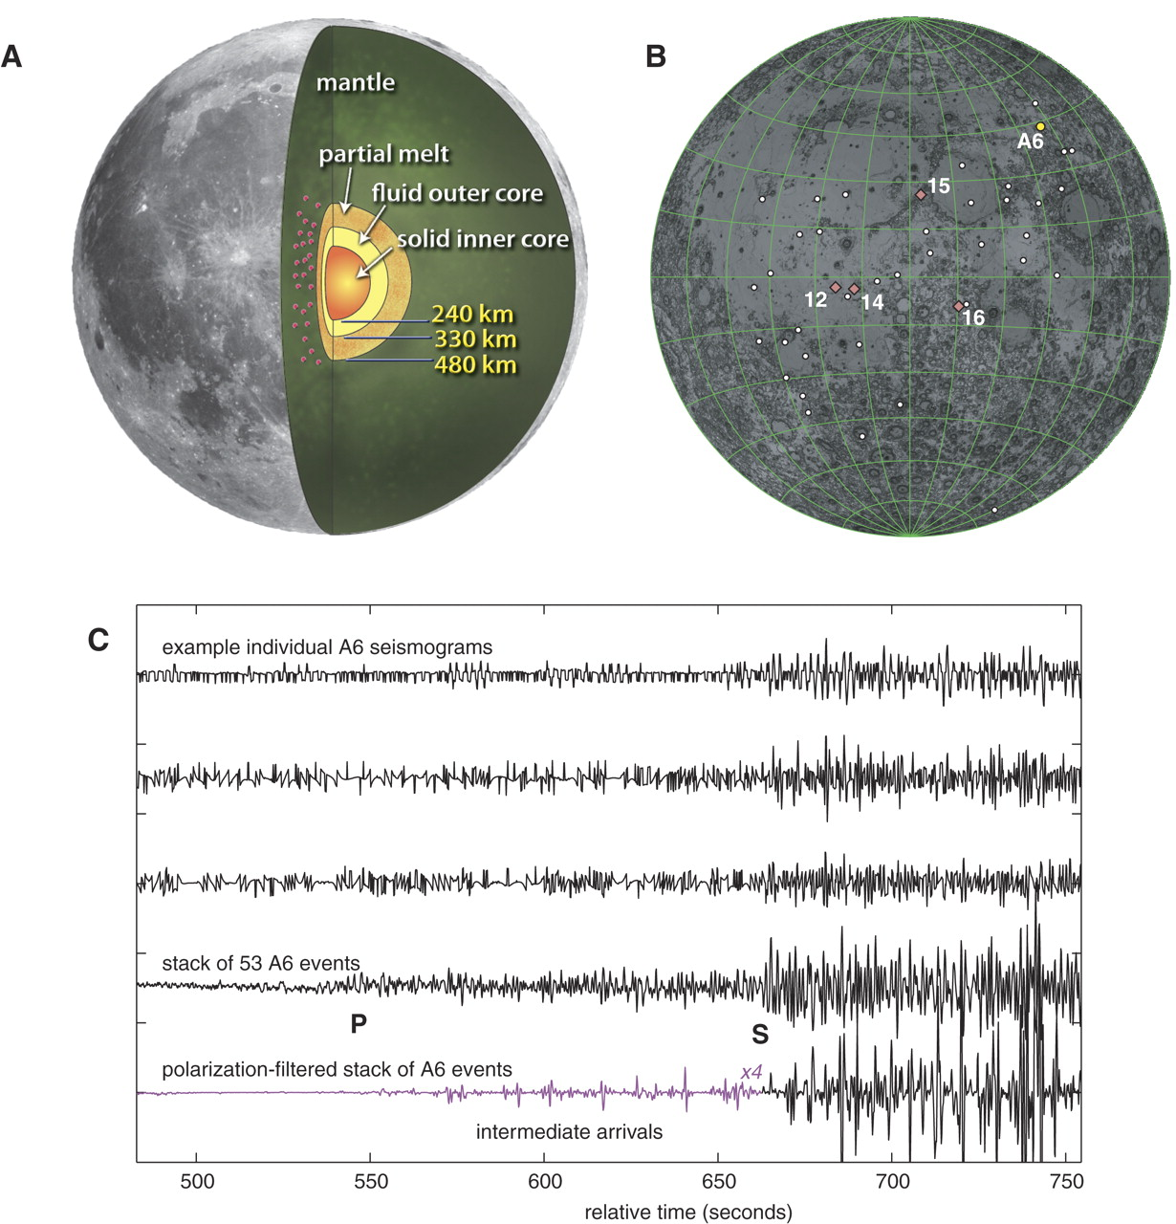
Lunar Core
Weber et al. (2011)

Slide 6
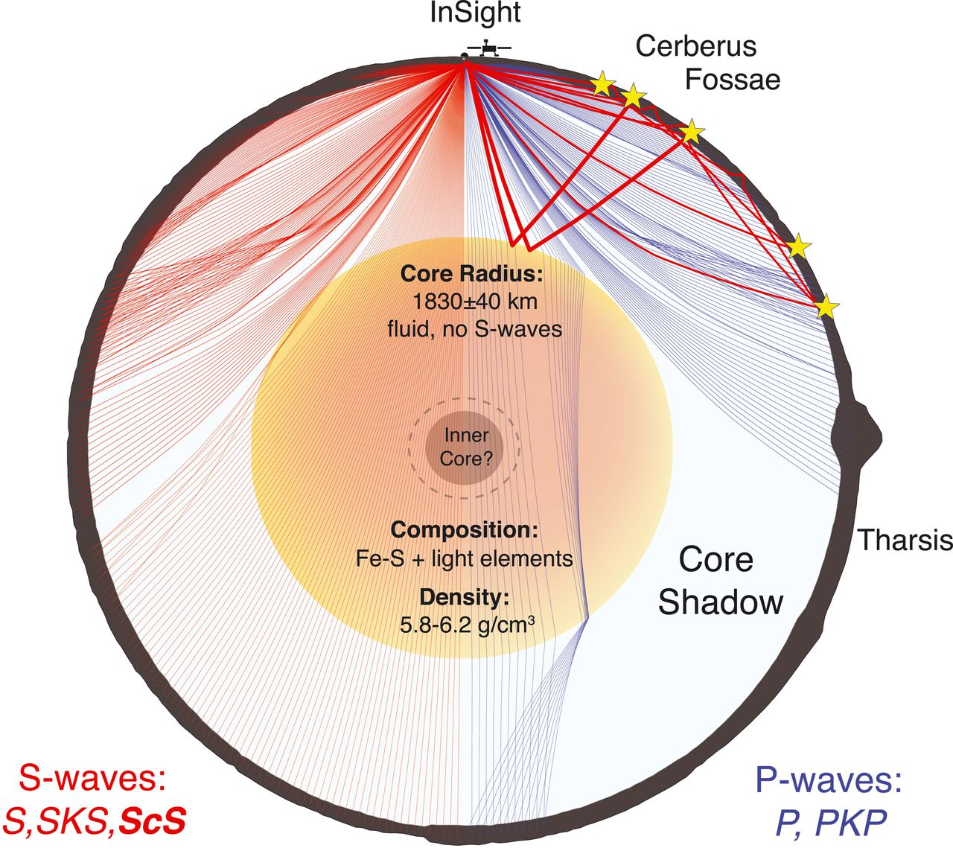
Martian Core
Stahler et al. (2021)

Slide 7
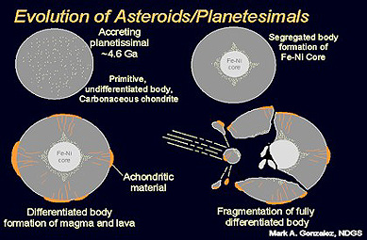
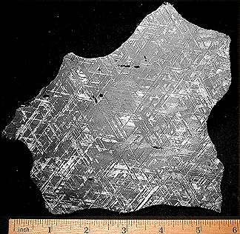
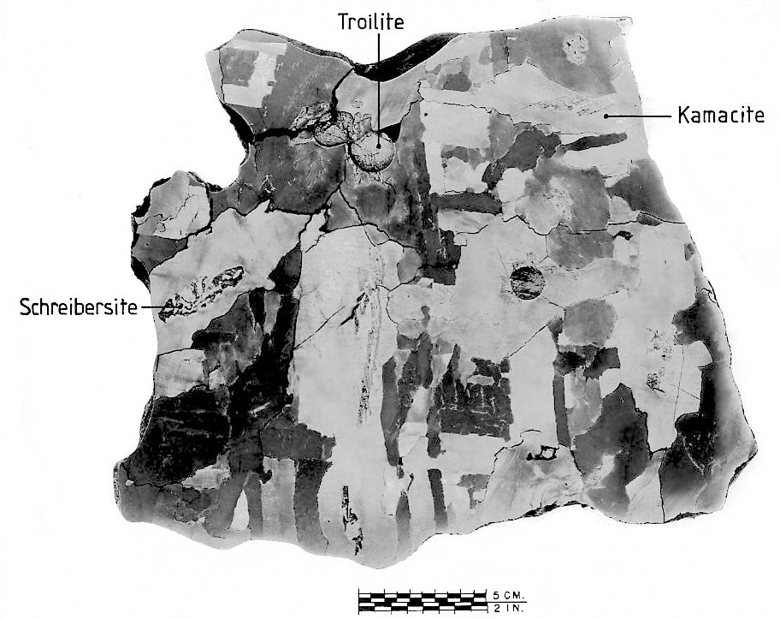
Troilite: FeS
Schreibersite: (Fe,Ni)₃P
Widmanstatten (bcc and fcc Fe)

Slide 8
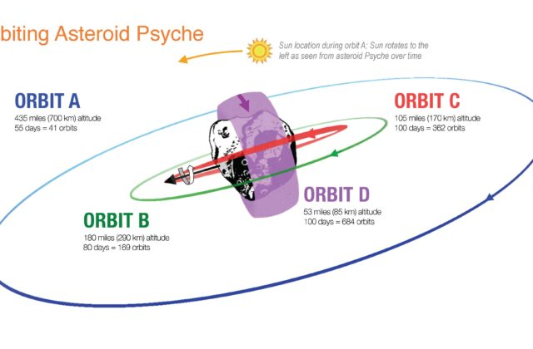
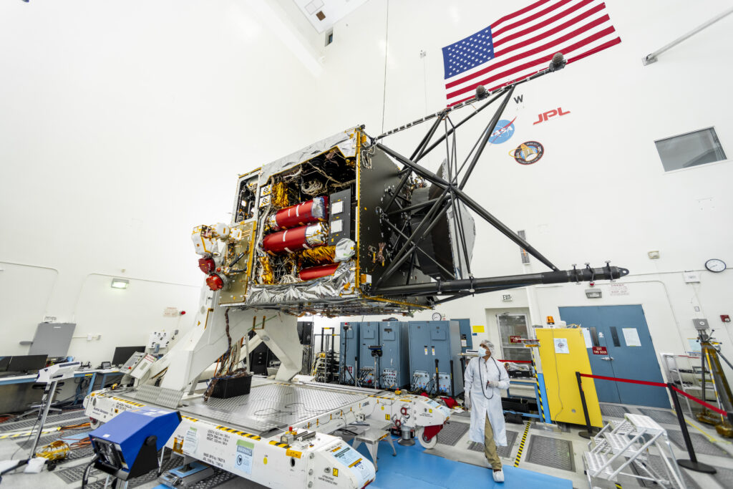
Launch scheduled for 2022; now delayed ....

Slide 9
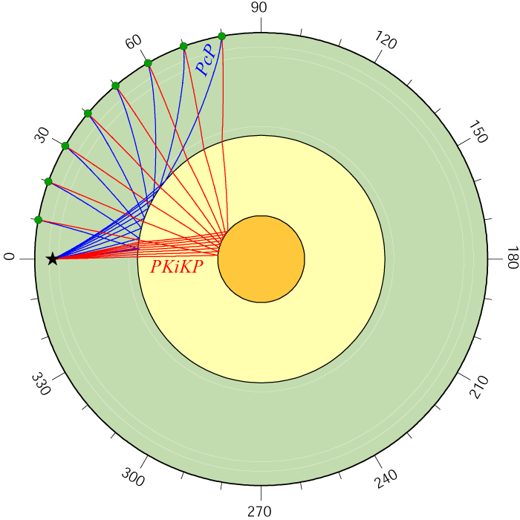
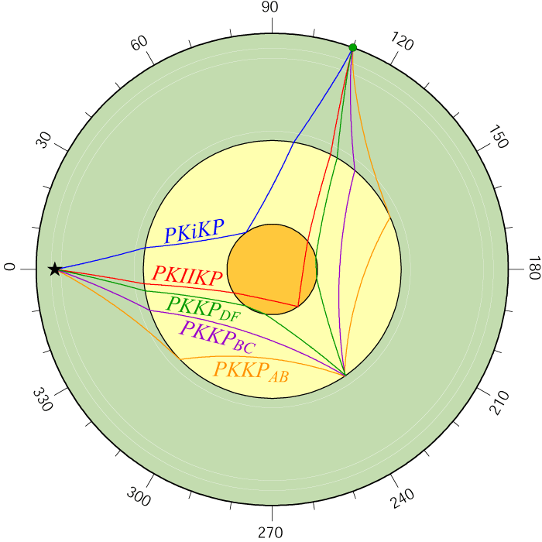
Seismic Core Probes (Remote Sensing)
(Reflected Waves, figures from Ed Garnero)

Slide 10
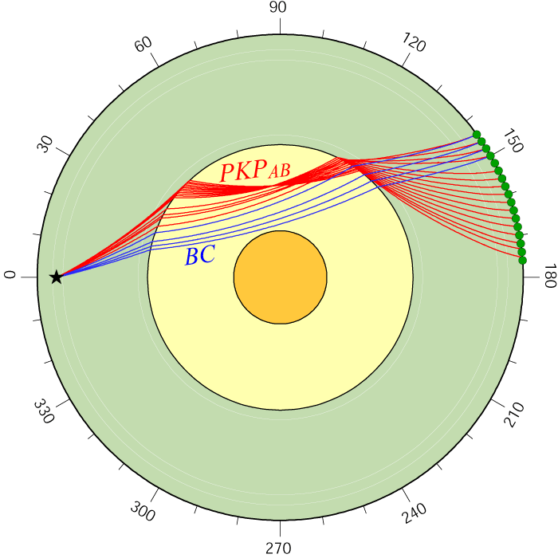
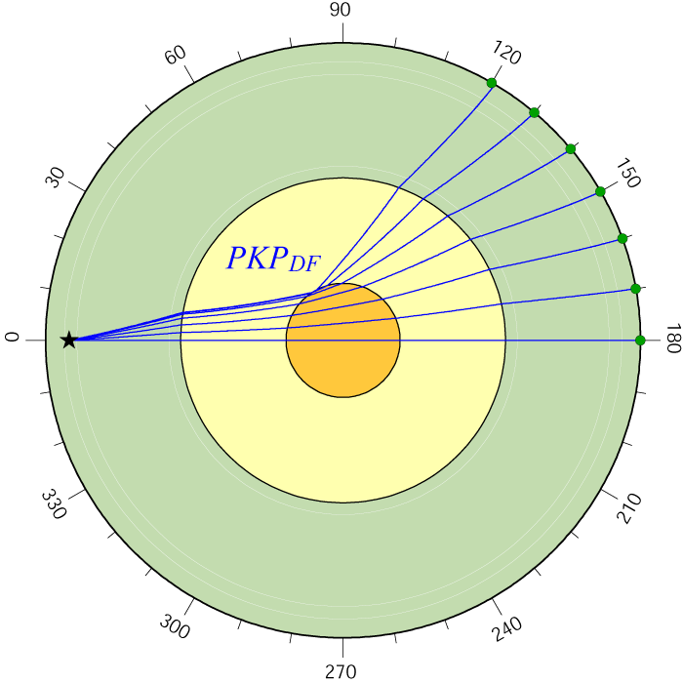
Seismic Core Probes (Remote Sensing)
(Refracted Waves, figures from Ed Garnero)

Slide 12
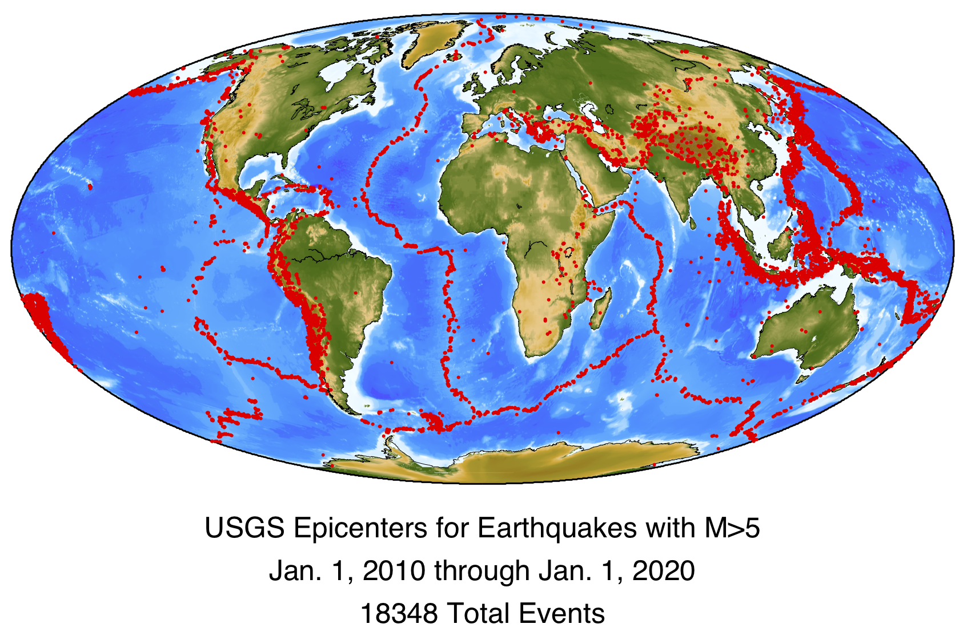

Slide 13
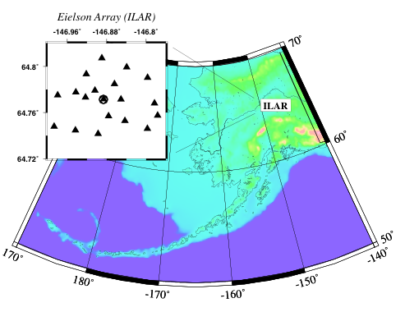
Seismic Arrays
Seismic arrays increase SNR by ~ sqrt(N) (and sometimes more!)
Seismic arrays are sensitive to the direction of incoming energy
Notes:
The increase in SNR is basically due to Central Limit Theorem and assuming that each element gives an independent estimate of the true waveform plus some random noise.
ILAR aperture is about 10 km, interstation separation of 2-3 km.

Slide 14
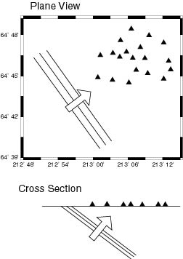
Directional Inference
Map View
Cross Section
(ray parameter)
(backazimuth)
In geologic terms, a seismic array can tell you the strike (backazimuth) and dip (ray parameter) of an incoming seismic wave.

Slide 15
Directional Inference
Increased Signal/Noise Ratio
Koper and Dombrovskaya (2005)
Notes:
This example is from an 5.8 mb earthquake that occurred 32.5 degrees away from ASAR.
The data have been bandpassed around 4 Hz.

Slide 16
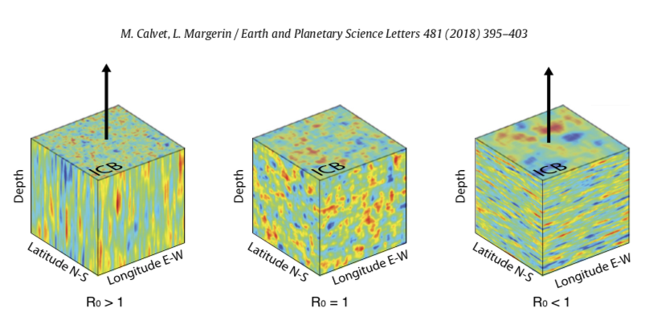
(Wu et al., in review, 2022)

Slide 17
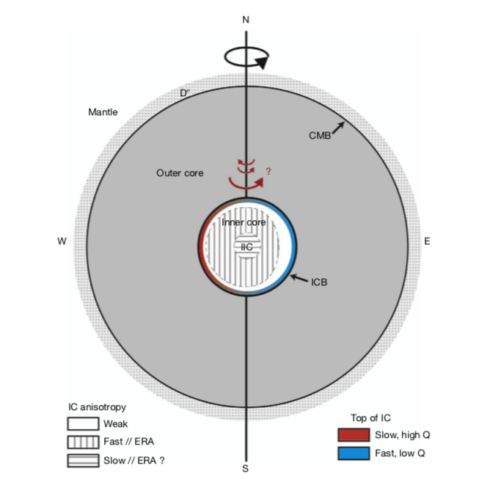
Standard Model for the Inner Core
Souriau & Calvet (2015)
Notes:
Don’t forget to talk about arrows.

Slide 18
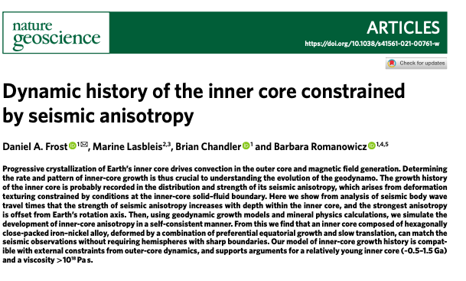
Latest Seismological Inner Core Models

Slide 19
Inner Core Questions
What is the density jump across the inner core boundary?
What are the thicknesses of layers within the inner core?
How sharp or gradual are layer boundaries?
What is the shear velocity (structure) of the inner core?
Is there any topography on the inner core boundary?
How does the P-wave velocity vary laterally?
How old is the inner core?
What is it made of (light element)?
What is the stable phase of iron?
Does it convect?
Is there partial melt?
Why is it elastically anisotropic?
How and why does it move/rotate with respect to the mantle ?
Why does the inner core have lateral heterogeneity at large spatial scales?

Slide 20
Lack of consensus on inner core rotation ...
Researches | Type | Rotation?
Song and Richards (1996) | Body wave (Anisotropic) | East ward 0.4°–1.8°/year
Creager (1997) | Body wave (velocity gradient) | East ward 0.2–0.3°/year
Souriau et al (1997) Poupinet et al (2000) | Body wave | artefacts
Vidale et al (2000) | Scattering body wave | 0.15°/year
Zhang et al (2005) | Body wave Earthquake doublets | East ward 0.3–0.5°/year
Wen (2006) | Body wave | ICB changes
Laske and Masters (1999; 2003) | Normal mode | No rotation
Lindner et al (2010) | Body wave | Accelerate super rotation
Waszek et al. (2011) | Body wave | 0.1–1°/million year
Tkalčić et al. (2013) | Body wave | Shuffling rotation
Yang and Song (2020) | Body wave | 0.05–0.1°/year
Wang and Vidale (2022) | Scattering body wave | East ward 0.29° from 1971 to 1974
Wang and Vidale (in review) | Scattering body wave | West ward 0.1° from 1969 to 1971
Oscillation?

