Slide 1






Beam background and detector considerations
Donatella Lucchesi
University and INFN Padova

Slide 2
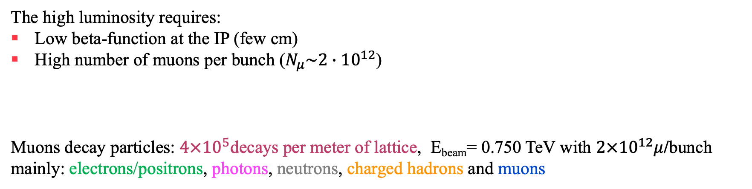
The Beam-Induced Background
The high luminosity requires:
Low beta-function at the IP (few cm)
High number of muons per bunch ($N_{μ}\sim 2∙{10}^{12}$)
Muons decay particles: $4×{10}^{5}$decays per meter of lattice, E_{beam}= 0.750 TeV with $2×{10}^{12}μ$/bunch
mainly: electrons/positrons, photons, neutrons, charged hadrons and muons

Slide 3
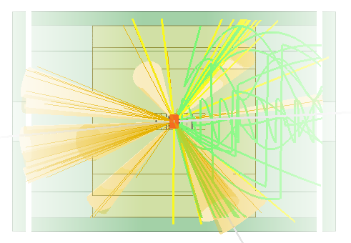
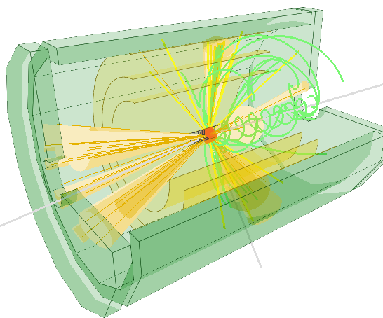
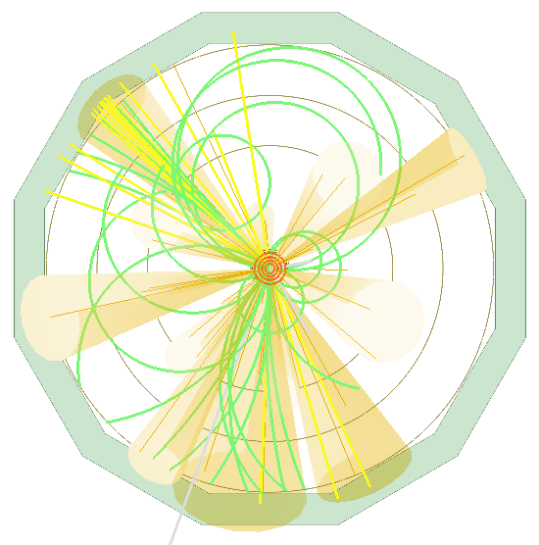
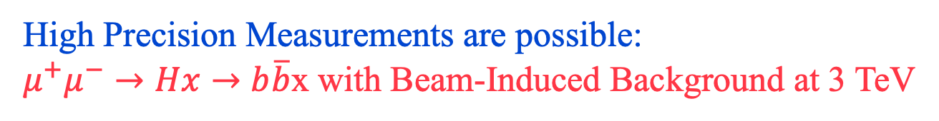
High Precision Measurements are possible:
$μ^{+}μ^{−}→Hx→b\overline{b}$x with Beam-Induced Background at 3 TeV
ECAL
Yellow/green tracks: Montecarlo particles
Inner/Outer Tracker
Vertex Detector
Event 1300, Run 13
Event display after the reconstruction
No cleaning cuts, no analysis requirements
Jets from beam background removed during the analysis

Slide 4
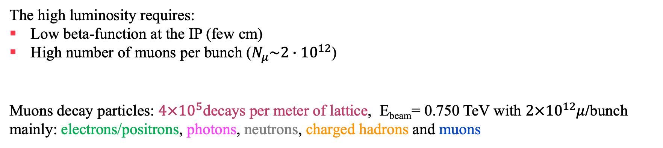
The Beam-Induced Background Mitigation
The high luminosity requires:
Low beta-function at the IP (few cm)
High number of muons per bunch ($N_{μ}\sim 2∙{10}^{12}$)
Muons decay particles: $4×{10}^{5}$decays per meter of lattice, E_{beam}= 0.750 TeV with $2×{10}^{12}μ$/bunch
mainly: electrons/positrons, photons, neutrons, charged hadrons and muons
So far, the best way to mitigate the particle fluxes effects on detector is the nozzles, two shielding cones entering in the detector.
Di Benedetto et al., A study of muon collider background rejection criteria in silicon vertex and tracker detectors. Journal of Instrumentation13(2018)

Slide 5
What the nozzles do?
charged hadrons
F. Collamati et al. 2021 JINST 16 P11009
Charged hadrons absorbed
Muon beam 0.75 TeV
Photons
electrons/positrons
neutrons
absorbed
Neutrons increased
Change cladding materials?
Lythium Polyethylene instead of BCH2?

Slide 6
Beam-Induced Background Properties
N. Bartosik et al 2020 JINST 15 P05001
Low momentum particles
Partially out of time with respect to beam crossing t₀

Slide 7
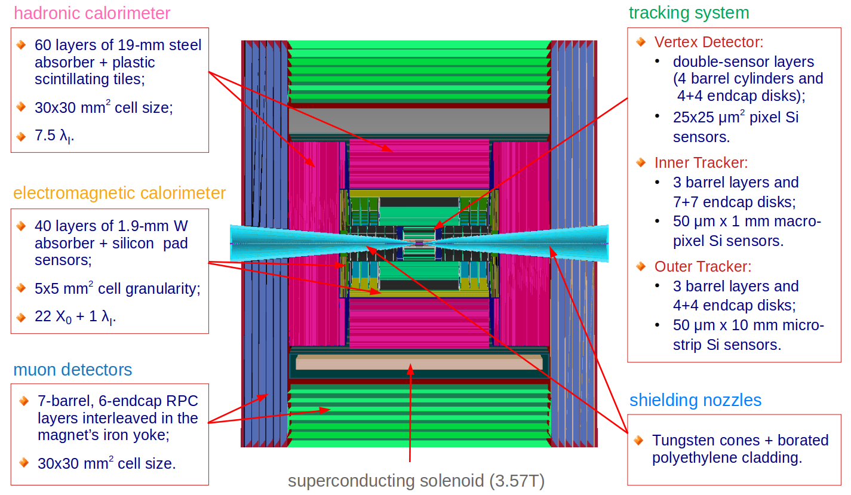
Detector Configuration $for \sqrt{s}=$1.5 TeV

Slide 8
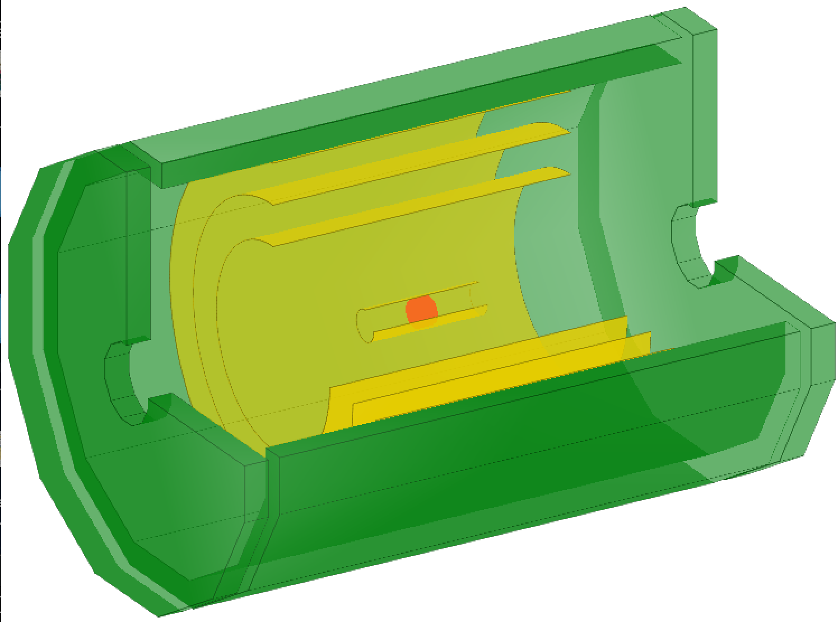
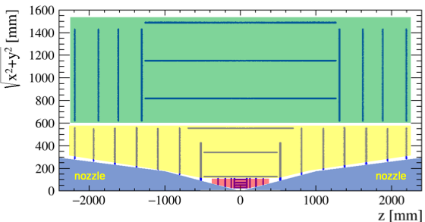
Beam-Induced Background affects mainly tracker and electromagnetic calorimeter
Only these two are discussed
ECAL
Outer Tracker
Inner Tracker
Vertex Detector
Vertex Detector
Inner/Outer Tracker

Slide 9
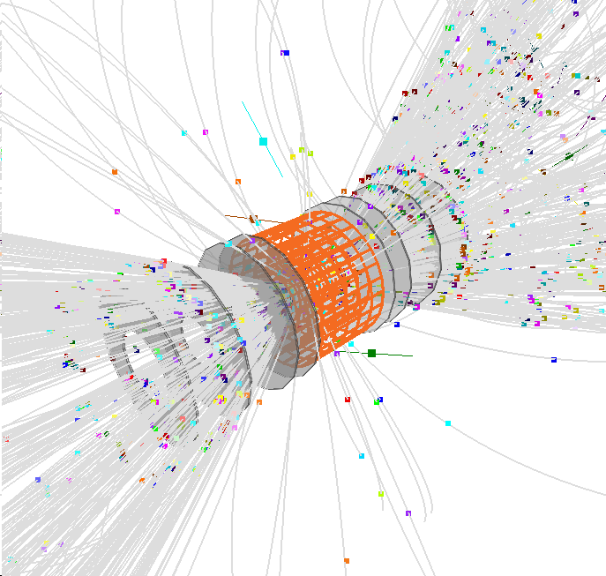
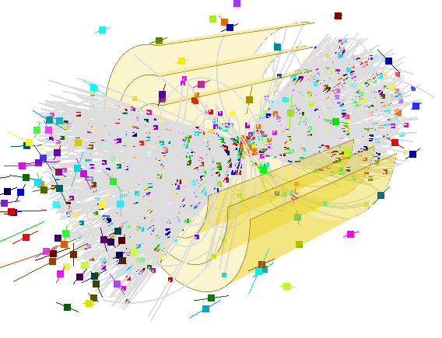
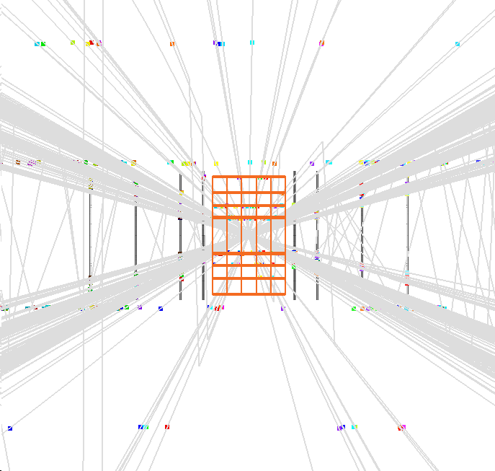
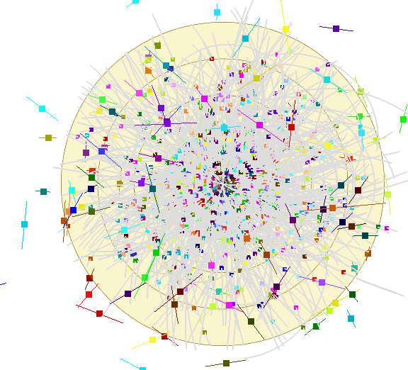
Beam-Induced Background in the Tracker
BIB events reconstruction by Massimo Casarsa
Vertex
Detector
Inner/Outer
Tracker

Slide 10
Origin of Beam-Induced Background in the Vertex Detector
One beam only, E = 0.750 TeV
Nazar Bartosik
Given a hit in the vertex tracker, central, backward (same side of beam), forward (opposite side of beam), z position of the original particle background that generated it.
Nozzle contributions on the barrel (same side) and on the other side for the endcap.
µ
nozzle
pipe
nozzle

Slide 11
Beam-Induced Background in the Tracker Detector
Nazar Bartosik
Direct 76%
Indirect 24%
Direct 67%
Indirect 33%
Electrons/
Positrons
80%
Photons
20%
Direct 100%
Indirect 0%
Direct 100%
Indirect 0%
Direct beam background affects first layers of central and forward tracker (indirect sizeable)

Slide 12
Origin of Beam-Induced Background in the Tracker
Nazar Bartosik
One beam only, E = 0.750 TeV
Inner tracker
Outer tracker
µ
µ
nozzle
pipe
nozzle
nozzle
pipe
nozzle
Given a hit in the tracker, central, backward (same side of beam), forward (opposite side of beam), z position of the original particle background that generated it.
Important contribution of back scattering on the nozzle on the other side

Slide 13
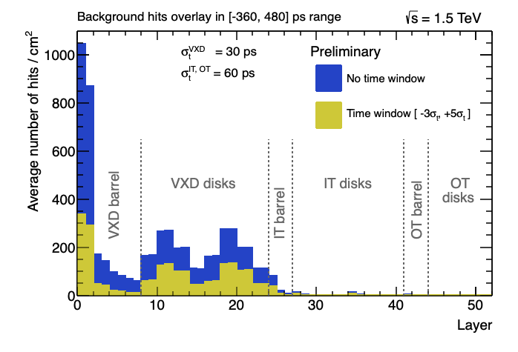
Considerations on Tracker
Apply timing window to reduce hits from out-of-time background. Effectiveness at high energies to be studied.
Design tracker avoiding beam hot spots, or
design IR that do not generate hot spots.
Preliminary
Preliminary
Sensor granularity and time resolution, layers configuration (tilted double layers, etc.), detector geometry and configuration to optimized

Slide 14
Use Directional Information at different stages
Correlation between two close layers could be very effective at pattern recognition
Realistic digitization reduce BIB hits
In progress, dedicated experienced person needed
Need optimization to avoid bias on secondary particles

Slide 15
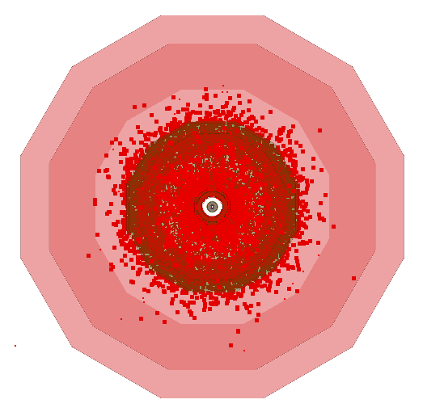
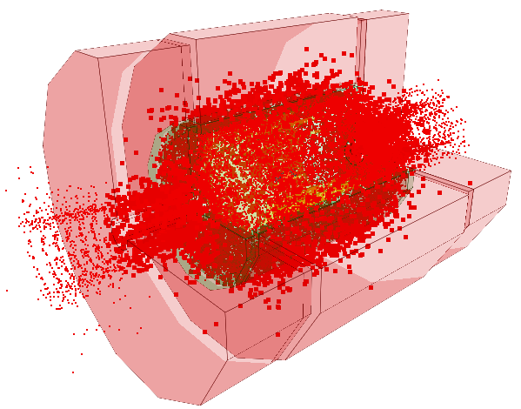
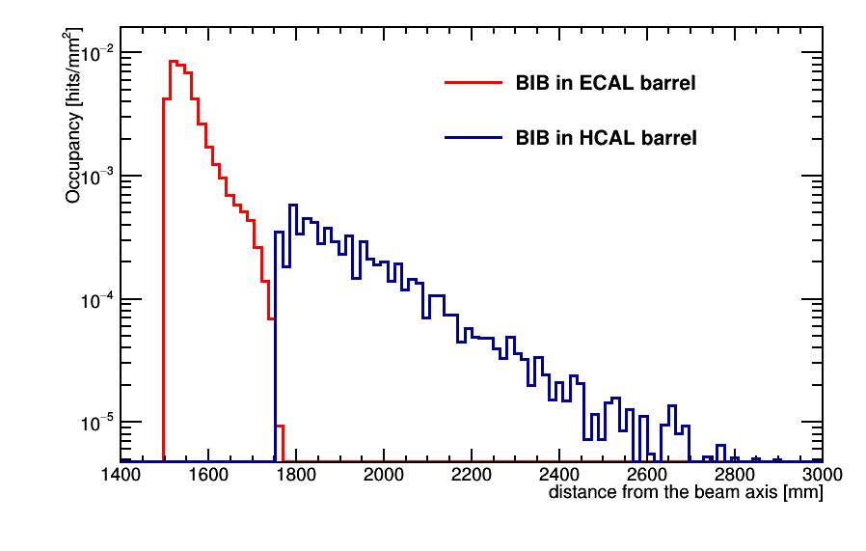
Beam-Induced Background in the Calorimeter
HCAL
HCAL
ECAL
ECAL
Beam background is not an issue for HCAL

Slide 16
Origin of Beam-Induced Background in the ECAL
Nazar Bartosik
One beam only, 0.750 TeV
Given a hit in the EM calorimeter, central, backward (same side of beam), forward (opposite side of beam), z position of the original particle background that generated it.
Important contribution of back scattering on the nozzle on the other side
pipe
nozzle
µ

Slide 17
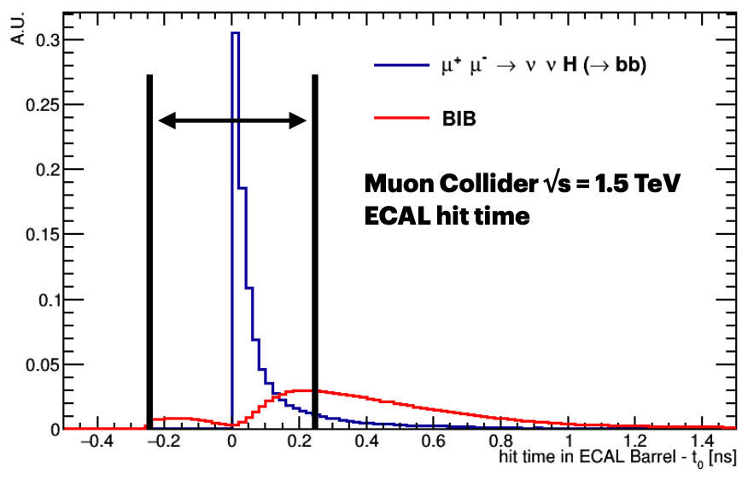
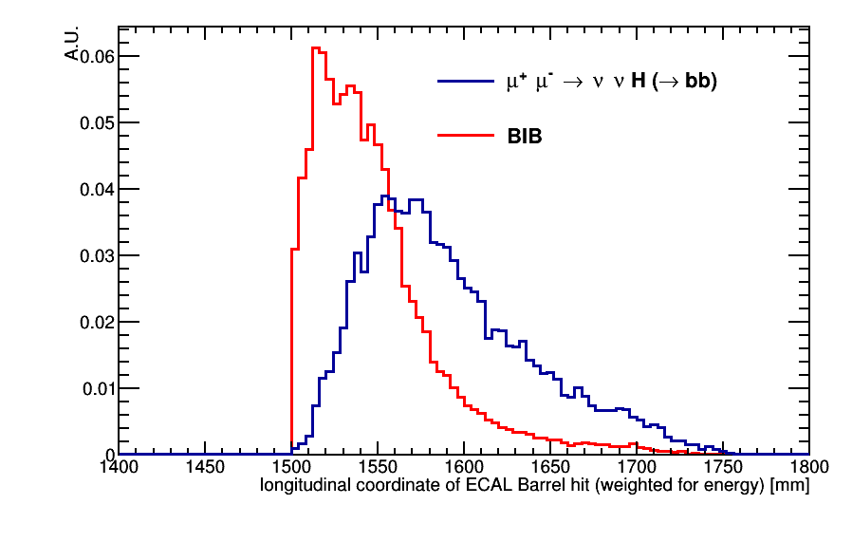
ECAL Beam Background Mitigation
Lorenzo Sestini
ECAL barrel hit arrival time – t₀
Optimization of the timing window will mitigate the beam background at acquisition time
Longitudinal shower profile is planned to be used in clusters reconstructions
Transversal shower profile still to be investigated
New calorimeter investigation: active/passive material, time information, granularity, etc.

Slide 18
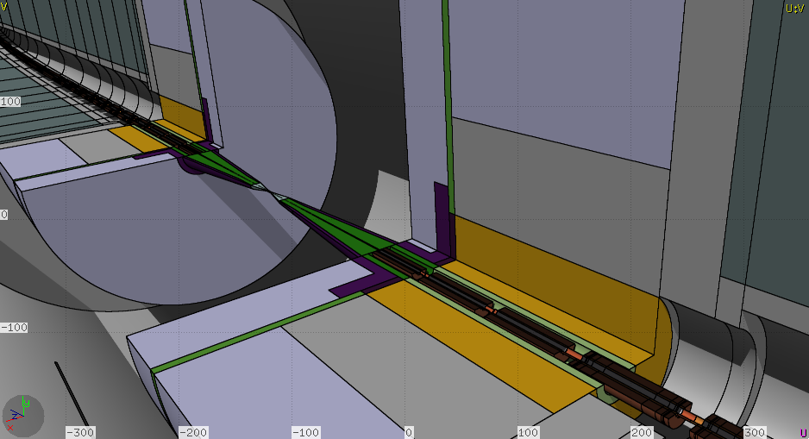







To conclude
Beam-Induced Background affects mainly tracker and ECAL.
Study of the origin of the most relevant contributions to such a background in progress.
Optimization of IR and detector design need to proceed in parallel, still to be done!
Very interesting activity specially for young scientists: possibility to design a detector together with accelerators experts since the very beginning!
Alessio Mereghetti
Insert here your detector

