Slide 1
Democratizing Access to Cyberinfrastructure
Kevin Thompson
Office of Advanced Cyberinfrastructure (OAC)
Computing and Information Science and Engineering (CISE)
OSG All-Hands Meeting
March 15, 2022

Slide 2
Outline
NSF and OAC
Democratizing access to the National Cyberinfrastructure Ecosystem
CC*,CyberTraining, and the HTC DCL

Slide 3
Outline
NSF and OAC
Democratizing access to the National Cyberinfrastructure Ecosystem
CC*, CyberTraining, and the HTC DCL

Slide 4
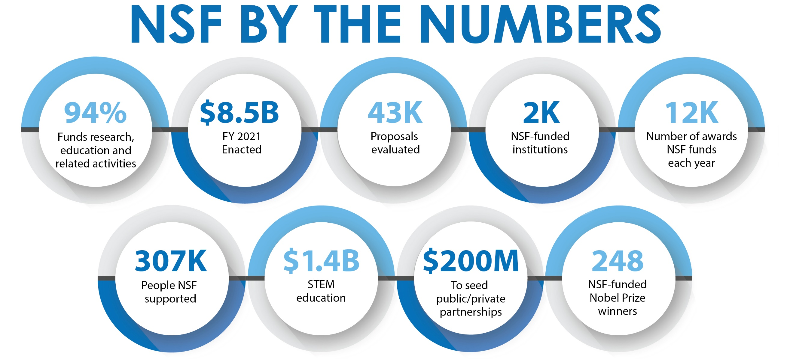

Slide 5
FY 2022 NSF Priorities
Enhance Fundamental Research and Development
Support research across the spectrum of science, engineering, technology, and education
Strengthen U.S. Leadership in Emerging Technologies
Includes the establishment of a new directorate for technology, innovation, and partnerships within NSF to advance science and engineering research and innovation
Advance Equity in Science and Engineering
Increase participation in science and engineering of individuals from racial and ethnic groups underrepresented in these fields
Advance Climate Science and Sustainability Research
Advance use-inspired, solution-oriented research and innovation in climate and clean energy-related research
Advance Forefront Infrastructure
Continue construction of major NSF research facilities

Slide 6
Designing for the Future: A New Horizontal
Translation
BIO
CISE
EHR
ENG
GEO
MPS
SBE
Technology & Innovation
Partnerships
Notes:
Our intent for ALL TIP programs to be diverse and inclusive: I-Corps, SBIR/STTR and REIs specifically – we want to make it possible for anyone, anywhere who has a great idea to get the entrepreneurial training and support to bring that great idea to market.

Slide 7
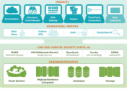
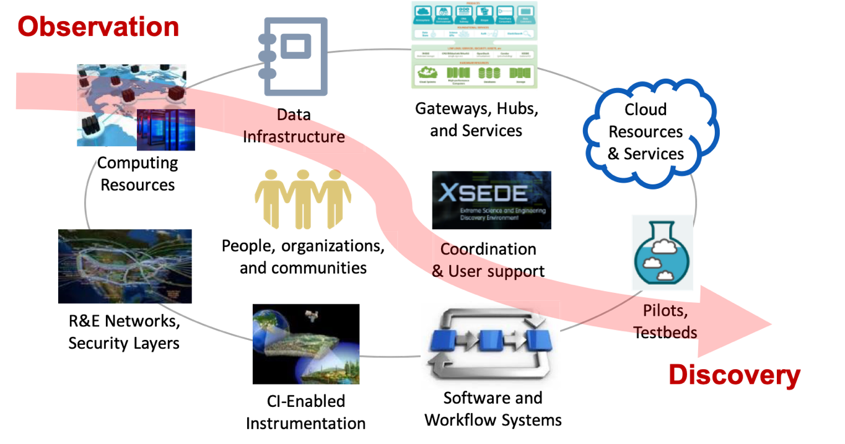
NSF Office of Advanced Cyberinfrastructure (OAC)
Foster a cyberinfrastructure ecosystem to transform science and engineering research… through Research CI and CI research
NSF’s vision for a National Cyberinfrastructure Ecosystem for Science and Engineering in the 21st Century
An agile, integrated, robust, trustworthy and sustainable CI ecosystem that drives new thinking and transformative discoveries in all areas of S&E research and education.
Overarching principles:
View CI more holistically
Support translational research
Balance innovation with stability
Couple discovery and CI innovation cycle
Improve usability
http://go.usa.gov/xm8bU
People, organizations,
and communities
Coordination
& User support
Gateways, Hubs,
and Services
Data Infrastructure
Software and
Workflow Systems
CI-Enabled
Instrumentation
Pilots,
Testbeds
Rapid (disruptive ) changes in S&E and CI landscapes → Cyberinfrastructure ecosystem must evolve!
Cloud Resources & Services
Computing
Resources
R&E Networks,
Security Layers
Notes:
Demand continues to grow, but is changing
Applications are evolving in numbers, scales and complexity
Computing and technology landscapes are changing
Value structures are different
E.g., Neil Jacob’s talk at the OSTP FACE Convening
Affinities in the COVID-19 HPC Consortium
More than 75% of all XSEDE jobs are now single node jobs (but still only about 25% of XD SUs)
Up to 50% of all jobs ON Frontera are single node jobs
Overall demand continues to grow, but is changing
Single node jobs dominating
Smaller jobs (i.e., using <= 8K cores) dominating
Gateway users dominating
Application needs are changing
Growing, broadening of domains
End-to-end workflows composing heterogenous components
Integration of analytics; use of AI/ML
Computing and technology landscapes are changing
Increasing heterogeneity / Proliferation of purposeful accelerators
Increasing use of high-level software stacks for packing, deployment, execution, tuning, etc. (e.g., containers)
Service model evolving to address a broad range of needs and customers
Deployment of exascale systems in 2021-2023
Value structures are different
Ease/speed of access and use V/S raw performance
Transparency, trust, robustness, etc., V/S raw performance
“Time to end result” more meaningful than performance of an individual code

Slide 8
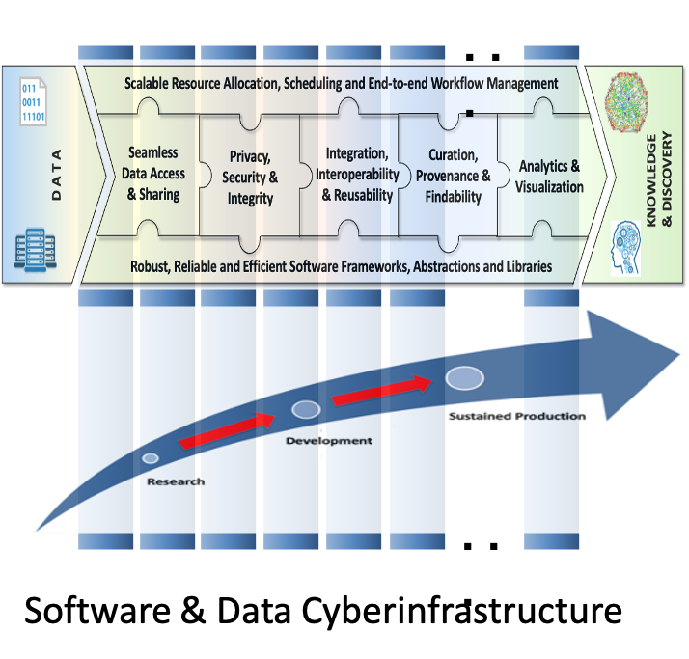
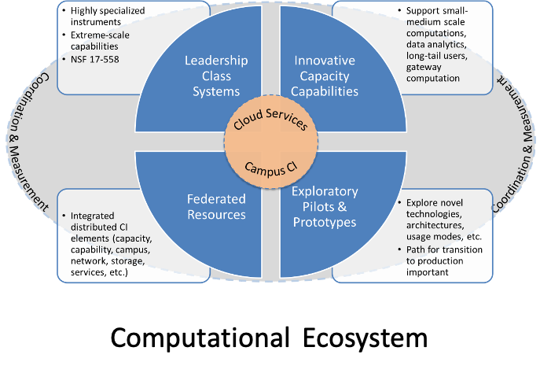
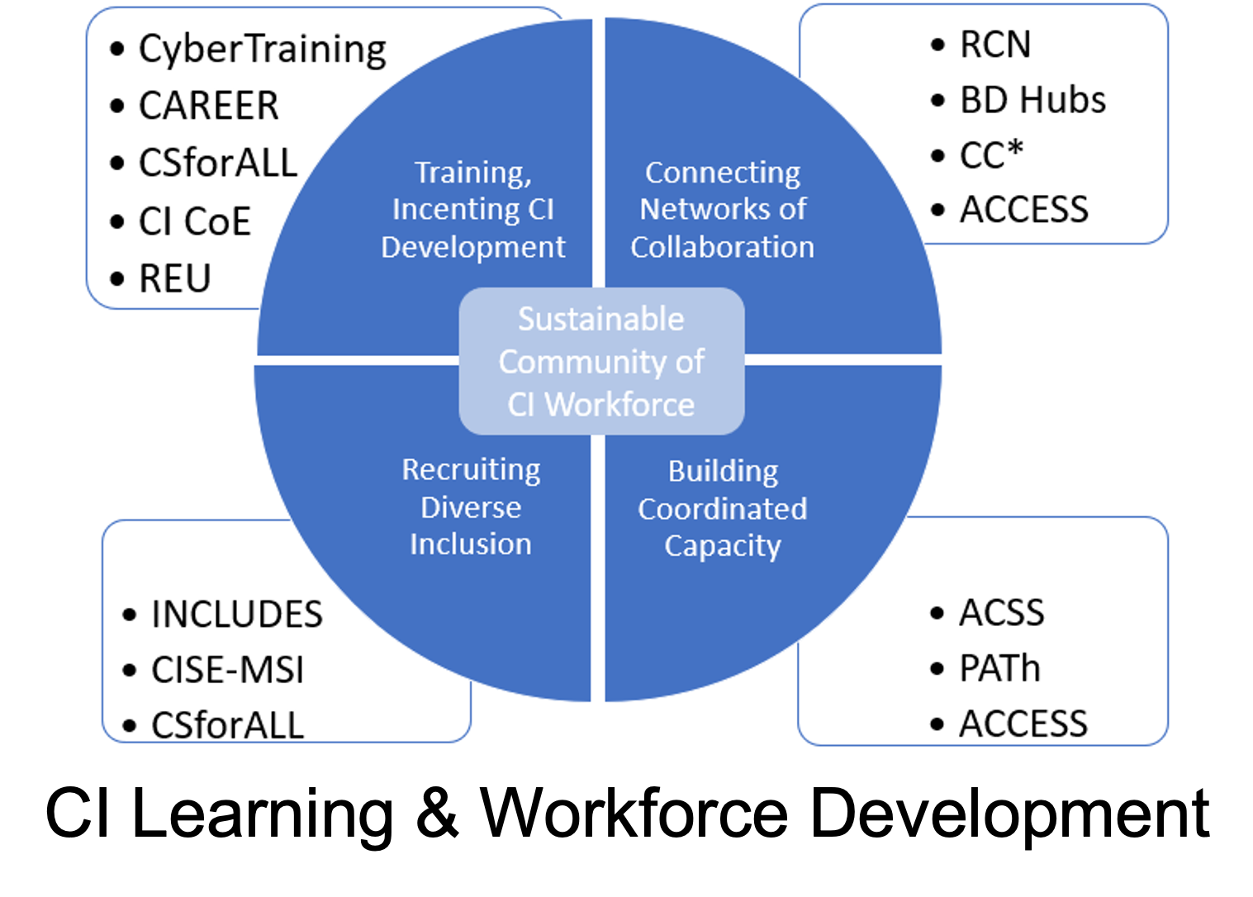
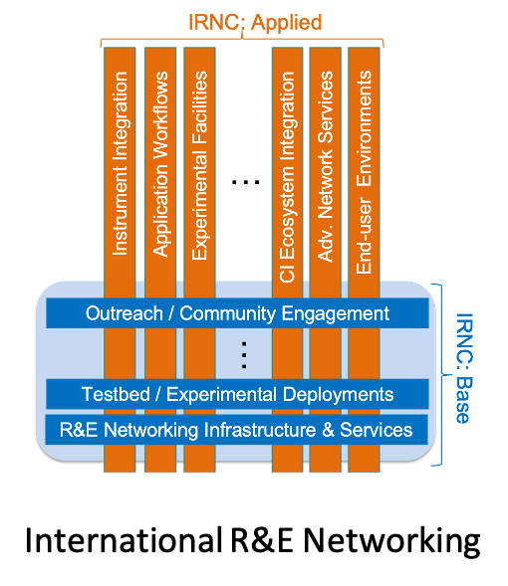
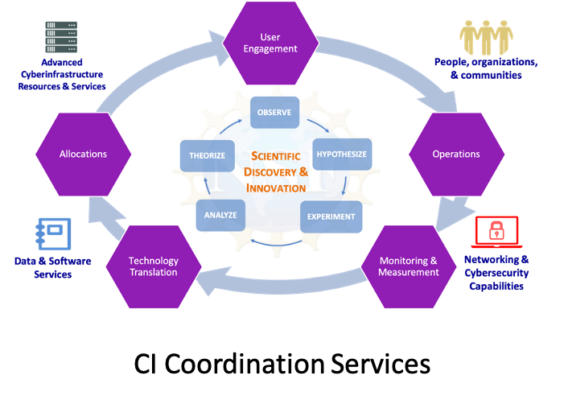
NSF’s vision for a National Cyberinfrastructure Ecosystem for Science and Engineering in the 21st Century
Community-informed blueprints provide implementation strategies for different elements of the CI ecosystem
More information at: http://go.usa.gov/xm8bU

Slide 9
Outline
NSF and OAC
Democratizing access to the National Cyberinfrastructure Ecosystem
CC*, CyberTraining, and the HTC DCL

Slide 10
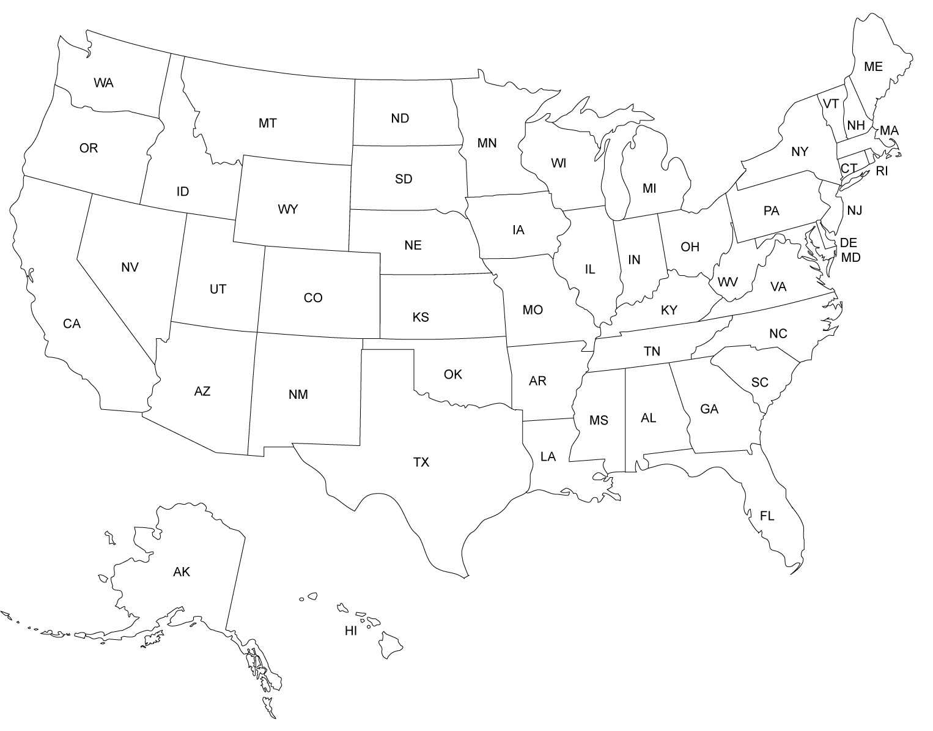
PATh/OSG (Madison)
Anvil (W. Lafayette)
Ookami (Stonybrook)
Cheyenne (Cheyenne)
Chameleon Lab (Chicago)
Bridges-2, Neocortex (Pitt)
Delta (Urbana-Champaign)
Jetstream, JetStream-2 (Bloomington)
CloudLab (Salt Lake City)
XSEDE 2 (Urbana-Champaign)
Expanse, Voyager, National Research Platform (San Diego)
Leadership-class
CloudBank (San Diego)
Innovative systems
Stampede 2, Wrangler (Austin)
Services
Frontera (Austin)
NCAR
ACES (College Station)
Cloud Resources
Shared Campus Resources
NSF-Supported Advanced CI Ecosystem
Notes:
NSF is largest single resource provider in consortium. 46% of projects, ~30% of cycles
OAC-funded: Frontera, XSEDE, and more
You all are correct. Ookami, Bridges-2, & Neocortex along with Expanse as our newly awarded systems are all presently in operations supporting S&E researchers. Our other awarded systems are presently all progressing but still being deployed.

Slide 11
Democratizing access to the National Research Infrastructure
Goals
Discovery & Access: Provide unified access portals / mechanisms across the CI ecosystem
Allocation: Support a diversity of allocation model, including on-demand (cloud-like)and urgent access; expedite access to resources
Support: Develop agile and scalable models for support; ensure support is responsive to local needs
The Missing Millions: Democratizing Computation and Data to Bridge Digital Divides and Increase Access to Science for Underrepresented Communities (A. Blatecky, EAGER)
https://www.rti.org/publication/missing-millions/fulltext.pdf
Notes:
Go over results of the poll

Slide 12
Democratizing access to the National Research Infrastructure
Goal => Actions
Access: Provide unified access portals / mechanisms across the CI ecosystem
Research Resource Access Pilot: Enable a user to launch a high-throughput workflow across a range of resources using existing allocations and credits
Allocation: Support a diversity of allocation models; expedite access to resources
Support: Develop agile and scalable models for support; accessibility and resource integration; ensure support is responsive to local needs
Notes:
EAGER Award# 2127459: Democratizing the use of Advanced Computational Resources

Slide 13
Democratizing access to the National Research Infrastructure
Notes:
EAGER Award# 2127459: Democratizing the use of Advanced Computational Resources

Slide 14
Democratizing access to the National Research Infrastructure
Goal => Actions
Access: Provide unified access portals/mechanisms across the CI ecosystem
Research Resource Access Pilot: Enable a user to launch a high-throughput workflow across a range of resources using existing allocations and credits
Allocation: Support a diversity of allocation models; expedite access to resources
Research Resource Allocation Pilot: Support allocations of high-throughput resources during proposal review (DCL NSF 22-051; 14 participating programs)
Support: Develop agile and scalable models for support; accessibility and resource integration; ensure support is responsive to local needs
OAC Vision & Blueprint: Cyberinfrastructure Learning & Workforce Development https://www.nsf.gov/cise/oac/vision/blueprint-2019/
Advanced Computing Cyberinfrastructure Ecosystem: Support Services (ACCESS - NSF 21-555; ACCESS-ACO - NSF 21-556)
Notes:
EAGER Award# 2127459: Democratizing the use of Advanced Computational Resources

Slide 15
Strengthening the CI Professionals Workforce
Developing an NSF-wide Strategy for CI Professionals: Goals
Promote professional development, career paths; incentivize coordination; address sustainability
Establish, foster and nurture a community
Incentivize/support the development of necessary academic structures/career paths

Slide 16
Strengthening the CI Professionals Workforce
Developing and NSF-wide Strategy for CI Professionals: Goals => Actions
Promote professional development, career paths, incentivize coordination; address sustainability
Nurturing Diverse, Skilled, Capable, and Productive Communities of Cyberinfrastructure Professionals (DCL; NSF 22-052)
CI Professional Mentoring and/or Professional Development Plan requirement in solicitations funding CI professionals
Better Scientific Software Fellows (https://bssw.io)
Establish, foster, and nurture a community
CI CoE Pilot: Minority Serving Cyberinfrastructure Consortium (MSCC)
Research Coordination Networks: Fostering and Nurturing a Diverse Community of CI Professionals (RCN:CIP;-NSF 22-558)
Training-based Workforce Development for Advanced Cyberinfrastructure (CyberTraining; NSF 22-574; due May 16, 2022)
Support the development of academic structures/career paths
CI CoE Pilot: Research Computing and Data Resource and Career Center (http://rcd-nexus.org)

Slide 17
#2137123: NSF Cyberinfrastructure (CI) Center of Excellence Pilot
Minority Serving Cyberinfrastructure Consortium (MS-CC)
Internet2 Principal Investigator: Ana Hunsinger [ana@internet2.edu]
Objectives
Scientific Impact
Create a connective and collaborative organization that serves as a centralized hub for HBCUs, TCUs, and other MSIs to utilize for CI advocacy, guidance and expertise
Increase awareness, availability, and financial support for professional development opportunities for faculty, staff, and students at HBCUs, TCUs, and other MSIs
Enhance communication among researchers, university leadership, and CI professionals
Increase access to shared CI resources at MS-CC organizations
Increase diversity in the STEM talent pool and workforce
Advance understanding of why CI collaboration among institutions is beneficial
Advance CI capabilities at minority serving campuses
Keywords
Anticipated Deliverables
HBCU
TCU
HSI
MSI
STEM
Broadening participation
Cyberinfrastructure
Professional Development
Digital divide
Diversity
Inclusion
Equity
MS-CC dedicated staff
Development and deployment of CI shared resources, including a CI cyberteam
Specialized campus workshops and community webinars
NSF Big Data Hub Collaborations
Presidents’ workshops
Travel stipends for faculty, students, and staff
Mentorships and Internships for MS-CC member organizations
Stakeholder alignment mini-surveys as feedback
Advancing opportunities that amplify successful NSF proposals from MS-CC members
See: https://internet2.edu/solutions/minority-serving-institutions/

Slide 18
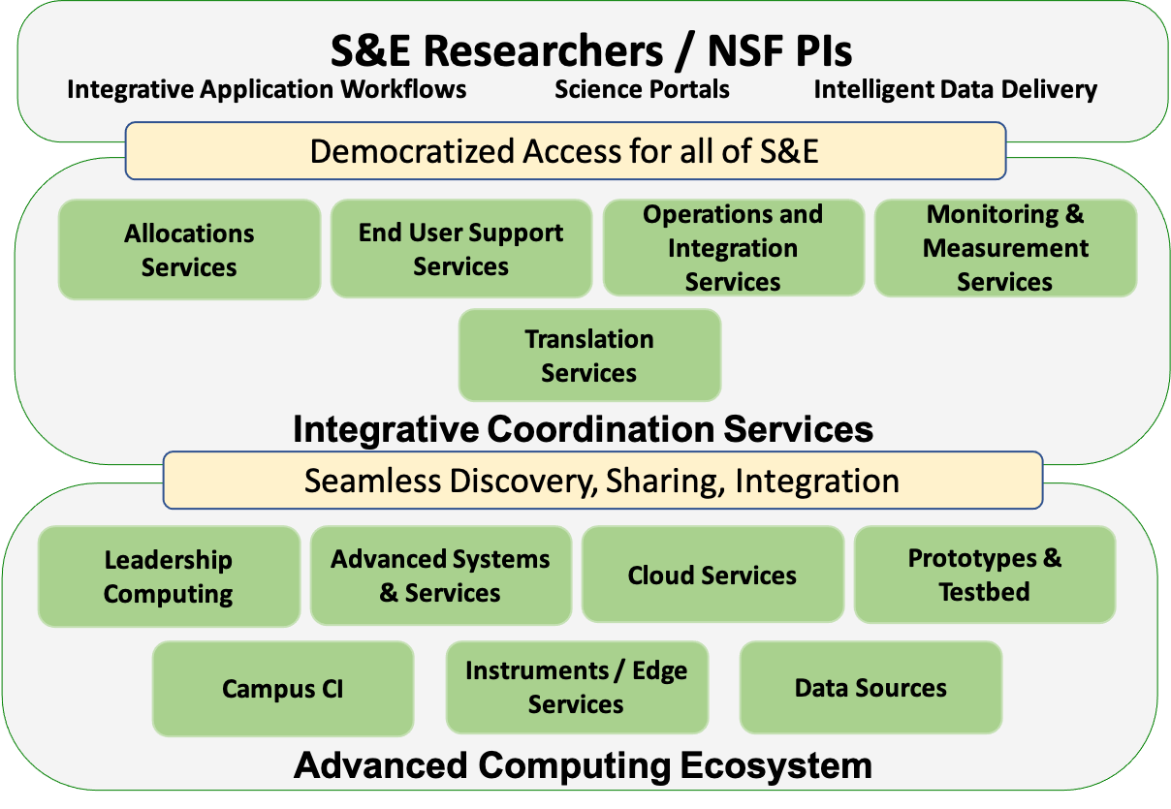
Envisioning a National Research Ecosystem (Cloud)
Notes:
Drivers:
Demand continues to grow, but is changing
Applications are evolving in numbers, scales and complexity
Computing and technology landscapes are changing
Value structures are different
Goals:
Address changing technology, system, application landscapes; user needs and values
Balance innovation with stability
Experiences from COVID19 HPC Consortium

Slide 19
Outline
NSF and OAC
Democratizing access to the National Cyberinfrastructure Ecosystem
CC*, CyberTraining, and the HTC DCL (PATh/OSG mentioned in all 3)

Slide 20
CyberTraining – Training-based Workforce Development for Advanced Cyberinfrastructure (NSF 22-574)
Three goals for research workforce development
Broaden adoption of CI tools/methods, or
Curriculum/Instructional Materials Development and Integration
Build research CI professional communities
Three project classes:
Pilot: Exploratory activities, $300K, 2 yrs
Implementation: Broadly accessible to community
Small: $500K, 4 yrs
Medium: foster a community, $1M, 4 yrs
CI Professional:
Up to 2 FTEs per institution, 4 FTEs total, up to 5 yrs
3 communities of concerns
CI Professionals, CI Contributors, and CI Users
Participation:
ENG, GEO, SBE, MPS, EHR, CISE, and various divisions within those directorates
OAC – lead
Send 1-page project summary
Excellent community response
~10-12 awards per year last several years for Pilot and Implementation projects
CI Professionals are new
Deadline:
May 16, 2022
Webinar on April 7 – sign up!
Notes:
Computational and Data-driven Science and Engineering for all

Slide 21
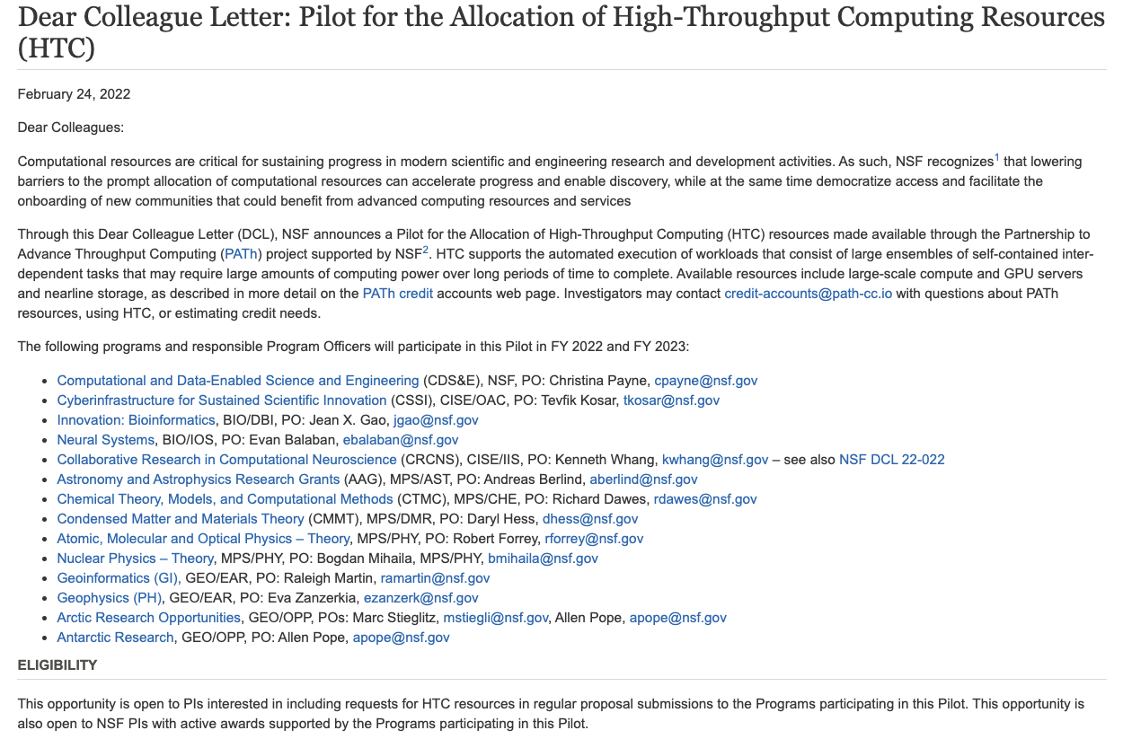

Slide 22
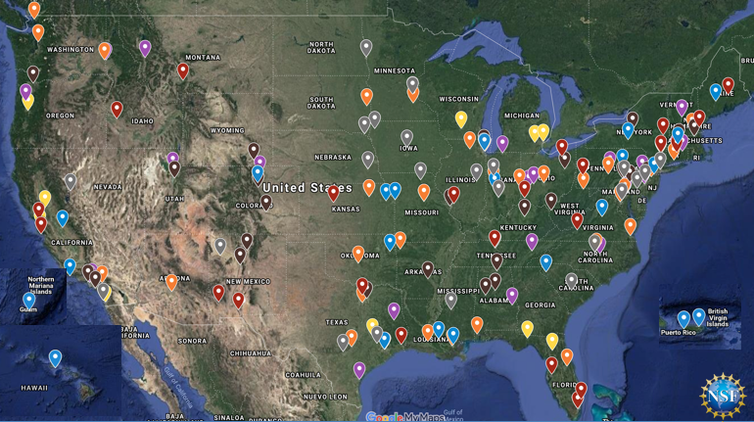
The Campus Cyberinfrastructure (CC*) Program
Networking as a fundamental layer and underpinning of Cyberinfrastructure, driven by scientific R&E needs
Most awards have gone to 10/100 Gbps Campus networking upgrades, external connectivity to the national R&E fabric, and campus border redesign prioritizing science traffic.
CC* emphasizes strong campus level partnerships between researchers/teachers and campus IT leadership

Slide 23
CC* 21-528 - Campus Cyberinfrastructure
https://www.nsf.gov/pubs/2021/nsf21528/nsf21528.htm
$13M-$15M in expected award funding
Proposals due March 1 and October 11, 2021
Area #1 – Campus Network upgrades
10/100Gbps+ inter- and intra-campus networking
Re-design of campus border to prioritize science flows
Awards up to $500,000
Area #2 – Regional coordination for Small Institutions
Establishing r&e network connectivity for multiple under-resourced institutions
Awards up to $1,000,000
Area #3 – Networking Integration and Applied Innovation
Applied R&D in networking motivated by science use cases
Awards up to $500,000 (small) and $1,000,000 (large)
Area #4 – Campus Computing
Shared cluster cycles for campus-wide science
Awards up to $400,000
Area #5 – Planning Grants and CI-Research Alignment
Awards up to $100,000 (planning) and $200,000

Slide 24
CC* Area#4 – Campus Computing and the Computing Continuum
This program area promotes coordinated approaches in scientific computing at the campus level. This area invests in the seeding of new and shared computing resources at the campus level through investments in capacity computing in campus clusters. The program promotes a coordinated approach incentivizing multi-campus and national resource sharing.
All proposals into this area must address:
Scientific and engineering projects and their research computing needs, describing project-specific scenarios for scientific computing tied to the proposed computing resources;
Features, capabilities, and software platforms representing the proposed computing resources; and
Scientific computing codes expected to run on the resources.
NSF encourages proposals in this program area from under-resourced institutions and strong preference will be given to proposals demonstrating a compelling need for access to campus/cloud resources, including institutions lacking necessary computing and storage resources on campus. Under-resourced institutions in need of technical direction/expertise during their proposal development are encouraged to engage the NSF-funded PATh project at: http://www.opensciencegrid.org.
Proposals are required to commit to a minimum of 20% shared time on the cluster and describe their approach to making the cluster available as a shared resource external to the campus, with access and authorization according to local administrative policy. Conversely, the proposal should describe the approach to providing on-demand access to additional external computing resources for its targeted on-campus users and projects. One possible approach to implementing such a federated distributed computing solution is joining a multi-campus or national federated system such as the Open Science Grid.

Slide 25
Awards from Area#4 FY21 (~31 prior to these)

Slide 26
“CC* Compute: A HPC Cluster for Science Research and Education at Tennessee Tech University” #2127188 Tennessee Tech University PI: Michael Rogers
Researchers at Tennessee Tech University (TN Tech) are making significant upgrades to the campus computing infrastructure that will significantly improve the university researchers’ and students’ ability to perform, enhance, and expand their systems-oriented, algorithms-oriented, or applications-oriented research activities. This enhanced new computing infrastructure complements other investments already made, in-progress, or in-planning at TN Tech. This modern campus cluster will enable TN Tech to grow and sustain the HPC culture by expanding on its current NSF-funded CyberTraining activities to include hundreds of faculty and their undergraduate students from resource-limited institutions from across the southeast. This new cluster will help TN Tech to build a regional resource for computational capacity and workforce development expanding opportunities to underrepresented groups in the region.
This award allows TN Tech to procure a state-of-the-art, cost-effective 10 node GPU cluster supporting 20 NVIDIA A100 GPUs, 1280 AMD Epyc2 CPU cores, and 5 TiB of main memory connected with 100 Gbit/s Infiniband. The cluster provides capabilities not previously available on campus. This project team anticipates significant research projects in computational fluid dynamics, biomechanics, and geospatial analysis, which will engage four partner universities. Seventeen ongoing research projects including 3 teaching projects will directly benefit from the improved infrastructure. Additional research projects will be enabled over time as the PIs and the planned internal advisory committee attract additional researchers and students requiring heterogeneous HPC. The project team expects about 100 of College of Engineering Ph.D. students will use the HPC infrastructure for their research.
And yes, they plan to join OSG under the project…

Slide 27
Thank You
Kevin Thompson
Office of Advanced Cyberinfrastructure
Email: kthompso@nsf.gov
To subscribe to the OAC Announce Mailing List
Send an email to: OAC-ANNOUNCE-subscribe-request@listserv.nsf.gov

Slide 28
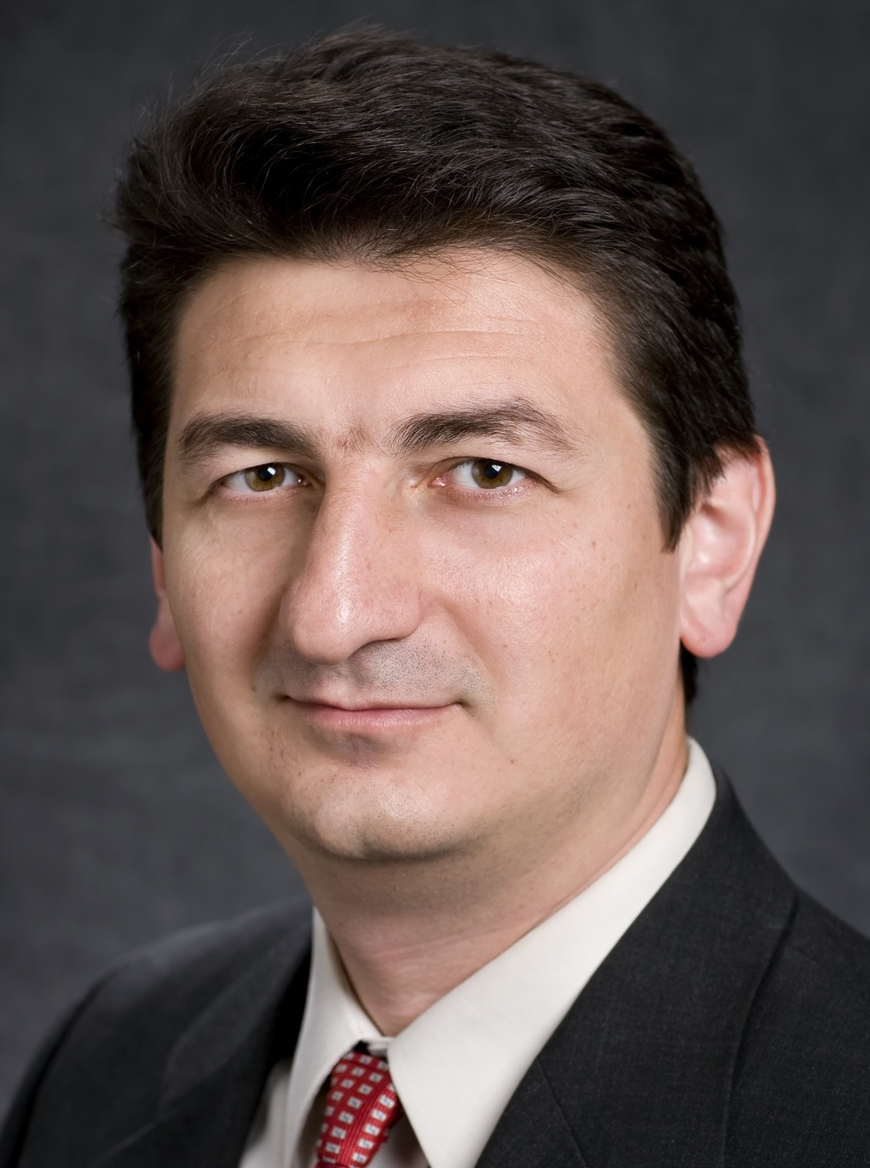
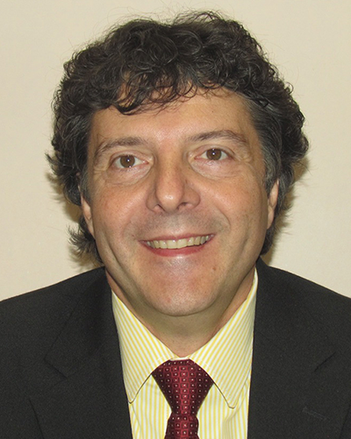
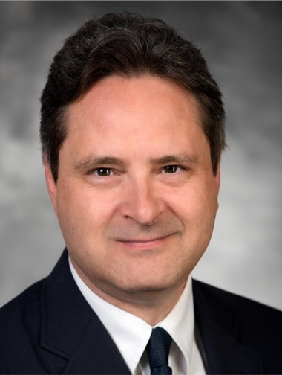
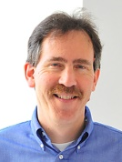
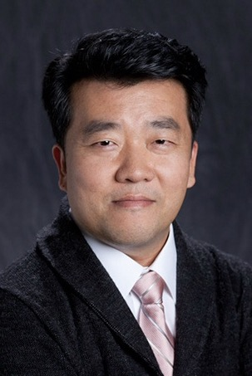
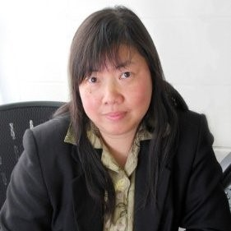
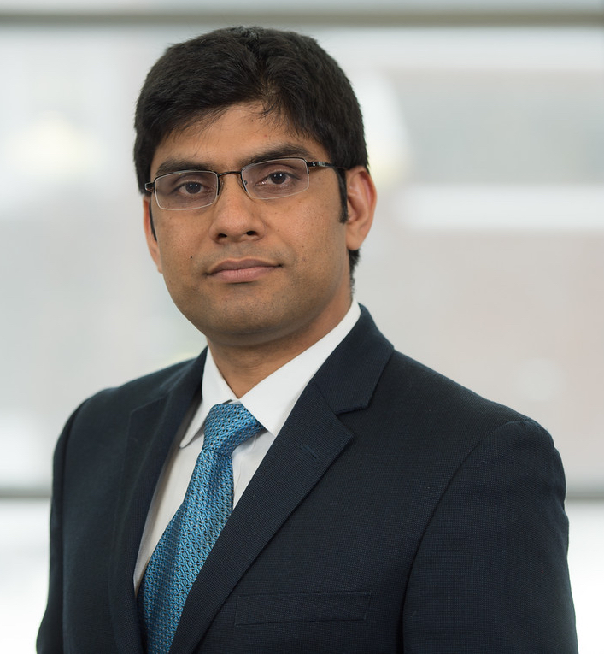
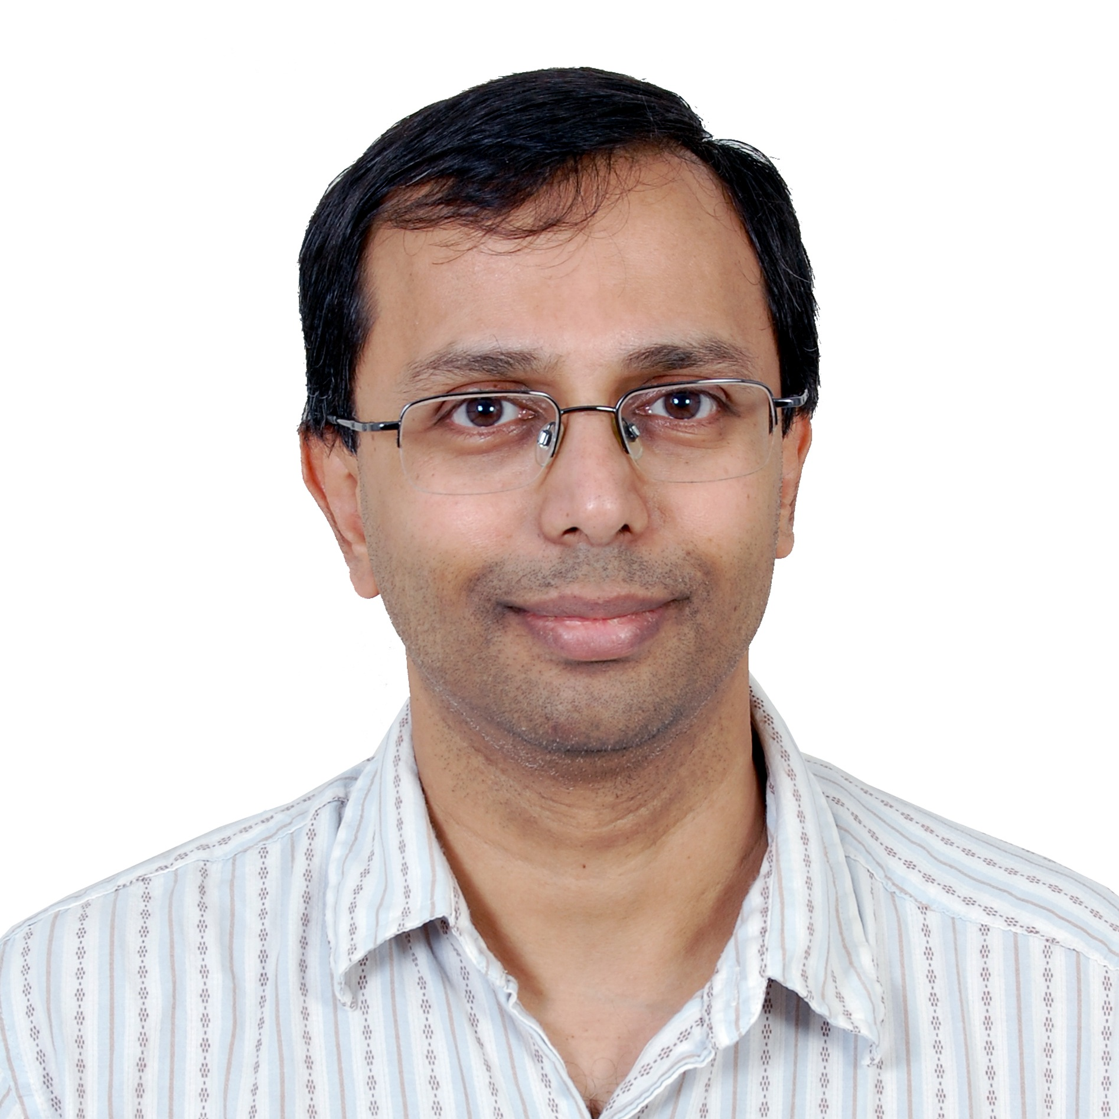
NSF Office of Advanced Cyberinfrastructure (OAC)
Foster a cyberinfrastructure ecosystem to transform science and engineering research… through Research CI and CI research
Manish Parashar
Office Director
Kevin Thompson
Acting Deputy Office Director
*
* IPA Appointment
** Federal Detail
*** NSF Detail
Bob
Chadduck
Amy
Walton
*
Andrey Kanaev
***
*
Tevfik
Kosar
Bogdan Mihaila (MPS/PHY)
Martin Halbert
*
*
Ed
Walker
Robert
Beverly
*
Seung-Jong (Jay) Park
Alan
Sussman
Alejandro Suarez
Juan
(Jenny) Li
*
*
Varun Chandola
Ashok Srinivasan
Tom Gulbransen
Bill Miller
(on detail at DOE)
*
We’re hiring!
Notes:
Demand continues to grow, but is changing
Applications are evolving in numbers, scales and complexity
Computing and technology landscapes are changing
Value structures are different
E.g., Neil Jacob’s talk at the OSTP FACE Convening
Affinities in the COVID-19 HPC Consortium
More than 75% of all XSEDE jobs are now single node jobs (but still only about 25% of XD SUs)
Up to 50% of all jobs ON Frontera are single node jobs
Overall demand continues to grow, but is changing
Single node jobs dominating
Smaller jobs (i.e., using <= 8K cores) dominating
Gateway users dominating
Application needs are changing
Growing, broadening of domains
End-to-end workflows composing heterogenous components
Integration of analytics; use of AI/ML
Computing and technology landscapes are changing
Increasing heterogeneity / Proliferation of purposeful accelerators
Increasing use of high-level software stacks for packing, deployment, execution, tuning, etc. (e.g., containers)
Service model evolving to address a broad range of needs and customers
Deployment of exascale systems in 2021-2023
Value structures are different
Ease/speed of access and use V/S raw performance
Transparency, trust, robustness, etc., V/S raw performance
“Time to end result” more meaningful than performance of an individual code

