Slide 1
Managing HTC workloads via an Access Point
Miron Livny
John P. Morgridge Professor of Computer Science
UW Center for High Throughput Computing
Morgridge Institute for Research

Slide 2
Please note –
When we use the term “Computing” it includes effective access to Input data and the placement of output data
When we use the term “Capacity” it includes the storage space needed to support effective access to data

Slide 3
Raw Computing Capacities is offered in a wide spectrum of “shapes, flavors, sizes, usage policies, …”
Access Points play a central stage role in enabling researchers with HTC workloads to effectively harness these diverse sources of raw capacity

Slide 4
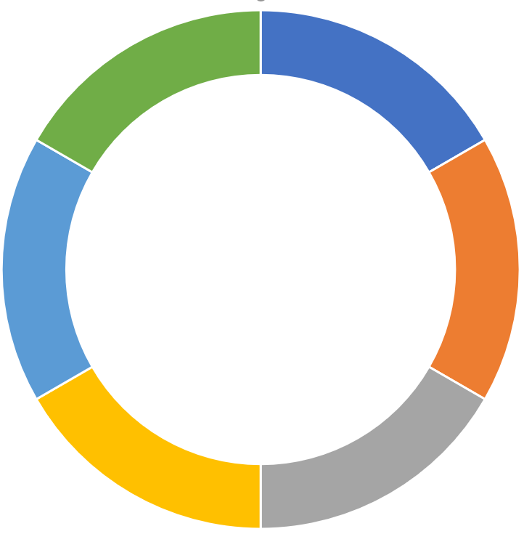
OSPool
PATh Facility
FAIR-Share
NSF
Awarded
Access
Point
NSF Awarded
Bring Your Own Capacity BYOC
Com. Clouds
My Campuse
Personal
Personal
XRAC
Allocation
Personal
My Collaboration

Slide 5
As a “researcher facing” technology and service the
Access Point holds the key to the democratization of the impact of High Throughput Computing Scientific Discovery.

