Slide 1
48 Hour Summary
Pat Dowdle
Wednesday 09:00 Meeting
February 2, 2022

Slide 2
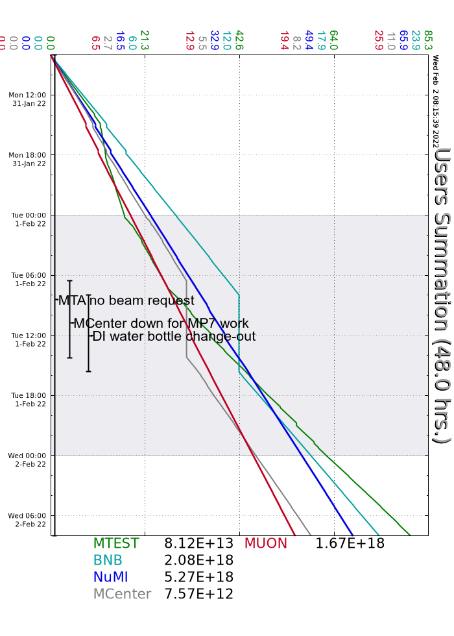
Past 48 Hours:
Daily
Performed footprint walkthroughs
Monitored systems & machine tuning
Monday
The elog was down for a short time in the morning
KRF2 was hit hard by a reflected power trip
Accessed the source A HV cabinet, also on Tuesday
Tuesday
BNB was off for DI bottle change out all shift
MI beam off for 15 minutes to change a module in the modulator for MIRF5
Muon and RR studies

