Slide 1
Fix Point Proposals
Sandor Feher – HL-LHC AUP L2 manager, Fermilab
February 4th, 2022

Slide 2
Cold Mass Design Requirements
Cold Mass design has been developed for CD3 (after this it is not expected to change)
Cold Mass design requirement has changed
Based on CERN’s experience with MQXFB magnet quench performance a new study was launched to revisit the SS shell welding since it caused additional pre-stress influence on the magnet structural integrity during cool down and warm up
Old requirement:
The interference between magnet and cold mass shell shall be kept under control and the coil pre-load increase shall not exceed 15 MPa at room temperature
New requirement:
The circumferential average interference after welding between the SS shell inner surface and magnet outer surface along each magnet length must be ≥ - 0.2 mm, resulting in average coil pre-load increase ≤ 3.2 MPa at room temperature
In short spots, for possible local repair, the local Delta_C must be ≥ - 0.5 mm, and the average along magnet length must meet the previous specification.
2

Slide 3
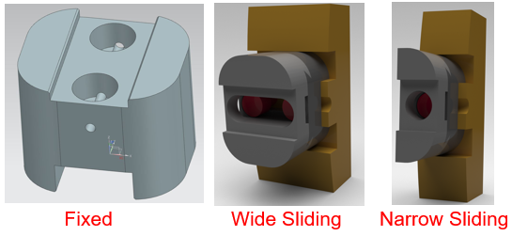
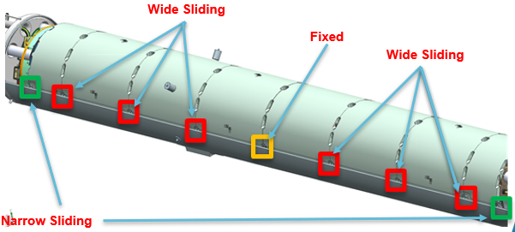
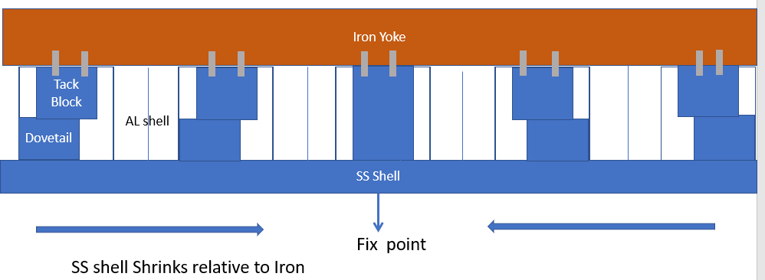
302.4.02 Cold Mass Design Change
Cold Mass design change
SS shell has minimal (as low as zero) interference with the magnet
The new requirement made it necessary changing the way how the magnet is supported by the SS shell to withstand shipping loads
SS friction was the primary support
Tack blocks are the new support
New design change has been reviewed and accepted internally within AUP
2.2 g load equivalent to 152 kN force to withstand
4 Bolts are good up to 32 kN
Two tack block welds are good to 78 kN (tack blocks are touching the aluminum shell so only the weld is the concern)
Planned to be used:
Two tack block with four bolts 32 kN
6 welded tack blocks 234 kN
Total 266 kN
Sliding tack blocks if positioned in the middle of the slot will not provide any additional support.
Tack blocks are offset to withstand shipping forces.

Slide 4
New Requirement
5 bar pressure wave (longitudinal pressure differential between the lead end and return end of the magnet)
Current design is not appropriate at cold since the tack blocks will move away from the Al shells. The center tack blocks are not sufficient:
5 bar is ~123 kN
4 Screws can hold 32 kN
Two tack block welds 78 kN (conservative value 80% of the ASME code value – FESHM requirement)
Frictional force 42 kN

Slide 5
Proposal A
Using large tack blocks at the fix point
Needs to fill in the gap entirely
Need extra weld area to increase the weld strength
Draw back is that the Al shell moves away from the tack block by ~0.6 mm each side
In principle it is not an issue since the alignment requirement is more generous
The center can be moved between warm up and if the pressure wave is too large to move the magnet it might also vibrate few times if the pressure has some reflection

Slide 6
Proposal B
Use friction to hold the magnet relative to fix point or just for not allowing to move under 5 bar pressure differential
5 bar pressure applied on the surface of the magnet is 123 kN / 0.61 = 202 kN
For 0.6 m long SS friction on the Al shell this corresponds to Pr = 0.17 MPa radial pressure and Ph = 6 MPa of hoop stress (azimuthal stress).
For 4.5 m long magnet, Pr =0.0225 MPa; Ph = 0.8 MPa
After shrinkage between the SS and Magnet Circumference will change by C*0.59 mm/m ~ 1.18 mm

Slide 7
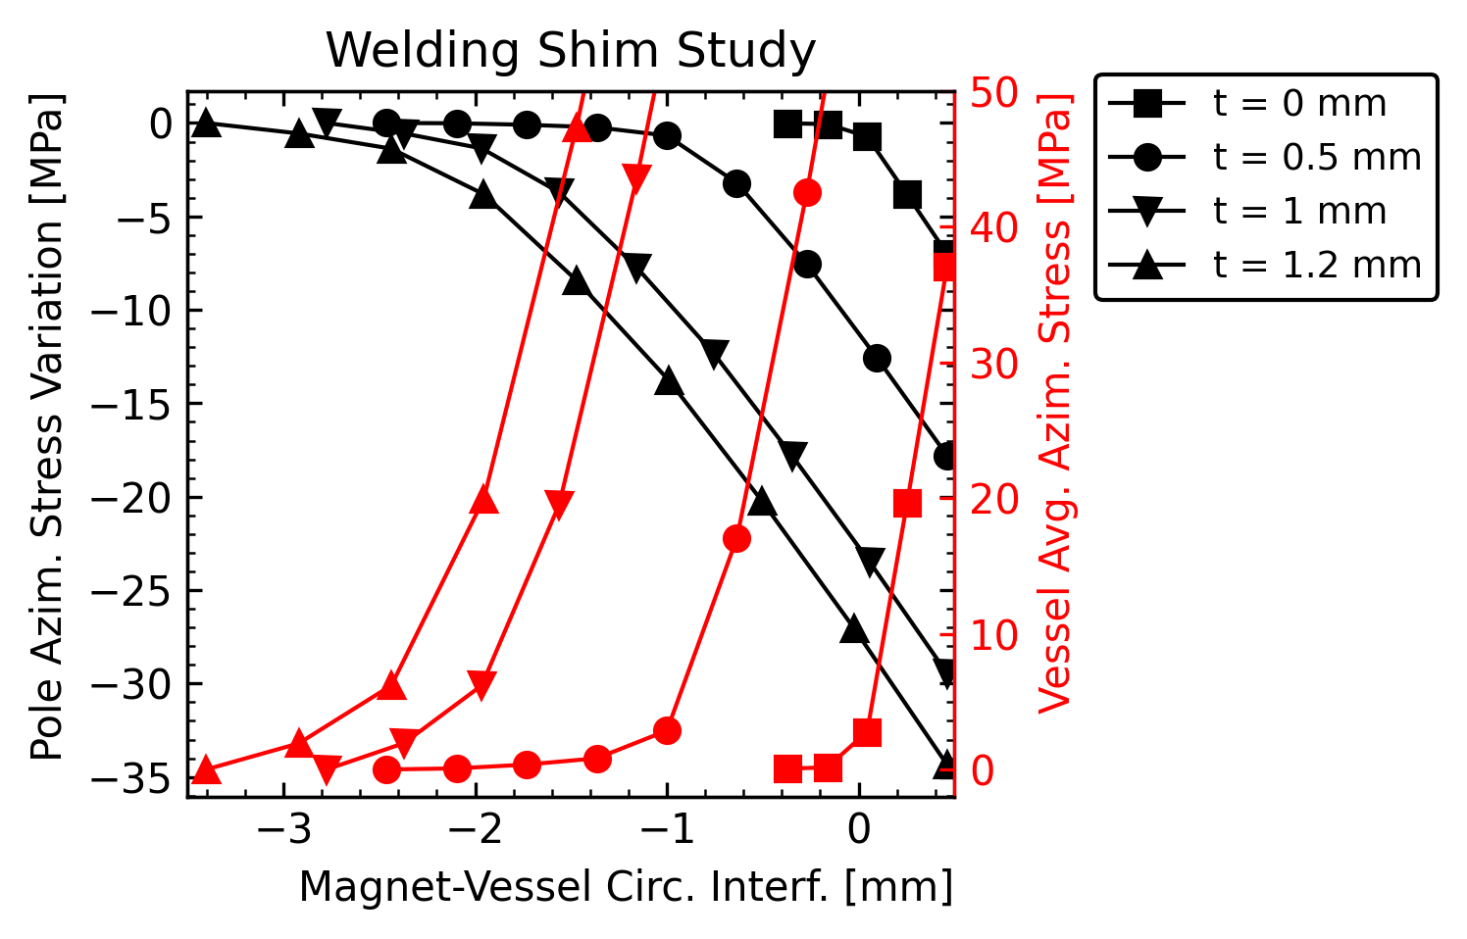
Proposal B
0.6 m long SS shell holding the fix point – using 1.2 mm shim
Starting at 6 MPa after loosing 1.18 mm of the Circumference ending up at ~ 50 MPa; but the allowed is 40 MPa
We need to examine higher shim values
allowed
required

Slide 8
Proposal B
4.5 m long SS shell holding the entire magnet – using 1.2 mm shim
Starting at 0.8 MPa after loosing 1.18 mm of the Circumference ending up at ~ 19 MPa; the allowed is 20 MPa
On the borderline we need to have a cushion
We still need to examine higher shim values
allowed
required

Slide 9
Proposal B
If we find a sweet spot, we still need to verify whether this is acceptable for magnet point of view
For fix point version need to determine the maximum acceptable length and location
For overall friction what is the acceptable highest radial pressure at 4.5 K

Slide 10
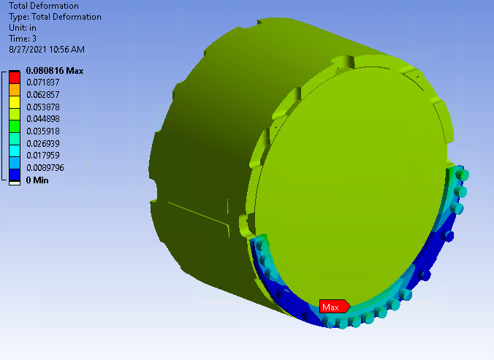
Proposal C
Using anchoring the magnet at both ends.
Is it acceptable to hold the magnet at the location envisioned?
The stopper is welded to the SS shell
Preloaded with Belleville washers to spring load the magnet when it is cold to allow some amount of variation due to shrinkage

