Slide 1


Muon Injection into FFAG Decay Ring
Update on progress
Jaroslaw Pasternak
Imperial College/RAL STFC
VLENF meeting,
February 28, 2012

Slide 2
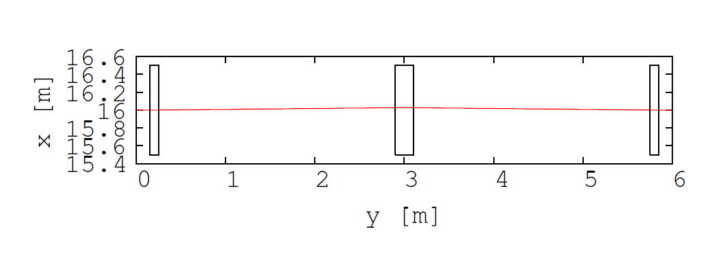
Assumptions and observations (2)
The drift length in the straights are long ( about 2.8 m)
for the J-B. Lgrange/Y. Mori FFAG ring!
They are ideal places to put kickers and septum.
I try to design injection system assuming that the muon beam is
formed in the decay channel (no D. Neuffer’s trick used).
From J-B. Lagrange

Slide 3
Preliminary injection
The long drifts are the natural place for septum and kickers.
Kickers must be distributed (the more the weaker they are), but the matching
conditions can be more difficult.
Optics of the drift has been reproduced and zero chromaticity
condition confirmed.
Closed orbits have been calculated.
The septum was assumed to be located downstream the D magnet.
The needed orbit separation was estimated based on
the acceptance plots in the paper on the FFAG Decay Ring ( by J-B and Mori-san)
and is about 12cm*2+1cm~25 cm.
The additional separation to clear the magnet was assumed
to be about 20 cm.

Slide 4
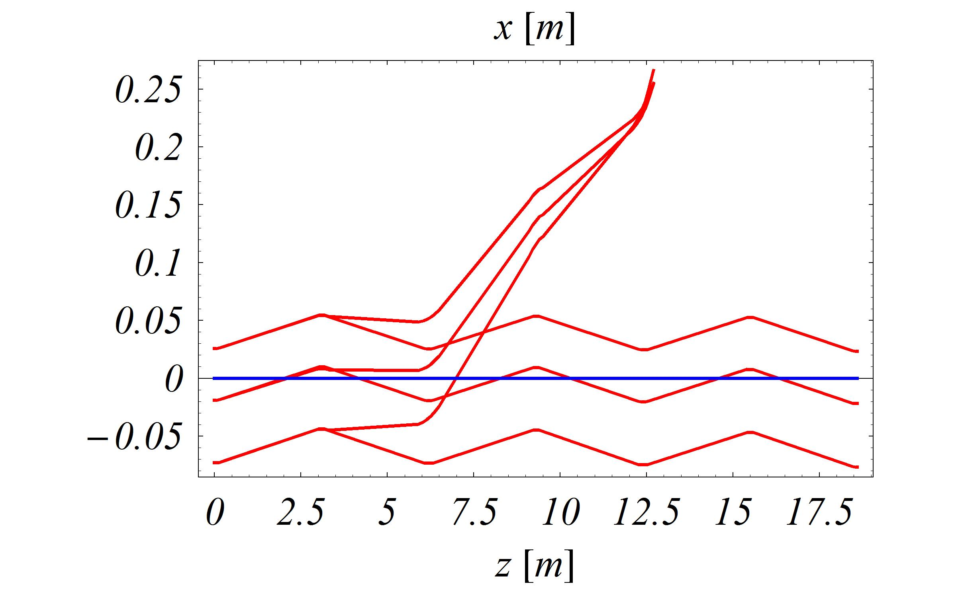
Injection from the outside of the ring (version 1)
Injected beam
Circulating beam orbits
0 and +/- 20% dp/p
B field too high
in the FFAG magnet!

Slide 5
Preliminary injection – parameters for injection
from the outside of ring (version 1)
Number of kickers 3
Kicker B field 0.05 T
Kicker length 2.6 m
Kicker aperture 60x30 cm
Septum B field 0.6 T
Septum length 2.6 m in length and
Septum aperture 30x30 cm

Slide 6
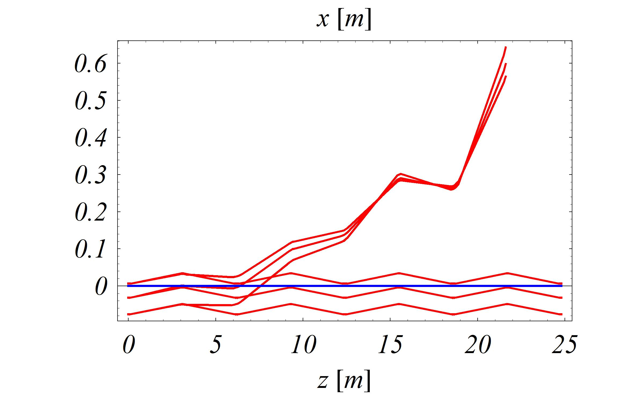
Injection from the outside of ring (version 2)
(Orbits for +-16%, effect of 2 kickers and septum included)
Magnetic field too high
for the room temperature magnets!

Slide 7
Preliminary for injection from the outside of ring (version 2)
Number of kickers 2
Kicker B field 0.038 T
Kicker length 2.6 m
Kicker aperture 40x30 cm and 30x30 cm
Septum B field 0.33 T
Septum length 2.6 m in length and
Septum aperture 30x30 cm

Slide 8
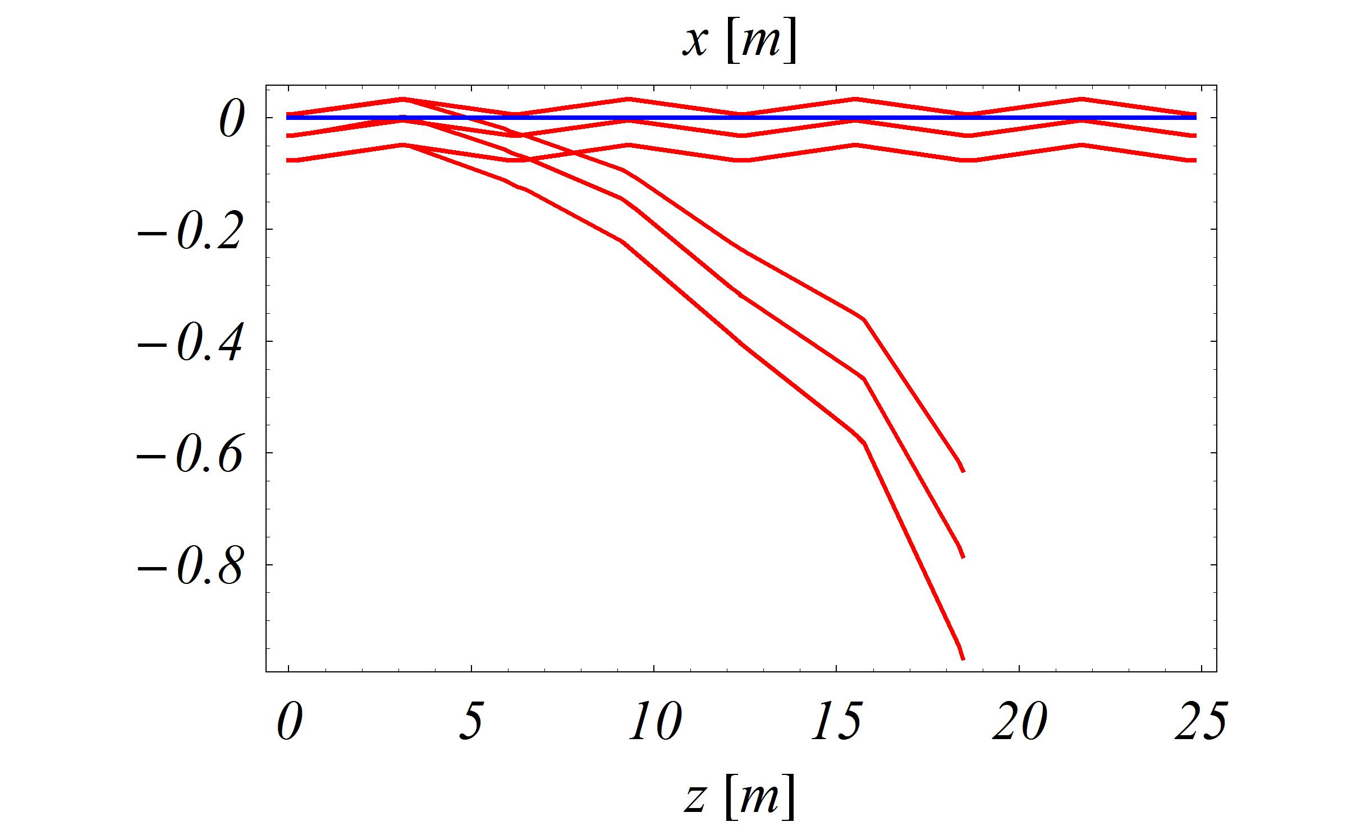
New injection scheme from the inside of the ring
(Orbits for +-16%, effect of 2 kickers and septum included)
B field vary as exp(m), for negative x
should be very small!
This option seems more feasible!

Slide 9
Parameters for injection from the inside of the ring
Number of kickers 2
Kicker B field 0.06 T
Kicker length 2.6 m
Kicker aperture 40x30 cm and 50x30 cm
Septum B field 0.33 T
Septum length 2.6 m in length and
Septum aperture 60x30 cm

Slide 10
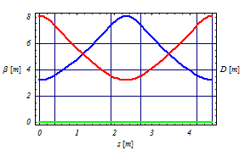
Decay Channel Considerations
Symmetric FODO type
Cell length 4.6 m
Quad length 0.8 m
Quad gradient 5.35 T/m
Distance between quads 1.5 m
B field at the poles 1.34 T
Half aperture 0.25 m -> Large quads!
Central momenum 2864 MeV/c
Momentum acceptance +-42%
(for all pions contributing to the muons wanted-2 GeV/c+-16%,
this means both forward and backward decays)
Physical acceptance 7.7 Pi.mm.rad
Phase advance per cell 53.6 degrees
Channel length minimum 16 cells -73.6 m (could be longer)
This includes 32 quads

Slide 11
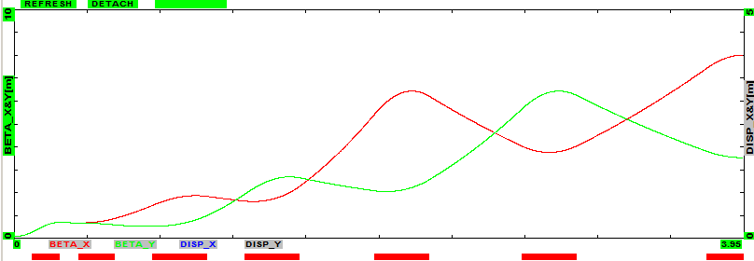
Coupling with the target
Details of the matching section between the target and
the decay channel still to be worked out!
Optimisation should include the question at which momentum to
set the reference matching condition.
We can use similar design to the one worked by David and Milorad
as a starting point.
From D. Neuffer

Slide 12
Summary and future plans
Single turn 2 GeV/c muon injection into FFAG Decay is possible,
but rather easier from the inside of the ring.
We need to work out, how to pass the ring
(a vertical separation or
passing first through a long drift in the straight and redirecting).
Using more than 2 kickers results in the optics being mismatched
(visible nonlinear dispersion) -> 2 kickers selected as a solution -> 0.06 T!
The decay channel has been designed based on the FODO channel
for both forward and backward decays.
Matching from the target to the decay channel needs to be defined.
Performance will be simulated in G4Beamline.
Final matching to the ring needs to be defined.
The pion decay into the FFAG-type ring should also be studied.
This is almost certainly possible! -> Next task...

