Slide 1
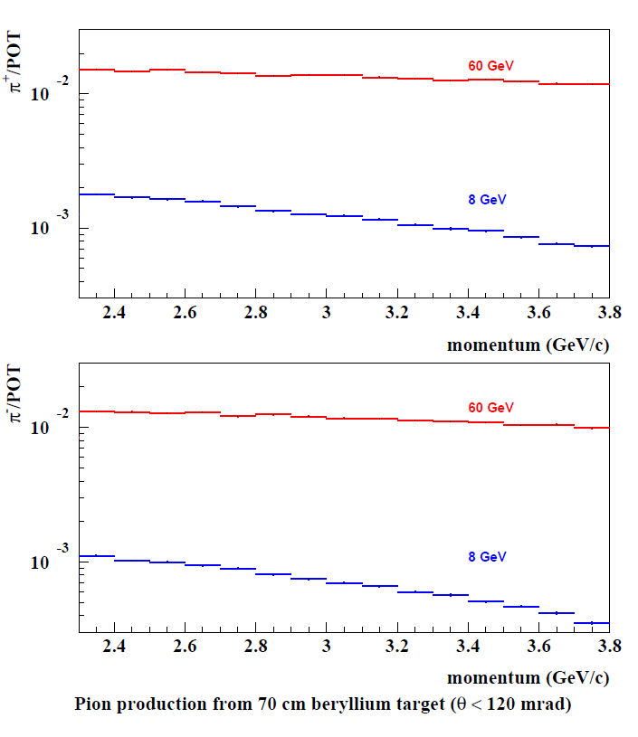
Targeting Optimization
Sergei Striganov looked at 8 GeV vs. 60 Gev protons

Slide 2
8 GeV vs. 60 GeV

