Slide 1
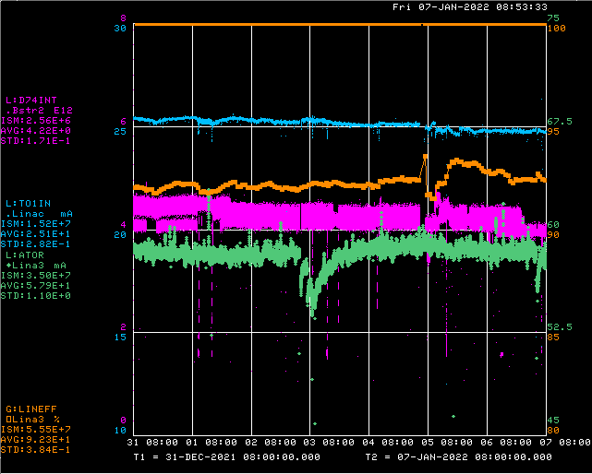
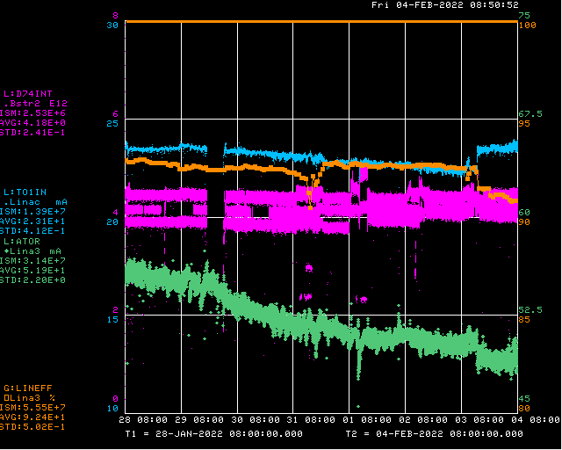
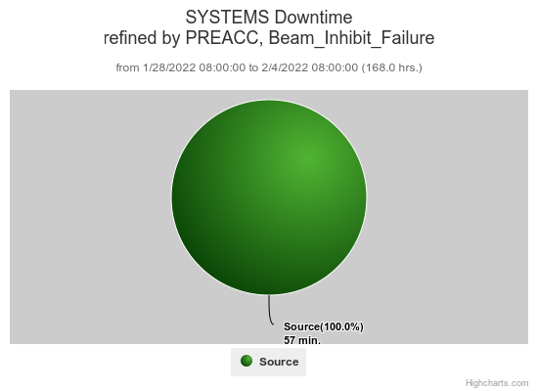
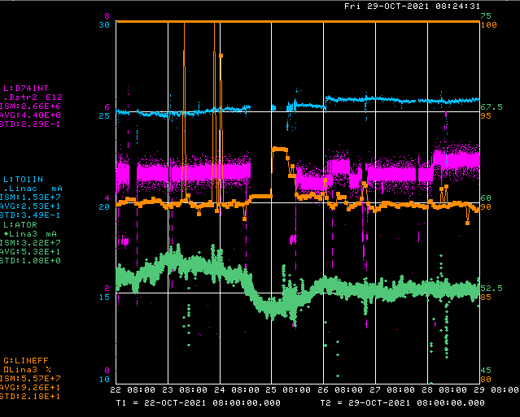
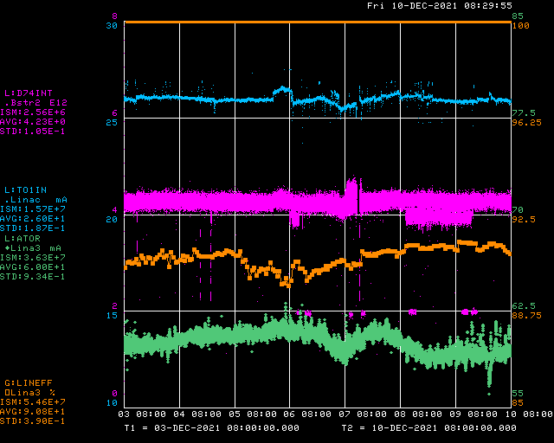
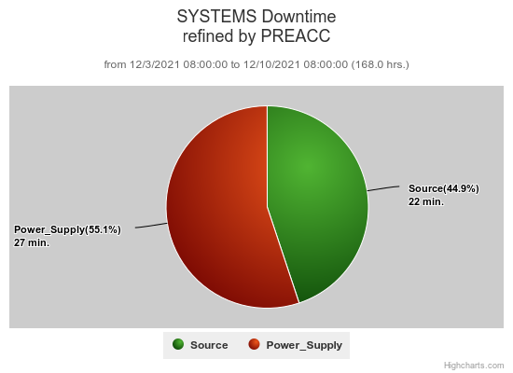
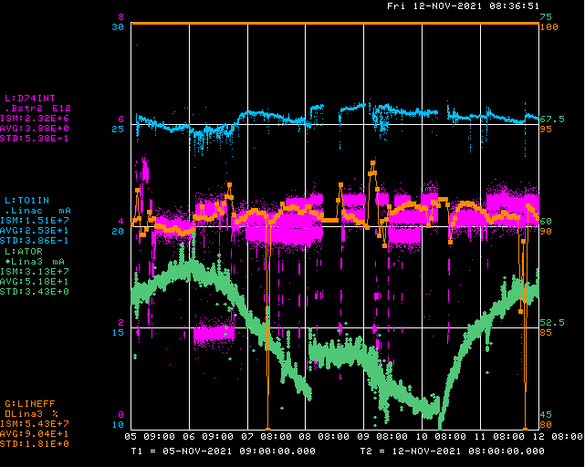
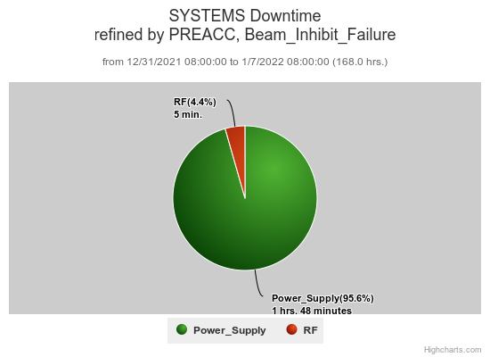
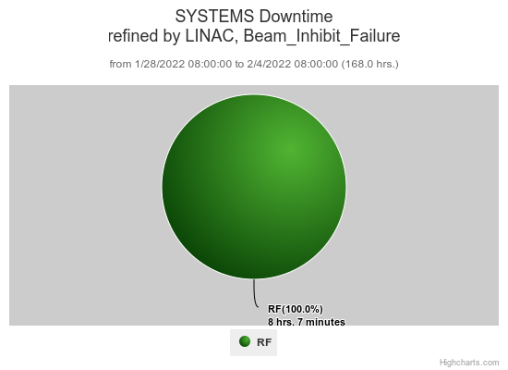
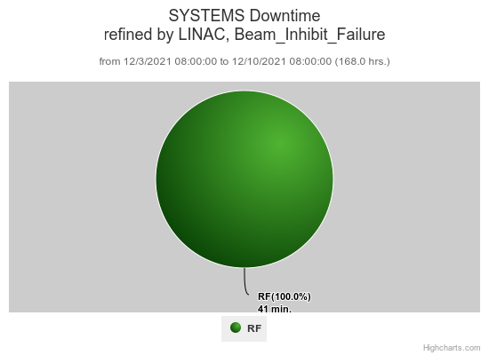
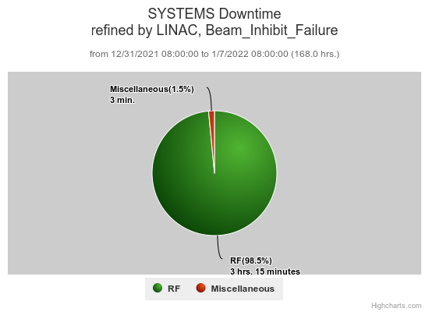
Preacc/Linac Weekly Performance
No Preacc
Downtime
Weekend Source heater trips
LRF5 driver screen failure
Monday KRF2 phase regulation issues
Thursday Preacc LEBT neutralization scan
Source heater trip

Slide 2
Current Conditions/Plans
Source A – 50 mA
Linac input – 24 mA
Linac output – 21 mA, 4.3 E12 /pulse
Downtime request
30 min. to check source emittance

