Slide 1
RR/MI status
Rob Ainsworth
9am ops meeting
04 Feb 2022

Slide 2
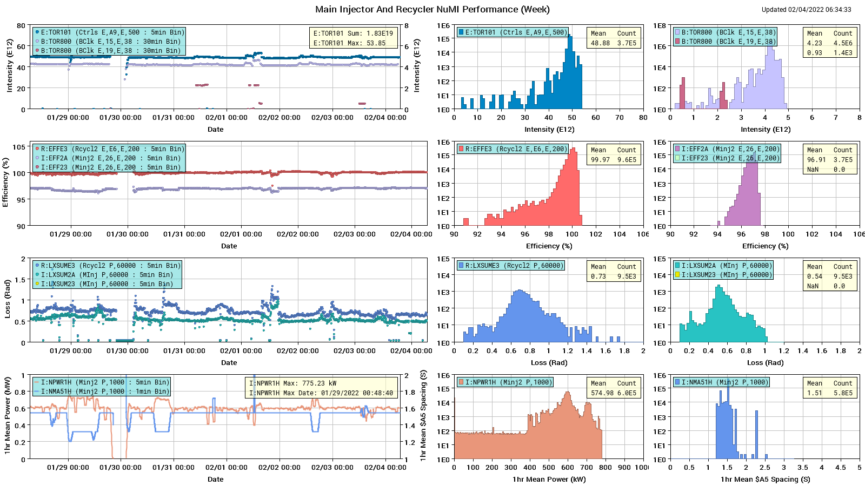
NuMI

Slide 3
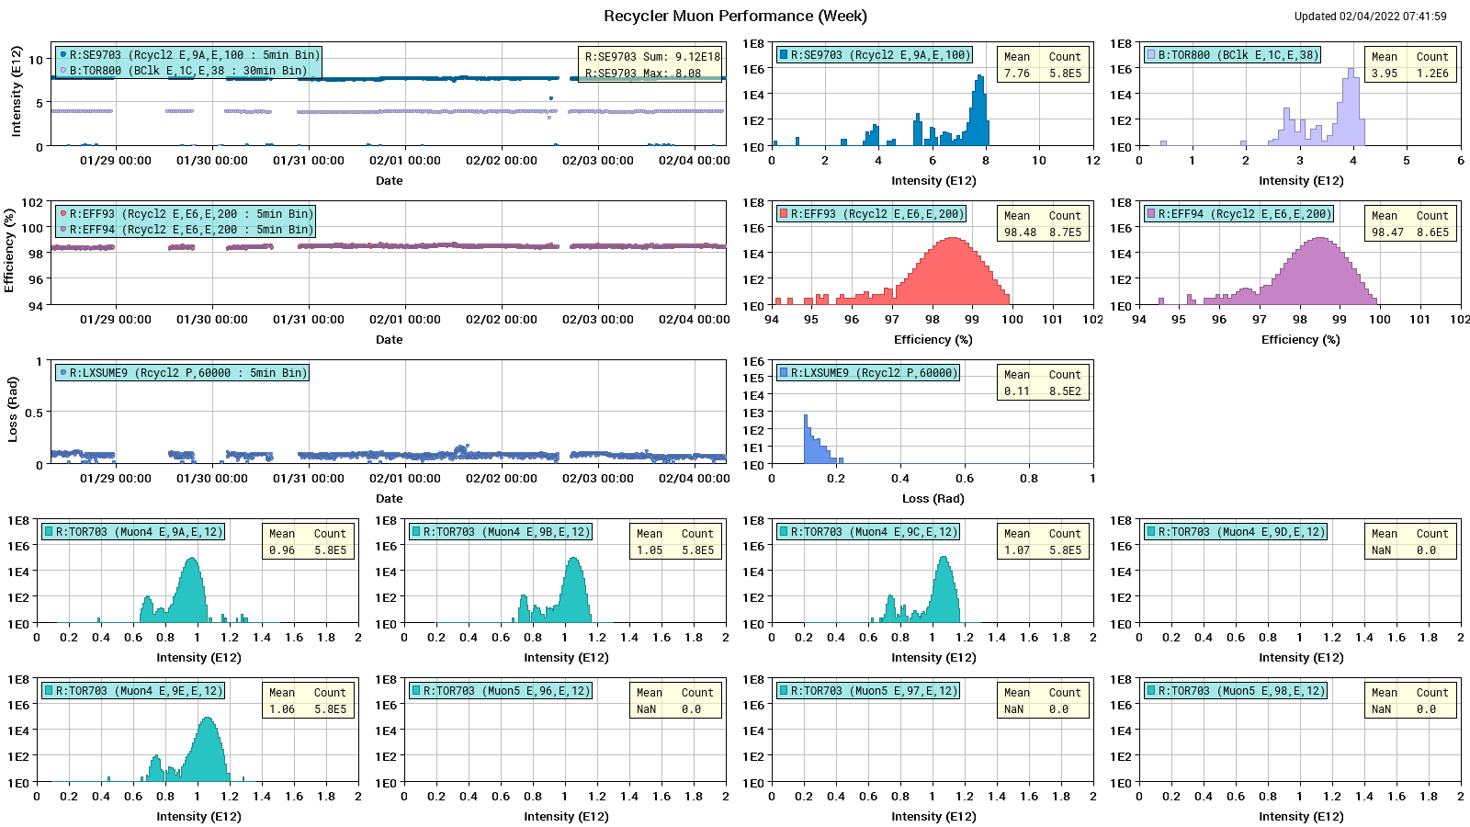
Muon

Slide 4
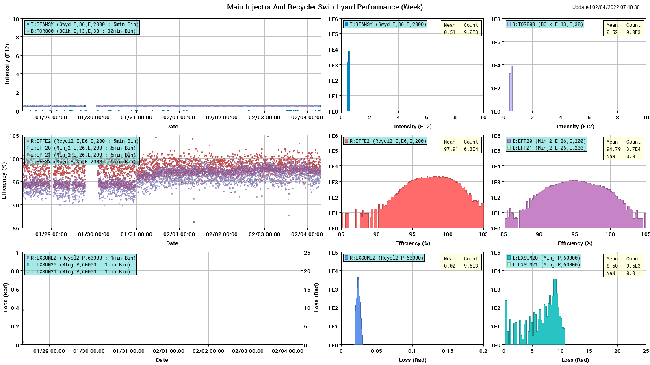
SY

Slide 5
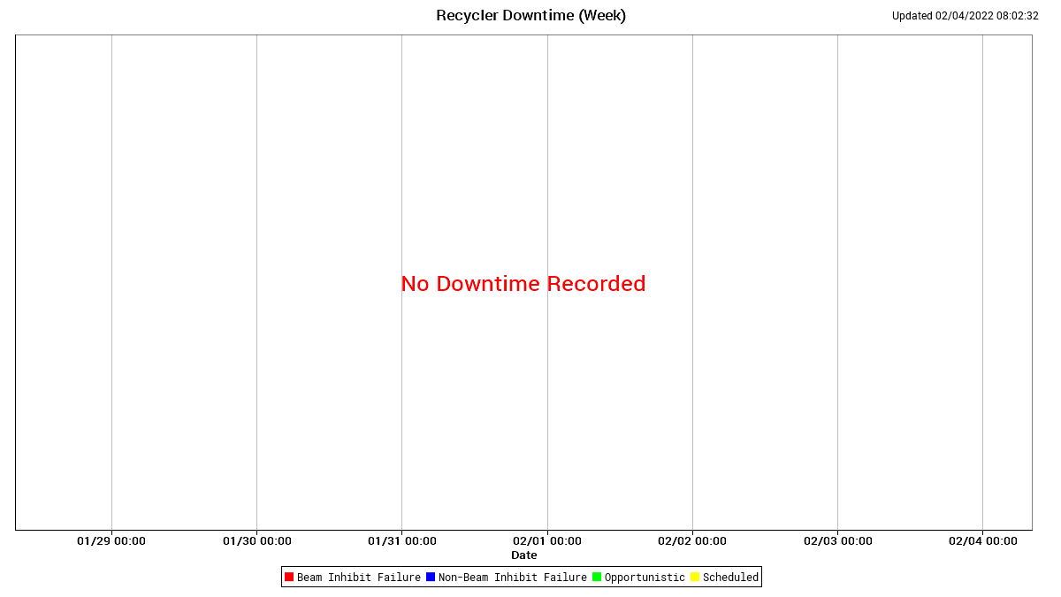
RR Downtime

Slide 6
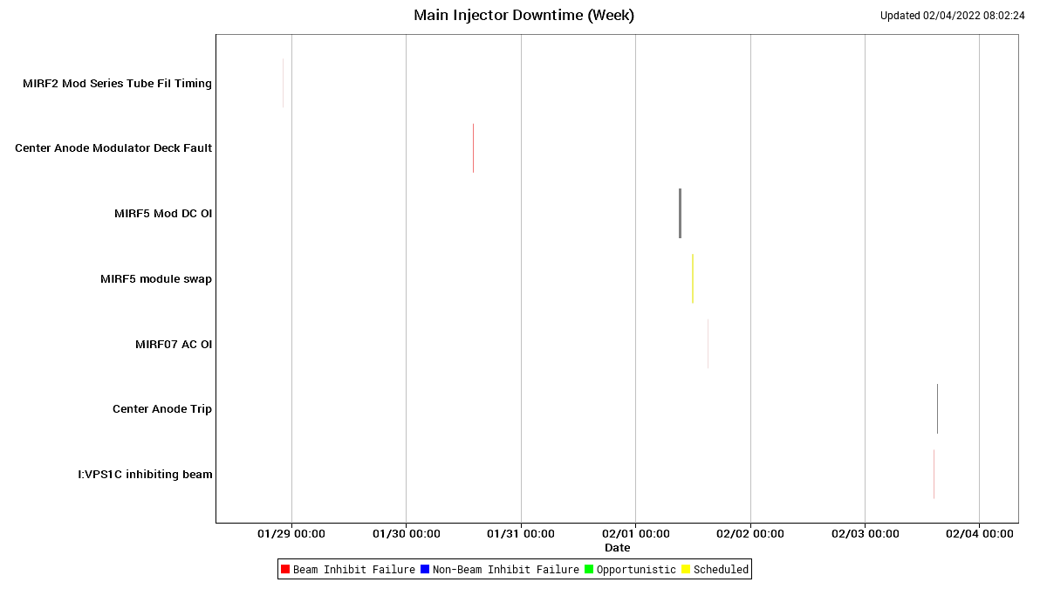
MI downtime

Slide 7
Summary + Next week
Machines are running well
Tested $2D DC ramp study yesterday
Looking to do an 8hr study next week sometime
Impact to users - Two $2As replaced a $2D and dry $2A each super cycle
Study request for today: $E0 under the $20 this afternoon. No impact to users

