Slide 1
48 Hour Summary
Pat Dowdle
Friday 09:00 Meeting
February 4, 2022

Slide 2
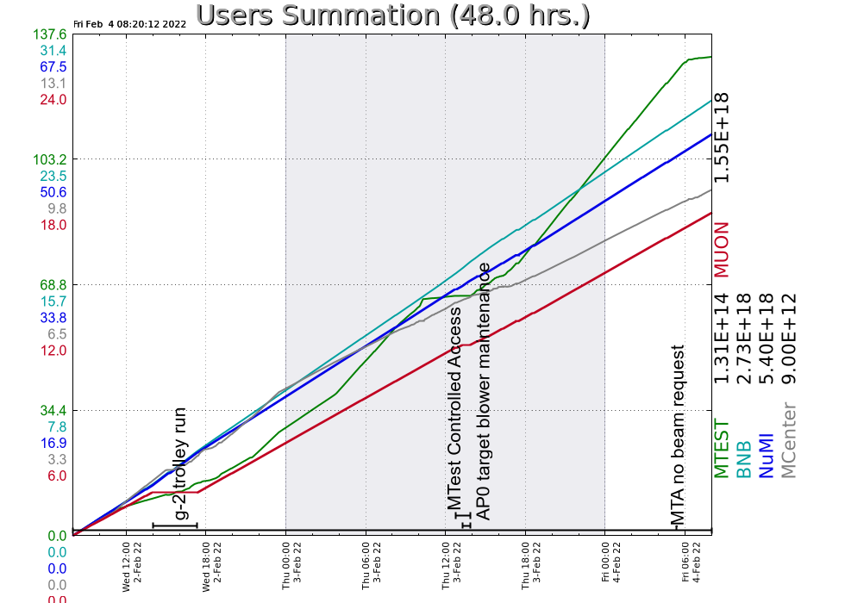
Past 48 Hours:
Daily
Performed footprint walkthroughs
Monitored systems & machine tuning
Wednesday
Column 1 at CUB was regenerated, regulator issue keeps us in internal recirculation mode
G-2 trolley run
Thursday
Recycler and Main Injector studies
Center Anode tripped twice on Mod Deck Fault
AP0 target blower maintenance

Slide 3
Current Conditions
Beam to NuMI: 615kW, 49.2E12 per pulse
Beam to g-2: 1.02 POT
Beam to BNB: 5.75E16 p/hr @ 4.09Hz
Beam to MCenter and MTest

