Slide 1
Muon Campus Report
Jim Morgan
February 4, 2022

Slide 2
Weekly overview and current issues
Decent up time since weekend
Most downtime happened last weekend, including M5 power supply issue
Two g-2 Trolley Runs, one partially overlapped Saturday downtime
D:LENS and D:PMAG trips
Scopes set up at AP-0 and AP-10 to monitor timing
Happened previously last April, went away on its own
Maintenance
Target Blower maintenance performed Thursday afternoon
Interlocked rad detectors (Chipmunks) swapped out for calibration
Ongoing problems
Bad D:IB transformer to power supply cable prevents 8 GeV operation
LCW leak rate continues to increase, ~90 Gal/Day
20% drop in g-2 CTAGs as compared to last spring
Largely appears to be a reduction in yield from the Target Station
Working to understand POT differences between now and last run
Intentional Accelerator
Standby Period
Downstream D30 Crossover Pipe

Slide 3
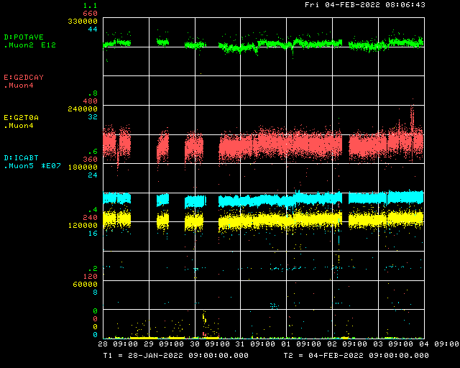
Beam to g-2 this week
Beam to AP-0 target
R:V703 & R:LAM52
M5 Line power supplies
Trolley Run
Trolley Run
LRF5
Decay Positrons
Delivery Ring
g-2 T0 Detector

Slide 4
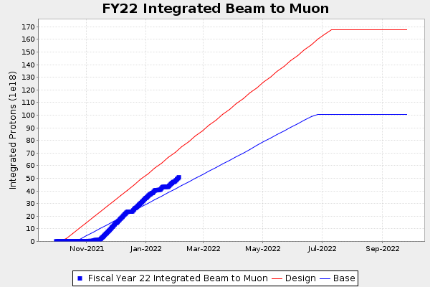
g-2 Run 5 Protons on Target
Detectors shifted upstream

Slide 5
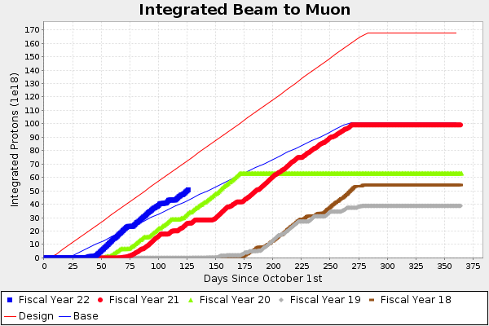
g-2 Protons on Target
Detectors shifted upstream

Slide 6
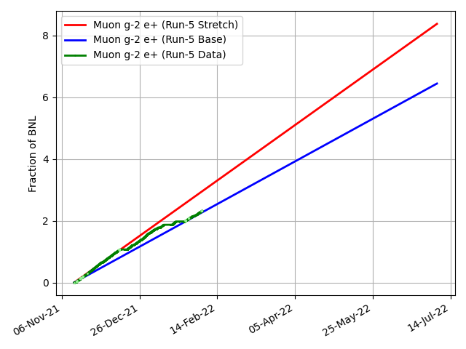
g-2 Performance this run
2.32 BNL
Detectors shifted upstream

Slide 7
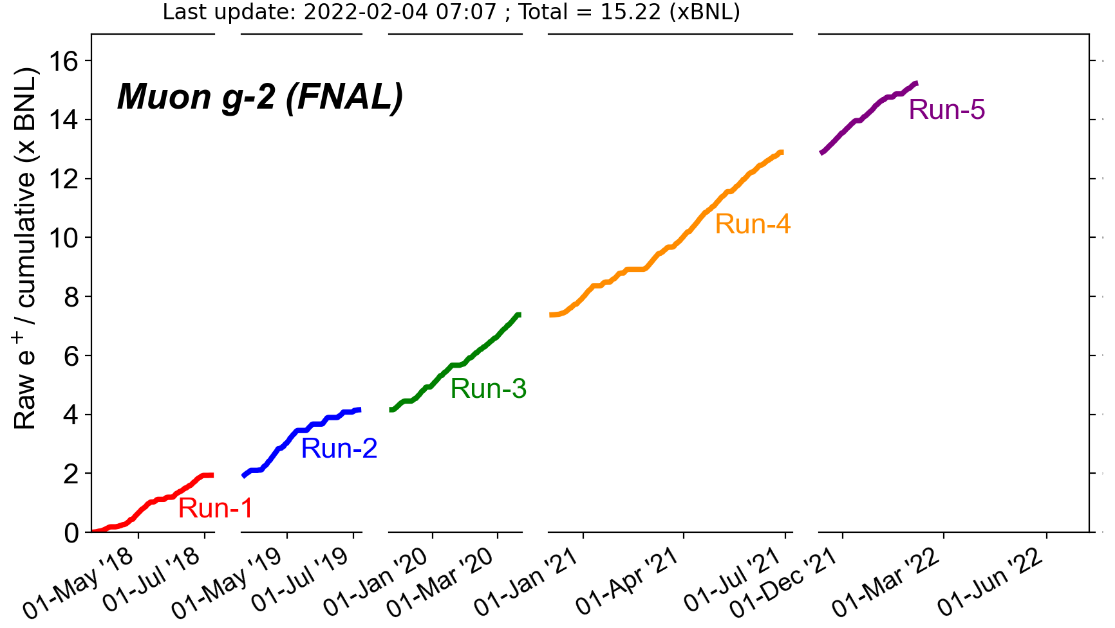
g-2 Overall Performance
2.32 BNL
5.51 BNL
3.22 BNL
2.21 BNL
1.94 BNL

Slide 8
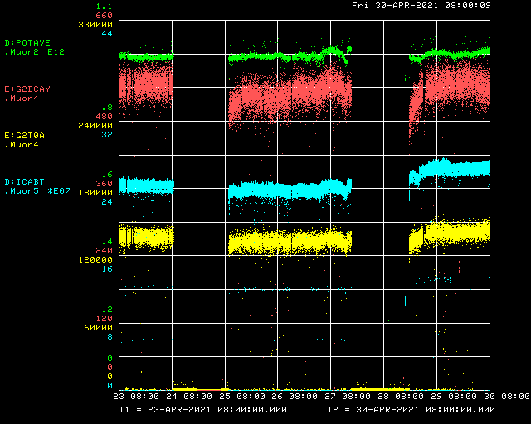
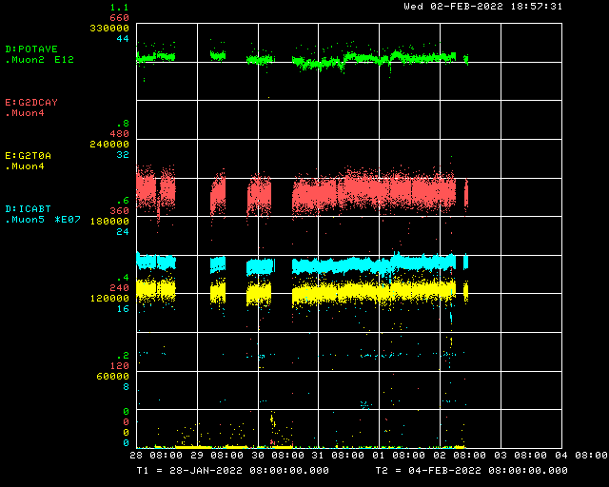
Drop in performance since last spring
April 2021 – best performance
February 2022 – CTAGs down 20%

Slide 9
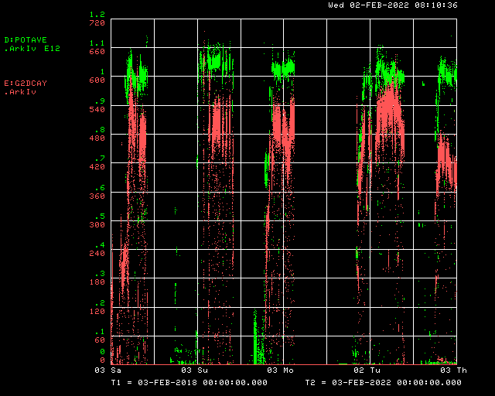
Short term plan
Keep running beam to g-2
No 8 GeV studies possible until D:IB is repaired
Nagging problems
LCW leak rate continues to climb
Continuing to investigate low CTAGs and try to get them back
Protons on target and CTAGs, Runs 1 - 5

