Slide 1
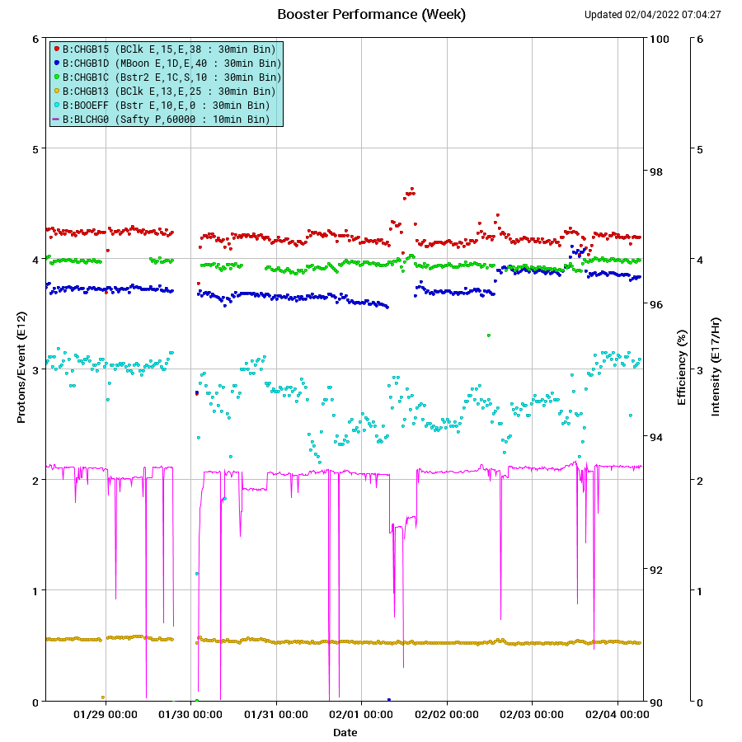
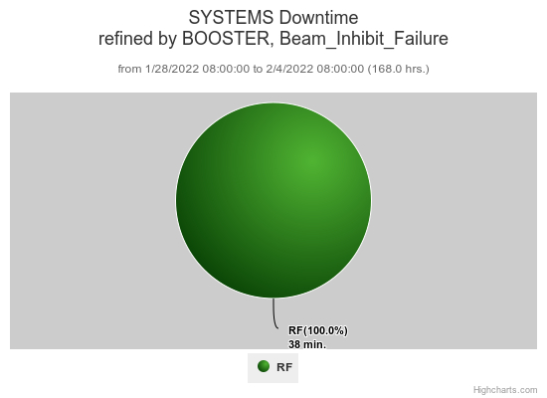
Booster Operations 1/28/22 – 2/4/22
F
T
F
F
Sa
Su
M
F
F
F
W
F
Sa
W
F
F
F
F
F
F
F
Sa
Su
Su
M
Tu
F
F
F
M
M
Su
M
Th
F
M
W
W
W
Th
Sa
W
F
F
Sa
Tu
F
Sa
F
F
Sa
Su
M
F
M
F
Sa
Su
M
Sa
Su
M
Tu
Th
Su
Su
Sa
Su
F
Sa
M
F
Sa
F
W
Su
W
F
M
W
Th
F
Sa
M
F
Sa
Su
W
Th
F
F
Su
W
F
Sa
Su
M
Tu
Sa
M
Su
M
M
W
Th
F
M
F
Su
M
W
Sa
Su
u
F
Sa
Th
Sa
M
W
F
Sa
Su
W
F
Su
M
Capture/Transition Issues
Linac LRF5 repairs
DOGL3 Flow Switch
Downtime: ~38min total
Misc RF trips, WAPS trips
MI access for Magnet GF
Booster Access
Proton Source
Studies and Repairs
Requests/Plans:
2 $17 Study cycles 2-4hrs.
One Shift dedicated PS Studies, TBD for this month.
This week:
Currently NuMI $15@ ~4.2E12 p/p G-2 $1C @ ~4.0E12 p/p. BNB 4.0E12 p/p 4Hz. SY120 @ ~5.5E11 p/p. Mid week while BNB was off on day shift , increased NuMI beam to 4.6E12 p/p.
Booster operations required extra care in beam intensity balancing as incoming beam intensity/characteristics fluctuated. Working with PreAcc and Linac to stabilize beam.
Tuned throughout the week to reduce losses and maintain total beam output. Worked on reduction of injection losses. Reduced extraction and upstream MI8 losses. Aperture Scan application debugging effort coordinated with controls and instrumentation, Booster RF penetration RTD calibration work, Orbit smoothing performance checkouts.
Booster RF performed well with spare stations available.
Thanks to Ops for maintaining Booster performance through the week.

