Slide 1
Applications for Total Loss Monitors (TLMs) in Radiation Safety Systems
JASMIN Collaboration Meeting
February 16, 2012
T. Leveling

Slide 2
What are TLMs?
A ion chamber
Variable length
Gas filled volume
Applied high voltage
Produces charge proportional to beam loss
Charge collected by an electrometer
Can provide detection and measurement of beam loss over extended distances
Also know as:
PLIC or Panofsky long ion chamber
LION
Long detector
Organ Pipe (a Fermilab variant)

Slide 3
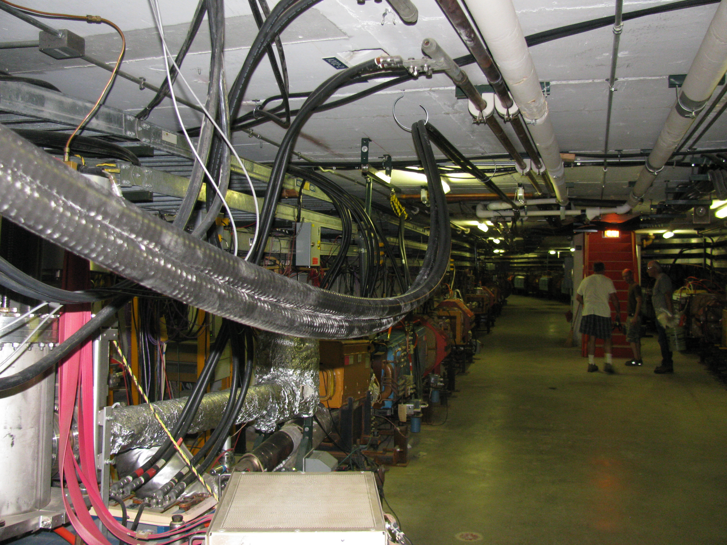
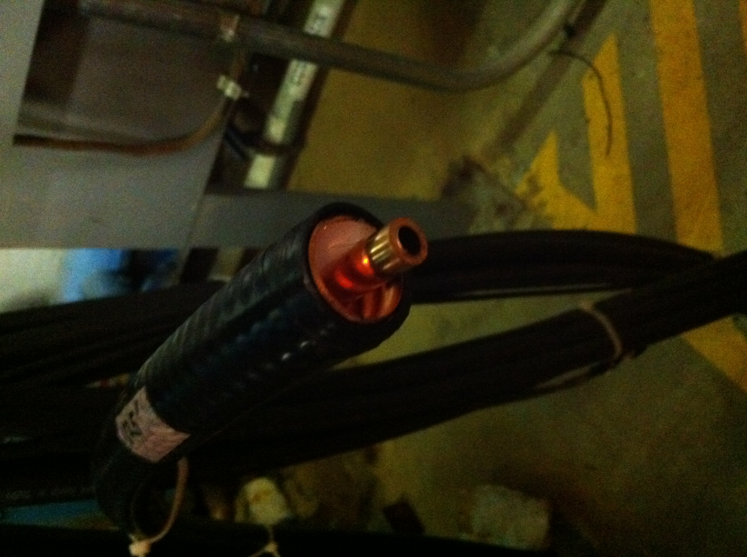
125 foot TLM
250 foot TLM

Slide 4
Why are TLMs being considered?
At Fermilab, we have left behind the energy frontier
Tevatron is superseded by LHC
Entering the intensity frontier
Very high intensity beams
E.g., 700 to 2,300 KW at 120 GeV in the Main Injector
Business as usual suggests:
Thicker radiation shielding is required
Increased use of interlocked radiation detectors
Collimation systems
very useful but do not qualify as radiation safety systems

Slide 5
Issues with Passive Shielding
Passive radiation shielding requirements are:
Difficult to meet
Existing structures cannot support addition earth burden
Expensive
Both in time and in $$$
Impractical
Implies very high beam power losses are sustainable
Accelerator equipment can be easily destroyed by prolonged high beam power loss

Slide 6
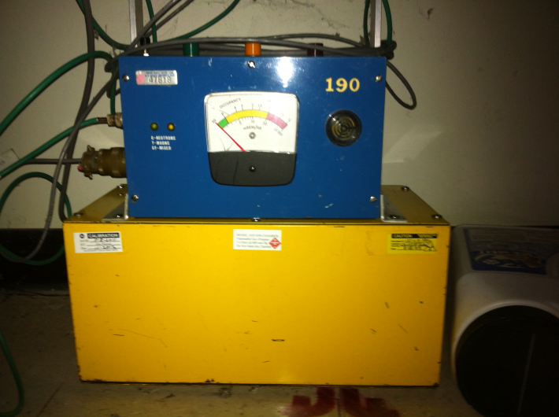
Issues with interlocked radiation detectors
Individual units:
are expensive ~$10K per installation
cover very limited regions
many individual detectors required
require periodic maintenance and calibration (overhead)
in some cases are not sensitive enough
e.g., ground water activation
could permit excessive beam loss harmful to equipment or,
could cause delays in maintenance activities due to excessive residual radiation dose rate in beam enclosures

Slide 7
TLM advantage
A few dozen TLMs could potentially replace a few hundred Chipmunks
Cost of TLM cable is ~ $10/foot
Cost of electrometer
Less than cost of new Chipmunk
Overhead for electrometer calibration similar to Chipmunk

Slide 8
TLM applications have been limited
Detect beam loss for machine protection
Not used for personnel radiation protection purposes
SLAC LIONs a recent exception
Though not a stand-alone system
Several reasons for restrictions:
No calibrated response
Not fail safe

Slide 9
Why now?
We have the means to calibrate the response of TLMs for known beam loss geometries
Pbar source has become available for testing TLms
Many tunnel/shield/magnet geometries are available
Dose rate as function of proton beam loss has been determined
2 convenient situations have be studied with a set of TLMs

Slide 10
Location 1
Install TLM and repeat loss condition

Slide 11
Location 2
338’ TLM

Slide 14
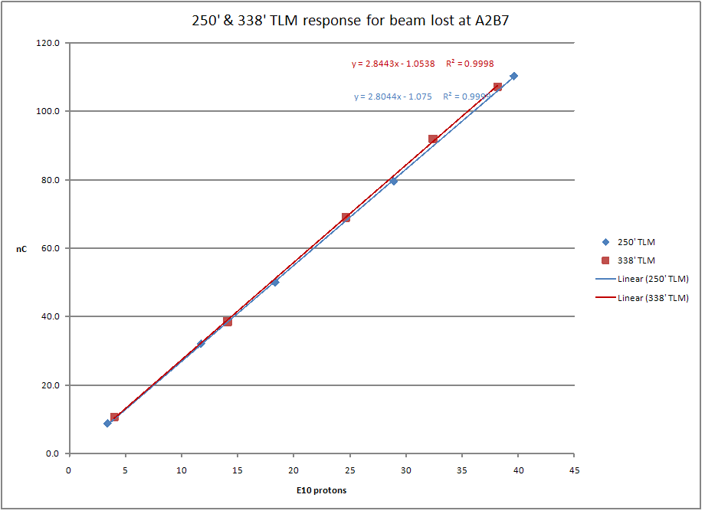
Two different length TLMs respond to a common beam loss

Slide 15
To make TLMs useful as RSS
Required to be failsafe
Similar to existing ion chamber system in use at FNAL (chipmunk)
Any detected failure of a TLM system inhibits beam
Monitor the physical cable
Cable connection to the electrometer
Electrometer heartbeat
Other parameters
Gas type (presently argon)
Gas pressure
Gas flow
Applied High voltage
Presence of ion chamber current

Slide 16
Dynamic Range
For system development
Need to understand applications
Determine response as a function of
Beam energy
Beam intensity
Applied voltage
Gas type

Slide 17
8 GeV TLM response constant |  | TLM baseline energy |  |  | Energy scalling factor |  |  | Baseline TLM distance to beam center
3.2 | nC/E10 | 8 | GeV |  |  | 0.8 |  | 5.5 | feet
Machine/Condition | Note | Beam power (KW) | Energy (GeV) | Protons per hour | Average intensity per second | Nominal Shielding feet | Magnet to ceiling distance | Shield Category or application basis | beam loss limit (p/s) | normal loss limit p/s | % of beam loss | nC/min (per meter in bold)
Mu2e Service Bldg. | 1 | 4 | 8 | 1.13E+16 | 3.13E+12 | 10 | 5.5 | skyshine | 3.3 watts | 2.58E+09 | 0.082% | 50
Mu2e Service Bldg. | 1 | 8 | 8 | 2.25E+16 | 6.25E+12 | 10 | 5.5 | skyshine | 3.3 watts | 2.58E+09 | 0.041% | 50
Mu2e Shielding Berm | 2 | 4 | 8 | 1.13E+16 | 3.13E+12 | 13 | 5.5 | 1A | 3.26E+10 | 1.63E+09 | 0.052% | 31
Mu2e Shielding Berm | 2 | 8 | 8 | 2.25E+16 | 6.25E+12 | 13 | 5.5 | 1A | 3.26E+10 | 1.63E+09 | 0.026% | 31
Booster May 2013 | 5 | 64 | 8 | 1.80E+17 | 5.00E+13 | 14 | 4 | 2A | 2.20E+11 | 1.10E+10 | 0.022% | 399
Booster 2016 | 5 | 80 | 8 | 2.25E+17 | 6.25E+13 | 14 | 4 | 2A | 2.20E+11 | 1.10E+10 | 0.018% | 399
Booster (any pwr) | 3 |  | 8 |  |  | 14 | 4 | 1 W/m | NA | 4.69E+10 |  | 1,701
Main Injector | 2 | 700 | 120 | 1.31E+17 | 3.65E+13 | 24 | 5 | 1A | 2.61E+13 | 1.31E+12 | 3.582% | 265,094
Main Injector | 2 | 2,300 | 120 | 4.31E+17 | 1.20E+14 | 24 | 5 | 1A | 2.61E+13 | 1.31E+12 | 1.090% | 265,094
Main Injector | 3 | 700 | 120 | 1.31E+17 | 3.65E+13 | 24 | 5 | 1 W/m | NA | 1.82E+11 | 0.499% | 36,960
Main Injector | 3 | 2,300 | 120 | 4.31E+17 | 1.20E+14 | 24 | 5 | 1 W/m | NA | 1.82E+11 | 0.152% | 36,960
Nova | 2 | 700 | 120 | 1.31E+17 | 3.65E+13 | 26 | 3 | 1A | 4.87E+13 | 2.44E+12 | 6.675% | 1,372,243
LBNE | 2 | 2,300 | 120 | 4.31E+17 | 1.20E+14 | 26 | 3 | 1A | 4.87E+13 | 2.44E+12 | 2.030% | 1,372,243
Nova | 4 | 700 | 120 | 1.31E+17 | 3.65E+13 | 26 | 3 | 10 ppm | NA | 3.65E+08 | 0.001% | 206
LBNE | 4 | 2,300 | 120 | 4.31E+17 | 1.20E+14 | 26 | 3 | 1 W/m | NA | 5.21E+07 | 0.000% | 29
Notes: | 1 | Distributed or concentrated loss limits public exposure to 1 mrem per year
 | 2 | Single point loss limits berm surface normal condition dose rate to 0.05 mrem/hr
 | 3 | Total charge limit in tunnel beam loss to 1 W/m - distributed among some number of TLMs
 | 4 | Limit total beam loss to 1 part in 1E5
 | 5 | Single point loss limits berm surface normal condition dose rate to 5 mrem/hr
Not recommended

Slide 18
Electrometer
To date, TLM testing with
Electrometer from the chipmunk
Keithley 6517B
A design effort has begun to develop a new electrometer with suitable charge collection capability
1 to 3 uC/sec should be sufficient

Slide 19
Prior to TLM deployment
A review by the FNAL ES&H Section will be required

Slide 20
Applications for TLM use in RSS
Limit radiation dose rate outside of tunnel shielding
Limit air activation
Limit ground water activation
Limit beam power loss on watt/meter basis
Limit radiation losses through cable ducts and penetrations

Slide 21
Extra slides

Slide 22
TLMs History at Pbar/Muon (1 of 2)
5/4/2011 - Director’s review for mu2e
6/16 - first TLM meeting
6/29 - first 2 TLMs installed with 6 decade rate BLM cards
7/14 - first TLM signal
7/19 – second meeting
7/19 – first BLM integration cards installed
8/18 - Chipmunk digitizer circuit installed (Blue box)
8/25 – third meeting
8/26 - Installed 16 bit VME scalar for higher counting rate from blue box (1 kHz)
9/1 - Installed third TLM of different length 103 m (338’)
9/2 - Standardized ACNET TLM responses on all electrometers to nC
9/13 – changed to 32 bit VME scalar
10/6 – Tried to pressurize TLMs – 6 psig 0.1 lpm
10/11 – reverted to unpressurized TLMs – 0.05 lpm
10/14 - Meeting with ES&H Section to get turnover for blue box construction
10/18 – Strategy for setting trip levels becomes apparent
10/26 – installed 1’ TLM at A2B7
10/31 – begin plateau measurements – suggested by ES&H section
10/31 – Established remote operation of TLM HV supply
11/18 – sequencer driven data collection for plateaus established
11-21 – low and medium intensity plateaus completed
11/23 – TOR910 rescaled for high intensity
12/8 – Marv provides 6517B electrometer for high intensity plateaus – suggested by ES&H section
12/8 – ES&H Section requests charge collection time measurement (TLMS on scope terminated in to 50 Ω)
12/15 – 4th meeting

Slide 23
TLMs History at Pbar/Muon (2 of 2)
12/15 – 4th meeting
12/21 – Started data collection for high intensity plateaus with 6517B
1/3/12 – nonlinear response of TLMs at high intensity becomes a concern
1/5/12 – observed HV sag for high intensity pulses
1/5- measured TLM response with scope terminated into 50 ohms
1/6- added in line capacitance to HV supply to reduce HV sag
1/9- Started making measurements with 6517B in voltage mode using capacitor voltage divider circuit
2/1 – Finished draft of TLM dynamic range requirements document
2/10 – 5th meeting

Slide 24
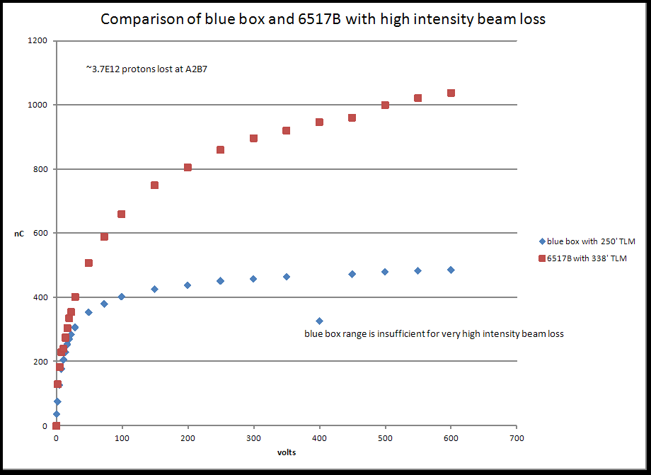

Slide 25
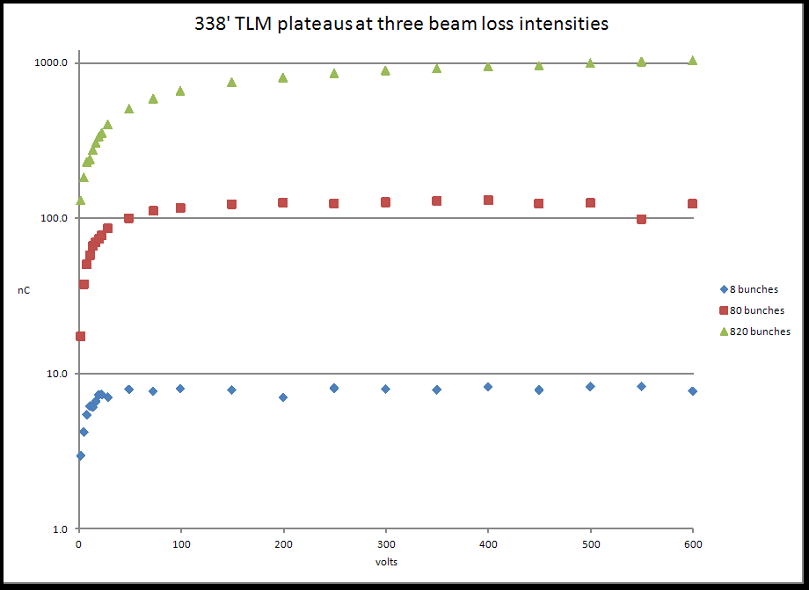

Slide 26
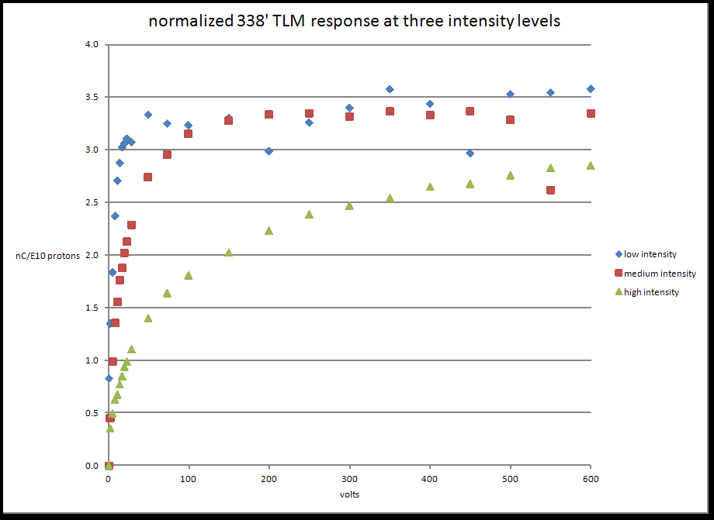

Slide 27
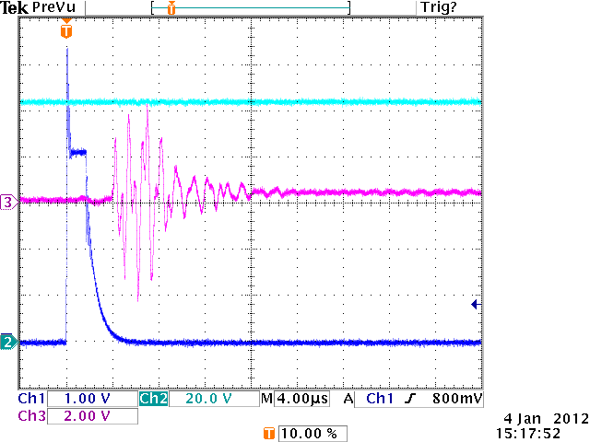
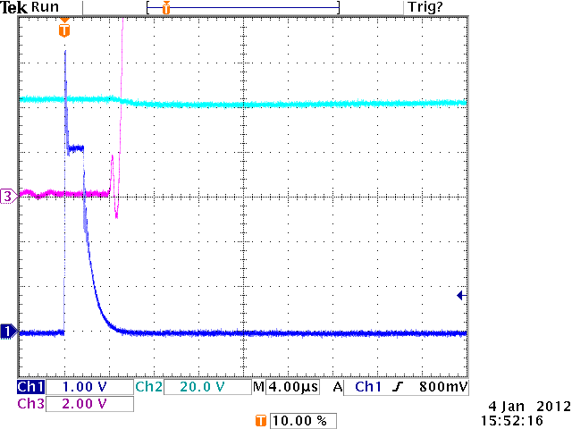
3.1E10 protons
3.35E12 protons
Scope terminated into 1 Mohm

Slide 28
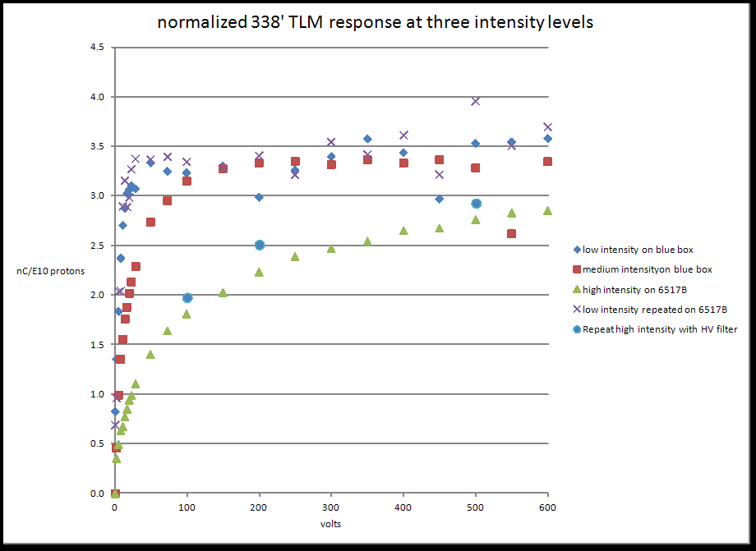
Added in line capacitance to HV

Slide 29
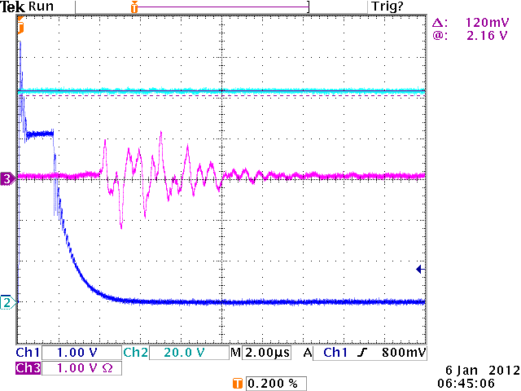
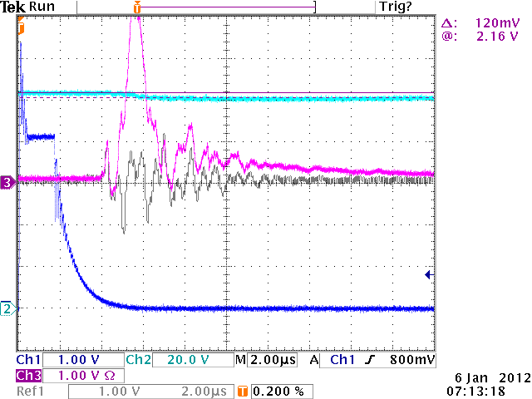
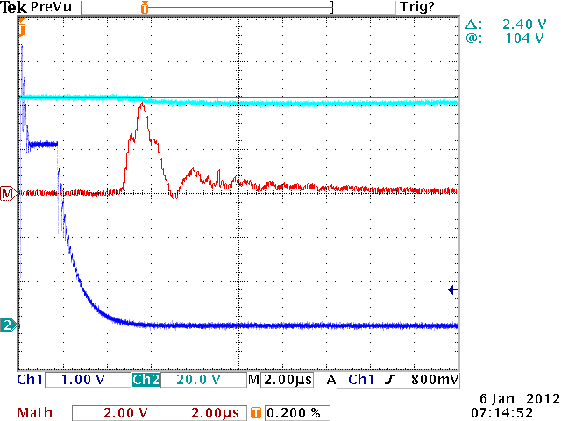
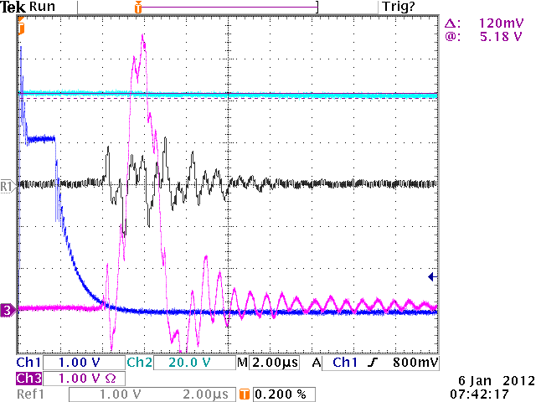
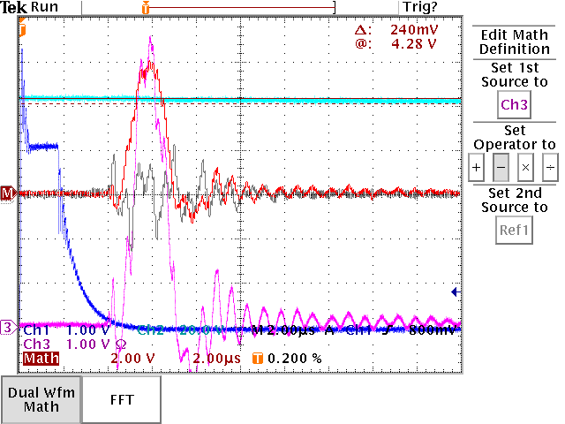
without inline HV capacitance
with inline HV capacitance

Slide 30
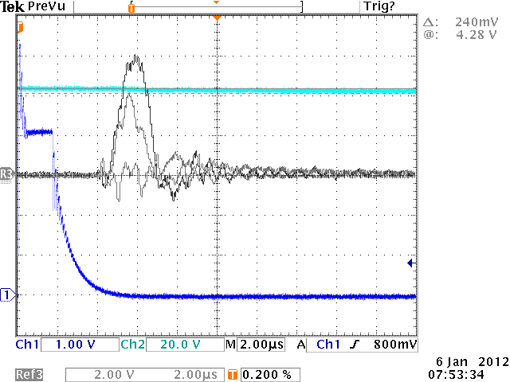
3
2
1
Three traces: 1- background, 2 – without HV cap, 3 – with HV cap

Slide 31
Compared Scope measurement with 6517B for similar beam loss
With TLM HV at 100 volts
Scope with no HV filter – 155 nC
Scope with HV filter – 145 nC
With 6517B – 660 nC
Scope technique didn’t work

Slide 32
Continued high intensity plateau measurements
Used capacitor voltage divider and 6517B in voltage mode
Results are similar to direct charge measurements with 6517B
Did a few additional points at higher voltages, up to 2000 volts

Slide 33
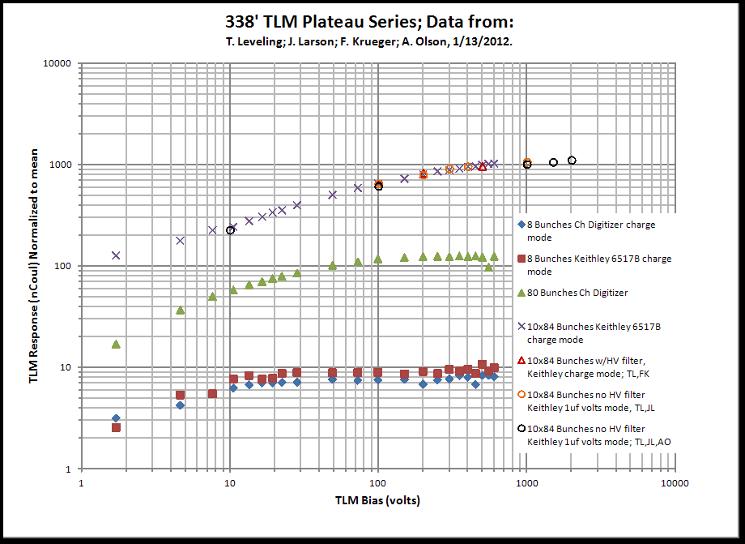

Slide 34
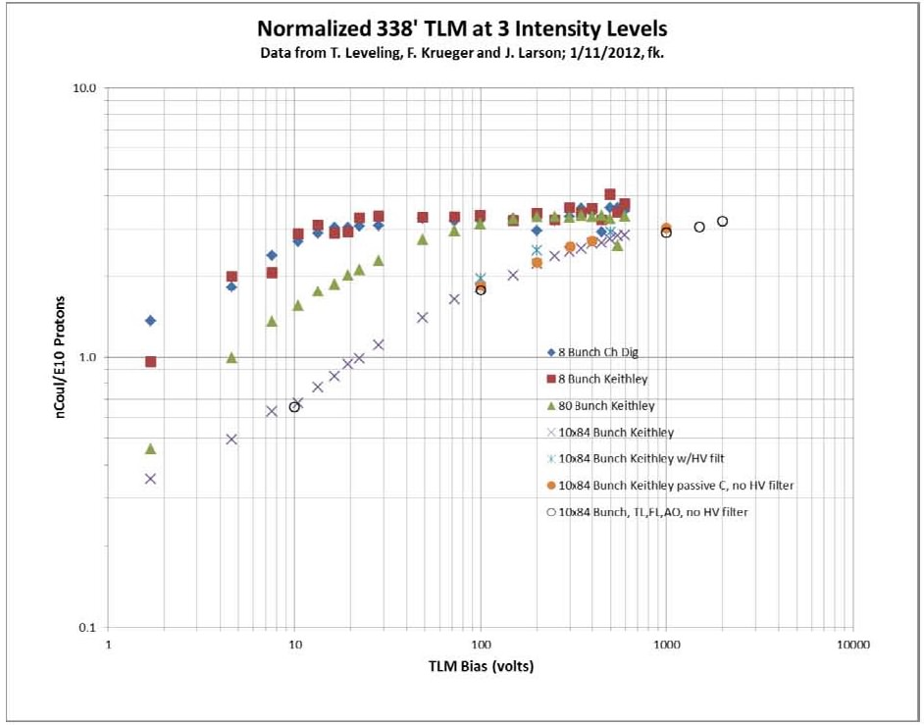

Slide 35
TLM use at the intensity Frontier
Clearly, beam intensity could be high enough to saturate TLMs
All measurements to date at 8 GeV
Response of TLM at 120 GeV expected to be:
(E₁₂₀/E₈)^{0.8} X 3.2nC/E10 protons = 28nC/E10 protons

Slide 36
Dynamic Range
A key question
Draft document has been written
Tentatively, 1 uC/beam pulse looks like a reasonable target

Slide 37
What’s next
High intensity plateaus for 250’ and 125’ TLMs
With the beam loss at A2B7
Compare with 338’ high intensity response
Fewer points required
Requires moving 125’ downstream about 50 feet
Continue discussion with ES&H regarding dynamic range requirements
Check a long detector response uniformly irradiated
E.g., coil up 125’ at A2B7
Or find a short (10’) piece from RF dept.

Slide 38
Backup slides

Slide 39
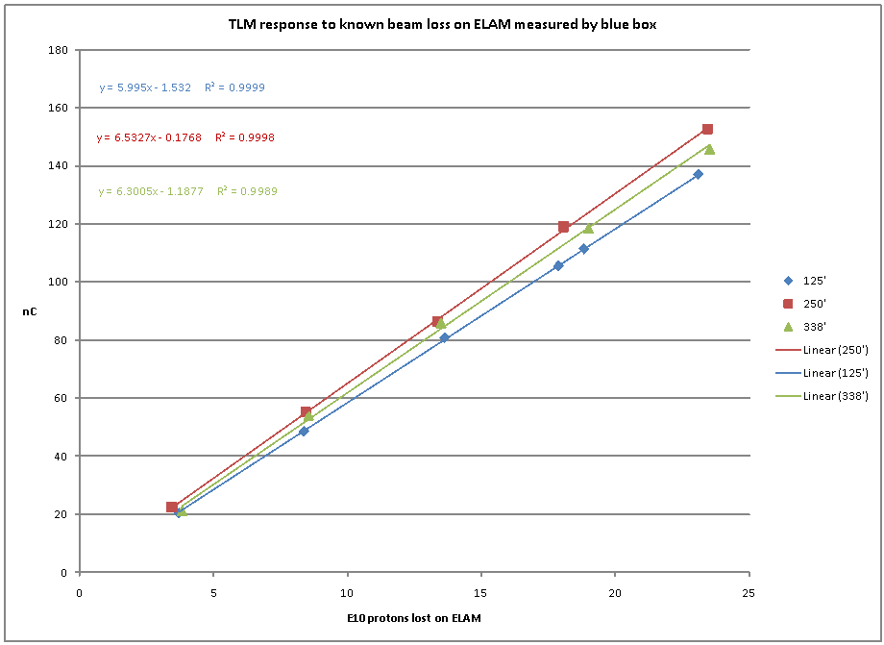
Saw this in September while
comparing blue box response to BLM chassis

Slide 40
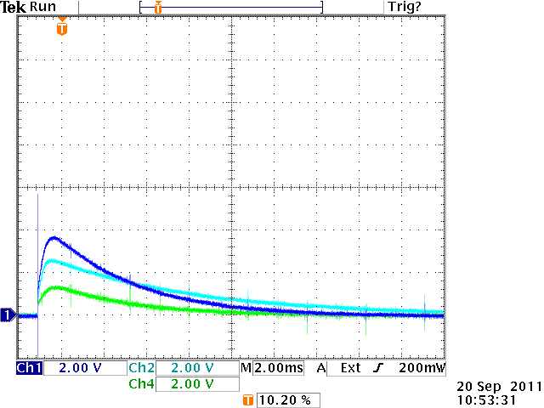
Ch1 – 125’
Ch2 – 250’
Ch4 – 338’

Slide 41
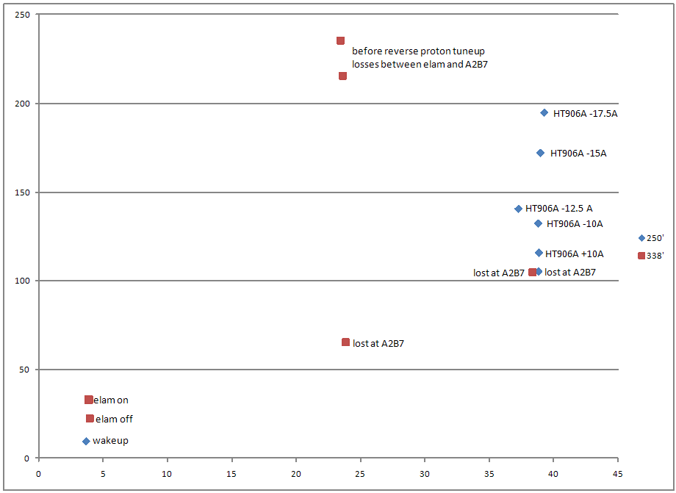
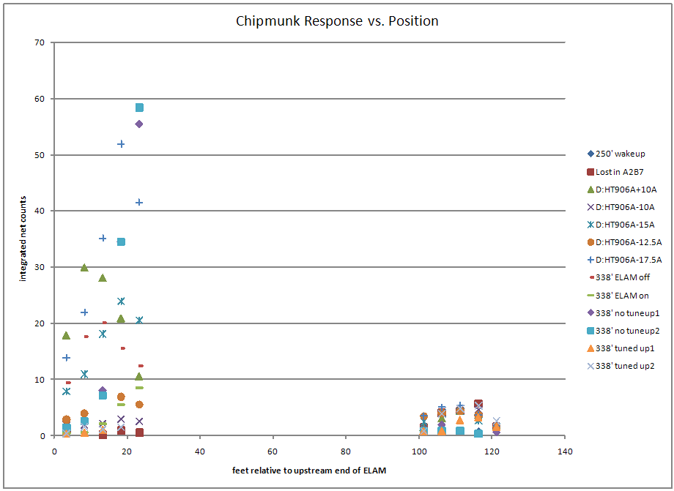
TLM response varies
with different loss mechanisms
Use the most conservative condition
to establish safety system trip

Slide 44
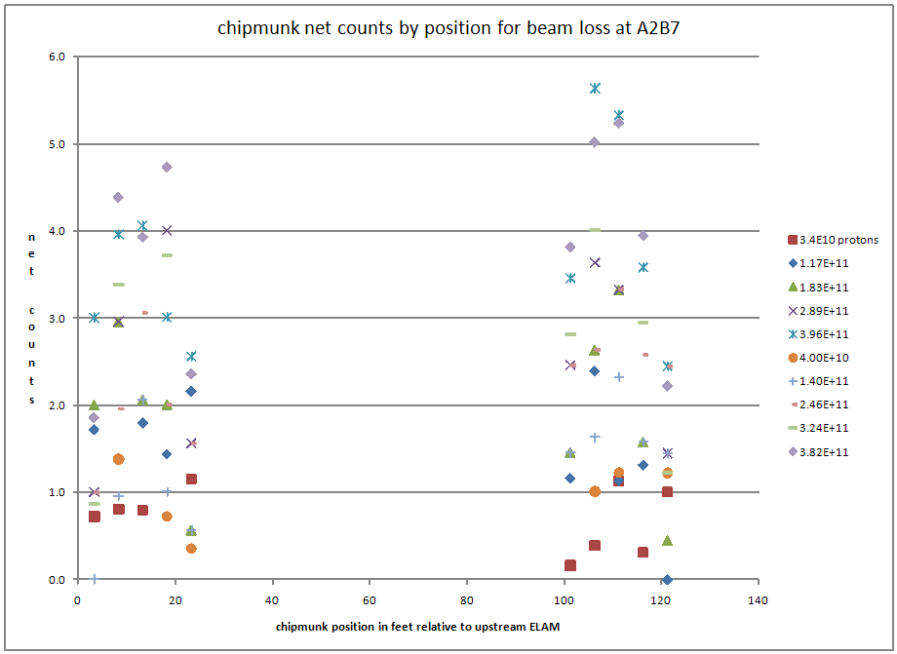

Slide 45
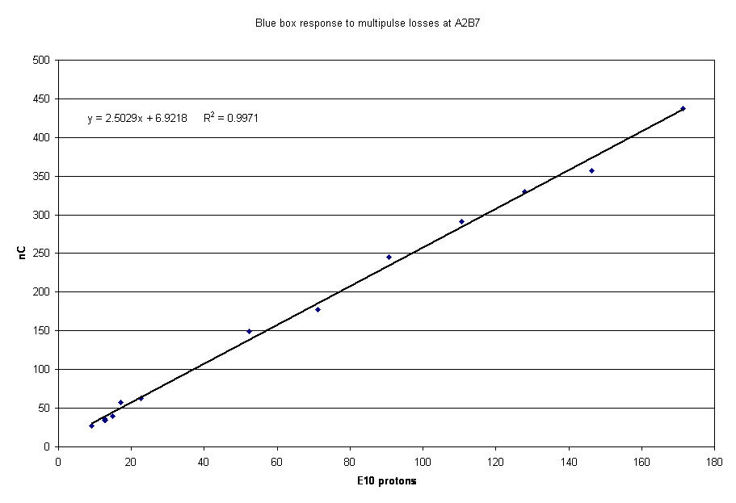

Slide 46
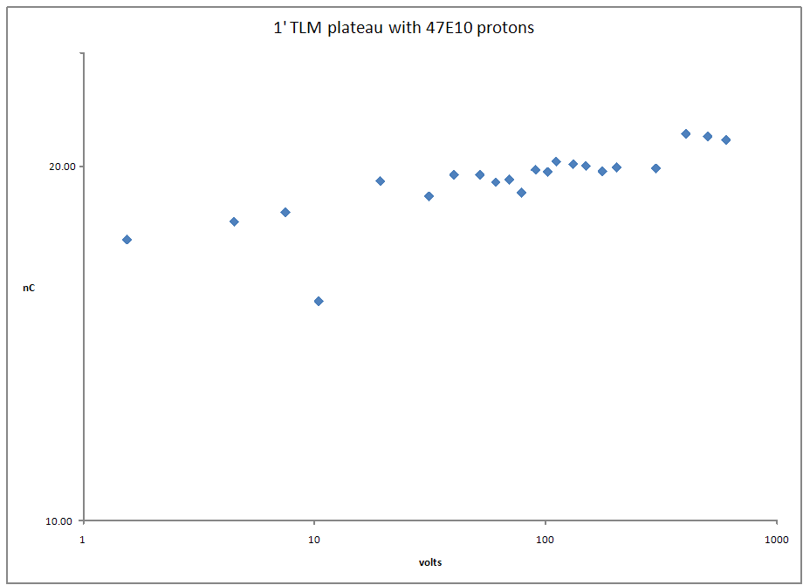

Slide 47
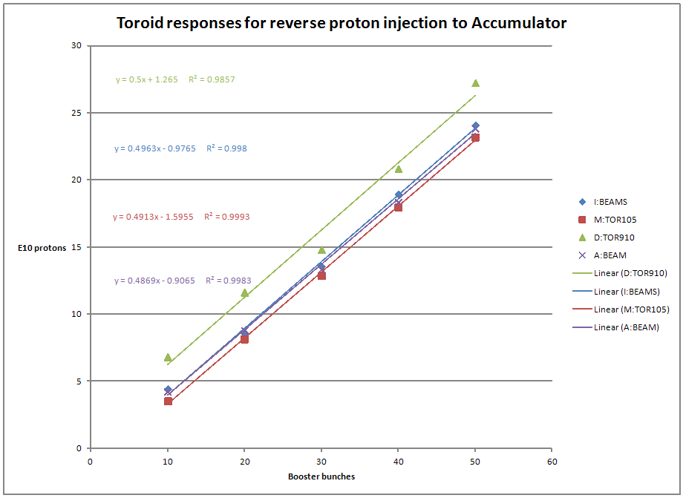

Slide 48
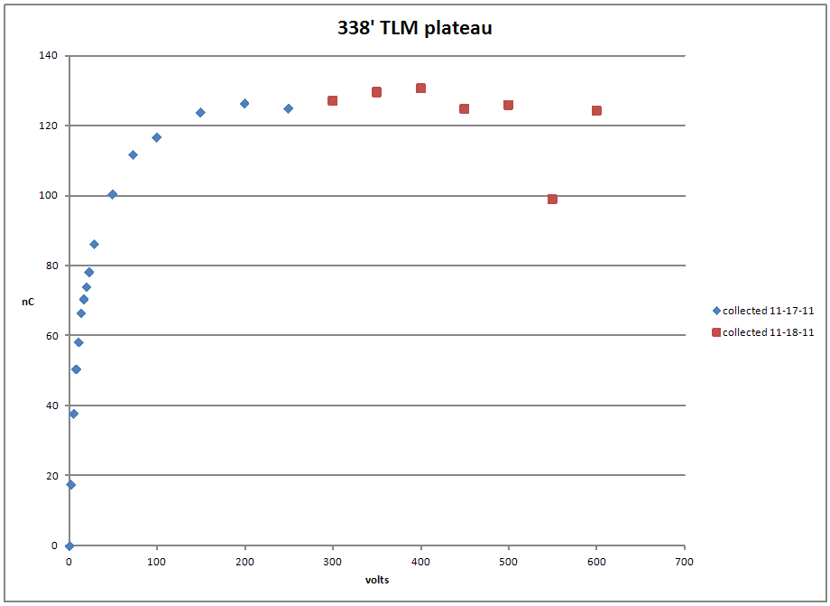
4E11 protons into A2B7

Slide 49
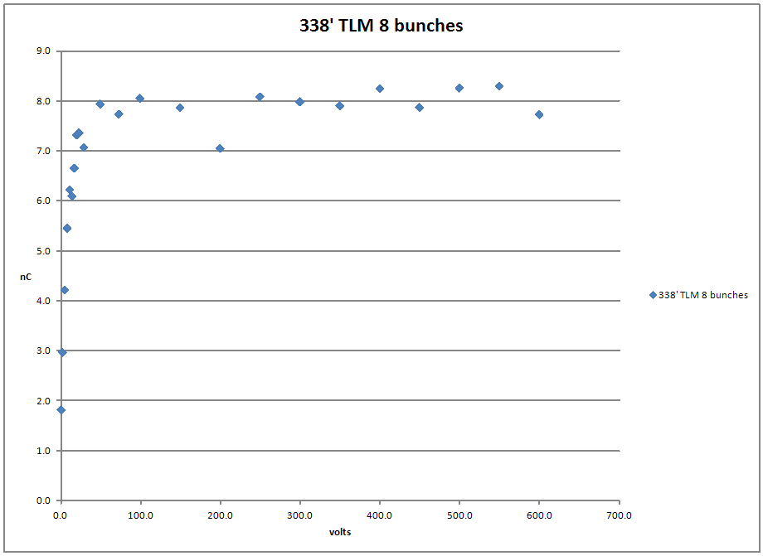
8E10 protons into A2B7

Slide 50
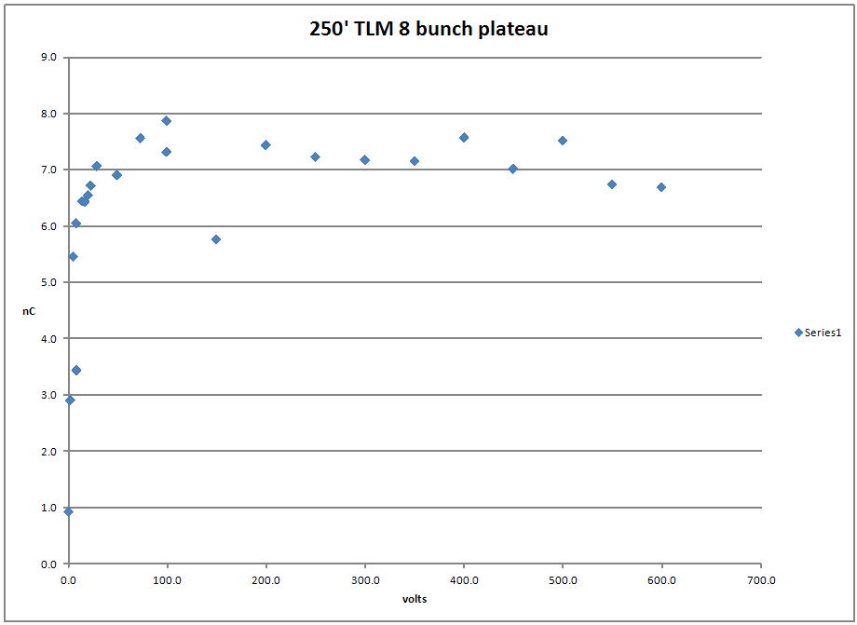

Slide 51
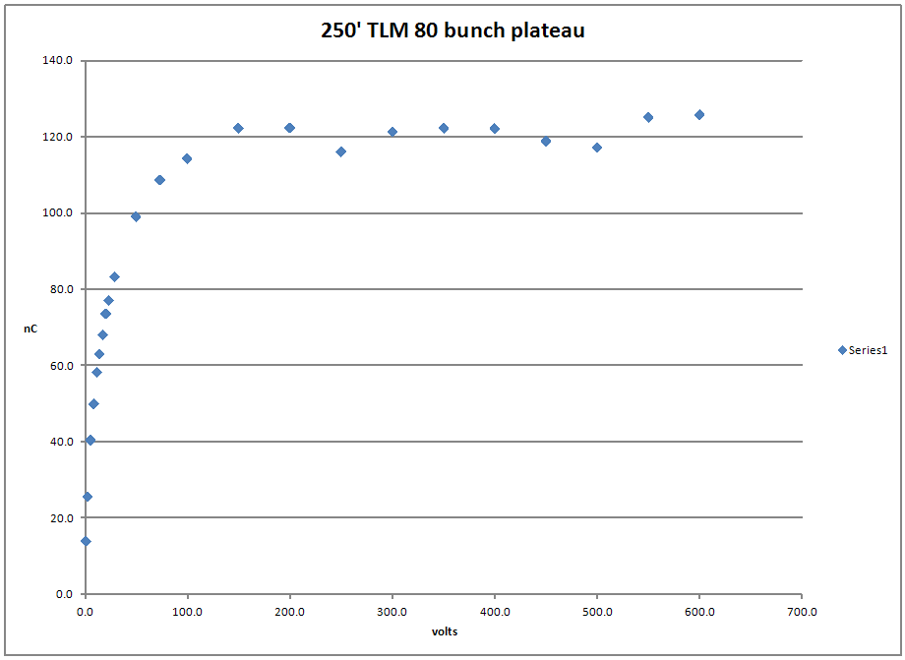

Slide 52
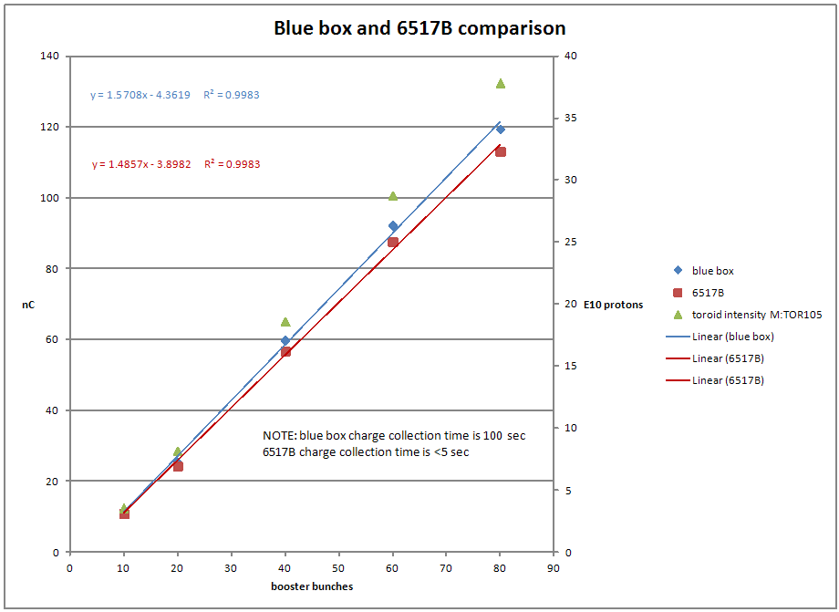

Slide 53
Next steps
Finish charge collection time measurement
Probably requires max intensity to get a signal
Do high intensity plateaus for 250’ and 338’ TLMs
Use 6517B for one and blue box for the other
Then switch
Look for roll off in blue box response

Slide 54
TLM electronics development resources
Management
EE?
ES&H?
M&S
Probably need a budget for this
First, need an estimate?
Funded by users?
ES&H
Mu2e
Pixie
Others
Resources
ES&H files
Labor
Marv
Others?

Slide 55
Since the last meeting
Current BLM chassis contains:
6 decade log rate cards
0.014 RADS
0.14 RADS
1.4 RADS
14 RADS

Slide 56
Scope pictures
125 foot response
250 response
50 Booster bunches
Partial scraping loss on elam

Slide 57
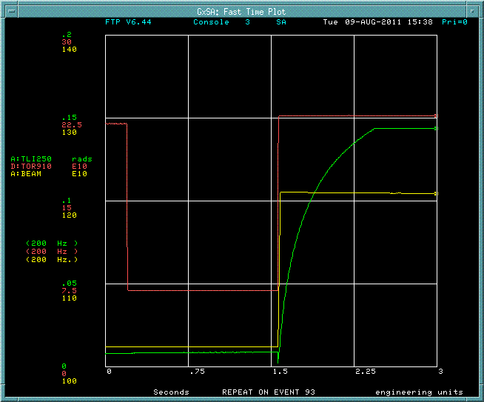
0.14 RAD cards saturate
Partial scraping loss on ELAM
50 Booster bunches
D:HT906A + 10A

Slide 58
Repeated 2000 Pbar SA measurement
Counts per mA lost
Expected these curves to be consistent
Demonstrates that scraping loss is unreliable technique to establish response

Slide 59
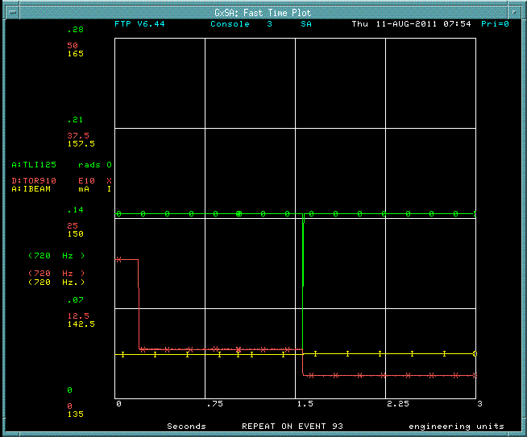
Single resets do not clear BLM cards in all cases

Slide 60
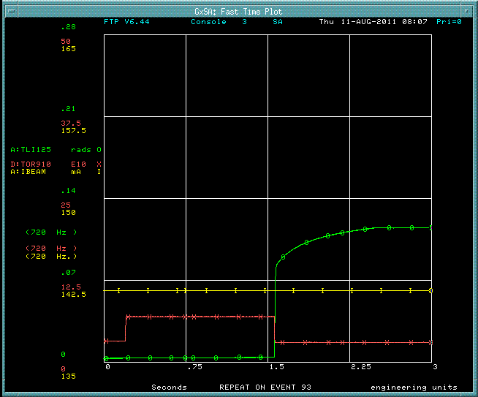
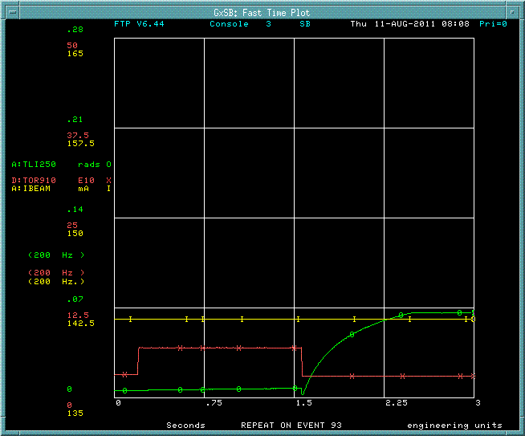
Clear on 00 event and 93 event
Used reset at beginning of transfer timeline to clear integrator

Slide 61
TLMs samples on 93 reverse proton tuneup event
Transfers over 24 h period
TLM response coincident with chipmunk response outside of shielding

Slide 62
Small negative currents occur
e.g. when
beam goes away
Chipmunks have Cs-137 source to drive current

Slide 63
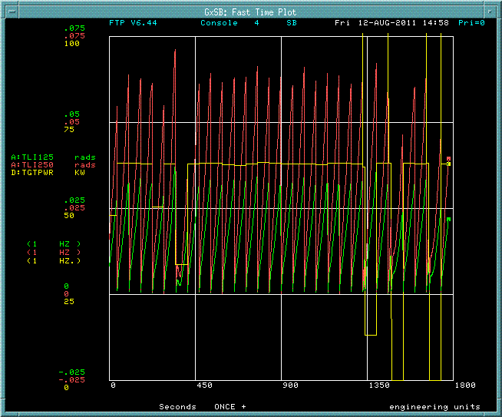
Some minutes of operation

Slide 64
Script has been written to ramp elam simplifies beam loss studies
Script by DVM

Slide 65
TLM response correlated with beam power on target by timeline variation

Slide 66
TLM response correlated with stacktail performance
TLM response to very subtle effects
Suggests good sensitvity

Slide 67
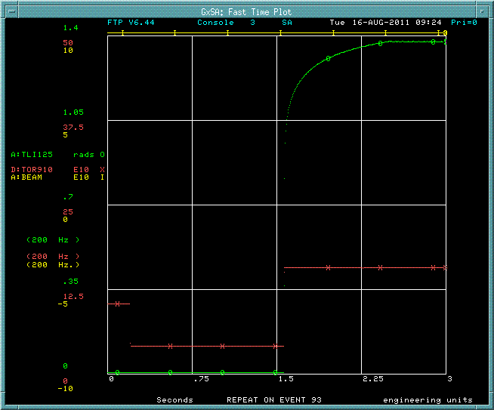
A series of measurements have been variable beam loss
35 Booster buckets - 15.7E10 protons
Others in 5 bucket increments from 5 to 50

Slide 68
Recorded response of 5 chipmunks

Slide 69
Chipmunk response is linear with number of protons lost
An expected
result

Slide 70
TLMs also have linear response!
A required result
NOTE!
125 foot response exceeds 250 foot response
250’ TLM response = 70%*125’response

Slide 71
TLM response as a function of length
Need another TLM installed to determine this!

Slide 72
During stacking operations
250’ cable response exceeds 125’ response during normal stacking operations
Could be losses in the second half of 250’ TLM not seen by 125’ TLM
A reverse proton cycle mixed in with stacking cycles

Slide 73
Tried reversing HV and signal roles of the TLM cable
Huge apparent increase in sensitivity
Perhaps should be repeated – ensure conductors are grounded before turning on HV

Slide 74
Blue box is in service connected to 125’ TLM

Slide 75
Blue box is in service connected to 125’ TLM

Slide 76
Blue box is in service connected to 125’ TLM
5 pC/count
Follows BLM card response on 250’ TLM

Slide 77
Next steps (1 of 3)
Install VME scalar for higher counting rate from blue box (1 kHz)
MUX good for 70 Hz
VME scalar good for 15 kHz
Repeat series of measurements with blue box and BLM chassis two ways
Blue box/125’ & BLM chassis/250’
Blue box/250’ & BLM chassis/125’
Determine dynamic range requirement for digitizer circuit for TLM application

Slide 78
Next steps (2 of 3)
Install third TLM of different length 103 m (338’)
Determine TLM response as function of length
Can’t do this with just 2 cables
Repeat measurements (5 Booster bunch increments)
Determine how AD instrumentation can make additional blue boxes
In collaboration with ES&H Section
Would help to speed up development of this resource

Slide 79
Next steps (3 of 3)
Distributed loss study
e.g., Scrape at ELAM with Accumulator bend bus off (October 2011?)
Determine blue box trip levels for 14 TLM cables required for mu2e
Needed to finalize radiation safety plan for mu2e

