Slide 1
Fermilab Accelerator Operating Schedule
JASMIN Collaboration Meeting
2/16/12
T. Leveling

Slide 3
Main Injector 2012 Shutdown
Begins May 2012
Main Injector (MI) to be upgraded
Upgrade:
removes features from MI related to Tevatron Collider Program
Prepares the Main Injector for the Intensity Frontier

Slide 4
Specific MI changes
Remove 2 transfer lines between MI and Recycler Ring (RR)
Remove electron cooling from the RR
Install new transfer line from RR to MI
Install direct injection line from the Booster to RR

Slide 5
Recycler Ring
Formerly Antiproton storage ring during Tevatron Collider Program
New role is to prepare high intensity beam from Booster for injection into MI

Slide 6
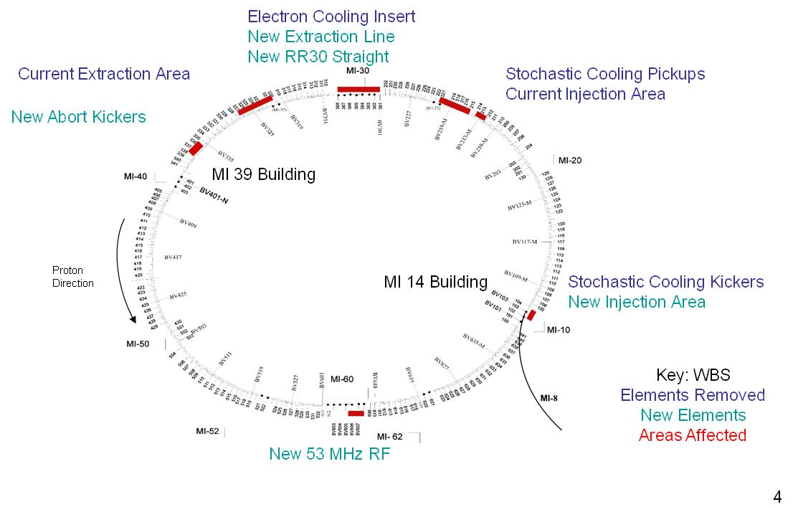
These changes repurpose MI from Collider era to the Intensity Frontier

Slide 7
HKICK
VLAM (MLA)
104
103
102
100
V2 (PDD)
Recycler
PDDM
K
QR852
QR853
HBEND (35 mr)
848
847
852
851
850
849
MI
MI8
103
102
101
8 Gev line
V1 (switch)
New injection line from Booster MI8 line to Recycler Ring

Slide 8
MI 8GeV Injection Lamb
RR Extraction Kicker
309
308
307
306
305
304
303
302
301
K
K
Q804
Q803
GM232A,B
GM230A,B
Trim quads
Q801
GM231A,B
GM229B
Q802
VDN2
Mirror magnets
Q805
VUP1
K
K
Q309
Q308
Q307
Q306
Q305
Q304
Q303
Q302
Q301
MI injection Kicker
MI VLAM Rolled
New injection line from RR to Main Injector

Slide 9
When MI resumes in 2013
Microboone – liquid argon calorimeter
8GeV proton beam for le neutrino experiment
NuMI (120 GeV, 700 KW proton beam to NuMI target)
MINOS
NOVA
MINERVA
Switchyard
Mtest (120 GeV, 1E13/protons/hr to test beam)
M01
MT6
Seaquest (120 GeV, 1E13 protons/min to NM4)

Slide 10
G-2 at the pbar source
Pbar Source and target station is to be repurposed
G-2 experiment
8 GeV, 25 KW beam on target
3.1 GeV pi⁺ beam to be collected and transported to new experimental area
Construction for detector hall to begin in late CY 2013
Startup/Commissioning late CY2015

Slide 11
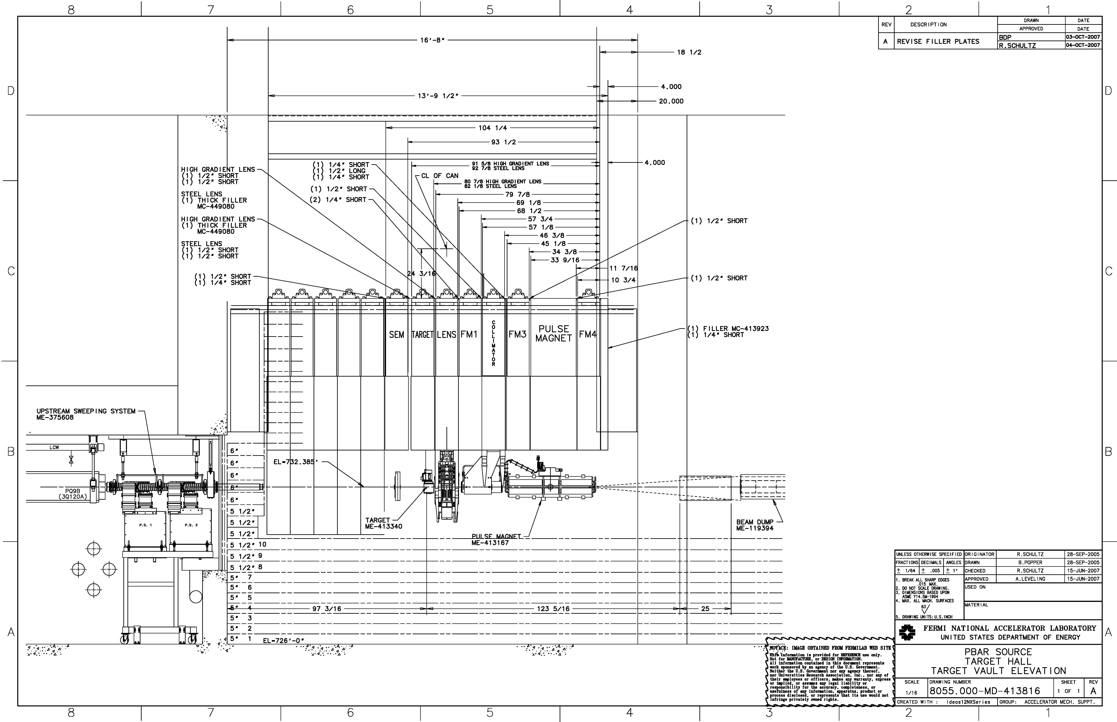
Two possibilities:
Existing target station with lithium lens, or
New target station with quadrupoles or a horn

Slide 12
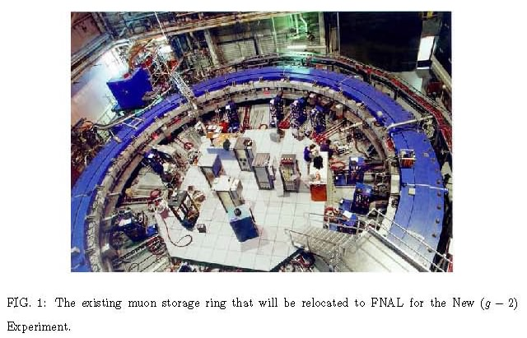

Slide 13
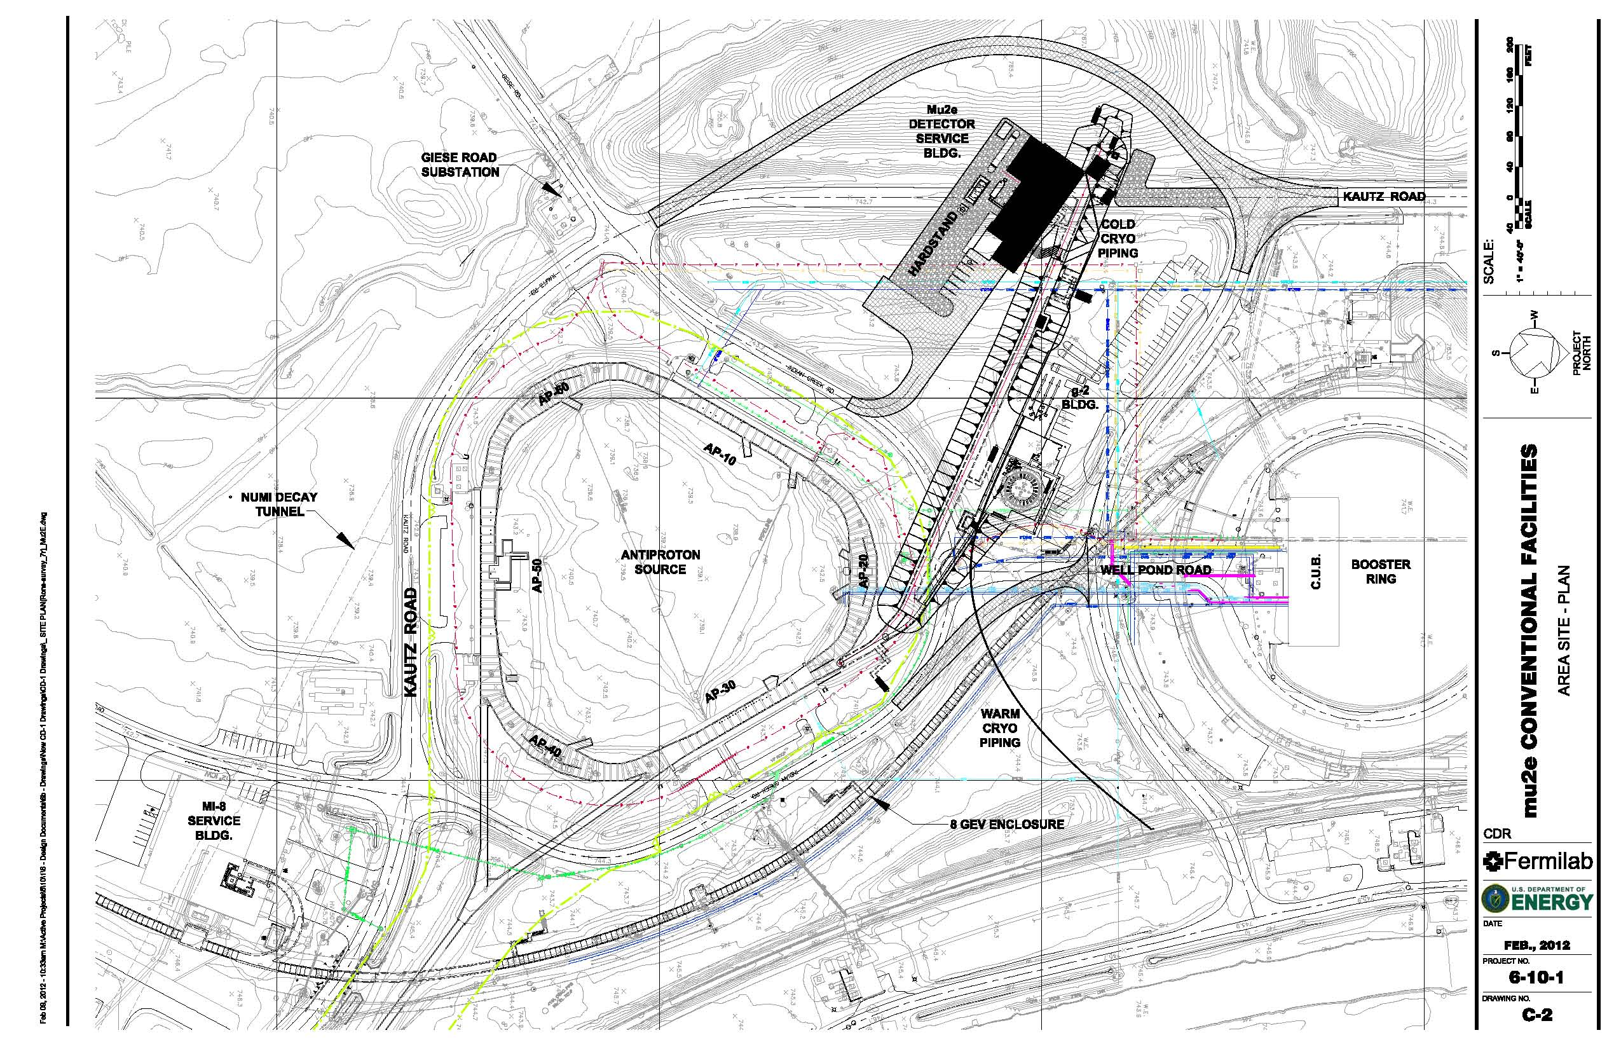

Slide 14
Stay tuned!
Important:
Actual schedule is based on budgetary opportunities and constraints

