Slide 1
The JASMIN Collaboration
FUTURE PLANES
(1) Study of nuclear reactions
induced by fast muons
(2) Study of colloid formation in water contacted with metallic material.
(3) Study of aerosol formation in air
around a high energy accelerator
Hiroshi MATSUMURA (KEK)
Hiroshi MATSUMURA (KEK)
Shun SEKIMOTO (KUR)
2/16/2012

Slide 2
The JASMIN Collaboration
FUTURE PLANES
(1) Study of nuclear reactions
induced by fast muons
(2) Study of colloid formation in water contacted with metallic material.
(3) Study of aerosol formation in air
in high energy accelerator room
Hiroshi MATSUMURA (KEK)
Hiroshi MATSUMURA (KEK)
Shun SEKIMOTO (KUR)
2/16/2012

Slide 3
FURTHER STUDIES
More details of muon reactions
We can used higher flux muons at Absorber Hall
Application for geosciences
We need depth profile of muon-induced production of cosmic nuclides in rock

Slide 4
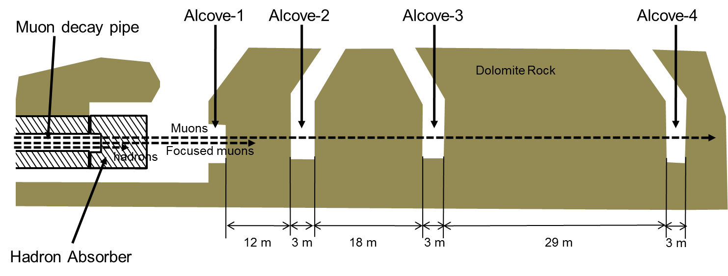
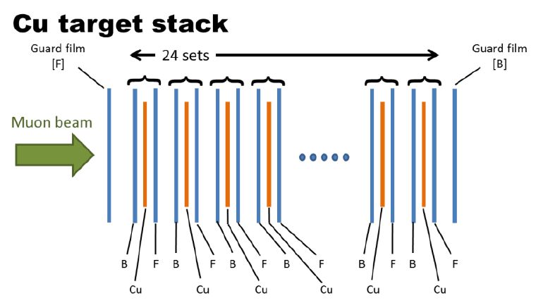
More details of muon nuclear reactions
spallation
Behind Hadron Absorber
in absorber hall
Bombardment
v
Cascade
Forward velocity
in the cascade step
Equilibrium
Evaporation
Thick target-thick catcher foil method
Forward velocity in the cascade step, v
Radstam's parameter, P
depend on energy and kind of incident particle

Slide 5
More details of muon nuclear reactions
hadron
at absorber
fast muon
photon
(bremsstrahlung)
FIG. Energy dependences of 1/P
in nuclear reactions on Cu.
FIG. Forward velocity, v, in the first step as a function of mass difference for Cu.
similar to fast muon (at alcove2)
similar to photon
similar to ~300 MeV hadron
similar to photon
similar to >3 GeV hadron
Nuclear reactions were induced by fast muons!

Slide 6
More details of muon reactions
We can used higher flux muons at Absorber Hall
Application for geosciences
We need depth profile of muon-induced production of cosmic nuclides in rock

Slide 7
Application for geosciences
alcove-2
alcove-3
alcove-4
Be-10
Al-26
Cl-36
Ca-41
etc.
FIG. Attenuation profile of the yields in rock.

Slide 8
The JASMIN Collaboration
FUTURE PLANES
(1) Study of nuclear reactions
induced by fast muons
(2) Study of colloid formation in water contacted with metallic material.
(3) Study of aerosol formation in air
in high energy accelerator room
Hiroshi MATSUMURA (KEK)
Hiroshi MATSUMURA (KEK)
Shun SEKIMOTO (KUR)
2/16/2012

Slide 9
EXPERIMENTS
A. Investigation in cooling-water systems in fermilab
B. Investigation in Cu/H2O bombarded with 120-GeV protons at M01 (will be talked in later session)

Slide 10
Detected radionuclides in the waters
The cooling waters contained various radionuclides depending on materials contacted with water.

Slide 11
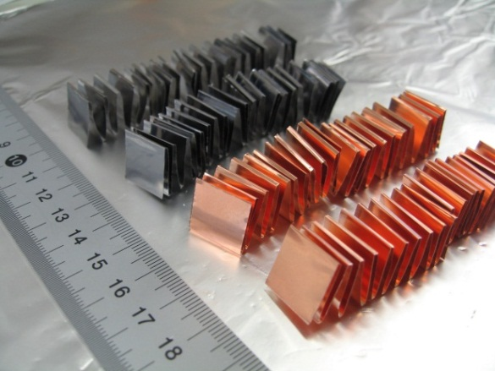
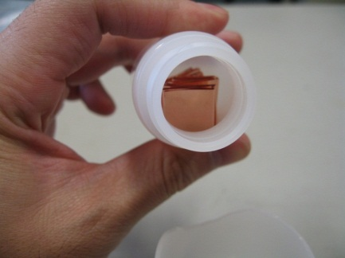
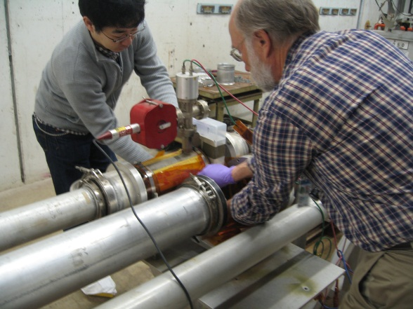
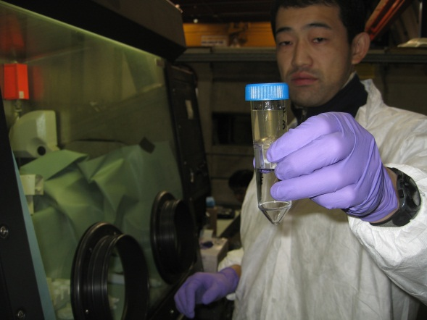
Proton irradiation experiment
At M01
30mL HDPE NALGENE bottle
Pure water
Two Cu foils
(0.03mmT)
34.3 mm
120-GeV
protons
41.6 mm

Slide 12
Behavior of radionuclides in Cu/H2O
How about Fe/H₂O, SUS/H₂O, Al/H₂O, Ni/H₂O,etc.

Slide 13
The JASMIN Collaboration
FUTURE PLANES
(1) Study of nuclear reactions
induced by fast muons
(2) Study of colloid formation in water contacted with metallic material.
(3) Study of aerosol formation in air
in high energy accelerator room
Hiroshi MATSUMURA (KEK)
Hiroshi MATSUMURA (KEK)
Shun SEKIMOTO (KUR)
2/16/2012

