Slide 1
The JASMIN Collaboration
Radio-colloid formation in cooling-waters
in 120-GeV proton accelerator at fermilab
Speaker: Hiroshi MATSUMURA
(KEK, JAPAN)
---EXPERIMENTS---
A. Investigation in cooling-water systems in fermilab
B. Investigation in Cu/H₂O bombarded with 120-GeV protons at M01
2/16/2012

Slide 2
EXPERIMENTS
A. Investigation in cooling-water systems in fermilab
B. Investigation in Cu/H2O bombarded with 120-GeV protons at M01 (will be talked in later session)

Slide 3
Radionuclides in cooling-waters
pipe (Al, SUS, Cu, etc.)
4
primary particle
dissolve
recoil
water (H₂O)
primary particle
recoil
primary particle
1
2
target (Al, Ni, Ta, etc.)
primary particle
2
dissolve
secondary
particle
secondary particle
recoil
dissolve
recoil
primary particle
4
3
3
Primary particle
Secondary particle
Nuclear reaction
Radionuclide

Slide 4
Removal of radionuclides from waters
Cooling-water system is equipped with a deionizer
(1) in order to keep water pure for accelerator materials
(2) in order to remove radionuclides for radioactivity control
If deionizer can collect radionuclides completely, ...
Deionizer
IN
OUT
ion
dirty water
pure water
radioactive
water
non-radioactive
water
resin
ion-exchange resin
water

Slide 5
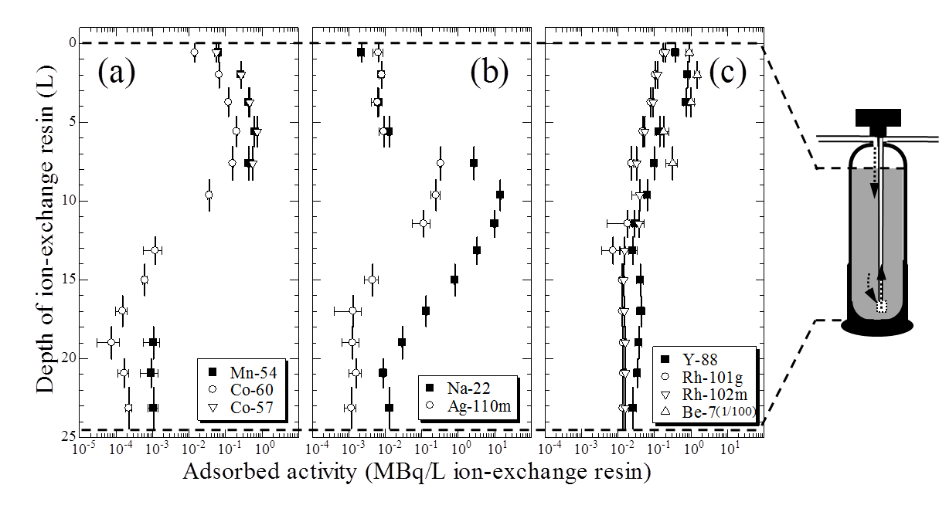
Colloid formation of radionuclides?!
The K2K target and magnetic horns
in KEK, JAPAN
Y-88, Rh-101g, Rh-102m, and Be-7 showed weak retention to ion-exchange resin.
12 GeV
protons
Al target
1st magnetic horn
due to colloid formation?!
60 L/min
2nd magnetic horn
This incomplete adsorption
will cause serious problems.
FIG.1 The water cooling system for the target and magnetic horns in the K2K experiment.
Deionizer
ion-exchange resin
(AmberLite, MB-2)
FIG. Distribution of radionuclides in the demineralizer of K2K at KEK in Japan.
(H. Matsumura et al., Nuclear Technology, 168, 979 (2009).)

Slide 6
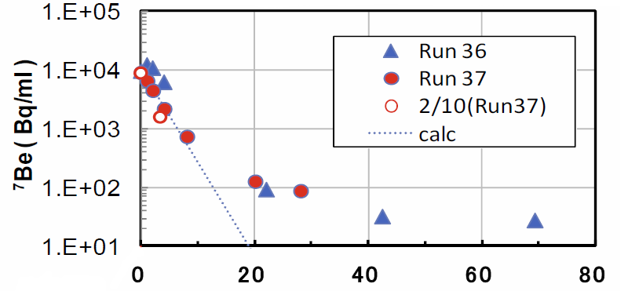
Serious problem at J-PARC
Our forebodings proved true in the T2K magnetic horns at J-PARC
Cooling-water system is drained and refilled at regular intervals.
Although we have to remove Be-7 more efficiently (>99.9%),
~1% of Be-7 was remaining in the cooling-water in spite of long deionization.
We have to understand behavior of radionuclides
in cooling-waters and do something.
Run36: 11/16-12/25/2010
Run37: 01/16-02/28/2011
~1% of Be-7
was remaining
NOTE
Limit of Be-7 activity for drain is 30 Bq/ml
Duration of deionization (hours)
T2K will be powered up in the near future.
FIG. Variation of Be-7 activity in the cooling-water
for the T2K magnetic horns in function of duration of deionization.
5

Slide 7
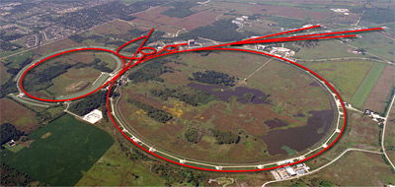
Investigation on waters at fermilab
We did not wait for proving the forebodings of the J-PARC problem.
When we found the weak retention of radionuclides to ion-exchange resin at the K2K horns, we decided to investigate on radionuclides in the cooling-water soon.
We performed investigation on colloid formation of radionuclides in the cooling-waters for 120-GeV proton accelerator at NuMI and Pbar TS in fermilab.
NuMI
M01
M-test
Wilson Hall
HIL
CDF
PbarTS
Tevatron
Main Injector
D0
120-GeV proton accelerator in fermilab (USA)

Slide 8
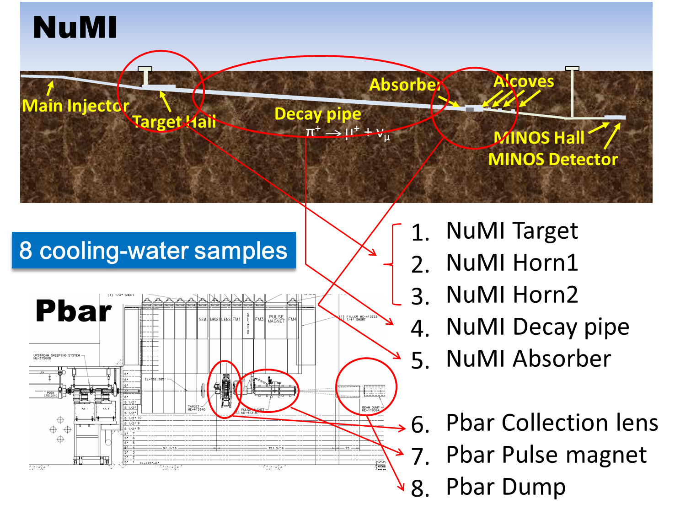
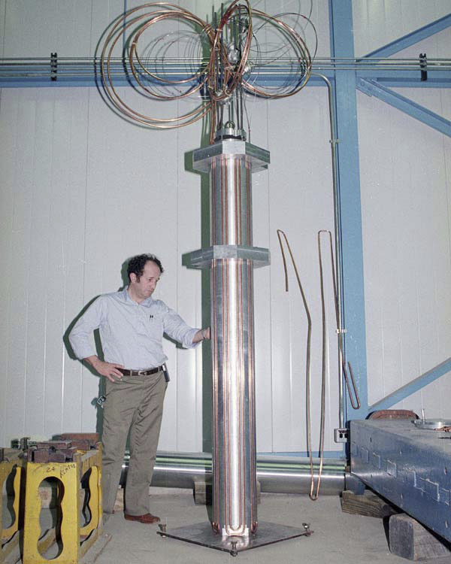
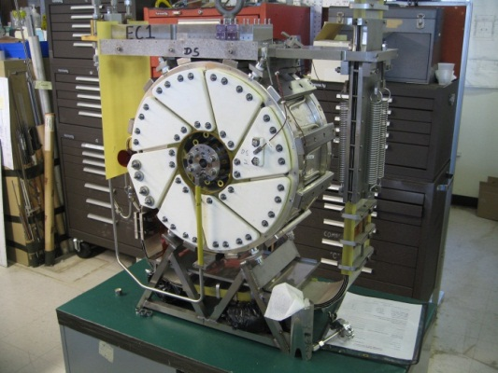
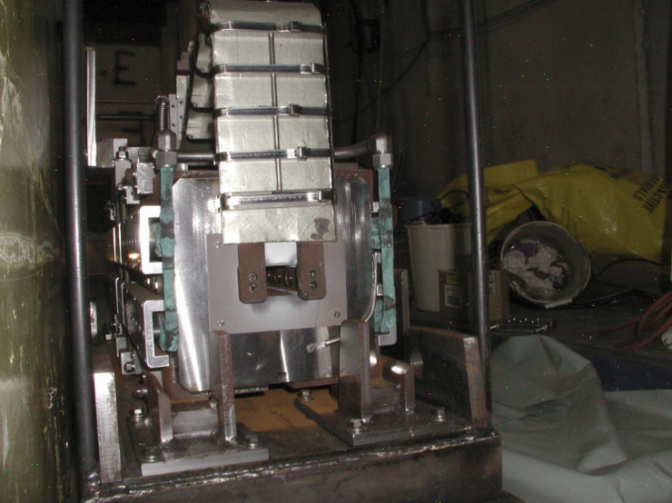
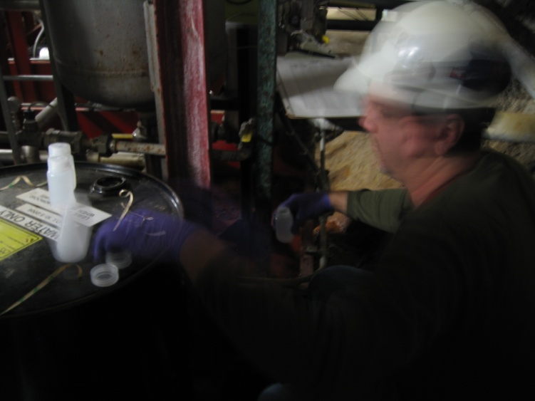
Sampling of cooling-waters
We collected 8 cooling-water samples from the NuMI and Pbar systems on
(1) Feb. 2010,
(2) Dec. 2010,
(3) Sep. 2011.
120-GeV p
8
6
7

Slide 9
Data of the cooling-water systems
Important data on the cooling-water systems

Slide 10
RESULTS

Slide 11
Detected radionuclides in the waters
The cooling waters contained various radionuclides depending on materials contacted with water.
arranged in order of activity
I will focus to Be-7 in this talk.

Slide 12
Activity of Be-7 in the waters
1
Activity is independent of the sampling date.
In only NuMI absorber, the activity increased.
2
Activities were quite different among the cooling-water systems.
High activity: the Pbar pulse magnet and dump
Low activity: the NuMI target, horns, decay pipe, and absorber, and Pbar lens
lower activity
increased
with deionizer
higher activity
no deionizer

Slide 13
Remaining rate of Be-7 in water
H-3
H-3
H-3
Be-7
Be-7
Be-7
A_{Be-7}
A_{H-3}
.
σ_{H-3}
σ_{Be-7}
.
SF_{H-3}
SF_{Be-7}
where
Remaining rate of Be-7 =
A: Activity
σ: Cross section
SF: Saturation factor
m
σ_{H-3}
σ_{Be-7}
= 6.1
low remaining rate
with deionizer
high remaining rate
no deionizer
(only string filter)
* Leaking and decomposition of water
during machine operation were ignored.
10

Slide 14
Colloid rates of Be-7
Very high colloid rates were measured in the systems with deionizer.
1
cent-
rifuge
cut off
Low colloid rates were measured in the systems without deionizer.
2
4000rpm
10min
ion
colloid
(1) Most of ions were removed by deionizer.
(2) Colloids were remaining in the cooling-water.
high
colloid rate
3 nm pore
ultrafiltration
membranes
with deionizer
low
colloid rate
no deionizer
ultrafiltration unit

Slide 15
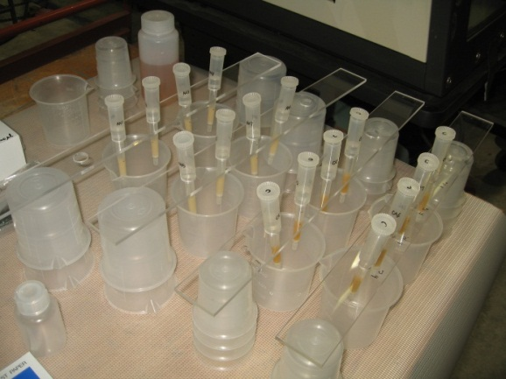
Charge of radio-colloid
1
Most of Be-7 (~100%) was passed through anion-exchange column.
2
Most of Be-7 (~100%) was adsorbed in cation-exchange column.
3
Small fraction of Be-7 was passed through cation-exchange column.
(1) Most of Be-7 colloids have plus charge.
(2) Weak retention power of Be-7 colloid on cation-exchange resin was observed.
Water samples (100 mL)
were passed thorough
cation-exchange column and anion-exchange column.
+
+
-
-
(Dowex 1X8 100-200 mesh)
Cation exchange column
Anion exchange column
(Dowex 50WX8 100-200 mesh)
Be-7 passing rate (%)
resin: 1 mL
resin: 1 mL
-
+
Be-7 passing rate (%)
+
-
1
2
3

Slide 16
Summary (experiment A)
In cooling-water for high-energy accelerators,
we found characteristics of radionuclides as following.
(1) cooling waters contained various radionuclides depending on materials contacted with water,
(2) activity and colloid rate of radionuclides in cooling-water depended on deionizer,
(3) remaining of Be-7 in the cooling-waters was due to weak retention of the Be-7 colloids to cation-exchange resin in deionizer.
We obtained a law of radionuclide behavior in cooling-water. We are considering a new removal method of radio-colloid from cooling-water.
Colloid resolution during operation?
Colloid resolution after operation?

Slide 17
EXPERIMENTS
A. Investigation in cooling-water systems in fermilab
B. Investigation in Cu/H2O bombarded with 120-GeV protons at M01 (will be talked in later session)

Slide 18

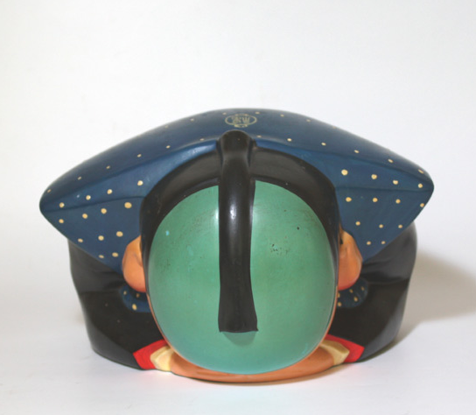

Thank you very much
for your valuable supports
for our experiments.

